Slide 1
Oregon Aviation Board Meeting
January 18, 2018
11-3 pm
Portland International Airport
Multnomah Room

Slide 2
Consent Agenda
October 19, 2017 Board Meeting Minutes
Next Aviation Board Meeting-
Potential Date and Location
2nd Day of OAMA Conference, Feb 13th
Location- Salem Convention Center
Director’s Calendar

Slide 4
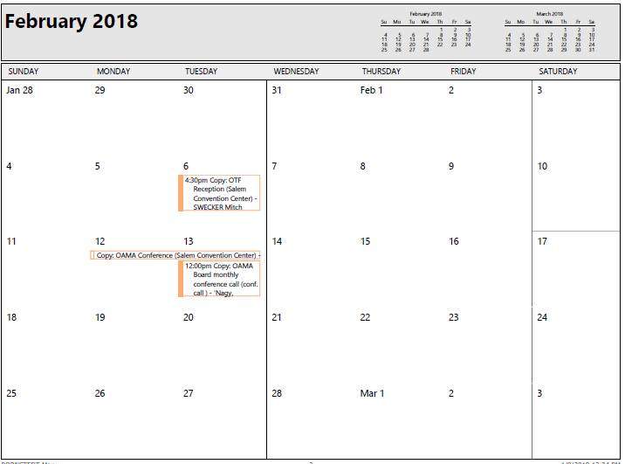

Slide 5
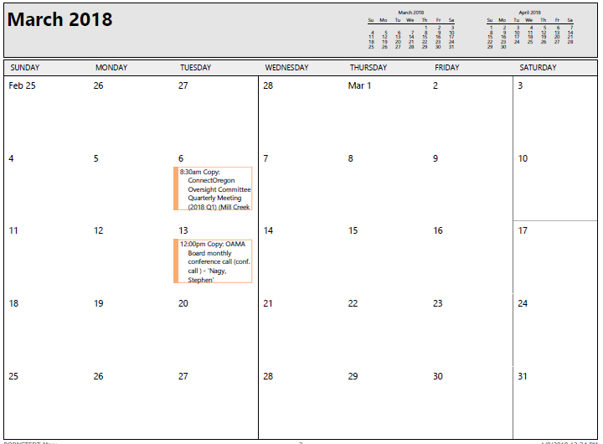

Slide 6
Public Comments
Limited to Two Minutes Per Speaker

Slide 7
Pacific City Discussion

Slide 8
Director’s Update
Aurora State Airport Constrained Operations
Cascade Locks State Airport Update
Potential New Board Member

Slide 9
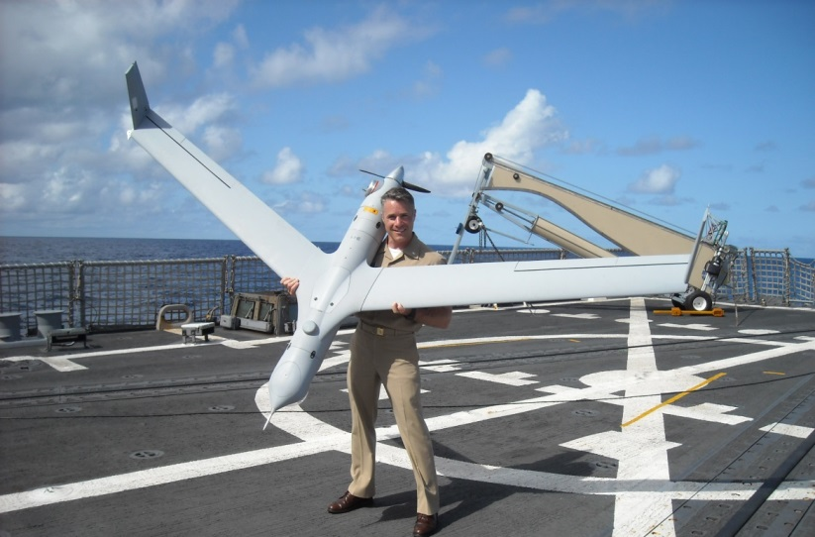
Oregon UAS Opportunities

Slide 10
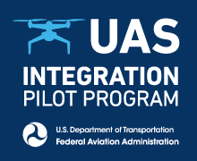
ODA Three Part UAS Proposal
Assume oversight and funding for three UAS ranges in Oregon
Applied for Federal UAS Integration Pilot Program
Applied for $1m High Impact Opportunity grant from Biz Oregon

Slide 11
Ranges at Tillamook, Warm Springs, Pendleton
SOAR Board of Directors Dissolves on Jan 31 2018
Executive Director Resigned
Funded with $3M Oregon Inc. Grant
Funding and management of funding of ranges
Metric required bringing jobs to Oregon
Marketing
No additional funding to support SOAR
$950,000 remaining to turn over to ODA
Asking today for Board vote to authorize receiving funds and accepting role of range funding
Requires Legislative approval

Slide 12
Range Administration Business Plan
Sustainability Plan for ranges
Continue to market and bring businesses to ranges
If sustainable funding not available, Approximately 19 months operating costs
$45k burn rate per month
10% admin for ODA staffing and administration
Taper plan to encourage ranges to become self sustainable
Decrease funding incrementally to ranges over life of remaining $
Offset with funds from range sponsors
Extends life of ranges plus creates exit plan for ODA
Extends funding to approximately 30 months

Slide 14
$950,000 19 Month Straight Line Plan

Slide 15
Presidential Executive Order –
Create UAS Integration Pilot Program
DOT/FAA Goal:
Accelerate safe integration of Unmanned Aircraft Systems into National Airspace
Partnerships with variety of governments – state, local, tribal
Variety of geographic environments
Variety of UAS missions
State of Oregon Goal:
Develop UAS strategic plan for UAS role in state aviation
Attract businesses and economic development in the state
Keep Oregon relevant for emerging technology
Sustainable funding!
UAS IPP Partner Goals:
Act in the best interest of your organization for profit or benefit.
Assist in developing template for UTM and airspace management

Slide 16
UAS IPP AREAS of EMPHASIS
To accelerate the safe integration of Unmanned Aircraft Systems into the National Airspace System.
Develop architecture directed toward shared jurisdiction between federal and state entities.
Through UAS IPP, the Oregon Department of Aviation along with participating partners, will work to define state policies that support unmanned traffic management such as remote ID and tracking in order to allow waivered operations such as:
BVLOS
Flights over people
Night operations
Waivered operations for unmanned aircraft over 55 pounds
Remote Identification, detection and tracking
Other waivered operations

Slide 17
Develop Standards
Develop policies that allow accelerated integration of UAS safely into the National Air space
ID requirements
Safety standards
Enforcement standards
Proficiency requirements and training
Privacy
Standards for shared jurisdiction of airspace
Develop and test the overarching architecture
Leverage existing state law and UAS work group

Slide 18
The benefits of participating as an interested party
Accelerate ability for businesses to operate
Creation of consistent policies statewide
Subject matter experts collaborate to develop policies with practical applications
Standards would be verified and tested at Oregon test ranges
Subsequent testing opportunities outside test ranges
Attract new businesses to Oregon
Test technology

Slide 19
Unique opportunity in Oregon
UAS industry is emerging technology that is coming (ready or not!)
Potential for high value investment in Oregon Economy
Successful testing at Pendleton and Near Space
Warm Springs training center
125+ companies in Oregon already
New company just moved from Australia to Hood River to make engines for INSITU
Department of Aviation has existing state statutory authority for creation of airways.
Three test ranges can take the lead for
Validating technology and operational protocols
Validating operator compliance with established policies and standards
Providing UAS certification
UAS State preemption statute and existing statutory authority
UAS workgroup that advises the Legislature
The lead is technology agnostic
Participation by five members of the FAA UAS-ID Remote ID and Tracking ARC

Slide 20
IPP Members, as of January 4, 2018
Due Dates
information and company background statement received Dec 22, 2017
Draft sent out for review Dec 28, 2017
Edits/inputs received by Jan 2, 2018
Executed agreements between companies and ODA received January 3, 2018.
ODA submitted Volumes III through VI to FAA Jan 3, 2018

Slide 21
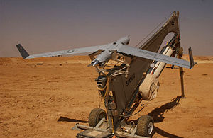
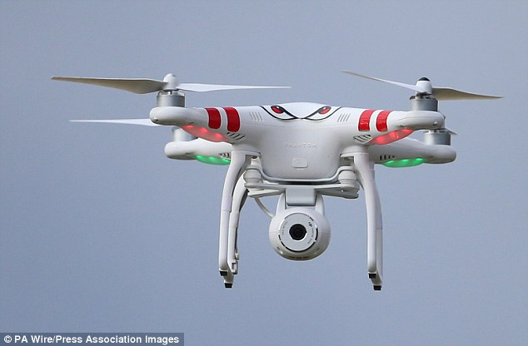
Next Steps
If selected for UAS IPP, convene members for implementation
Develop Strategic Plan for UAS in Oregon
Must have sustainable funding
Submitted High Impact Opportunity Program grant to Business Oregon/Oregon Inc.
$1million dollar request
Decision in February
Requires Board Vote
Requires Legislative approval
Metrics
Create 60 jobs
Attract/create 6 new businesses to Oregon

Slide 22
Grant Distribution
40% to Range Support - $400k
Extends life of range managers
25% for marketing consultant
Outsourcing this keeps ODA out of Business Development
20% for staffing support
ODA not in a position to support IPP without staff and funding
15% admin/software
Data collection
UTM development costs

Slide 23
EcoNW Rural Air Service Study

Slide 24
VOTE- Accept Funds, UAS Test Range Funding
Up to $950,000
SOAR will dissolve as an entity as of January 31st 2018
February Session request legislative approval to increase limitation

Slide 25
VOTE- $1 Million High Impact Opportunity Grant

Slide 26
Administration Division Update LAB Summary
13-15 Total
$10,972,491
15-17 Total $20,483,639
17-19 Total
$22,030,766

Slide 27
Administration Division Update LAB Summary

Slide 28
Administration Division Update Staff Update

Slide 29
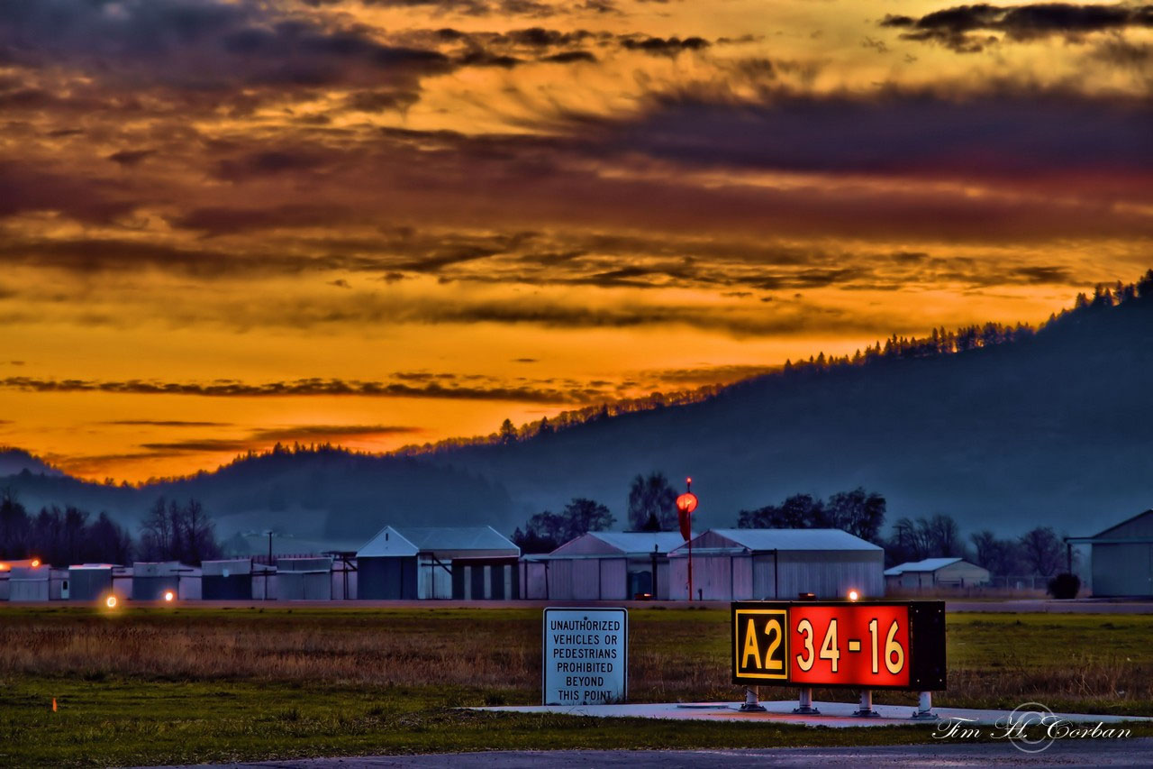
Oregon Department of Aviation

Slide 30
The Agency
28 State Owned Airports
Class D
Pavement Maintenance
Airport Inspections
Register Aircraft and UAS
Land/Hangar Lease
Promote Safe Operation
Communicate with Law Makers
Airport/Tenant Relations
Not an Enforcement Agency
Notes:
28 airports, inspections, pavement, improvements, engage the community all funded through grants, state and federal dollars

Slide 31
The Job
Marketing
Social Media
Communications
Operations
UAV Coordination
Notes:
About myself and where I am today, Part 107 or COA, advising agencies on creation of drone program, free seminars that fit the needs of government for licensing staff

Slide 32
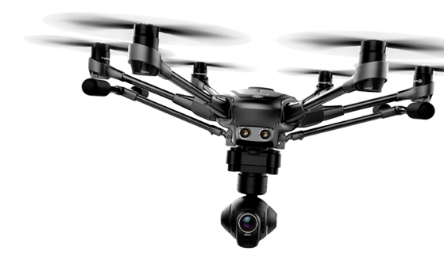
Legislation
HB 2710 – Security, Privacy and UAS Registration
HB 4066 – Weaponized Drones, Reporting Requirements, Commercial Purposes (Privacy and Compliance)
HB 3047 – Modifies HB 4066, Redefines Weaponized Drones (Allowable under circumstances), Law Enforcement and Privacy
Notes:
Federal Pre emption, state pre emption, waived reg for oregon public schools

Slide 33
Understand your environment
Federal Pre-Emption
Congress has directed the FAA to “develop plans and policy for the use of the navigable airspace and assign by regulation or order the use of the airspace necessary to ensure the safety of aircraft and the efficient use of airspace.” 49 U.S.C. §40103(b)(1).
State Pre-Emption
Except as expressly authorized by state statute, the authority to regulate the ownership or operation of unmanned aircraft systems is vested solely in the Legislative Assembly. Except as expressly authorized by state statute, a local government, as defined ORS 174.116 ("Local government" and "local service district" defined), may not enact an ordinance or resolution that regulates the ownership or operation of unmanned aircraft systems or otherwise engage in the regulation of the ownership or operation of unmanned aircraft systems. [2013 c.686 §17; 2015 c.315 §12]
Legislation
Integration
Pan Pacific Test Range - SOAR
Organization – Primary or Auxiliary
Part 107 or COA
Notes:
Premption Fed/State, SOAR, understand whats coming, salary

Slide 34
Safety is Key
SMS
Operating Procedures
Battery Management
Crew Policies
Weather Policies
Aircraft Standards
Personal Protective Equipment
Training Standards
Flight Limitations
A safety management system is a method by which risk management and safety assurance is integrated into operational constructs.
Decision Making
Risk Controls
Safety Assurance
Knowledge Sharing
Safety Promotion/Culture

Slide 35
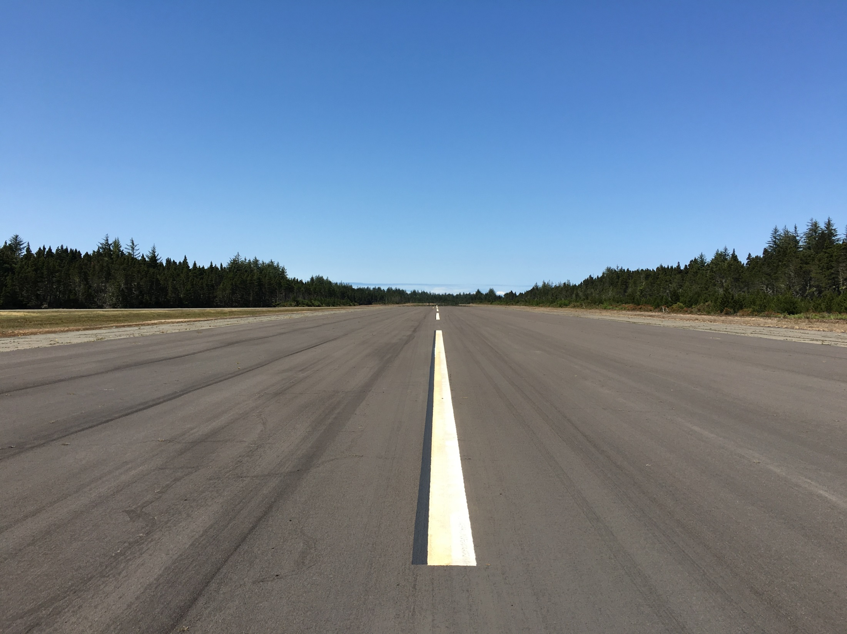
State Involvement
State Agency UAS Programs
Aviation Grants
Oregon Emergency Management
Part 107 Instruction
Community Outreach
Provide Support for UAS Technologies
Sections of part 107 that may be waived can be found in § 107.205 and are listed below
§ 107.25 Operation from a moving vehicle or aircraft.
§ 107.29 Daylight operation.
§ 107.31 Visual line of sight aircraft operation.
§ 107.33 Visual observer.
§ 107.35 Operation of multiple small unmanned aircraft systems.
§ 107.37(a) Yielding the right of way.
§ 107.39 Operation over people.
§ 107.41 Authorization to conduct operation in certain airspace.
§ 107.51 Operating limitations for small unmanned aircraft.

Slide 36
Current topic : Unmanned Aircraft Systems Integration Pilot Program
Integration
BVLOS
3 Year Duration

Slide 37
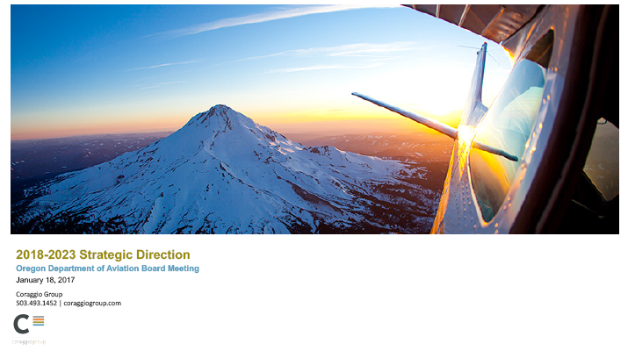

Slide 38
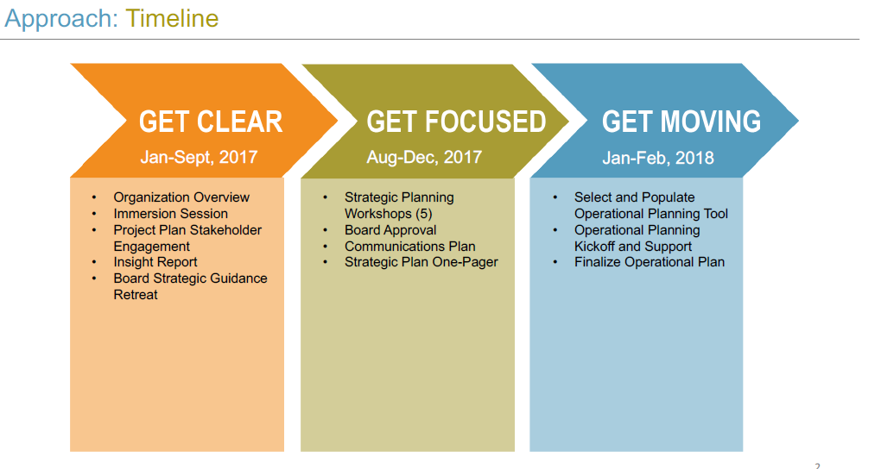

Slide 39
Vote- Oregon Department of Aviation 1 Page Strategic Plan

Slide 40
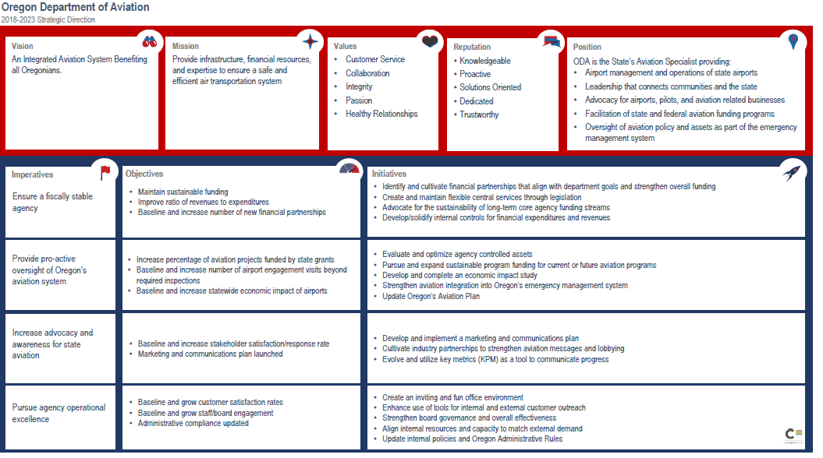
Vote- Oregon Department of Aviation 1 Page Strategic Plan

Slide 41
Planning Division Update

Slide 42
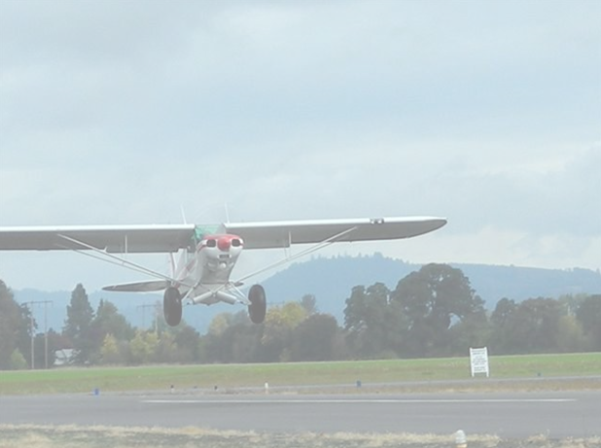
Aviation System Action Program
(ASAP)
COAR Update
State Aviation Board
January 18, 2018

Slide 43
OVERVIEW
Update: ASAP Financial Snap Shot
Overview: 2018 COAR grant cycle
Timeline
Grant Priorities
Minimum Match Requirements
Aviation Review Committee (ARC)
Statutory Considerations
Project Rankings
What’s New and Next Steps

Slide 44
ASAP Financial Snap Shot
ROAR 25%,
1,716,989
COAR 50%,
3,434,988
SOAR 25% ,
1,716,989
2015-17 administrative costs $313,582
2017-19 administrative costs (to date) $97,587
Funded by 5% Fuel Tax Increase Revenue
Aviation System Action Program Financial Summary
Since inception January 1, 2016 - January 15, 2018
ASAP Program | Revenue | Expenditures to Date | Remaining Encumbrances | Balance after Encumbrances | Current Cash Balance
COAR- Critical Oregon Airport Relief Program 2016-2017 grant cycle | 1,673,315 | 280,350 | 1,392,964 | 1 | 1,392,965
COAR 2017-2018 grant cycle | *1,761,673 | - | - | - | 1,761,673
SOAR- State Owned Airport Reserve Program | 1,716,989 | 498,589 | **1,138,258 | 80,142 | 1,218,400
ROAR- Rural Oregon Aviation Relief Program | 1,716,989 | 82,002 | 136,420 | 1,498,567 | 1,634,987
ASAP Fund Total | 6,868,966 | 860,941 | 2,667,642 | 1,578,710 | 6,008,025
*1 month of revenue remains to be collected. Projected total revenue: $1.8M
**Includes remaining budget for seasonal & temp workers and contingency fund.

Slide 45
COAR Grant Cycle 2018
Overview

Slide 46
September 1
To October 2
Grant application available.
March/April
Staff notifies awarded projects and begins the agreement process
Late January/Early Feb.
Aviation Review Committee compiles project list to recommend to Aviation Board
March
Aviation Board reviews, reprioritizes(as needed) and approves recommended apps
October 16 – December 22
ACT review and grading
October 3 – October 13
ODA’s completeness review
You are Here!
COAR Cycle 2017-2018 Timeline

Slide 47
COAR Grant Priorities
1st priority – Assist with match requirements for FAA Airport Improvement Program (AIP) grants
2nd priority – Safety and infrastructure development
3rd priority – Aviation-related economic benefits related to airports

Slide 48
COAR Minimum Match Requirements
Both FAA and non-FAA eligible projects: the level of sponsor/owner grant matching requirements are based upon category of airport as defined in the Oregon Aviation Plan.
Category 1a – Commercial Primary: 50%
Category 1b – Other Commercial Non-Primary (less than 10k enplanements): 35%
Category 2 – Business: 25%
Category 4 – Community: 10%
Category 5 – Low Activity: 5%
Category 3 – Regional: 10%

Slide 49
Aviation Review Committee (ARC)
Met to consider the application information, application base scores and the ACT review grades.
The ARC broke ties in scores among projects and compiled recommendations to the Board for Priorities 1-3.

Slide 50
Statutory Considerations
The following considerations played a role in the completeness review of applications and in the review by the ACTs.
ORS 367.804:
(3)In selecting transportation projects the commission shall consider:
(a)Whether a proposed transportation project reduces transportation costs for Oregon businesses or improves access to jobs and sources of labor;
(b)Whether a proposed transportation project results in an economic benefit to this state;
(c)Whether a proposed transportation project is a critical link connecting elements of Oregon’s transportation system that will measurably improve utilization and efficiency of the system;
(d)How much of the cost of a proposed transportation project can be borne by the applicant for the grant from any source other than the Connect Oregon Fund;
(e)Whether a proposed transportation project is ready for construction; and
(f)Whether a proposed transportation project has a useful life expectancy that offers maximum benefit to the state.

Slide 51
Total Numbers
Received 58 applications / Total Grant Request of $5.9 Million
Total Complete Applications Priority I: $2,105,461
(24 applications for consideration)
Total Complete Applications Priority II: $710,603 (6 applications for consideration)
Total Complete Applications Priority III: $3,093,850 (28 applications for consideration)
Available awards: approx. $1.8 Million

Slide 52
Priority I Projects
Priority I Projects: | Airport Name | Project Name | Match | Amount Requested from ODA | Total Project Cost
1 | Ontario Municipal Airport | Ontario Airport Project AIP 14-2018 | $229,522 | $22,700 | $252,222
2 | Baker City Municipal | South Apron Reconstruction Project | $1,516,650 | $150,000 | $1,666,650
3 | Grant County Regional Airport | FAA Match for GCRA Reconstruct Aprons: Phase I | $475,222 | $47,000 | $522,222
4 | Hobby Field | AIP Match Taxilane Improvements | $1,046,500 | $103,500 | $1,150,000
5 | Florence Municipal | Runway/Taxiway Seal Coat and Lighting Project | $1,041,445 | $103,000 | $1,144,445
6 | Gold Beach Municipal Airport | AIP Match for Replace Rotating Beacon and Install PAPI | $232,000 | $23,555 | $255,555
7 | Tillamook Airport | TMK- FAA Match_COAR 2018 | $546,000 | $54,000 | $600,000
8 | Albany Municipal Airport | Taxi-way connector realignment, apron rehab | $1,305,850 | $129,150 | $1,435,000
9 | McMinnville Municipal Airport | Pavement Rehabilitation Phase I - Environmental/Design | $493,333 | $40,000 | $533,333
10 | Madras Municipal Airport | Rehabilitate Parallel Taxiway (Construction) | $2,577,778 | $150,000 | $2,727,778
11 | Newport Municipal Airport | FAA AIP-25 grant matching funds for Predesign for Storm Pipe Rehabilitation and slope repair environmental | $233,400 | $18,924 | $252,324
12 | Prineville/Crook County Airport | Aircraft Apron Joint Use Facility Design and Construction | $758,333 | $75,000 | $833,333
13 | Hermiston Municipal Airport | Apron Rehab/RPZ Land Acquisition/Road Relocation-Environmental | $252,777 | $25,000 | $277,777
14 | Scappoose Industrial Airpark | Future AIP Match - Phase III Taxiway Relocation Construction. | $3,271,441 | $150,000 | $3,421,441
15 | Crater Lake-Klamath Regional Airport | LMT - Master Plan Update | $644,889 | $44,000 | $688,889
16 | Salem Municipal Airport | RWY 13/31 Rehabilitation | $3,505,742 | $150,000 | $3,655,742
17 | Southwest Oregon Regional Airport | FAA AIP EA Runway 22 Safety Area Improvements | $516,667 | $16,667 | $533,333
18 | Port of Astoria Regional Airport | AIP 23: Taxiway A Relocation Project | $3,783,333 | $150,000 | $3,933,333
19 | Eastern Oregon Regional Airport | Runway 7-25 Rehabilitation - Design | $432,829 | $14,539 | $447,368
20 | Rogue Valley International-Medford | Hangar Taxilane Reconstruction-Phase 1 & Acquire SRE & ARFF Equipment | $2,668,359 | $80,859 | $2,749,219
21 | Southwest Oregon Regional Airport | FAA AIP Airfield Lighting, Signage and Marking | $3,334,567 | $107,567 | $3,442,133
22 | Redmond Municipal Airport | Runway 11-29 Rehabilitation Project | $9,983,334 | $150,000 | $10,133,334
23 | Bend Municipal Airport | Bend Municipal Airport Master Plan Update & AGIS | $350,000 | $150,000 | $500,000
24 | Redmond Municipal Airport | Terminal Aircraft Parking Apron Expansion Project | $6,000,000 | $150,000 | $6,150,000
 |  | Total Priority I Projects: |  | $2,105,461

Slide 53
Priority II Projects
Priority II Projects: | Airport Name | Project Name | Match | Amount Requested from ODA | Total Project Cost
25 | Hobby Field | Airport Improvements - Emergency Operations Center - Multi-Purpose STEM\Educational Facility | $16,667 | $150,000 | $166,667
26 | Newport Municipal Airport | CSZ Airport Resiliency Emergency Solar Power/Battery Storage System | $45,000 | $45,000 | $90,000
27 | Tillamook Airport | Dedicated Helicopter Terminal Operations Area Paving | $15,000 | $135,000 | $150,000
28 | Hobby Field | Airport Improvements - Emergency Stand-by Generator with Automatic Power Transfer Switch | $16,666 | $150,000 | $166,666
29 | Scappoose Industrial Airpark | Seismic Resiliency Plan for the Scappoose Industrial Airpark | $26,868 | $80,603 | $107,470
30 | Newport Municipal Airport | CSZ Airport Resiliency Emergency Generator (100LL) | $150,000 | $150,000 | $300,000
 |  | Total Priority II Projects: |  | $710,603

Slide 54
Priority III Projects
Priority III Projects: | Airport Name | Project Name | Match | Amount Requested from ODA | Total Project Cost
31 | Sisters Eagle Airport | Infrastructure for Growth - Hangar | $1,700,000 | $150,000 | $1,850,000
32 | Seaside Municipal Airport | Aviation Weather Cameras | $2,000 | $18,000 | $20,000
33 | Seaside Municipal Airport | Critical Airport Improvements | $8,200 | $73,800 | $82,000
34 | Sisters Eagle Airport | Infrastructure for Growth - Water/Building Addition | $205,000 | $150,000 | $355,000
35 | Twin Oaks Airpark | Taxiway Rehabilitation Airport Access | $17,000 | $48,500 | $65,500
36 | Twin Oaks Airpark | Transient Parking Ramp | $37,000 | $107,000 | $144,000
37 | Miller Memorial Airpark | Miller Memorial Airpark Parking Area and Taxi Way Phase 1 | $7,500 | $142,500 | $150,000
38 | Tillamook Airport | Preliminary Hangar Development | $6,000 | $54,000 | $60,000
39 | Burns Municipal Airport | Public Water Supply Well and Water Distribution System | $8,200 | $73,800 | $82,000
40 | Burns Municipal Airport | Jet Fuel Storage Tank | $12,000 | $108,000 | $120,000
41 | Sisters Eagle Airport | Infrastructure for Growth - Jet A Fuel Tank | $60,000 | $150,000 | $210,000
42 | Beaver Marsh | Safety Widening and Lenghtening | $1,250 | $23,750 | $25,000
43 | Lakeview Airport | Emergency generator installation | $16,666 | $150,000 | $166,666
44 | Gold Beach Municipal Airport | Fuel Tank Replacement | $52,500 | $150,000 | $202,500
45 | Illinois Valley Airport | Airport Equipment/Maintenance Building Upgrades | $4,000 | $36,000 | $40,000
46 | Portland Downtown Heliport | Portland Downtown Heliport Modernization Project | $40,000 | $123,000 | $163,000
47 | Sisters Eagle Airport | Infrastructure for Growth - Electrical/Sewer | $20,000 | $150,000 | $170,000
48 | Twin Oaks Airpark | Back Up Electrical Generator | $5,000 | $43,500 | $48,500
49 | Grants Pass Airport | Airport Improvement - Hangar Development | $60,000 | $150,000 | $210,000
50 | Grants Pass Airport | Airport Improvements - Critical Water Supply and Electrical Distribution System Upgrades | $16,667 | $150,000 | $166,667
51 | Sisters Eagle Airport | Infrastructure for Growth - GPS Approach &amp; Maintenance | $20,000 | $150,000 | $170,000
52 | Madras Municipal Airport | Madras Airport Helicopter Base (design & environmental) | $20,000 | $116,500 | $136,500
53 | City of Creswell Hobby Field Airport | Construct a 60 x 60.5 Hangar | $16,667 | $150,000 | $166,667
54 | Illinois Valley Airport | 100LL Self-serve Cardlock Aircraft Fuel System | $16,600 | $150,000 | $166,600
55 | City of Creswell Hobby Field Airport | Installation of Two (2) Restrooms without Limits | $16,667 | $150,000 | $166,667
56 | Prineville/Crook County Airport | Standby Generator | $14,500 | $130,500 | $145,000
57 | Ashland Municipal Airport | Terminal Building Maintenance and Improvements | $5,000 | $45,000 | $50,000
58 | Illinois Valley Airport | Airport Industrial Park Fire Suppression System Repairs | $16,000 | $150,000 | $166,000
 |  | Total Priority III Projects: |  | $3,093,850

Slide 55
What’s New?
Milestone Progress Report
Migrating the form to e-Grants
Grant Agreements
Date of Board approval will become the effective date of grant agreements.
Projects receiving FAA AIP grants will not execute grant agreements until FAA grant has been received.

Slide 56
Next Steps
Complete
Sent to ACTs for their statutory grading
11 of the 12 ACTs received applications to review within their ACT region
All ACT grades were completed by December 22nd
Combined list and associated materials have been sent to the ARC
ARC met January 11th 2018 in Salem. Staff has compiled the final list of ARC recommendations. Board members may access the material online via the grant software.
On Going Steps
Administer the 2016-2017 Grants

Slide 57
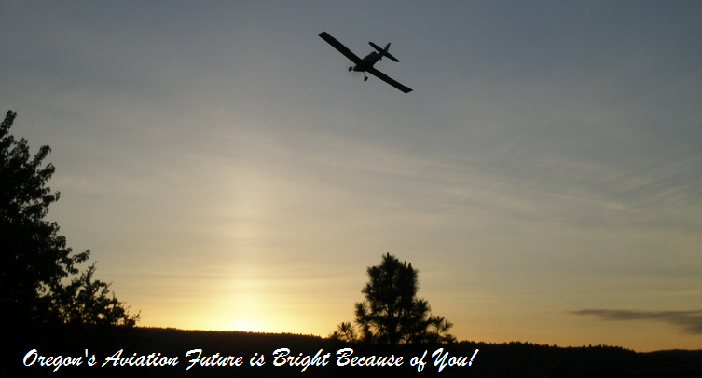

Slide 58
Oregon Aviation Plan Update Jviation

Slide 59
Executive Session
Per ORS 192.660 (2)(e) To Deliberate Real Property Transactions
Discuss Bandon State Airport Property Acquisition

Slide 60
Bandon Property Purchase
Asking price: $140,000
Appraisal, escrow, survey, environmental, etc. $40,000-$60,000
Timber Value Estimation: $88,300
Timber value on ODA property: little to no value (property access issue) If ODA has access through Janis property either through agreement or after purchase, timber is valued approx. $15,000
FAA Reimbursement: would require full Environmental Assessment $150-$250K and add 18 months to the purchase of property and removal of obstructions.
No FAA Reimbursement: ODA could work to purchase property immediately and look to have a timber company on contract after closing to remove the trees.

Slide 61
Needed Airport Property Purchases
Bandon: Obstruction, Approach Surfaces/Safety
Aurora: Runway Extension Runway Safety Area, RPZ/Safety
Independence: Approach Surfaces/Hangar Development/Economic
Joseph: Hangar Development/Economic
Lebanon: Hangar Development/Economic
Prospect: Obstruction, Approach Surfaces/Safety
Toledo: Runway Safety Area/Safety
Pacific City: Obstruction Encroachment/Safety
Wakonda Beach: Obstruction/Safety
All Obstruction Removal Due to FAA Protected Surfaces, FAA Part 77

Slide 62
Vote 2018-2019 SOAR Project Approval

Slide 63
Vote 2018-2019 SOAR Project Approval
SOAR Projects | Cycle 1 | Cycle 2 | Cycle 3
Actuals and Forecast | 2016 & 2017 | 2018 & 2019 | 2020-2021
 | *Actuals & Projections | Projections | Projections
Beginning Balance | $ - | $ 1,289,170 | $ 890,044
Revenue | $ 1,785,928 | $ 1,798,350 | $ 1,795,627
Cycle 1 Projects Expenditures | $ 496,758 | $ 1,047,477 | $ -
Cycle 2 Proposed Project Expenditures | $ - | $ 1,150,000 | $ 2,000,000
TOTAL EXPENDITURES | $ 496,758 | $ 2,197,477 | $ 2,000,000
Ending Balance | $ 1,289,170 | $ 890,044 | $ 685,671
 | *Includes 1 month Projected Revenue for December 2017

Slide 64
Adjourn

