Slide 1

Impact of Oregon’s Drug Decriminalization on the Oregon Sentencing Guidelines
2022 NASC Annual Conference
August 9, 2022
Chris Campbell, Ph.D.
Criminology & Criminal Justice
Portland State University
Kelly Officer
Research Director
Oregon Criminal Justice Commission
CRIMINAL JUSTICE COMMISSION ∙ STATE OF OREGON

Slide 2
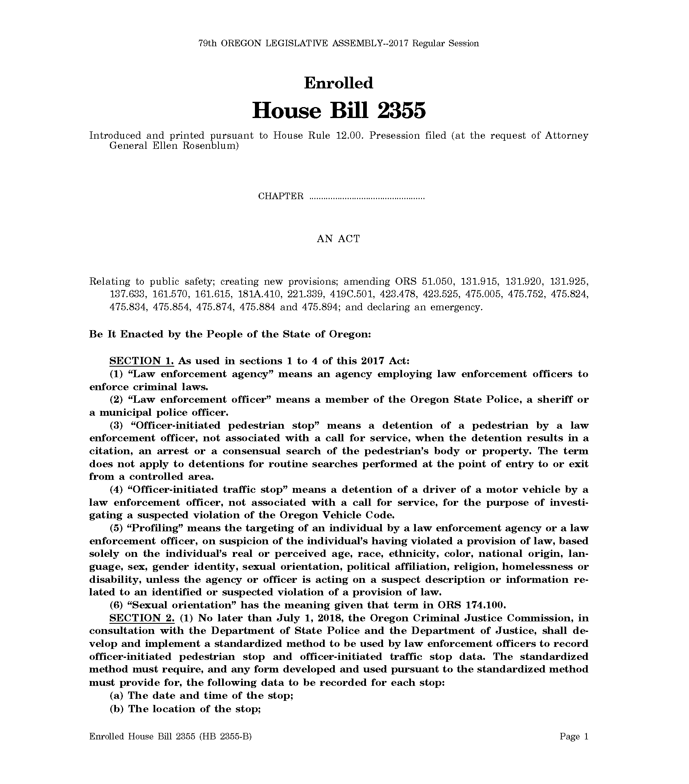
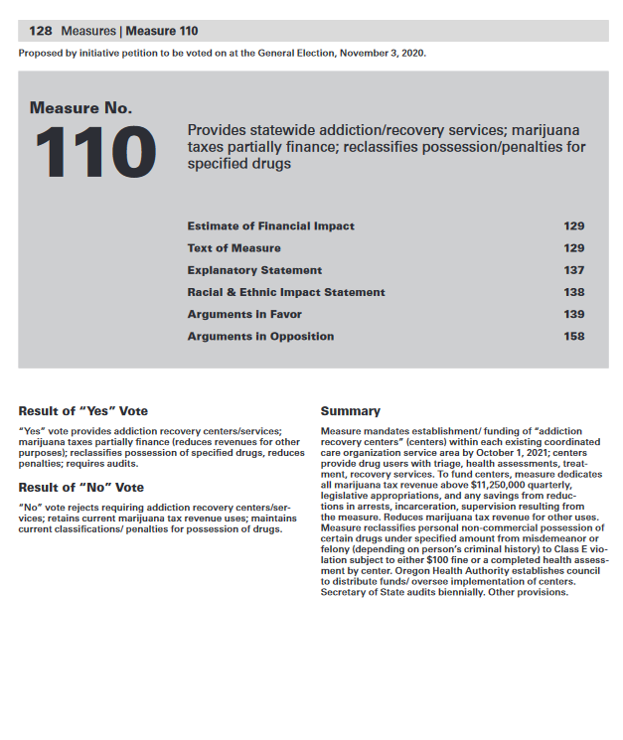
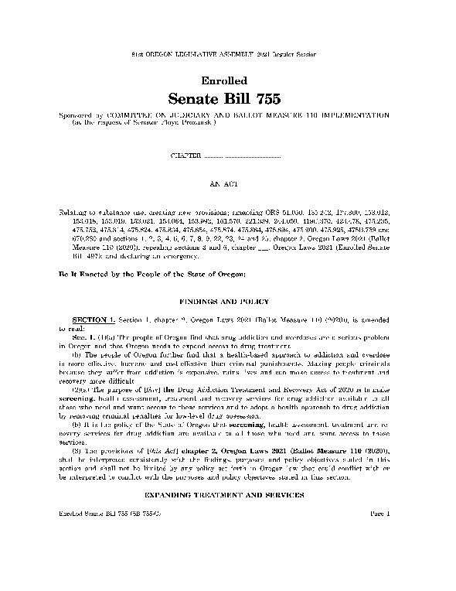
M110 Background Recent Changes to Criminal Laws for Possession of Controlled Substances
Since 2017, three substantial changes to criminal laws related to possession of controlled substances (PCS) have been passed.
HB 2355 in 2017 changed PCS of user amounts for first time defendants from a felony to a misdemeanor
Ballot Measure 110 in 2020 made more sweeping changes, lowering most PCS to a violation.
SB 755 in 2021 made numerous technical changes to the language in the ballot measure.
CRIMINAL JUSTICE COMMISSION ∙ STATE OF OREGON

Slide 3
M110 Background PCS Law Changes in BM 110 & SB 755†
Post-Ballot Measure 110
What quantity leads to a misdemeanor?
Felony
 | Subject is convicted of a commercial drug offense Subject possess a substantial quantity of controlled substance(s) defined by 475.900(2)(b)†
Misdemeanor
 | Subject possesses more than a user quantity of controlled substance(s)
Violation
 | All other non-felony and non-misdemeanor PCS
Heroin: 1g | LSD: 40 units
MDMA: 1g or 5 pills | Psilocybin: 12g
Cocaine: 2g | Methadone: 40g
Methamphetamine: 2g | Oxycodone: 40 pills
What quantity leads to a felony?
Heroin: 5g | LSD: 200 units
MDMA: 5g or 25 pills | Psilocybin: 60g
Cocaine: 10g | Fentanyl†: 5g
Methamphetamine: 10g
CRIMINAL JUSTICE COMMISSION ∙ STATE OF OREGON

Slide 4
Impacts: Data Arrest Patterns
Arrest Patterns
While arrest patterns for PCS and non-PCS crimes followed similar trends before M110, since its passage, these trends have diverged.
Between 2017 and 2019, PCS arrests averaged 1,250 per month.
In April 2022, only 165 PCS arrests were logged.
This represents an 87% reduction.
Notes:
The co-occurring impact of COVID-19 makes it difficult to detect the true early effects of BM 110 on arrest patterns.
Since Nov 2020, however, the patterns for non-PCS arrests and PCS arrests have diverged.
Non-PCS arrests have rebounded, although not to pre-pandemic levels.
While PCS arrests averaged around 1,250 from 2017-2019, only 165 PCS arrests were logged in April 2022. This represents a reduction of 87%.

Slide 5
Impacts: Data Conviction Patterns
PCS Convictions 2017 through May 2022
Conviction Patterns
The COVID-19 impact makes it difficult to detect the true early effects of BM 110 on convictions.
In 2019, Oregon averaged 165 felony and 178 misdemeanor PCS convictions per month.
In May 2022, the monthly average has fallen to 31 felony and 22 misdemeanor PCS convictions.

Slide 6
Other Impacts Community Corrections Population
April 2022 Oregon Probation Population Forecast
Community Corrections Forecast
By design, BM 110 bypasses the justice system, which is resulting in both caseload and funding reductions for community corrections.
April 2022 Probation Population Forecast:
The forecast shows a significant dip due to COVID-19 and Measure 110.
There is a predicted rebound, however, due to new populations falling under the “funded population” for community corrections (see SB 497 (2021)).

Slide 7
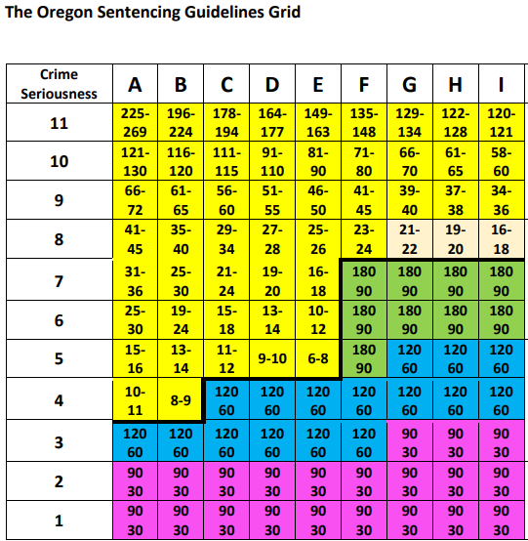
Sentencing in Oregon Presumptive Grid
Criminal History
Presumptive Sentencing Grid
Like many states, Oregon uses a presumptive sentencing grid that provides a basic common ground for plea bargaining and intersectionality in sentencing.
Index offense severity is generally provided by statutes defining the crime and if not, then by the sentencing commission.
Criminal history on the grid is defined largely by the state sentencing commission.
Numbers shown in the colored grid squares represent the presumptive months on the person’s sentence.
Index offense severity

Slide 8
Sentencing in Oregon Presumptive Grid
Criminal History
Presumptive Sentencing Grid
Like many states, Oregon uses a presumptive sentencing grid that provides a basic common ground for plea bargaining and intersectionality in sentencing.
Index offense severity is generally provided by statutes defining the crime and if not, then by the sentencing commission.
Criminal history on the grid is defined largely by the state sentencing commission.
Numbers shown in the colored grid squares represent the presumptive months on the person’s sentence.
Those in the top portion of the grid represent presumptive months in prison.
The bottom portion represents days in local control (jail).
Probation terms, post-prison supervision and maximum departures are also defined in the grid, but not shown here.
Index offense severity

Slide 9
Sentencing in Oregon Presumptive Grid
Lengthier/severe criminal history
Walking the Grid
More severe a defendant’s index offense charge is, the higher up the presumptive sentence may “walk” up the grid.
More severe (violent) and lengthier criminal history may “walk” left along the grid.
Includes felony or Class A misdemeanor convictions
Over the person’s lifetime, including felonies adjudicated as a juvenile
More severe index offense

Slide 10
Possible Impacts of BM 110 on Sentencing Presumptive Grid Criminal History
Criminal history
Walking the Grid
When considering the impacts of BM 110, we need to consider walking the criminal history segment.
PCS charges, even before 2017 defelonization, can only impact those columns that encompass non-person offenses and Class A misdemeanors
A | 3 or more person felonies over lifetime
B | 2 person felonies over lifetime
C | 1 person felony, and 1 or more non-person felony
D | 1 person felony, but no non-person felony
E | 4 or more non-person felonies, but no person felony
F | 2 or 3 non-person felonies, but no person felony
G | 4 or more Class A misd. or 1 non-person felony; and no person
H | No more than 3 non-person felonies, and no person felony
I | No felony or Class A misdemeanors

Slide 11
Possible Impacts of BM 110 on Sentencing Presumptive Grid Criminal History
Criminal history
Walking the Grid
When considering the impacts of BM 110, we need to consider walking the criminal history segment.
PCS charges, even before 2017 defelonization, can only impact those columns that encompass non-person offenses and Class A misdemeanors:
Prior to 2017 Defelonization
1 PCS felony on record could feasibly move any presumptive column left by one
E.g., From I to H
Between 6 months in jail and 122 months in prison
E.g., From E to C
Between 6 months in jail and 178 months in prison
A | 3 or more person felonies over lifetime
B | 2 person felonies over lifetime
C | 1 person felony, and 1 or more non-person felony
D | 1 person felony, but no non-person felony
E | 4 or more non-person felonies, but no person felony
F | 2 or 3 non-person felonies, but no person felony
G | 4 or more Class A misd. or 1 non-person felony; and no person
H | No more than 3 non-person felonies, and no person felony
I | No felony or Class A misdemeanors

Slide 12
Possible Impacts of BM 110 on Sentencing Presumptive Grid Criminal History
Criminal history
Walking the Grid
When considering the impacts of BM 110, we need to consider walking the criminal history segment.
PCS charges, even before 2017 defelonization, can only impact those columns that encompass non-person offenses and Class A misdemeanors:
Since defelonization
1 PCS misdemeanor on record could feasibly move any presumptive column left by one
E.g., From I to H
Between 6 months in jail and 122 months in prison
Theoretically, BM 110 will not result in any grid walking
A | 3 or more person felonies over lifetime
B | 2 person felonies over lifetime
C | 1 person felony, and 1 or more non-person felony
D | 1 person felony, but no non-person felony
E | 4 or more non-person felonies, but no person felony
F | 2 or 3 non-person felonies, but no person felony
G | 4 or more Class A misd. or 1 non-person felony; and no person
H | No more than 3 non-person felonies, and no person felony
I | No felony or Class A misdemeanors

Slide 13
Simulated Impacts of BM 110 on Sentencing Presumptive Grid Criminal History
 | Without PCS History | With PCS History | PCS Most Serious Index
A | 2.0% | 0.2% | 0.2%
B | 2.6% | 0.5% | 0.4%
C | 3.0% | 1.3% | 1.1%
D | 3.0% | 0.0% | 0.0%
E | 12.8% | 20.2% | 16.0%
F | 30.3% | 16.6% | 32.7%
G | 38.0% | 45.2% | 40.2%
H | 7.6% | 16.0% | 9.6%
I | 0.8% | 0.0% | 0.0%
Total | 16,668 | 7,743 | 281
Simulating Retroactively Nullifying PCS
Central Question
Where would a defendant fall on the presumptive grid if PCS convictions were removed?
Data from Department of Corrections
Convicted between 2010-2017: Height of PCS charging
Sentenced to incarceration: Longest criminal history
N = 24,451 individuals
7,743 (31.7%) had 1 or more misdemeanor or felony convictions for PCS
4,308 (55.6%) of those with PCS convictions had only one in their history
281 (1.2%) had PCS as most serious index offense

Slide 14
Simulated Impacts of BM 110 on Sentencing Presumptive Grid Criminal History
n = 7,743 |  | % of Current Grid Column
 |  | A | B | C | D | E | F | G | H | I
Sim. Grid | A | 100
 | B |  | 100
 | C |  |  | 80.8
 | D |  |  | 19.2 | 0.0
 | E |  |  |  |  | 28.4
 | F |  |  |  |  | 34.2 | 44.9
 | G |  |  |  |  | 2.2 | 52.5 | 71.5
 | H |  |  |  |  |  | 0.5 | 20.5 | 24.1
 | I |  |  |  |  | 35.1 | 1.4 | 2.6 | 16.4 | 0.0
 | Off |  |  |  |  |  | 0.7 | 5.4 | 59.5
Simulating Retroactively Nullifying PCS
Central Question
Where would a defendant fall on the presumptive grid if PCS convictions were removed?
This table shows what percent of the current grid placement would fall along the simulated, retroactive grid.

Slide 15
Simulated Impacts of BM 110 on Sentencing Findings
n = 7,743 |  | Current Grid
 |  | A | B | C | D | E | F | G | H | I
Sim. Grid | A | 100
 | B |  | 100
 | C |  |  | 80.8
 | D |  |  | 19.2 | 0.0
 | E |  |  |  |  | 28.4
 | F |  |  |  |  | 34.2 | 44.9
 | G |  |  |  |  | 2.2 | 52.5 | 71.5
 | H |  |  |  |  |  | 0.5 | 20.5 | 24.1
 | I |  |  |  |  | 35.1 | 1.4 | 2.6 | 16.4
 | Off |  |  |  |  |  | 0.7 | 5.4 | 59.5
Simulating Retroactively Nullifying PCS
19.2% of those who were listed as a C history, would be downgraded to D
Assuming the most severe index offense (severity=11), the prior sentence minimum (178 months) would now be the maximum (177mo)

Slide 16
Simulated Impacts of BM 110 on Sentencing Findings
n = 7,743 |  | Current Grid
 |  | A | B | C | D | E | F | G | H | I
Sim. Grid | A | 100
 | B |  | 100
 | C |  |  | 80.8
 | D |  |  | 19.2 | 0.0
 | E |  |  |  |  | 28.4
 | F |  |  |  |  | 34.2 | 44.9
 | G |  |  |  |  | 2.2 | 52.5 | 71.5
 | H |  |  |  |  |  | 0.5 | 20.5 | 24.1
 | I |  |  |  |  | 35.1 | 1.4 | 2.6 | 16.4
 | Off |  |  |  |  |  | 0.7 | 5.4 | 59.5 | 100
Simulating Retroactively Nullifying PCS
71.5% listed as an E history, would be downgraded to a lower category
35.1% dropped four levels
Assuming a moderately severe index offense (severity=5 to 7), those previously receiving prison (E), would likely be presumptive probation (F through I).

Slide 17
Simulated Impacts of BM 110 on Sentencing Findings
n = 7,743 |  | Current Grid
 |  | A | B | C | D | E | F | G | H | I
Sim. Grid | A | 100
 | B |  | 100
 | C |  |  | 80.8
 | D |  |  | 19.2 | 0.0
 | E |  |  |  |  | 28.4
 | F |  |  |  |  | 34.2 | 44.9
 | G |  |  |  |  | 2.2 | 52.5 | 71.5
 | H |  |  |  |  |  | 0.5 | 20.5 | 24.1
 | I |  |  |  |  | 35.1 | 1.4 | 2.6 | 16.4
 | Off |  |  |  |  |  | 0.7 | 5.4 | 59.5 | 100
Simulating Retroactively Nullifying PCS
55.1% listed as F history, would be downgraded at least 1 lower category
0.7% would no longer be on the grid
Assuming a lesser severe index offense (severity=3 to 5), maximum jail days (90 at severity=5) could decrease by 60 days.

Slide 18
Simulated Impacts of BM 110 on Sentencing Findings
n = 7,743 |  | % of Current Grid Column
 |  | A | B | C | D | E | F | G | H | I
Sim. Grid | A | 100
 | B |  | 100
 | C |  |  | 80.8
 | D |  |  | 19.2 | 0.0
 | E |  |  |  |  | 28.4
 | F |  |  |  |  | 34.2 | 44.9
 | G |  |  |  |  | 2.2 | 52.5 | 71.5
 | H |  |  |  |  |  | 0.5 | 20.5 | 24.1
 | I |  |  |  |  | 35.1 | 1.4 | 2.6 | 16.4 | 0.0
 | Off |  |  |  |  |  | 0.7 | 5.4 | 59.5
Simulating Retroactively Nullifying PCS
2,661 (34.4%) of sample would no longer be on the presumptive grid in terms of criminal history:
5.41% formerly listed D = 1,890 defendants
59.5% formerly listed H = 771 defendants
Assuming a more severe index offense (severity=8 to 11), the maximum prison sentences (134 mo) could decrease over a year.

Slide 19
Conclusion
The impacts of M110 are varied and far-reaching
The sentencing changes in M110 are not retroactive, and the impact to the Oregon Sentencing Guidelines will fade in over time
At full impact, the measures appear to have a substantial impact on criminal history scores
) have been passed.
CRIMINAL JUSTICE COMMISSION ∙ STATE OF OREGON

