Slide 1
State Funding for Supervision
National Association of Sentencing Commissions| August 9, 2022

Slide 2
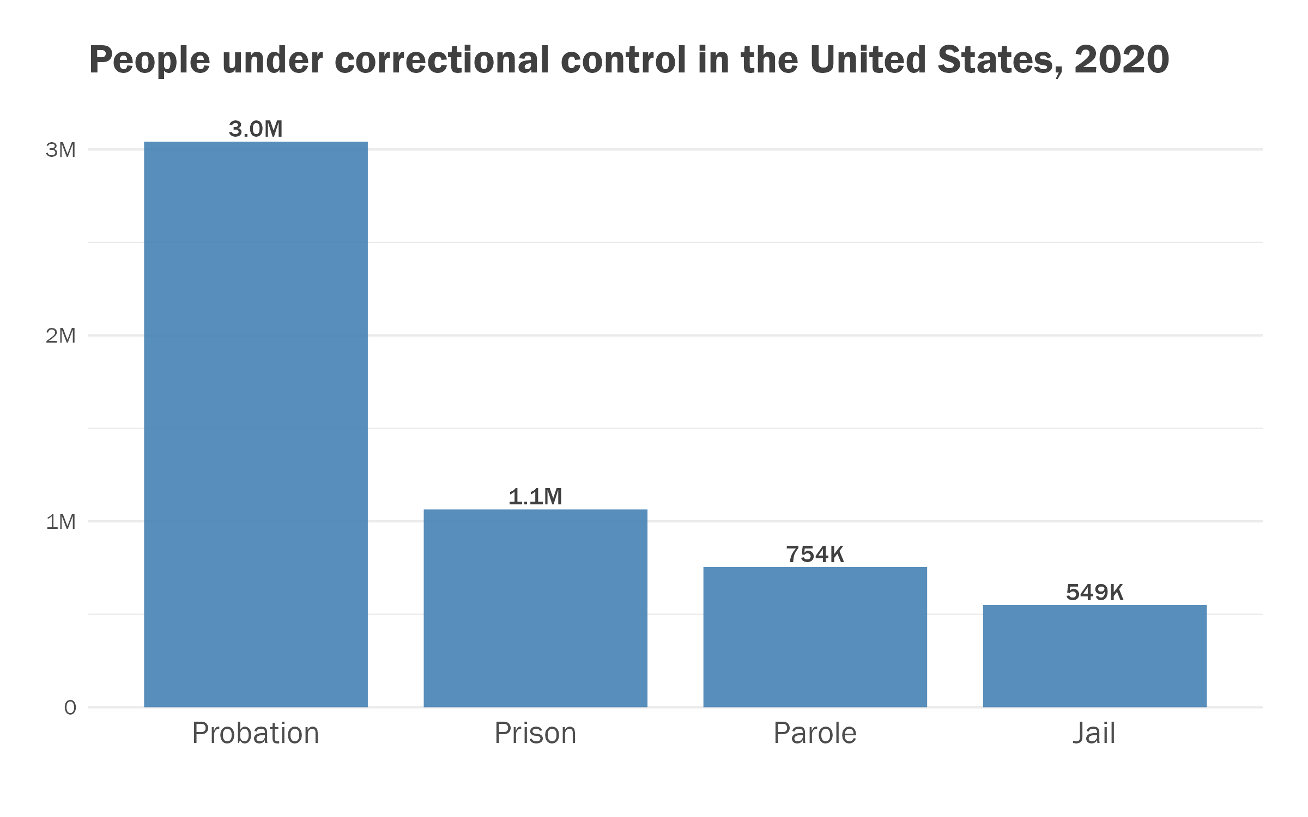
State funding for supervision is really important!
In every state, the biggest volume in the corrections system is people on probation at the “front end.”
Shrinking mass supervision is important, but ensuring supervision works well is also crucial.
Holding people accountable and providing programming in the community has the greatest potential for reducing recidivism, but attention to and funding for the front end rarely matches its potential.

Slide 3
Some common themes appear across state approaches to funding supervision.
Inadequate attention and funding for the community corrections function
Organizational challenges based on variations in governance, e.g.,
  State versus county employees
  Judicial branch versus executive branch governance
  “Community corrections” versus “regular probation” where they are not the same thing
Policy tensions between, e.g.,
  Funding that rewards desirable practices versus
  Funding to “lift up” the communities with less desirable performance
Multiple approaches in a single state
Potential for sentencing guideline states to leverage data for a funding model

Slide 4
Most states have a “community corrections act” approach to providing funding for local correctional engagement.
State “CCAs” have these common features:
  A subsidy with restrictions on its use;
  Local participation, collaboration, and planning;
  A target population and performance target(s);
  A funding formula or other form of grant-making or subsidy.
Fourteen states have an explicit version of a CCA in statute, and it appears that most or all have an approach by another name but with these features.
Twelve states have county or district-level probation supervision, while most states use a statewide agency (usually the DOC) that may or may not include parole supervision.

Slide 5
Explicit CCA approaches are not co-extensive with locally run probation.
Locally Run Probation
State-Run Probation
CCA in Statute
Statute
Even in locally run states, the state provides supervision in some counties.
At both the state and county levels, probation systems are in the executive or judicial branch.
American Probation and Parole Association Adult and Juvenile Probation and Parole National Firearm Survey, Second Edition, October 2006; Lexis search of 50 states for “community corrections act” in statute.

Slide 6
Community corrections funding formulas are common and take various approaches.
Texas, Pennsylvania, Minnesota, and Oregon all use a funding formula to compare counties and share funding across county or multi-county probation departments.
Some states (e.g., California, Arizona, Illinois, and Arkansas) tie funding to reducing revocations from probation to prison, referred to as “performance incentive funding” or “PIF.”
Other states use sentencing guidelines or risk assessment to define a target population and tie funding to programs serving that population (e.g., Michigan and Kansas).
“Performance Incentive Funding,” Vera Institute, accessed March 10, 2021, https://www.vera.org/projects/performance-incentive-funding/overview k to insert source; research by the CSG Justice Center. Research on Pennsylvania, Texas, Oregon, Kansas and Michigan by CSG Justice Center
Notes:
CARL

Slide 7
This presentation describes seven states’ approaches and highlights the Oregon approach.
County-run: Texas, Pennsylvania, Minnesota, and Oregon
PIF: California
SGLs and CCAs: Michigan and Kansas
Notes:
CARL

Slide 8
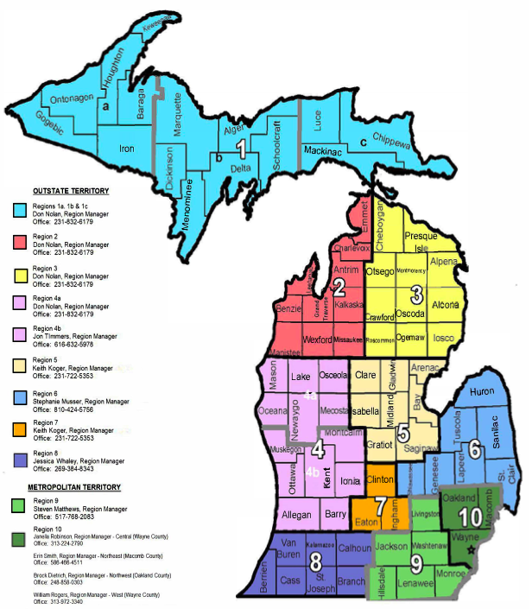
Like many states, Michigan has state-run probation plus community corrections (Act 511 of 1988) to support local initiatives alongside probation.
State-run Field Services supervises probation and parole clientele.
CCA funding targets certain people convicted of felonies (straddle cell and higher-end violators) for programs and services.
Funding provides for cognitive behavioral programming; substance use treatment; mental health treatment; case management; education; pretrial services; day reporting; electronic monitoring; employment and community service.
Source: (for map) Michigan Department of Corrections Field Operations Administration Territories and Regions As of December 31, 2018
https://www.michigan.gov/corrections/0,4551,7-119-33218_49414-222913--,00.html; (for text) “Report to the Legislature Pursuant to P.A. 87 of 2021 and P.A. 511 of 1998, OFFENDER SUCCESS ADMINISTRATION, Office of Community Corrections,” (2022) at https://www.michigan.gov/corrections/-/media/Project/Websites/corrections/Files/Legislative-Reports/2022/Office-Of-Community-Corrections-Annual-Report.pdf?rev=80b27f48abfd4cbf8dd0c8cba2906297&hash=776D33924A004543836AE62FC84597C9

Slide 9
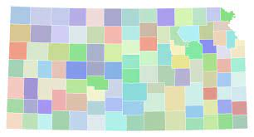
Kansas combines local and state governance across executive and judicial branches with three delivery systems based on different supervised populations.
Each system exists in every judicial district:
  “court services” funded through the judiciary
  “community corrections” funded through the DOC and
  “post-release supervision” by state DOC agents
Community corrections provides funding for the higher-risk probation population based on staffing levels justified by active cases under supervision and other program costs.

Slide 10
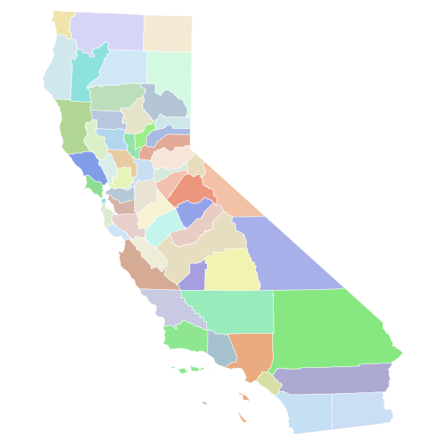
California’s performance incentive funding program is well documented and appears successful at promoting county-level evidence-based practices.
Payments are based on reductions in county-level “return to prison” (RPR) rates from people on local supervision with a baseline of 7.9 percent.
Total state payments in FY2020–21 were $112,514,699.
An Annual Assessment survey focuses on five practices: (1) use of validated risk and needs assessments; (2) effective supervision practices, including training on EBPs; (3) effective treatment and targeted intervention; (4) effective management practices; and (5) collaboration among justice system partners.

Slide 11
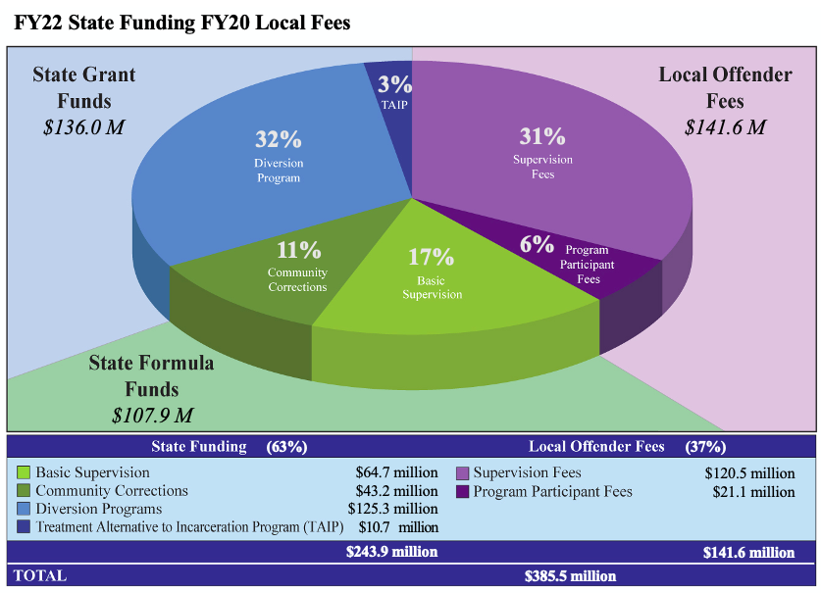
Texas provides significant state funding for local departments, and counties have limited financial obligations.
123 “CSCDs” are organized within judicial districts serving 254 counties.
Basic supervision funding is based on a county’s share of the state’s overall population and probation population.
Additional line items support more specialized programs including alternative facilities.

Slide 12
In 2011 Texas adopted a “performance incentive funding” approach on top of formula funding, but no agency has applied for PIF.
States with PIF Legislation
Under SB 1055 (2011), a local probation department (CSCD) may submit a prison commitment reduction plan to the TDCJ Community Justice Assistance Division.
The CSCD would receive an initial lump sum of 35 percent of state savings described in the plan. Incentive payments would come out of the remaining 65 percent of savings for achieving certain goals.
A penalty would be assessed if the commitment reduction goal is not met.
Sources: “Performance Incentive Funding,” Vera Institute (2012), accessed March 10, 2021, https://www.vera.org/publications/performance-incentive-funding-aligning-fiscal-and-operational-responsibility-to-produce-more-safety-at-less-cost; Interview with Carey Green, Director, Texas Department of Criminal Justice Community Justice Assistance Division, June 2021.

Slide 13
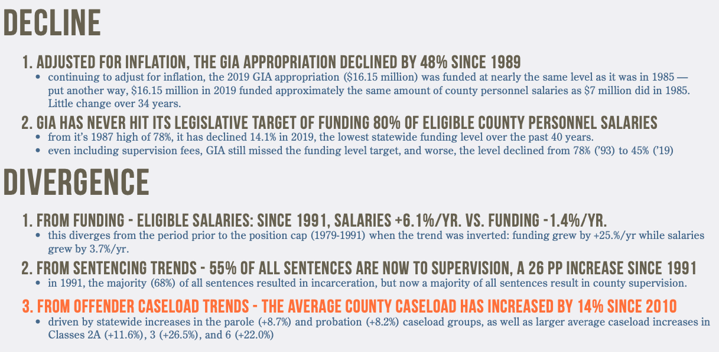
After Justice Reinvestment legislation, Pennsylvania is revising a deficient grant-in-aid formula tied to salaries.

Slide 14
Pennsylvania is moving to a “supervised population” model (that is still underfunded).
The proposed formula for distributing $16.222M will equally use two measures of the volume of people under supervision, with each weighted by a measure of the challenges represented by the people under supervision.
JRI 2.0 savings will be used to help “hold harmless” the counties that otherwise lose funding under the new formula.
Step 1: [Probation Sentences] x [Sentencing Severity Index] | Step 2: [Active Caseload] x [Risk Index]
Step 3: Weight Percentages in Steps 1 & 2 50% Each | Step 4: Total “Score” x $16,222,000

Slide 15
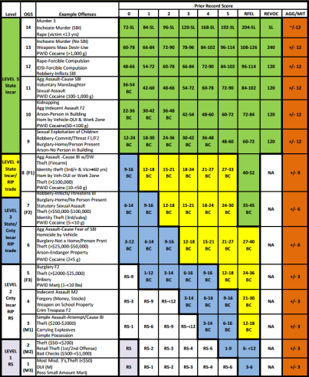
Pennsylvania also has state funding for specific programs in a CCA approach that uses the sentencing guidelines.
Pennsylvania’s County Intermediate Punishment (CIP) Act of 1990 was the state’s first community corrections act for the adult population.
Rules governing the CIP program include typical CCA requirements for local collaboration and planning and target people who would otherwise be sentenced to confinement.
The Pennsylvania Commission on Sentencing (PCS) sentencing guidelines have been used to further target appropriate populations for the use of more restrictive conditions.
Pennsylvania Code, Title 37 Chapter 451, at https://www.pacodeandbulletin.gov/Display/pacode?file=/secure/pacode/data/037/chapter451/chap451toc.html&d=

Slide 16
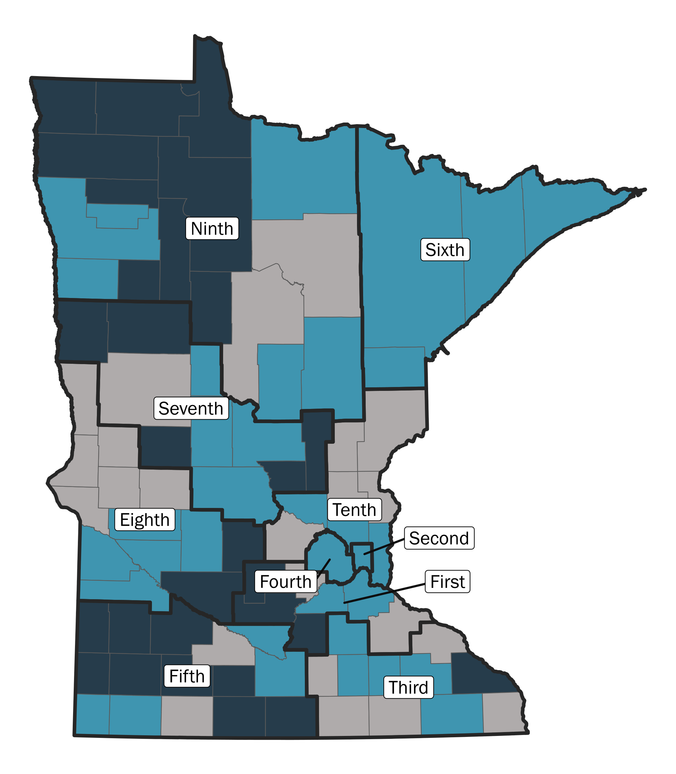
JRI in Minnesota focused on funding and supervision practices for its three supervision systems.
Minnesota Counties by Probation Delivery System and Judicial District, 2021
Judges in 7 of 10 judicial districts encounter two or three supervision systems.
CCA Counties
CPO Counties
DOC Counties
Council of State Governments Justice Center, “Justice Reinvestment in Minnesota, Second Presentation to the Governor’s Council on Justice Reinvestment,” (2022) at https://csgjusticecenter.org/wp-content/uploads/2022/02/Governors-Council-on-Justice-Reinvestment_January-21_final.pdf.
Notes:
Grace
They can: (1) opt to administer all correctional field services according to the Minnesota Community Corrections Act (CCA),
(2) supervise adults charged with misdemeanors and youth in the juvenile justice system, with the DOC providing felony supervision, according to the County Probation Officer (CPO) model, or
(3) have DOC manage the entire caseload for the county.
Of the total probation population, 72 percent are supervised in CCA counties, 17 percent are supervised in DOC counties, and 11 percent are supervised in CPO counties.

Slide 17
In 2020, Minnesota spent the lowest proportion of state general funds on corrections.
Notes:
CARL

Slide 18
State funding to Minnesota counties has evolved to include seven line items, dominated by CCA formula funding.
FY2020 DOC Funding Streams
CCA | 1. CCA Subsidy | $61,006,999
 | 2. Alternative to Incarceration Grant | $160,000
 | 3. Reentry HWH Grant | $300,000
 | 4. Intensive Supervision ISR Grant | $3,869,000
 | 5a. REAM Grant | $417,500
CPO | 5b. REAM Grant | $185,500
 | 6. CL/WL Reduction Grant | $1,314,812
 | 7. CPO Reimbursement | $5,043,000
$30,512,000
$65,753,499
$6,543,312
Communication from MN DOC to the CSG Justice Center on 10/08/2021.
Notes:
CARL
CCA
Part of the CCA subsidy is based on a fixed “hold harmless” amount for each county, and part is determined by the statutory CCA formula.
The statutory formula accounts for local need based on case filings, at-risk population, and sentences to probation, as well as local ability to generate revenue.
Source: Minn. State Section 401.10 (2020); Laws of Minnesota 1st Spec.Sess. Chapter 11 (2021); Carli Stark, “Minnesota Probation Delivery: The County’s Role”, January 27, 2021, at https://www.senate.mn/committees/2021-2022/3099_Committee_on_Judiciary_and_Public_Safety_Finance_and_Policy/Minnesota%20Probation%20Delivery.pdf.
CPO
The statutory formula accounts for local need based on case filings, at-risk population, and sentences to probation, as well as local ability to generate revenue.
Source: Minn. State Section 401.10 (2020); Laws of Minnesota 1st Spec.Sess. Chapter 11 (2021); Carli Stark, “Minnesota Probation Delivery: The County’s Role”, January 27, 2021, at https://www.senate.mn/committees/2021-2022/3099_Committee_on_Judiciary_and_Public_Safety_Finance_and_Policy/Minnesota%20Probation%20Delivery.pdf.

Slide 19
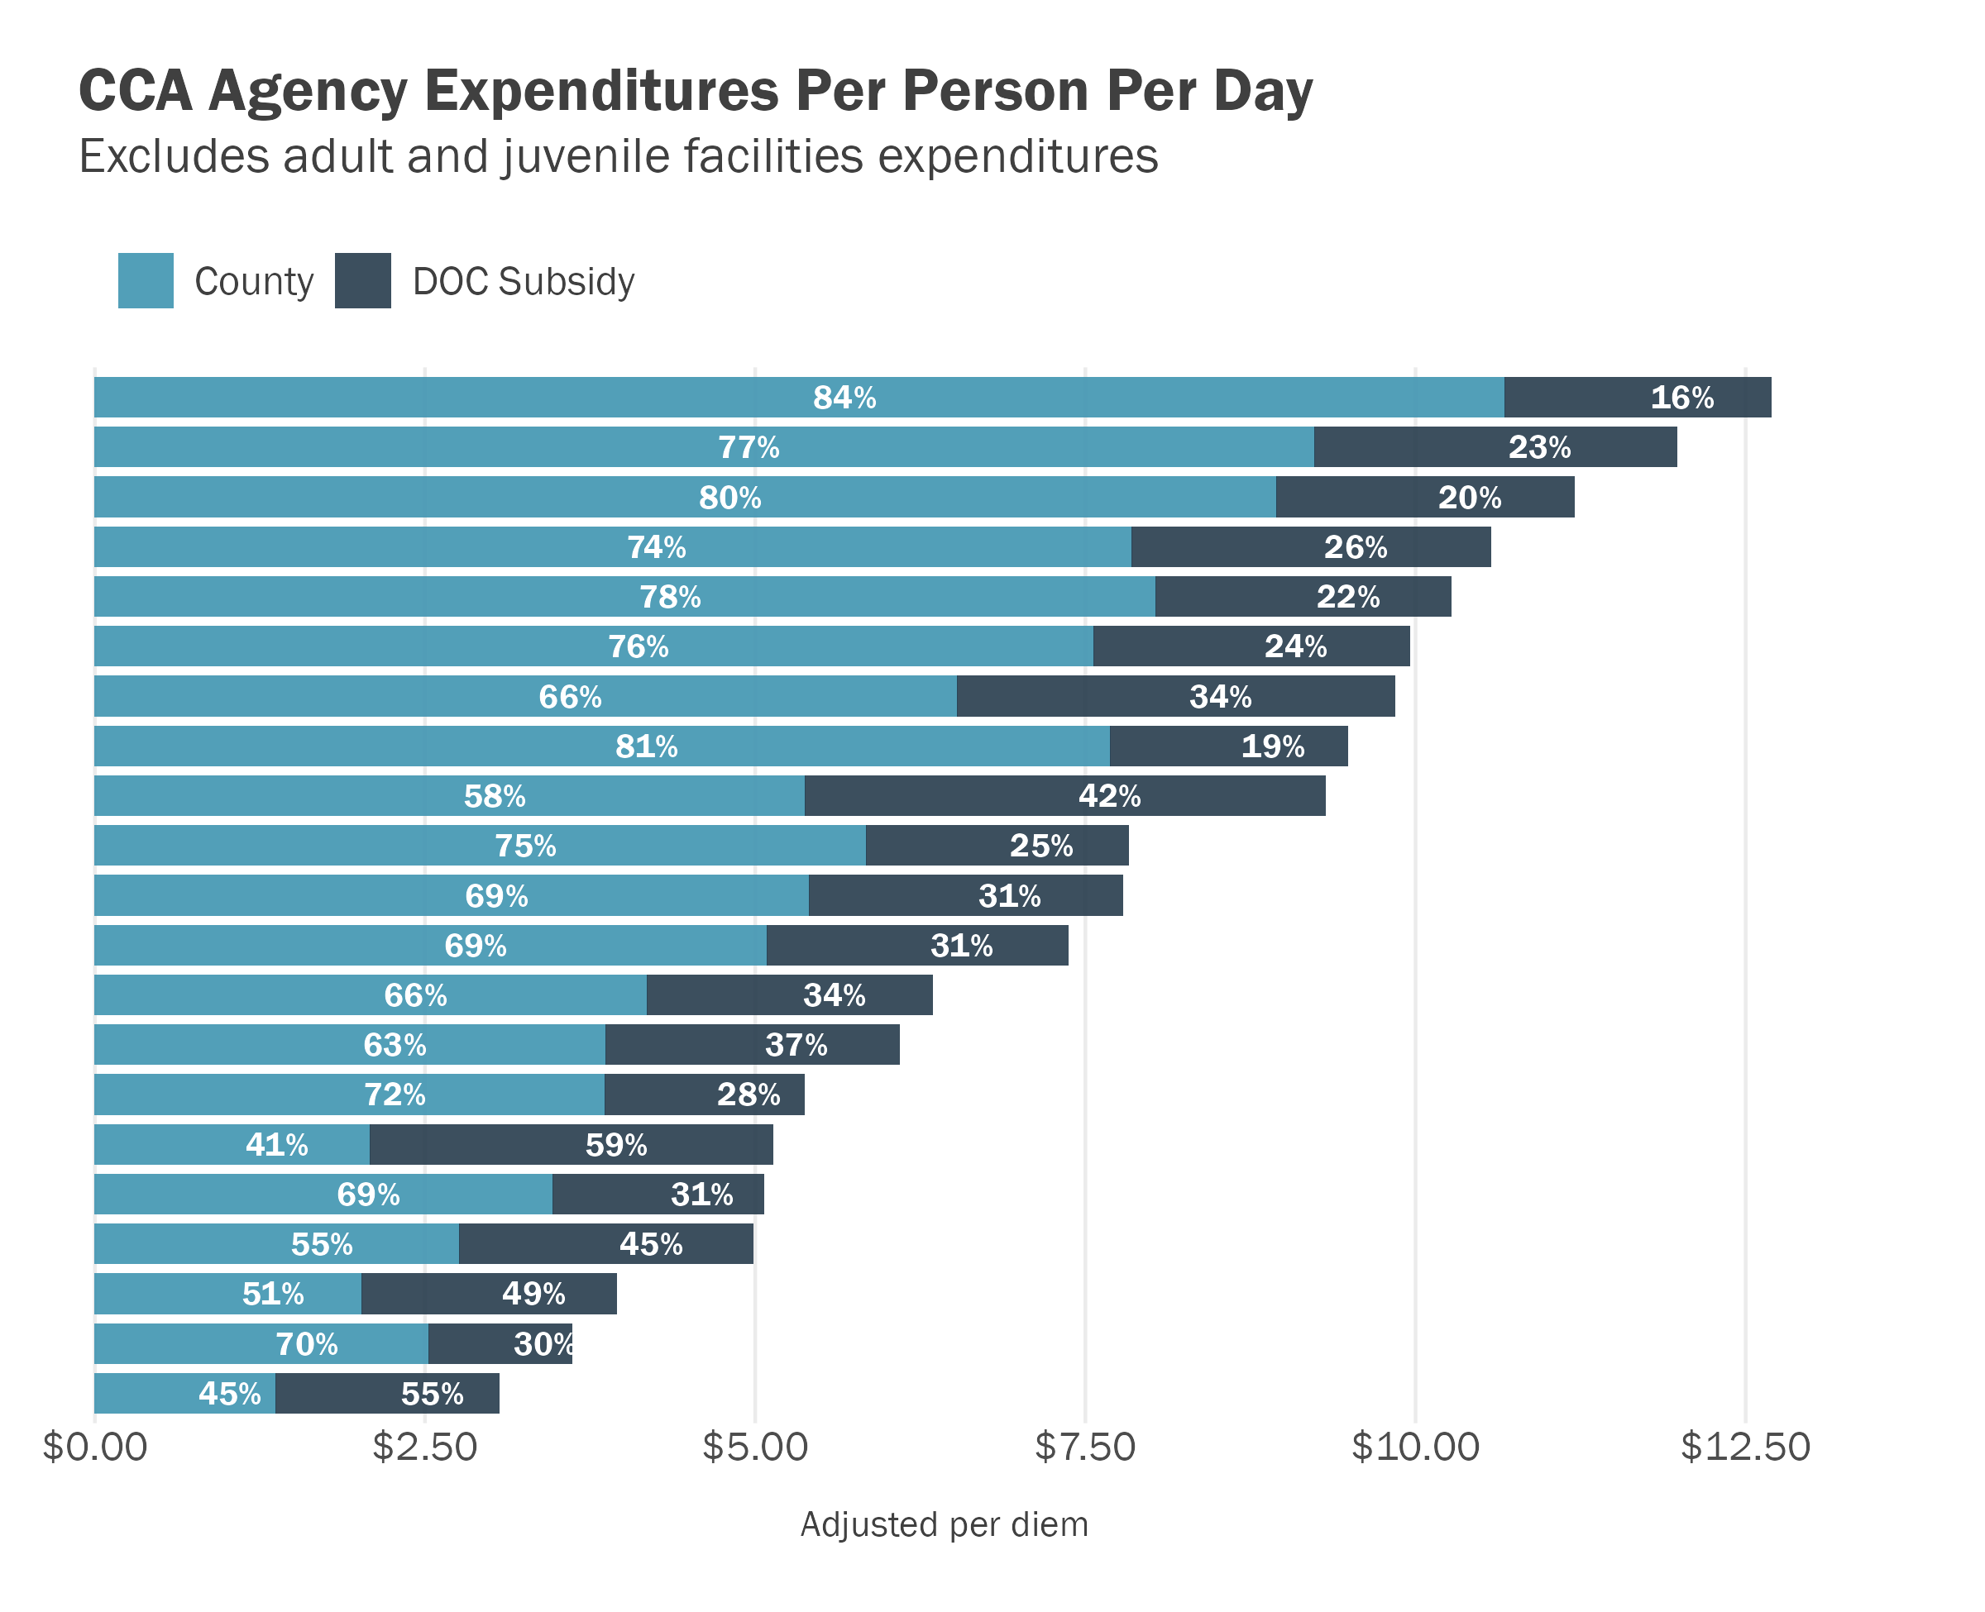
Minnesota’s state contribution ranges from $1.00 to $4.00 per diem, while counties are making up the difference.
This funding does not account for the state’s contributions to the other two (smaller) delivery systems—CPO and DOC.
In Minnesota, per diem expenditures for CCA agencies range from 3 to 13 dollars per person under supervision, depending on the county’s level of funding.
CSG Justice Center analysis of CCA Agency Comprehensive Plan Budgets, 2020–2021; Minnesota Probation Survey, 2020.
Notes:
I'm good with it as it. Range of calculated DOC contributions is from $1 per day to nearly $4 per day

Slide 20
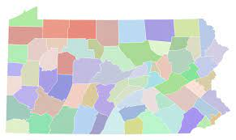
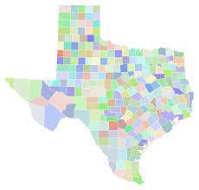
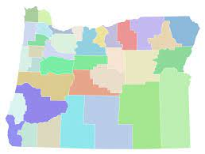
In county-run probation states, per diem state funding ranges from 50 cents to over 12 dollars, similar to the range found in Minnesota CCA counties.
State | Annual Funding | Per Capita Per Diem
Pennsylvania | $33 million | $.50
Texas | $238 million | $2.13
Kansas | $17 million | $6.40
Oregon | $234 million | $12.42

Slide 21
Oregon provides remarkably generous supervision funding to counties.
The 2021–2023 capitated rate is $12.42 and the budget is $284.1M, which incorporates the following:
  $234.4M based on the forecasted population (CSL)
  Three additional line items totaling about $50M
Counties also receive $53M from Justice Reinvestment grants via the Criminal Justice Commission for diverting prison-eligible property and drug cases.

Slide 22
Oregon’s funding approach is based on the Actual Cost Study.
Every 6 years the DOC is required to submit an Actual Cost to the Legislature.
Purpose is to give Legislature information to reset or adjust Community Corrections Funding.
DOC historically has conducted a Time Study in conjunction with the actual financial impact of providing supervision, sanctions and services.
CJC provided significant support to create and present the Time Study.

Slide 23
Oregon’s funding approach has incorporated three promising policy changes.
Short Term Transitional Leave
Earned Discharge
Eliminating Supervision Fees

Slide 24
Short Term Transitional Leave (STTL) is designed to improve reentry from the Department of Corrections.
JRI initiatives saw early release from custody expand from 30 to 120 days
More than 1/3 of DOC population releases to STTL
Counties are fully funded to supervise this population
CJC: Recidivism Study showing slightly better results than those who serve their full sentence

Slide 25
An earned discharge from supervision does not diminish per capita funding for the year of the discharge.
Most probation sentences are eligible to be terminated at the 50% mark if certain criteria/milestones are met.
Effective July 2022, many post-prison sentences are also eligible.
CC has full authority to discharge without court or parole board approval and are funded through the original (max) term of supervision.
CJC: Recidivism Study showing slightly better results for those discharged early.

Slide 26
Oregon is the first state to eliminate supervision fees statewide.
As of January 2022, Oregon has eliminated supervision fees, including any past due amounts.
Positive feedback and results from officers (who had to collect) and those on supervision (who had to pay)
Legislative backfill to offset loss of fee collection

Slide 27
Do these themes resonate in your state?
Do Oregon’s reforms?
Inadequate attention and funding for the community corrections function
Organizational challenges based on variations in governance, e.g.,
Policy tensions between funding that rewards desirable practices versus funding to “lift up” the communities with less desirable performance
Multiple approaches in a single state
Potential for sentencing guideline states to leverage data for a funding model
Oregon:
  STTL
  Earned Discharge
  Elimination of Fees

Slide 28
For more information, please contact
Carl at creynolds@csg.org or Jeremiah at Jeremiah.P.STROMBERG@doc.oregon.gov

Slide 29
For reference: states with sentencing guidelines or a commission (or something like a commission).
Guidelines
Commission
Sources: Robina Institute Sentencing Guidelines Resource Center at:
https://robinainstitute.umn.edu/publications/sentencing-guidelines-resource-center-depth-jurisdiction-profiles;
Colorado included per current work of the Commission on Criminal and Juvenile Justice - Sentencing Reform Task Force, see https://ccjj.colorado.gov/ccjj-srtf;
California included per current work of the Commission on Revision of the Penal Code, see http://www.clrc.ca.gov/CRPC.html.

