Slide 1


Housing
Mentor
Family Sentencing Alternative
Pilot
Program
(FSAP)
FSAP Participant + Family
DHS
PO
Washington County
Community Corrections
Tx Provider
Court / DA

Slide 2
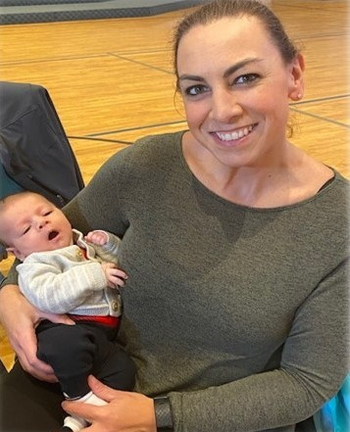
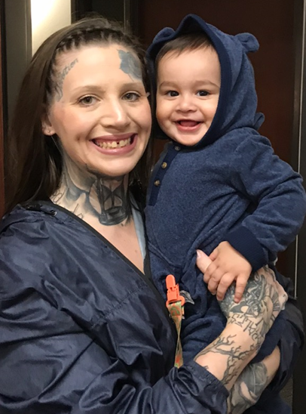
What Makes FSAP Different?
Diverts individuals from prison sentences to a needs-based community supervision model
Eligible participants continue parenting with support
Collaboration with DHS aimed at reducing the number of children entering foster care
Reduces generational involvement in the criminal justice system

Slide 3
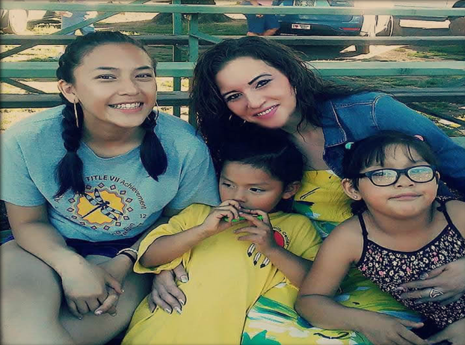
“You are the first and only PO I have ever felt close to, and you have a connection with my children, which means the most to me. Thank you, Christina.”
“I thank FSAP for everything I have today. I remember thinking this was the worst thing that could have happened to me. It turned out to be the greatest. Especially the three great women I called my FSAP team. They made FSAP what it was for me. Thank you.”

