Slide 1
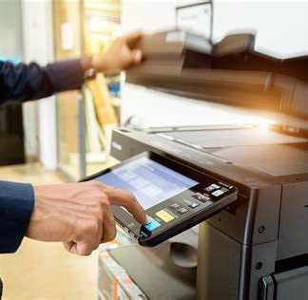
Oregon Department of Administrative Services Office of Sustainability
Going Paperless: Two Agency Case Studies
Notes:
We appreciate the opportunity to share our statewide plug load strategy with you. I am going to focus on the drivers for developing the strategy, how it came together and what’s included in it – along with implementing policy.
My colleague Stephanie Kruse is going to then talk about how we’re implementing plug load management strategies in Oregon.

Slide 2
Today’s Agenda
Introductions and why consider going paperless? (10 minutes)
Dave Wortman, Statewide Sustainability Officer, DAS
Case Study 1: OHA/DHS (15 minutes)
Jennifer Bittel, Brenda Brown, OHA/DHS
Case Study 2: ODOT (15 minutes)
Kayla Vanhoose, ODOT
Group Questions and Discussion (20 minutes)
Adam Helvey, DAS Sustainable Procurement Program Manager
Wrap up

Slide 3
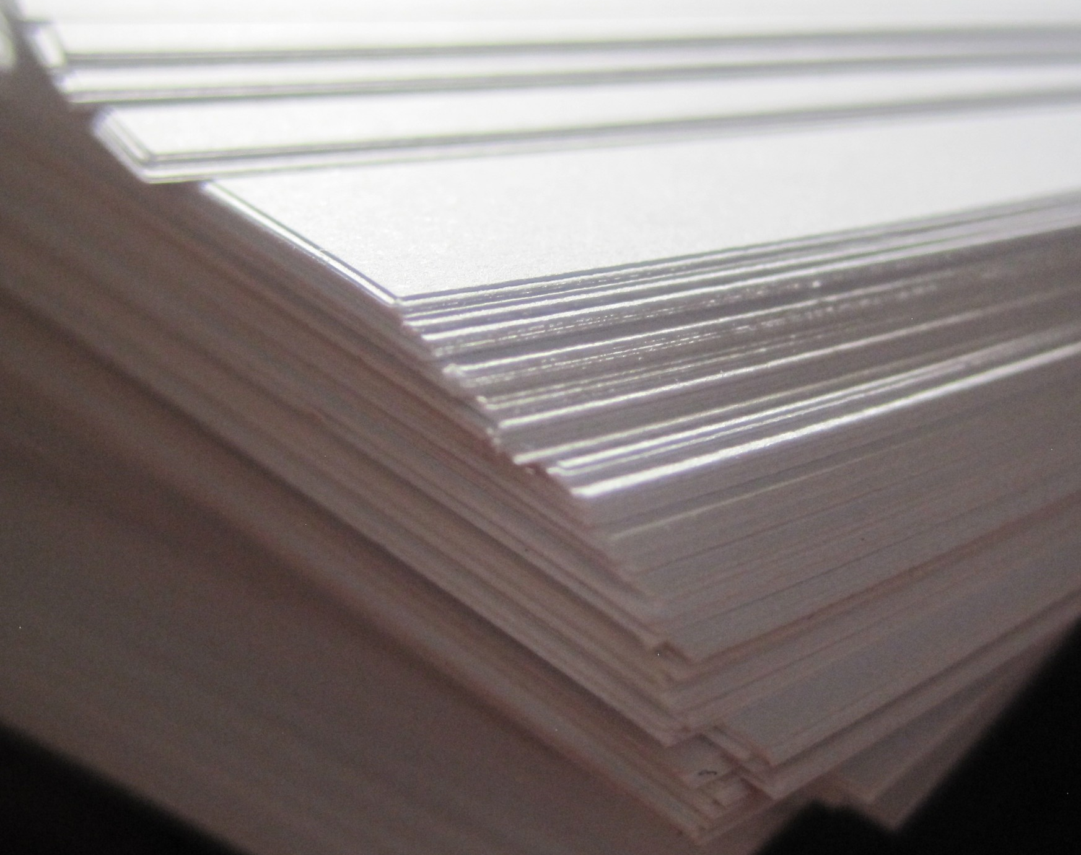
Paper Use in the U.S.
Before Covid, the average office worker used 10,000 sheets of copy paper each year.
Over 40% of wood pulp goes toward the production of paper.
Printing and writing paper equals about one-half of U.S. paper production.
The federal government spent upwards of $1.3 billion on paper pre-Covid.
Notes:
more than one-third of all paper forms they printed out were never actually used.

Slide 4
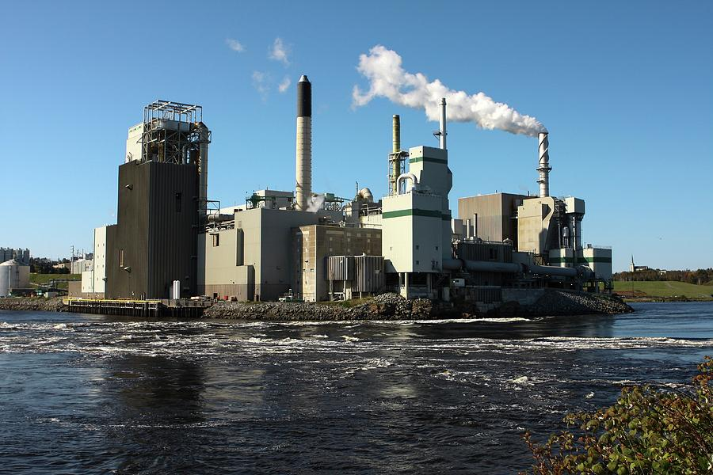
Impacts of Paper Use
The U.S. pulp and paper industry is among the largest energy consuming industries in the US.
Water use: It takes about 47 gallons of water to produce one ream of paper.
Air and water quality impacts from paper mills.
Greenhouse gas emissions: changes in forest carbon storage, transport, processing, use and disposal of paper.
Calculator for paper impacts: Paper Calculator 4.0 | Environmental Paper Network
Notes:
States. As of 2006, the industry (NAICS 3221) accounted for over 8% of the purchased fuels and over 9%
of the electricity consumption of the entire U.S. manufacturing sector [2]. Moreover, purchased fuels
represent less than half of the fuels consumed by U.S. pulp and paper mills, since much on-site energy is
generated using waste wood and bark (i.e., hog fuel) and spent cooking chemicals (i.e., black liquor) [5, 9].

Slide 5
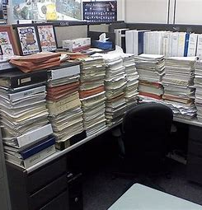
Some Benefits of Going Paperless
Reduce the amount of paper, ink and power used to produce paper documents (and dollars).
Help reduce the cost of producing and mailing paper documents.
Reduce time printing, filing and searching for documents – easier access in the cloud.
Reduce physical storage space needs.
Easier to share files, particularly when employees are working remotely.

Slide 6
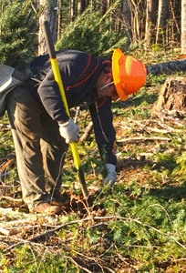
But – paper is still our friend
Paperless isn’t right for every operation or agency need (business cards, letterhead, legislation, etc.)
Paperless operations also have a footprint on the environment (energy and carbon use for digital storage) (about 3-7kWh per gigabyte in the cloud).
Trees are a renewable resource and a part of Oregon’s economy.
According to the American Forest and Paper Association, the 2020 paper recycling rate was 65.7 percent.
80 percent of all US paper mills use at least some recycled fiber to make paper products.
Notes:
The combination of transmitting your data and storing it in a data center probably requires about 3 to 7 kWh per gigabyte. That’s about a million times more than the energy you used to save to your hard drive. Instead of 0.1 microwatt-hours, your text document has sucked down 0.1 watt-hours of electrical energy — enough to light an LED bulb for about 30 seconds.

Slide 7
Case Study 1: OHA/DHS
Jennifer Bittel, Brenda Brown

Slide 8
Case Study 2: ODOT
Kayla Vanhoose

Slide 9
Q and A/Discussion
What questions do you have for our presenters?
What lessons can your agency take away from today?

Slide 10
Thank you!
Dave Wortman, Statewide Sustainability Officer, DAS
David.wortman@das.oregon.gov
Adam Helvey, Sustainable Procurement Program Manager, DAS
Adam.helvey@das.oregon.gov

