Slide 1
Statewide Balancing (SWB) Training
Collaborative Training with SFMS & SARS Units
April 14, 2026
Office of the State Controller

Slide 2
Agenda
Context & Expectations
How to Read the Reports
Researching SWB Exceptions
SWB Exceptions

Slide 3
Context & Expectations
The who, what, when, where, and why of SWB Reports

Slide 4
Purpose of Reports
Matching owed to amount due
Matching received to sent
Helps tie transactions together

Slide 5
Why Do They Exist?
GASB Statement 38 – Certain Financial Note Disclosures
Reports Created by SARS
Tracking Internal Money Movement for Reporting

Slide 6
What is a G38-Transfer or Agy GL?
An 8-digit code that connect the Agency and D23 Fund for opposite side of the transaction (e.g. 12345670)
123
4567
0
First 3 Digits
Next 4 Digits
Last Digit
Agency Number
D23 Fund
Zero

Slide 7
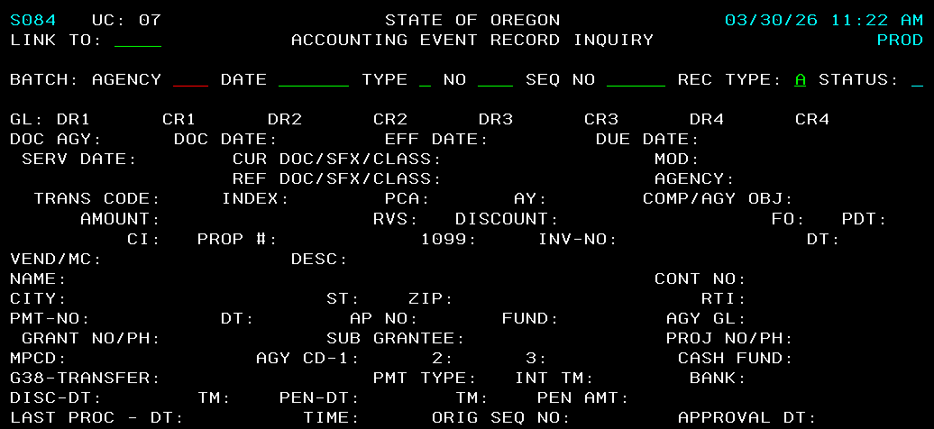
Where is G38-Transfer & Agy GL?

Slide 8
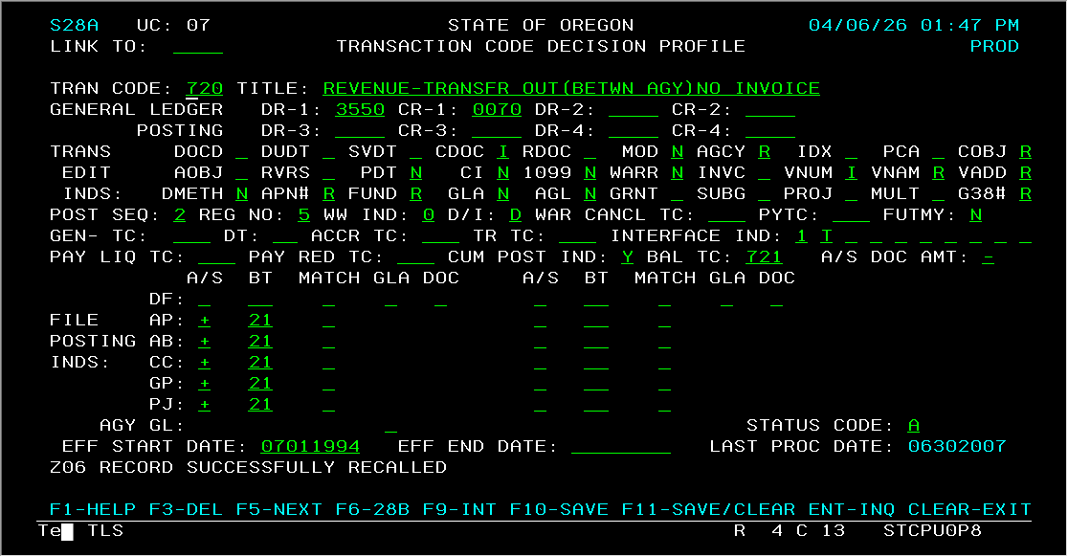
The 28A Screen T-Code G38 Requirement
Coding:
I = Input Required, Manual
R = Required, input or lookup
N = Not Allowed
Blank = Optional

Slide 9
The 28A Screen T-Code AGL Requirement
Coding:
I = Input Required, Manual
R = Required, input or lookup
N = Not Allowed
Blank = Optional

Slide 10
Agency Expectations
Review Reports Regularly
Research & Correct Variances
Communicate Any Issues
Verify Results

Slide 11
Website Posting Frequency
Fiscal Month 1 – 11 Monthly
Fiscal Month 12 Weekly
Fiscal Month 13 3 Times weekly

Slide 12
How to Read the Reports
Breakdown of Each Report

Slide 13
All Statewide Balancing Reports
Due To/From Other Funds (GL 0586/1532) by GL & Exceptions
Interagency Transfers by Transfers In/Out & Exceptions
Statewide Balancing
Advances To/From Other Funds (GL 0950/1800) by GL & Exceptions
Indirect Transfers & Exceptions
Operating Transfers & Exceptions

Slide 14
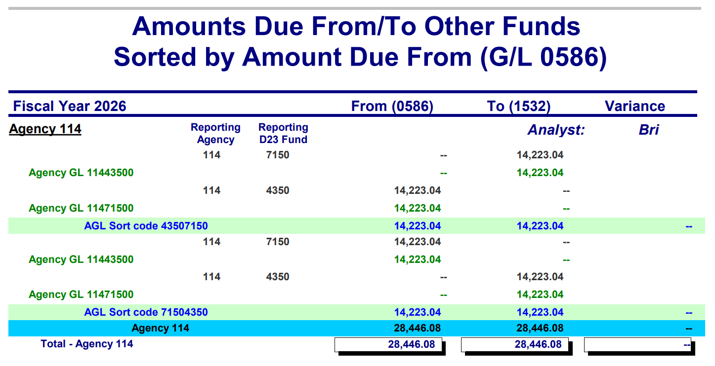
Due To/From Other Funds (GL 0586)
All transactions that include GL Accts 0586 and 1532.

Slide 15
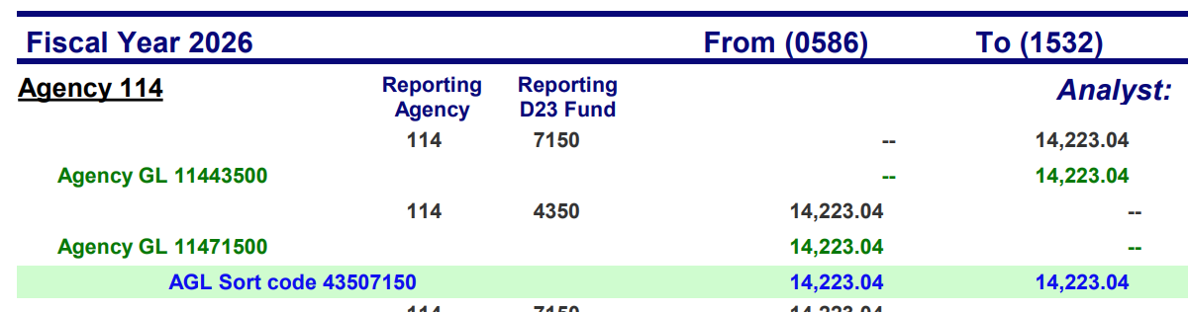
Due From Other Funds (GL 0586)
(1) Sorted by the Agency with balance in GL 0586
(2) Who entered batch and where
(3) “From” shows all GL 0586 balances
(4) “To” shows all GL 1532 balances
(5) Agy GL entered for these transactions.

Slide 16
Due From (GL 0586) – pt 2
(6) AGL Sort Code: Custom Code with both D23 Funds to combine transactions to be balanced
(7) Totals between Sort Agency and other agency.

Slide 17
Putting it together – is it balanced?
1
2
1
Agency 114 entered in D23 Fund 7150.
The Agency GL code says Agency 114 Fund 4350 is the other side.
Total amount of $14,223.04 in GL 1532.
2
Agency 114 entered in D23 Fund 4350.
The Agency GL code says Agency 114 Fund 7150 is the other side.
Total amount of $14,223.04 in GL 0586.

Slide 18
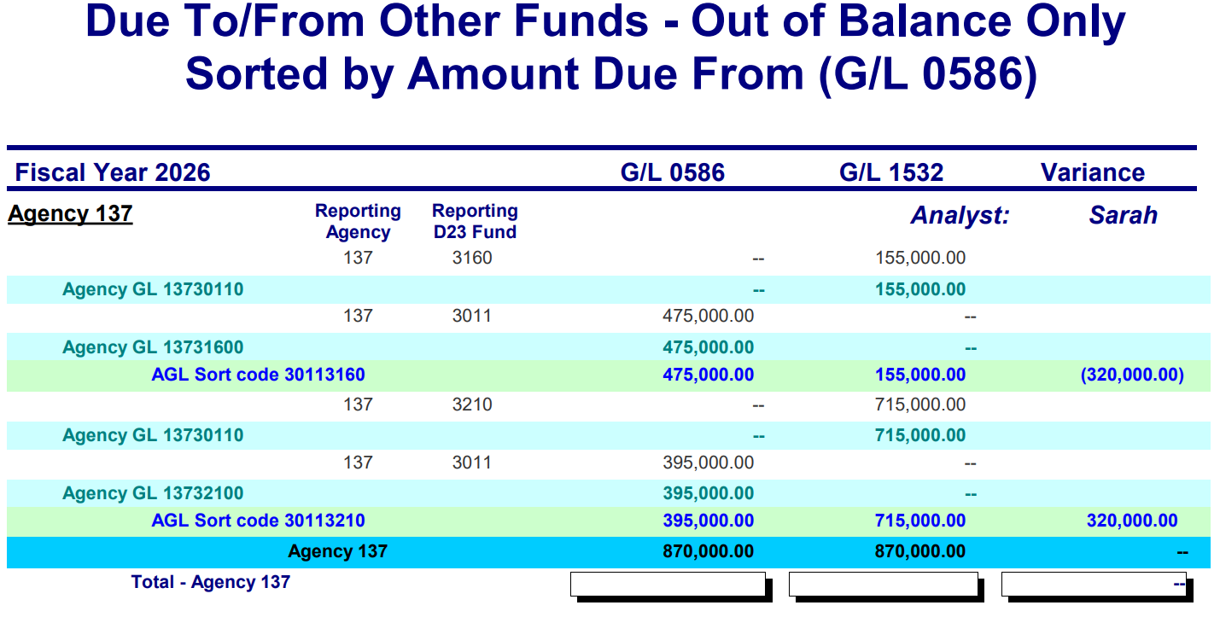
Due From - Exception Example
1
2
1
Agency 137 entered in D23 Fund 3160.
The Agency GL code says Agency 137 Fund 3011 is the other side.
Total amount of $155,000.00 in GL 1532.
2
Agency 137 entered in D23 Fund 3011.
The Agency GL code says Agency 137 Fund 3160 is the other side.
Total amount of $475,000.00 in GL 0586.

Slide 19
Exception Example – Zoomed Out
There may be more to the story and a quick fix. The variance is equal and offset between these two AGL Sort Codes.

Slide 20
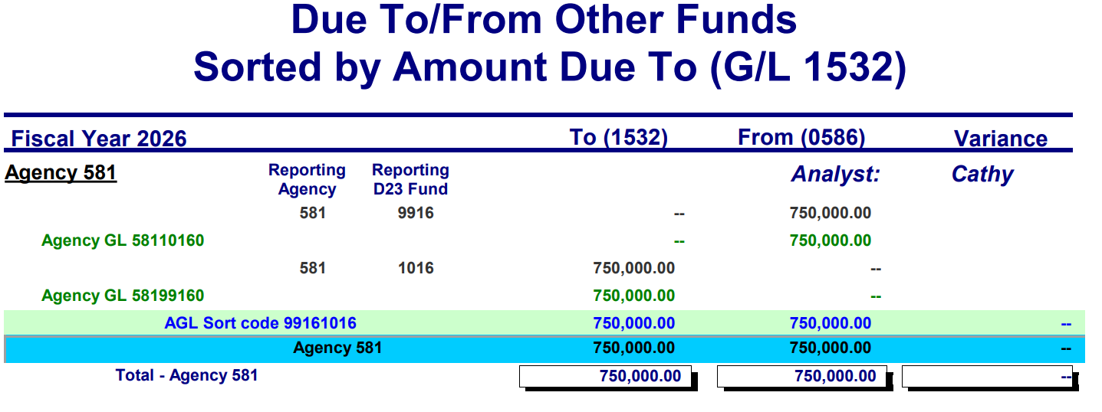
Due To Other Funds (GL 1532)
All transactions that include GL Accts 0586 and 1532.

Slide 21
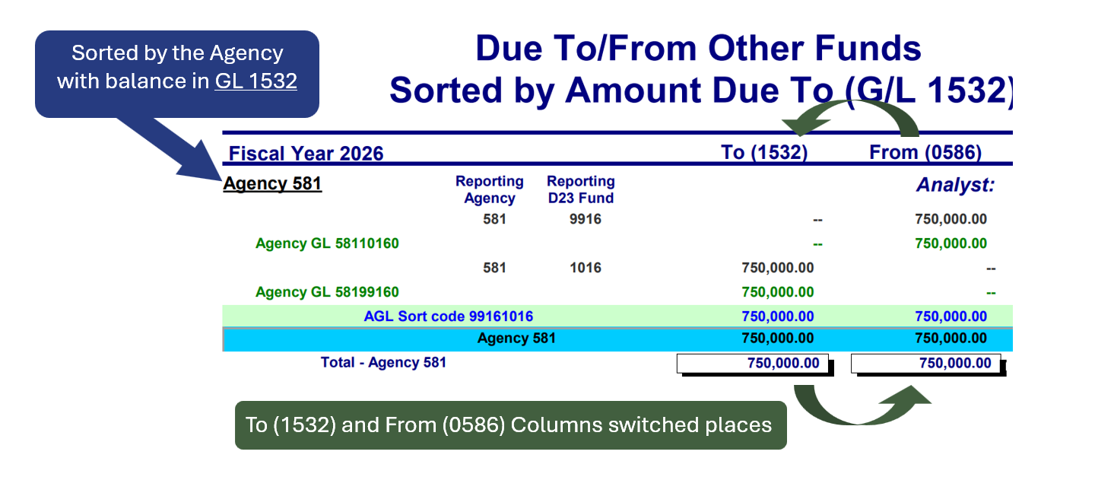
Differences from GL 0586

Slide 22
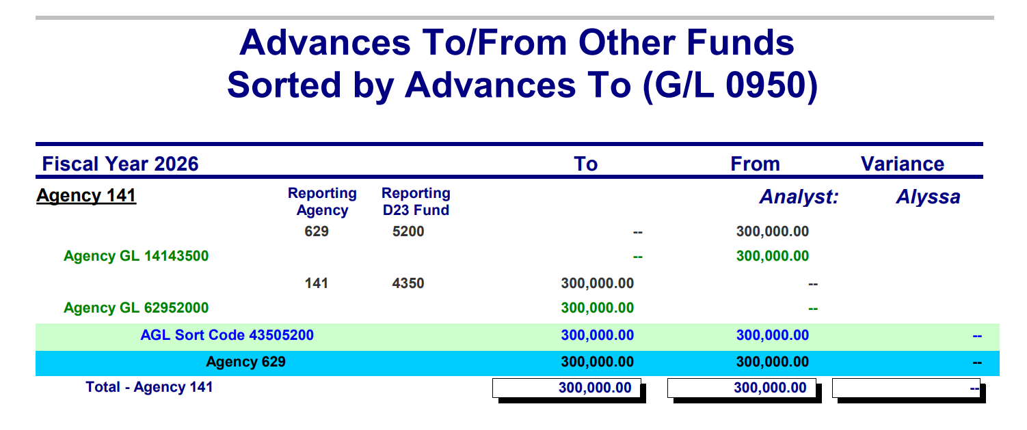
Advances To/From Other Funds
All transactions that include GL Accts 0950 and 1800.

Slide 23
Advances To (GL 0950)
(1) Sorted by the Agency with balance in GL 0950
(2) Who entered batch and where
(3) “To” shows all GL 0950 balances
(4) “From” shows all GL 1800 balances
(5) Agy GL entered for these transactions.

Slide 24
Advances To (GL 0950) – pt. 2
(6) AGL Sort Code: Custom Code with both D23 Funds to combine transactions to be balanced
(7) Totals between Sort Agency and other agency.

Slide 25
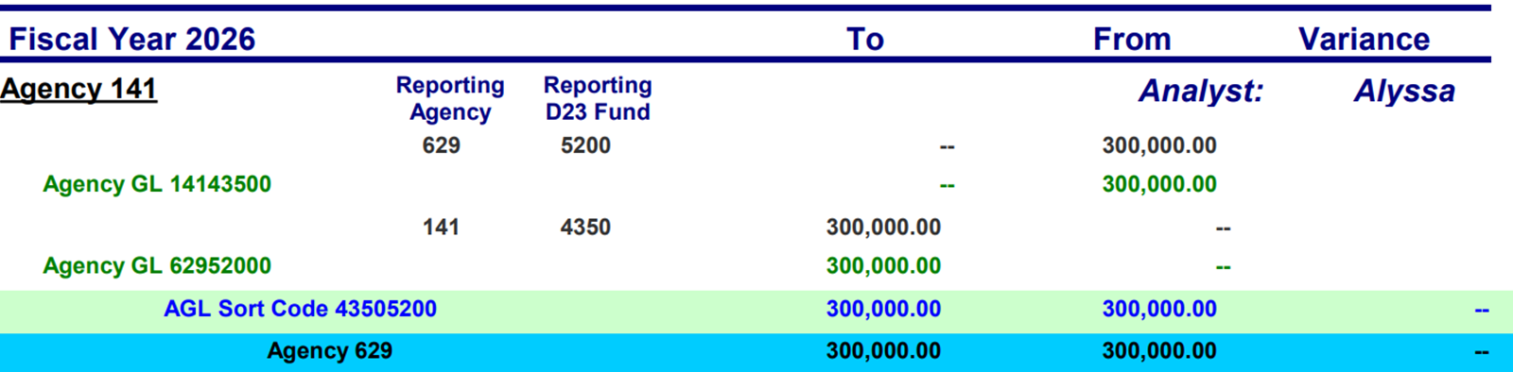
Advances Grouped – is it balanced?
1
2
1
Agency 629 entered in D23 Fund 5200.
The Agency GL code says Agency 141 Fund 4350 is the other side.
Total amount of $300,000.00 in GL 1800.
2
Agency 141 entered in D23 Fund 4350.
The Agency GL code says Agency 629 Fund 5200 is the other side.
Total amount of $300,000.00 in GL 0950.

Slide 26
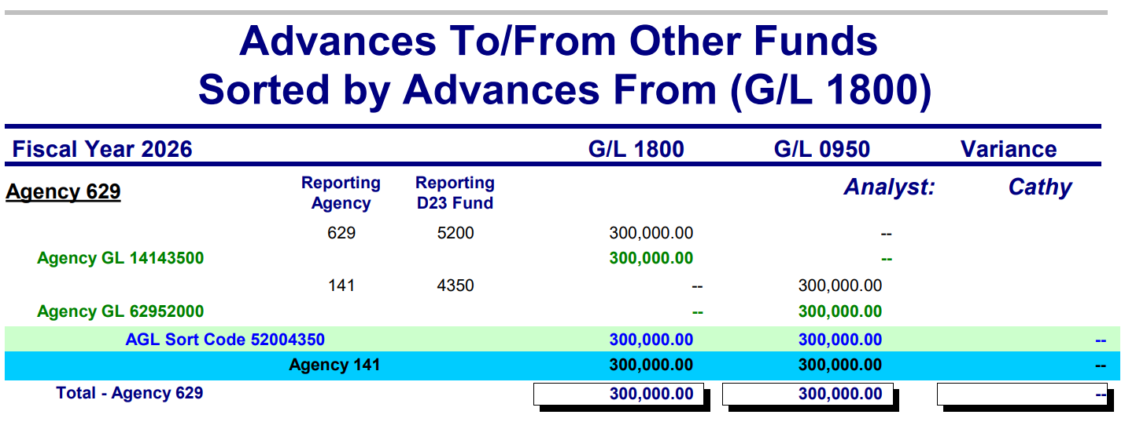
Advances From(GL 1800)
All transactions that include GL Accts 0950 and 1800.

Slide 27
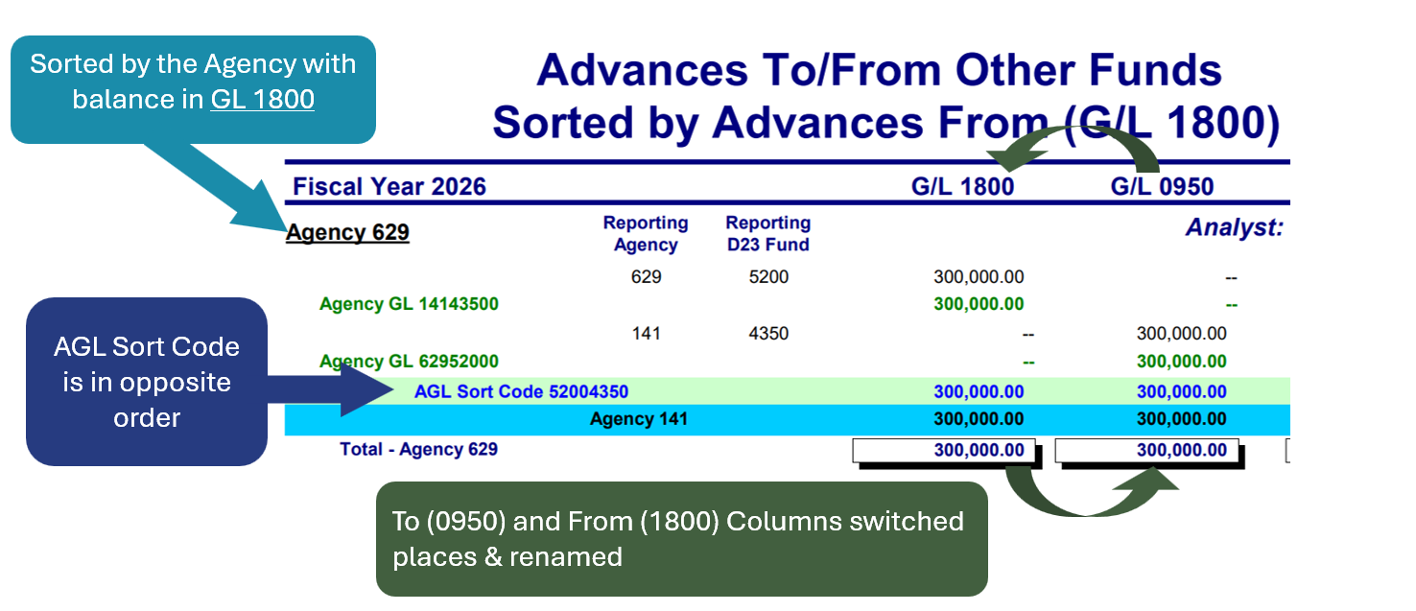
Differences from (GL 0950)

Slide 28
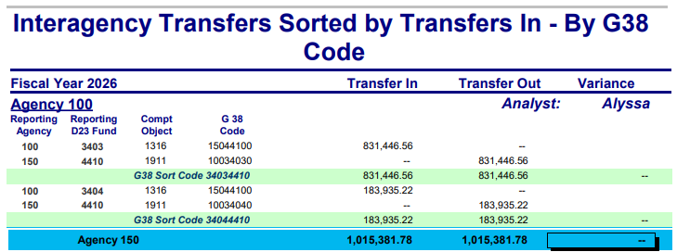
Interagency Transfers by Transfers In
Includes all transactions in:
GL Accts 315# (Transfer In Control), 335# (Transfer In Offset), 355# (Transfer Out Control), and 375# (Transfer Out Offset).
All Special Payment Compt. Objs. (6000-6200) in GL Acct 3500 & 3600.
Compt. Objs. 1407, 1430, and 1431 in GL Acct 3100, 3101, 3102, 3105.
Excludes Compt. Objs. 1301, 1302, 1303, 1356, 1401, 1402, 1403, 1456, 6093, 6200

Slide 29
Interagency Transfers In
(1) Sorted by the Agency with balance in Transfer in
(3) All Transfer In Balances
(4) All Transfer Out Balances
(2) Agency and D23 Fund where entries were posted

Slide 30
Interagency Transfers In - Differences
(1) Compt. Obj. entered for transactions. Determines the Agency group for (3).
(2) G38-Transfer entered for transaction
(3) Totals between Sort Agency and other agency. Other Agency based on Transfer in Compt. Obj.
(4) G38 Sort Code: Custom Code with both D23 Funds to combine transactions to be balanced.

Slide 31
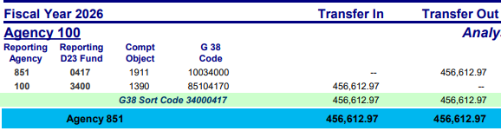
Transfers In Grouped– is it balanced?
1
2
1
Agency 851 entered in D23 Fund 0417
G38-Transfer says Agency 100, Fund 3400 is the other side
Total of $456,612.97 Transferred Out
Compt. Obj 1911 = X-fer Out to A100
2
Agency 100 entered in D23 Fund 3400
G38 Transfer code says Agency 851, Fund 0417 is the other side
Total of $456,612.97 Transferred In
Compt. Obj 1390 = X-fer In from A851

Slide 32

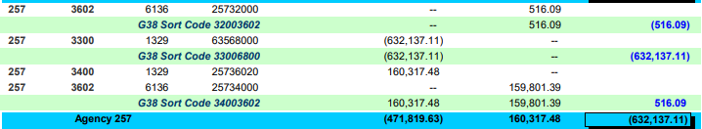
Exception Example – Compt. Obj.
What we know:
  Agency 257 Recorded Transfer In
  G38 Code indicates Agency 635 and D23 Fund 6800 should be the Transfer Out
  Compt Obj 1329 – Transfers In from State Police was used
  Total for Agency is Agency 257

Slide 33
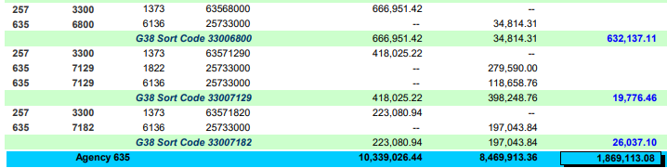
Exception Example – Zooming Out
Looking further – what we find:
  Total for Agency 635
  Agency 257 Recorded Transfer In
  Agency 635 and D23 Fund 6800 has a variance for the same amount

Slide 34
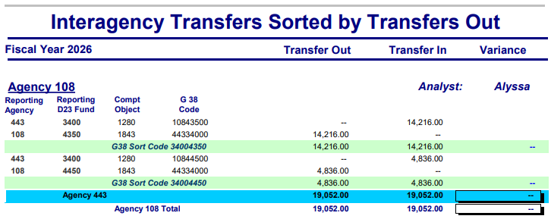
Interagency Transfers Out
Includes all transactions in:
GL Accts 315# (Transfer In Control), 335# (Transfer In Offset), 355# (Transfer Out Control), and 375# (Transfer Out Offset).
All Special Payment Compt. Objs. (6000-6200) in GL Acct 3500 & 3600.
Compt. Objs. 1407, 1430, and 1431 in GL Acct 3100, 3101, 3102, 3105.
Excludes Compt. Objs. 1301, 1302, 1303, 1356, 1401, 1402, 1403, 1456, 6093, 6200

Slide 35
Differences from Transfers In
Sorted by the Agency with balance in Transfer Out
Transfer In and Transfer Out balance columns switched places
Other Agency based on Transfer Out Compt. Obj.

Slide 36
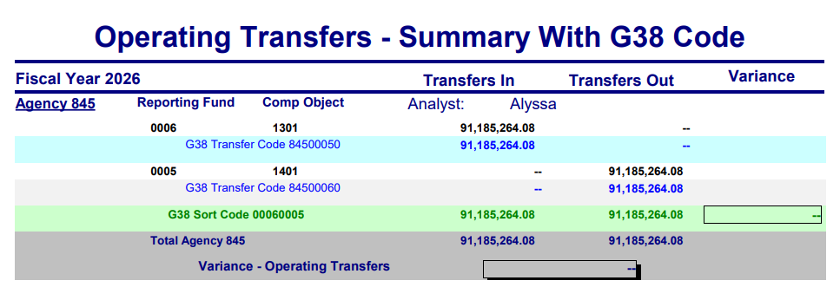
Operating Transfers - Summary
All transactions that include Compt. Objs. 1301, 1302, 1303, 1401, 1402, 1403 and 6200

Slide 37
Operating Transfers
(1) Sorted by the Agency that posted transactions
(2) Where it was posted and Compt. Obj used
(3) All Transfer In Balances
(4) All Transfer Out Balances

Slide 38
Operating Transfers – pt. 2
(5) G38-Transfer Code used in transaction
(7) G38 Sort Code: Custom Code with both D23 Funds to combine transactions to be balanced

Slide 39
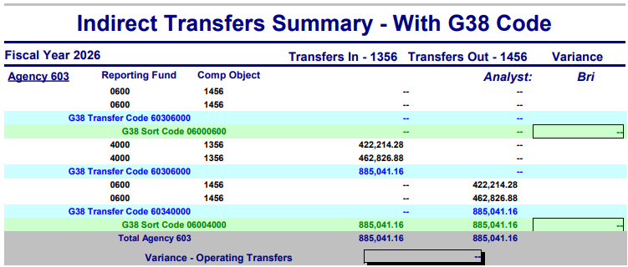
Indirect Transfers
All transactions that include Compt. Objs. 1356 & 1456

Slide 40
Links to Resources
SWB Reports & Update Schedule
Agency Guide to Year-End Close (Ch C.4.d, p8-16 & Ch D.19)
OAM Chapter 15 Sections (15.45.10, 15.45.20 & 15.45.30)
ACFR Contacts List
ACFR Contacts News List

Slide 41
Outro Page with Contact Info
SARS Analysts
ACFR Contacts List
https://www.oregon.gov/das/Financial/Acctng/Documents/ACFR_Contacts.pdf

Slide 42
Researching SWB Exceptions
Steps to follow

Slide 43
SWB Exception – Now what?
Step 1: Locate the transaction(s).
Step 2: Determine what entry should have been.
Step 3: Make the correction.
Step 4: Confirm SWB exception cleared.

Slide 44
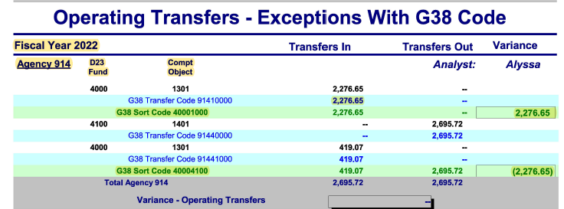
Step 1: SWB Exception Report

Slide 45
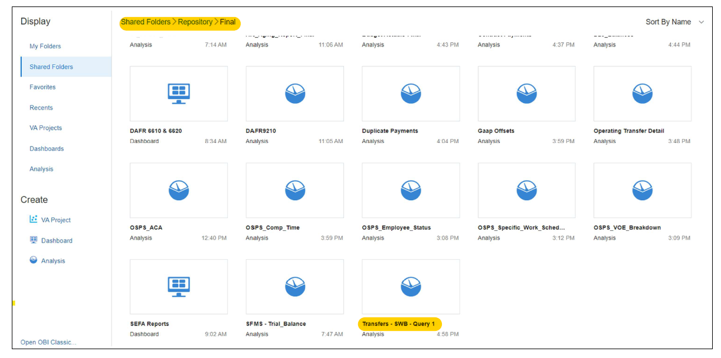
Step 1: Datamart Repository Query

Slide 46
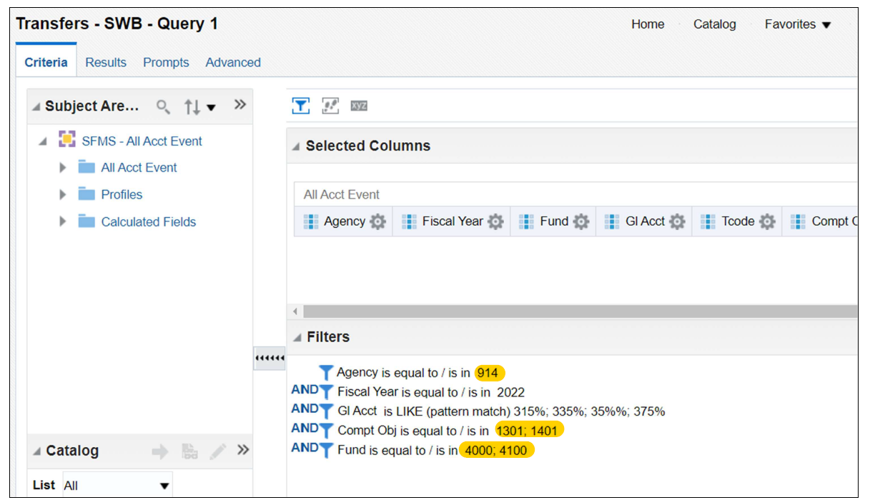
Step 1: Update Query Filters
From SWB Report:
Agency
Fiscal Year
Compt Obj
D23 Fund
GL Accounts:
No changes

Slide 47
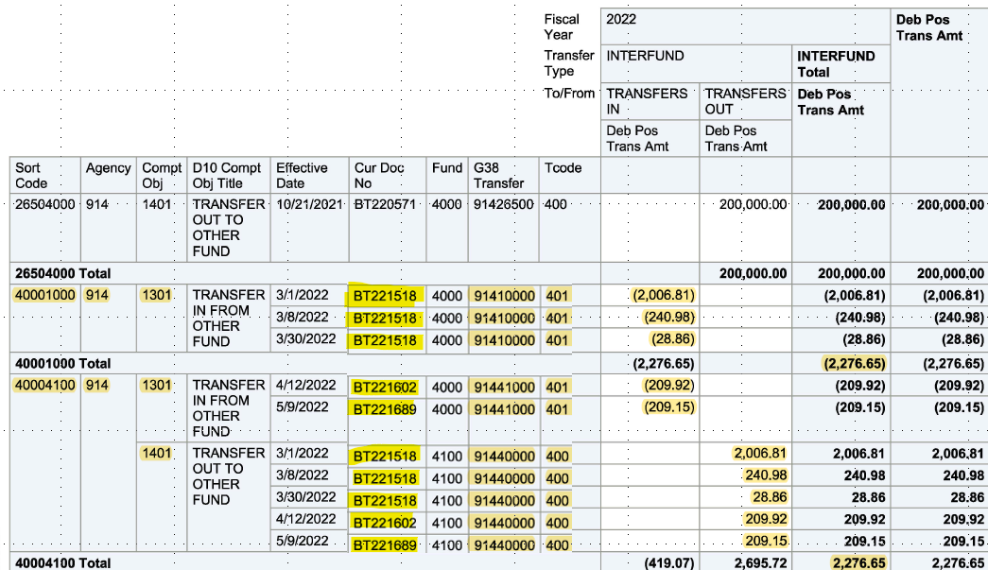
Step 1: Locate the transaction(s)
Confirm Sort Code subtotals results match SWB report.
Review entries that make up variance balances.

Slide 48
What to look for in your review?
Offsetting Activity in Both Columns?
G38s Entered Correctly?
Correct Compt Objects?
G38 should identify Agency & D23 Fund on opposite side of the transfer.
If incorrect, activity will be under different sort codes.
Intra-agency transfers (within one agency)
will use different
compt objects than
interagency transfers (between agencies).
Transfer In should have a matching Transfer Out.
Due To should have a matching Due From.

Slide 49
Correct G38 Format
G38 identifies the Agency & D23 Fund on opposite side of the transfer.
G38 (8-digit number) Format
First 3 digits
Agency Number
914
Next 4 digits
D23 Fund
1000
Last digit
Will always be zero
0
914 1000 0
If I see this G38 on a Transfer In entry, this indicates that these funds were transferred from Agency 914 D23 Fund 1000.

Slide 50
Step 1: Find the issue(s)
3 documents:
  BT221518
  BT221602
  BT221689
Narrow down which is causing the problem.

Slide 51
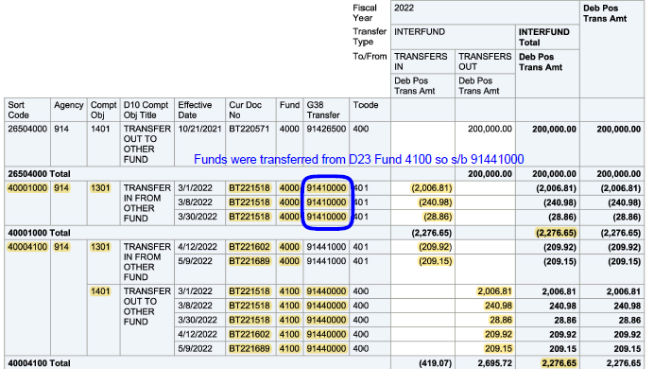
Step 2: What should this entry be?
Look at BT221518 for sort code 40001000.
G38 entered as 91410000.
Transfer was from Fund 4100.
G38 should be 91441000.

Slide 52
Step 3: Make the correction
Option #1
RECOMMENDED
Reverse BT221518 exactly as entered with TC 400R/401R.
Re-enter new BT with TC 400/401 with correct information.
Easier to trace & reduces risk of additional SWB errors.
Option #2
ALTERNATIVE
Use TC 423 to reverse BT221518 TC 401 entry with incorrect G38.
Re-enter with the correct G38 using TC 424.
To correct G38 on one side of entry only. Use TC 425 & 426 if error on TC 400 side.
Option #3
NOT RECOMMENDED
Use TC 401R to reverse out BT221518 TC 401 entry with incorrect G38.
Re-enter with the correct G38 using TC 401.
R*STARS allows but more difficult to trace and can create more SWB errors if done incorrectly.

Slide 53

One-sided BT corrections
Option 2 and 3 on the prior slide are examples of one-sided BT corrections.
Use caution when recording a one-side BT correction.
These could cause more SWB errors if not done properly or done for prior BT already in balance on SWB report. The more corrections attempted, the more difficult to research & identify what corrections are still needed.
If prior BT involved another agency, a one-sided BT correction could cause new SWB errors for your agency and the other agency.
If in doubt, Option 1 is the safest method.

Slide 54
One-sided correction error example
Assume Option #2 used to correct G38 error.
Use TC 423 to reverse TC 401 entry with incorrect G38.
Use TC 424 to re-enter with correct G38 but also decide D23 Fund needs to be corrected from 4000 to 2000.
New SWB error because G38 entered on TC 400 side of original BT entry was 91440000.
Option #2
ALTERNATIVE
Use TC 423 to reverse BT221518 TC 401 entry with incorrect G38.
Re-enter with the correct G38 using TC 424.
To correct G38 on one side of entry only. Use TC 425 & 426 if error on TC 400 side.

Slide 55
One-sided correction error entries
Entry 1 - Original BT document with G38 error.
Agency | Document # | T-Code | D23 Fund | G38 | Compt Obj | Transfer In | Transfer Out
914 | BT221518 | 401 | 4000 | 914 1000 0 | 1301 | (2,276.65)
914 | BT221518 | 400 | 4100 | 91440000 | 1401 |  | 2,276.65
Entry 2 - One-sided correction to correct D23 Fund & G38 on TC 401 entry.
Agency | Document # | T-Code | D23 Fund | G38 | Compt Obj | Transfer In | Transfer Out
914 | BTADJUST | 423 | 4000 | 91410000 | 1301 | 2,276.65
914 | BTADJUST | 424 | 2000 | 914 4100 0 | 1301 | (2,276.65)
End Result - New SWB error from updating D23 Fund with one-sided correction.
Agency | Document # | T-Code | D23 Fund | G38 | Compt Obj | Transfer In | Transfer Out
914 | BTADJUST | 424 | 2000 | 91441000 | 1301 | (2,276.65)
914 | BT221518 | 400 | 4100 | 914 4000 0 | 1401 |  | 2,276.65

Slide 56
Does BT involve another agency?
Coordinate with the other agency on the correction.
One agency cannot reduce cash for another agency.
If error by sending agency, receiving agency must reverse.
List of BT Contacts by Agency: BT-Contact-List.pdf

Slide 57
How can I view other agency transactions?
Contact the other agency.
Request UC 78 access.
Use a Datamart query.

Slide 58
Step 4: Did SWB Exception Clear?
Option #1
Check SWB Report
Check SARS website or SFMS Calendar for dates updated SWB reports are available.
Option #2
Run Datamart Query
Use SWB Repository query to confirm correction worked as expected.
Datamart information updated weekly.
Updated monthly and more frequently prior to fiscal year-end.

Slide 59

Did you know?
If you post a correcting entry in an Edit Mode 2 batch on a Friday and leave it in unreleased status on the 530 screen, the impacts of this entry will still appear in your Datamart query results on the following Monday.
Can be helpful trick if you want to review that a correcting entry had the desired effect before you release the batch. If it did not, that batch is still on the 530 screen.
Unreleased batches can be changed or deleted with UC 48.

Slide 60
SWB Exception Examples
How to Research & Correct

Slide 61
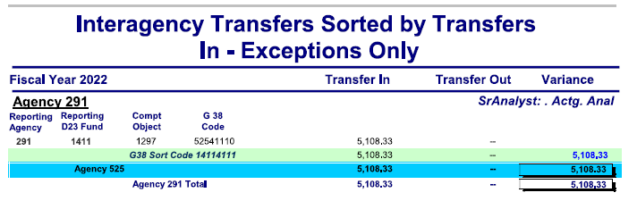
Example 2: SWB Exception

Slide 62
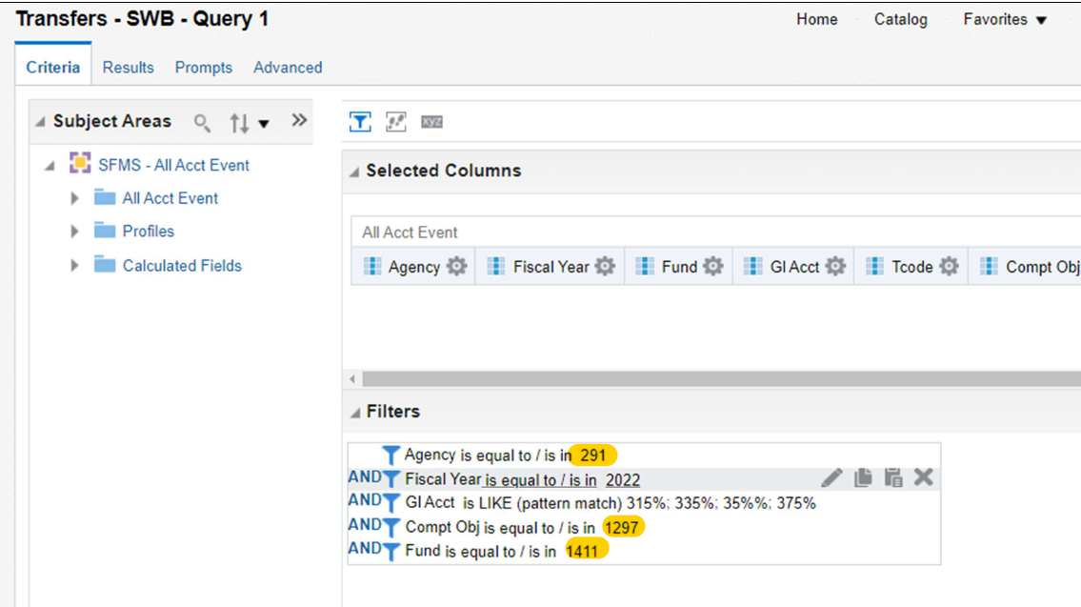
Example 2: Repository Query
From SWB Report:
Agency
Fiscal Year
Compt Obj
D23 Fund
GL Accounts:
No changes

Slide 63
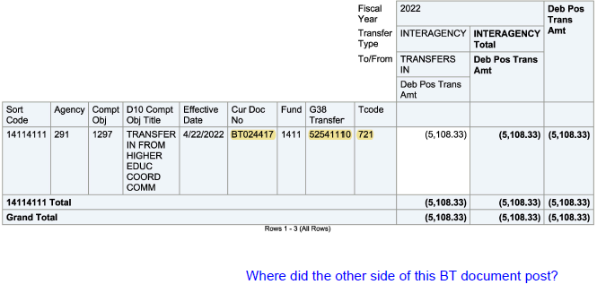
Example 2: Locate the transaction(s)
Review entries that make up exception balance.
Why am I only seeing one side of this BT entry?

Slide 64
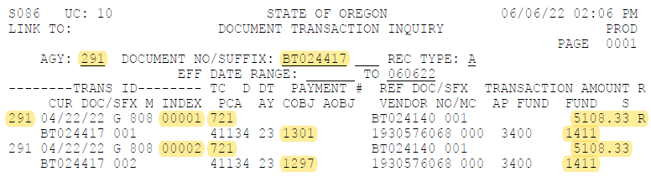
Example 2: Research transaction
One-sided correction using TC 721R/721 to correct Compt Obj.
See next slide for Compt Obj titles.

Slide 65
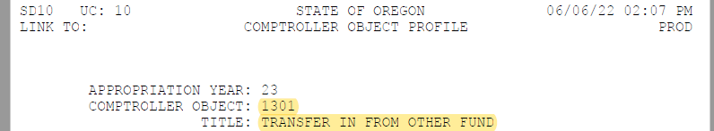
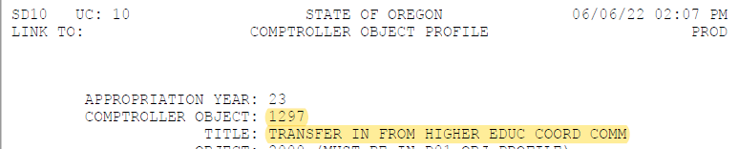
Example 2: Compt Obj Mismatch
Compt Obj 1301 for transfers within a single agency.
Compt Obj 1297 is for transfers between two agencies.

Slide 66
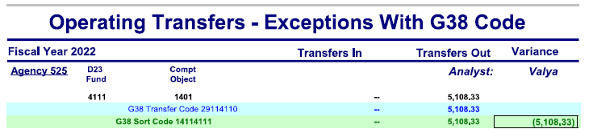
Example 2: Additional SWB Report
The other side of the original BT transfer is showing on a different SWB report.

Slide 67
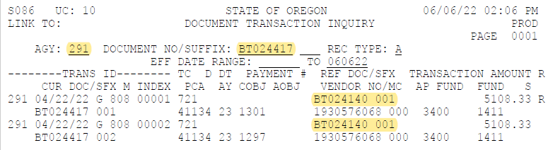
Example 2: Reference Document
This correction includes a reference document.
See next slide for original BT this entry was correcting.

Slide 68
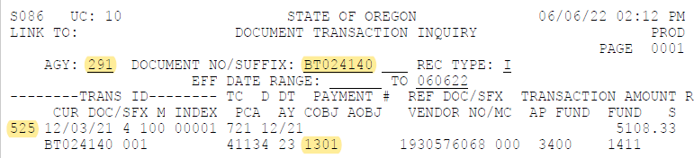
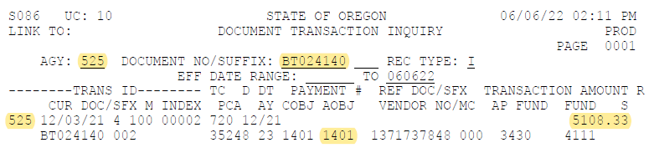
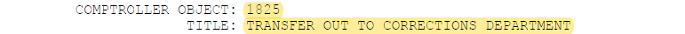
Example 2: Incorrect Compt Obj
Original BT used COBJ 1301/1401 for transfer between two agencies.
Agy 291 corrected their side from COBJ 1301 to 1297.
Agy 525 side needs to be corrected from COBJ 1401 to 1825.

Slide 69
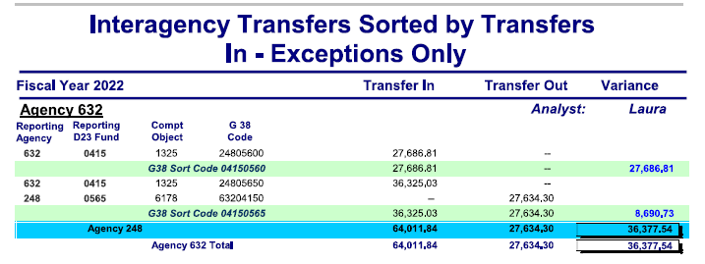
Example 3: SWB Exception

Slide 70
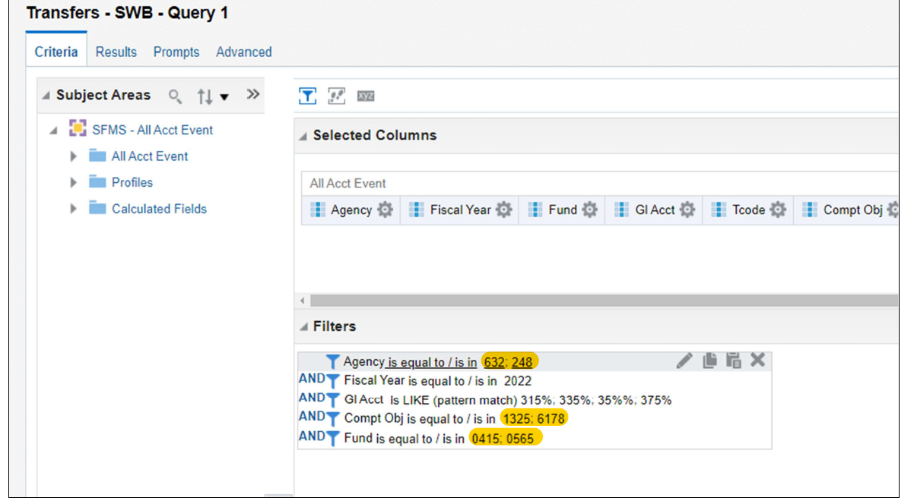
Example 3: Repository Query
From SWB Report:
Both Agencies
Fiscal Year
Compt Obj
D23 Fund
GL Accounts:
No changes

Slide 71
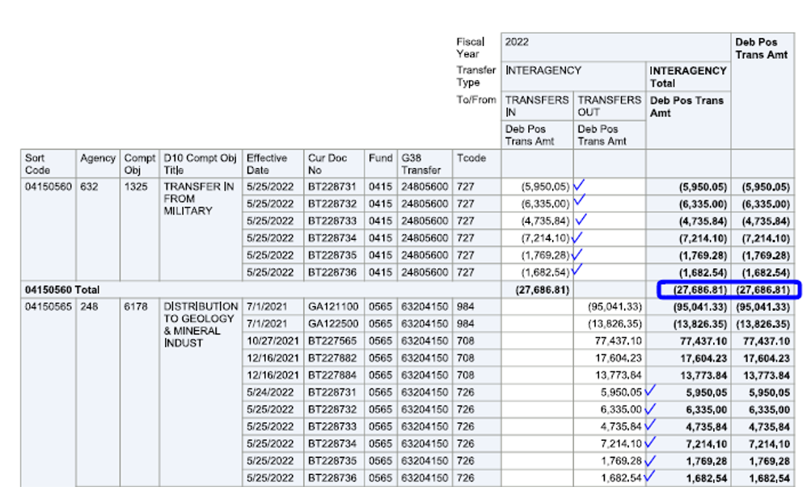
Example 3: Locate transaction(s)
Review entries that make up exception balance.
Here is the first variance from our SWB report.

Slide 72
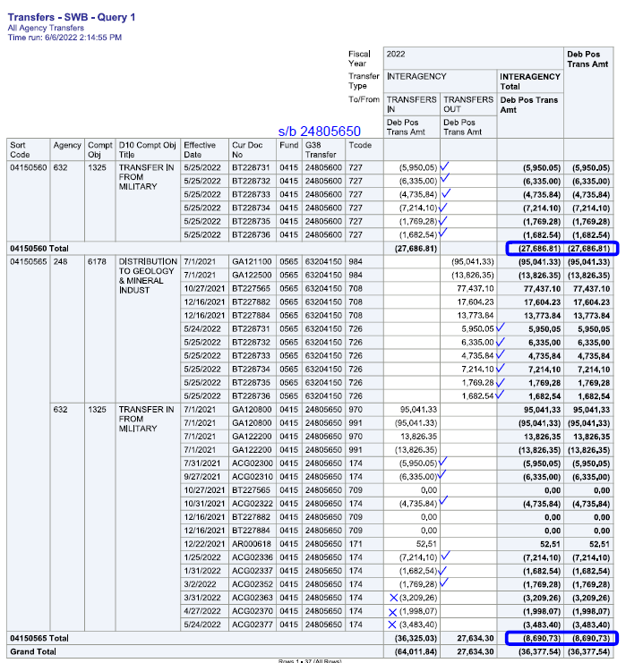
Example 3: Locate transaction issues
Look at BTs for sort code 04150560.
G38 entered as 24805600.
Transfers from Fund 0565.
G38 should be 24805650.

Slide 73
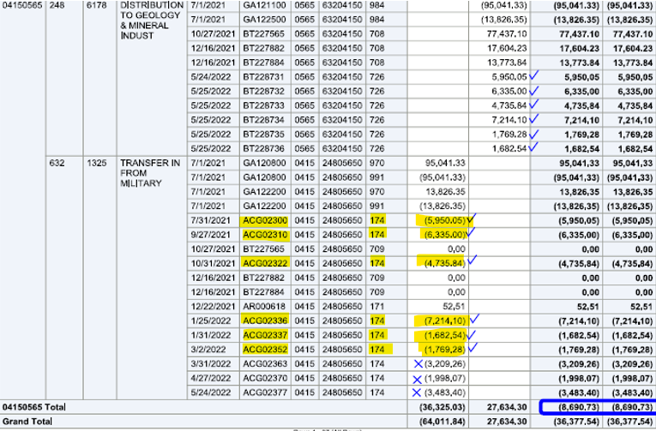
Example 3: Remaining transaction(s)
Here is the second SWB variance.
Prior slide shows 6 transfers to Agy 632 totaling $27,686.81.
Same 6 transfers showing here with TC 174.
Why are transfers listed twice?

Slide 74
Example 3: Make the corrections
Agy 632 created invoices with TC 174 for amounts due from Agency 248
TC 174 requires a G38 to be input with it and activity appears on SWB reports.
Agency 248 paid invoices with TC 726/727 which does not clear invoices.
TC 708/709 should have been used for the BT payments instead.
Option #1
Agy 632 reverses BTs exactly as entered with TC 726R/727R.
Agency 248 re-enters BTs with TC 708/709 to clear invoices.
Option #2
Agy 632 reduces invoices to zero with TC 171R for amounts already paid.

Slide 75
Example 3: Remaining Activity
Results also showed 3 more invoices set up by Agy 632 using TC 174 for amounts due from Agy 248
Appears these invoices above not yet paid at time query was run.
If still due, no action needed by agencies to correct them.
Will clear SWB exception report once paid using correct TCs 708/709.

Slide 76
Scenarios that cause SWB errors (1 of 4)
  Correcting a transaction that is already in balance on the SWB report.
    If original transaction involved another agency, correcting only your agency’s side of the BT can result in SWB errors.
    Coordinate with the other agency. If in doubt, it is best to have the receiving agency reverse out the original BT and have the sending agency re-record that BT with the corrected information.

Slide 77
Scenarios that cause SWB errors (2 of 4)
  Corrections of corrections (…of corrections)
    It you are unsure what is causing a SWB exception or are unsure if your planned correction will clear the error, reach out to the other agency or to your SARS & SFMS analysts.
    You may always test the impact of a correcting entry by leaving the batch on the 530 screen over the weekend before releasing to confirm the entry looks as expected in Datamart to help avoid multiple corrections of corrections.
    The more corrections posted, the more difficult it is to pinpoint which entries are contributing to the SWB exception and what corrections are still needed.

Slide 78
Scenarios that cause SWB errors (3 of 4)
  Correcting prior fiscal year activity
    SWB reports only show activity for the current fiscal year.
    If a BT entry was made in a prior FY and you are correcting it in the current FY, the SWB report will only show the impacts of the current FY correction.
    If you attempt a one-sided BT correction of a BT that was recorded in a prior FY, this could result in a new SWB exception for the current FY.

Slide 79
Scenarios that cause SWB errors (4 of 4)
  SWB exceptions due to Auto-Reversals of Financial Statement accruals
  If your agency had SWB variances at the end of the prior FY due to inaccurate financial statement (FS) accruals that auto-reverse, there will be offsetting exceptions in the current fiscal year SWB reports.
  For T-Codes that auto-reverse, R*STARS generates auto-reversals using documents starting with GA to back out FS accruals at the start of the next FY.
  Do not make entries to correct SWB variances that are a result of GA auto-reversal documents without contacting your SARS analyst. SWB variances that result from GA auto-reversals will drop off of next fiscal year’s SWB reports. If the incorrect prior year FS accrual was material, your SARS analyst may advise a prior period adjustment.

Slide 80
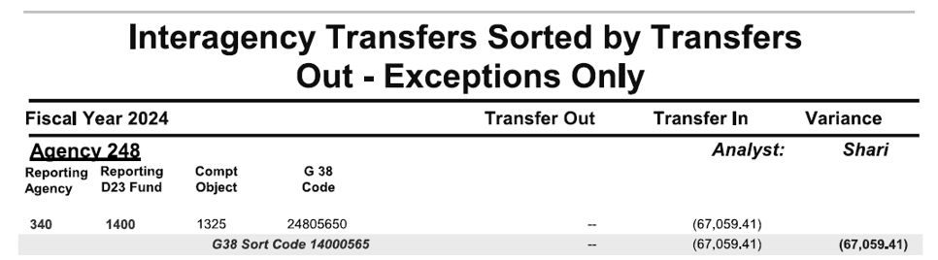
Example 4: SWB Exception

Slide 81
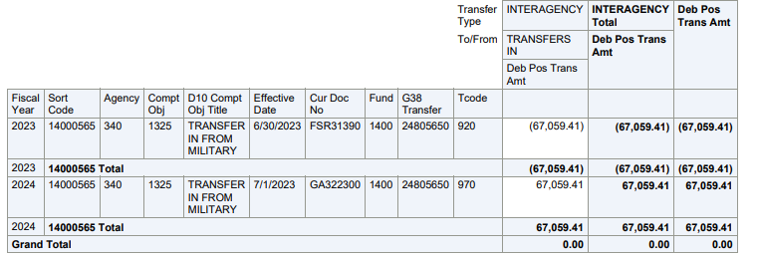
Example 4: Locate the transaction(s)
SWB report shows only FY 2024 activity.
Results below shows both FY 2023 and 2024.

Slide 82
Example 4: Research transactions
Agency 340 (DEQ) recorded FY23 transfer in accrual from Military (Agency 248).
Agency 248 & 340 had outstanding SWB variances at the end of FY23.
Agency 248 did not record a matching transfer out accrual for FY23 year-end.
  Auto-reversal of FY23 accrual also caused variances for both agencies in FY24.
  Amount was not due from Agency 248. It was due from Agency 258 instead.
  Agency 258 did not record a FY 23 transfer out accrual for this either.

Slide 83
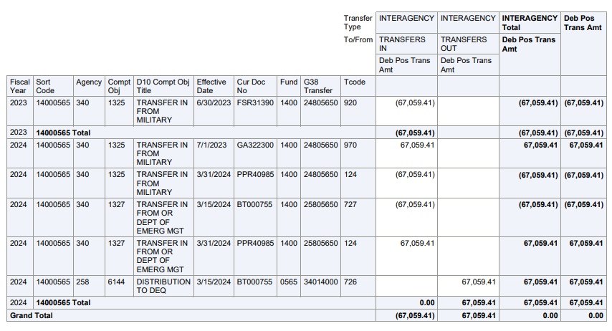
Example 4: How this was resolved
SARS advised Acy 340 to record a TC 124R/124 entry to correct G38 & Compt Obj from 1325 to 1327.

Slide 84
Example 4: End Result on FY24 SWB
Correction of G38 & Compt Obj cleared FY24 variances between Agy 340 & 248.
However still had outstanding SWB variance in FY24 between Agy 340 & 258 since Agy 258 did not previously accrue.
SWB variances from this auto-reversal will drop off in FY25 SWB reports.
D Do not make another accrual entry to correct a GA document.
If agency tried to back out the impact of GA document with a TC 920R entry, that FS entry would then generate another GA auto-reversal document.

Slide 85
More Resources
SFMS Desk Manual
T-Code
Spreadsheet
Your SARS & SFMS Analysts

Slide 86
Presenter Contact Information
Liz Schultz
SFMS Senior Operations Analyst
971-900-7616
elizabeth.schultz@das.oregon.gov

