Slide 1
Transaction Code Basic Training
Statewide Financial Management Services
September 9 & 23, 2026
Department of Administrative Services

Slide 2
Agenda
General Information
Deposits
Accounts Receivable
Accounts Payable

Slide 3
Accounts Payable
Presented by Amber Nunnery

Slide 4
You received a bill
What information do I have?
How can I issue them a payment through R*STARS?
Where do I start?

Slide 5

Step 1: Identify type of transaction
OAM 60.10.00 list GL’s associated with payables.
Vouchers Payable (GL 1211) is used to generate payments in R*STARS.
Payments are issued via a physical warrant or ACH.

Slide 6
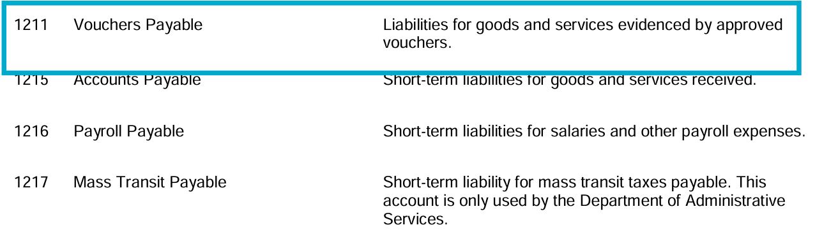
Oregon Accounting Manual Definition

Slide 7

Voucher Payable
Checks vs. Warrants
Warrant Writing Indicator
Due Date

Slide 8
Checks Compared to Warrants
Warrants
  Promise to pay.
  Receipted Account at Treasury.
  Issued through R*STARS
  In a fiscal emergency, the State is not legally required to immediately redeem.
Checks
  Demand drafts
  Suspense Account at Treasury
  Not issued through R*STARS
  Agencies must have check-writing authority to issue checks.

Slide 9
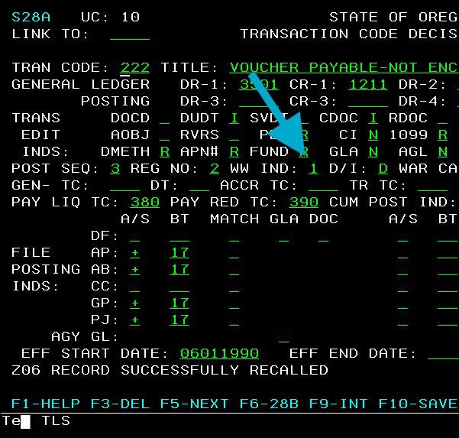
Warrant Writing Indicator
Found on 28A Screen
WW IND = 1 a warrant will generate.

Slide 10
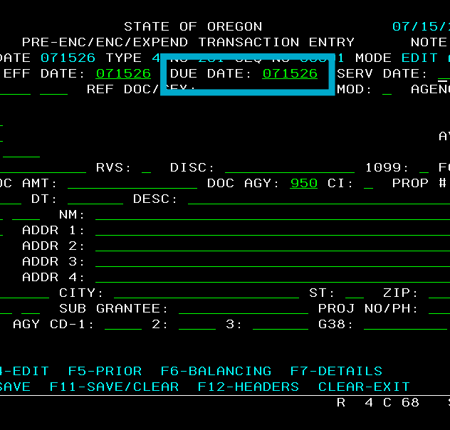
Due Date
Required for Voucher Payable Transaction.
Indicates when payment will generate.
Future dated transaction remain on the 530 screen until the due date.

Slide 11

Vendors & Payment Distribution Types (PDT)
Vendor Profiles
PDT’s
Frequently used PDT’s

Slide 12
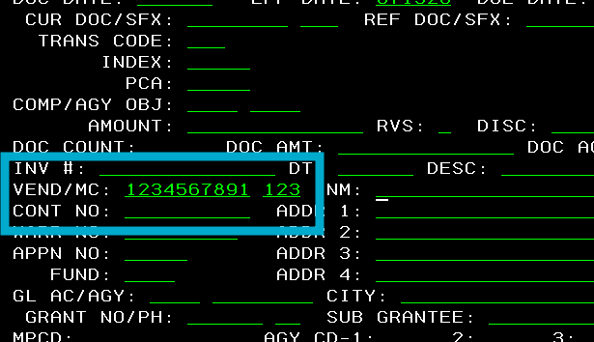
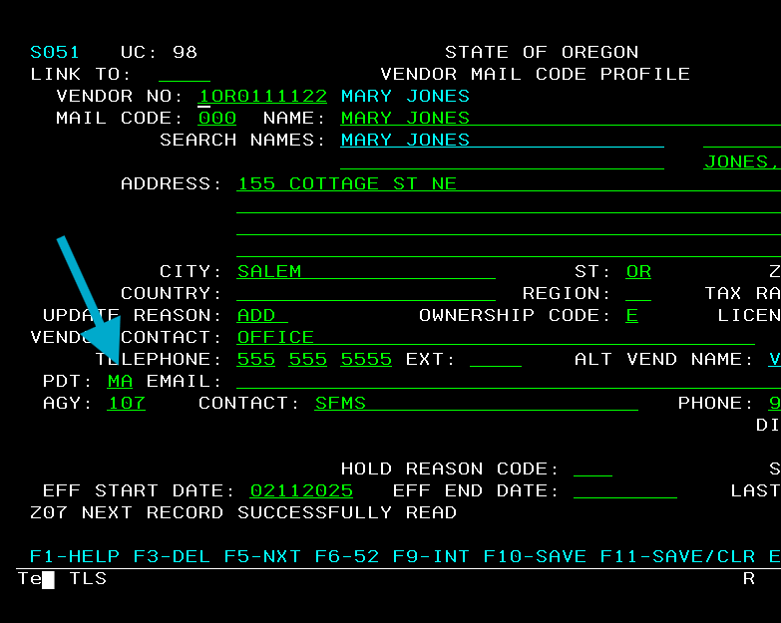
Vendor Profiles
Voucher Payables require a vendor number and mail code.
Mail codes are listed on 51 screen.
The PDT (Payment Distribution Type) on the profile indicates default PDT for vendor payments.

Slide 13
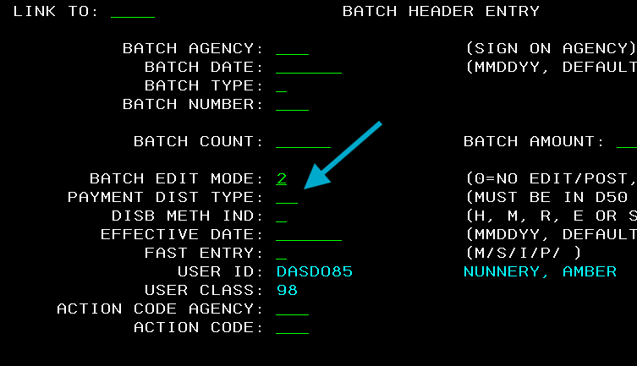
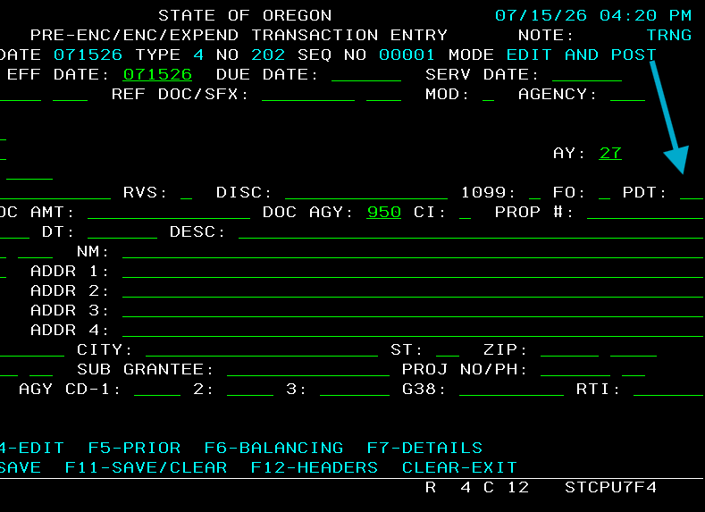
Payment Distribution Type (PDT)
Default PDT is pulled from the 51 screen.
You can enter a PDT on the batch header this will overwrite default PDT.
You can enter a PDT on the individual transactions this will overwrite both batch header and default PDT.

Slide 14

Frequently Used PDT
MA: Mails Warrant.
RA: Warrants returned to agency.
DA: ACH payment to vendor.
All PDT options

Slide 15
Accounts Payable Examples
Example #1 – Record a Voucher Payable for an Expenditure
Example #2 – Record a Voucher Payable to Clear a Deposit Liability Balance
Example #3 – Correct Coding Used on a Voucher Payable

Slide 16

Example 1: Voucher Payable-Expenditure
Your agency ordered and received new business cards for your employees. You have received a bill from the vendor. You have already confirmed that this vendor is correctly set up in R*STARS. You want to record this expenditure in R*STARS and have the system generate a warrant that will be mailed directly to the vendor.

Slide 17

Example 1: Step 1
Step 1: Identify the type of transaction.
What General Ledger (GL) accounts?
What Comptroller Object (COBJ) ?

Slide 18
Example 1: GL Accounts to Use- GL 1211
Generate a payment in R*STARS
We need to post to GL1211 (Vouchers Payable)
The system will liquidate the voucher when payment is issued.
Liquidation clears GL1211 and reduces cash in GL0070
We credit GL1211 to increase Voucher Payable

Slide 19
Example 1: GL Accounts to Use - GL 3501
This activity is an agency expenditure.
We debit GL 3501 to increase accrued expenditures.
The system updates it to cash expenditure when payment is issued.

Slide 20

Example 1: COBJ to Use
The amounts collected are for business cards.
Choose the Comptroller Object that best fits the activity.
In this example, use 4200 – Office Supplies.

Slide 21

Example 1: Finding a T-code
Our T-code must:
Debit GL 3501
Credit GL 1211
Use COBJ 4200
Step 2: Use available research tools.
Use the Transaction Code spreadsheet to narrow the options.

Slide 22
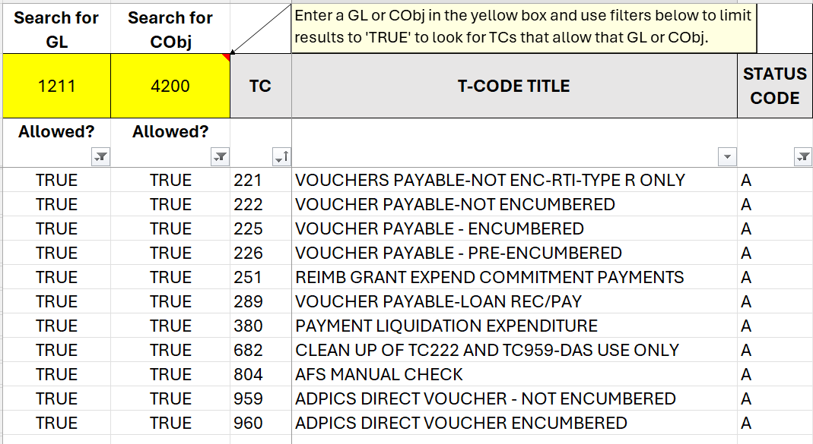
Example 1: T-codes to Review

Slide 23
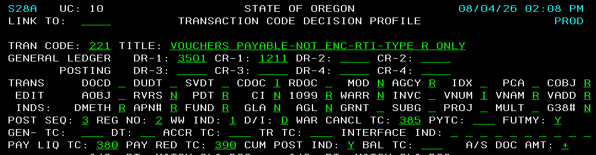
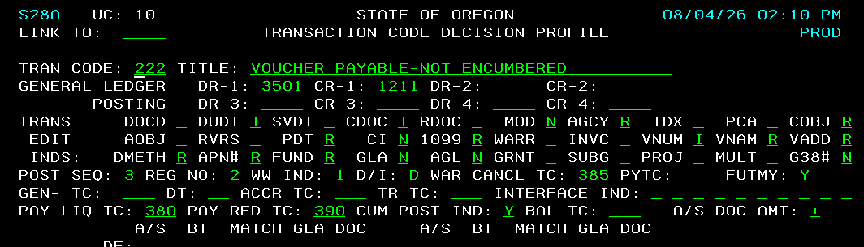
Example 1: Review the 28A Screen
T-codes 221 & 222
T-codes that may be generated from these T-codes.
  Warrant Stop/Cancel = 385
  Payment Liquidation = 380
  Payment Redemption = 390

Slide 24
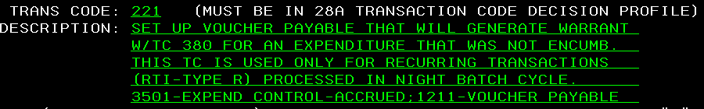
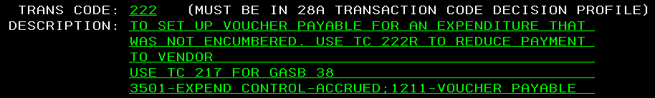
Example 1: Review the 28B Screen
The description for T-code 221 has more detail on when it should be used.
T-code 222 looks to be the right choice.

Slide 25
Example 1: Making the Entry
Step 4: Identify entry requirements.
Use the 28A and 28B for help
Find correct Vendor Number and Mail Code
Enter a due date:
  Today for immediate payment.
  Future date for delayed processing.
Verify User Class

Slide 26
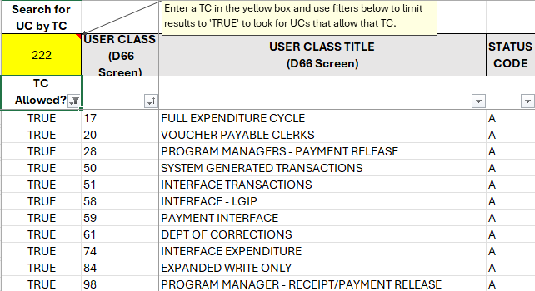
Example 1: How do I find the right User Class?
Filter to T-code 222
Compare results with the User Classes you have.

Slide 27
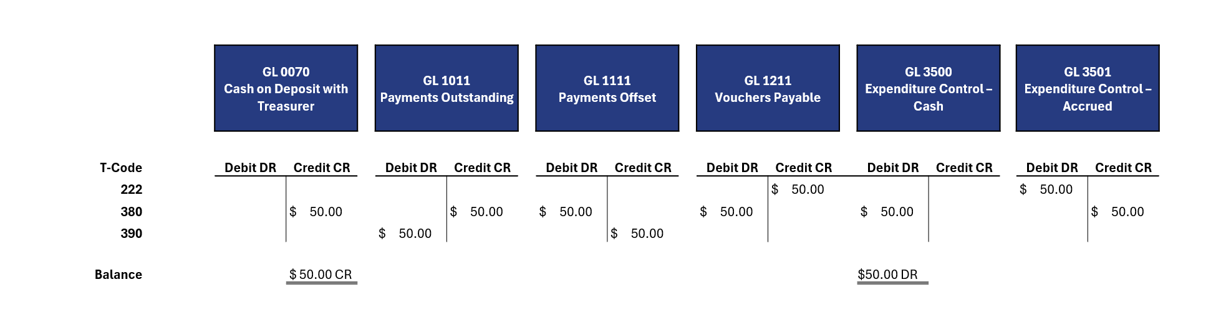
Example 1: End Results of Entry

Slide 28

Example 2: Voucher Payable to Clear Deposit Liability Balance
Your agency previously received a refundable deposit from a client. You recorded the deposit as a Deposit Liability with T-code 162 and the deposit reconciled on the 13 screen.
You are now ready to return this deposit to the client.
How will you process in R*STARS to generate a payment and clear the associated Deposit Liability balance?

Slide 29
Example 2: Getting Started –Use the steps.
Steps
Tools
Step 1 - Identify type of transaction
Step 2 - Use available research tools
Step 3 -Find the best fit
Step 4 - Identify entry requirements
General Ledger Accounts
Comptroller Objects
T-codes & User Classes: T-code Spreadsheet

Slide 30
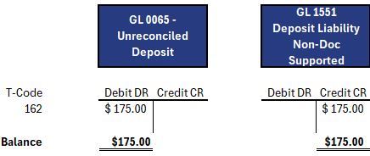
Example 2: What GL should I use?
  Goal:
    Clear the Deposit Liability balance from T-code 162.
    Issue a payment through R*STARS to return funds.
  Need to debit GL 1551 to clear the balance.
  We want to credit GL 1211 Vouchers Payable with this entry.

Slide 31
Example 2: What COBJ to use?
No COBJ used on original TC162 entry recording the Deposit Liability
No COBJ needed for entry to clear the Deposit Liability
No COBJ is needed to return the funds.

Slide 32

Example 2: Finding a T-code
Start with the T-code Spreadsheet.
Another option, look at the 28B screen for the original entry.
It might either give us information of what T-code to use next or more GL’s to consider.

Slide 33
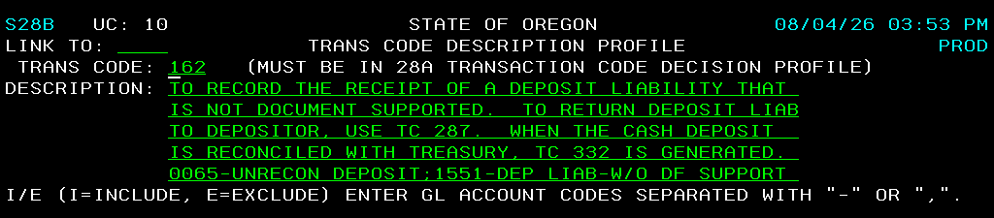
Example 2: 28B Screen Description

Slide 34
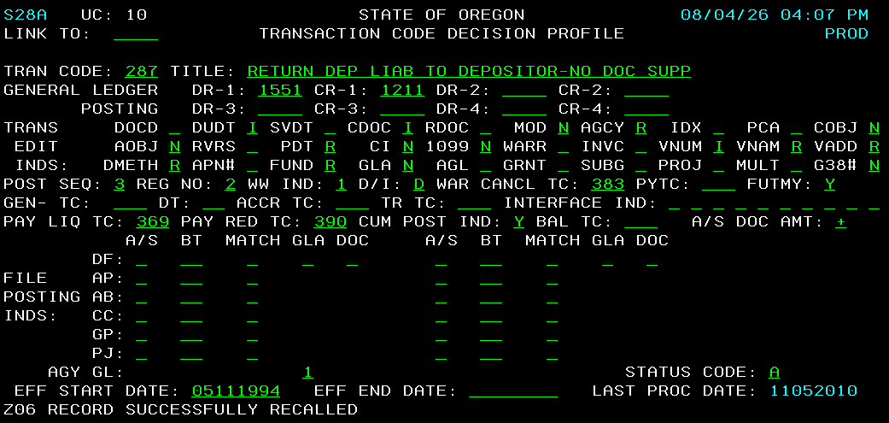
Example 2: Review the 28A Screen
Debits – GL 1551
Credits – GL 1211
Due Date must be input
No COBJ required
Vendor Number and Mail Code must be input.
Liquidation TC 369

Slide 35
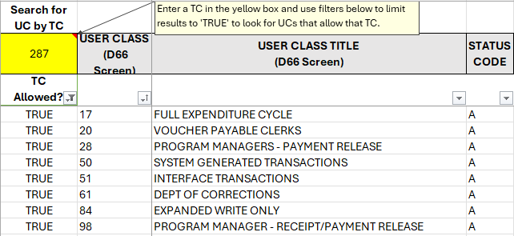
Example 2: User Class
Which User Classes allow T-code 287.
Remember to update filter on TC Allowed?
Compare against your User Classes.

Slide 36
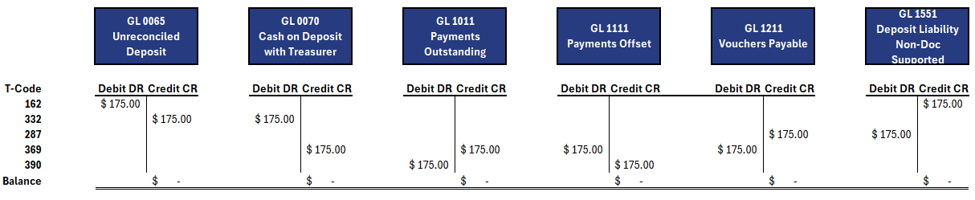
Example 2: End Results of Entry

Slide 37

Example 3: Correct Coding on previously recorded Voucher Payable
In Example #1, we recorded a voucher payable to pay for new business cards. The voucher payable was entered in R*STARS and the batch was released. The voucher payable batch has cleared from the 530 screen and a payment number generated.
The payment was for the correct amount and issued to the correct vendor, but we discovered that we used the wrong PCA when recording this voucher payable. How should we correct this?

Slide 38

Example 3: Step 1
Step 1: Identify type of transaction.
What General Ledger (GL) accounts?
What Comptroller Object (COBJ) ?

Slide 39
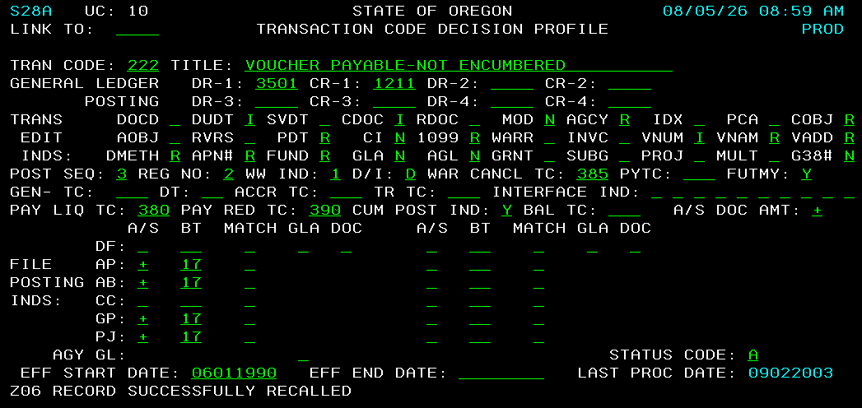
Example 3: Original Voucher Payable Entry
Example 1 recorded with TC 222
Credits GL 1211 Voucher Payable
Debits GL 3501 Accrued Expenditures.

Slide 40
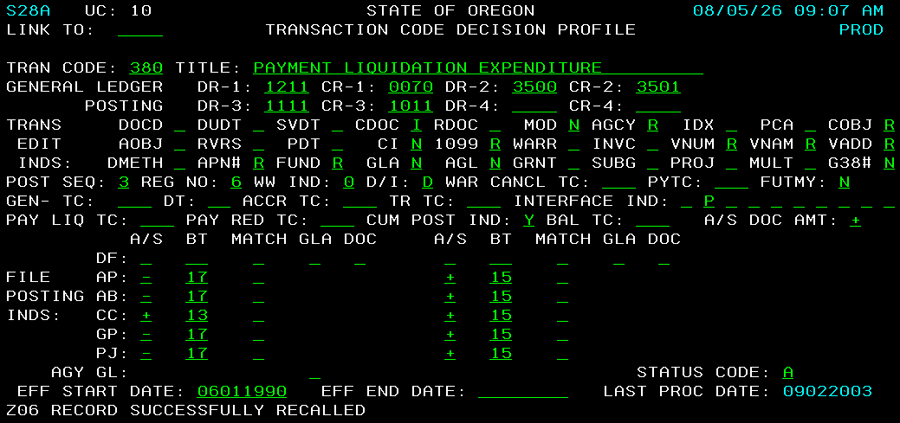
Example 3: System Generated Entry
Clears GL impacts of TC 222 entry.
Credits GL 0070 and Debits GL 3500 (This is what we want to correct.)
GL 1111 and GL 1011 track outstanding payments . They will clear when payment is redeemed.

Slide 41
Example 3: COBJ
Original COBJ 4200
4200 - Office Supplies is correct
Use 4200 for PCA Correction

Slide 42

Example 3: Finding a T-code
We have determined that we want to record a transaction that will correct GL 0070 and GL 3500 activity. We also want to use COBJ 4200 to make this correction.

Slide 43
Example 3: Use Research Tools
Step 2: Use available research tools
What T-codes can we use?
Filter columns in the Transaction Code Spreadsheet to narrow down our options.

Slide 44
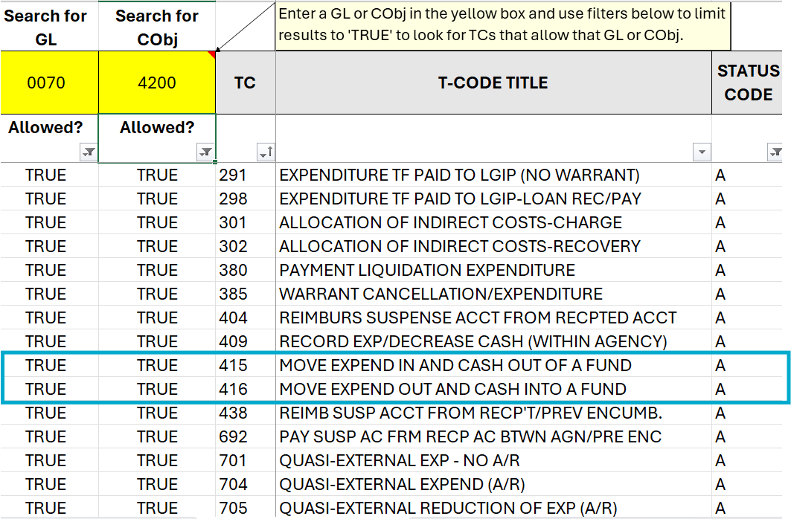
T-code Spreadsheet Options

Slide 45
Example 3: Pick the best T-code
Step 3: Find the best fit.
Important Tip:
Correcting previously recorded expenditures (GL 3500)?
  Check out T-codes 415 & 416.
Correcting previously recorded revenue (GL 3100)?
  Check out T-codes 407 & 408.

Slide 46
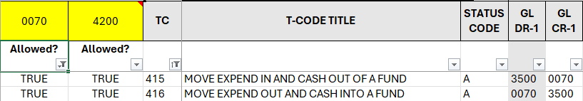
Example 3: T-codes 415/416

Slide 47
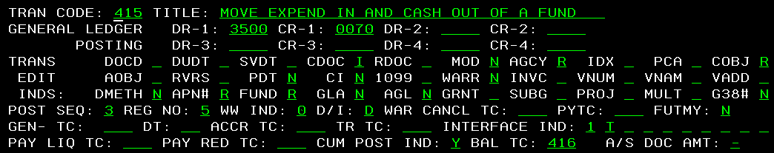
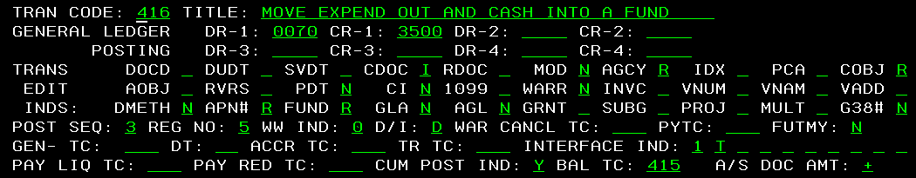
Example 3: Review the 28A Screen
These are Balanced Transfer (BT) T-codes.
BT T-codes are entered together in a batch, and the document amount will always net to zero.
Use T-code 416 to back out the impact of our prior entry and T-code 415 to record the correct PCA.

Slide 48
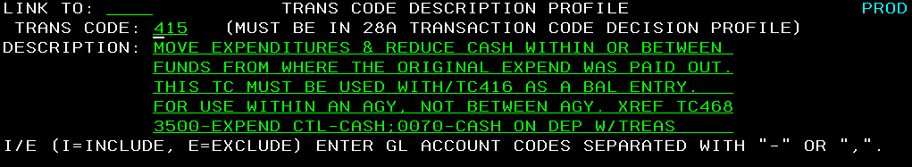
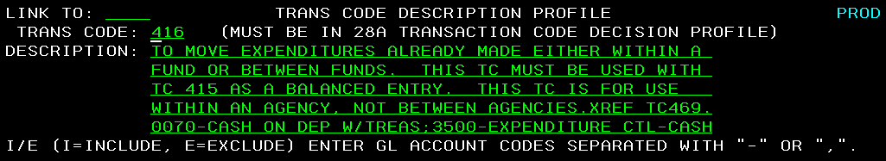
Example 3: Review the 28B Screen
These T-codes will correct the coding on our books for this payment.
No impact to the payment that was already sent out to the vendor.

Slide 49

Example 3: Making the Entry
Step 4: Identify entry requirements.

Slide 50
Example 3: Required Coding
T-code 416
Original Coding
T-code 415
BT Document
Back outs the impacts of T-code 222 and T-code 380.
To move the transaction, use the same coding as TC 222 entry on the TC 416 entry.
Repost the expenditure using the correct coding. Use the correct PCA on this entry.
Enter both TC 416 and TC 415 in the same batch using the same BT document number. BT document amount will be zero.

Slide 51
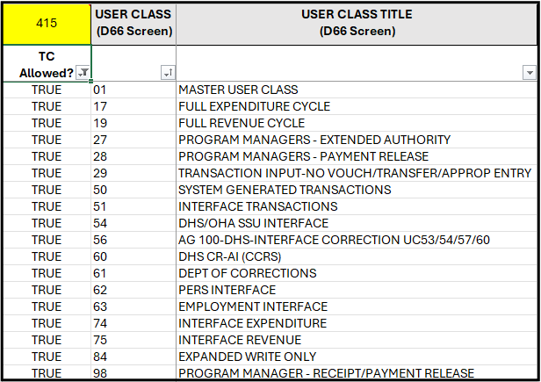
Example 3: User Class for Entry
Which User Classes will allow T-codes 415 & 416?
Same results for both TC 415 & 416.

Slide 52
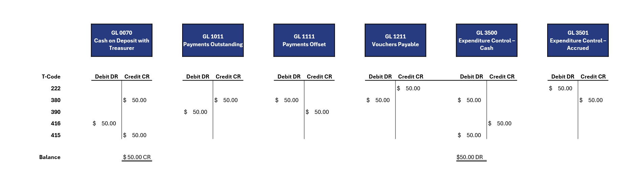
Example 3: End Results of Entry

Slide 53
Amber Nunnery
SFMS Trainer
971-900-9773
amber.nunnery@das.oregon.gov

Slide 54

Questions?

