Slide 1
Account Receivable
Maria Jazaei Berglund
09/23/2026
Department of Administrative Services

Slide 2
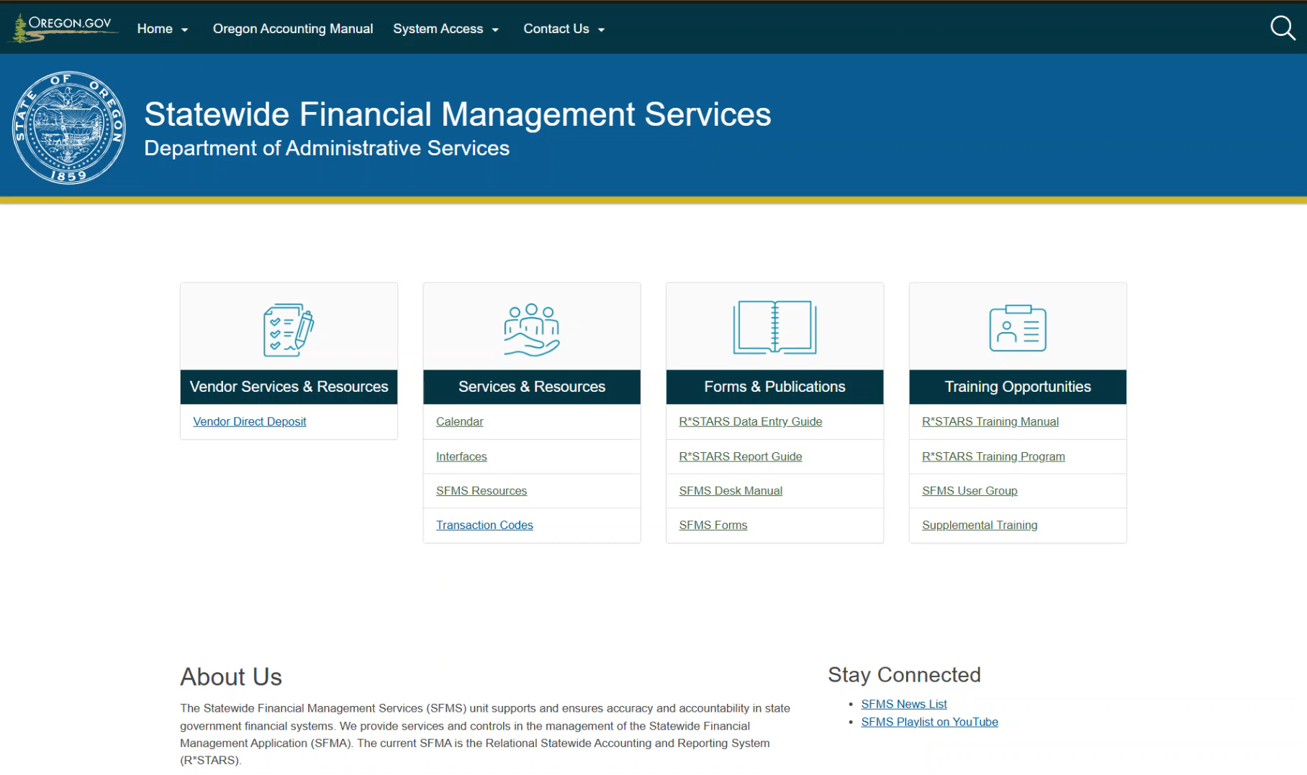
Statewide Financial Management Services website.

Slide 3

Required process
Step 1: Identify the type of transaction you want to record.
Step 2: Use research tools to narrow down possible Transaction Code options.
Step 3: Pick the Transaction Code that is the best fit for your transaction.
Step 4: Make sure you have all required coding and the correct User Class to make the entry.
      GL Accounts
      Comptroller Objects
      T-codes & User Classes

Slide 4
Accounts Receivable Terminology
Current Receivable
Short‑term collection
Within one year for proprietary type funds
Noncurrent Receivable
Long‑term collection.
Billed
Tracked on 64screen
Current Document number will be used as Reference Document
Unbilled
Invoice
Not Tracked
No Reference Document
T‑Codes generate a system invoice
90 days: governmental funds
More than 90 days: governmental funds
More than one year for proprietary type funds

Slide 5
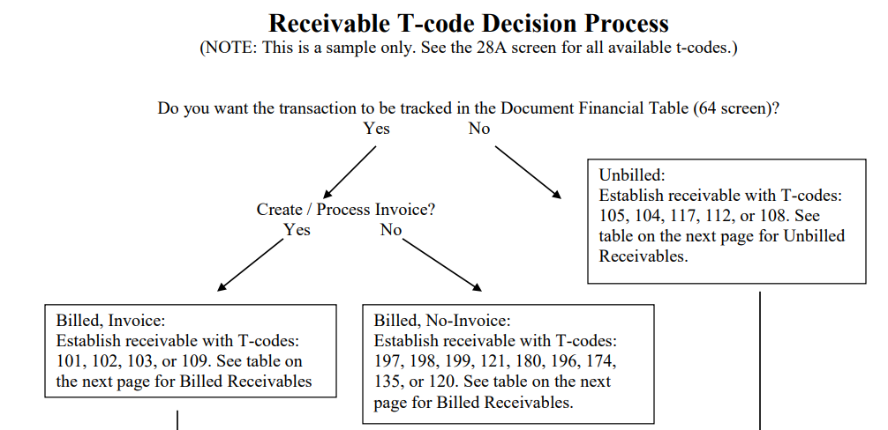
Accounts Receivable Tools
Source: Receivable T-code Decision Process

Slide 6




Accounts Receivable Examples
Establish Accounts Receivable
Adjust Accounts Receivable
Collect Accounts Receivable
Adjust Collection Entry

Slide 7

1

Slide 8
Example 1: Establish Accounts Receivable
The program sends monthly invoices.
You enter the invoices in R*STARS.
This tracks what clients owe.
You can run aging reports.

Slide 9
Example 1: process
Identify the type of transaction you want to record.
General Ledger (GL)
Comptroller Object (COBJ)
T-code

Slide 10
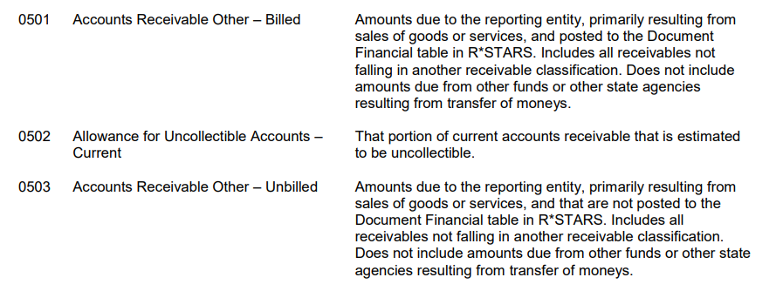
Example 1: Step 1, GL
What General Ledger (GL) accounts do we want:
Oregon Accounting Manual 60.10.00
Billed
Tracked on 64 screen
Unbilled
Not Tracked on 64 screen

Slide 11
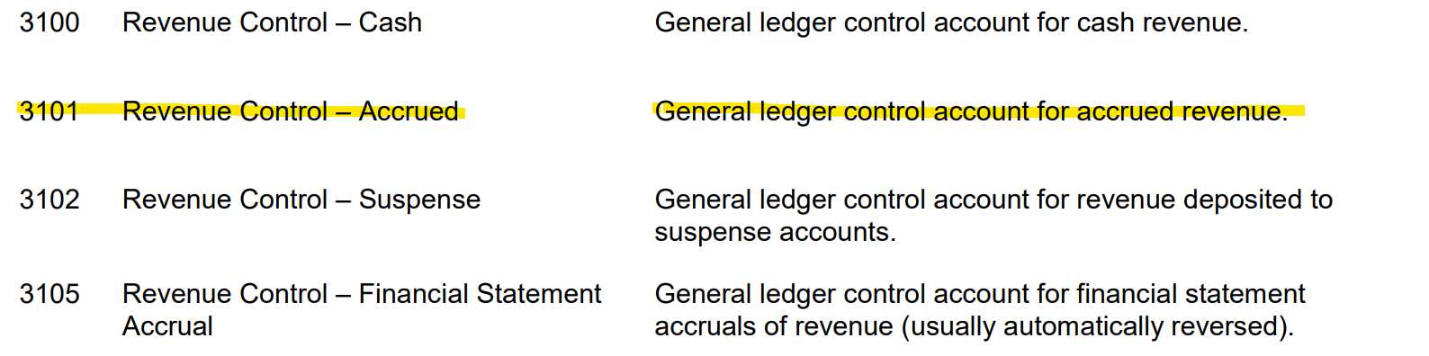
Example 1: Step 1, GL 3101
These invoiced amounts are considered revenue for the program.
We have not yet received the cash, so we will want to credit GL 3101 to increase accrued revenue.

Slide 12
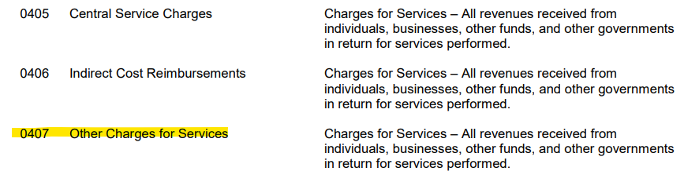
Example 1: Step 2, COBJ
The OAM definitions have various categories services.
Pick the Comptroller Object that best describes the activity.

Slide 13
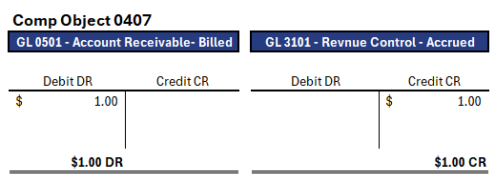
Example 1: Step 3, T-code
The example noted that the amounts collected are charges for services.
For this example, we will use 0407 - Other Charges for Services.

Slide 14
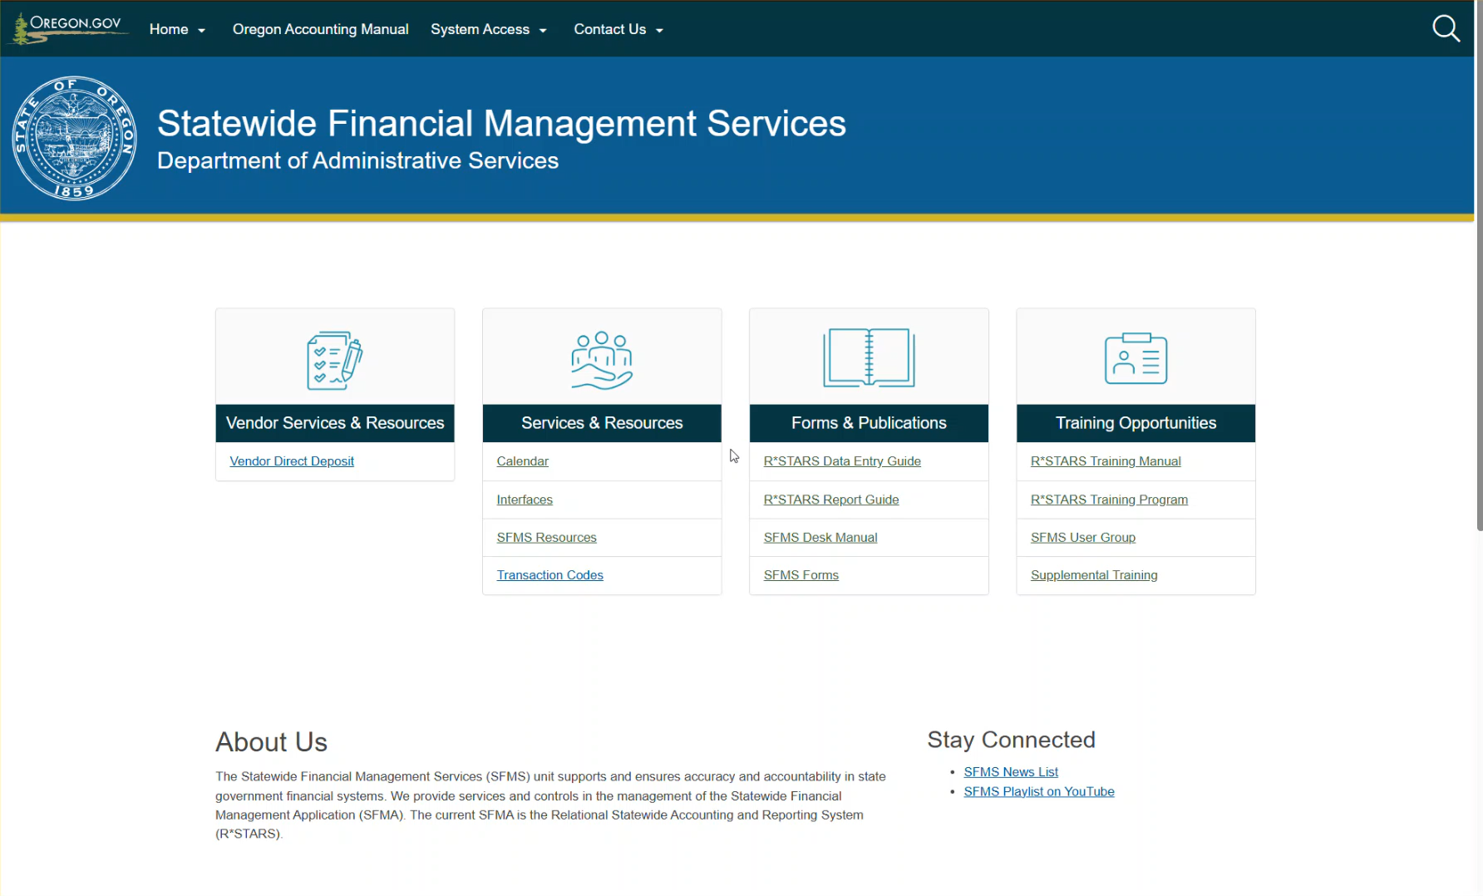
Example 1: Step 3, Filter list
T-code-Excel

Slide 15
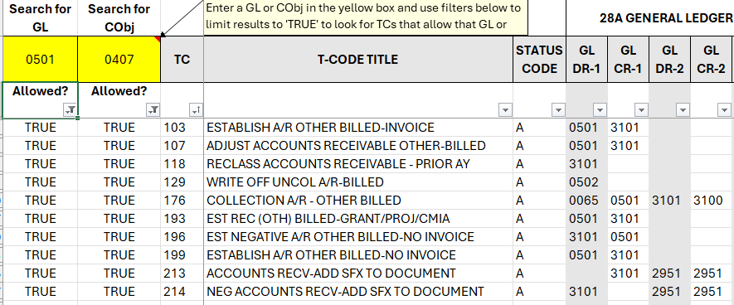
Example 1: Step 3, Review T-codes
.

Slide 16
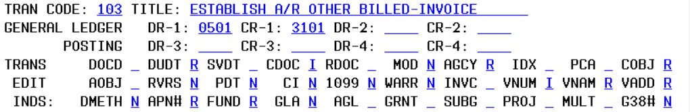
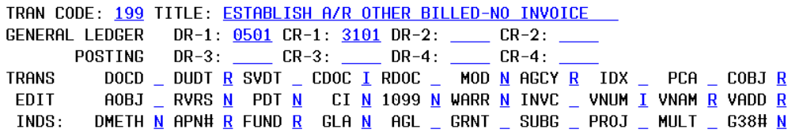
Example 1: Step 3, Review 28A Screen
The difference between 103 and 199 appears to be whether we want R*STARS to generate an invoice or not.

Slide 17
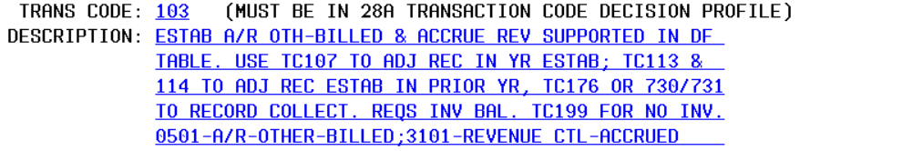
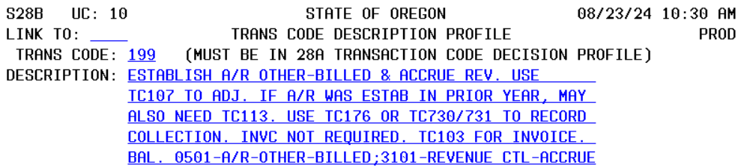
Example 1: Step 3, Review 28B Screen
The program creates and sends the monthly invoices.

Slide 18
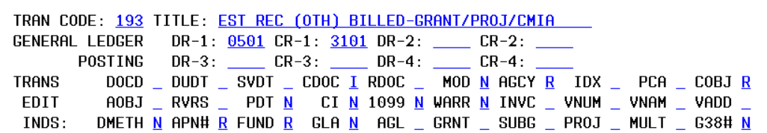
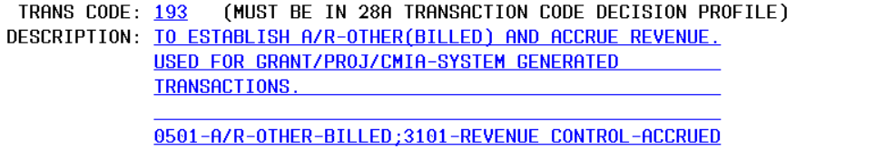
Example 1: Step 3, Review 28A and 28B Screen
T-code 193 is used for system generated transactions, so this is not what we want.

Slide 19
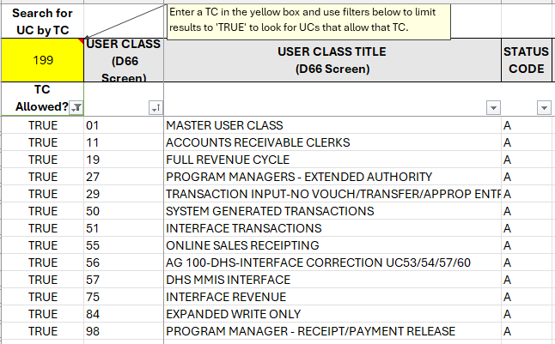
Example 1: Step 4, User class
After identifying the T-code we need to find the right user class.
Use the User Classes you have to determine if you have the correct access to be able to make the entry.

Slide 20
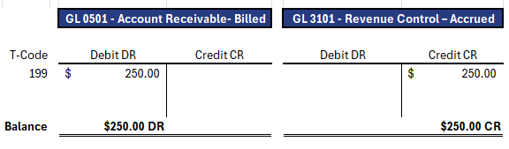
Example 1: Step 5,Data Entry
Establish Accounts Receivable
COBJ 0407 Other Charges for Services

Slide 21
Example 1: 64 Screen Results
S064 UC: 01 STATE OF OREGON 09/24/24 08:00 AM
LINK TO: DOCUMENT RECORD INQUIRY PROD
AGY: 101 DOC NO/SFX/CLASS: AR100101 001 001
CREATE DATE: 092424 CLOSE DATE:
INQ TYPE: MC (MA, YA, MY, YY, MC, YC)
INQ YEAR: 25 INQ MONTH: 03 DOC BALANCE: 250.00
BT TITLE AMOUNT BT TITLE AMOUNT
01 ORIG AMOUNT 250.00
F1-HELP F5-NEXT F9-INTERRUPT ENTER-INQUIRE CLEAR-EXIT

Slide 22
2

Slide 23
Example 2: Adjust Accounts Receivable
Step 1: Identify the type of transaction you want to record.
What General Ledger (GL) accounts do we want to use for this transaction?
Oregon Accounting Manual 60.10.00
What Comptroller Object (COBJ) do we want to use for this transaction?
Oregon Accounting Manual 60.30.00

Slide 24
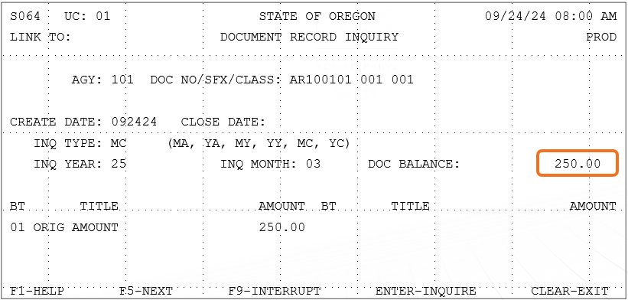
Example 2: GLs & COBJs to Use
We want to reduce the invoice balance!
Amount due should be 225.00

Slide 25
Example 2: Finding a T-code
Step 2: Look at the 28B screen description!

Slide 26
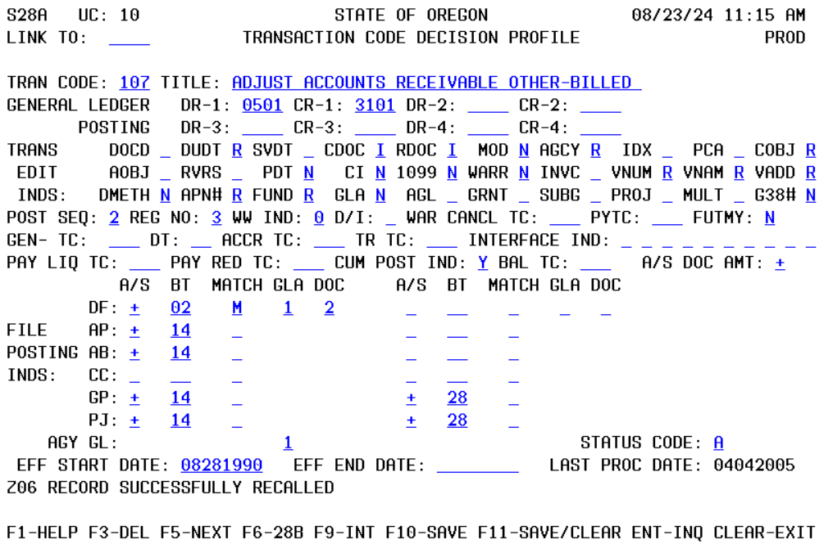
Example 2: Review the 28A Screen
The reverse field is blank, so a reversal is optional for this T-code.
This T-code requires a Reference Document (RDOC) to be entered.
We need to enter the original AR document number so all activity for invoice AR100101 can be tracked on the 64 screen.

Slide 27
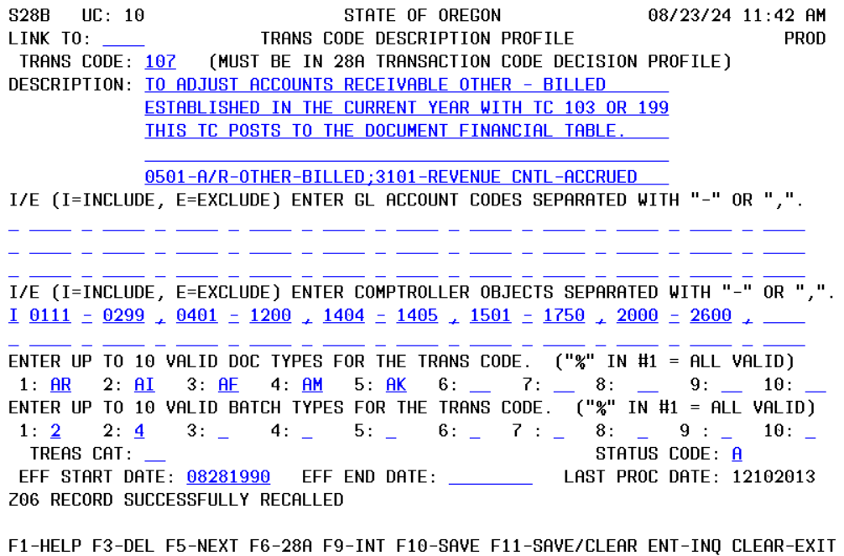
Example 2: Review the 28B Screen
The description of this T-code helps to confirm this T-code

Slide 28
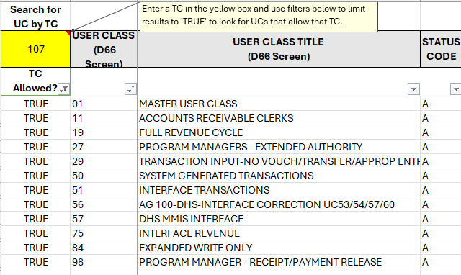
Example 2: User Class
Step 3: Identify the right User Class

Slide 29
Example 2: Making the Entry
Use the 28A and 28B screens to identify what information is required for your entry.
Make sure to enter an “R” in the reverse field.
Use a new current document number for this adjustment entry.
Enter the original receivable document number as the reference document number.

Slide 30
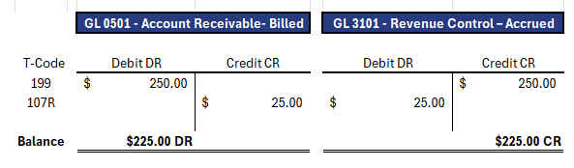
Example 2: End Results of Entry
T-code 107: Adjust Accounts Receivable
COBJ 0407 Other Charges for Services

Slide 31
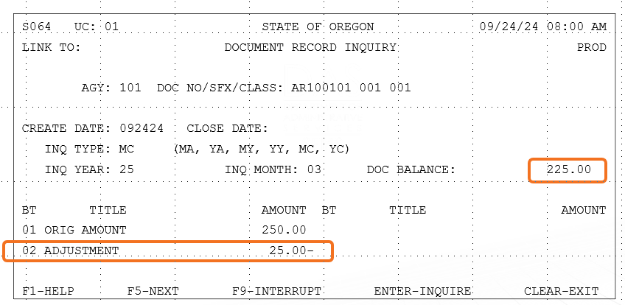
Example 2: 64 Screen Results

Slide 32
3

Slide 33
Example 3: Collect Accounts Receivable
Step 1: Identify the type of transaction you want to record.
Step 2: Use research tools to narrow down possible Transaction Code options.
Step 3: Pick the Transaction Code that is the best fit for your transaction.
Step 4: Make sure you have all required coding and the correct User Class to make the entry.
      GL Accounts
      Comptroller Objects
      T-codes & User Classes

Slide 34
Example 3: GLs & COBJs to Use
What GLs to Use?
This is a payment on an existing invoice.
Reverse the original entry to clear A/R and accrued revenue.
Record the deposit.
What COBJ to Use?
Use the same COBJ to record the collection.

Slide 35
Example 3: Finding a T-code
What T-code to Use?
Use 28B

Slide 36
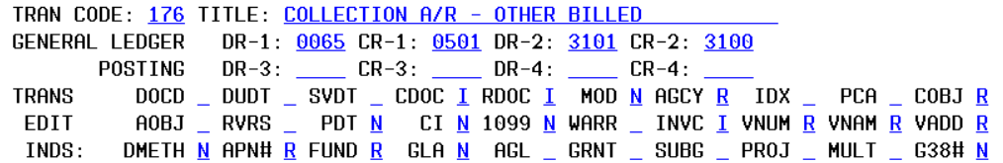
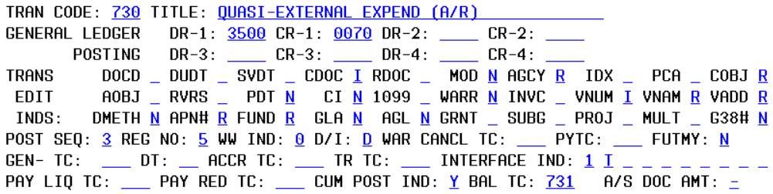
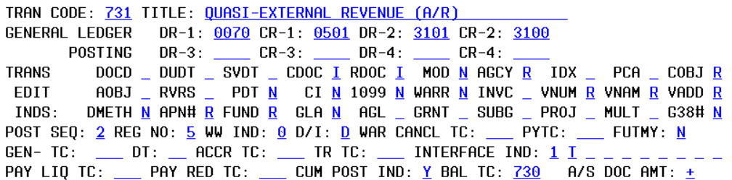
Example 3: Review the 28A Screen
T-code 730 & T-code 731
are balanced transfer T-codes.

Slide 37
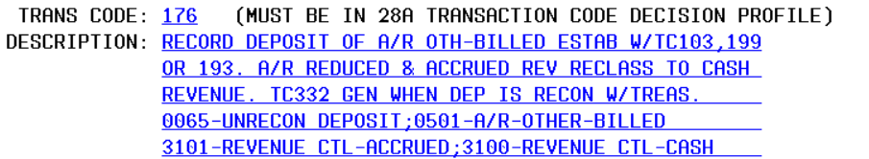
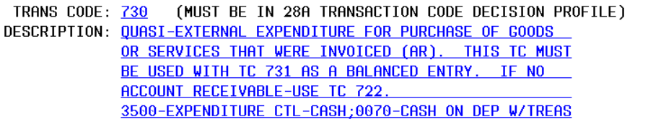
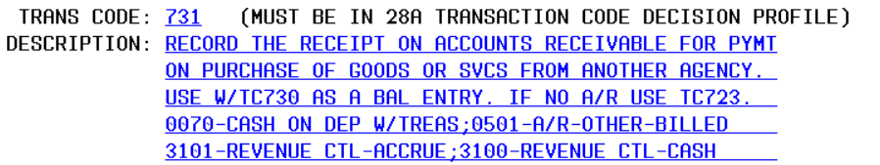
Example 3: Review the 28B Screen
T-codes 730 & 731 must
be used together

Slide 38
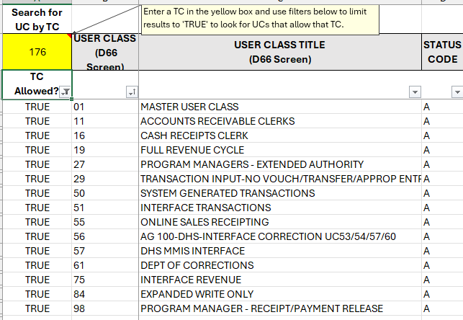
Example 3: Required Fields & User Class
we want to record this
Transaction with
TC 176 and COBJ 0407.
We also need to find
a User Class that
allows T-code 176.

Slide 39
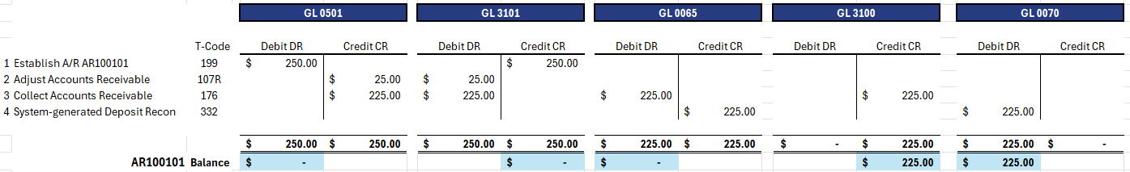
Example 3: End Results of Entry
Note: Whenever a deposit on the 13 screen reconciles with treasury, the system generates TC 332. The agency cannot spend money that sits in GL 0065, only what sits in GL 0070.

Slide 40
Example 3: 64 Screen Results
S064 UC: 01 STATE OF OREGON 09/24/24 08:00 AM
LINK TO: DOCUMENT RECORD INQUIRY PROD
AGY: 101 DOC NO/SFX/CLASS: AR100101 001 001
CREATE DATE: 092424 CLOSE DATE:
INQ TYPE: MC (MA, YA, MY, YY, MC, YC)
INQ YEAR: 25 INQ MONTH: 03 DOC BALANCE: .00
BT TITLE AMOUNT BT TITLE AMOUNT
01 ORIG AMOUNT 250.00
02 ADJUSTMENT 25.00-
03 LIQUIDATIONS 225.00
04 PYMT/COLLECTIONS 225.00
F1-HELP F5-NEXT F9-INTERRUPT ENTER-INQUIRE CLEAR-EXIT

Slide 41
4

Slide 42
Example 4: Adjust Collection Entry
Step 1: Identify the type of transaction you want to record.
What General Ledger (GL) accounts do we want to use for this transaction?
Oregon Accounting Manual 60.10.00
What Comptroller Object (COBJ) do we want to use for this transaction?
Oregon Accounting Manual 60.30.00

Slide 43
Example 4: GLs & COBJs to Use
We applied the payment to the wrong invoice.
Back out the impacts of TC 176.
Enter a T-code 176R – It depends whether this deposit has already reconciled on the 13 screen.
  If deposit is still unreconciled, use T-code 176R and T-code 176.

Slide 44
Example 4: Finding a T-code
For this example, assume the deposit reconciled and the cash is currently sitting in GL 0070.
Step 2: Use research tools to narrow down possible Transaction Code options.

Slide 45
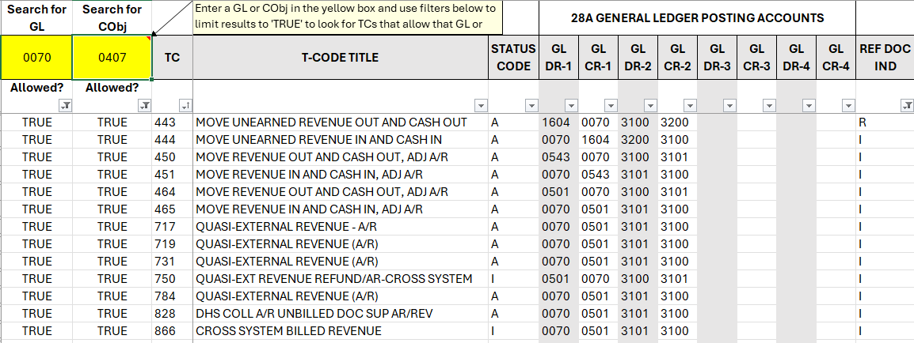
Example 4: T-codes to Review

Slide 46
Example 4: Narrow Down T-codes

Slide 47
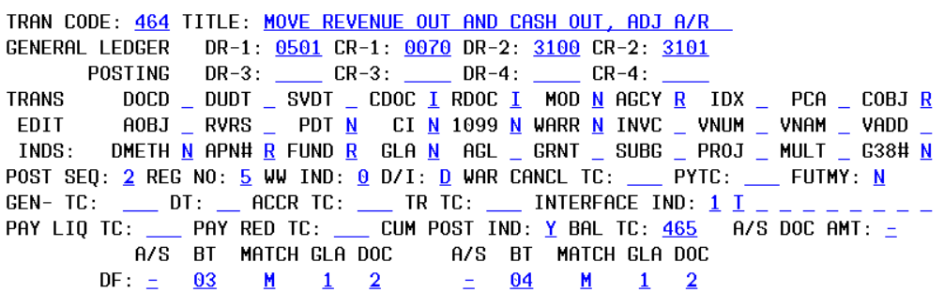
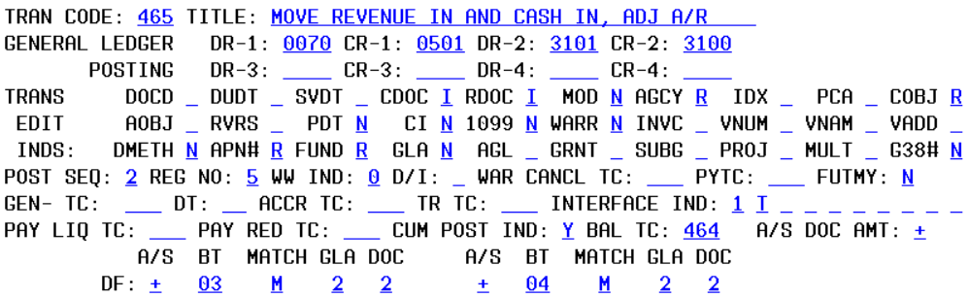
Example 4: Review the 28A Screen
BT T-codes must be entered together in a batch and the document amount for the entry will always net to zero.

Slide 48
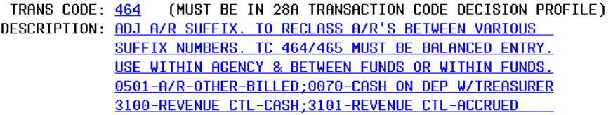
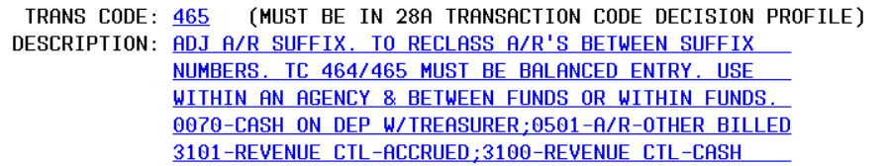
Example 4: Review the 28B Screen
The descriptions mention
that these can be used to
reclass A/Rs between
suffix numbers.

Slide 49
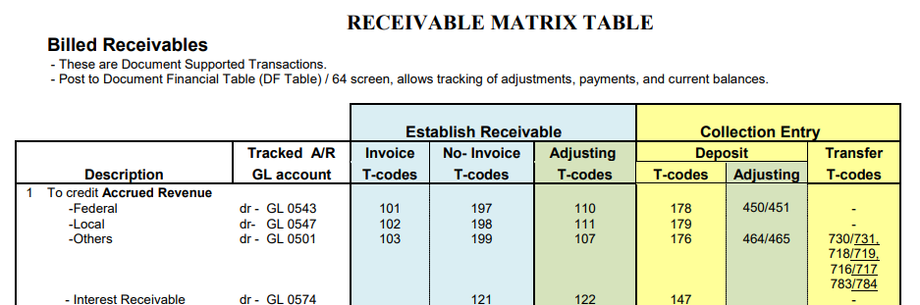
Example 4: Other T-code Tools
Receivable T-code Decision Process is available on the SFMS website to help you find T-codes.
Source: Receivable T-code Decision Process (see page 2).

Slide 50
Example 4: Making the Entry
Step 4: Make sure you have all required coding and the correct User Class to make the entry.
T-code 464 will back out the impacts of the T-code 176 entry that reconciled on the 13 screen.
T-code 465 will then repost this transaction.
Enter T-code 464 & 465 in the same batch using the same BT document number. The BT document amount will be zero.

Slide 51
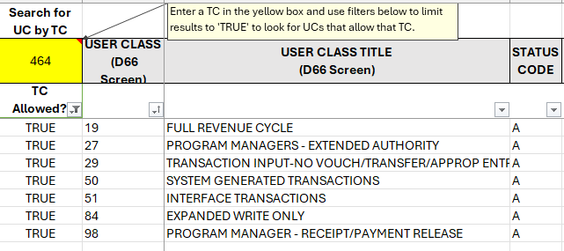
Example 4: User Class for Entry

Slide 52
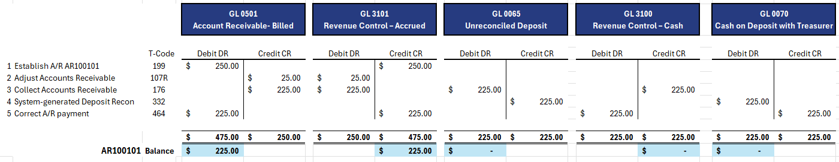
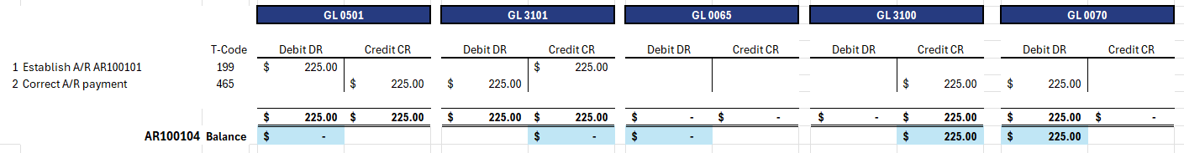
Example 4: End Results of Entry

Slide 53
Example 4: 64 Screen Results
S064 UC: 01 STATE OF OREGON 09/24/24 08:00 AM
LINK TO: DOCUMENT RECORD INQUIRY PROD
AGY: 101 DOC NO/SFX/CLASS: AR100101 001 001
CREATE DATE: 092424 CLOSE DATE:
INQ TYPE: MC (MA, YA, MY, YY, MC, YC)
INQ YEAR: 25 INQ MONTH: 03 DOC BALANCE: 225.00
BT TITLE AMOUNT BT TITLE AMOUNT
01 ORIG AMOUNT 250.00
02 ADJUSTMENT 25.00-
F1-HELP F5-NEXT F9-INTERRUPT ENTER-INQUIRE CLEAR-EXIT
S064 UC: 01 STATE OF OREGON 09/24/24 08:00 AM
LINK TO: DOCUMENT RECORD INQUIRY PROD
AGY: 101 DOC NO/SFX/CLASS: AR100104 001 001
CREATE DATE: 092424 CLOSE DATE:
INQ TYPE: MC (MA, YA, MY, YY, MC, YC)
INQ YEAR: 25 INQ MONTH: 03 DOC BALANCE: .00
BT TITLE AMOUNT BT TITLE AMOUNT
01 ORIG AMOUNT 225.00
03 LIQUIDATIONS 225.00
04 PYMT/COLLECTIONS 225.00
F1-HELP F5-NEXT F9-INTERRUPT ENTER-INQUIRE CLEAR-EXIT

Slide 54



Thank you
Maria.J.Berglund@das.Oregon.gov
971-900-9768

