Slide 1
Deposits
Scott Wood
09/23/2026
Department of Administrative Services

Slide 2
Agenda
Deposit Transactions
Record Agency Revenue
Record Unidentified Receipts
Correct Unidentified Receipts
Record Treasury Fees

Slide 3
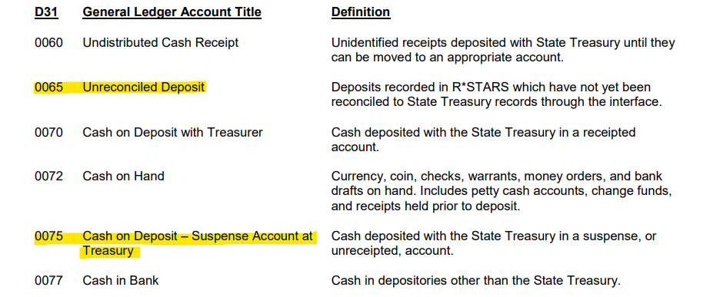
Deposit Transactions
Identify deposit type:
  Receipted Accounts use GL 0065
  Suspense Accounts use GL 0075
Note: Suspense Accounts are rare

Slide 4
Purpose of Cash Receipts
Record Revenue Earned
Record Refund Expenditure
Collect on Agency Receivable
Record Deposit Liability

Slide 5
Purpose of Cash Receipts (Continued)
Record Unearned Revenue
Record Receipt of Investment Funds
Reduce Electronic Fund Transfers (EFT) Cash Balance
Record Treasury Fees

Slide 6
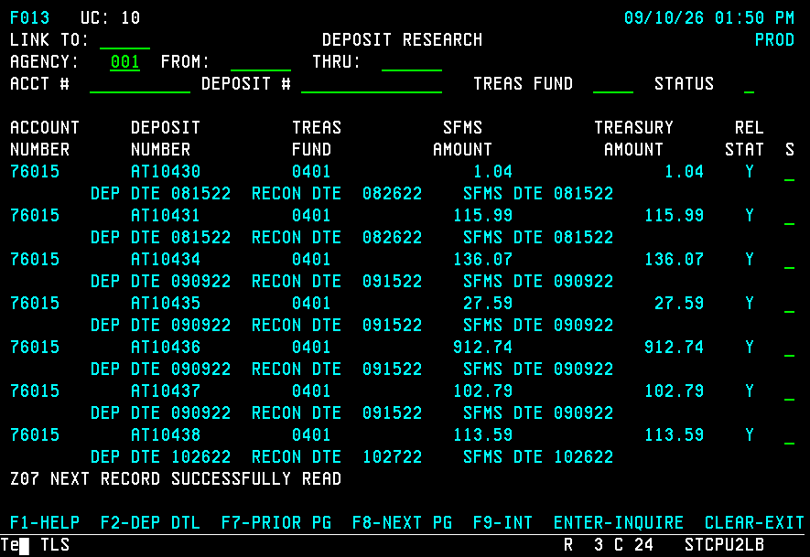
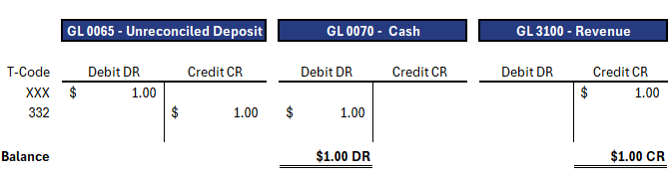
Example 1: Record Agency Revenue
Activity on 13 screen
  Record against GL 0065
  TC 332 moves GL 0065 to GL0070
Fees charged are considered revenue
  Credit GL 3100 to increase revenue

Slide 7
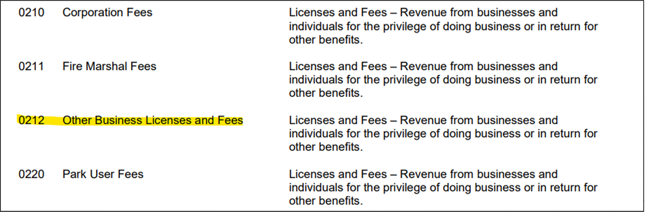
Example 1: COBJ to Use
Pick the best COBJ
  OAM 60.30.00
  0212 Other Business Licenses and Fees
    Best for general use

Slide 8
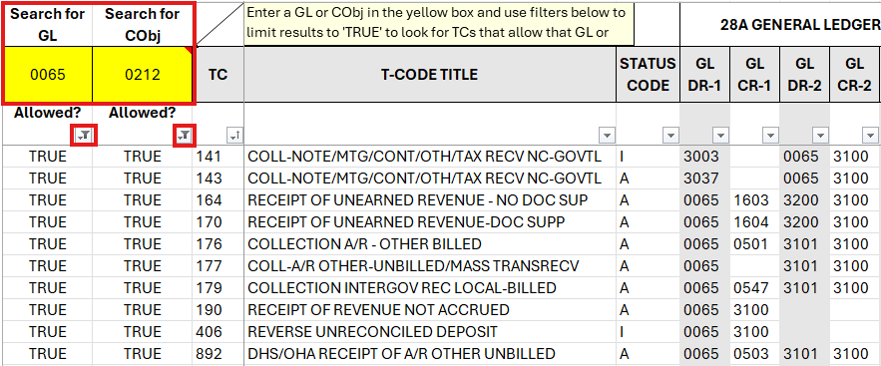
Example 1: Using the Spreadsheet

Slide 9
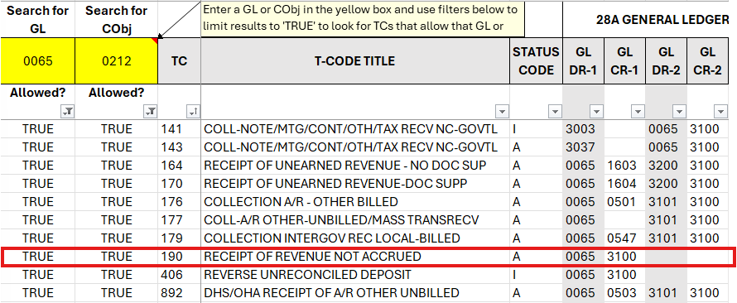
Example 1: Pick the Best T-code
Two things to consider
  Inactive status code
  Additional GL impacted

Slide 10
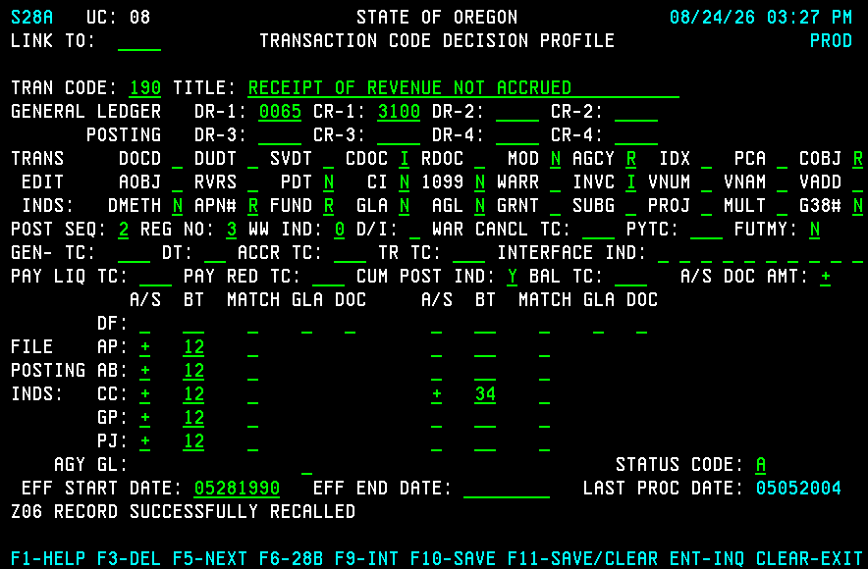
Example 1: Review the 28A Screen
Look up TC used
  Check title
  Check indicators

Slide 11
Example 1: 28A Screen Indicators
I = Input Required
R = Required
N = Not Allowed
Blank = Optional

Slide 12
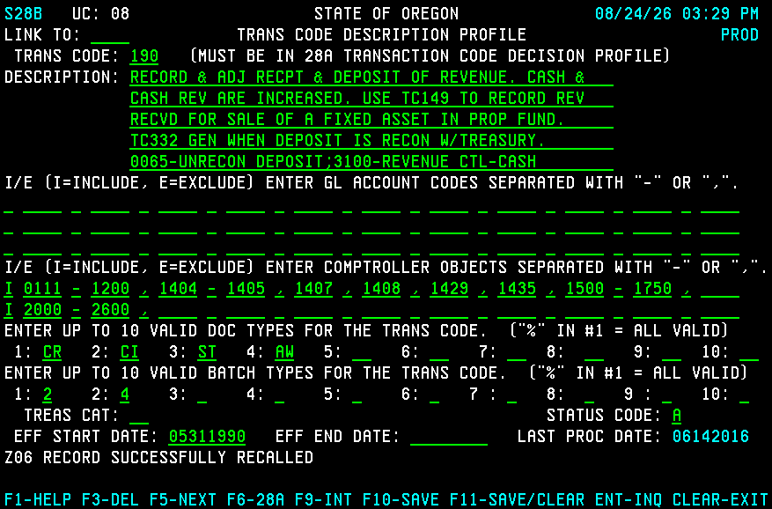
Example 1: 28B Screen
Press F6 from 28A
Describes T-code
Shows
  Valid Document Types
  Valid Batch Types

Slide 13
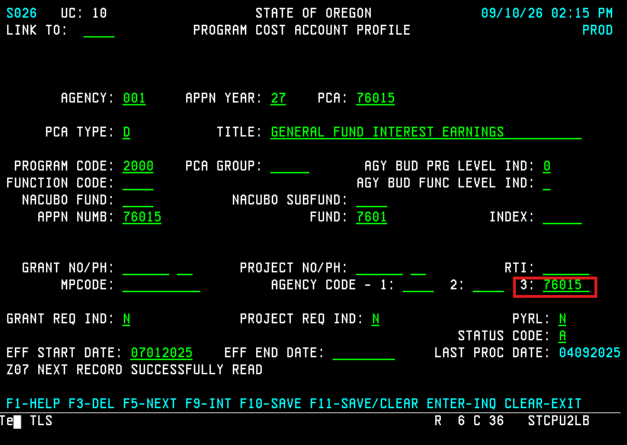
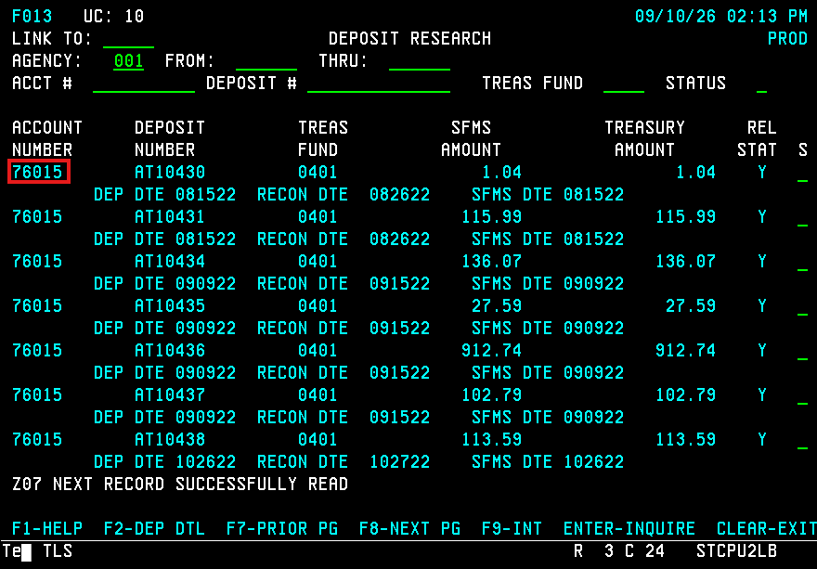
Example 1: Making the Entry
Check coding and User Class
Use 28A and 28B screens
For Deposits
  Enter Deposit Number
  And Agency Code 3

Slide 14
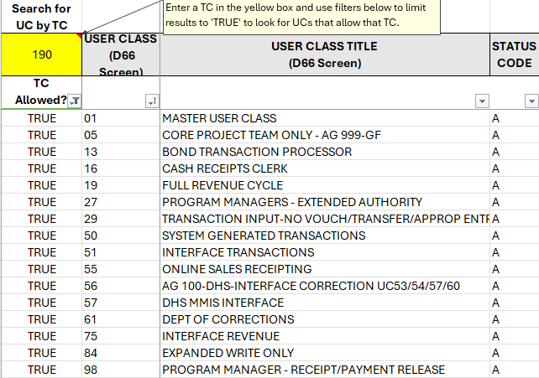
Example 1: User Class for Entry
Use TC Spreadsheet
  Filter by T-code 190
  Compare User Class results
  Check which you have

Slide 15
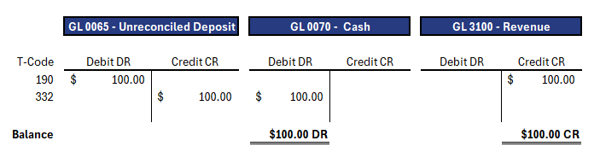
Example 1: End Results of Entry

Slide 16
Example 2: Record Unidentified Receipt
Identify the following:
  Type of transaction
  General Ledger accounts to use
  Comptroller Objects to use

Slide 17
Example 2: GL Accounts and COBJ to Use
Record against GL 0065
Automatic reconciliation with TC 332
Need to figure out
  Deposit Purpose
  Comptroller Object

Slide 18
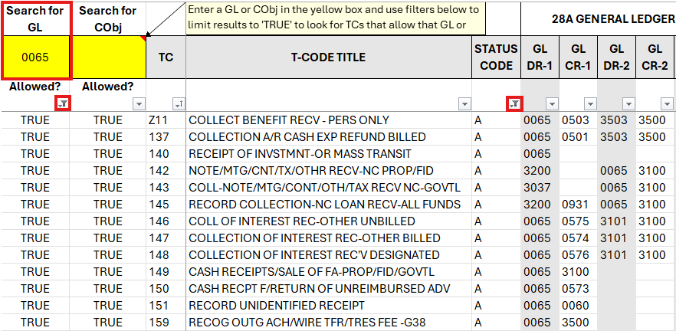
Example 2: Finding a T-code
Use the spreadsheet:
Filter by GL 0065
Filter by active status
Check titles

Slide 19
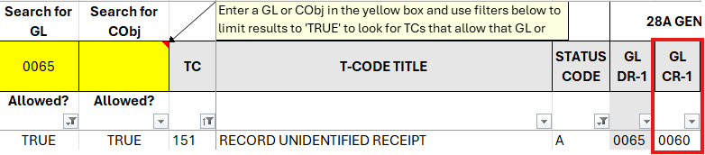
Example 2: Pick the best T-code
Double check other GL
Check OAM (60.10.00) for GL

Slide 20
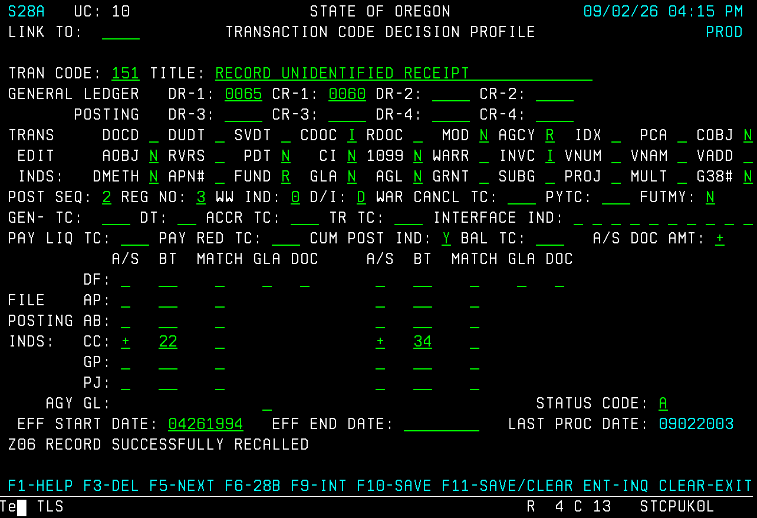
Example 2: Review 28A Screen
Review 28A screen
COBJ = N
No need for a COBJ

Slide 21
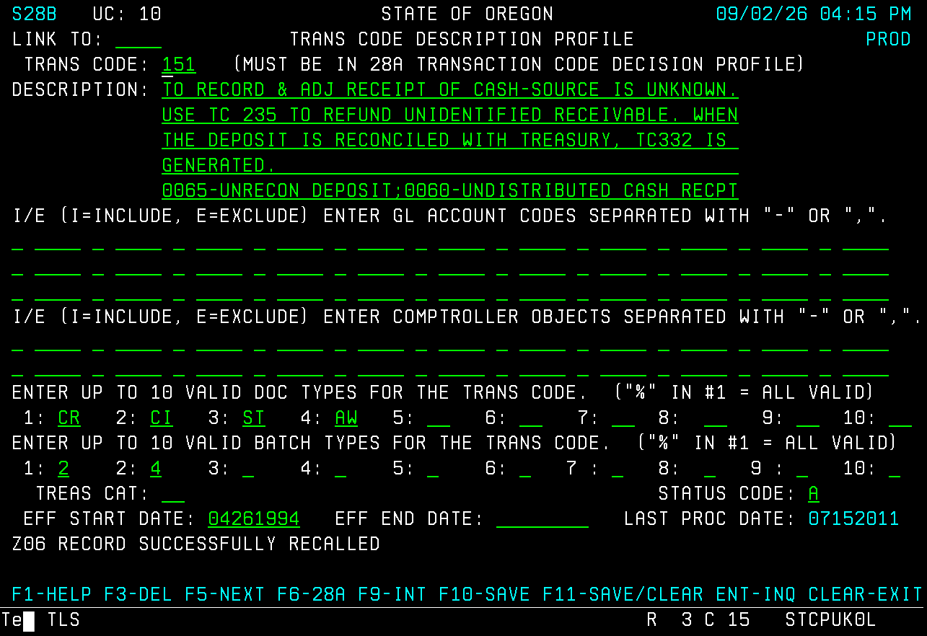
Example 2: Review 28B screen
Review 28B screen
Review title
  Cash-source is unknown
Check other T-codes

Slide 22
Example 2: Making the Entry
Check coding and User Class
Use 28A and 28B screens
For Deposits
  Enter Deposit number
  And Agency Code 3

Slide 23
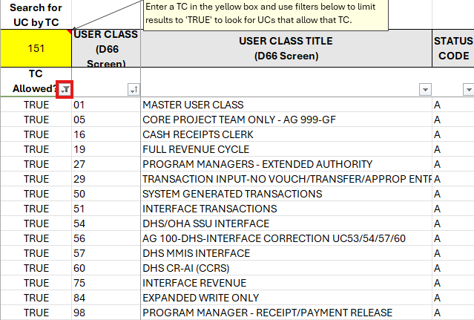
Example 2: User Class for the Entry
Use TC Spreadsheet
  Filter by T-code 151
  Compare User Class results
  Check which you have

Slide 24
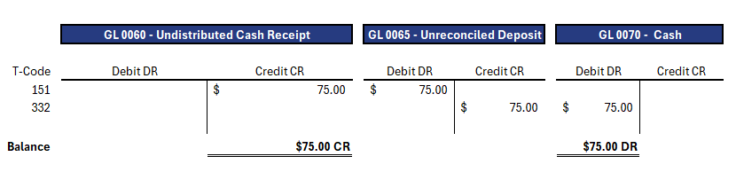
Example 2: End Results of Entry

Slide 25
Example 3: Correct Unidentified Receipt
Identify the following:
  The type of transaction
  General Ledger accounts to use
  Comptroller Objects to use

Slide 26
Example 3: GL Accounts to Use
Check if deposit has reconciled
Current Credit balance in GL 0060 Fund A
We need to move
  Debit GL 0060 Fund A
  Credit GL 3100 Fund B

Slide 27
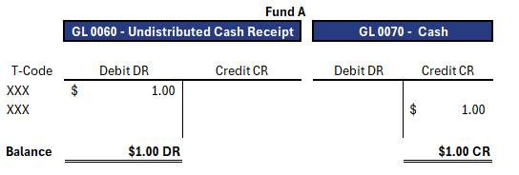
Example 3: Finding a T-code
Fund A
  Debit GL 0060
  Credit GL 0070
  No COBJ required

Slide 28
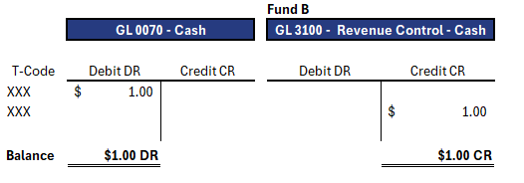
Example 3: Finding a T-code Part 2
Fund B
  Debit GL 0070
  Credit GL 3100
  COBJ 0212

Slide 29
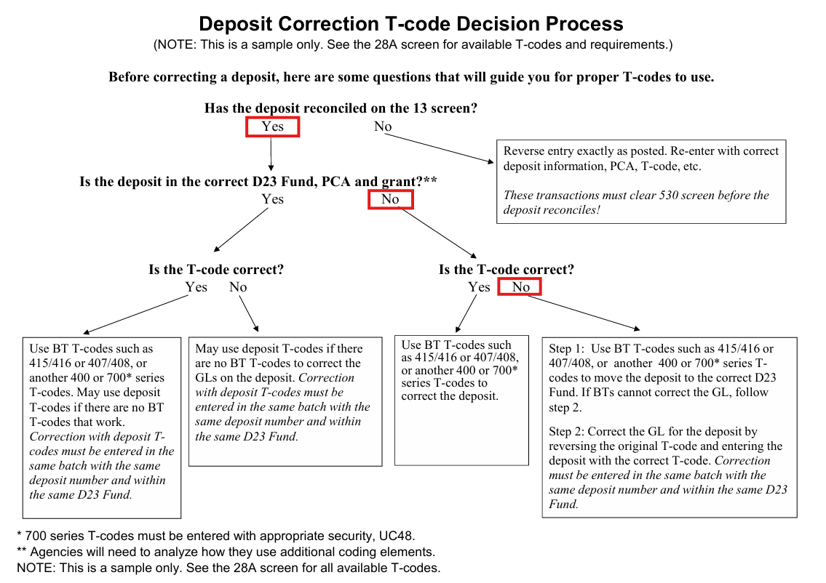
Example 3:Deposit Correction
Refer to Decision Tree
  Narrow down steps needed
T-code Decision Process Link

Slide 30
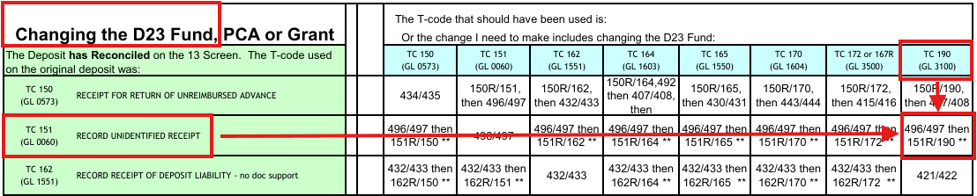
Example 3: Deposit Correction Matrix

Slide 31
Example 3: Pick T-codes and User Class
From our Matrix:
  T-codes 496 and 497
    To move Fund activity
  T-codes 151R and 190
    Correct GL and COBJ
UC 29

Slide 32
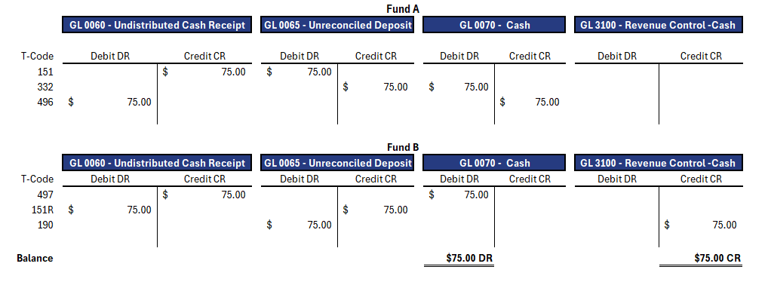
Example 3: End Results of Entry

Slide 33
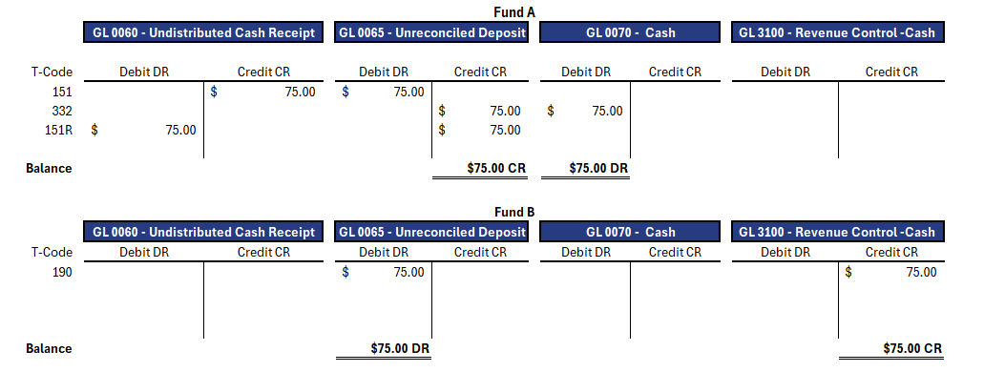
Example 3: Can’t we just use 151R and 190?

Slide 34
Example 4: Record Treasury Fees
Identify type of transaction
Narrow down T-code options
Pick the best T-code
Double check coding and UC

Slide 35
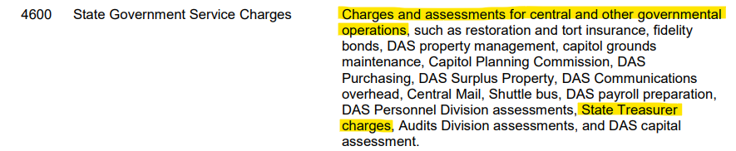
Example 4: GLs and COBJ to Use
Credit GL 0065
Debit GL 3500
COBJ 4600
OAM 60.30.00

Slide 36
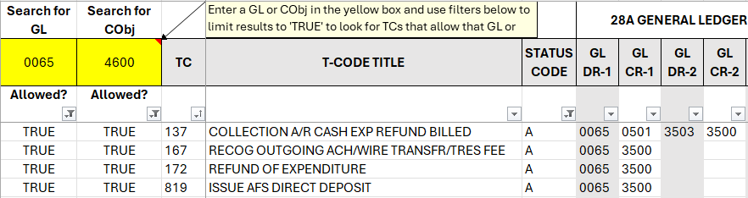
Example 4: T-codes to Review
Filter by
  Active status
  GL 0065
  COBJ 4600

Slide 37
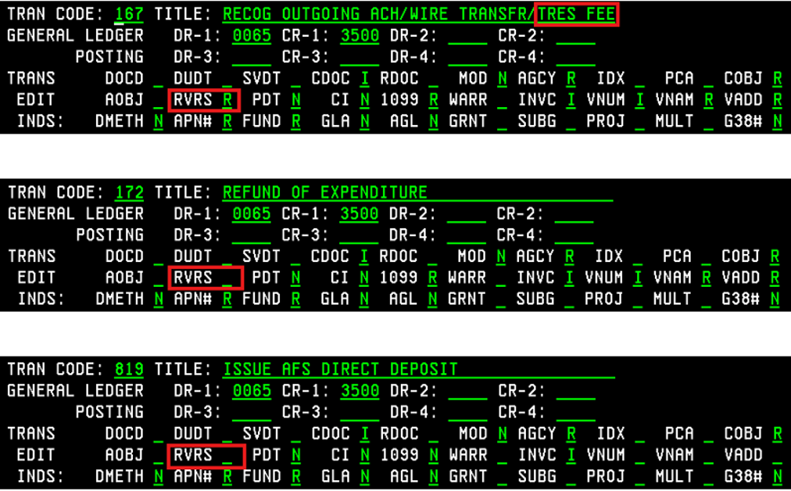
Example 4: Review 28A screens
T-code 167
T-code 172
T-code 819
Which ones allow reversal?

Slide 38
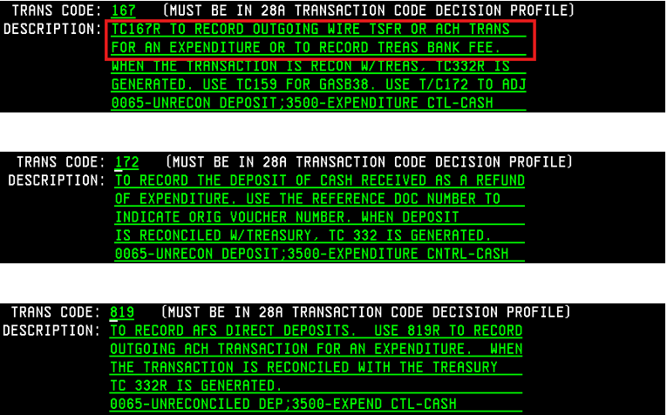
Example 4: Review 28B screens
Review T-code Descriptions
Confirm appropriate UC
Find the best fit
  T-code 167R seems right

Slide 39
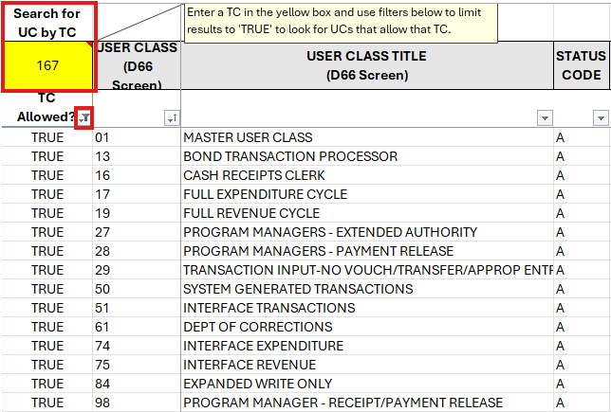
Example 4: Required Fields and User Class

Slide 40
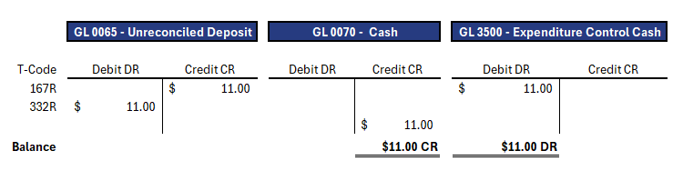
Example 4: End Results of Entry

Slide 41
Scott Wood
SFMS Analyst
971-718-2861
Scott.Wood@das.Oregon.gov

Slide 42

Questions?

