Slide 1
Transaction Code Basic Training
Statewide Financial Management Services
September 9 & 23, 2026
Department of Administrative Services

Slide 2
Agenda
General Information
Deposits
Accounts Receivable
Accounts Payable

Slide 3
General Information
Presented by Liz Schultz

Slide 4

Transaction Codes
A 3-character code
Input with every transaction
Records debit and credit
Controls how transaction posts

Slide 5
Why R*STARS uses T-codes?
Simplifies transaction entry
Debits and credits balance
Standardize entry requirements

Slide 6
Selecting a T-code
Step 1
Step 2
Step 3
Step 4
Identify type of transaction
Use available research tools
Find the best fit
Identify entry requirements

Slide 7
Step 1: Identify Transaction Type
Revenue?
Expenditure?
Transfer?

Slide 8
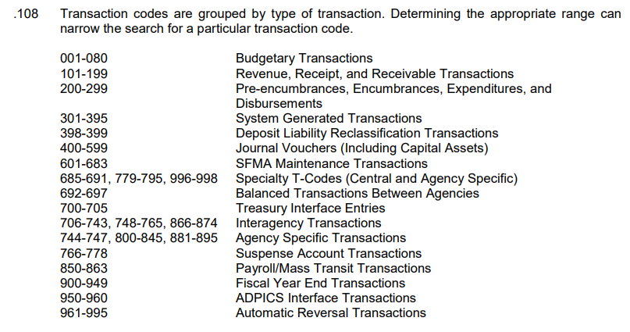
Oregon Accounting Manual 05.35.00

Slide 9
Step 1: General Ledger (GL) Accounts
Included on every T-code
Updates GL Account balances
Effects Balance Sheet – DAFR6620

Slide 10
GL Account
Resources
OAM 60.10.00 Definitions
SFMS Website GL List
R*STARS D31 Screen

Slide 11
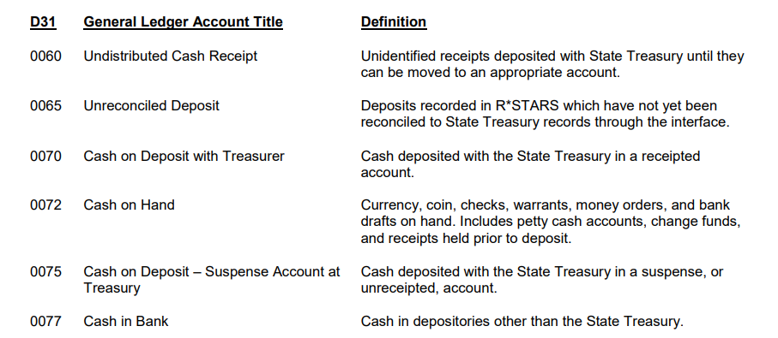
Oregon Accounting Manual 60.10.00

Slide 12
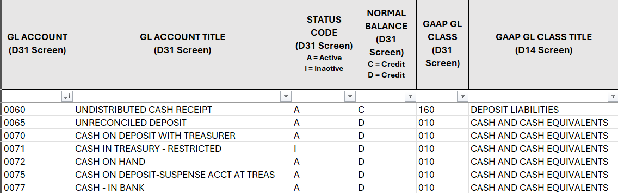
SFMS Website GL List

Slide 13
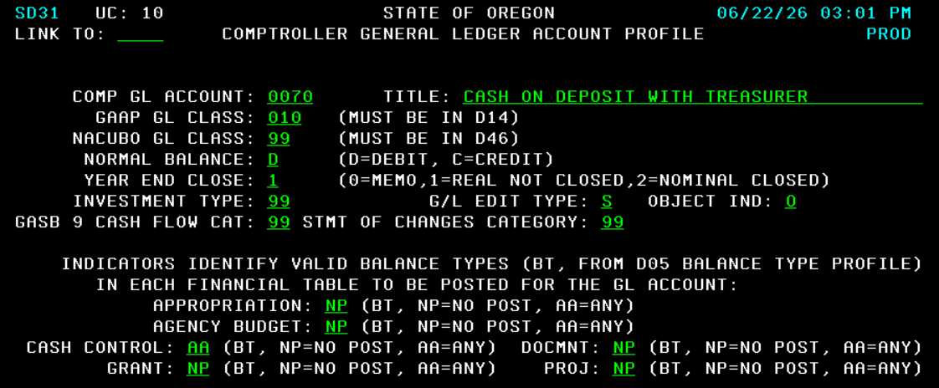
R*STARS D31 Profile

Slide 14
Step 1: Comptroller Objects (COBJ)
Required for many T-codes
Classifies revenue, expenditures & transfers
Effects Operating Statement – DAFR6610

Slide 15
Comptroller Object
Resources
OAM 60.30.00 Definitions
SFMS Website COBJ List
R*STARS D10 Screen

Slide 16
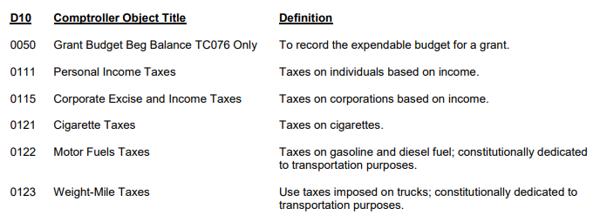
Oregon Accounting Manual 60.30.00

Slide 17
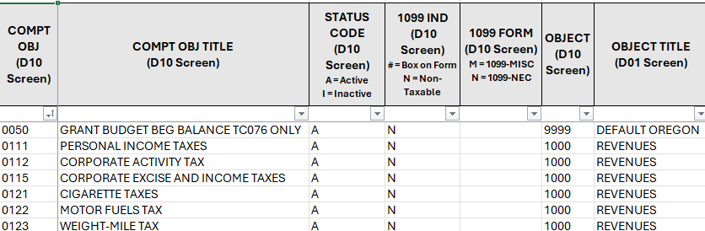
SFMS Website COBJ List

Slide 18
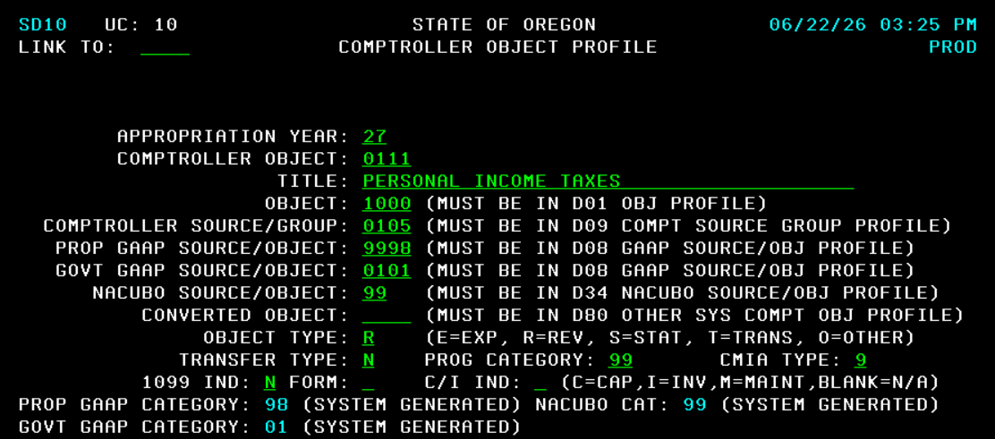
R*STARS D10 Profile

Slide 19
GL Accounts & COBJs
GL Accounts
DAFR6620
COBJ
DAFR6610
Included on every T-code
T-code shows each GL Account to debit and credit
Balance Sheet
Displays cumulative balances by GL Account
T-codes that use specific GL Accounts
GL Accounts that begin with
31, 32, 35 or 36
Operating Statement
Displays current year revenue, expenditure & transfers by COBJ

Slide 20
Step 2: Use Research Tools
Which GL Accounts?
Is Comptroller Object needed?
Find T-code options

Slide 21
T-code
Resources
SFMS T-code Spreadsheet
Use T-charts
R*STARS 28A & B Screens

Slide 22
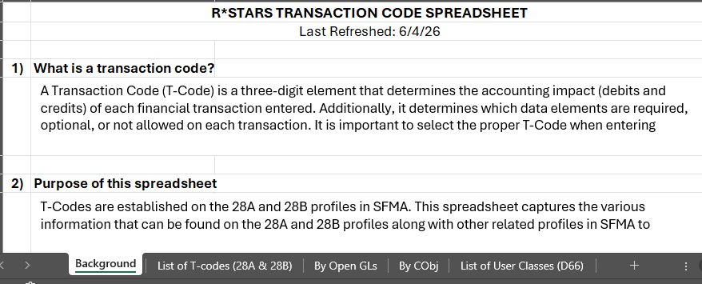
SFMS T-code Spreadsheet

Slide 23
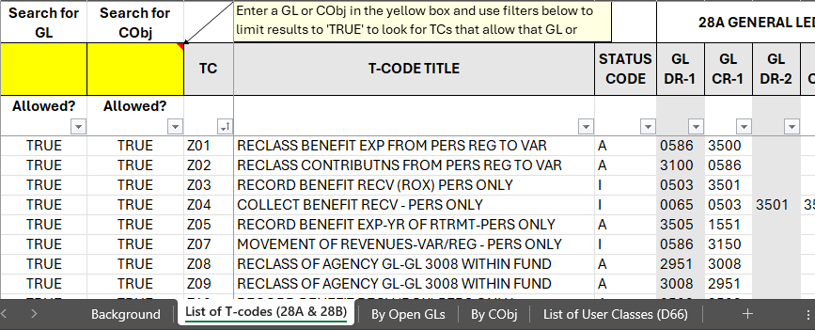
Lists all T-codes

Slide 24
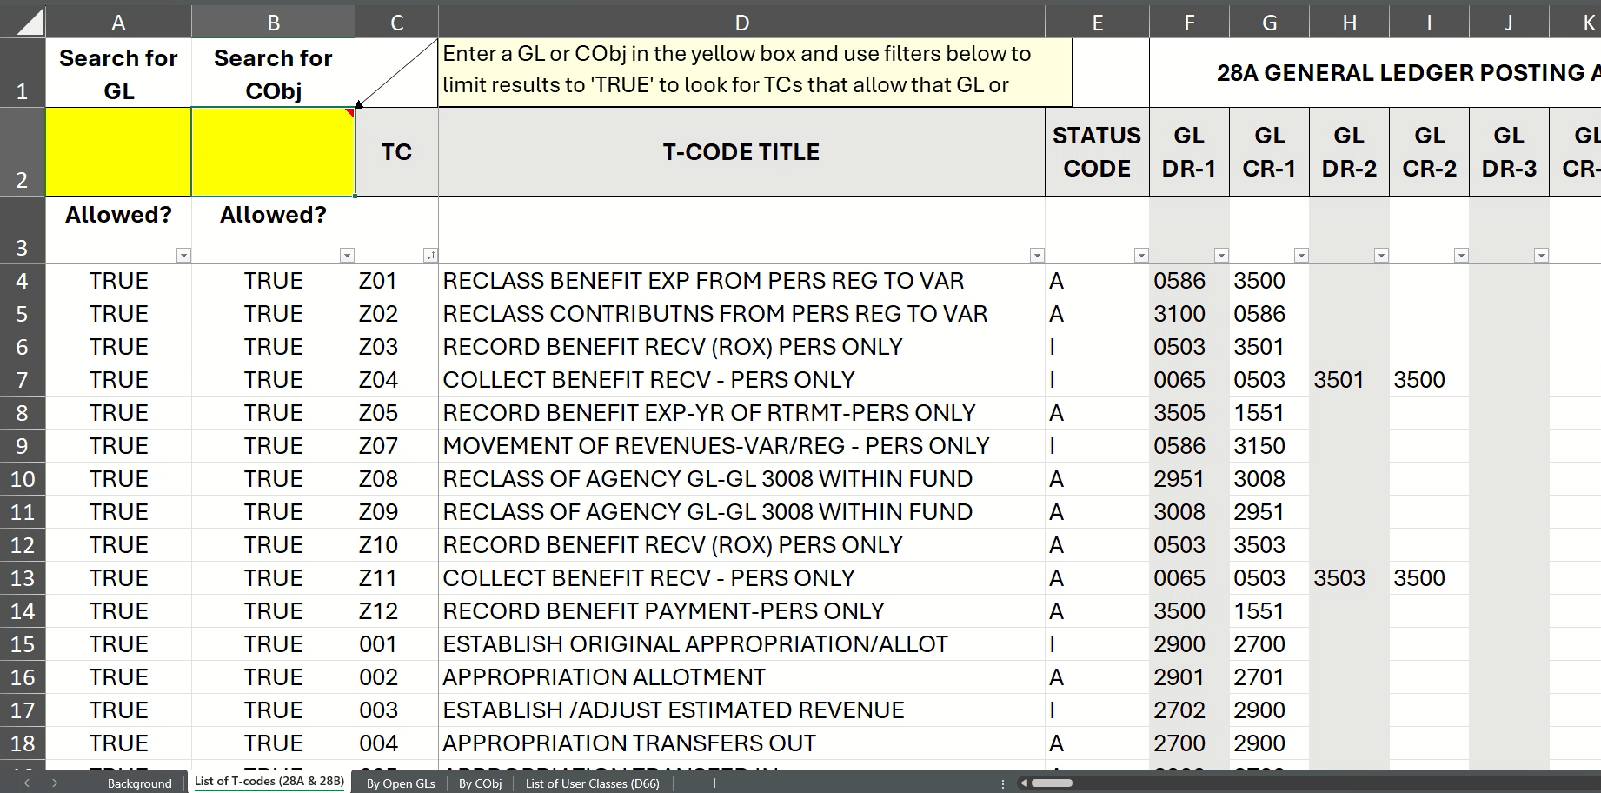
How to Search – List of T-codes

Slide 25

T-charts
Useful to outline entries.
GL Accounts to debit & credit.
Include all associated entries.
Confirm totals are as expected.

Slide 26
T-chart Tips
GL Accounts
T-codes
Other Entries
D31 Profile
T-code shows each GL Account to debit and credit.
Using T-code with “R” will reverse debit and credit impact
T-code profile shows if system generates another entry.
Shows if GL Account normally has debit or credit balance.

Slide 27
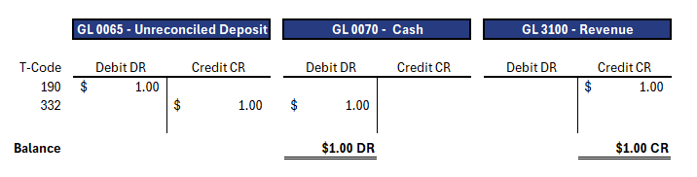
T-chart Example
T-code 190 - Record cash receipt.
T-code 332 - System-generated when deposit reconciles.

Slide 28
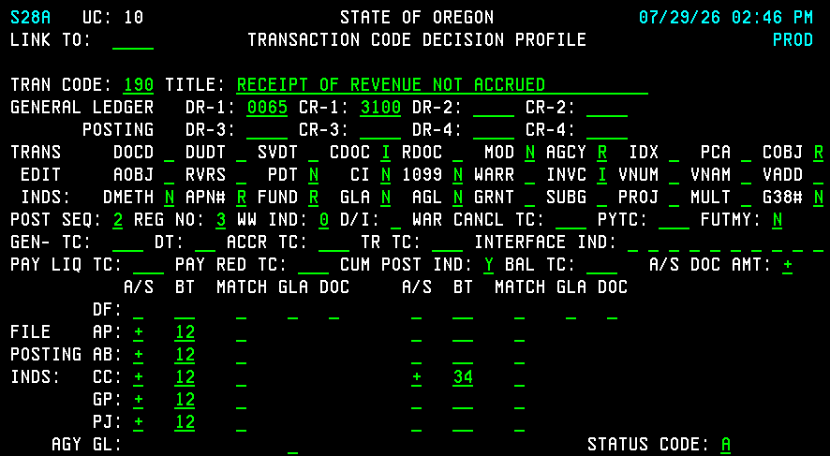
R*STARS 28A Profile

Slide 29
28A – General Ledger Posting

Slide 30
28A – Transaction Edit Indicators

Slide 31
28A – Special Indicators

Slide 32
28A – File Posting Indicators

Slide 33
R*STARS Transaction Posting
Accounting Event
(86 & 84 screen)
Agency Budget
(61 screen)
General Ledger
(65 & 89 screen)
Financial Tables
Cash Control
(63 screen)
Document Financial (64 screen)
Grant Financial
(66 screen)
Appropriation
(62 screen)
Project Financial
(80 screen)

Slide 34
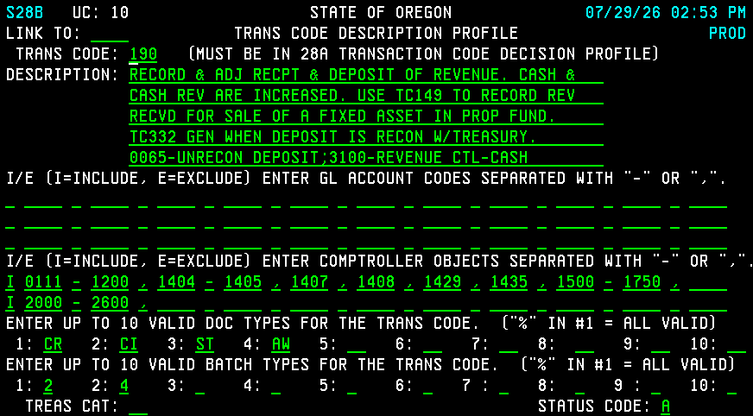
R*STARS 28B Profile

Slide 35
28B - Description

Slide 36
28B –General Ledger Accounts

Slide 37
28B – Comptroller Objects

Slide 38
28B – Document & Batch Type

Slide 39
Step 3: Find Best Fit
One T-code option?
Multiple T-code options?
No T-code options?

Slide 40
One T-code Option?
Confirm T-code is Active
T-code Title on 28A
T-code Description on 28B

Slide 41
Multiple
T-code Options?
Confirm T-codes are Active
T-code Title & Descriptions
Compare Differences

Slide 42
No T-code Options?
Check your Understanding
Consider Multiple Entries
Ask for Assistance

Slide 43
Step 4: Identify Entry Requirements
Required Fields
Document and Batch Type
User Class

Slide 44
Required Fields
Look at 28A Indicators
What fields are required?
Any optional fields to add?

Slide 45
Document & Batch Type
Look at 28B screen
Document Prefix to Use
Available Batch Types

Slide 46
User Class
What User Class Needed?
T-code Spreadsheet
R*STARS D66 Profile

Slide 47
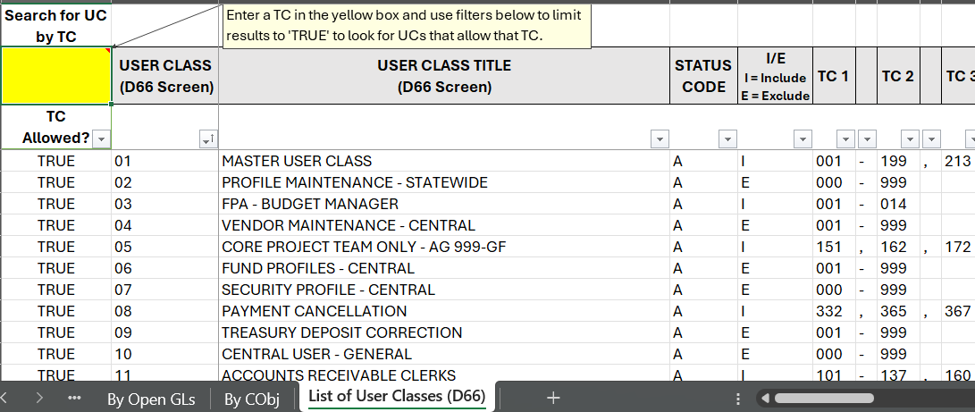
List of User Classes

Slide 48
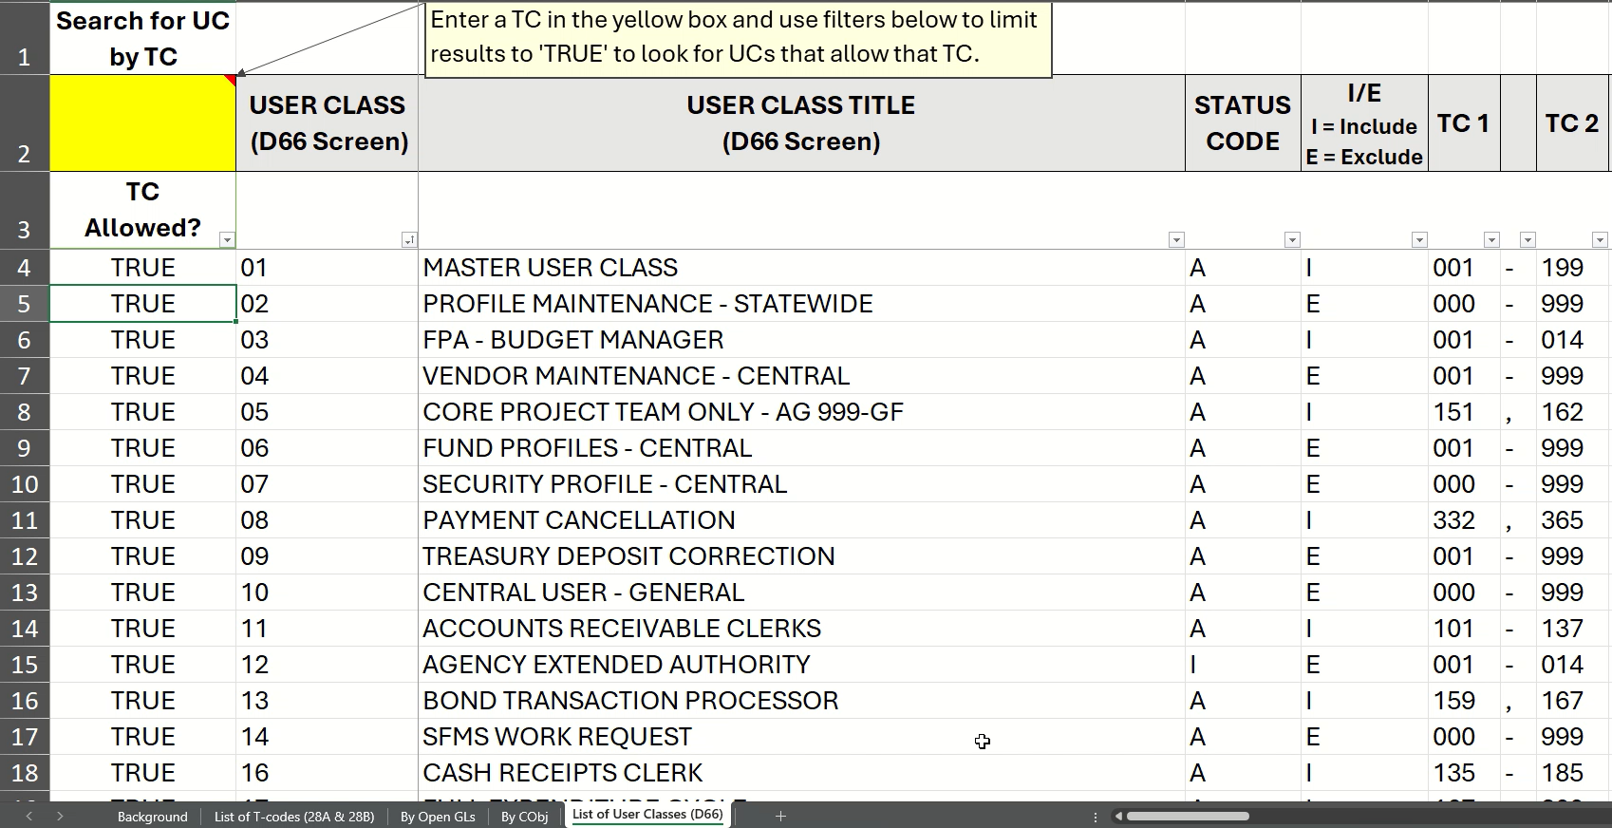
How to Search – List of User Classes

Slide 49
Contact Information
Liz Schultz
SFMS Senior Operations Analyst
(971) 900-7616
elizabeth.schultz@das.oregon.gov

Slide 50
Questions?

