Slide 1

SARS Year-end Close Training
June 14, 2018
Employment Auditorium
8:30 a.m. – 11:30 a.m.

Slide 2
Agenda
What’s New and What’s Coming from SARS – Rob Hamilton
GASB 75 Accounting and Financial Reporting for Postemployment Benefits Other Than Pensions – Shri Vajratkar
GASB 84 Fiduciary Activities – Barbara Homewood
GASB 86 Certain Debt Extinguishment Issues – Sangit Shrestha
GASB 87 Leases – Rob Hamilton
Year-end Schedule – Barb Watson
Disclosure of Restricted Assets – Michael Cutler
Changes to Disclosures – Karen Williams and Sangit Shrestha
Federal Funds Participation (FFP) Reporting – Barbara Homewood
Summary – Rob Hamilton

Slide 3
What’s new and what’s coming from sars
Presented by Rob Hamilton

Slide 4
Introductions
Key dates and deliverables
  GASB 68 information – ASAP
  GASB 75 information
    RHIA and RHIPA – July
    PEBB – late July/early August
  Compensated absences – July 20
  Securities lending and pension-related debt – July 27
  Communication with DPCUs about outstanding balances (OAM 15.51.00)
    First communication with DPCUs no later than July 20
    Second communication with DPCUs no later than August 9
      This is to provide late-arriving information or to change previously communicated amounts
  Resolve statewide balances issues with other state agencies by August 3, which is the soft close

Slide 5
Current Portion of Loans Receivable - **NEW**
  GL 0431 reports the current portion of the loan
  GL 0436 reports the allowance for the uncollectible portion of the current portion
  GL 0931 reports the noncurrent portion of the loan
  GL 0936 reports the allowance for the uncollectible portion of the noncurrent portion
  Tcodes 474 and 474R to reclassify the amounts from GLs 0931 and 0936 to 0431 and 0436, respectively.
  If you have a balance in GL 0931, our expectation will be that there is a balance in GL 0431

Slide 6
Noncurrent Accounts Receivable T-code - **NEW SUGGESTION**
  When a current A/R is assigned to DOR (or a PCF until 7/1/18), to maintain the account history, use TC 945 for the entire amount assigned to decrease current A/R and increase noncurrent A/R (OAM 15.35.00, paragraph 135).
    Month 13 FY 2018
      TC 945
      DR GL 3105 – Revenue Control F/S Accrual
      DR GL 0935 – Other Receivables – Noncurrent
      CR GL 0503 – A/R Unbilled
      CR GL 3037 – Nonspendable Fund Balance – Noncurrent Receivables
    Month 1 FY 2019
      TC 946 (Auto-reversal of TC 945)
      DR GL 0503 – A/R Unbilled
      DR GL 3037 – Nonspendable Fund Balance – Noncurrent Receivables
      CR GL 3105 – Revenue Control F/S Accrual
      CR GL 0935 – Other Receivables – Noncurrent
  OAM 15.35.00 will be updated to reflect this suggestion

Slide 7
Deferred Outflows for Contributions Subsequent to the Measurement Date
  Comptroller Object 3210 – Public Employees Retirement Contribution
  Comptroller Object 3215 – PERS Contribution – RHIA **New CO**
  Comptroller Object 3216 – PERS Contribution – RHIPA **New CO**
  **NEW PROCESS for agencies with ENTERPRISE and INTERNAL SERVICE funds**
    Pension:
      Record the GASB 68 information as instructed from SARS. Contributions subsequent to the measurement date (GL 1005) will be zeroed out. Comptroller object 3210 is not impacted.
      Record the pension-related debt entries as instructed by SARS, which will reclassify the amounts in comptroller object 3210 to interest expense and a reduction of the related liability.
      Use Tcode 457R to reclassify the entire amount remaining in comptroller object 3210 after step 2 to GL 1005.
    OPEB:
      Record the GASB 75 information as instructed by SARS. Contributions subsequent to the measurement date (GL 1010) will be zeroed out. Comptroller object 3215 and 3216 are not impacted
      Use Tcode 457R to reclassify the entire amount remaining in comptroller objects 3215 and 3216 to GL 1009.

Slide 8
GASB 81 Irrevocable Split-Interest Agreements
  Although there are irrevocable split-interest agreements with which state agencies are involved, the amounts are small and SARS has decided not to apply GASB 81 to the agreements.
  Beginning in FY 2019, a new agency disclosure will be included, in which N/A is not an option, to ensure that we have the information in case SARS does decide to apply GASB 81 to the agreements.

Slide 9
LFO Report on Liquidated and Delinquent Accounts Receivable – Allowance for Uncollectible Accounts
  Two new fields for uncollectible accounts receivable information will be added for FY 2018:
    Number of uncollectible accounts
    Balance of uncollectible receivables
      Determined the same way agencies do for CAFR reporting
  Balance in LFO Report should be equal to or less than what’s on the agency accounting records as not all accounts receivable are liquidated and delinquent
    Both sets of information are submitted to SARS for review
  May be an opportunity for agencies to reassess their allowance calculations for CAFR reporting, especially if their getting actual data.
  LFO report due annually on October 1

Slide 10
GASB 75
Presented by Shri Vajratkar

Slide 11
Retiree Health Insurance Account - RHIA
Cost-sharing, multiple-employer defined Benefit OPEB plan administered through a trust.
Plan is closed to new entrants hired on or after August 29, 2003.
Payment of up to $60 towards the monthly cost of health insurance for eligible members.
Contributions are actuarially determined as a percentage of payroll.
Net OPEB Asset.
Funds proportionate share of activity based on percentage of total contributions.
All proprietary funds and the GWRF will report their proportionate share of the Net OPEB Asset and activity.
Measurement Date June 30th 2017.
Beginning in FY18, all OPEB contributions will be deferred outflows for financial reporting purposes.

Slide 12
Retiree Health Insurance Premium Account - RHIPA
Single-employer defined Benefit OPEB plan administered through a trust.
Plan is closed to new entrants hired on or after August 29, 2003.
Pays the average difference between health insurance premiums paid by retirees and those paid by active state employees – only to those retirees who are not eligible for Medicare coverage.
Contributions are actuarially determined as a percentage of payroll.
Net OPEB Liability.
Funds share of activity based on percentage of total contributions.
All proprietary funds and the GWRF will report their share of the Net OPEB Liability and activity.
Measurement Date June 30th 2017.
Beginning in FY18, all OPEB contributions will be deferred outflows.

Slide 13
Public Employees Benefit Board - PEBB
Single-employer defined Benefit OPEB plan NOT administered through a trust.
No Employer Contributions – Pay as You Go Plan.
Implicit Rate Subsidy.
Total OPEB Liability.
Funds share of activity based on percentage of annual health insurance premium costs.
All proprietary funds and the GWRF will report their proportionate share of the Total OPEB Liability and activity.
Measurement Date June 30th 2018.
No deferred outflows for Contributions subsequent to measurement date.

Slide 14
New Accounts in SFMA
GLA | GL Title | GLA | GL Title
0968 | Net OPEB Asset | 1775 | Net OPEB Liability
1006 | D/O – OPEB Diff. in Econ Experience | 1857 | D/I – OPEB Diff. in Econ Experience
1007 | D/O – OPEB Diff. b/w Projected & Actual Earnings | 1858 | D/I – OPEB Diff. b/w Projected & Actual Earnings
1008 | D/O – OPEB Change in Assumptions | 1859 | D/I – OPEB Change in Assumptions
1009 | D/O – OPEB Change in Emp. Cont. & Prop. | 1860 | D/I – OPEB Change in Emp. Cont. & Prop.
1010 | D/O – OPEB Contribution After MD
Comp. Object 3215 - PERS Contribution – RHIA
Comp. Object 3216 - PERS Contribution – RHIPA
Comp. Object 3213 – OPEB Expense – GASB 75

Slide 15
Accounts to be used in FY 2018
RHIA | RHIPA | PEBB
Comptroller Object 3215 – PERS Contribution – RHIA | Comptroller Object 3216 – PERS Contribution – RHIPA | N/A
Net OPEB Asset – GL 0928 | Net OPEB Liability – GL 1775 | Total OPEB Liability – GL 1775*
D/I of Resources for Difference b/w Projected and Actual Earnings on Invst. – GL 1858 | D/I of Resources for Difference b/w Projected and Actual Earnings on Invst. – GL 1858 | N/A
D/O of Resources for Changes in Proportionate Share– GL 1009 | N/A | N/A
D/O of Resources for Contributions Subsequent to Measurement Date – GL 1010 | D/O of Resources for Contributions Subsequent to Measurement Date – GL 1010 | N/A

Slide 16
GASB 84
Presented by Barbara Homewood

Slide 17
Concept of GASB 84
Establishes criteria for identifying fiduciary activities and guidance on reporting those activities, including clarifying when stand-alone business-type activities should report fiduciary activities.
Effective July 1, 2019 (FY20)
Exposure Draft is due December 2018

Slide 18
Three types of fiduciary activities
  Fiduciary component units (paragraphs 6 – 9)
  Pension and OPEB arrangements that are NOT component units
  Other fiduciary (paragraph 11)
    BOTH of the following must be met:
      Government controls the assets (paragraph 12)
      Assets are NOT derived from fees, taxes, or investment earnings (para 11b)
      And….

Slide 19
In addition, one or more of the following:
  Assets administered through a trust (paragraph 11c1)
    Government itself is not a beneficiary
    Assets are dedicated to providing benefits to recipients under benefit terms
    Assets are legally protected from creditors of the government
  Beneficiaries are individuals and government has no administrative or direct financial involvement (11c2)
    Assets not derived by fees, taxes, and investment earnings
  Beneficiaries are organizations or other governments and the assets are not part of the financial reporting entity (11c3)
    Assets not derived by fees, taxes, and investment earnings

Slide 21
Four types of Fiduciary funds
  Pension and other employee benefit trust funds
  Investment trust funds
  Private-purpose trust funds
  Custodial funds

Slide 22
Private Purpose Trust Funds
  Fiduciary activities held in trust and are NOT required to be reported as pension, OPEB, or investment trust funds
    Assets administered through a trust
      Government itself is not a beneficiary
      Assets are dedicated to providing benefits to recipients under benefit terms
      Assets are legally protected from creditors of the government

Slide 23
Custodial Funds
  Report fiduciary activities not held in trust
  Agency funds will be known as custodial funds
  Will include an operating statement
    Revenue will be separately identified at gross level
      Source of inflow such as Restitution Payments Received
    Expenditures will be separately identified at gross level
      Type of outflow such as Distribution to Counties/Cities/ Individual, etc.

Slide 24
What Agencies Need To Do
Determine if an activity qualifies as fiduciary
  Use the flowchart
  Paragraphs 5 – 13 of statement
Determine which fiduciary fund is correct
  Review Private-Purpose Trust Funds
    Is there a trust? If not, then Custodial fund
Balances in Custodial Assets (GL’s 0335 and 0945)
Balances in Custodial Liabilities (GL’s 1575, 1576, 1577, 1578)

Slide 25
What Agencies Need To Do – cont.
Ensure profiles are capable of recording revenues and expenditures
Send Appropriation profile requests (20) to orbits.help@state.or.us
  Trust/Custodial fund subject to GASB 84
  Include authority to be non-budgeted
  Include the current D23 fund

Slide 26
OAM
More accounting guidance to follow in the OAM
KPMG training on July 12th
  www.kpmg.com/us/governmentinstitute

Slide 27

Questions?

Slide 28
GASB 86
Presented by Sangit Shrestha

Slide 29
Definitions
  Debt refunding: The State issues debt and uses the proceeds to repay previously issued debt.
  Current refunding: New debt used to redeem the existing debt within 90 days of issuance.
  Advanced refunding: Proceeds held by escrow for future payments.
    In-substance defeasance: Debt is considered defeased “in-substance” if all of the following conditions apply:
      The placement of the resources in escrow is irrevocable.
      Escrow resources can be used only for the scheduled debt service payments on the old debt.
      The possibility of the State having to make future payments on that debt is remote.
      All escrow resources are monetary and essentially risk-free.
      Cash flows approximately coincide as to timing and amount with scheduled debt service payments.

Slide 30
GASB 86 Certain Debt Extinguishment Issues
  Establishes accounting and financial reporting requirements for in-substance defeasance of debt using existing resources other than the proceeds of refunding debt.
  Include remaining prepaid insurance associated with debt that is extinguished in the net carrying amount of debt for purpose of calculating the gain or loss on refunding. This applies to all refundings.
  Substitution of essentially risk-free investments with not essentially risk-free investments in subsequent periods would reverse in-substance defeasance accounting.
  Effective FY 2018.

Slide 31
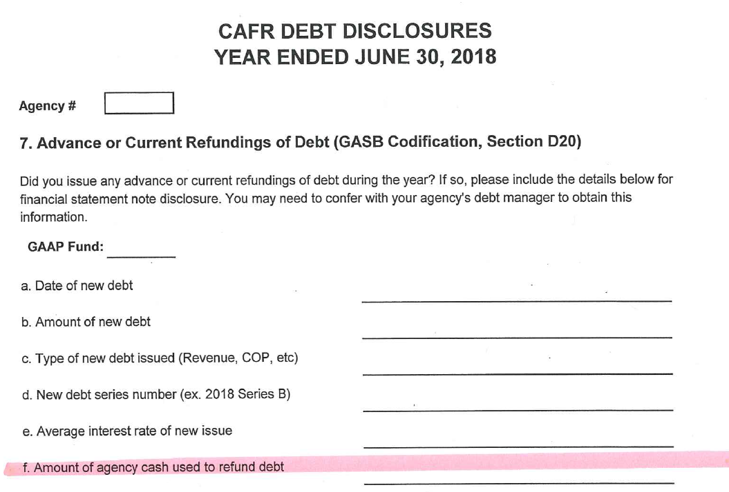
GASB 86 Certain Debt Extinguishment Issues – Changes in Agency Disclosures

Slide 32
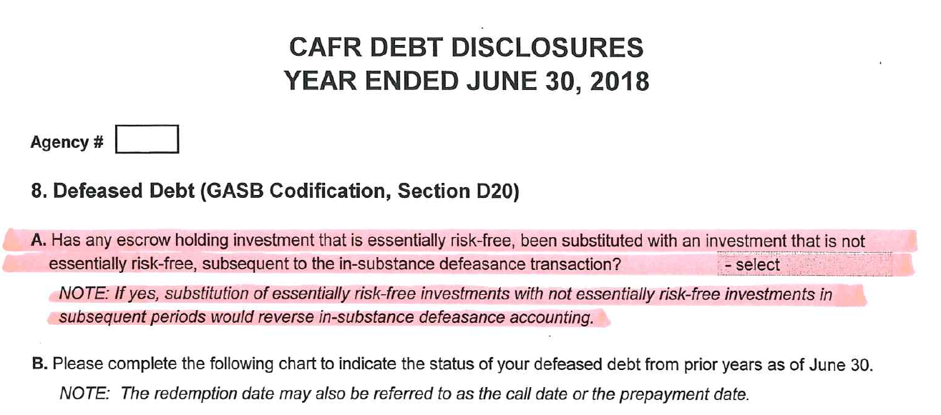
GASB 86 Certain Debt Extinguishment Issues - Changes in Agency Disclosures continued

Slide 33
GASB 86 Certain Debt Extinguishment Issues - Entries
Example:
Existing Bond:
Bonds payable – noncurrent: $90,000.00
Unamortized discount as of date of defeasance: $2,000.00
Remaining Prepaid Insurance: $1,200.00
Agency cash payment to escrow to defease debt (using existing resources): $100,000.00

Slide 34
GASB 86 Certain Debt Extinguishment Issues - Entries
TC 167R Record payment to escrow from existing resources.
- DR 3500 Expend Cntrl–Cash 100,000.00
(C/O 4051 Bond Refund Debt Pmt)
- CR 0065 Unreconciled Deposit 100,000.00
Governmental fund

Slide 35
GASB 86 Certain Debt Extinguishment Issues – Entries - continued
TC 528 Eliminate defeased debt.
- DR 1714 Bonds Payable - Noncurrent 90,000.00
- CR 3600 GAAP Expend Offset 90,000.00
(C/O 4051 Bond Refund Debt Pmt)
TC 514R Eliminate discount related to defeased debt.
- DR 3600 GAAP Expend Offset 2,000.00
(C/O 4051 Bond Refund Debt Pmt)
- CR 1712 Discount on Bonds Sold 2,000.00
Government-wide Reporting Fund

Slide 36
GASB 86 Certain Debt Extinguishment Issues – Entries - continued
TC 514R Eliminate prepaid insurance related to defeased debt.
- DR 3600 GAAP Expend Offset 1,200.00
(C/O 4051 Bond Refund Debt Pmt)
- CR 0602 Prepaid Expense 1,200.00
Government-wide Reporting Fund

Slide 37
GASB 86 Certain Debt Extinguishment Issues – Entries - continued
Agencies must calculate gain or loss as follows:
    Face value of refunded debt $90,000
Discount on refunded debt (2,000)
Prepaid Insurance (1,200)
Net carrying amount 86,800
Payment to escrow agent 100,000
Loss on refunding (13,200)

Slide 38
GASB 86 Certain Debt Extinguishment Issues – Entries - continued
TC 113: To record loss on refunding.
- DR 1714 3200 GAAP Revenue Offset 13,200.00
(C/O 2317 Gain/Loss on Refunding)
- CR 3060 Prior period adjustment 13,200.00
TC 114: To reclassify Bond Refund Debt Payment.
- DR 3060 Prior period adjustment 13,200.00
- CR 3600 GAAP Expend Offset 13,200.00
(C/O 4051 Bond Refund Debt Pmt)
Government-wide Reporting Fund

Slide 39
Questions?

Slide 40
GASB 87
Presented by Rob Hamilton

Slide 41
GASB 87 Leases
Effective for periods beginning after 12/15/2019 – FY 2021 for the state
Exposure draft to come about January 2019
Agencies must be ready by July 1, 2020 as operating activity will need to be recorded throughout the year
GASB 87 establishes a single model for lease accounting based on the foundational principle that leases are financings of the right to use an underlying asset.
  No more operating or capital leases
  Most similar to a capital lease, but not the same
A lease is a contract that conveys control of the right to use another entity’s nonfinancial asset (the underlying asset) as specified in the contract for a period of time in an exchange or exchange-like transaction
  Underlying asset does not have to be a capital asset
  As a “contract” , the lease, whether written or verbal, be legally enforceable

Slide 42
GASB 87 Leases
Exclusions from the accounting required by this standard:
  If, at the beginning of the lease term, the maximum possible term of the lease is 12 months or less, including any options to extend, regardless of their probability of being exercised
    Noncancelable portion only. Month-to-month leases are cancelable
  Contracts that transfer ownership by the end of the contract period (even if called a “lease”)
    Account for this as a financed purchase or sale
    The existence of a bargain-purchase option does not trigger this exclusion – it must be exercised
  Leases of intangible assets, including licensing contracts for computer software
  Leases of biological assets (timber, plants, animals)
  Leases of assets that are investments
  Supply contracts
  Leases of inventory
  Service concession arrangements
  Certain regulated leases (specific criteria, airport/aviation leases are the example)
  Leases in which the underlying asset is financed with conduit debt, unless both are reported by the lessor

Slide 43
GASB 87 Leases
Lease term – noncancelable portion plus/less options that are “reasonably certain” of being exercised
Lessee (economic resources measurement focus):
  Debit intangible right-to-use leased asset (a capital asset)
    Equal to the lease liability + lease payments made prior to lease term – lease incentives received from lessor + direct ancillary costs to place the leased asset into service
    Amortize over the shorter of lease term or useful life of leased asset (generally)
  Credit lease liability
    Present value of payments expected to be made during the lease term
      First use interest rate the lessor charges the lessee
      If #1 cannot be readily determined by lessee, use estimated incremental borrowing rate
    Reduced by payments made to lessor (principal portion only)
For governmental funds (current financial resources measurement focus):
  Other financing source and expenditure in first year – just like debt issuance
  Subsequent payments – same treatment as debt service payments

Slide 44
GASB 87 Leases
Lessor:
  Debit lease receivable – applies to governmental funds too
    Present value of payments expected to be received during the lease term
      Discount using the interest rate charged by the lessor to the lessee
      No other option provided for discounting
    Reduced as payments are received from lessee (principal portion only)
  Credit deferred inflow of resources – applies to governmental funds too
    Equal to the lease receivable + lease payments received prior to the lease term that relate to future periods – lease incentives paid
    Amortize over the lease term
  Lessor continues to recognize the asset being leased to the lessee and apply other applicable guidance to the underlying asset, including depreciation and impairment
    If lessee must return the asset in its original or enhanced condition – do not depreciate

Slide 45
GASB 87 Leases
Contracts that contain a lease component and a nonlease component must be accounted for separately, unless an exception applies
  i.e. the contract covers access to a building (lease) and maintenance services on the building (nonlease)
If a lease involved multiple underlying assets, which have different lease terms, each underlying asset should be accounted for as a separate lease (lessor/ee)
  Lessee should also do this if multiple asset classes are covered by the lease
    Consider in conjunction with contract combinations (next slide)
  Exception: If contract does not identify cost of separate underlying assets, or if those prices appear unreasonable:
    Use professional judgment to estimate and allocate to the underlying assets (components), maximizing observable information
    If #1 is not practical for some or all underlying assets (components), account for the contract as a single lease
      Accounting should be based on primary underlying asset’s components (i.e. lease term)

Slide 46
GASB 87 Leases
Contract combinations
  Contracts that are entered into at or near the same time with the same counterparty should be considered part of the same contract if either of the following are met:
    The contracts are negotiated as a package with a single objective
    The amount paid in one contract depends on the price or performance of the other contract
  Still need to consider whether the lease needs to be separated into its components as discussed in the previous slide

Slide 47
GASB 87 – What Agencies Need to Know and Do
LFO, OST, DAS CF&P Information Request on Current Operating Leases
  Operating leases with commitments longer than 20 years:
    Does it have a fiscal funding clause?
      For those that do, an aggregated “yes” is sufficient and no more information is needed.
      For those that do not, for each lease, provide a brief description about the lease.
  The Oregon Constitution requires LFO approval for debt beyond 20 years, and operating leases without fiscal funding clauses are debt for this purpose.
  Nationally, there is growing interest from stakeholders about debt
  LFO has asked that information start coming to SARS from agencies in January or February of 2019. Formal ask to be coming in the not-too-distant future.

Slide 48
GASB 87 – What Agencies Need to Know and Do
Start reviewing your leases as soon as you can and determine:
  Do any of the exclusions apply to your current operating leases?
  Does the lease include an explicit discount rate?
  What’s the lease term? What about options to extend and their likelihood?
  Does the lease also contain nonlease components, such as for maintenance?
  Does the lease cover multiple underlying assets that need to be separated?
Begin working through the accounting
Read GASB 87 (www.gasb.org)
Attend trainings – KPMG will have two in fall 2018 (www.kpmg.com/us/governmentinstitute)
Expect the implementation of this to take time – plan ahead! Be ready for July 1, 2020!
More accounting guidance to follow in future OAMs and trainings!

Slide 49

Questions?

Slide 50


Slide 51
YEAR-END SCHEDULE
Presented by Barb Watson

Slide 52

Due Date Reminders
Agency disclosures due Friday, August 17 (Gold Star Date)
SEFA disclosures due Friday, August 17 (Gold Star Date)
Schedule of Key Dates
  http://www.oregon.gov/das/Financial/Acctng/Pages/Yr-end-cls.aspx

Slide 53

R*STARS Reports Year-end Schedule
Close of June is July 13, at which point there will be a full report run
During Month 13 (July 16 - Aug 10), agencies can request various R*STARS reports, which run each Tuesday evening
SFMA Calendar: http://www.oregon.gov/das/Financial/AcctgSys/Documents/2018agy.pdf

Slide 54

Datamart Tables Update Schedule
Updates over the weekend
  GL Detail Table
  GL Summary Table
  All Accounting Event Table
YE Tables – Contain FY 2018 data only
  Updates Tuesday/Thursday/Saturday evenings during Month 13
      YE GL Detail Table
      YE GL Summary Table
  Updates the final three Wednesday evenings of Month 13
      YE Accounting Event Table
  Repository Reports with “YE” in the title and the SWB Reports update on the same schedule.

Slide 55
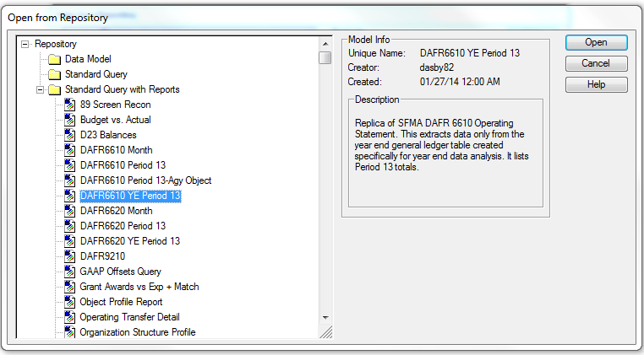
DAFR6610 YE Period 13
Operating Statement
DAFR6610 YE Period 13
START using
July 16, 2018

Slide 56
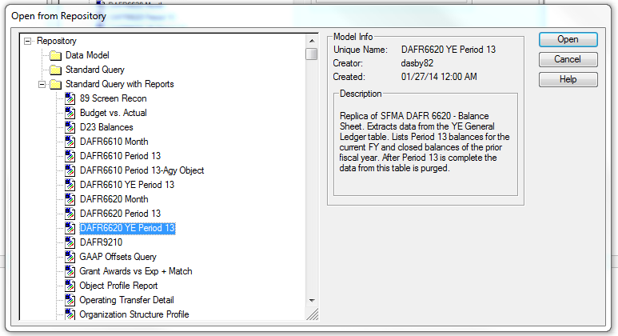
DAFR6620 YE Period 13
Balance Sheet
DAFR6620 YE Period 13
STOP using
August 13, 2018

Slide 57

Statewide Balance (SWB) Reports
Same update schedule as the YE Tables
  SWB Report Schedule and Reports
  Website:
    http://www.oregon.gov/das/Financial/Acctng/Pages/Balancing.aspx
No update messages will be sent out during Month 13

Slide 58
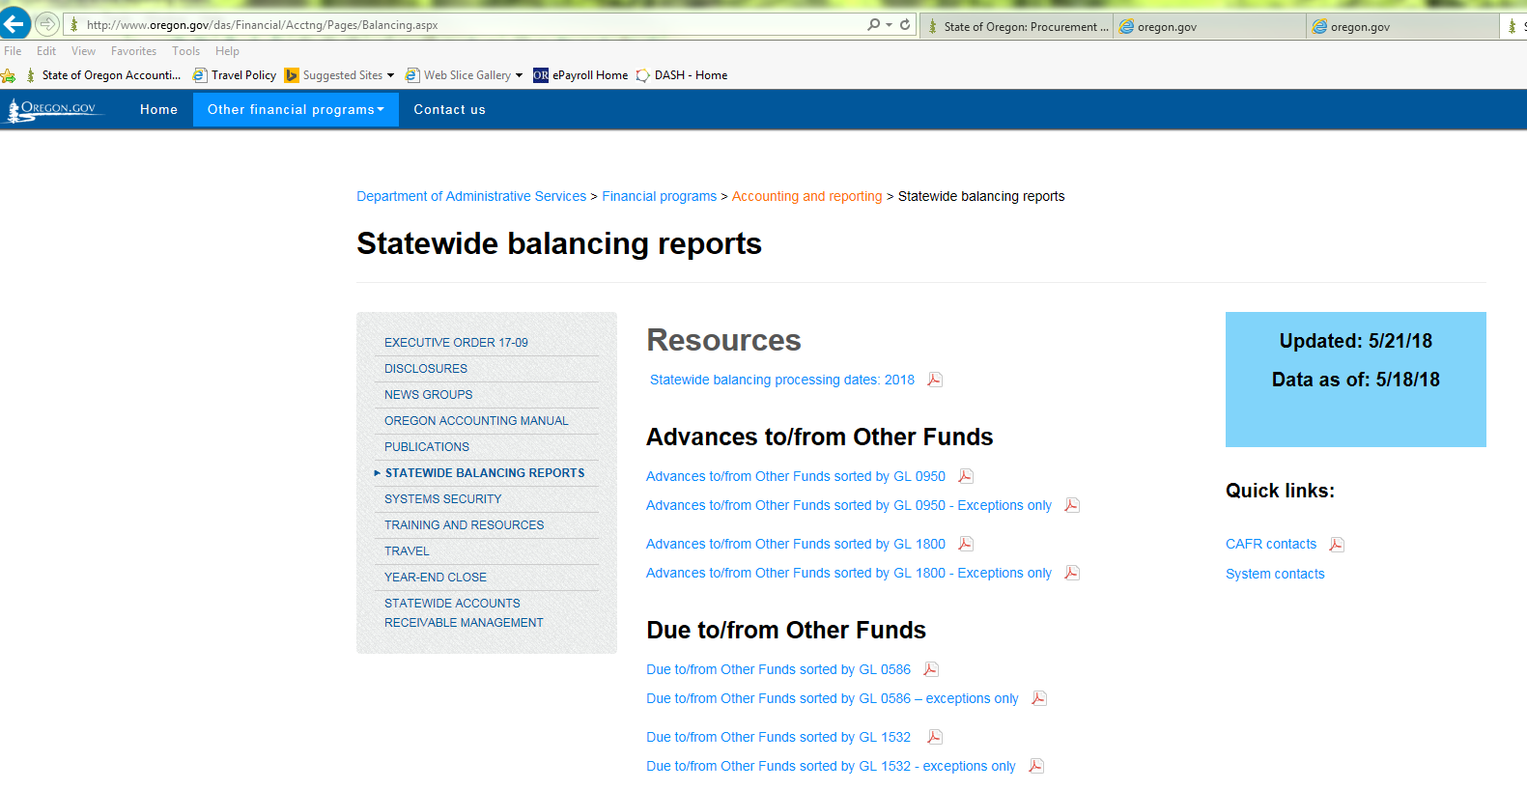
Statewide Balance (SWB) Reports

Slide 59
Resources for Month 13
Agency Guide to Year-end Closing
  http://www.oregon.gov/das/Financial/Acctng/Pages/Yr-end-cls.aspx
  Checklist located at Section D.10
  Instructions to access repository reports at Section D.4
Datamart ad hoc queries and repository reports
R*STARS reports
Statewide balancing reports
Prior year closing entries and disclosures
Chapter 15 of the Oregon Accounting Manual
SARS Analyst

Slide 60
July 2018
Sun | Mon | Tues | Wed | Thur | Fri | Sat
8 | 9 | 10 | 11 | 12 | 13 Close Mo 12 | 14 SFMA upload
15 | 16 Begin using YE Period 13 Datamart reports SWB / SFMA YE updated | 17 | 18 SWB / SFMA YE updated | 19 | 20 SWB / SFMA YE updated | 21
22 | 23 SWB / SFMA YE updated | 24 | 25 SWB / SFMA YE updated | 26 YE Acctg Event table updated | 27 SWB / SFMA YE updated | 28

Slide 61
August 2018
Sun | Mon | Tues | Wed | Thur | Fri | Sat
29 | 30 SWB / SFMA YE updated | 31 | 1 SWB / SFMA YE updated | 2 YE Acctg Event table updated | 3 Soft Close SWB / SFMA YE updated | 4
5 | 6 SWB / SFMA YE updated | 7 | 8 SWB / SFMA YE updated | 9 YE Acctg Event table updated | 10 Close Mo 13 SWB / SFMA YE updated | 11
12 | 13 Start using Period 13 Datamart reports w/o YE | 14 | 15 | 16 | 17 Disclosures due to SARS (General, Debt, SEFA) | 18

Slide 62
Restricted assets
Presented by Michael Cutler

Slide 63
Restricted Assets – What are they?
Assets whose use is subject to constraints that are either:
  Externally imposed by
    Creditors (debt covenants)
    Grantors
    Donors
    Laws and/or regulations of OTHER governments

Slide 64
Restricted Assets - What are they? (continued)
  OR
  Imposed by law through
    Constitutional provisions
    Enabling legislation
  AND
      The constraints change the nature or normal understanding of the availability of those assets
  OR
  Imposed by law through
    Constitutional provisions
    Enabling legislation
  AND
      The constraints change the nature or normal understanding of the availability of those assets

Slide 65
Nature or Normal Understanding of Availability
Is there a restriction for the use of the asset?
Is the asset available for regular operational uses?
Is there a restriction that means that the asset won’t be used in the next operational period?
Can you only use interest earnings but maintain the principal amount?

Slide 66
Enabling Legislation
Enabling legislation “authorizes the government to assess, levy, charge or otherwise mandate payment of resources (from external resource providers) and includes a legally enforceable requirement that those resources be used only for the specific purposes stipulated in the legislation.”
GASB 34, paragraph 34

Slide 67
Restricted Assets vs. Restricted Net Position
Restricted assets often will NOT tie to Net Position – Restricted
  Net Position – Restricted includes liabilities in the total
  In some cases, Restricted Assets are offset by liabilities in the fund –
    That means that there could be NO effect on net position, but still have restricted asset balances

Slide 68
Changes in Disclosure
2. Restricted Cash and Investments
In the GL Account column we added GLs 0230 Investments – OITP and 0235 Investment Valuation Account – OITP
We are now asking for the D23 fund detail for restricted Cash and Investments, instead of just GAAP Fund.
We also ask if the restricted cash is current or noncurrent

Slide 69
Current vs. Noncurrent
  Current = expected to be used within one year for the reason for the restriction
    Cash used to pay debt service principal and interest in the next year
    Cash accumulated to pay claims for the next year
  Noncurrent = expected to be used over one year out for the reason of the restriction
    Cash accumulated to pay future fiscal year debt service
    Cash accumulated to pay legal claims in future years, more than one year away

Slide 70



Slide 71
Changes to disclosures
Presented by Karen Williams and Sangit Shrestha

Slide 72

What’s new?
Disclosure forms updated to Adobe Acrobat DC
Do you have an older version of Acrobat?
  If YES - Please volunteer to do a short, 2-3 page test for compatibility.
  Contact Karen.A.Williams@oregon.gov

Slide 73
What’s new? -continued
B. INSURANCE RECOVERIES
4. Does the insurance recovery relate to a loss incurred in FY 2018? Yes No
If Yes, enter the GAAP object (D08) used to record the loss (if expenditures cover multiple GAAP objects, please attach a spreadsheet.)
D. COMPONENT UNITS
Significance means the individual organization has assets that exceed $3,000,000 or revenues that exceed $1,000,000. If the balances are less than these amounts, do not include.

Slide 74
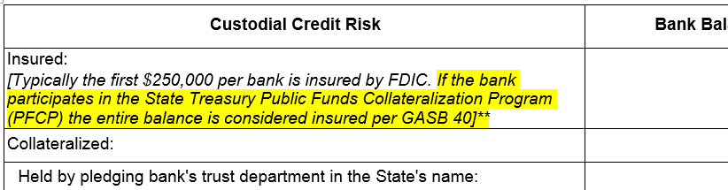
What’s new? -continued
1. Cash and Investments
Applies to 1. A – D and 1. L

Slide 75
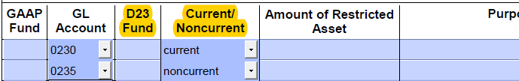
What’s new? -continued
2. Restricted Cash and Investments
GLs added:
0230 – Investment-OITP
0235 – Investment Valuation-OITP

Slide 76
What’s new? -continued
Disclosure 12 – now states that no lease agreement between state agencies should be included, previously specified just office space.
Disclosure 13 –column added for Total from Funding Sources
Disclosure 15 – now in GAAP Object order
SEFA Disclosures – reminder to submit Repository reports with information saved
SEFA Disclosure 3 – updated Federal reference from OMB Circular A-133 to Title 2 CFR Part 200

Slide 77
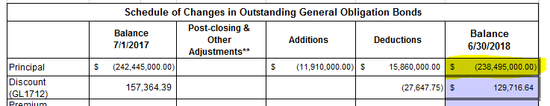
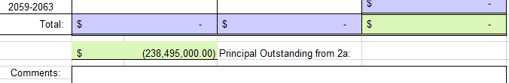
What’s new? -continued
Debt
Disclosure 2a
Debt
Disclosure 2b

Slide 78
Good news!
No duplicate pdf. / Excel forms
In Excel Format Only!
General Disclosures
  10 – Capital Leases
  12 – Leases
  13 – Construction Contract Commitments
  14 – Other Commitments
  22 – Changes in Fund Equity
  23 – Prior Period Adjustments
  24 – Cumulative Effect of Change in Accounting Principle
Debt Disclosures
  2 – General Obligation Bonds
  3 – Revenue Bonds
  4 - Cert. of Participation
  7 – Refundings of Debt
  8 – Defeased Debt

Slide 79
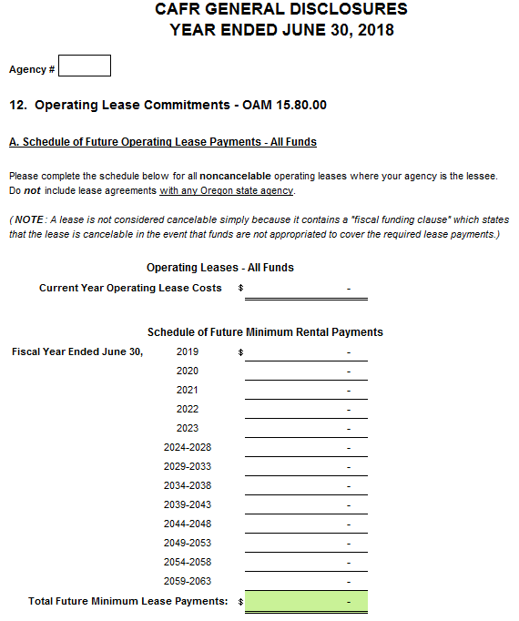


Slide 80
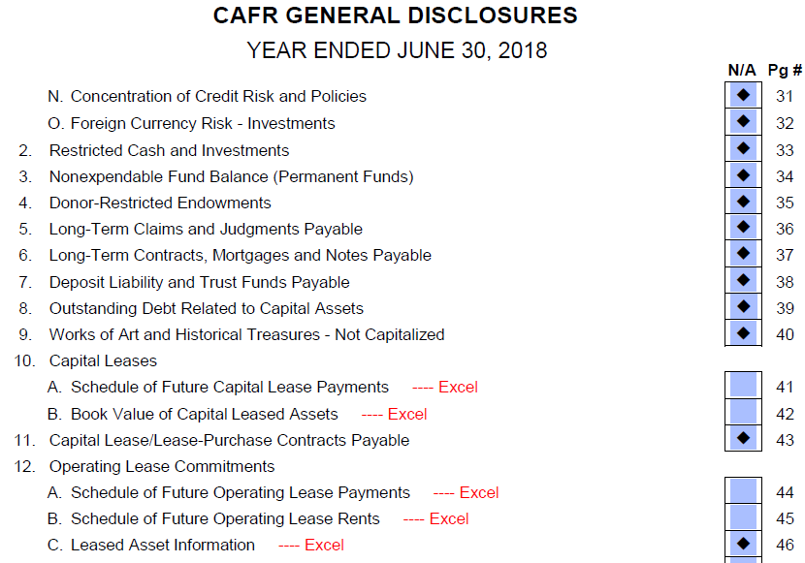
Excel Disclosures

Slide 81
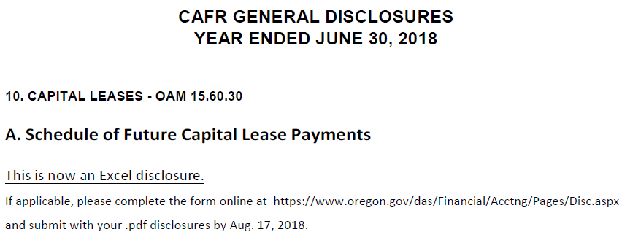
Excel Disclosures – cont.

Slide 82
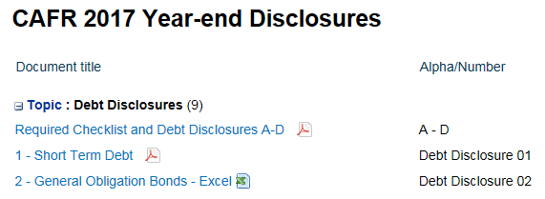
Excel Disclosures – cont.
https://www.oregon.gov/das/Financial/Acctng/Pages/Disc.aspx

Slide 83
Last bits….
Use correct signage for all disclosures
Fill in Agency number on first page of grouped forms, the rest will populate
In pdf.
  Tab or mouse click to navigate
  If you have Acrobat version older than DC, contact Karen to test
  In Excel
  Watch for tabs within workbooks
  Navigation works with tab, mouse click, or enter

Slide 84
Last bits….cont.
Disclosures sent to agencies the first Monday of Month 13.
Completed disclosures and certifications returned before close of business Friday, August 17.

Slide 85
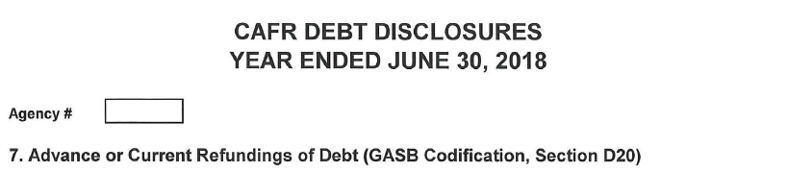
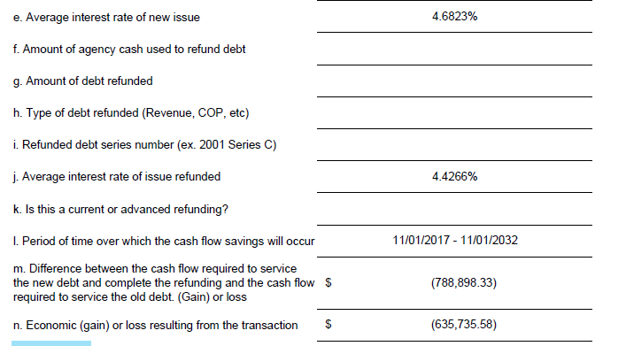
Principal Savings Summary
 | Date | Amount
COP 2007B Original Principal | on 5/25/2016 | 6,330,000.00
COP 2007B Unrefunded Principal | on 5/25/2016 | 960,000.00
COP 2007B Principal Refunded | on 5/25/2016 | 5,370,000.00
XI-Q 2016G Refunding Principal | on 5/25/2016 | 4,740,000.00
Savings on Principal | on 5/25/2016 | 630,000.00
Debt Service(P+I) Savings Summary
 | Date | Amount
COP 2007B Original Debt Service | 2015-17 | 1,469,300.00
COP 2007B Unrefunded Debt Service | 2015-17 | 1,232,850.00
COP 2007B Debt Service Savings | 2015-17 | 236,450.00
XI-Q 2016G Refunding Debt Service | 2015-17 | 202,626.67
Debt Service Savings | 2015-17 | 33,823.33
Debt Service Savings | 11/1/2017 - 11/1/2032 | 755,075.00
Total Savings |  | 788,898.33
 | Net PV Savings (based on "all-in TIC") | $ 635,735.58
 | Average coupon of refunded bonds | 4.426615%
 | Average coupon of the Series replacement coupons | 4.682277%
 | All-In TIC | 2.460862%

Slide 86
Questions?

Slide 87
Federal Funds Participation (FFP) Reporting
Presented by Barbara Homewood

Slide 88
FFP Certification
New for FY 2018
Timely review of data
This is to certify that I have reviewed the methods used to calculate the fiscal year 2018 federal funds participation rates submitted herewith and to the best of my knowledge and belief:

Slide 89
Certification Statements
All submitted information is true and correct. Documentation has been maintained and is available upon request.
All sources of federal funds were used in the calculation. This includes funds received directly from the federal government and federal funds received as another source—including State agencies.
All FFP rate changes from fiscal year 2017 to fiscal year 2018 that were 10 percentage points or greater and the percent change was 20% or greater were reviewed and have been determined to be appropriate.

Slide 90
Examples
First example, in fiscal year 2017 the FFP rate was 45% (0.4500) and in fiscal year 2018 the FFP rate is 35% (0.3500). There was a 10 percentage point change (45% - 35%) and the percent change was 22% (10/45 = .22). This scenario would warrant a closer or second review because both conditions were met.
Second example, in fiscal year 2017 the FFP rate was 45% (0.4500) and in fiscal year 2018 the FFP rate is 36% (0.3600). There was a 9 percentage point change (45% - 36%) and the percent change was 20% (9/45 = .20). This scenario would not necessarily need a closer or second review because both conditions were not met.

Slide 91

Fourth Statement and More
4. No FFP rate is greater than 100% or less than 0%.
…and more…
  Programs where no federal funds can be used
    For example, State Police Security
    Specifically prohibited in Uniform Guidance
  Signed by the person who can take responsibility for accuracy
  Due by August 22, 2018

Slide 92

Questions

Slide 93
Summary
Presented by Rob Hamilton

Slide 94
New noncurrent A/R process allows the history of the receivable assigned to DOR to be maintained
Complete communication with DPCUs on time
For proprietary funds, reclassify CO 3210 amounts after pension-related debt information is recorded
There are three separate OPEB plans – so three different sets of entries
Review your fiduciary activities:
  Does a trust exist?
  Ensure the 20 profiles are set up for agency funds
  Need to be ready by July 1, 2019
Review your leases:
  Do any of the exclusions apply to your current operating leases?
  Does the lease include an explicit discount rate?
  What’s the lease term? What about options to extend and their likelihood?
  Does the lease also contain nonlease components, such as for maintenance?
  Does the lease cover multiple underlying assets that need to be separated?
  Need to be ready by July 1, 2020

Slide 95
Information is available much more frequently during Month 13 – check the calendar
Review your restricted asset information – does it need to be updated in light of the training?
Excel disclosures this year!
Remember the proper sign when completing your disclosures
Sign the FFP certification
Questions?

Slide 96
Thanks for coming!
Training will be available on our website soon
Please complete an evaluation of this training on iLearn
Have a Great Year-end!
SARS Webpage: https://www.oregon.gov/das/Financial/Acctng/Pages/Index.aspx

