Slide 1

Long-term Debt Training
Department of Administrative Services
Statewide Accounting & Reporting Services
June 27, 2019

Slide 2
Agenda
Overview of Oregon’s Debt
Determining the Appropriate Fund Structure
Recording the Initial Debt Issuance
Recording Debt Service Payments
Refunding a Debt Issue
Recording Year End Transactions
Disclosure Requirements
Learning Opportunities

Slide 3
Overview of Oregon’s Debt

Slide 4
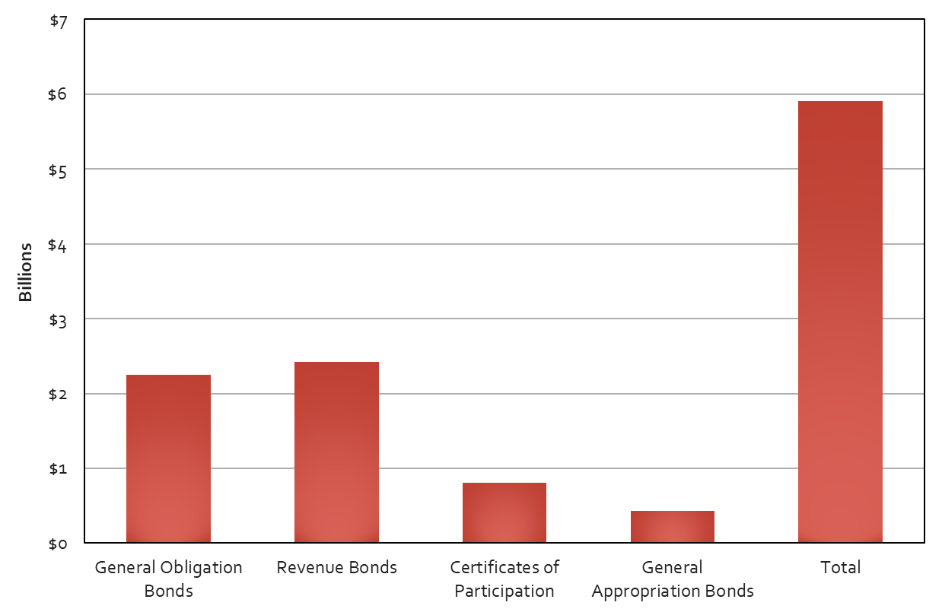
Outstanding Debt Balance – As of FY 2003
Notes:
Over the years, the debt disclosure package was discussed occasionally at year-end trainings. In 2004, SARS conducted the first stand alone debt training which referenced the latest data available from fiscal year 2003. At that time the state had almost $6 billion dollars in debt on the books.

Slide 5
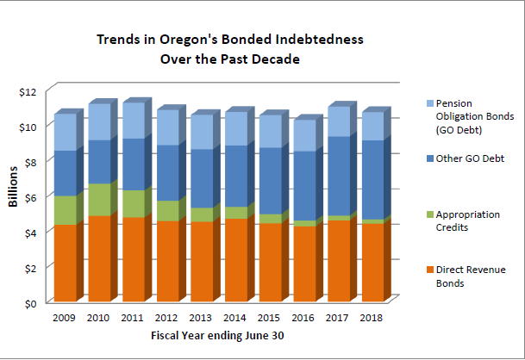
Outstanding Debt Balance – Past 10 years
Notes:
Fast forward to fiscal year 2018 and the state’s ending debt balance was over $10 billion. This chart from the State Debt Policy Advisory Commission Report for 2019 shows how the amount and mixture of debt has changed over the past 10 years. Direct Revenue bonds and the Pension obligation bonds haven’t changed much – the real change is the reduction of what the Commission calls “Appropriation Credits” (now just COPs), and the increase in other GO debt. The two go hand-in-hand as the State has been refunding the COPs in order to get better rates with GO bonds.
Now let’s discuss the different types of long-term debt.

Slide 6
Types of Long-term Debt
General Obligation (GO) Bonds
Authorized by the Oregon Constitution.
Are direct, general obligations of the State of Oregon
The full faith, credit, and taxing power of the State of Oregon are irrevocably pledged to pay the bonds
Includes governmental, business, and fiduciary activities
Notes:
State and local governments generally issue long-term obligations in two forms:
General obligation bonds
and revenue bonds
So what is the difference?
Mainly it is the source of funds for repayment.
Often referred to as GO bonds, general obligation bonds are usually considered to be very safe because they are backed by the full faith, credit, and taxing ability of the state. They are essentially a state version of US Treasury notes which are often described as the “safest investment in the world” since the US government guarantees them.
The early articles of the Oregon Constitution, that authorized the issuance of debt for various purposes, contains a line that says that if there are not sufficient funds available to make the debt payments, a property tax will be levied on all the real property in the State.
This has never happened and later articles authorizing the issuance of general obligation debt do not include that option.
Either way the chances of the state defaulting and the bondholder not being repaid are pretty remote.

Slide 7
Types of Long-term Debt (cont.)
GO Bond examples:
Pension bond liability.
Higher education facilities.
Correctional facilities for adult and youth offenders.
State hospital replacement.
Statewide building projects.
Seismic rehab of public schools and emergency buildings.
Loan programs at Veterans’ Affairs, Housing, Energy, and DEQ.
Notes:
The biggest single item that is funded with outstanding GO bonds is the pension liability.
GO bonds are also used to fund capital projects:
At OHSU, the state Universities and community colleges;
to build correctional facilities to house both adult & youth offenders, the Veterans’ Home in Lebanon, and the Public Safety Training Academy;
to replace the state hospital;
To upgrade the capital building and renovate the Transportation building;
as well as numerous other projects and deferred maintenance.
Around the state GO bonds fund the construction of military facilities, courthouse improvements, and the replacement of aging public safety communications systems.
With the addition of some recent articles to the state constitution it is now possible for GO bonds to be issued to do seismic rehab work on public schools and to provide matching funds to finance capital costs for school districts.
In business type activities, GO bonds provide the funds to create loan programs for Veterans’ Affairs, Housing and Energy.

Slide 8
Types of Long-term Debt (cont.)
Revenue Bonds
Authorized by Oregon Revised Statutes.
Secured by pledge of revenues derived from the operation of the program funded by bond issuance.
Includes both governmental and business activities.
Notes:
Revenue bonds are obligations where repayment will be supported by specific revenue sources other than property taxes.
These bonds are authorized by ORS, secured by pledge of revenues derived from the operation of the program funded by bond issuance, and includes both governmental and business type activities.

Slide 9
Types of Long-term Debt (cont.)
Revenue Bond examples:
Lottery bonds finance education, economic development, state parks, light rail, acquisition of state forestland, watershed improvements, and economic development projects in rural and distressed communities.
Highway user taxes repay bonds issued to fund road building and improvement.
Single family loans and multi-family housing projects.
Notes:
Examples of Revenue bonds include: lottery bonds, highway user taxes, and single family loans and multi-family housing projects.
In Oregon you will see lottery revenue bonds used for a variety of education, economic development, environmental, and transportation projects.
Highway user taxes repay bonds issued for various road building and improvement projects and mortgage payments repay bonds issued for single family loans and multi-family housing projects.

Slide 10
Types of Long-term Debt (cont.)
Lottery Revenue Bonds:
Not general obligations of the state.
Not secured or payable from funds other than amounts pledged.
All contain a statement that says the state is not obligated to pay lottery bond principal, interest or premiums from any source other than the amounts pledged for payment and the full faith and credit or taxing powers of the state of Oregon are not pledged to the payment of lottery bonds.
Notes:
Lottery bonds are repaid from lottery sales and qualify to be called revenue bonds but they have some further restrictions that you do not see in other revenue bonds.
Basically, if lottery proceeds all of a sudden are no longer available, the bond holders could not come after the state for repayment.

Slide 11
Types of Long-term Debt (cont.)
Other Types of Long-term Debt:
Certificates of participation
Tax anticipation notes
Short-term debt
Demand bonds
Conduit debt
Direct borrowings/placements
Notes:
So, while general obligation and revenue bonds are the two main types of debt, there are several other types that are less common but that you may encounter.
These include:
Certificates of Participation
Tax anticipation notes
Short-term debt
Demand bonds
Conduit debt
and direct borrowings and placements

Slide 12
Types of Long-term Debt (cont.)
Certificates of Participation (COPs)
Authorized in ORS Chapter 283.
Financing agreements normally secured by the asset being purchased or constructed.
Includes both governmental purpose and business-type activities.
Majority being refinanced and replaced with Q bonds.
Notes:
Certificates of participation are actually a type of lease financing arrangement with real property used as collateral.
While in many respects they are similar to bonds, there is one big difference: balances payable under a financing arrangement are limited to available funds.
If there are insufficient funds available to make payments, the lender can take control of the asset.
You can probably see that this type of arrangement is not as secure.
In the case of default, the bondholder would receive a share of the collateral but last time I checked there wasn’t much of a market for something like a used prison.
Since there is more risk, the interest rate would most likely be higher.
In 2010 Article XI-Q was added to the State’s Constitution to authorizes the issuance of General Obligations bonds to finance real or personal property that will be owned or operated by the state because the interest rate should be lower.
Since then many COPS have been refunded with XI-Q bonds.

Slide 13



Types of Long-term Debt (cont.)
Historical COP project examples:
Computer and telecommunications systems.
Capital construction.
Building acquisition.
Deferred maintenance.
Equipment purchases.
Notes:
COP’s historically have financed many projects.
There are a few areas that require continued COP financing because the state holds the debt but not the asset.
For example:
Several years ago COPs were issued to build county correctional facilities.
The debt is on the state’s books but the assets belong to the county.
When these were refunded a few years back, new COPs had to be issued.

Slide 14
Types of Long-term Debt (cont.)
Tax Anticipation Notes
Issued with expectation that:
Government will receive specific resources in the near future.
These resources will be used to retire the liability.
Often issued as part of a cash management strategy.
Generally short-term in nature.
Notes:
Tax Anticipation notes are similar to a payday loan.
They can be issued in anticipation of bond issuance, tax payments, or some other specific revenue source that is expected to be received in the near future.
When the revenue is received, the liability will be retired.
Oregon issues tax anticipation notes as a cash management tool.
They know that income taxes will be coming but are not collected evenly over the fiscal year.
Therefore, the funds are not always available to pay bills as they come due.
Debt is issued to cover immediate expenses and then repaid when the taxes are collected.
If the Tax Anticipation Notes, or TANS, are issued and paid off in the same fiscal year they only require a note disclosure in the CAFR.
If they are outstanding at June 30th a liability will appear on the balance sheet.

Slide 15
Types of Long-term Debt (cont.)
Demand Bonds
Allows bondholders to redeem bonds on the basis of terms specified in the bond agreement.
Financial institution makes agreement to provide funds if the call is exercised.
Can be long or short term depending on terms of agreement.
Additional disclosure is required.
Notes:
In most bond issues, there are a series of maturity dates that mean that repayment will be spread out over twenty years or more.
However, in the official debt offering statement, it may say that any bonds maturing after a certain date are subject to redemption, prior to maturity, at the option of the state.
This is what is termed a call feature and is fairly common.
The call date helps to enable debt refundings.
However, there are some bonds with what is called a put feature, which is far less common.
These are called demand bonds because the bondholder can demand payment prior to maturity as long as certain conditions are met.
Since there is uncertainty, and there is a potential need to raise funds unexpectedly, a financial institution will extend a line of credit to the government that could be exercised, as needed, to meet the obligation.
Depending on the terms of the agreement between the bank and the government, it can be a current or long-term liability.
Also, there is quite a bit of additional disclosure required.
In the state’s CAFR, this type of bond is currently only seen at Vets and Housing.

Slide 16
Types of Long-term Debt (cont.)
Conduit Debt
Limited-obligation bonds or similar debt instruments that provide capital financing for third parties not part of the reporting entity.
Issuer has no obligation for the debt.
Debt repaid by third party.
Not recorded in the financial statements but still must be disclosed.
Notes:
It is commonly known that government entities can issue tax-exempt bonds for public projects in order to borrow money at lower interest rates.
Some non-profits can also qualify for these same lower interest rates but they can not directly issue the bonds.
This is where conduit debt comes into play.
A government agency issues the bonds and the proceeds are loaned to the nonprofit.
The bonds are called “conduit debt” because the government acts as a conduit between the nonprofit and the people or institutions that buy the bonds.
The government agency has no obligation other than possibly to help creditors exercise their rights in the event of default.
Since it is not really the government’s debt, there is no liability recorded on their books.
However, the amount outstanding as of the balance sheet date must be disclosed in the debt note plus we have to report the amount issued during the year to the US census bureau.
The last type of “other” long-term debt relates to direct borrowings and placements. Sangit will discuss these in more detail later in the presentation.

Slide 17
Determining the Appropriate Fund Structure
Notes:
So, the debt management folks, whether from your agency or centrally from DAS, have informed you that debt has been or will be issued. Now what do you do?
First, you need to set up the appropriate fund structure to record the debt. Let’s discuss how to do that.

Slide 18
Important Factors
Purpose of debt issuance.
Source of funds for repayment.
Legal requirements.
Where cash is held.
How costs are budgeted.
Notes:
Unfortunately, this is an area where there is no real clear cut set of rules.
You need to consider:
the purpose of the debt issuance
the funding source for debt repayment
If there is a legal requirement that you have a sinking fund or some sort of reserve
Where the cash will be held
and how the costs are budgeted

Slide 19


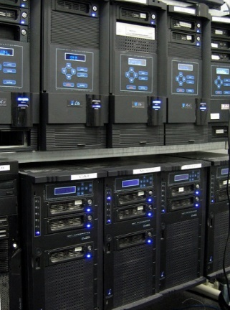
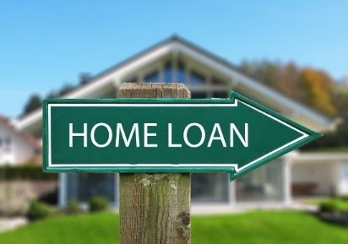
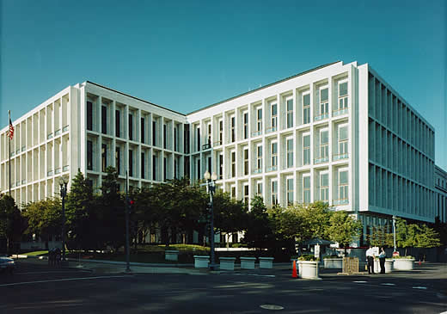

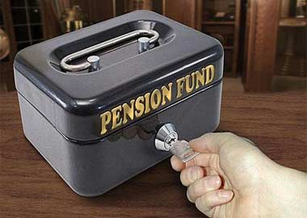
Purpose of Debt
Governmental
Proprietary
Fiduciary
Notes:
The purpose of the debt is important since that determines which GAAP fund type the debt will be recorded.
A description of each GAAP fund type is available in OAM 05.20.00.

Slide 20

Source of Repayment
General fund appropriation
Lottery funds
Federal grants
Assessments
User charges
Program operations
Loan repayments
Notes:
The source of funds that will be used to repay the debt may limit what GAAP fund can be used.
Sources include General fund appropriation, lottery funds, federal grants, assessments, user charges, program operations and loan repayments.
Now let’s talk about each of the GAAP fund type structures.

Slide 21
Governmental Funds Structure
Requires at least two funds.
“Project” funds for expenditure of proceeds.
Debt service fund to record capitalized (accrued) interest received from proceeds and payment of principal and interest.
Possibly a third fund for reserves (debt service fund)
Possible a fourth fund for issuance costs (fund type as budgeted)
Government-wide Reporting Fund
To record long-term liability
Notes:
If you have debt that will be for governmental activities, you are going to use a minimum of two GAAP funds.
The debt proceeds and payments are accounted for in governmental GAAP funds. This may require one fund for the expenditure of the proceeds and a second fund to record the payment of the principal and interest.
You may also use a third fund for recording reserves and, depending on the budget, a different fund for the issuance costs.
All debt proceeds, related premium and discounts, and debt payments must also be recorded as liabilities in the government-wide reporting fund.

Slide 22
Proprietary/Fiduciary Funds Structure
Best to set up same number of D23 funds as described for Governmental Funds.
All would be in the same GAAP fund type:
Enterprise Fund
Internal Service Fund
Pension Trust Fund
Notes:
For proprietary and fiduciary activities, it is recommended that you set up d23 funds that would accomplish the same type of segregation; however,
the cash transactions and recording the liability should be reported in the same GAAP fund.

Slide 23
Legal Requirements
Debt service reserve
Sinking fund
Notes:
A sinking fund, or some sort of debt service reserve fund, may be required in the debt covenant or in legislation.
Wherever the requirement comes from, there needs to be a place where these funds can be segregated.

Slide 24
Where the Cash is Held
Due to cash controls in SFMA:
Cash in Bank must be separated from Cash in State Treasury.
Cash in State Treasury Funds (separate Treasury account numbers) must be separated.
If the agency has multiple Treasury accounts, a separate D23 fund is required for each.
Notes:
Where the proceeds are held is also important.
Because of the cash controls in SFMA, money held outside of the state treasury must be segregated and identified using the “Cash in Bank” GL account 0077.
At this time, most funds to account for the proceeds from bond issues are held in State Treasury Funds. When Treasury funds are used, the money should be accounted for using the “Cash on Deposit with Treasurer” GL account 0070. If the agency has multiple Treasury accounts, a separate D23 fund is required for each.

Slide 25
How Costs are Budgeted
Many times costs of issuance are required to be paid out of regular operating budgets.
Some costs may be paid from a separate appropriation but this is less common.
Advanced refundings require the establishment of administrative limitation (could be more than one) in a non-limited fund.
Notes:
Finally, the way the debt is budgeted will also influence how you record it.
Sometimes the cost of issuance is paid out of your regular operating budgets while occasionally there may be a completely separate appropriation.
Advanced refundings will need an administrative limitation since the revenue and expenditure may not have been included in your operating budget.
You might use appropriated fund 3200 Other Funds Non-Limited to record the costs and appropriated fund 3230 Other Funds Debt Service Non-Limited to record the proceeds that will actually pay off the old debt.
The other variable is your agency’s policy.
Some agencies will make use of a minimum of d23 funds and others use separate funds for each project or even for each phase of a single project.
Basically, there are many variables and you will need to work with the people that issue the debt for your agency and your budget people to get the structure set up appropriately for your situation.
Once you have the structure in place, the transactions need to be recorded. I’m going to turn it over to Sangit to walk you through recording the debt.

Slide 26
Recording the Initial Debt Issuance
Notes:
Good Morning, I’m Sangit Shrestha. I am a senior accounting Analyst at DAS.
First of all I would like to thank everyone for coming to this training. (I hope everyone is excited!)
Secondly, I would like to thank agencies whose information are included in this training for providing us with the information to make this training possible.
Last but not the least, I would like to thank all the other agencies for providing us with the accurate information to make the CAFR reporting possible.
In my portion of the long-term debt, I will be spending time :
reviewing the accounting transactions required for recording debt.
looking at the Official Statement and the Sources and Uses Statement identifying the different sections.
GASB 88 implemented in FY 19 and GASB 86 implemented in FY 18
Once we’re done with that I will walk you through each accounting entry. Sadly, accounting entries do not make an exciting topic. I’ll try to make it as painless as possible.
After going through the example for debt issuance and debt payments, I will give you roughly 30 minutes (including break) to complete an exercise on debt issuance and debt payments. You can do it by yourself or in groups.
Later on you will have another problem on debt refunding. You will have 30 minutes to complete the exercise (including break)
Hopefully, you printed out the handouts that will be using in this training.
Before we get started I want to clarify that there are 2 different ways an agency can issue debt:
1. An agency can go through DAS to issue debt or;
2. An agency can issue its own debt
Most agencies go through DAS – so this will be my main focus today.

Slide 27
Official Statement
$238,415,000
State of Oregon
2017 Series A
General Obligation Bonds
Feb 21, 2017
Notes:
Please grab your handout.
The first page is the cover page of the Official Statement. Close to the bottom of the page there is a heading “Closing Settlement” off to the right of that is the date of February 21 , 2017. This is the settlement date.
The issuance was arranged through DAS and as you all know before FY 2017, Wells Fargo was the paying agent and now all the cash transactions take place in State Treasury Account.
Page 2 - The document states that the issuance was for General Obligation Bonds of which there are 6 different series, A, B,C, D,E and F. We’ll be working with Series A for debt issuance and debt payments. Series A is all new debt in the amount of $238.4 million dollars and was authorized for different projects.

Slide 28
Official Statement
Source of Funds:
Principal amount of 2017 bonds $238,415,000
Original issue premium 40,688,724
Total sources $279,103,724
Uses of Funds:
Project construction and acquisition $278,130,381
Underwriter’s discount 785,625
Cost of issuance 188,018
Total uses $279,103,724
Notes:
In the page 3 you will see estimated sources and uses of funds summary for Series A Bonds.
The summary reports the total principal for the series A as $238.4 million, but there is also a premium of nearly $40.7 million so gross proceeds or sources end up totaling approximately $279.1 million.
Like any debt issuance there is a reduction to the proceeds for the underwriter and the cost of issuance. So the State really walks away with nearly $278.1 million in net proceeds.
Although I using the words net proceeds, make sure not to record debt at net. There are two major reasons:
The CAFR requires full disclosure in the financial statements and the notes and;
Netting does not provide for a clean audit trail.

Slide 29
Official Statement
Description of the 2017 Series A projects we will focus on:
Oregon Department of Corrections, Facility Capital Improvements (example)
Oregon Department of Justice, Child Support Enforcement System (exercise)
Notes:
In the next page (Table 9) you will see how the proceeds from 2017 Series A GO Bonds are used for different projects. We will be focusing on Oregon Department of Corrections, Facility Capital improvements as an example and Oregon Department of Justice, Child Support enforcement System as a an exercise.

Slide 30
Department of Corrections Facility Capital Improvements
Source of Funds:
Principal amount of 2017 bonds $11,785,000
Original issue premium 2,023,239
Total sources $13,808,239
Uses of Funds:
Project Funds $13,770,432
Underwriter’s discount 32,320
Cost of issuance 5,487
Total uses $13,808,239
Notes:
Before we go any further, on the very back of the handout (on pages 25a___ and _25b__ is a listing of most frequently used t-codes to record debt. Following that on pages __26a_ and __26b__ is the most frequently used accounts related to debt. You may want to keep them handy for a quick reference.
Now, lets look at page 5, which is the Sources and Uses Statement for Oregon Department of Corrections (DOC). Let’s go over this Exhibit C together. The top part of the document includes both the sources and uses:
The first item is the principal amount (term used is Bonds payable) of $11.8 million. This is the face value of the bonds. More importantly it is the amount of proceeds the agency will record.
Next, is the Original Issue Premium – this is the price the bond purchaser is willing to pay over and above the face value of the bond for an interest rate that is higher than the market rate. The opposite would be - Original Issue Discount, where the bond purchaser would pay less than the face value of the bond instrument. The premium and discount are also part of the proceeds, as either an addition or reduction. But they are recorded separately. Remember no netting.
The underwriter’s discount and cost of issuance are expenditures of the offering. DAS will bill the agencies separately for cost of issuance. Only Underwriter’s discount fees will be deducted when funds are deposited in agency account.
Finally, the Project Funds ($13.8 million) is the amount that is left for spending on the Project.
The center of the document represents the Project Account Funds. Sometimes you may see estimate of interest earned on idle funds over the course of the construction period, and if you do , you want to ignore this when recording your entries. It is merely an estimate, it does not meet the definition of either revenue or an asset at this time.
The last part of the statement identifies the different costs incurred with the issuance of the bond. The second and third sections of the document when added together (excluding estimated interest earned if any) should agree with the total of the top portion of the statement. There could also be other sections such as; accrued interest, reserves, or other bond costs of some sort. Regardless of how many sections there are, they should still add up to the top portion of the document.
Sometimes you may discover error and if you do and are uncertain of the dollar amount, please contact Capital Finance and Facilities Planning.
True interest cost is defined as the rate necessary to discount the amounts payable on the respective principal and interest payment dates to the purchase price received for the new issue of bonds. In order words it the interest cost to the State incorporating Face Value, Premium or discount and underwriters discount.

Slide 31
Project Funds – Proceeds (Treasury)
T-code 190 To record face value of the bond
- DR 0065 Unreconciled Deposit 11,785,000.00
(debits to GL 0070 – cash deposit with treasurer
after reconciling to Screen 13 in R*stars)
- CR 3100 Rev Control – Cash 11,785,000.00
( c/o 1501 GO Bonds – Debt service from GF)
Fund Type – Governmental (Capital Projects)
Notes:
Now let’s go ahead and record our entries beginning with our cash transactions. You may want to pay close attention to these examples as they will be very helpful when doing your exercise later on.
Lets look at Exhibit C on page 5 of your handout and record the face value of the bond (Bonds Payable)
T-code 190: We will record the issuance in the capital projects fund.
DR GL 0065 Unreconciled Deposit
CR Comp Obj. 1501 GO Bond – Debt Service paid from GF
The amount we will record is $11.8 million.
This entry would also apply to proprietary or fiduciary funds.
Remember, when ever there is a debt issuance through DAS there will be an Interagency Agreement between DAS and the participating agency. The Agreement stipulates such things as: what type of funds are to be received; where the funds will be held; how the moneys will be used; and how debt payments will be made.
Use T-code 567 if cash is not held in State Treasury.
DR GL 0077 Cash in Bank
CR Comp Obj. 1501 GO Bond Proceeds
The amount we will record is $11.8 million.

Slide 32
Project Funds – Premium (Treasury)
T-code 190 To record the premium received on bonds
- DR 0065 Unreconciled Deposit 2,023,239.25
(debits to GL 0070 – cash deposit with treasurer
after reconciling to Screen 13 in R*stars
- CR 3100 Rev Control – Cash 2,023,239.25
(c/o 1510 OIP – Bonds)
Fund Type – Governmental (Capital Projects)
Notes:
Next we’ll record the premium on the bond.
We will use T-code 190 to record the premium:
DR GL 0065 Unreconciled deposit
CR Comp Obj. 1510 Original Issue Premium - Bonds
The amount is $2 million.

Slide 33
Project Funds – Underwriter’s Discount Costs(Treasury)
T-code 167R To record the underwriter’s discount
- DR 3500 Expend Control – Cash 32,320.29
(c/o 4050 Bond Costs)
- CR 0065 Unreconciled Deposit 32,320.29
(credits to GL 0070 – cash deposit with treasurer
after reconciling to Screen 13 in R*stars
Fund Type – Governmental (Capital Projects)
Notes:
DAS will bill the agencies separately for cost of issuance. Only Underwriter’s discount fees will be deducted when funds are deposited in agency account.
Will use T-code 167R to record the underwriters discount costs.
DR Comp Obj. 4050 Bond Costs
CR GL 0065 Unreconciled Deposit
Proprietary and Fiduciary funds will use t-code 167R as well.
No ACH wire or warrant is necessary as this amount is deducted directly from your proceeds prior to delivery.
Once you’ve recorded the entries you should verify that the balance in Cash in Treasury accurately reflects the transactions. The net cash in Treasury should be your project funds of $13.8 million plus costs of issuance of $5,486.96.
Use T-code 568 when the funds are handled outside Oregon State Treasury.

Slide 34
Project Funds – Premium(Treasury) If not enough cash to record Bond Costs
T-code 190 To record the premium received on bonds(subtract underwriter’s discount)
- DR 0065 Unreconciled Deposit 1,990,918.96
(debits to GL 0070 – cash deposit with treasurer
after reconciling to Screen 13 in R*stars
- CR 3100 Rev Control – Cash 1,990,918.96
(c/o 1510 OIP – Bonds)
Fund Type – Governmental (Capital Projects)
Notes:
Sometimes agencies may not have enough cash in the fund to cover the bond costs. In such situation, you will have to take different approach:
First, record Bonds payable – Same
Original Issue Premium - $2,023,239.25 – 32,320.29 = $1,990,918.96
This will clear your R*stars 13 screen

Slide 35
Project Funds – Underwriter’s Discount Costs(Treasury) If not enough cash to record Bond Costs
T-code 409 To record the underwriter’s discount
- DR 3500 Expend Control – Cash 32,320.29
(c/o 4050 Bond Costs)
- CR 0070 Cash on deposit w/Treas 32,320.29
T-code 410 To record the remaining premium received on bonds
- DR 0070 Cash on deposit w/Treas 32,320.29
- CR 3100 Rev Control - Cash 32,320.29
(c/o 1510 OIP – Bonds)
Fund Type – Governmental (Capital Projects)
Notes:
Use T-codes 409 and 410 instead of 167R to record UD and remaining premium received on bonds. Make sure to record T-codes 409 and 410 the next day after the Screen 13 in R*stars is cleared.

Slide 36
Project Funds – Bond Issuance Costs(Treasury)
T-code 760 To remit the cost of issuance payment to DAS
- DR 3500 Expend Control – Cash 5,486.96
(c/o 4050 Bond Costs)
- CR 0070 Cash on deposit w/Treas 5,486.96
T-code 761 To record the other side of payment for DAS
- DR 0070 Cash on deposit w/Treas 5,486.96
- CR 0501 A/R – Other billed 5,486.96
Fund Type – Governmental (Capital Projects)
Notes:
Agencies will use T-code 760 and 761 to record the payment to DAS for Costs of issuance of $5,486.96.
T-code 760
DR Comp Obj. 4050 Bond Costs
CR GL 0070 Cash on deposit w/Treas
T-code 761 (DAS side)
DR 0070 Cash on deposit w/Treas
CR 0501 A/R – Other billed
Proprietary and Fiduciary funds will use same t-code as well.

Slide 37
Accrued Interest
Record in the fund where principal and interest payments are made.
T-code 191 - Cash on Deposit with Treasury
DR GL 0065 – Unreconciled Deposit
CR GL 1225 – Accrued Interest on Bonds sold (use GL 1235 for COPs)
Do not use GL 1230 (It is for year-end accruals)
Notes:
Accrued interest is earned when there is a time lapse between the date of issuance and the date of the debt sale. The accrued interest is normally reduced or offset with the first interest payment.
Although there is not any accrued interest in this example, sometimes you may see it on Sources and Uses Statement. It may appear as “Capitalized Interest”. Just remember, this is nothing more than accrued interest.
If the debt is issued through the State Treasury then you would use T-code 191, debiting GL 0065 Unreconciled Deposit and crediting GL 1225 Accrued Interest Payable on Bonds Sold. (or 1235 for COPs)
Use T-code 507, debiting GL 0077 Cash in Bank and crediting GL 1225 Accrued Interest Payable on Bonds Sold. (or GL 1235 for COPs) if cash is held outside Treasury.
Do Not use GL 1230 Interest Payable – Current this is for your year-end accrual.

Slide 38
Liability – Bond Payable
T-code 504 To record face value of GO Bond liability
-DR 3200 GAAP Revenue Offset 11,785,000.00
(c/o 1501 Bond Proceeds)
- CR 1714 Bond Payable – NC 11,785,000.00
Fund Type – Government-wide Reporting Fund
Notes:
It is always wise to set up the liability when you record the proceeds. In fact, to be in accordance with GAAP, the liability should be posted on the settlement date not the sale date.
Now to make this entry DOC must record the face value of the bond in the amount of $11.8 million in the government-wide reporting fund using T-code 504. This transaction code will utilize the GAAP offsets. Remember when we recorded the debt issuance in the governmental fund we credited the revenue account comp object 1501 for Bond Proceeds. Here we will be debiting the same comp object. In addition, we are crediting or setting up the Bond Payable.
This holds true for proprietary and fiduciary funds as well, but all transactions are recorded in the same GAAP fund .
The same t-code would be used for COP issuance and direct borrowings/placements as well however, the GL accounts and comp objects will change.

Slide 39
Liability – Premium on Bonds
T-code 504 To record the premium on bonds sold
- DR GL 3200 GAAP Revenue Offset 2,023,239.25
(c/o 1510 OIP on Bonds)
- CR GL 1713 Premium on Bonds 2,023,239.25
Fund Type – Government-wide Reporting Fund
Notes:
Next you will need to record the Original Issue Premium on Bonds in the government-wide reporting fund. A discount or premium on a bond or COP is considered a contra account to the Long-term Payable, similar to Accumulated Depreciation for Capital Asset. Therefore, it must be amortized over the life of the debt.
In order to set up the Premium we use t-code 504 debiting comp object 1510, and crediting GL 1713 Premium on Bonds Sold in the amount of $2 million.
Remember, we debit comp object 1510 here because we have to eliminate the governmental fund entry recorded with the issuance a few slides back, where we credited the 1510 account.

Slide 40
Underwriter’s Discount or Issuance cost
Expense at the time of issuance
Capitalize prepaid insurance if any.
Use T-code 514
DR GL 0602 – Prepaid Insurance
CR GL 3600 – GAAP Expenditure offset
(c/o 4050 Bond costs for bonds, c/o 4055 COPs cost for COPs, c/o 4041 Direct Borrowings/ Placement costs)
Notes:
Underwriters discount or issuance costs are expensed at the time of issuance.
Capitalize prepaid Insurance if any:
Use T-code 514 with debit to GL 0602 – Prepaid Insurance and credit to GL 3600 with appropriate CO (4050 for Bonds, 4041 for Direct Borrowings/Placement, and 4055 for COPs)
Amortize the prepaid Insurance in a systematic and rational manner over the life of the related debt. (Use Comp Object 7468 Amortization of prepaid debt insurance)

Slide 41
Variations
Cash in State Treasury vs. Cash in bank
Uses different t-codes
Other types of debt
Certificates of Participation
Direct Borrowings/Placements
Uses different comp objects and general ledger accounts
Notes:
Use different T-codes for Cash in bank and Cash in State Treasury.
Use different comp objects and GL accounts for other types of debt such as COPs.

Slide 42
Basic Accounting Entry
DR Cash 13,770,432.00
DR Bond Costs 37,807.25
CR Bond Premium 2,023,239.25
CR Bonds Payable 11,785,000.00
To record debt issuance.
Notes:
After all bond issuance and capitalization entries are completed, and the transactions summarized, the basic accounting entry should look like this
So looking at page 5, you should have $13.8 million left in Cash in Treasury, bonds payable of $11.8 million, bond premium of $2 million and bond costs of $38 thousand..

Slide 43
Recording Debt Service Payments
Notes:
Now, let’s move on to recording debt service payments.

Slide 44
Where to Record Payments?
Governmental activities
Principal and interest payment in governmental fund
Liability adjusted in government-wide fund
Proprietary funds
Payments and liability adjustments are recorded in the same fund
Notes:
Principal and interest payments are made in governmental funds. Just remember that debt service payments can never be reported in a capital projects fund. Make sure also not to pay from GWRF.
After the payment is made it is always a good idea to adjust or reduce the liability for principal payment in GWRF while it is all still fresh in your mind. Also it eliminates one more adjustment at year-end.
Agencies using proprietary or fiduciary funds will record both the debt service payments and the liability adjustment in the same GAAP fund.

Slide 45
Principal and Interest
Paid through DAS
Paid by agency
Comp objects – Interest expense
Bonds - 7250
COPs – 7300
Direct Placements/Borrowings - 7225
Comp objects – Principal
Bonds - 7100
COPs - 7150
Direct Placements/Borrowings - 7125
Notes:
Principal and interest payments can be paid in many different ways, making them not quite as straight forward as the debt issuance. I will cover the most commonly used.
As I previously mentioned, The majority of agencies issue debt through DAS. DAS in turn creates an Interagency Agreement identifying how and when principal and interest payments are made. Generally, for COPs and GO Bonds DAS will invoice the agencies for the debt service payment prior to its due date. Agencies in turn make their payment to DAS.
Agencies issuing their own debt, will pay their own debt.
The comp objects for interest and principal are different depending on the types of debt, as you can see from the slides.

Slide 46
Principal & Interest Payment
T-code 760 To record DOC second payment on Series A GO Bond
- DR 3500 Exp Control – Cash 835,000.00
(c/o 7100 Principal)
- CR 0070 Cash w/Treasury 835,000.00
- DR 3500 Exp Control – Cash 294,625.00
(c/o 7250 Interest)
- CR 0070 Cash w/Treasury 294,625.00
Fund Type – Governmental (Debt Service)
Notes:
Let’s review some of the t-codes used to record debt service payments.
Let’s look at page 6 of the handout, Exhibit D. There you will see a debt schedule for DOC. We are going to assume it is May 1, 2018 and the debt service is budgeted in a Debt Service Fund.
Because DAS handled the issuance, the agency will pay the debt service payment to DAS after receiving an invoice. DAS then makes the payment.
Here we will use T-code 760 to record the principal and interest payment debiting the expenditure accounts 7100 Principal on Bonds for $835 thousand and comp object 7250 Interest on Bonds for $295 thousand. The credit will be to Cash on Deposit with Treasury.

Slide 47
Principal & Interest Payment
T-Code 761 To record the other side of debt service payment for DAS
- DR 0070 Cash w/Treasury 835,000.00
- CR 0501 A/R – Billed 835,000.00
- DR 0070 Cash w/Treasury 294,625.00
- CR 0501 A/R - Billed 294,625.00
Notes:
Agency also need to record the other side of the entry for DAS using T-code 761. DAS will provide the D23 fund to be used, on their invoice.
With this entry DAS’s accounts receivable GL 0501 will be reduced and Cash with Treasury GL 0070 will be increased for the principal and the interest.
These T-codes 760 and 761 are also used for governmental, proprietary, and fiduciary funds.

Slide 48
Lottery Bonds
DAS transfers lottery monies (Revenue) to agency accounts using
T-code 185R – moves money out of DAS
DR GL 3550 Operating Transfer Out
CR GL 0065 Unreconciled Cash
T-code 186-Deposit into agency
DR 0077 – Cash in Bank
CR 3150 Operating Transfer In control
T-code 568 Agency record debt service payment
DR 3500 Expend Control – Cash
(c/o 7100 – Principal on Bonds, or c/o 7250 – Interest on Bonds)
CR 0077 Cash in Bank
Notes:
In the case of lottery bonds DAS transfers moneys from lottery sales annually into the agency’s Union Bank account. Lottery moneys are pledged to pay for debt service. DAS initiates the debt service payment out of the Union Bank account on behalf of the agencies. Agencies only need to record the debt service payment on their books.
DAS transfers money using t-codes 185R and 186. T-code 185R moves money out of DAS’s Treasury account GL 0065 while debiting the appropriate transfer out account. T-code 186 will deposit the funds into the agency’s Union Bank account using GL 0077 Cash in Bank with an offset to transfer in from DAS.
As payments become due DAS wires the payment to the paying agent. Each agency should record the principal and interest payment in accordance with the date on their debt service schedule. To post the debt service agencies are required to use t-code 568 debiting the appropriate expenditure 7100 for Principal on Bonds or 7250 for Interest on Bonds and crediting Cash in Bank GL 0077.
The payment should be reported in the appropriate fund for debt service, whether that be a governmental fund, proprietary fund or fiduciary fund but, remember debt cannot be recorded in capital project funds (or GWRF).

Slide 49
Certificate of Participation
COPs are issued through DAS
T-code 760 To payment on COPs
- DR 3500 Exp Control – Cash
(c/o 7150 - Principal, or 7300 - Interest)
- CR 0070 Cash w/Treasury
T-Code 761 To record the other side of debt service payment for DAS
- DR 0070 Cash w/Treasury
- CR 0501 A/R – Billed
Notes:
COPs are issued through DAS. Therefore, agencies that still have COPs on their books will use t-codes 760 and 761 to remit their cash for principal and interest to DAS. DAS in turn remits the payment to the paying agent.
Make sure that the comp objects are different then those used for bonds. CO 7150 is for Principal on COPs and CO 7300 is used for Interest expense on COPs.

Slide 50
ACH Wire Payment – Outside Treasury
T-code 167R (ACH wire transfer)
- DR 3500 Exp. Control – Cash
(c/o 7100 Principal Bonds)
- CR 0065 Unreconciled Deposit
T-code 167R (ACH wire transfer)
- DR 3500 Exp. Control – Cash
(c/o 7250 Interest Bonds)
- CR 0065 Unreconciled Deposit
Notes:
To make a debt service payment directly, agencies usually use T-code 167R if payment is made outside Treasury. This t-code will debit principal and/or interest and credit Unreconciled Deposit. You may need to co-ordinate with Treasury to request the ACH wire payments.

Slide 51
Transfer to Treasury – Suspense Account
T-code 714 (BT with TC 715)
- DR 3500 Exp Control – Cash
(c/o 7100 – Principal Bonds)
- CR 0070 Cash on Deposit with Treasury
T-code 714 (BT with TC 715)
- DR 3500 Exp Control – Cash
(c/o 7250 – Interest Bonds)
- CR 0070 Cash on Deposit with Treasury
Notes:
Use t-code 714 with a BT doc and a balancing t-code of 715 if the payment is to State Treasury Suspense Account.

Slide 52
Reduce Liability
T-code 528 Reduce bond payable
- DR GL 1714 Bonds Payable NC 835,000.00
- CR GL 3600 GAAP Expend Offset 835,000.00
(c/o 7100 Principal)
Government-wide Reporting Fund
Notes:
Continuing with our example from the debt payment, this entry will reduce bond payable in the government-wide reporting fund by $835 thousand.
Use T-code 528 to reduce GL 1714 for the principal amount of $835 thousand in GWRF. Make sure to use the Comp Object 7100 – Principal-Bonds.

Slide 53
GASB 88 Certain Disclosures Related to Debt, including Direct Borrowings and Direct Placements
Disclosure required by GASB 88:
Amount of unused lines of credit
Assets pledged as collateral for debt
Terms specified in debt agreements related to significant
(1) events of default with finance-related consequences,
(2) termination events with finance related consequences, and
(3) subjective acceleration clauses
Should provide separate information in debt disclosures regarding (a) direct borrowings and direct placements of debt from (b) other debt.
Notes:
Lets briefly talk about GASB 88. GASB 88 is the new statement effective FY 19. GASB 88 requires additional disclosures in notes to financial statements and defines debt as a liability that arises from a contractual obligation to pay cash (or other assets that may be used in lieu of cash) in one or more payments to settle an amount that is fixed at the date the contractual obligation is established. Additional disclosures are:
-Amount of unused lines of credit
-Assets pledged as collateral for debt
-Terms specified in debt agreements related to significant
(1) events of default with finance-related consequences,
(2) termination events with finance related consequences, and
(3) subjective acceleration clauses
-Should provide separate information in debt disclosures regarding (a) direct borrowings and direct placements of debt from (b) other debt.

Slide 54
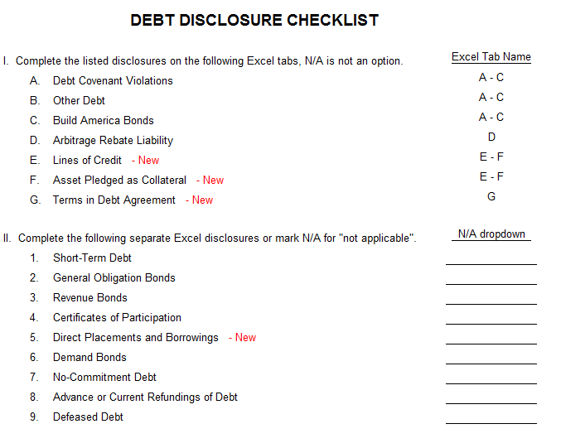
GASB 88 (continued)
Notes:
As you can see, we have updated the debt disclosure. You will see lines E, F, G and 5 added in FY 19.

Slide 55
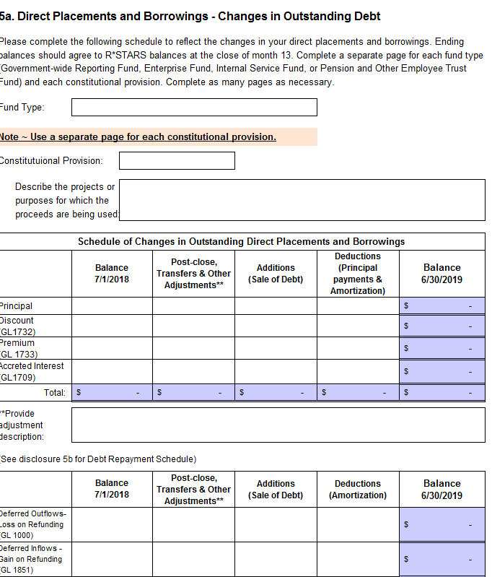
GASB 88 (continued)
Notes:
This disclosure is similar to Bonds and COPS, but if you have any direct placements and borrowings, then they now need to be disclosed separately.

Slide 56
GASB 88 – (continued) New Accounts
GLs:
1277 - Bonds Pay -Current – Direct Place/Borrow
1732 - Disc on Bonds Sold – Direct Place/Borrow
1733 - Prem on Bonds Sold – Direct Place/Borrow
1734 - Bonds Pay-Noncurr – Direct Place/Borrow
Comp Objects:
1515 - Direct Placements/Borrowings
1516 - OID Direct Placements/Borrowings
1517 - OIP Direct Placements/Borrowings
4041 - Direct Placements/Borrowings Costs
7125 - Principal Direct Placements/Borrowings
7225 - Interest Direct Placements/Borrowings
7457 - Amort-Discount/Premium on Direct Place/Borrowings
Notes:
These are the new accounts added in FY 2019 related to Direct Borrowings/Placements.

Slide 57
GASB 88 (continued) – Reclassify GL Accounts
Use T-codes 475 and 475R to reclassify GLs related to Direct Borrowings/Placements from Bonds Payable if any.
You will also have to reclassify comp objects related to Direct Borrowings/Placements.
Notes:
If you agency has direct borrowings/placements, then you may have been using GLs related to bonds payable in the past.
Please use T-codes 475 and 475R to reclassify GLs related to Direct Borrowings/Placements from Bonds Payable if any.
You will also have to reclassify comp objects related to Direct Borrowings/Placements if any.

Slide 58
Exercise 1

Slide 59
Exercise 1
Debt issuance – Series A GO Bond for Department of Justice
Proceeds and issuance cost
Establish liabilities accounts
Debt service payment – Department of Justice
Reduce liability
Assume a governmental fund for Department of Justice & DAS
Issuance is through DAS and Oregon State Treasury
Notes:
Now its time for our first exercise starting in page 7. You have 14 entries to make for this exercise 1. It is for new debt issued to Department of Revenue for Child Support Enforcement System. The debt is part of Series A out of the issuance settled on February 21, 2017. Behind the problems is the Sources and Uses Statement (on page 9) followed by the Debt schedule ( on page 10) you will need them to complete the accounting entries in the exercise.
Page 8 of the exercise involves the debt payment, please use date May 1, 2018 from debt schedule (on page 10) for answering the problem.
Assume a governmental fund for both Department of Revenue and DAS. Also, remember this issuance is with DAS and Oregon State Treasury.
All you need to do is fill-in the blanks. You can choose to work in a group if you prefer.
Okay, go ahead and begin working the problem, I’ll give you 20 minutes and after you are done, you can take a break and be back by ___________

Slide 60
Answer: Debt Issuance
1. TC 190 Record bond proceeds at face value
- DR 0065 Unreconciled Deposit 2,655,000.00
- CR c/o 1501 GO Bond Proceeds 2,655,000.00
2. TC 190 Record premium on GO Bonds
- DR 0065 Unreconciled Deposit 308,567.75
- CR c/o 1510 OIP – Bonds 308,567.75
Governmental Fund
Notes:
Let’s go through the answers quickly.
As you may recall, the issuance was thru DAS and funds are held in Oregon State Treasury – you should have the following answers.
For cash transactions both the face value of the bond and the premium should be recorded using t-code 190 so that there are debits to Unreconciled Deposit. You should have comp obj 1501 for GO Bond Proceeds for 2.7 million and 1510 for Premium on Bond in the amount of $308.6 thousand.
Since the new debt issuance is related to the child support enforcement system, the entry should be recorded in a governmental GAAP fund.

Slide 61
Answer: Debt Issuance
3. TC 167R Record underwriter’s discount costs
- DR c/o 4050 Bond Costs 6,638.14
- CR 0065 Unreconciled Deposit 6,638.14
Governmental fund
Notes:
#3: Assuming you have enough cash to cover the underwriter’s discount, you may use a TC 167R, DR to c/o 4050 Bond costs for $6.6 thousand at the same time you record the TC 190 face value of bond proceeds.
DAS will bill you for the $1.2 thousand bond issuance costs; you will record those costs when you remit payment to DAS.
Again, record the entry in the Governmental fund.

Slide 62
Answer: Debt Issuance – not enough cash to cover bond costs
2a. TC 190 Record premium on GO Bonds (subtract underwriters discount)
- DR 0065 Unreconciled Deposit 301,929.61
- CR c/o 1510 OIP – Bonds 301,929.61
Governmental fund
Notes:
Let’s look at question #2a: What do you do if there is not enough cash to cover the bond costs? The initial entry to reconcile the SFMA 13 screen will be using a TC 190 w/ a CR to c/o 1510 for $302 thousand. This amount represents the original issuance premium of $308,567.75 less underwriter’s discount of $6,638.14.
This entry is recorded in the governmental fund.
Once the transaction clears the 13 screen (next business day), you will process an adjustment to accurately report the premium and underwriter’s discount. Let’s see what that looks like!

Slide 63
Answer: Debt Issuance – not enough cash to cover bond costs
3a. T-code 409 To record the underwriter’s discount
- DR 3500 Expend Control – Cash 6,638.14
(c/o 4050 Bond Costs)
- CR 0070 Cash on deposit w/Treas 6,638.14
T-code 410 To record the remaining premium received on bonds
- DR 0070 Cash on deposit w/Treas 6,638.14
- CR 3100 Rev Control - Cash 6,638.14
(c/o 1510 OIP – Bonds)
Governmental fund
Notes:
T-409 and 410 with a debit to object 4050 and credit to object 1510 for $6 thousand. The end result will be premium of $308, 567.75 and underwriter’s discount of $6,638.14.
Again, in the governmental fund.

Slide 64
Answer: Debt Issuance
4. T-code 760 To remit bond issuance costs to DAS
- DR c/o 4050 Bond Costs 1,157.61
- CR 0070 Cash with Treasury 1,157.61
5. T-code 761 To collect bond issuance costs on invoice
- DR 0070 Cash with Treasury 1,157.61
- CR 0501 A/R – Billed 1,157.61
Governmental Fund
Notes:
Moving on to #4 and #5. It’s time to pay DAS! Yay! So you should have used t-codes 760 and 761. Here we are processing moneys thru Treasury.
In t-code 760 the bond issuance costs should be for $11 hundred using object 4050.
And with t-code 761 there should be a credit to DAS’s GL 0501 Accounts Receivable
Again you should be using a governmental fund.

Slide 65
Answer: Establish New Debt
6. T-code 504 Record bond payable at face value
- DR c/o 1501 GO Bond Proceeds 2,655,000.00
- CR 1714 Bonds Payable - NC 2,655,000.00
7. T-code 504 Record Premium on Bonds Sold
- DR c/o 1510 OIP – Bonds 308,567.75
- CR 1713 Premium on Bonds 308,567.75
Government-wide Reporting Fund
Notes:
#6 & 7: To record the bond payable, you would use t-code 504 for both the bond payable and the premium using the same comp objects that were used in the cash transactions; c/o 1501 and 1510 respectively.
Make sure you have the right GL accounts 1714 for Bonds Payable and 1713 for the Premium.
These entries should be recorded in the government-wide reporting fund.

Slide 66
Answer: Debt Payment
8. T-code 760 To remit principal payment to DAS
- DR c/o 7100 Principal on Bonds 455,000.00
- CR 0070 Cash with Treasury 455,000.00
9. T-code 761 To collect principal on invoice
- DR 0070 Cash with Treasury 455,000.00
- CR 0501 A/R – Billed 455,000.00
Governmental Fund
Notes:
Again, you will be remitting the principal payment to DAS! So you should use t-codes 760 and 761. Here we are processing moneys thru Treasury.
In t-code 760 the principal payment should be for $455 thousand using object 7100.
And with t-code 761 there should be a credit to DAS’s GL 0501 Accounts Receivable
This entry will be in the governmental fund.

Slide 67
Answer: Debt Payment
10. T-code 760 To remit interest on bonds to DAS
- DR c/o 7250 Interest on Bonds 66,375.00
- CR 0070 Cash with Treasury 66,375.00
11. T-code 761 Collect interest on invoice
- DR 0070 Cash with Treasury 66,375.00
- CR 0501 A/R Billed 66,375.00
Governmental Fund
Notes:
The interest is paid the exact same way as the principal for $66 thousand.

Slide 68
Answer: Reduce Liability
12. T-code 528 To reduce bond payable for principal payment
- DR 1714 Bonds Payable NC 455,000.00
- CR c/o 7100 Principal on Bonds 455,000.00
Government-wide Reporting Fund
Notes:
Finally #12, use t-code 528 to reduce the bond for the principal of $455 thousand using comp object 7100 and debiting GL 1714 Bond payable.
This entry should be posted to the government-wide reporting fund.
So, how did everyone do? Did you get them all right?
Any questions?
Now, Sangit will talk about refunding a debt issue.

Slide 69
Refunding a Debt Issue
Notes:
Why do we refund debt and what is a refunding?
A refunding is when we issue new debt to payoff old debt. Typically we do this to get a better interest rate, much like you and I do when we refinance the mortgage on our homes. However, the State may also enter into a refunding to get out from under restrictive covenants.

Slide 70
Types of Refunding
Debt refunding: The State issues debt and uses the proceeds to repay previously issued debt.
Current refunding: New debt used to redeem the existing debt within 90 days of issuance.
Advanced refunding: Proceeds held by escrow for future payments.
In-substance defeasance: Debt is considered defeased “in-substance” if all of the following conditions apply:
The placement of the resources in escrow is irrevocable.
Escrow resources can be used only for the scheduled debt service payments on the old debt.
The possibility of the State having to make future payments on that debt is remote.
All escrow resources are monetary and essentially risk-free.
Cash flows approximately coincide as to timing and amount with scheduled debt service payments.
Notes:
There are two types of debt refunding, current and advanced.
With a current refunding proceeds from the new debt will be used to redeem the existing debt within 90 days of issuance.
However, a current refunding may not be possible if the outstanding debt had a call protection clause when issued. In such case the State would enter into an advanced refunding. Advanced refunding transfers the proceeds to escrow where the funds are held until maturity or a call date. The old debt is then redeemed.

Slide 71
COPs Refunded with Q Bonds
What GAAP fund accounts for the refunding debt?
GAAP Fund 2003 – General Obligation Bond
Report the debt itself in the Government-wide Reporting Fund
What GAAP fund accounts for the payoff of old debt?
GAAP Fund 2002 – Certificate of Participation Bond

Slide 72
COPs Refunded with Q Bonds (continued)
Which GAAP funds report the deferred gain or loss on refunding?
Government-wide Reporting Fund or Proprietary fund
Deferred gain is recorded as Deferred Inflows – Gain on Debt Refunding
Deferred loss is recorded as Deferred Outflows – Loss on Debt Refunding
Do not net deferred gain and loss.
Deferred gain or loss is amortized over the remaining life of old debt or refunding debt whichever is shorter

Slide 73
What Goes Where?
Debt service fund ~ Cash transactions
Face value of refunding debt issuance
Premium or discount on issuance
Underwriter’s discount
Bond issuance costs
Remittance to Escrow for refunded debt
Notes:
Recording the issuance of a refunding whether current or advanced is the same as new debt.
You use the same t-codes in the governmental, proprietary, and fiduciary funds as used with new debt. The only difference is, instead of proceeds from the refunding going into a capital projects fund it will generally go into debt service fund, special revenue fund or wherever appropriated. So in other words, rather than using the proceeds for expenditures on projects you are extinguishing old debt.
Be careful with the comp object used for the face value of the refunding debt. It is different than that used for bond or COP proceeds. Also, the comp object used for the refunded or old debt payment to escrow is different than that used for a debt payment for bonds or COPs .
GAAP requires governmental funds to disclose refunding debt issuance and refunded debt payment to escrow separately on the Other Uses and Sources section of the operating statement. Therefore, in order for SARS to track these debt transactions specific comp objects were created for your use.
Proprietary funds also are required to disclose the refunded debt payment to escrow on the Noncash Financing Activities section of the cash flow statement.
All refunding debt must be disclosed separately in the notes to the financial statements.

Slide 74
What Goes Where?
Government-wide reporting fund / Proprietary fund ~ Use full accrual method
Establish refunding debt
Capitalize premium/discount
Remove old debt and contra accounts
Record deferred gain/loss on debt refunding
Notes:
GAAP requires the use of the economic resource measurement focus in the government-wide reporting, proprietary, and fiduciary funds financial statements so we eliminate the sources and uses (proceeds and costs) through the establishment of balance sheet accounts using GAAP offsets.
As I mentioned before, the deferred gain/loss on debt refunding is reported only in the government-wide reporting, proprietary, and fiduciary funds.

Slide 75
Example: Bond Refunding
Old debt ~ Advance refunded 2009 Series A COP,
Junction City; Original face value was $4,745,000.00
New debt ~ Refunds COP with 2016 Series F GO Bond (XI-Q) for $347,000.00
Amount to escrow agent is $396,969.92
Notes:
The refunding example we will be reviewing today comes from the issuance dated May 25, 2016. (See page 11)
This particular series happens to be an a partial advanced refunding. (you can see it on page 11) This entire issuance is handled through DAS.
In Summary, what the state is doing here is: issuing a new debt 2016 Series F GO Bond to payoff a portion of 2009 Series A COP outstanding on books.
Let’s go ahead and look at Correction’s Junction City. The example starts on page __12___ of your handout. The first document is the Sources and Uses. On this document we will find all the information necessary to book the cash transactions and record the new debt. The second document is a Summary sheet on page 13 showing how to calculate % refunded on partial refunding and also how to calculate deferred loss/gain. This summary sheet has all the figures you need to make rest of your entries. Next is the Savings Summary on page 14 that will provide us with the principal amount of the COP to be eliminated. Following is the debt schedule of the COP prior to the refunding on page 15. The page 17 are t-accounts that can be useful in ensuring entries made are correctly. (helpful but not required)
Lets look at the summary sheet on page 12
The face value of the refunding or new debt (Bonds Payable) is $347 thousand
After premiums and issuance costs the actual amount remitted to escrow is under $397 thousand.

Slide 76
Checklist for Recording Debt
Review documents from DAS
Interagency Agreement (page 11)
Sources and Uses Statement (page 12)
Savings Summary (page 14)
Revised debt service schedules
Set up new D23 funds if required
Notes:
Before we get into the transactions, I would like to provide you with a quick checklist you can use when recording a debt refunding. I hope you find it very useful.
Using the checklist the first thing you should do is review the documents received from DAS. You should have Interagency agreement, Sources and Uses Statement, Savings Summary and Revised debt service schedules.
Next, review your appropriations and where they are reported. You may find that you may need to set up more than one D23 fund. For our example we are reporting at the GAAP fund level, using Debt Service Funds and the Government-wide reporting fund.

Slide 77
Checklist for Recording Debt
Prior to recording the sale, reconcile GL accounts related to debt
Using an amortization schedule amortize related debt accounts for old debt up to settlement date
Verify the balances in amortized GL accounts
Calculate percentage of refunded debt by dividing principal amount that is refunded by balance of old debt prior to sale.
Notes:
In order to ensure your debt related GL balances are correct, it’s a good idea to reconcile them before you make any refunding debt related entries. Compare your GL balances on the 89 screen to last years balances on the DAFR6620 repository report. If there are differences, investigate them.
Once you have reconciled the GL accounts, using an amortization schedule calculate amortization of the accounts related to old debt from July 1 to the settlement date. The account you need to amortize is the original issuance premium or discount. Then, record the amortization on the books.
Verify the balances in the amortized GL accounts and make sure they are what you calculated them to be.
Next, since this is a partial refunding you need to calculate the amount of each amortized GL account related to the debt that should be removed from the books. Look at page 13.

Slide 78
Checklist for Recording Debt
Prepare T-accounts to analyze transactions and ensure entries will result in accurate balances. (very helpful)
Prepare batches to record:
Cash transactions
Removal of refunded debt and related accounts from books in government-wide or proprietary funds
Record refunding debt in government-wide or proprietary funds
Notes:
I find preparing T-accounts very helpful and when I used to make entries while at DHS, I always used to balance my entries in T-accounts before posting anything in R*stars. I think preparing T-accounts with all the debt transactions before you actually enter your batches may save you a headache later.
If everything looks correct, go ahead and draft your batches for cash transactions, removal of old debt, recording the refunding debt and the deferred gain or loss on refunded debt.

Slide 79
Cash Transactions
T-code 567 To record face value of refunding debt
- DR 0077 Cash in Bank 347,000.00
- CR 3100 Rev Control – Cash 347,000.00
(c/o 1505 Proceeds from Refunding
Bond/COP Debt)
Fund Type – Governmental (Debt Service)
Notes:
Lets assume that we have already calculated the amortization up to the settlement date, booked it and also verified our GL accounts. From page 13, we calculated the percentage of debt refunded was 26% for Junction City.
Now let’s get started with the cash transactions.
You might want to refer to your handouts as we work through this problem.
To record the amount of the refunding debt, we use t-code 567. So we debit for the face value of the bond $347 thousand (page 12) and credit Revenue Control – Cash using comp object 1505, Proceeds from Refunding Bond/COP Debt.
In this example we will record this in Debt Service Fund.
The same t-code would be used for a proprietary and fiduciary fund.

Slide 80
Cash Transactions
T-code 567 Record original issue premium
- DR 0077 Cash in Bank 51,195.08
- CR 3100 Revenue Control - cash 51,195.08
(c/o 1510 Premium on Bonds)
T-code 568 Record underwriter’s discount and cost of issuance
- DR 3500 Exp Control – Cash 1,225.16
(c/o 4050 Bond Costs)
- CR 0077 Cash in Bank 1,225.16
Fund Type ~ Governmental (Debt Service)
Notes:
The original issue premium and costs associated with the bond should be recorded in the debt service fund as well.
To record the premium again use t-code 567 debiting Cash in Bank and crediting comp object 1510 Premium on Bonds for $51 thousand. (page 12)
Underwriters discount and COI costs are recorded using t-code 568. Debiting comp object 4050 and crediting GL 0077. The underwriter’s discount is reported on the Source and Use Statement total $970.29. ( you can find this under Cost of Issuance Summary in page 12). Cost of issuance is $254.87.

Slide 81
Payment to Escrow Agent
T-code 568 Record payment to escrow
- DR 3500 Expend Control – Cash 396,969.92
(c/o 7050 Rfnd Pym to Escrow)
- CR 0077 Cash in Bank 396,969.92
Fund Type – Governmental (Debt Service)
Notes:
Finally, you want to record the payment for the refunded debt to escrow using t-code 568 debiting comp object 7050 Refunded Payment to Escrow and crediting the Cash in Bank for $397 thousand in the debt service GAAP fund. This amount can be found on the Source and Uses Statement titled “Escrow Account Funds”. (on page 12)
Now that we have completed our cash transactions we can move on to eliminating the refunded COP. Finally, we will establish our new debt related to bond and record the deferred gain or loss on the refunded debt.

Slide 82
Eliminate Old Debt
T-code 528 to remove the COP payable in the Government-wide reporting fund
- DR 1704 COP Payable - NC 355,000.00
- CR 3600 GAAP Exp Offset 355,000.00
(c/o 7050 Rfnd Pym to Escrow)
T-code 514 To remove partial premium on COP
- DR 1703 Premium on COP 41,715.08
- CR 3600 GAAP Exp Offset (c/o 7050) 41,715.08
Fund Type – Government-wide Reporting
Notes:
Let’s look at page 13 again. You can find all the information here but you can also refer to your Savings Summary, debt schedules and your amortization schedules to find these information.
To take the COPs payable of $355 thousand off the books we will use T-code 528. You’re going to debit the COPs payable and credit the GAAP Expenditure Offset using comp object 7050 Refunded Debt Payment to Escrow.
Make sure to use comp object 7050.
The next item to remove is the premium on the COPs. Looking at the page 13, we will remove $42 thousand. To accomplish this we use t-code 514 debiting the premium and crediting comp object 7050.
All transactions to eliminate the debt and related accounts will be recorded in the government-wide reporting fund.

Slide 83
Record New Debt
T-code 504 To record the face value of the refunding debt in the Government-wide reporting fund
- DR 3200 GAAP Rev Offset 347,000.00
(c/o 1505 Proceeds on Rfnd Bonds)
- CR 1714 Bond Payable NC 347,000.00
T-code 504 To capitalize premium on bond
- DR 3200 GAAP Rev Offset 51,195.08
(c/o1510 Premium)
- CR 1713 OIP on Bonds Sold 51,195.08
Fund Type – Government-wide Reporting
Notes:
Now we have eliminated a partial amount of the refunded debt and its related accounts.
The next step is record the new debt or refunding debt in the government-wide reporting fund. We will record the Bond Payable using T-code 504 debiting comp object 1505 Proceeds on Refunding Bonds for $347 thousand and crediting GL 1714.
The Original Issue Premium on the bond will also be recorded using T-code 504. This time we debit comp object 1510 for $51 thousand and credit the liability contra account GL 1713.

Slide 84
Deferred Gain/Loss Calculation
Face value of refunded debt 355,000.00
Unamortized Premium on COP 41,715.08
Net Carrying Value 396,715.08 (a)
Bond Payable 347,000.00
Original Issue Premium 51,195.08
Underwriter’s Discount (970.29)
Costs of Issuance (254.87)
Net Proceeds to Escrow 396,969.92 (b)
Deferred Loss on Refunding (b - a) 254.84
Notes:
Finally, the last step is to calculate the Deferred Gain or Loss on Refunding.
Turn to page 13, in your examples handout.
First we start with the principal or face value of the refunded debt, $355 thousand. Then add the unamortized premium, $42 thousand. Remember, % refunded is 26%. You will have to subtract prepaid insurance if any. The result is the net carrying value of $397 thousand.
We then subtract the net carrying value from the payment to escrow of $397 thousand. Because we are paying $254.84 more to Escrow than the net carrying value of COP refunded, we have a Deferred Loss on Refunding.

Slide 85
Deferred Gain/Loss on Refunding
T-code 514 To record loss on debt refunding
- DR 1000 Deferred Outflows-Loss on Debt
Refunding 254.84
- CR 3600 GAAP Exp Offset 254.84
(c/o 7050 Rfnd Pym to Escrow)
Fund Type – Government-wide reporting
Notes:
To record our deferred loss use T-code 514 in the government-wide reporting fund. Debit GL 1000 for $254.84 and credit comp object 7050.
Now all entries pertaining to the debt refunding have been entered. There are complex entries, therefore it is best to complete the refunding transactions as soon as you get the paper work from DAS. Don’t wait until year-end.

Slide 86
GASB 86 Certain Debt Extinguishment Issues
Establishes accounting and financial reporting requirements for in-substance defeasance of debt using existing resources other than the proceeds of refunding debt. (gain/loss recognized in the period of defeasance)
Include remaining prepaid insurance associated with debt that is extinguished in the net carrying amount of debt for purpose of calculating the gain or loss on refunding. This applies to all refundings.
Substitution of essentially risk-free investments with not essentially risk-free investments in subsequent periods would reverse in-substance defeasance accounting.
Effective FY 2018.
Notes:
Lets briefly talk about GASB 86 Certain Debt Extinguishment Issues
Establishes accounting and financial reporting requirements for in-substance defeasance of debt using existing resources other than the proceeds of refunding debt. Basically an agency is using its own existing resources to defease an old debt. - Gain/loss recognized in the period of defeasance
Include remaining prepaid insurance associated with debt that is extinguished in the net carrying amount of debt for purpose of calculating the gain or loss on refunding. This applies to all refundings.
Substitution of essentially risk-free investments with not essentially risk-free investments in subsequent periods would reverse in-substance defeasance accounting.
Effective FY 2018.

Slide 87
GASB 86 Certain Debt Extinguishment Issues
Example:
Existing Bond:
Bonds payable – noncurrent: $90,000.00
Unamortized discount as of date of defeasance: $2,000.00
Remaining Prepaid Insurance: $1,200.00
Agency cash payment to escrow to defease debt (using existing resources): $100,000.00
Notes:
Lets go through an example:
Existing Bond:
Bonds payable – noncurrent: $90,000.00
Unamortized discount as of date of defeasance: $2,000.00
Remaining Prepaid Insurance: $1,200.00
Agency cash payment to escrow to defease debt (using existing resources): $100,000.00

Slide 88
GASB 86 Certain Debt Extinguishment Issues - Entries
TC 167R Record payment to escrow from existing resources.
- DR 3500 Expend Cntrl–Cash 100,000.00
(C/O 4051 Bond Refund Debt Pmt)
- CR 0065 Unreconciled Deposit 100,000.00
Governmental fund
Notes:
Use TC 167R to record payment to escrow from existing resources.

Slide 89
GASB 86 Certain Debt Extinguishment Issues – Entries - continued
TC 528 Eliminate defeased debt.
- DR 1714 Bonds Payable - Noncurrent 90,000.00
- CR 3600 GAAP Expend Offset 90,000.00
(C/O 4051 Bond Refund Debt Pmt)
TC 514R Eliminate discount related to defeased debt.
- DR 3600 GAAP Expend Offset 2,000.00
(C/O 4051 Bond Refund Debt Pmt)
- CR 1712 Discount on Bonds Sold 2,000.00
Government-wide Reporting Fund

Slide 90
GASB 86 Certain Debt Extinguishment Issues – Entries - continued
TC 514R Eliminate prepaid insurance related to defeased debt.
- DR 3600 GAAP Expend Offset 1,200.00
(C/O 4051 Bond Refund Debt Pmt)
- CR 0602 Prepaid Expense 1,200.00
Government-wide Reporting Fund

Slide 91
GASB 86 Certain Debt Extinguishment Issues – Entries - continued
Agencies must calculate gain or loss as follows:
Face value of refunded debt $90,000
Discount on refunded debt (2,000)
Prepaid Insurance (1,200)
Net carrying amount 86,800 (a)
Payment to escrow agent 100,000 (b)
Loss on refunding (b-a) (13,200)

Slide 92
GASB 86 Certain Debt Extinguishment Issues – Entries - continued
TC 113: To record loss on refunding.
- DR 1714 3200 GAAP Revenue Offset 13,200.00
(C/O 2317 Gain/Loss on Refunding)
- CR 3060 Prior period adjustment 13,200.00
TC 114: To reclassify Bond Refund Debt Payment.
- DR 3060 Prior period adjustment 13,200.00
- CR 3600 GAAP Expend Offset 13,200.00
(C/O 4051 Bond Refund Debt Pmt)
Government-wide Reporting Fund

Slide 93
Exercise 2

Slide 94
Exercise 2
Record Cash Transactions
Remove old debt
Record refunding debt
Record deferred gain/loss on refunding
Assume Governmental Fund
Issuance is through DAS
Notes:
Now its time for another exercise . It starts on page 18 of the handout.
It is a refunding of the 2009 Series D COP by issuing 2016 Series G Q Bonds. Please remember the refunding is issued through DAS and the funds are held in Oregon State Treasury.
Go ahead and get started. You have 30 minutes. You can take a break after you are done and lets be back by ____________

Slide 95
Answer: Cash Transactions
1. T-Code 567 To record refunding debt proceeds
- DR 0077 Cash in Bank 15,216,000.00
- CR 3100 Rev Control – Cash 15,216,000.00
(c/o 1505 Proceeds from Refunding)
2. T-Code 567 To record cash from premium
- DR 0077 Cash in Bank 2,936,471.95
- CR 3100 Rev Control – Cash 2,936,471.95
(c/o 1510 Premium - Bond)
Fund Type – Governmental Fund (Debt Service)
Notes:
Remember this issuance was thru DAS and funds are Union Bank. All cash transactions should be recorded in a debt service fund.
Once again you use t-code 567 just like with new debt.
For the proceeds record the face value of bonds $15.2 million. However, the comp object is different. You should use 1505 Proceeds from refunding
The premium is recorded using object 1510 for $2.9 million.

Slide 96
Answer: Cash Transactions
3. T-code 568 Record underwriter’s discount and cost of issuance
- DR 3500 Expend Control – Cash 51,246.05
(c/o 4050 Bond Costs)
- CR 0077 Cash in Bank 51,246.05
Fund Type – Governmental Fund (Debt Service)
Notes:
Use t-code 568 to record the underwriter’s discount and cost of issuance.
For the underwriters’ discount is $42.5 and cost of issuance of $8.6K thousand in comp object 4050 Bond Costs .

Slide 97
Answer: Cash Transactions
4. T-code 568 Record payment to escrow
- DR 3500 Exp Control - Cash 18,101,225.90
(c/o 7050 Rfnd Pym to Escrow)
- CR 0077 Cash in Bank 18,101,225.90
Fund Type – Governmental Fund (Debt Service)
Notes:
For the payment to escrow use t-code 568
Use comp 7050 for the refunded payment to escrow for $18 million.

Slide 98
Answer: Debt Elimination
5. T-code 528 To remove defeased debt
- DR 1704 COP Payable 15,870,000.00
- CR 3600 GAAP Exp Offset 15,870,000.00
(c/o 7050 Rfnd Pym to Escrow)
6. T-code 514 To remove premium on COP
- DR 1703 Premium on COP 1,273,821.57
- CR 3600 (c/o 7050) 1,273,821.57
Fund Type – Government-wide Reporting Fund
Notes:
All of the debt accounts will be eliminated using comp object 7050
To eliminate the accounts use t-code 528 to remove the COP and t-code 514 to remove the Premium.
Here is where the GL accounts will be different, you should have GL 1704 for the COP for $15.9 million
And GL 1703 for the Premium in the amount of $1.3 million
Obviously, debiting the GLs

Slide 99
Answer: Record New Debt
7. T-code 504 To record bond payable
- DR 3200 GAAP Rev Offset 15,216,000.00
(c/o 1505 Proceeds from Rfndg)
- CR 1714 Bond Payable 15,216,000.00
8. T-code 504 To capitalize premium
- DR 3200 (c/o 1510 Premium-Bond) 2,936,471.65
- CR 1713 Premium on Bond 2,936,471.65
Fund Type – Government-wide Reporting Fund
Notes:
To record the new debt you should use t-code 504 for both the face value (CR GL 1714) and the premium (CR GL 1713).
The face value should be booked with comp obj 1505 Proceeds from refunding debt
Record the premium using CO 1510

Slide 100
9. Answer: Deferred Gain/(Loss)
Calculation of Deferred Loss/Gain on Debt Refunding 2009 Series D COP
Face Value of Refunded Debt 15,870,000.00
Add: Original Issue Premium 1,273,821.57
Net Carrying Value (a) 17,143,821.57
Bond Payable 15,216,000.00
Add: Original Issue Premium 2,936,471.95
Less: Underwriter’s Discount (42,547.46)
Less: Costs of Issuance (8,698.59)
Net Proceeds to Escrow Agent (b) 18,101,225.90
Deferred Loss on Refunding (b-a) 957,404.33
Notes:
To calculate the Deferred Gain/Loss on Refunding Debt start with the face value of the refunded debt - $15.87M
Next you should have added in 24% of the premium the original premium which equates to 1.3 million
This will give you the Net Carrying Value of $17.1 million
After subtracting the Net carrying value from the payment to escrow you should end up with a Deferred Loss on Refunding for $957 thousand.

Slide 101
Answer: Deferred Gain/(Loss)
9. T-code 514 To record deferred (loss) on debt refunding
- DR 1000 Deferred Outflows - Loss on
Debt Refunding 957,404.33
- CR 3600 GAAP Exp Offset 957,404.33
(c/o 7050 Rfnd Debt Payment)
Fund Type – Government-wide Reporting Fund
Notes:
Because we have a loss on refunding, use TC 514 and DR GL 1000 Deferred Outflows - Loss on debt refunding and CR c/o 7050. To record a gain, you would use GL 1851-Deferred Inflows-Gain on Debt Refunding.
If you look at t-accounts, you would find comp objects used: 1505, 1510, and 7050 would result in zero.
Any questions on debt refunding?
Okay, Sangit is now going to discuss year-end transactions and some debt disclosures.

Slide 102
Recording Year End Transactions
Notes:
So, you’ve gotten the new debt on the books,
you’ve made a payment, or maybe even two,
and now year end is approaching.
Let’s go over the entries that are needed for year-end adjustments and accruals.
We are going to use Junction City Creek 2016 Series F Refunding Bonds example. As you remember, refunded debt is 2009A COP and refunding debt is 2016F Series Bond.
Since our example is a governmental activity all of these year-end entries are going to be done in the government-wide GAAP fund 8500.

Slide 103
Premium Amortization Calculation
Original premium amount (2009A) $ 319,122.10
Amortized to date (05/31/2016) (158,679.50)
Amount written off with refunding ( 41,715.08)
Remaining premium amount $ 118,727.52
Months outstanding on old debt 36
Original Premium (Refunding Debt) $51,195.08
Months outstanding on new debt 48
Amortization amount=
( $118,727.52 / 36 months ) X 1 month = $3,297.99 for refunded COP
(51,195.08/48 months) X 1 month = $1,066.56 for refunding debt
Notes:
Lets look at page 16, where you can find the Original premium amount for 2009A COP for $319 thousand.
This COP is amortized through May 2016 and the amount of amortization taken is $159 thousand.
Since this COP is partially refunded (26%), the amount written off with refunding is $42 thousand, with the remaining premium amount of $119 thousand.
If you look at page 27, the months outstanding on old refunded debt 2009A COP is 36 months i.e from June 2016 through May 2019.
From page 13, you can see that premium on refunding debt 2016 Series F is $51 thousand.
Also if you look at page _28______, the months outstanding on refunding debt 2016F Series Bond is 48 months i.e from June 2016 through May 2020.
Now you can calculate the amortization to be recorded for the month of June 2016.

Slide 104
Premium Amortization Entry
T-code 523 Record amortization of premium
DR 1713 Premium on Bonds Sold
CR 3600 GAAP Expenditure Offset
(comp obj 7450 Amort – Discount/Premium on Bonds)
Notes:
For amortization entry, you will be using t-code 523,
debit GL account 1713 premium on bonds sold, or GL account 1703 for premium on COPs sold. and
Credit comp object 7450 amortization of discount/premium on bonds sold

Slide 105

…or Discount
T-code 520 Amortize discount
DR 3600 GAAP Expenditure Offset
(comp obj 7450 Amort Disc/Prem on bonds)
CR 1712 Discount on Bonds Sold
Notes:
We haven’t seen a discount on bonds sold in quite some time but if that ever happens again you would use Tcode 520 which
Credits GL 1712 Discount on Bonds Sold or GL 1702 Discount on COPs sold.
Just remember, there is a different t-code for discounts and premiums but both use the same comp object.

Slide 106
Loss Amortization Entry
T-code 520 Amortize deferred outflow loss on refunding
DR 3600 GAAP Expenditure Offset
(comp obj 7470 Amort Deferred Loss/Gain on Refunding)
CR 1000 Deferred Outflows-Loss on Debt Refunding
Notes:
Lets look at page 13 again. As you can see that net proceeds to escrow agent is greater than Net carrying value of the refunded 2009A Series COP by $254.84. Therefore, there is a deferred loss on refunding.
This deferred loss on refunding needs to be amortized over the shorter of:
Remaining life of 2009A Series COP (36 months from previous slide)
Or
2. Life of 2016 Series F GO Bond (48 months from previous slide)
You would use tcode 520 to record the amortization with a credit to GL 1000 deferred outflow loss on debt refunding and debt to comp object 7470.
If there is a deferred inflow-gain on debt refunding, you would use tcode 523 to debit GL 1851 deferred inflow gain on debt refunding but on the credit still use comp object 7470.

Slide 107
Interest Payable Calculation
New debt interest payment $5,205.00
Remaining old debt payment 13,708.98
Total interest payment $18,913.98
Divide by 6 months $18,913.98/6=$3,152.33
Multiply by 2 months $3,152.33*2=$6,304.66
Notes:
At fiscal year-end, an accrual for interest payable, as of June 30, must be recorded. This interest payable is equal to the amount of interest attributable to the period beginning the day after the last interest payment through June 30.
In our example, interest is payable semiannually in May and November.
From page 28, the next interest payment due is $5,205.00 in November 2017 for 2016F Refunding Bond.
From page 27, the next interest payment due is $13,708.98 in November 2017 for Refunded COP 2009A Series.
So, at June 30 we’re in the middle of an interest period. Since this is a partial debt refunding we need to pick up both the interest due on the old debt and the interest due on the new debt, divide by the six months the payment covers and then multiply by the two months i.e time between the last payment and year end.

Slide 108
Interest Payable Entry
T-code 437 Establish estimated expense w/auto reverse
DR 3505 Expenditure Control
(comp obj 7250 Interest bonds)
CR 1230 Interest Payable – current
Notes:
The accrual is made with t-code 437 to
Credit GL 1230 Interest payable current and
Debit comp object 7250 interest bonds.
This entry will auto reverse on next fiscal year so that when you actually make the payment in November, the two months of interest will not be duplicated.

Slide 109
Current Liability Calculation
Principal payments due within one year = current liability
Reclassify current portion from noncurrent
New debt principal payment due in FY 18 $ .00
Old debt principal payments due in FY 18 330,000.00
Balance to be reclassed $ 330,000.00
Notes:
You will need to reclass the part of the noncurrent bonds payable equal to the principal payments due in the next fiscal year to current.
Once again we need to combine the old and new debt schedules however, in this case the new debt (2016 F in page 28) does not have a principal payment due until May of 2020.
The reclassification amount would be for $330,000 for the one remaining principal payment due on the old debt (2009 Series A COP in page 27) in May of 2018.

Slide 110
Arbitrage Rebate Payable
Arbitrage rebate payable represents amounts due to the Internal Revenue Service for interest earned on unspent bond or COP proceeds that exceeds legally allowable returns.
Liability must be adjusted at least annually.
Notes:
Most of the adjustments to arbitrage rebate payable that we have seen in the last few years have been to make the liability go away, although this is not the case for all agencies.
As long as interest rates are low there is not as much of a chance that unspent proceeds could be invested and earn a large enough return that it would exceed the IRS allowable limit.
However, the arbitrage rebate calculation must be done annually, whether it is done internally or is contracted out.
And don’t forget: if you contract out the calculation of your arbitrage liability, and the amount will not be available until after period 13 closes, be sure to request approval for a post closing adjustment.

Slide 111
Arbitrage Rebate Entry (part 1)
T-code 526 Record the full amount of the liability
DR 3200 GAAP Revenue Offset
(comp obj 0800 Interest on Investments)
CR 1719 Arbitrage Rebate Payable
Notes:
If you are one of the few agencies that does still have an arbitrage rebate payable, when you get the amount, the liability balance is adjusted in two steps.
First the entire liability is recorded using tcode 526, to Credit GL 1719 arbitrage rebate payable and debit
comp object 0800 Interest on Investments.

Slide 112
Arbitrage Rebate Entry (part 2)
T-code 475R/475 To reclassify the current portion of the liability
DR 1719 Arbitrage Rebate Payable
CR 2951 System Clearing
DR 2951 System Clearing
CR 1619 Arbitrage Rebate Payable-Current
Notes:
And then the second step is to use tcode 475R and 475 to move any balance that is due within the coming year into GL 1619 Arbitrage Rebate Payable-current.
This step needs to be repeated each year while there is a liability.

Slide 113
Reclass Cash in Bank
Bank statement – Lottery bonds
Reclass in R*Stars
Cash balances held at Treasury
Disclosure
COP certificate accounts - DAS will provide necessary information
Notes:
It may be necessary for you to make another reclassification entry for restricted cash if you have COP or Lottery bond funds that are not in the Oregon State Treasury.
This is the one end of the year entry related to debt that is done in the governmental fund and not the government –wide fund.
The terms of any debt agreement are pretty specific and may restrict the usage for something like construction of a building, software development or for a loan program.

Slide 114
Reclass Cash in Bank Entry
T-code 474R/474 To reclassify cash to restricted
DR 2951 System clearing
CR 0077 Cash in Bank
DR 0928 Cash-Restricted
CR 2951 System Clearing
Notes:
If this applies to your agency you will need to use Tcode 474R and 474 to move the balance out of GL 0077 Cash In Bank and into GL 0928 Restricted Cash-Noncurrent

Slide 115
Disclosure Requirements
Notes:
I am sure that all of you are aware of disclosure requirements related to long-term debt and they are part of a separate debt disclosure package.
Lets look at what disclosures would be required for
1. 2017 Series A Department of Correction New Issuance from our example and
2. 2016 Series F Refunding 2009 Series A COP from our second example.

Slide 116
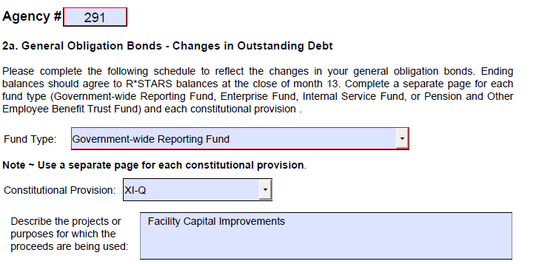
Changes in Debt Outstanding
Notes:
The first example Sangit (I) used was for the 2017 Series A XI-Q bonds - new money issue on pages _4,5 and 6__ of the examples handout.
We know that they are general obligation bonds so that determines which disclosure form to use.
The constitutional provision that authorizes the issuance of the bonds is XI-Q and the proceeds are being used for deferred maintenance projects on several of the prisons.
For the description of what the proceeds are being used for please give us some specifics.
If the description is capital projects, multiple projects, or it could equally apply to some other agency you should add some more details.
And please remember that some acronyms that you use in your agency may mean nothing to an outsider.
Now lets go to the bottom half of the form

Slide 117
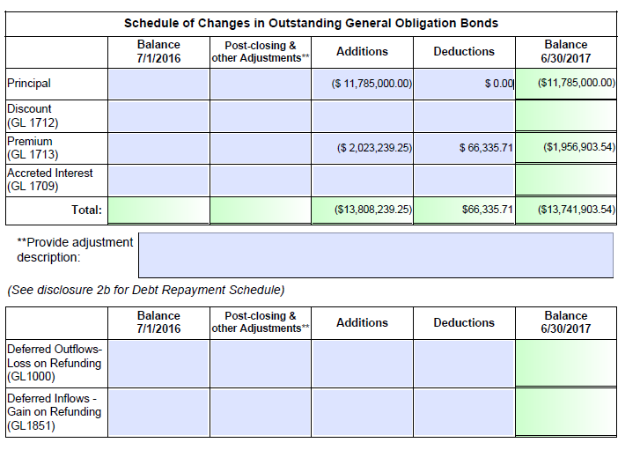
Changes in Debt Outstanding
Notes:
Before we go any further I want to point out that since the issuance was in FY 17, I am using disclosure from FY 17 to avoid confusion.
The amount of the new debt, $11,785,000 shows up as an addition on the principal line, the $2,023,239.25 as an addition on the premium line.
Since there is no principal payment in FY 17 as you can see in page 6, there will be no deduction in the principal line. The life of the loan is 122 months (March 1, 2017 through 05/01/2027). Amortization has to be deducted for 4 months in FY 17. You can calculate that by dividing $2,023,239.25 by 122 and then multiplying by 4.
Please note that both of these accounts are liabilities so they have brackets around them.
So the brackets need to be on the disclosures or they will be returned for correction.

Slide 118
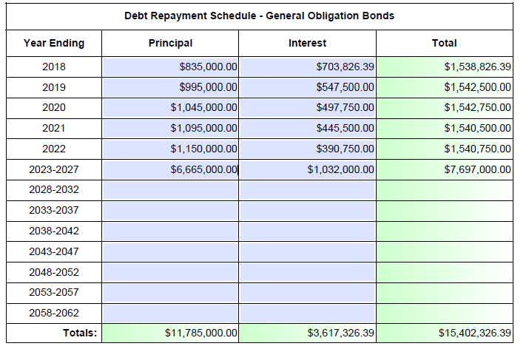
Debt Repayment Schedule
Notes:
The next section is the debt repayment schedule. This information comes right off the semi-annual payment schedule that is on page 6___ of your handouts.
Make sure that ending principal balance from the last slide matches with the Totals Principal in this slide. If they don’t match, then our SARS analyst will return the disclosure forms and ask you to revise the disclosure forms.

Slide 119
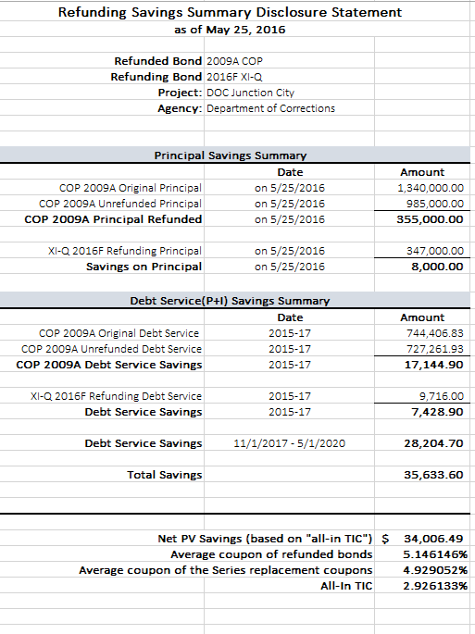
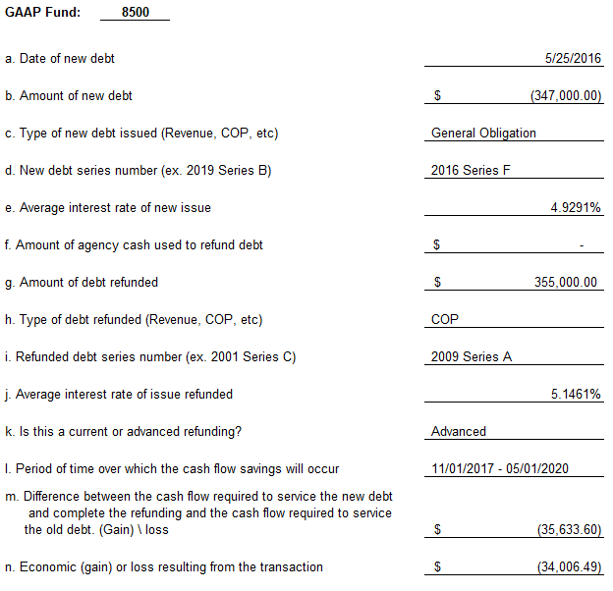
Debt Refunding
Notes:
The refunding example that Sangit (I) covered was for 2016 Series F GO Bonds refunding 2009 Series A COP.
If you will turn to page__14___ of your handouts you will see a copy of the savings summary for these bonds. When filling out the Debt Refunding disclosure form, you will have to use the Refunding Saving Summary that your received from DAS. This slide will show you where you get the information you need and required to be filled out on each line of the disclosure form.
If your debt was issued through DAS almost all of the information you will need to complete Debt Refunding disclosure is included in the savings summary.
If your debt was not issued through DAS please check with your debt people. Someone has already done the calculations.

Slide 120
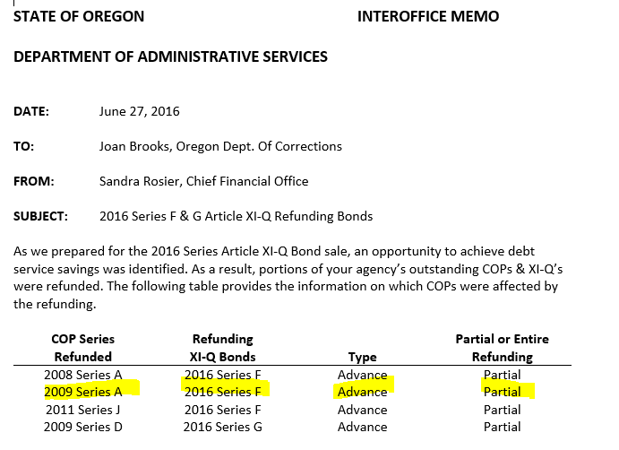
Debt Refunding
Notes:
The one piece of information that is not on this savings summary is whether this was a current or advanced refunding.
When the agency was notified of the refunding, they received this memo that indicated it was an advanced ** refunding.

Slide 121
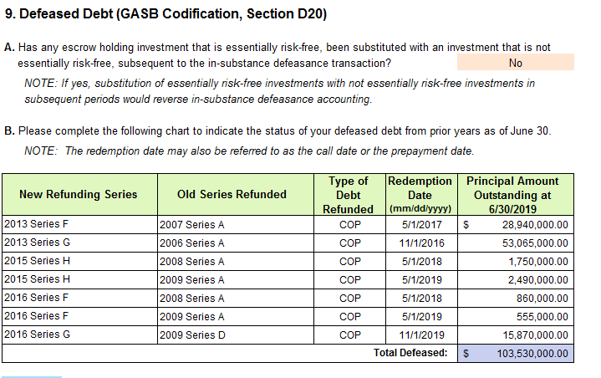
Defeased Debt
Notes:
Now, since this refunding took place in May of 2016, and it was an advanced refunding, it will need to be listed on the defeased debt disclosure.
The debt was taken off the books and is in an escrow account waiting until it can be paid out to the bond holder.
The information that you need to complete this disclosure come from DAS or from your agency debt managers

Slide 122
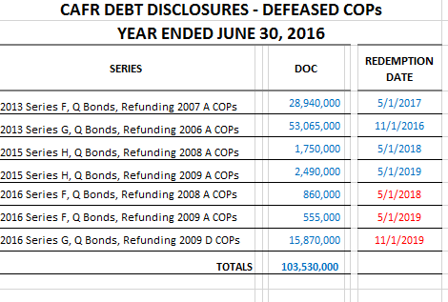
Defeased Debt Schedule
Notes:
This is a sample of the debt schedule that was sent out at year end of 2016 with the defeased COP information.

Slide 123
Disclosure Bloopers
LEARNING OPPORTUNITIES
Notes:
Lets talk about few learning opportunities.

Slide 124
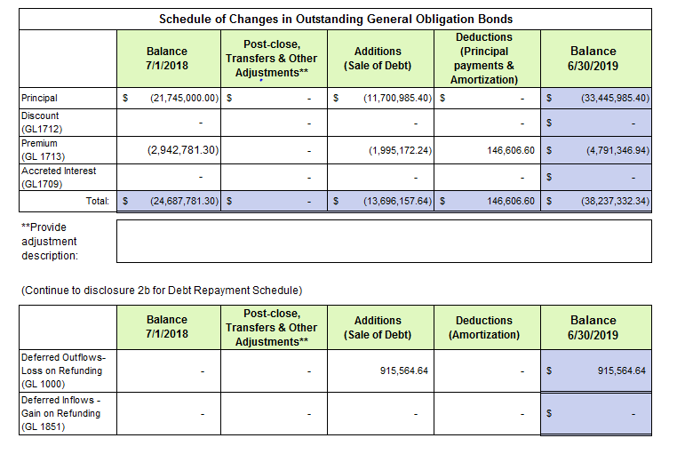
6610/6620 Doesn’t Match
Notes:
Before we go any further, let me give you few pointers:
The beginning balances, ending balances, additions and deductions you report on disclosure form need to match to DAFR 6610 and 6620 reports.
Lets look at this example. As you see, in this example,
For Principal: beginning balance is $21.7M, ending balance is $33M and additions to principal is $11.7M.
For premium: beginning balance is $2.9M, ending balance is $4.8M, addition is $1.99M and deduction is $146.6 thousand.
On the next slide are some check figures.

Slide 125
6610/6620 Doesn’t Match (continued)
DAFR 6620
GL Acct | GL ACCT Title | Prior Year |  | Current Year
1276 | BONDS PAYABLE-CURRENT | - |  | (595,000.00)
1714 | BONDS PAYABLE-NONCURRENT | (21,745,000.00) |  | (33,212,938.29) | (33,807,938.29)
1713 | PREMIUM BONDS SOLD | (2,942,781.30) |  | (4,791,346.94)
DAFR 6610 - REVENUE
Compt Obj | Compt Obj Title |  |  | Current Year
1500 | LONG TERM DEBT ISSUED |  |  | (3,900,000.00)
1505 | PROCEEDS FRM REFUNDING |  |  | (8,162,938.29) | (12,062,938.29)
1515 | DEBT ISSUANCE PREMIUM-PROP |  |  | (1,995,172.24)
DAFR 6610 - EXPENDITURE
Compt Obj | Compt Obj Title |  |  | Current Year
7450 | AMORT-DISC/PREM ON BONDS |  |  | 146,606.60
Notes:
On this slide you can see some of the accounts taken from DAFR 6610 and 6620 reports,
Lets first look at the Beginning Balances:
The beginning balance of Bonds payable of $21,745,000 match up to the prior year balance in the 6620
The beginning balance of Premium $2,942,781.30 match up to the prior year balance in the 6620
Lets look at the Additions and Deductions:
Additions to principal amount according to DAFR 6610 report should be $12,062,938.29, but if you look at the disclosure form, it is $11,700,985.40. Oops. The difference is $361,952.89. Looks like time to solve the mystery.
Additions and deductions to Debt premium matches to the disclosure form.
One thing that looks strange to me is that, there is long term debt issued and proceeds from refunding without a reduction in the principal, but I can’t tell without further information.
Lets looks at the ending balances:
The ending balance of Bonds payable of $33,445,995.40 from disclosure form does not match up to the current year balance in the DAFR 6620 of $33,807,938.29. There is a difference of $361,942.89. This is exactly the same difference in additions. To determine which amount is correct we would need revisit the source documents from the debt refunding.
The ending balance of Premium $4,791,346.94 from disclosure match up to the prior year balance in the DAFR 6620.
But the problem does not end there

Slide 126
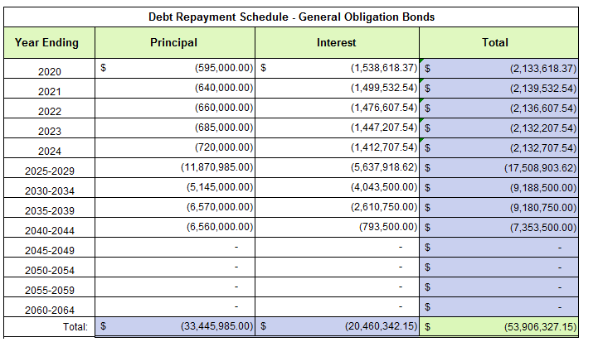
6610/6620 Doesn’t Match (continued)
Notes:
The ending principal balance must match the total of the principal column in the repayment schedule.
Since the balance matches the disclosure, but does not match the DAFR reports, there is potentially an issue here as well.
Either the disclosure needs to corrected or an entry needs to be made to correct the balance.
If you (or your SARS analyst) is making this comparison after period 13 has closed we might be looking at a post closing adjustment.

Slide 127
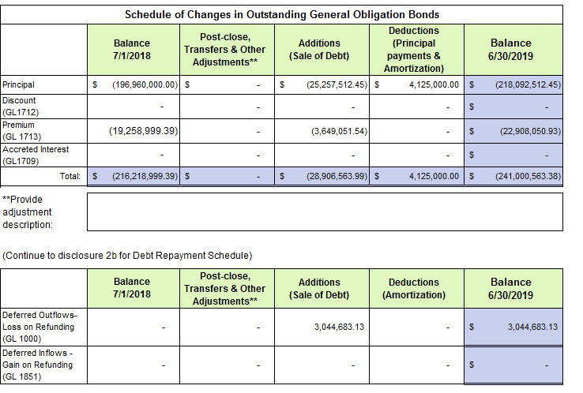
Netted Additions/Deductions
Notes:
As I have mentioned before, you do not want to net additions and deductions.
Lets try to tie the additions and deductions from this disclosure example to DAFR report (next slide)
The principal line was okay and the additions and deductions match with DAFR report.
Premium and deferred outflows-loss on refunding are netted together.

Slide 128

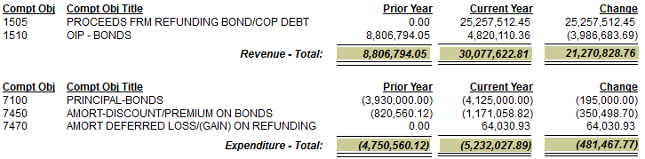
Netted Additions/Deductions (continued)

Slide 129
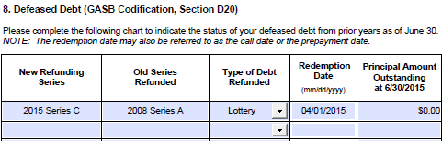
Zero Balance
Notes:
Save yourself some time. Do not report zero balance.

Slide 130
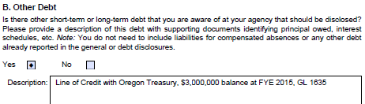
Duplication of Work
Notes:
This disclosure is for debt that your agency may have that has not been reported elsewhere in the packet.
In this case the same line of credit was appropriately reported on the short term debt disclosure #1.

Slide 131





Proceeds being used for:
Notes:
Please be specific. I don’t think that any of these descriptions could apply to a number of agencies.
If you have multiple projects mention the biggest ones.

Slide 132

Does it make sense?
Notes:
And the final review-does it makes sense what I am reporting?
What are the chances that when all of the different pieces of the refunding puzzle are put together that they would break even?
Sometimes, you need to step back from the trees occasionally to look at the forest.

Slide 133

Questions?
Notes:
So after all of this do you have any questions?

Slide 134
Resources
OAMs:
15.65.10 Bonds and Certificates of Participation
15.65.20 Arbitrage
15.65.30 Debt Refunding
Government Finance Officers Association Governmental Accounting, Auditing, and Financial Reporting Blue Book
SARS analyst
Notes:
Here is a listing of references that may help you:
-The latest debt related OAMs.
-The GAAFR or the Governmental Accounting, Auditing, and Financial Reporting Blue Book has an entire chapter on debt.
-Also, you can always contact your SARS analyst with any agency specific questions.
Please, if you are having problems, do not wait until the last day of period 13.
The debt and refunding entries are complex and it is best to get them completed as soon as possible. That will allow for review and to still have time to make adjustments when necessary. When you are making adjustments that might involve allocations in more than one d23 fund and then an offsetting adjustment to the liability, it is really easy to be off slightly. Unfortunately, this is an area where the offsets must be exact and adjustments of a few cents may be required.

Slide 135

Notes:
Thanks for coming.

