Slide 1


Sars year-end close training
June 11, 2019
9:00 a.m. – 11:30 a.m.

Slide 2
Agenda
Welcome & Introductions – Rob Hamilton
Update from SARS – Rob Hamilton
Year-end Close Schedule – Barb Watson
GASB 84 Fiduciary Activities – Stacey Chase
GASB 87 Leases – Alyssa Engelson
Applying Budgetary Policies at the End of the Biennium – Barbara Homewood
SEFA & CAFR Adjustments – Barbara Homewood
Restricted Cash & Investments – Shrikant Vajratkar
Report Government Fraud, Waste or Abuse – Shelly Cardenas, Oregon Audits Division
Disclosures – Rob Hamilton
Key Takeaways – Rob Hamilton

Slide 3
Update from SARS
FY2019 Agency Guide to Year-End Close:
  Updates in progress
  Email will be sent to the CAFR Contacts news list once the updated guide is posted to the SARS website
A/R t-code 945 usage:
  Use to reclassify document-supported A/R balances, assigned to Department of Revenue (DOR), in governmental funds only for year-end reporting.
  Use t-codes 474/474R to reclassify document-supported A/R balances, assigned to DOR, in proprietary and fiduciary funds for year-end reporting.
New GASB Pronouncements for FY 2019
  GASB 83 Certain Asset Retirement Obligations
  GASB 88 Certain Disclosures Related to Debt ,Including Direct Borrowing and Direct Placements

Slide 4
Year-end Schedule
FY 2019
Presented by Barb Watson
Notes:
Good morning! I am going to review the year-end schedule.
I will cover important due dates and go over the days that R*Stars and Datamart reports will be updated and available during year end close.

Slide 5

Due Date Reminders
Agency disclosures due Friday, August 16 (Gold Star Date)
SEFA disclosures due Friday, August 16 (Gold Star Date)
Agency Gold Star Award Criteria
  https://www.oregon.gov/das/financial/Acctng/Pages/Index.aspx
Verify outstanding balances with component units twice
  First communication no later than July 19
  Second communication no later than August 8
Schedule of Key Dates
  http://www.oregon.gov/das/Financial/Acctng/Pages/Yr-end-cls.aspx
Notes:
August 16th is a gold star date. Both the agency disclosures and the SEFA disclosures are due on August 16th – and both submissions are comprise gold star date requirement.
A list of the all of the gold star criteria dates can be found on the SARS website.
Contact the component units that you typically have transactions with to identify and confirm outstanding balances and record as agreed. Communicate two times in order to provide late-arriving information or to change previously communicated amounts. The outstanding balance that you report must agree to the Balance Sheet.
Outstanding balances of $100,000 or more with component units must be reported on Disclosure 30. All outstanding balances need to be recorded but only disclose those greater than $100,000.
Additionally , the Schedule of Key Dates can be found in the Guide to Year-End Closing - Chapter A

Slide 6

R*STARS Reports Year-end Schedule
Close of June is July 12, at which point there will be a full report run
During Month 13 (July 15 - Aug 9), agencies can request various R*STARS reports, which run each Tuesday evening
SFMA Calendar:
  https://www.oregon.gov/das/Financial/AcctgSys/Documents/2019SFMS-Agency-Calendar.pdf
Notes:
We will now review the year-end schedule for the R*STARS reports. A full report run will occur on July 13th which will close June business (month 12).
Beginning July 14th, agencies can request various R*STARS reports which will run each Tuesday evening, therefore the reports will be viewable on Wednesday morning throughout month 13 (July 15 through Aug 9)
The link to the SFMA calendar is noted on the slide for your reference

Slide 7

Datamart Tables Update Schedule
Updates over the weekend
  GL Detail Table
  GL Summary Table
  All Accounting Event Table
YE Tables – Contain FY 2019 data only
  Updates Tuesday/Thursday/Saturday evenings during Month 13
      YE GL Detail Table
      YE GL Summary Table
  Updates the final three Wednesday evenings of Month 13
      YE Accounting Event Table
  Repository Reports with “YE” in the title and the SWB Reports update on the same schedule.
Notes:
Now moving on to the Datamart Table updates.
Weekend Updates occur for the GL Detail Table, GL Summary Table & the All Accounting Event Table
The YE tables contain the current fiscal year only. The YE GL Detail Table and the YE GL Summary Table update three times per week during Month 13 – on Tuesday, Thursday, and Saturday evenings. Therefore updated information can be viewed on Monday, Wednesday and Friday.
The YE Accounting Event Table is updated each Wednesday evening during Month 13 allowing us to retrieve updated information each Thursday.
Please note that the repository reports that contain YE in the title and the Statewide Balancing reports update on the same schedule.

Slide 8
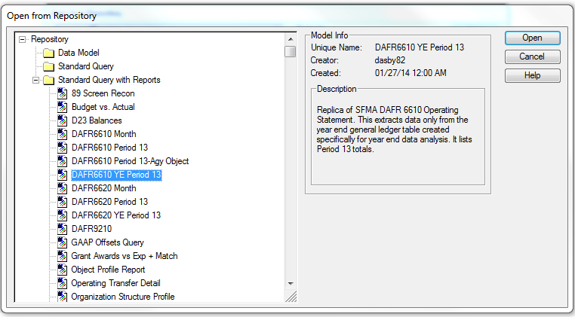
DAFR6610 YE Period 13
Operating Statement
DAFR6610 YE Period 13
START using
July 15, 2019
Notes:
Here is a screen print of the repository reports.
Looking specifically at DAFR 6610 YE Period 13 (also referred to as the operating statement), starting July 15th, which is the first day of Month 13, be sure to select the report with YE in the title, as shown here, to obtain the most current information. As a reminder, this will display current fiscal year information only.
This report is similar to the regular DAFR6610, but this Datamart report is linked to the YE tables. If you run the DAFR 6610 without the YE during month 13, you will retrieve data as on month 12.

Slide 9
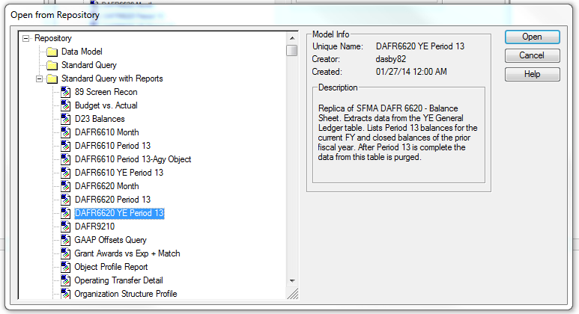
DAFR6620 YE Period 13
Balance Sheet
DAFR6620 YE Period 13
STOP using
August 12, 2019
Notes:
Here is another repository report example, this time with the balance sheet listed as DAFR 6620 YE Period 13. It is similarly linked to the YE tables.
Please remember that these year end tables are updated for a limited time. Their last update will occur on the evening of Thursday, August 8th, therefore viewable on Friday, August 9th, which is the last day of Month 13. On Monday, August 12th, be sure to revert to using the regular DAFR 6610 and 6620 reports.

Slide 10

Statewide Balance (SWB) Reports
Same update schedule as the YE Tables
  SWB Report Schedule and Reports
  Website:
    http://www.oregon.gov/das/Financial/Acctng/Pages/Balancing.aspx
No update messages will be sent out during Month 13
Notes:
Next up is the Statewide Balance Reports
As stated earlier these reports update on the same Tuesday/Thursday/Saturday schedule as the YE repository reports.
This slide lists the link for the Statewide Balance Reports as well as the processing dates.
Because of the increased frequency in the Statewide Balance Report updates during month 13, we will not be sending out a notice every time these reports are updated. But you can always reference the website which displays the latest date as shown on the next slide.

Slide 11
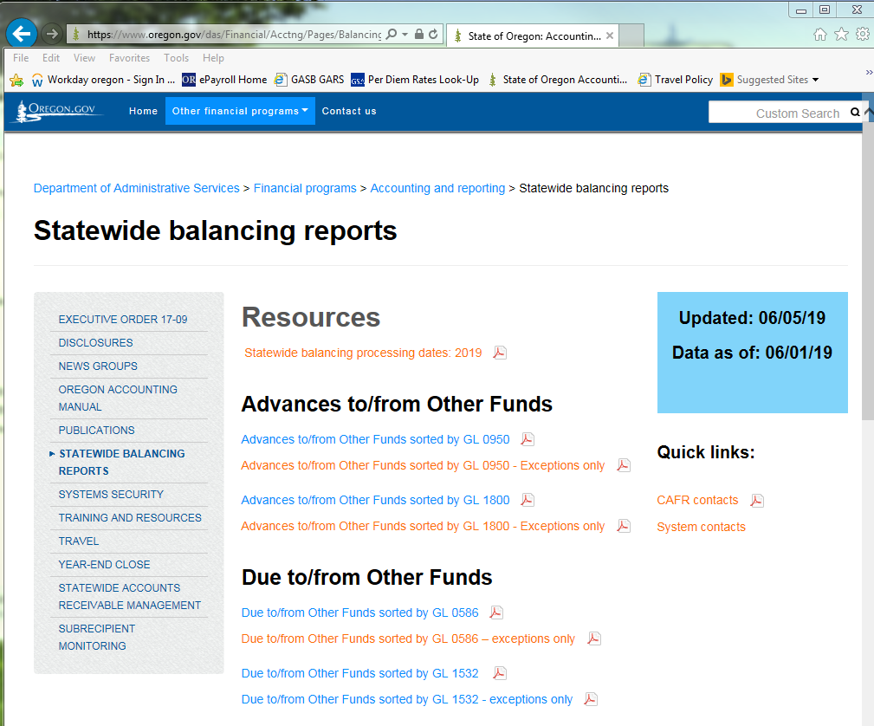
Statewide Balance (SWB) Reports
Notes:
This is a screen shot of the Statewide Balance Reports website. For June (Month 12), we run the Statewide Balance Reports weekly, and they will be run three times per week during Month 13.
The blue box indicates the date when the reports were updated and what timeframe the data reflects. Under Resources, there is a link to the Statewide Balancing Report Schedule for the whole year, listing the Report date and the respective period end date.
Note the link to System Contacts – this is helpful in determining who you should contact within the offsetting agency if there is an imbalance.

Slide 12
Resources for Month 13
Agency Guide to Year-end Closing
  http://www.oregon.gov/das/Financial/Acctng/Pages/Yr-end-cls.aspx
  Checklist located at Section D.10
  Instructions to access repository reports at Section D.4
Datamart ad hoc queries and repository reports
R*STARS reports
Statewide balancing reports
Prior year closing entries and disclosures
Chapter 15 of the Oregon Accounting Manual
SARS Analyst
Notes:
Here is a list of resources that may come in handy during month 13.
The agency guide on the SARS website is quite extensive and provides a check list in Section D.10. It is in the process of being updated and we will send out a notice to the CAFR newslist when complete. I strongly encourage you to become familiar with it -especially if you are new to the year end process.
The year-end guide also includes instructions on accessing the repository reports in section D.4
Analyze the Datamart Reports each time they are updated to ensure they reflect what is expected and ensure adjustments have been properly booked
Instructions for ordering R*STARS reports can be found in section D.3 – helpful reports include “Status of Appropriation and Expenditure”; “Trial Balance by Fund/GL”; “Revenues & Expenditures by Fund, Program, Object
As mentioned before analyze the Statewide Balance Reports each time they are updated
Also refer to your prior year closing entries and disclosures
Chapter 15 of the OAM covers just about everything
And last but certainly no least – use your SARS Analyst – if they don’t know they can track down someone who does!

Slide 13
Soft Close – August 2
Target August 2nd for all year-end adjustments
Utilize soft close to ensure interagency transfers are in balance
Review correspondence with your SARS analysts
Notes:
August 2 is the soft close date. Shoot for August 2 as your actual close date – not “oh no I have one only more week!” This will allow you and SARS to review and make any necessary adjustments to avoid rushing and eliminate the need for any post close adjustments.
Specifically work with the agencies with which you have imbalances. Review the imbalance reports each time they are updated to verify corrections and identify any new imbalances that need to be addressed.
Additionally, review any correspondence with your SARS analyst to ensure all outstanding issues are resolved.
Again target August 2 for all adjustments.

Slide 14
July 2019
Sun | Mon | Tues | Wed | Thur | Fri | Sat
7 | 8 | 9 | 10 | 11 | 12 Close Mo 12 | 13 SFMA upload
14 | 15 Begin using YE Period 13 Datamart reports SWB / SFMA YE updated | 16 | 17 SWB / SFMA YE updated | 18 | 19 SWB / SFMA YE updated | 20
21 | 22 SWB / SFMA YE updated | 23 | 24 SWB / SFMA YE updated | 25 YE Acctg Event table updated | 26 SWB / SFMA YE updated | 27
Notes:
There has been a lot of dates thrown at you in the past few minutes. The next two slides layout the dates we have discussed in calendar format. It summarizes the SFMA Closing Schedule and Datamart Processing calendar along with key SARS dates for your reference.
The dates noted are the dates the reports are viewable.

Slide 15
August 2019
Sun | Mon | Tues | Wed | Thur | Fri | Sat
28 | 29 SWB / SFMA YE updated | 30 | 31 SWB / SFMA YE updated | 1 YE Acctg Event table updated | 2 Soft Close SWB / SFMA YE updated | 3
4 | 5 SWB / SFMA YE updated | 6 | 7 SWB / SFMA YE updated | 8 YE Acctg Event table updated | 9 Close Mo 13 SWB / SFMA YE updated | 10
11 | 12 Start using Period 13 Datamart reports w/o YE | 13 | 14 | 15 | 16 Disclosures due to SARS (General, Debt, SEFA) | 17
Notes:
Note the soft close as discussed earlier on Friday, August 2. We encourage you to have all journal entries in by that date so there is time for any unexpected corrections.
Remember August 16th is the gold star dates for all disclosures.
Unless you have any questions, that’s it for me!
Next Stacey will give you an update on GASB 84.

Slide 16
Gasb 84 fiduciary activities
Presented by: Stacey Chase ☺

Slide 17
GASB 84 – Background Information
Provides specific criteria for identifying fiduciary activities.
  Enhances consistency and comparability of fiduciary activities reported by governments.
  Improves the value of information reported in financial statements.
Primary reporting changes:
  Eliminates Agency Funds.
  Creates Custodial Funds.
  Requires an Operating Statement for Custodial Funds.
Effective July 1, 2019 (for FY2020 financial reporting).

Slide 18

GASB 84 – Types of Activities
Identifies three types of fiduciary activities:
  Fiduciary component units.
  Pension and other post employment benefit (OPEB) arrangements that are not component units.
  Other fiduciary activities.
Provides criteria for each type of activity.
  Criteria illustrated in Decision Tree.

Slide 19
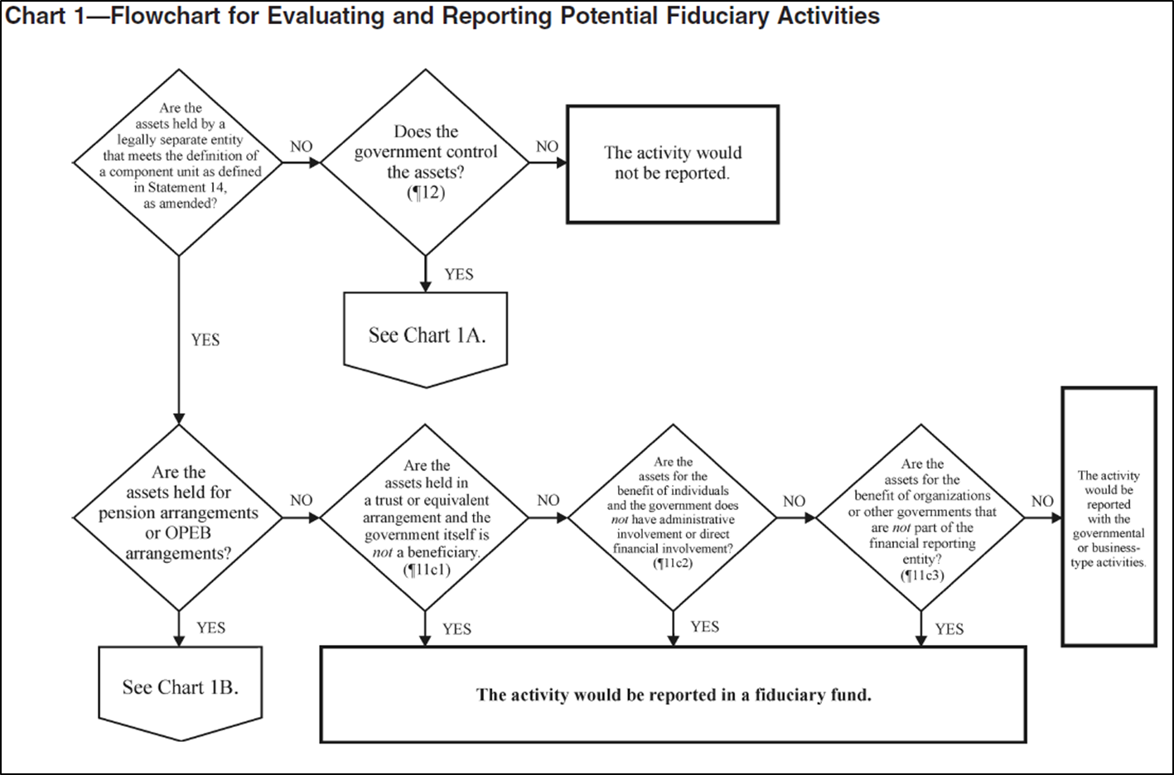
GASB 84 - Decision Tree (chart 1)
Notes:
Flowcharts officially referenced in the statement.

Slide 20
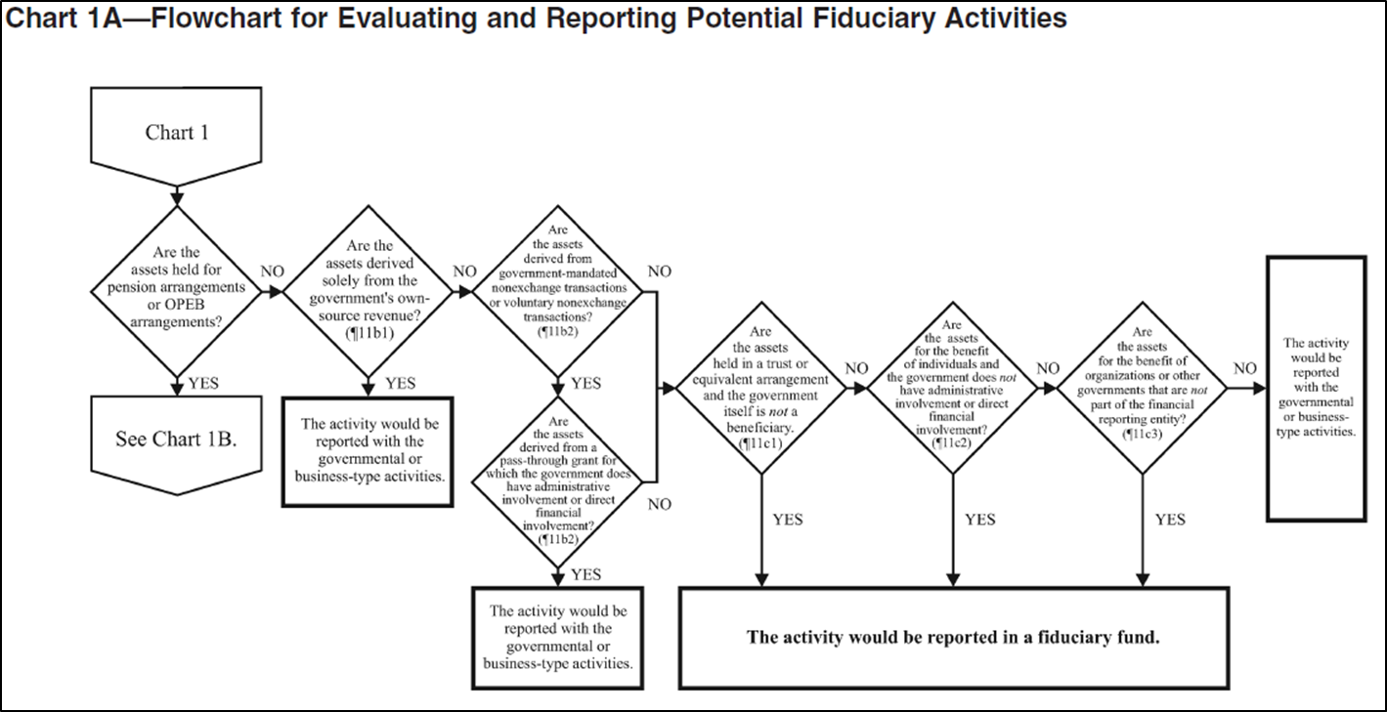
GASB 84 - Decision Tree (chart 1a)
Notes:
Flowcharts officially referenced in the statement.

Slide 21
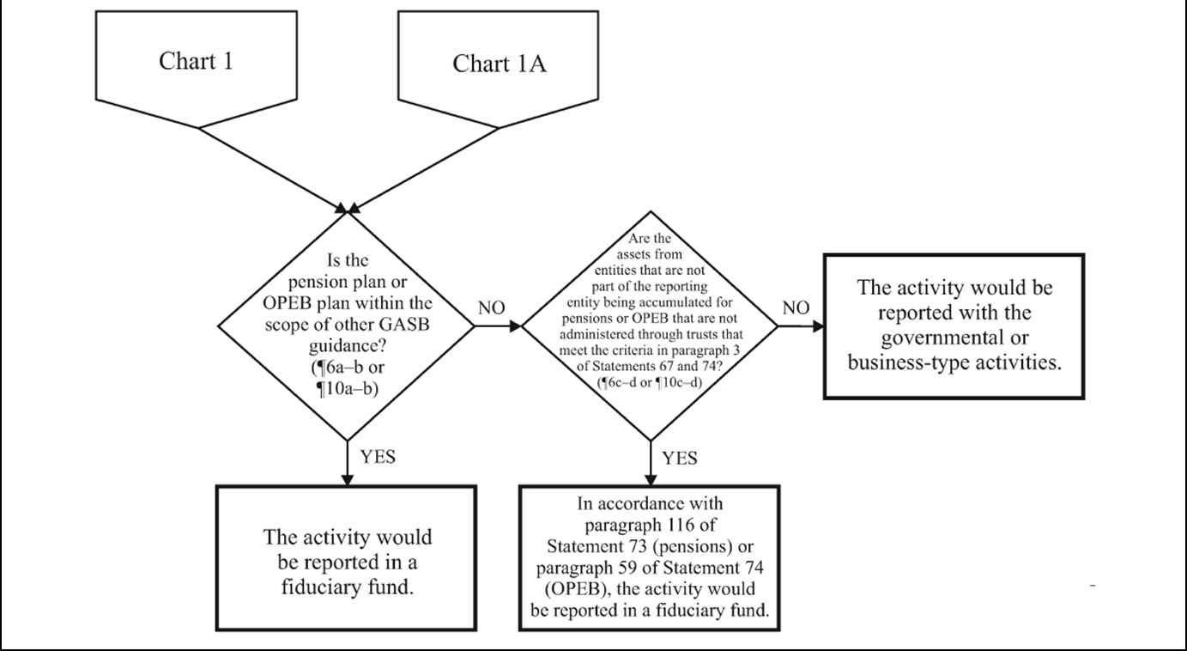
GASB 84 - Decision Tree (chart 1b)
Notes:
Flowcharts officially referenced in the statement.

Slide 22




GASB 84 - Agency Evaluation
Does the agency have fiduciary activities?
Maybe?
I sure hope not.

Slide 23
GASB 84 - Agency Evaluation
Review balances reported as custodial assets.
  D14 Balance sheet class 021.
  GLs 0330, 0335, 0945.
Review balances reported as custodial liabilities.
  D14 balance sheet class 160.
  GLs 0060, 1550, 1551, 1575, 1576, 1577, 1578.
Evaluate activities reported in the private purpose trust fund (GAAP Fund 7002).
Evaluate activities reported as agency funds (GAAP Funds 6405 and 6406).
Notes:
Emphasis: STARTING POINT!!
Agency funds (GAAP funds 6405 and 6406).
-Repurposed as clearing accounts for use by Oregon State Treasury (OST) and Oregon Housing and Community Services (OHCS) only.

Slide 24

GASB 84 - Agency Evaluation
Determine where fiduciary activities should be reported:
  Pension and OPEB trust funds.
  Investment trust funds.
  Private purpose trust funds.
  Custodial funds.
Notes:
Private purpose trust funds – include trust or equivalent arrangement
Custodial funds – no held in trust
Refer to OAM 05.20.00 for GAAP fund numbers

Slide 25

GASB 84 - Accounting changes
Custodial funds will be reported on the Operating Statement (DAFR 6610).
  Sources of additions/inflows (e.g. restitution payments received).
  Types of deductions/outflows (e.g. restitution distributions to individuals).
Notes:
As a result…next slide

Slide 26

GASB 84 - Accounting Changes
New appropriation(s)?
  Coordinate with agency budget staff.
  Ensure profiles are capable of recording revenues and expenditures.
  Send appropriation profile (20) requests to: orbits.help@state.or.us
    Trust/Custodial fund is subject to GASB 84.
    Include authority to be non-budgeted.
    Include the current D23 fund.
New D23 fund(s)?
New account codes to record custodial fund inflows and outflows?
Notes:
New account codes to record custodial fund inflows and outflows?
-PCAs
-Comptroller object codes?
-Agency object codes?
-Project numbers (to track individual accounts)?

Slide 27

GASB 84 - Agency Implementation
Record custodial fund inflows and outflows in FY2020.
Process reclassification entries in FY2020.
  Reclassify fiduciary activities to the correct GAAP fund in FY2020.
  Reclassify custodial asset balances in FY2020, if applicable.
  Reclassify custodial liability balances in FY2020, if applicable.
Eliminate deposit liability balances associated with fiduciary activities.
  Reclassify to revenue in FY2020.
  Record change in accounting principle in FY2020.
Notes:
Deposit liabilities:
-clear the deposit liability
– record revenue
– record change in accounting principal in the “new fiduciary fund”; there isn’t a change in fund equity in the original fund.

Slide 28
GASB 84 - Summary
GASB 84 is effective July 1, 2019 (FY2020)!
Agency evaluation starts now; if not already underway.
Identifying applicable accounting changes starts now, if not already underway.
Agency implementation may begin after FY2019 disclosures are submitted to SARS.
  Once agency year-end close processes are complete, begin reclassifying applicable account balances.
  Some SFMA profile changes are scheduled to occur after August 16, 2019.
Notes:
RECAP!!
To ensure changes aren’t inadvertently made associated with FY2019 efforts, we encourage agencies wait to begin reclassifying activity after all FY2019 reporting is completed.

Slide 29

GASB 84 - Summary
Next steps for SARS:
  Updating applicable OAM policies.
  Creating a new OAM policy.
  Evaluating GL accounts.
  Establishing new SFMA profiles, as needed.
Notes:
Associations and boards: link to governmental accounting standards board

Slide 30
GASB 84 - Resources
SARS Training and Resources webpage: https://www.oregon.gov/das/Financial/Acctng/Pages/Training.aspx
  Accounting and reporting training
    June 14, 2018 SARS Year-End Close Training (pages 16-26)
    May 23, 2019 GASB 84 Fiduciary Activities Training
  Associations and Boards
    Governmental Accounting Standards Board
SARS contacts:
  Stacey Chase (stacey.a.chase@oregon.gov)
  Barbara Homewood (barbara.homewood@oregon.gov)
Notes:
Associations and boards: link to governmental accounting standards board

Slide 31


Slide 32
GASB 87 Leases
Presented by Alyssa Engelson
Notes:
Hello!
My name Alyssa Engelson. I joined SARS in March 2018, so this will be my first time presenting at Year-End Close training!
Today, I am fortunate enough today to present about GASB 87!

Slide 33
GASB 87- Overview
Background Information
Status Updates
Planning Phases
Asset Class Matrix
Lease Data Matrix
Summary of Next Steps
Notes:
The following is an overview of what I plan to cover during this presentation.
We’ll be doing a quick recap of what Rob Hamilton presented during last year’s year-end close training to provide some background information on GASB 87.
Then, I’ll provide some updates on what has happened since last year-end close training! (Hint: it’s a lot!)
I’ll be giving some detail on some planning phases that the GASB 87 implementation team has drafted, which can be used as a resource as you navigate the implementation world.
Next, I’ll present an overview of the results from the Asset Class Matrix poll SARS performed in April 2019.
After that, I will be presenting the Lease Matrix, which is another tool developed form the implementation group.
Finally, we will conclude with a summary of the next steps as we get close to implementing this standard!

Slide 34
GASB 87- Background Information
A lease is a contract that conveys control of the right to use another entity’s nonfinancial asset (the underlying asset) as specified in the contract for a period of time in an exchange or exchange-like transaction
  Underlying asset does not have to be a capital asset
Lease term – noncancelable portion plus options that are “reasonably certain” of being exercised
Contracts that contain a lease component and a nonlease component must be accounted for separately
Notes:
Background information
A lease is a contract that conveys control of the right to use another entity’s nonfinancial asset (the underlying asset) as specified in the contract for a period of time in an exchange or exchange-like transaction
Please note, the underlying asset does not have to be a capital asset
Lease term is the noncancelable portion plus options that are “reasonably certain” of being exercised
What is reasonably certain? This language is straight from the Standard. Since we couldn’t find a definition provided by GASB, we interpret reasonably certain to mean that with all the information available to you at the time, you know that your agency will absolutely exercise the option to extend the lease.
For example, if there is a clause that the lease could be extended by 6 months and the agency is sure they will exercise that option, that 6 months should be added to the total lease term.
Contracts that contain a lease component and a nonlease component must be accounted for separately

Slide 35
GASB 87- Background Information
Effective for the fiscal year beginning July 1, 2020 (FY 2021)
Implementation Guide released February 2019
  Final draft expected July 2019
GASB 87 establishes a single model for lease accounting on the foundational principle that leases are financings of the right to use an underlying asset
  No more operating or capital leases
  Most similar to a capital lease, but not the same
Notes:
This Standard is effective for July 1, 2020 (FY 2021)
While it may seem like we have quite a while until the Standard is implemented, this Standard requires a lot of pre-work before implementation. We hope this training will help provide a head-start!
Current Exposure Draft was released in February 2019
Final draft expected July 2019
GASB 87 establishes a single model for lease accounting on the foundational principle that leases are financings of the right to use an underlying asset
No more operating or capital leases
Under the new Standard, accounting for leases will be most similar to a capital lease, but it is not the same

Slide 36
GASB 87- Status Updates
Stacey Chase named as new lead representative from SARS
Alyssa Engelson and Barb Watson are supporting Stacey in her lead role
Formed Implementation Team
  30 members total from 14 different agencies
  4 Meetings
  The following materials have been developed from the team:
  Planning Phases
  Asset Class Matrix
  Lease Data Matrix
Notes:
So what has happened since the last year-end close training?
As of March 2019, Stacey Chase has been named the Senior Financial Reporting & Policy Analyst. She will be leading the GASB 87 implementation efforts along with other GASB standards. Barb Watson and I will be supporting Stacey and will be available to answer any questions agencies may have before, during, and after the GASB 87 Implementation.
There was an Implementation Team formed and we had our first meeting on October 30, 2018. We have 30 members on the team from 14 different state agencies. We’ve had a total of 4 meetings so far, and our last meeting was held on April 3, 2019. The Implementation team has worked together to identify opportunities and challenges during the early stages of the implementation process. Together, we have developed planning phases, an asset class matrix and lease matrix to help with implementation. We will be discussing these tools a little later in the presentation.

Slide 37
GASB 87- Planning Phases
SARS developed planning phases to help agencies navigate how best to implement the standard
Please note these planning phases are a starting point. Agencies should include additional goals, as needed
Phases:
1- Research/Identify
2- Develop
3- Execution
Notes:
Planning phases were drafted by the implementation team to help successfully implement GASB 87. With so many different elements required in the Standard, the planning phases were drafted as an aid to visually represent the steps that need to be taken with relation to the implementation process. Please note that the planning phases drafted are a starting point. Agencies should include different or additional goals as needed for their specific agency.
Three phases that were identified include:
Phase 1- Research/Identify
Phase 2- Develop
Phase 3- Execution
Let’s find out what action items are included in each stage.

Slide 38
GASB 87- Planning Phases
Phase 1-Research
Identify other contracts not previously deemed a ‘lease’ that identify ‘right to use’ assets
Identify impacted employees in agency divisions
Determine resources available to obtain required data elements in Lease Data Matrix
Identify data availability challenges
Notes:
Phase 1- Research
The following are some actions items that were identified that needed to be the starting point of implementation. The answers to these actions items will aide in how to best move forward in phase(s) 2 & 3.
During the research phase, it is encouraged that agencies:
Identify other contracts not previously deemed a ‘lease’ that identify ‘right to use’ assets
Outside of leases, it may be important to look at other documents that may not have been deemed a ‘lease’ before GASB 87
Identify impacted employees in agency divisions
Some agencies might need to contact their Procurement personnel to help obtain/interpret leases
For example, DAS-SARS has worked with DAS Procurement and DAS Real Estate Services. Those divisions were instrumental in obtaining key information related to existing DAS leases to understand the impact the new Standard will have on the agency as a whole. DAS Real Estate Services is looking to provide as much information as possible for all agencies that have leases through them.
SARS is looking to work directly with RICOH, and statewide copier contracts held with RICOH, so that agencies wouldn’t need to.
Determine resources available to obtain required data elements in Lease Matrix
Is there an application that could help streamline how information is gathered? Some agencies that are part of the implementation team are looking to see if their Fixed Asset Systems can extract information for them.
Identify data availability challenges
What required information is difficult to obtain just by looking at the lease document? What are ways these challenges could be resolved?
Once these actions items have been completed, the agency could move onto the next phase, development!

Slide 39
GASB 87- Planning Phases
Phase 2- Develop
Create a process for evaluating and identifying leases based on standard criteria
Develop an internal training strategy for impacted employees identified during Phase 1
Develop a mechanism to share required data between impacted employees identified in Phase 1 (e.g. central data repository)
Notes:
Phase 2- Develop
The answers to these actions items will aide in phase 3-Execution
During the development phase, it is encouraged that agencies:
Create a process for evaluating and identifying leases based on standard criteria
Consider using the Lease Data Matrix, which will be presented in a few more slides.
Develop an internal training strategy for impacted employees identified during Phase 1
Ensure all impacted employees are familiar with key points of the Standard and understand their resources if they have questions
Develop a mechanism to share required data between impacted employees identified in Phase 1
Consider using a central data repository so associates from different division can access all applicable data relating to leases
Once these actions items have been completed, the agency could move onto the next phase, execution!

Slide 40
GASB 87- Planning Phases
Phase 3-Execution
Evaluate and identify leases based on GASB 87 criteria
Gain all required data elements associated with existing leases
Collect all required data elements associated with future leases
Share required data elements between impacted employees using mechanism developed in Phase 2
Enter required data elements into SFMA or equivalent (e.g. TEAMS)
Notes:
Phase 3- Execution
The answers to these actions items will aide in a smooth implementation.
During the execution phase, it is encouraged that agencies:
Evaluate and identify leases based on GASB 87 criteria
Using processes established during the development phase
Gain all required data elements associated with existing leases
This includes any ‘contracts’ that were identified as having a ‘right-to-use’ asset
Again, consider using the Lease Data Matrix (to be presented) for a uniform approach in gathering required data
Collect all required data elements associated with future leases
Share required data elements between impacted employees
Use mechanism identified during development phase
Will likely be sharing information between accountants, procurement staff, and facilities management staff
Enter required data elements into SFMA or equivalent
SARS working on developing proper GL Accounts and T-Codes
More guidance to come as implementation gets closer

Slide 41
GASB 87- Planning Phases
Highlights of SARS planning phases
Analyze impacted OAM policies and applicable paragraphs
Identify impacted GL Accounts, Comp Objects, and T-Codes
Determine how Financial Statements/Cash Flow formats will be impacted
Distribute new disclosures
Generate training material for statewide implementation
Notes:
SARS Planning Phases
At SARS, we developed our own planning phases to help us create goals and visually ensure we are incorporating all necessary steps before the implementation date. The following are some of the highlights:
Analyze impacted OAM policies and applicable paragraphs
We will be revising applicable OAM policies identified
Identify impacted GL Accounts, Comp Objects, and T-Codes
We developed an Asset Class Matrix, which was sent out statewide, to help with this identification. I will be presenting the results of that inquiry on the next slide.
Determine how Financial Statements/ Cash Flow formats will be impacted
SARS will be making all format changes, as needed, to ensure the statements are in compliance with the Standard.
SARS will distribute new disclosures
Expect new disclosures by for FY 2021.
Will generate training material for statewide implementation
Before implementation in FY 2021, SARS will put together a training which will be available to all state agencies. This training will be to help provide additional implementation guidance.

Slide 42
GASB 87- Asset Class Matrix
Purpose: To ensure all asset classes with leases are represented in the chart of accounts
  Leases with other state agencies were excluded
  Software leases were excluded
Notes:
One of the action items on SARS’ planning phases is to identify all GL Accounts, Comp Objects and T-Codes affected by the changes brought on by the Standard. As such, SARS will need to update the Chart of Accounts to ensure completeness.
SARS developed the Asset Class Matrix to help understand the quantity and category of the leases agencies currently have, both as lessees and lessors. Ultimately, SARS wanted to understand if agencies had a large number of leases that wouldn’t be able to be classified using the current Asset Classes represented in the Chart of Accounts.
In April 2019, SARS sent out a statewide request asking all agencies to provide a general estimate of the number of leases per asset class they had.
Leases that were excluded from the poll include leases with other agencies and software leases.

Slide 43
GASB 87- Asset Class Matrix
Lessees:
86 agencies were polled
70 responded to the request
3,302 leases identified so far
Lessors:
86 agencies were polled
70 responded to the request
729 leases identified so far
Notes:
SARS summarized all of the results received by agencies and found the following:
Lessees:
86 agencies were polled
70 responded to the request
3,302 leases identified so far
Lessors:
86 agencies were polled
70 responded to the request
729 leases identified so far
Generally speaking, we found that the asset classes in the current Chart of Accounts are sufficient to represent the types of leases agencies have.

Slide 44
GASB 87- Lease Data Matrix
The lease data matrix was developed by the implementation team to be used as a tool that would help ensure all required data elements from the Standard are captured when reviewing leases
Goal:
  To use this matrix for all existing leases (at implementation) and new leases (following implementation)
  Provide uniform approach to identifying essential data elements required by the standard
Notes:
Lease Matrix
The lease matrix was a tool developed by team members of the implementation team. This tool was developed because the requirements of the standard are many, and the group wanted a resource to help them ensure they are capturing all required data elements from the Standard.
The goal of the lease matrix is to provide a uniform approach to identify essential data elements required by the Standard. The goal would be to use this matrix for all existing leases (at implementation) and new leases (following implementation). This would not be required, but hopefully most agencies find this to be a useful tool that can be utilized.

Slide 45
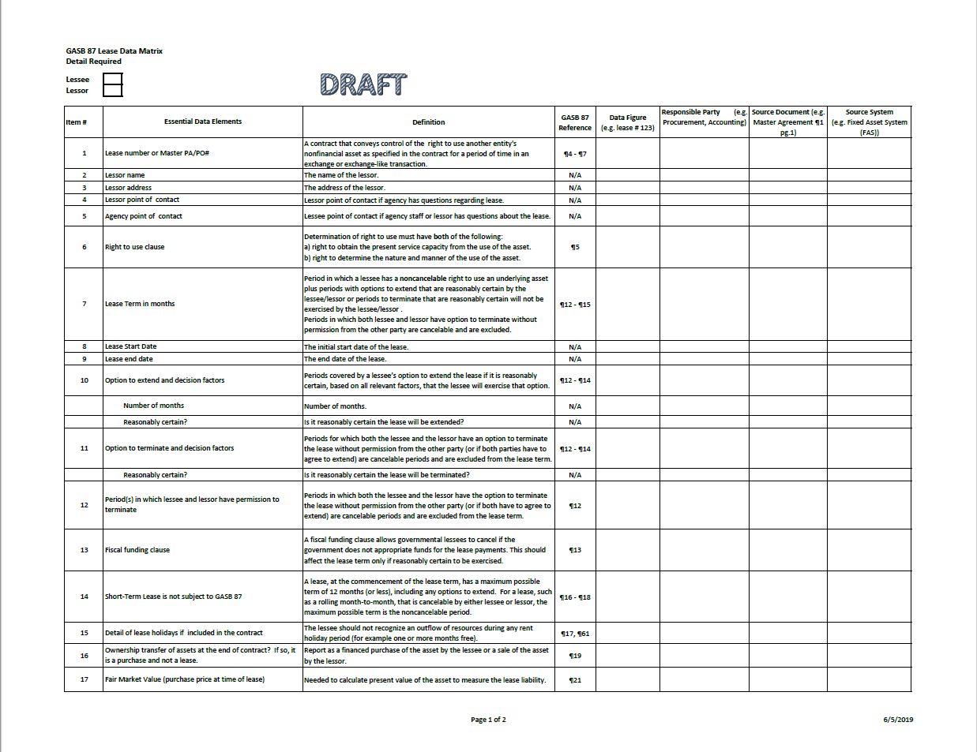
Notes:
The following two slides are a visual representation of what the most current draft of the lease data matrix looks like. We know you likely won’t be able to make out the detail on this slide, but this Lease Data Matrix will be up on our website for your convenience. Please note, this data matrix is still in draft form.
Overall, there are 33 essential data elements listed. Each essential data element has a definition listed. This will be helpful for all staff, in case they have questions, as well as if this matrix will be passed to departments like Procurement. These definitions will provide some consistent guidance on what the essential data element is.
Each essential data element also has the GASB 87 reference listed to eliminate the guess work on how that essential data element was determined to be essential.

Slide 46
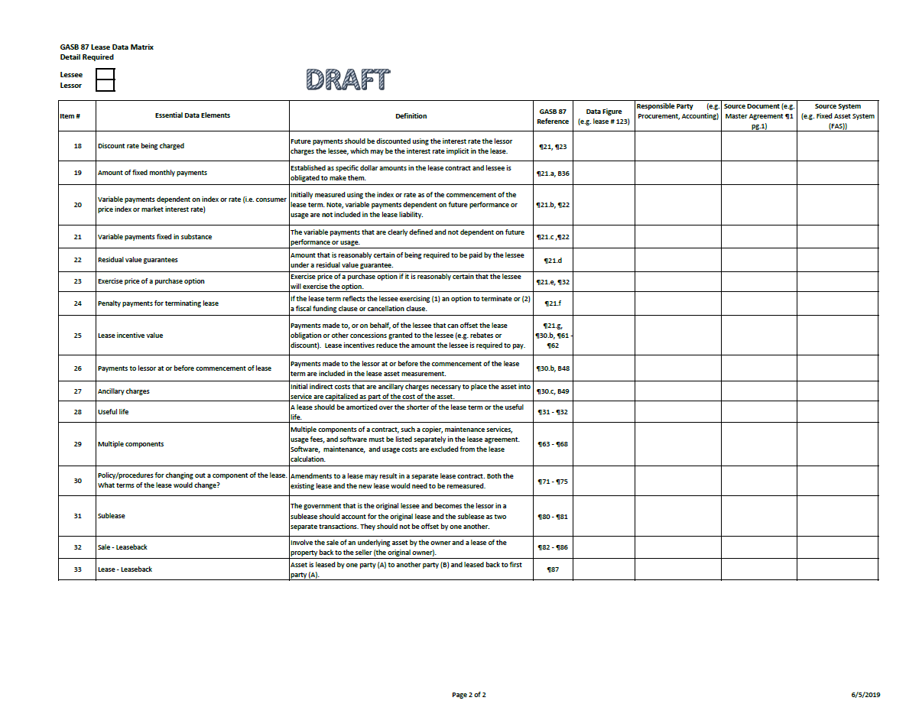
Notes:
The remaining columns are a space for the employee completing the matrix to fill in the information that is needed. These columns include the data figure, responsible party, source document, and the source system. That way, any employee could pick up the lease, and this lease matrix attached, and know who the responsible party for providing the information was, where that responsible party obtained that information, and from which source system the information came from.
It is our hope this tool can be used so that the information gathering process is as transparent as possible, and if any questions arise, it will be easy to know who to contact.
Overall, this lease data matrix is a tool for you to use. SARS will not need a copy of this matrix, if you choose to use it.

Slide 47
GASB 87- Summary of Next Steps
Finalized Exposure Draft expected July 2019
Encouraged to create a process for evaluating and identifying leases based on standard criteria
Begin to identify impacted employees in agency divisions
Start identifying other contracts not previously deemed a ‘lease’ that identify ‘right to use’ assets
SARS will be developing new chart of account options
Notes:
Summary of Next Steps
Finalized Exposure Draft expected July 2019
Agencies are encouraged to create a process for evaluating and identifying leases based on standard criteria
Feel free to use the Lease Data Matrix as a guide on where to get started. To the best of our knowledge, the elements listed capture what is required of the Standard.
Start now to find out what methods work best for your agencies.
Begin to identify impacted employees in agency divisions
This may include forming new relationships with departments like Procurement to help relieve some of the pressure of an accountant having to perform all of the work gathering required data elements on their own.
Start identifying other contracts not previously deemed a ‘lease’ that identify ‘right to use’ assets
While the implementation for this Standard seems far away, it isn’t. This new Standard will require a lot of work to prepare for proper implementation, so get a head start!
SARS will be developing new chart of account options
SARS team is actively working on developing options. More information will be provided as it becomes available.

Slide 48
Questions?
Contact us:
Stacey Chase: Stacey.A.Chase@Oregon.gov
Alyssa Engelson: Alyssa.Engelson@Oregon.gov
Barb Watson: Barbara.Watson@Oregon.gov

Slide 49
Applying Budgetary Policies at the End of the Biennium
Notes:
Good morning everyone:
As we are rapidly approaching the end of the 17-19 biennium, so we thought it would be a good idea to review the application of budgetary policies.
The differences between Generally Accepted Accounting Principles and Budgetary Accounting Policies become very apparent when transitioning from one biennium to another.
Since the start of a new biennium only happens every two years, we wanted to provide a bit of a refresher.

Slide 50
Can I still record this in the old biennium?
Notes:
My goal today is to provide you with the tools necessary to confidently answer this question: Can I still record this transaction in the 17 - 19 biennium, aka AY19?

Slide 51

Key Topics
General Fund Revenue / Receivables
Interfund Transfers with General Fund
Expenditures
Encumbrances
Commitments
Notes:
Here is a summary of the topics we will cover today regarding Budgetary Policies:

Slide 52
Fiscal vs. Appropriation Year
Generally Accepted Accounting Principles (GAAP) requirements determine which fiscal year (FY) transactions should be recognized
Oregon’s budgetary accounting policies established in the OAM determine which appropriation year (AY) transactions should be recognized
Notes:
As accountants, have the challenge of not only closing the fiscal year but also closing the appropriation year.
Let’s start out by looking at the difference between a fiscal year and an appropriation year.
A fiscal year begins each July 1 and runs through the following June 30—every year. It is identified by the calendar year in which it ends, so we are about to wrap up fiscal year 19 and begin fiscal year 20. Generally Accepted Accounting Principles, or GAAP, provides the basis to determine in which fiscal year a transaction should be recognized.
The appropriation year, or AY, begins on July 1 of an odd-numbered year and continues until June 30 of the following odd-numbered year.
It is also identified by the calendar year in which it ends, so we are about to finish appropriation year 19 and begin appropriation year 21.

Slide 53
General Fund Revenue
Recognize General Fund revenue in the appropriation year during which the revenue was received in cash
Revenue recognition for Federal, Lottery, and Other funds is not addressed in budgetary policies
Notes:
I want to point out that in the slides today, I regularly refer to the General Fund.
There are several different definitions of what the General Fund is made up of depending on whether you are talking about GAAP reporting requirements, banking, or some other definition.
For this presentation I am only talking about the budgetary General Fund, which represents appropriated funds that begin with the number “8”.
A key to remember: for the budgetary General Fund, revenue is recognized in the appropriation year in which the cash was received.
There is no accrual of revenues in the General Fund for budgetary purposes. It is strictly cash basis with the possible exception of some entries at the Department of Revenue or for Capital Construction. However, as a side note, for financial reporting purposes an accrual will take place. We will see examples of this in the slides that follow.
These budgetary guidelines do not apply to all fund types; only to the general fund.
Revenue recognition for Federal, Lottery, and Other Funds are not addressed in the budgetary chapter of the OAM.
These rules are critical because of the calculation done to determine if the general fund revenue is sufficient to trigger the “kicker”.

Slide 54
General Fund Revenue Accrual
Agency receives General Fund revenue on July 5:
Cash revenue will be recorded in AY 21
Accrued revenue needs to be recorded in fiscal year 2019 for financial reporting purposes
Notes:
Here’s an example based on this concept:
An agency receives General Fund revenue on July 5th for an amount owed to the State on June 30th. For this scenario, the timing crosses both the fiscal year and the appropriation year.
For budgetary reporting purposes, this revenue is recorded in appropriation year 21.
However, for financial reporting purposes, this would be considered revenue in fiscal year 19 and should be accrued.

Slide 55
General Fund Revenue Accrual Example
Accrue General Fund revenue for financial reporting:
TC 436 (Month 13, FY 2019, AY 19)
  Dr 0503 Accounts Receivable - Unbilled
    Cr 3105 Revenue - FS Accrual
Auto reversal of TC 436:
TC 981 (Month 1, FY 2020, AY 19)
  Dr 3105 Revenue - FS Accrual
    Cr 0503 Accounts Receivable - Unbilled
Notes:
For financial reporting requirements, accrue the revenue using t-code 436 in month 13, fiscal year 19, and appropriation year 19.
This will debit GL 0503 and credit GL 3105.
This entry will automatically reverse in month 1 of fiscal year 20, and appropriation year 19.
As a result of these entries, revenue is recognized in fiscal year 19 in accordance with GAAP (via t-code 436), and after t-code 981 is posted, there is a zero net impact to revenue for appropriation year 19.

Slide 56
General Fund Revenue Accrual
Example (continued)
Record General Fund cash revenue:
TC 190 (Month 1, FY 2020, AY 21)
  Dr 0065 Unreconciled Deposit
    Cr 3100 Revenue - Cash
Notes:
For budgetary purposes, record the general fund cash using t-code 190 in month 1, fiscal year 20 , appropriation year 21.
This will debit GL 0065 and credit GL 3100. This records the revenue in appropriation year 21, which is in accordance with the OAM budgetary policy.
The auto-reversal t-code 981 and t-code 190 are both recorded in fiscal year 20, and thus, there is a zero net impact to revenue.

Slide 57
Move General Fund Receivable
Document supported General Fund receivables, not collected as of June 30, 2019, will need to be moved to the new biennium
Non-document supported receivable accruals do not need to be moved:
  TC 436 will auto reverse
  TC 104 will need to be reversed using TC 104R
Notes:
If you have document supported general fund accounts receivable that will not be collected by June 30 you will need to move them to the new biennium.
_____________________________
Non-document supported receivables do not need to be moved.
Tcode 436 is usually used and it will auto reverse with a system generated tcode 981
But if tcode 104 is used, it will need to be manually reversed with a 104R

Slide 58
Move General Fund Receivable
Example
A General Fund accounts receivable was initially established in AY 19 but was not collected by June 30, 2019
Initial entry (AY 19) was:
TC 103 Establish doc supported A/R
  Dr 0501 Accounts receivable – Billed
    Cr 3101 Revenue – Accrued
Notes:
Let’s look at an example to see why it is necessary to move the document supported receivables:
Let’s say in appropriation year 19 you recorded an entry with T-code 103 which recognized revenue that you now know will not be received in AY 19.
The following steps will show how to move the General Fund Accounts Receivable forward to the new biennium.

Slide 59
Move General Fund Receivable
Example (continued)
Step 1:
Reverse A/R established with TC 103 but not yet collected at June 30
TC 118 (Month 12, FY 2019, AY 19)
  Dr 3101 Revenue – Accrued
    Cr 0501 Accounts Receivable – Billed
Notes:
First you will first need to reverse the accounts receivable that was established previously with T-code 103 by using T-code 118 in month 12, fiscal year 19, appropriation year 19.

Slide 60
Move General Fund Receivable
Example (continued)
Step 2:
Accrue General Fund revenue for financial reporting purposes
TC 436 (Month 13, FY 2019, AY 19)
  Dr 0503 Accounts Receivable – Unbilled
    Cr 3105 Revenue – FS Accrual
Notes:
Next use T-code 436 in month 13, fiscal year 19, appropriation year 19 to accrue the receivable for financial reporting purposes.
This entry will automatically reverse with a system generated entry.

Slide 61
Move General Fund Receivable
Example (continued)
Step 3:
Move document supported General Fund accounts receivable forward to new biennium
TC 213 (Month 1, FY 2020, AY 21)
  Dr 0501 Accounts Receivable – Billed
    Cr 3101 Revenue – Accrued
Notes:
Next, re-establish the document supported accounts receivable in the new biennium, AY21, by using T-code 213 in month 1, fiscal year 20, and appropriation year 21.
This effectively moves the document supported General Fund accounts receivable forward to the new biennium.

Slide 62
Move General Fund Receivable
Example (continued)
Step 4:
When revenue is collected, record cash revenue and liquidate A/R
TC 176 (Month 2, FY 2020, AY 21)
  Dr 0065 Unreconciled Deposit
  Dr 3101 Revenue - Accrued
    Cr 0501 Accounts Receivable - Billed
    Cr 3100 Revenue - Cash
Notes:
Finally, when the revenue is collected, record the cash revenue and liquidate the accounts receivable with a T-code 176 in month 2 (or whatever month the cash is received), fiscal year 20, and appropriation year 21.

Slide 63
Move General Fund Receivable
Example (continued)
Effects of movement of GF Receivable Example entries:
Accrued revenue is reported in FY 2019
Auto reversal results in no net effect to AY 19 revenue
    Document-supported accounts receivable is moved from AY 19 to AY 21
    General Fund cash revenue is reported in AY 21
Notes:
So after all of these transactions are done you will have:
Accrued revenue reported in fiscal year 19.
The auto reversal will result in a zero net effect to the revenue in appropriation year 19.
A document supported accounts receivable that is moved from appropriation year 19 to appropriation year 21.
And finally, General Fund cash revenue that will be reported in appropriation year 21.

Slide 64
Reduction of Revenue
If the biennium is still open: record reduction in same appropriation year as the original revenue was posted
If the biennium is closed: record as an expenditure
Applicable to all appropriated fund types
Notes:
In the event that it is necessary to record a reduction of revenue, first determine if the biennium is open or closed.
If the biennium is still open, record the reduction of revenue in the same appropriation year as the original revenue was posted.
If the biennium is closed, it will have to be recorded as an expenditure.
And please remember: this is true for all appropriated fund types, not just the general fund.

Slide 65
Interfund Transfers With the General Fund
Recognize in appropriation year during which the cash is moved
If cash is moved July 1 or later, it must be recorded in the new biennium
Both sides of the transaction (to and from) must be recorded in the same biennium by both agencies or funds
Notes:
And, of course, there are differences between GAAP and budget regarding transfers as well:
If you have an interfund transfer that involves a transfer to, or from, the general fund it must be recognized in the appropriation year when the cash is moved.
If cash is moved July 1 or later, it must be recorded in the new biennium (AY21).
Both sides of the transaction, both the to and the from, must be recorded in the same biennium by both agencies or both funds.
So, as with any transfer, you need to communicate with the other agency.

Slide 66
General Fund Transfer
Example
Agency A collects General Fund revenue on June 29 but does not transfer money to Agency B until July 6
Agency A records General Fund revenue (Month 12, FY 2019, AY 19)
    Dr Cash
    Cr Revenue Control - Cash
Notes:
Let’s look at an example:
Agency A collects general fund revenue on June 29th but does not transfer the money to agency B until July 6th
Agency A would record General Fund revenue in month 12, fiscal year 19, and appropriation year 19

Slide 67
General Fund Transfer
Example (continued)
Agency A records General Fund transfer to Agency B:
Agency A
TC 720 (Month 1, FY 2020, AY 19)
    Dr 3550 Operating Transfer Out
      Cr 0070 Cash
Agency B
TC 721 (Month 1, FY 2020, AY 19)
    Dr 0070 Cash
      Cr 3150 Operating Transfer In
Notes:
Because the transfer did not occur until July 6, Agency A will also record a General fund transfer out to Agency B with T-code 720 in month 1, fiscal year 20, and appropriation year 21.
Agency B will record a General Fund transfer in from Agency A with T-code 721, also in month 1, fiscal year 20 and appropriation year 21.

Slide 68
General Fund Transfer
Example (continued)
An entry by each agency is needed to accrue the General Fund transfer in FY 2019 (Month 13), AY19 for financial reporting
Accrual coded to AY 19 will be offset by auto-reversal, which will also post to AY 19 for a net zero effect to interfund transfers for AY 19
Notes:
For financial reporting purposes, an entry by each agency is also needed to accrue the General Fund transfer in Month 13 of fiscal year 19 and AY19.
This accrual will be offset by an auto-reversal, which will also post to appropriation year 19 resulting in a net zero effect to interfund transfers for appropriation year 19.

Slide 69
General Fund Transfer
Example (continued)
Agency A accrues transfer to Agency B
TC 919 (Month 13, FY 2019, AY 19)
  Dr 3550 Operating Transfer Out
    Cr 1532 Due to Other Agencies
Agency B accrues transfer from Agency A
TC 920 (Month 13, FY 2019, AY 19)
  Dr 0586 Due from Other Agencies
    Cr 3150 Operating Transfer In
Notes:
Now, let’s take a look at the entries:
Agency A accrues the transfer out to Agency B with T-code 919 in month 13, fiscal year 19, appropriation year 19, and
Agency B accrues the transfer in with T-code 920, with the same date parameters

Slide 70
Avoid Confusion
A “transfer” of expenditures using TC 415 and 416 is not an interfund transfer
Movement of expenditures must be recorded in the same AY and FY as the original expenditures
Notes:
Remember, a transfer of expenditures using T-codes 415 and 416 is not an interfund transfer, rather it is a movement of expenditures and cash from the fund where the original expenditure was paid, to a more appropriate fund within the agency.
The movement of expenditures must be recorded in the same appropriation year and the same fiscal year as the original expenditures.

Slide 71
Movement of Expenditure
Example
On June 28 the General Fund paid expenditures for an other funds budget item
On July 22, the expenditures were moved from the General Fund to the Other fund (June closes on July 12)
Notes:
For example:
On June 28 the General Fund at your agency paid for expenditures that are actually an other funds budget item.
On July 22, which is after the close of June in SFMA, the expenditure is moved from the General fund to the other fund budget. Notice that calendar-wise, we are now in fiscal year 20.

Slide 72
Movement of Expenditure
Example (continued)
GAAP fund for the two D23 funds is not the same so the agency must:
record the entries in Month 1 of FY 2020 and
record additional entries to accrue the movement of expenditures in FY 2019 (Month 13) for financial reporting
Notes:
For budgetary purposes the expenditures are reported in the old biennium (AY19) but an entry is still needed for financial reporting purposes.
Since the GAAP fund for the two D23 funds is not the same, the agency must record entries in Month 1 of fiscal year 20 and record an additional entry to accrue the movement of expenditures in Month 13 of fiscal year 19 for financial reporting purposes.

Slide 73
Movement of Expenditure
Example (continued)
The entry to move the expenditures in FY 2020 (Month 1):
TC 415 in Other Fund (AY 19)
  Dr 3500 Expenditure Control – Cash
    Cr 0070 Cash
TC 416 in General Fund (AY 19)
  Dr 0070 Cash
    Cr 3500 Expenditure Control – Cash
Notes:
To record this movement of expenditures, use T-code 415 in the Other Fund in appropriation year 19 and T-code 416 in the General Fund, also in appropriation year 19 (because the biennium is still open).
The debits and credits cancel each other out, but the expenditure is now appropriately reported in Other Funds in the appropriation year 19—the year of the budgeted expenditure—and just as important—the appropriation year of the original expenditure.

Slide 74
Movement of Expenditure
Example (continued)
The entry to accrue the movement of expenditures in FY 2019 (Month 13) for financial reporting:
TC 925 in Other Fund (AY 19)
  Dr 3505 Expenditure Control – FS Accrual
    Cr 1532 Due to Other Funds
TC 926 in General Fund (AY 19)
  Dr 0586 Due From Other Funds
    Cr 3505 Expenditure Control – FS Accrual
Notes:
In month 13, fiscal year 19, and appropriation year 19, record an entry using T-code 925 in Other Funds and T-code 926 in the General Fund to move the expenditure and recognize a due to, due from between the funds.

Slide 75


Expenditure Recognition
To charge obligations against a prior biennium appropriation:
The services must be performed or supplies received
  by June 30, and
  the vendor paid by December 31
Notes:
Now let’s talk about expenditure recognition.
As a reminder, this applies to all budgetary fund types.
In order to charge obligations against appropriation year 19, the services must be performed, or supplies received, by June 30, and, the vendor must be paid by December 31, 2019.

Slide 76
Encumbrance Definition
Obligations in the form of purchase orders or contracts which are chargeable to an appropriation or limitation and for which a part of the appropriation or limitation is reserved, and
Intend to represent obligations that will be liquidated with available financial resources of the current biennium
Notes:
OAM 20.20 defines encumbrance as a formal commitment to purchase goods or services within the current biennium (AY 19).
Encumbrances are
1) an obligation that is recorded as a liability
AND 2) there is an intention to liquidate/pay the liability with financial resources of the current biennium (AY19).

Slide 77

Remember !!!
If you did not receive the goods or services by June 30, you will not be able to charge anything further to the old biennium’s appropriation
Notes:
Even if there is a signed contract for goods or services, but by June 30, the contract has not been fulfilled, the encumbrance is no longer valid for AY19.
You will not be able to charge any more expenditures to the 17-19 biennium—appropriation year 19.

Slide 78
Review Your Encumbrances
Encumbrance no longer valid
  Record entries to eliminate for financial reporting purposes.
Goods or services received at June 30
  Liquidate encumbrance and report the obligation as a liability
Goods or services not received by June 30
  Either (1) cancel or (2) eliminate and move encumbrance to the new biennium and disclose a commitment
Notes:
You will need to review all of your outstanding encumbrances:
Some may no longer be valid. If so, record entries to eliminate them.
If the goods or services were received by June 30, the encumbrance should be liquidated and a liability recorded (payable).
If the goods or services were not received by June 30, there are two options:
either cancel the encumbrance,
or eliminate and move the encumbrance to the 21 biennium and disclose the commitment when submitting the disclosure forms.
We will discuss commitments further in a few minutes.

Slide 79

Eliminate Invalid Encumbrance
Reverse encumbrance:
TC 931R (Month 12, FY 2019)
  Dr 3011 Reserved for Encumbrances
    Cr 2734 Encumbrance Control/Non-Doc Supported
Notes:
In the event that you determine that there are invalid encumbrances, eliminate them for financial reporting purposes with T-code 931R, which will auto reverse in Month 1 of fiscal year 20 Later, if the encumbrance is still outstanding, the encumbrance canceling program will permanently remove it in December.

Slide 80
Goods and Invoice
Received by June 30
Record TC 225 (during Month 13)
Dr 3501 Expenditure Control-Accrued
Dr 3011 Reserved for Encumbrances
Cr 1211 Voucher Payable
Cr 2735 Encumbrance Control
Notes:
If you determine that goods or services have been received and you have received an invoice
During month 13 you would record an entry to accrue the payable using T-code 225.

Slide 81
Effects of Transaction
The obligation is recorded as an accrued expenditure (FY 2019 and AY 19) with an offsetting liability
The encumbrance for the obligation is liquidated (removed from appropriation table)
Notes:
The effect of that transaction will be that an expenditure is accrued for fiscal year 19 and appropriation year 19 with an offsetting liability.
The encumbrance will be liquidated and removed from the appropriation table

Slide 82
Goods Received by June 30 but No Invoice Received
Record TC 437 (during Month 13)
  Dr 3505 Expenditure Control – FS Accrual
    Cr 1215 Accounts Payable
Record TC 931R (during Month 13)
  Dr 3011 Reserved for Encumbrances
    Cr 2734 Encumbrance Control – Non-doc
Notes:
If the goods or services are received by June 30, but the invoice has not yet been received by the end of Month 13, a slightly different approach is needed.
Since the obligation becomes a liability when the goods or services are received, record an accounts payable accrual with Tcode 437 in month 13.
However, since the invoice has not been received, do not yet remove the document-supported encumbrance.
Instead, record an additional entry for financial reporting purposes to prevent the same obligation from being reported as an encumbrance.
This additional entry is to use T-code 931R, which will offset the document supported encumbrance that has already been established.

Slide 83
Goods Received by
June 30 but No Invoice
(continued)
Auto reversal of TC 437:
TC 983 (Month 1, FY 2020, AY19)
  Dr 1215 Accounts Payable
    Cr 3505 Expenditure Control – FS Accrual
    Auto reversal of TC 931R:
TC 963R (Month 1, FY 2020, AY19)
  Dr 2734 Encumbrance Control – Non-doc
    Cr 3011 Reserved for Encumbrances
Notes:
In month 1 of fiscal year 20 the system will auto-reverse both of these entries and the reversals will post to appropriation year 19 since the original entries were recorded there.

Slide 84
Effects of Transactions
The obligation is recorded as an accrued expenditure (FY 2019 and AY 19) with an offsetting liability
The encumbrance for the obligation is eliminated for FY 2019 financial reporting (does not affect appropriation table)
Document-supported encumbrance is still on the books as AY 19 encumbrance
Notes:
The effect of these transactions are that:
The obligation is recorded as an accrued expenditure in fiscal year 19 and appropriation year 19 with an offsetting liability.
The encumbrance for the obligation is eliminated for fiscal year 19 financial reporting; but
The document supported encumbrance is still on the books as an appropriation year 19 encumbrance for budgetary purposes.
But let’s take this one step further so you can see the entire process

Slide 85
Payment Made
Assume the invoice is received and paid September 16, 2019
Record TC 225 (Month 3, FY 2020, AY 19)
Dr 3501 Expenditure Control - Accrued
Dr 3011 Reserved for Encumbrances
  Cr 1211 Voucher Payable
  Cr 2735 Encumbrance Control - Doc
Notes:
Extending the previous scenario, assume the invoice for goods or services received by June 30 finally arrives in September and payment is made September 16.
At this point, Month 13 has already closed, as has Month 1 and 2 of fiscal year 20.
Record the entry using T-code 225 in fiscal year 20; however, since the goods or services were received by June 30, it would still be recorded in appropriation year 19.

Slide 86

System Generated Entry
Liquidate voucher payable TC 380 (Month 3, FY 2020, AY 19)
  Dr 1211 Voucher Payable
  Dr 3500 Expenditure Control – Cash
    Cr 3501 Expenditure Control – Accrued
    Cr 0070 Cash
Notes:
RSTARS generates T-code 380 to liquidate the voucher payable when the warrant is issued and,
please note, this entry will be to the same month (in this case Sept), fiscal year, and appropriation year.

Slide 87
Effects of Transactions
Cash expenditure is recorded in FY 2020 for AY 19 (offset by auto-reversal of accrued expenditure)
Document-supported encumbrance is liquidated
Notes:
In the end, the effects of the transactions are that the cash expenditure is recorded to fiscal year 20 for appropriation year 19, which is offset by the automatic-reversal of accrued expenditure, and the document-supported encumbrance is liquidated.

Slide 88
Goods Not Received by June 30
Eliminate Encumbrance in AY 19
TC 931R (during Month 12, FY 2019)
Dr 3011 Reserved for Encumbrances
  Cr 2734 Encumbrance Control/Non- Doc Supported
Notes:
This last scenario is where the goods or services are not received by June 30.
As I mentioned a few slides ago, there are two options to address this issue: using T-code 931R, you can eliminate the encumbrance for financial reporting purposes; or,
using T-code 206 you can cancel the encumbrance altogether.
But an entry will be necessary to re-establish the encumbrance in the following biennium if your agency is still planning on making the purchase of goods or services.

Slide 89
Goods Not Received by June 30
(continued)
Re-establish Encumbrance in AY 21
TC 212 (post to Month 1, FY 2020)
    Dr 2735 Encumbrance Control
      Cr 3011 Reserved for Encumbrances
Notes:
Re-establish the encumbrance in appropriation year 21 with T-code 212 in Month 1, fiscal year 20
Please note that the timing of this is important.
If the appropriation year 19 encumbrance is not canceled or eliminated soon after July 1, there is the risk that someone processing a payment sometime between July 1 and the cancelation or elimination of the encumbrance will input the transaction in the wrong biennium.

Slide 90
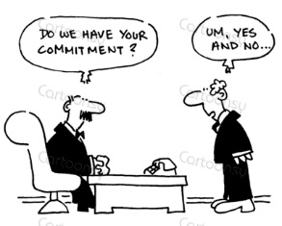
Effect of Transactions
Document supported encumbrance is removed from AY 19
Document supported encumbrance is established for AY 21
Commitment will need to be disclosed
Notes:
The effect of these transactions are:
The document supported encumbrance is removed from appropriation year 19,
And re-established in appropriation year 21.
In addition, a commitment needs to be reported in your disclosures

Slide 91
Commitment Definition
Commitments represent obligations related to unperformed agreements that are not encumbered
Obligations are not expected to be paid with current financial resources
Disclosed in the notes to the State’s financial statements
Notes:
So what is a commitment?
Commitments represent:
-obligations related to unperformed agreements that are not encumbered
-they are not expected to be paid with current financial resources (FY 19)
-they are not reported in the financial statements as a liability
-but they are disclosed in the notes

Slide 92
Commitment Disclosed
For FY 2019 year-end closing, disclose “commitment” for goods ordered or services contracted for that have not been fulfilled by calendar date June 30
When eventually paid, will be charged to AY21
Notes:
For fiscal year 19, report commitments for goods ordered or services contracted for, but that have not been fulfilled by June 30.
When they are received they will be paid for out of the AY21 budget.

Slide 93

Commitment Examples
Long-term contracts or agreements associated with:
  Grants
  Loans
  Leases
  Capital Construction
Notes:
Generally commitments are:
Long-term contracts or agreements associated with
Grants
Loans
Leases
And/or
Capital construction

Slide 94
Commitment vs. Encumbrance
An obligation is either an encumbrance or a commitment, but not both (do not duplicate)
If uncertain which you have; consult the OAM:
  Commitments 15.80.00
  Encumbrances 20.20.00
Notes:
An obligation can be either an encumbrance or a commitment, but not both - do not duplicate (this especially applies to the first year of a biennium when encumbrances do not need to be eliminated).
There is further information about commitments and encumbrances in the OAM or if your situation is not clear please call your SARS analyst for assistance.

Slide 95

Balance Type 33
Grant Commitments
If you are using balance type 33 to track your grant activity be sure to include it in your commitment disclosures
Notes:
As a reminder:
If you are using balance type 33 (Grant Commitment) to track your grant activity, please be sure to record those commitments in your disclosures.

Slide 96
Reduction of Expense
Only used in special circumstances
  See OAM 20.40.00
May not exceed actual expense
Must occur in same appropriation year as the original expenditure
If appropriation year already closed must be recorded as revenue
Notes:
A reduction of expense is used only in special circumstances as defined in the OAM.
This includes, but is not limited to: refunds for overpayment; purchase rebate; job rotations; amounts collected or reimbursements for hosting special events, insurance recoveries, to name a few.
Be sure to see OAM 20.40 for additional details.
Remember:
The reduction may not exceed the actual expense.
The reduction must occur in the same appropriation year as the original expenditure.
And, if the appropriation year has already closed, the transaction must be reported as revenue in the new biennium. If the expenditure was made from the general fund, but the AY is closed, talk to your SFMS analyst on the steps needed to revert the money to the general fund.

Slide 97
OAM Chapter 20 – Budgetary Accounting & Reporting
20.20 Encumbrances
20.30 Expenditure and interfund transfer recognition
20.40 Reduction of expense
20.50 Revenue and interfund transfer recognition
http://www.oregon.gov/das/Financial/Acctng/Pages/OAM.aspx#chapter20
Notes:
All of what I have covered today is in the budgetary chapter of the OAM and the link is there on the bottom of the slide; however, if you have questions feel free to contact your SARS analyst.

Slide 98

Notes:
Any questions?
Okay, now I will speak briefly about SEFA.

Slide 99
SEFA & CAFR Adjustments
Schedule of Expenditures of Federal Awards (SEFA)
Notes:
Now, a few words about SEFA. Thankfully, this section is not nearly as loquacious as Budgetary verses Financial accounting.

Slide 100
Post-Close and/or Audit Adjustment
Notify your SARS analyst if the adjustment relates to a federal program.
  - CFDA number and title
  - SARS and SOS-Audits will determine the impact to the SEFA
  - If material, send a SEFA correction form
Notes:
If your agency has a post-close adjustment or receives an audit adjustment that involves a federal program, you will need to notify your SARS analyst. Include the CFDA number and title in the email .
At that time SARS and SOS auditors will determine if the adjustments will have a material effect to the SEFA.
If it is determined the adjustment will have a material effect, your SARS analyst will request a SEFA correction form.

Slide 101
Other SEFA Topics
SEFA Correction Forms
Complete only if RSTARS records are incorrect.
There is now a separate column for Tax ID number
Enter the Tax ID number as 123456789 (not 12-3456789)
Non-Cash Assistance Reporting
Complete using the Excel workbook provided by SARS
Year-End Closing Guide – Chapter F
F.6. SEFA Year-End Reporting
Notes:
Correction Forms: You only need to complete the correction forms if the data in RSTARS is incorrect. For instance, an incorrect grant number was used; an incorrect amount was recorded; or a distribution to a subrecipient was recorded as a direct expenditure. There could be other examples, but this gives the concept.
If you are correcting subrecipient information (which is on the expenditure correction tab), there is now a separate column for the tax ID number. Please enter the number without a hyphen. This is because SARS uses an Access database to compile the SEFA and the tables do not accept hyphens.
Non-Cash Assistance Reporting: This year agencies will receive an Excel workbook to report non-cash assistance information. There is a separate tab for revenue, transfers-in, expenditures, transfers-out, and distribution to subrecipients. Included in the workbook are tabs that have examples and instructions on how to complete each tab. Use these forms even if your agency is only reporting one line of information. Using these Excel forms will make it much easier for the SEFA compiler to assemble a master spreadsheet that will be used to load data in to the Access database.
Lastly, Chapter F of the Year-End Closing Guide is dedicated to SEFA and there is a lot of good information in the chapter.
Section F.6, beginning on page F-5, is about SEFA Year-End Reporting. This section includes information of the different reports within the SEFA Repository queries in the Datamart. It also gives detailed instruction on how to save the queries to be sent to your SARS analyst.
The Year-End Closing Guide is in the process of being updated. When the update is complete, an email will be sent to all agencies.

Slide 102

Questions?
Notes:
Any questions?
Now it is my great honor to introduce Shrikant Vajratkar to tell us all about restricted cash and investments.

Slide 103
Restricted Cash & Investments

Slide 104
Restricted Assets – What are they?
Assets whose use is subject to constraints that are either:
  Externally imposed by
    Creditors (debt covenants)
    Grantors
    Donors
    Laws and/or regulations of OTHER governments

Slide 105
Restricted Assets - What are they? (continued)
  OR
  Imposed by law through
    Constitutional provisions
    Enabling legislation
  AND
      The constraints change the nature or normal understanding of the availability of those assets
  OR
  Imposed by law through
    Constitutional provisions
    Enabling legislation
  AND
      The constraints change the nature or normal understanding of the availability of those assets

Slide 106
Nature or Normal Understanding of Availability
Is there a restriction for the use of the asset?
Is the asset available for regular operational uses?
Is there a restriction that means that the asset won’t be used in the next operational period?
Can you only use interest earnings but maintain the principal amount?

Slide 107
General Disclosure 2.
Restricted Cash and Investments
GL 0065, 0070, 0075 Unreconciled Deposit, Cash in Receipted and Suspense Account
GL 0230 Investments – OITP
GL 0235 Investment Valuation Account – OITP
GL 0240 Investments – Designated
GL 0245 Investment Valuation Account - Designated
D23 fund detail for restricted Cash and Investments, instead of just GAAP Fund.
Whether restricted cash is current or noncurrent.

Slide 108
Current vs. Noncurrent
  Current = expected to be used within one year in keeping with restriction.
    Cash used to pay debt service principal and interest in the next year
    Cash accumulated to pay claims for the next year
  Noncurrent = expected to be used over one year out in keeping with restriction
    Cash accumulated to pay future fiscal year debt service
    Cash accumulated to pay legal claims in future years, more than one year away
    Cash used for the acquisition or construction of noncurrent assets OR Segregated for the liquidation of long-term debts - Noncurrent

Slide 109
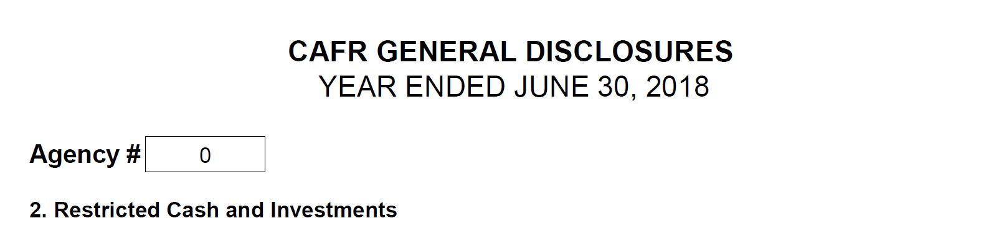
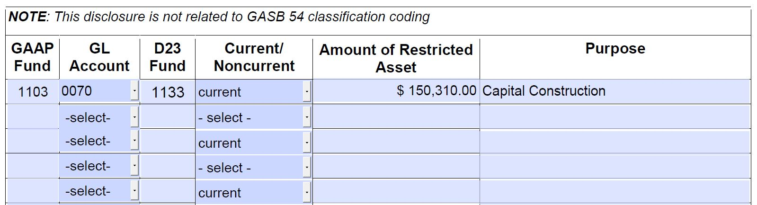
Cash to be used to construct a Capital Asset – Noncurrent

Slide 110
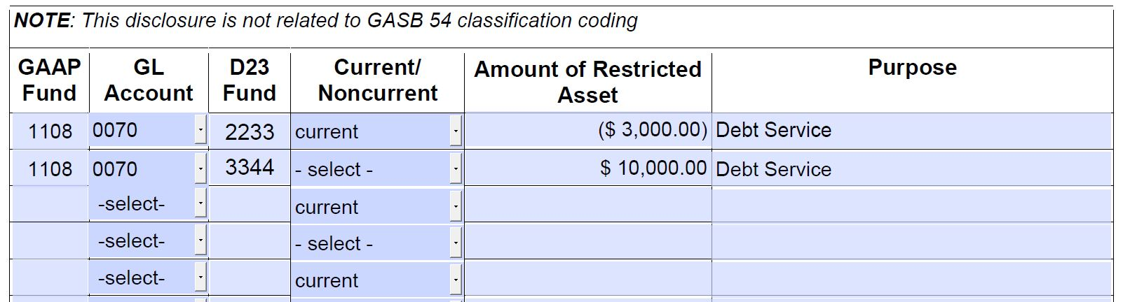
Negative Balance!!

Slide 111
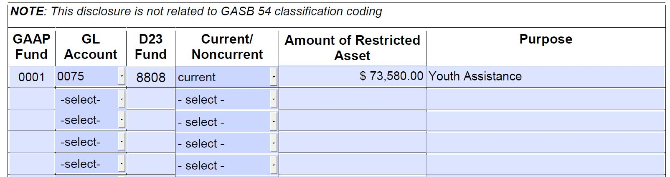
GASB 54 Code = A1

Slide 112
Cash and Securities Held in Trust
NOT included in the General Disclosure
GL 0335 Savings and Time Certificates of Deposit Held in Trust
GL 0330 Securities Held in Trust
Roll up to Balance Sheet class 021 Cash and Securities Held in Trust

Slide 113


Slide 114
Report Government fraud, waste or abuse
Shelly Cardenas, CPA
Principal Auditor
Secretary of State, Oregon Audits Division

Slide 115
How to report
sos.oregon.gov/audits/pages/fraud.aspx
Toll Free: 800-336-8218
Fax: 503-378-6767
U.S. Mail:
  Confidential
  Oregon Audits Division
  Government Waste Hotline
  255 Capitol Street NE, Suite 500
  Salem, Oregon 97310

Slide 116
Disclosures

Slide 117
Disclosure Changes
FY2019 disclosures in Excel format
  Transmittal and Certifications (.pdf)
Sample disclosures will be updated on the SARS website
  Notification will be sent via CAFR Contacts news list
General Disclosure 7 – Deposit Liability and Trust Fund Payable
  Enter the amount due within one year; SARS will reclassify the noncurrent portion for balances in a current GL when a noncurrent GL is not available

Slide 118
New Disclosures
New FY2019 General Disclosures:
  Disclosure K – Irrevocable Split-Interest Agreements
  Disclosure L – Asset Retirement Obligations (ARO)
  Disclosure 31 – Taxes Receivable
  Disclosure 32 – Loans Receivable
  Disclosure 33 – Other Receivables – NC
New FY2019 Debt Disclosures:
  Disclosure E – Lines of Credit
  Disclosure F – Asset Pledged as Collateral
  Disclosure G – Terms in Debt Agreement
  Disclosure 5 – Direct Placements and Borrowings

Slide 119
Common
Disclosures
Errors
Signage errors
  Correct: GL balances should be reported as DR (CR)
  Correct: increases = positive; decreases = negative
Enter increases and decreases separately; do not net the activity (where applicable)
Disclosure amounts do not match R*STARS
GL balances reported on DAFR 6610 or 6620 are not properly disclosed (where applicable)
General Disclosure 21 – Emergency Board Requests Pending
  Should only include approved emergency board requests
Debt Disclosures (various)
  Incorrect interest rates
Table of Content/Disclosure Checklist applicability inconsistent
  i.e. disclosures listed as N/A but completed and vice versa

Slide 120
Key Takeaways

Slide 121
FY 2019 Year-end Schedule
  First communication of outstanding balances with component units no later than July 19.
  Second communication of outstanding balances with component units no later than August 7.
  Resolve statewide balance issues with other state agencies by the soft close, August 2.
GASB 84 Fiduciary Activities
  Effective July 1, 2019 (FY 2020).
  Use the Decision Tree!
  Review the identified GLs to determine if a you have a previously unreported fiduciary activity.
GASB 87 Leases
  Effective July 1, 2020 (FY 2021).
  Nearly all leases with non-state agencies will need to be reported on the balance sheet.
  Start researching and identifying leases now.
  Use the Lease Data Matrix.
Applying Budgetary Policies at the End of the Biennium
  Use OAM Chapter 20

Slide 122
SEFA
Restricted Cash and Investments
  Normal understanding of availability of the cash or investment must be impacted.
  If the cash or investment is restricted to build a capital asset, the cash or investment is restricted – noncurrent.
  No negative balances.
Report Government Fraud, Waste or Abuse
  Website: https://sos.oregon.gov/audits/Pages/fraud.aspx
  Phone: 800-336-8218
  U.S. Mail.
Disclosure Changes
  All are now in Excel.
  New disclosures for Accounts Receivable
  Remember your signs! DR/(CR)
Contact you SARS Analyst with questions
  Website: https://www.oregon.gov/das/Financial/Acctng

