Slide 1
Federal Award
Risk Analysis
Financial Leadership Council
April 5, 2017
Notes:
This template can be used as a starter file for presenting training materials in a group setting.
Sections
Right-click on a slide to add sections. Sections can help to organize your slides or facilitate collaboration between multiple authors.
Notes
Use the Notes section for delivery notes or to provide additional details for the audience. View these notes in Presentation View during your presentation.
Keep in mind the font size (important for accessibility, visibility, videotaping, and online production)
Coordinated colors
Pay particular attention to the graphs, charts, and text boxes.
Consider that attendees will print in black and white or grayscale. Run a test print to make sure your colors work when printed in pure black and white and grayscale.
Graphics, tables, and graphs
Keep it simple: If possible, use consistent, non-distracting styles and colors.
Label all graphs and tables.

Slide 2
Committee Members
Jeff Aldridge DHS/OHA
Michael Cutler DAS
Clay Flowers ODOT
Rob Hamilton DAS
Sophanna Kuch Education
Lori LeVeaux Fish & Wildlife
Andrew O’Keefe ODOT

Slide 3
2 CFR Part 200
Uniform Administrative Requirements, Cost Principles and Audit Requirements for Federal Awards
Notes:
Give a brief overview of the presentation. Describe the major focus of the presentation and why it is important.
Introduce each of the major topics.
To provide a road map for the audience, you can repeat this Overview slide throughout the presentation, highlighting the particular topic you will discuss next.

Slide 4
Subpart A
Acronyms and Definitions
Subpart B
General Provisions (200.1XX)
Subpart C
Pre-Federal Award Requirements and Contents of Federal Awards
(200.2XX)
Notes:
Give a brief overview of the presentation. Describe the major focus of the presentation and why it is important.
Introduce each of the major topics.
To provide a road map for the audience, you can repeat this Overview slide throughout the presentation, highlighting the particular topic you will discuss next.

Slide 5
Subpart D
Post Federal Award Requirements (200.3XX)
Subpart E
Cost Principles (200.4XX)
Subpart F
Audit Requirements (200.5XX)
Notes:
Give a brief overview of the presentation. Describe the major focus of the presentation and why it is important.
Introduce each of the major topics.
To provide a road map for the audience, you can repeat this Overview slide throughout the presentation, highlighting the particular topic you will discuss next.

Slide 6
200.100
Purpose – Section (a)
(1) Establishes uniform administrative requirements
(2) Provides the basis for a systematic and periodic collection and uniform submission by Federal agencies of information on all Federal financial assistance.
Notes:
Give a brief overview of the presentation. Describe the major focus of the presentation and why it is important.
Introduce each of the major topics.
To provide a road map for the audience, you can repeat this Overview slide throughout the presentation, highlighting the particular topic you will discuss next.

Slide 7
Section (b)
Administrative requirements
Section (c)
Cost Principles
Section (d)
Single Audit Requirements and Audit Follow-up
Notes:
Give a brief overview of the presentation. Describe the major focus of the presentation and why it is important.
Introduce each of the major topics.
To provide a road map for the audience, you can repeat this Overview slide throughout the presentation, highlighting the particular topic you will discuss next.

Slide 8
200.331 – Requirements for pass-through entities
All pass-through entities must:
(a) Ensure that every subaward is clearly identified to the subrecipient as a subaward and includes lengthy admin information………..
Notes:
Give a brief overview of the presentation. Describe the major focus of the presentation and why it is important.
Introduce each of the major topics.
To provide a road map for the audience, you can repeat this Overview slide throughout the presentation, highlighting the particular topic you will discuss next.

Slide 9
(b) Evaluate each subrecipient's risk of noncompliance with Federal statutes, regulations, and the terms and conditions of the subaward for purposes of determining the appropriate subrecipient monitoring described in paragraphs (d) and (e) of this section, which may include consideration of such factors as:
Notes:
Give a brief overview of the presentation. Describe the major focus of the presentation and why it is important.
Introduce each of the major topics.
To provide a road map for the audience, you can repeat this Overview slide throughout the presentation, highlighting the particular topic you will discuss next.

Slide 10
(1) The subrecipient's prior experience with the same or similar subawards;
Notes:
Give a brief overview of the presentation. Describe the major focus of the presentation and why it is important.
Introduce each of the major topics.
To provide a road map for the audience, you can repeat this Overview slide throughout the presentation, highlighting the particular topic you will discuss next.

Slide 11
(2) The results of previous audits including whether or not the subrecipient receives a Single Audit in accordance with Subpart F - Audit Requirements of this part, and the extent to which the same or similar subaward has been audited as a major program;
Notes:
Give a brief overview of the presentation. Describe the major focus of the presentation and why it is important.
Introduce each of the major topics.
To provide a road map for the audience, you can repeat this Overview slide throughout the presentation, highlighting the particular topic you will discuss next.

Slide 12
(3) Whether the subrecipient has new personnel or new or substantially changed systems; and
Notes:
Give a brief overview of the presentation. Describe the major focus of the presentation and why it is important.
Introduce each of the major topics.
To provide a road map for the audience, you can repeat this Overview slide throughout the presentation, highlighting the particular topic you will discuss next.

Slide 13
(4) The extent and results of Federal awarding agency monitoring (for example, if the subrecipient also receives Federal awards directly from a Federal awarding agency).
Notes:
Give a brief overview of the presentation. Describe the major focus of the presentation and why it is important.
Introduce each of the major topics.
To provide a road map for the audience, you can repeat this Overview slide throughout the presentation, highlighting the particular topic you will discuss next.

Slide 14
Effective Dates
Requirements to be effective by December 26, 2014
Per 200.110
FAQ 110-1 through 110-15
Notes:
Give a brief overview of the presentation. Describe the major focus of the presentation and why it is important.
Introduce each of the major topics.
To provide a road map for the audience, you can repeat this Overview slide throughout the presentation, highlighting the particular topic you will discuss next.

Slide 15
Apply to new awards and funding increments of existing awards made on or after December 26, 2014
Federal award date (200.39) is when signed by the authorized official of the Federal awarding agency
Notes:
Give a brief overview of the presentation. Describe the major focus of the presentation and why it is important.
Introduce each of the major topics.
To provide a road map for the audience, you can repeat this Overview slide throughout the presentation, highlighting the particular topic you will discuss next.

Slide 16
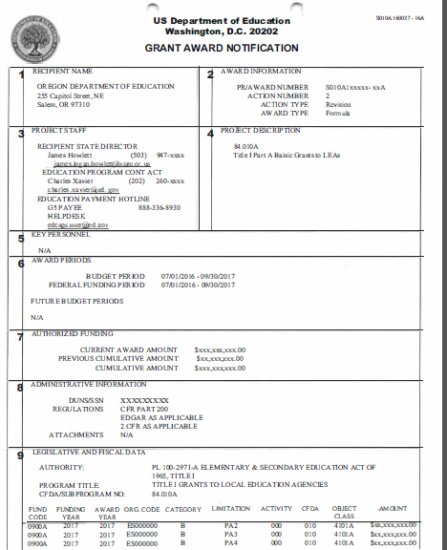

Slide 17
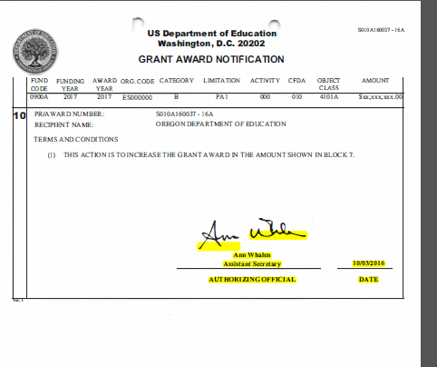

Slide 18
Risk Assessment Tool
Notes:
Give a brief overview of the presentation. Describe the major focus of the presentation and why it is important.
Introduce each of the major topics.
To provide a road map for the audience, you can repeat this Overview slide throughout the presentation, highlighting the particular topic you will discuss next.

Slide 19
Case Study: Low Risk
Existing grantee with good compliance record.
Prior experience with program.
Systems in place to address program requirements.
All prior site compliance findings closed out in timely manner.
Internal control deficiency addressed within requested timeline.

Slide 20
Case Study: High Risk
New grantee.
No prior experience with program.
Federal program requirements not met.
Lack of sufficient staff for adequate separation of duties.
Policies & procedures out of date/missing.

Slide 21
Committee Roundtable

Slide 22
Resources
2 CFR Part 200
https://www.gpo.gov/fdsys/pkg/CFR-2014-title2-vol1/pdf/CFR-2014-title2-vol1-part200.pdf
FAQ (Updated 09/2015)
https://cfo.gov/wp-content/uploads/2015/09/9.9.15-Frequently-Asked-Questions.pdf

Slide 23
Questions?

