Slide 1

Department of Administrative Services
2024 Emergency Board Overview and Deadlines

Slide 2
Emergency Board Deadlines
 | NOI* Email due to DBS | NOI emailed to CFO/LFO by DBS | Submission of Letters/Reports due to DBS | Submission of Letters/Reports to CFO/LFO by DBS | E-Board Committee Meets
 | Internal deadline | Statewide Deadline | Internal deadline | Statewide Deadline | Statewide
May Eboard | April 18, 2024 (Friday) | April 22, 2024 (Monday) | April 25, 2024 (Thursday) | April 29, 2024 (Monday) | May 29th- 31st, 2024 (Thurs-Friday)
September Eboard | August 15, 2024 (Friday) | August 19, 2024 (Monday) | August 22, 2024 (Thursday) | August 26, 2024 (Monday) | Sept. 23rd-25th, (Mon-Tues)
December Eboard | October 25, 2024 (Friday) | October 28, 2024 (Monday) | October 30, 2024 (Wednesday) | November 4, 2024 (Monday) | Dec. 10-12, 2024 (Tues-Thurs)
*Notice of Intent (NOI)- The initial NOI email is an informal email intending to give CFO and LFO a brief high-level description of the request before the formal Emergency Board Letter is completed. The letter or the report should be a detailed description of the request.

Slide 3
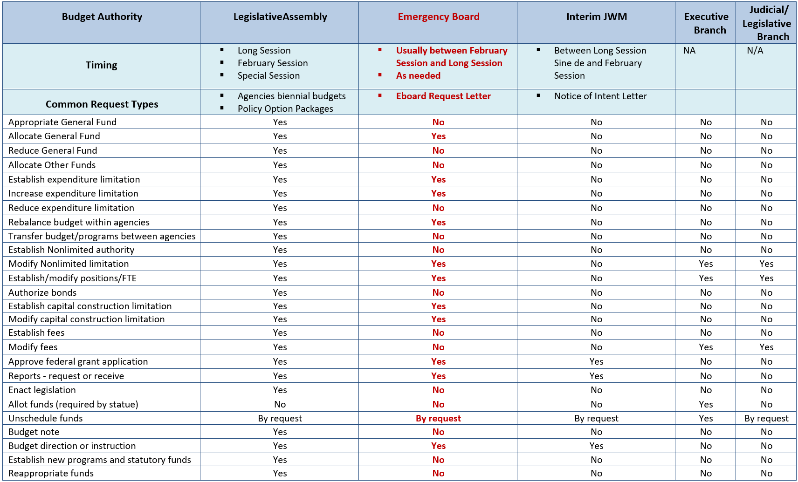
Budget Authorities Overview
The Constitution and state statutes provide direction on budget authority for the period when the Legislature is in session and during interim periods between sessions.
The table summarizes the different authorities during session and the interim.

Slide 4
Emergency Board Overview
Required by Article III, Section 3 of the Oregon Constitution (ORS 291.322 – 334). The Emergency Board has limited legislative authority and can increase expenditure limitations and approve requests for General Fund appropriations from either the State Emergency Fund if an “emergency” exists or from a Special Purpose Appropriation. The Board cannot reduce limitations or pass substantive legislation. The most common items, brought forward as letters, to an Emergency Board meeting are:
  Reports of major issues including those required by Budget Notes in Agency or other bills
  Federal grant application requests
  Requests for increases in position authority or expenditure limitation that do not require General Fund appropriation
  Requests for General Fund from the State Emergency Fund or a Special Purpose Appropriation
At the beginning of each biennium, CFO and LFO issue a joint letter that sets out the process, formats and other requirements that agencies must follow to submit Emergency Board letters. In addition, before each meeting a more detailed calendar of due dates is produced.
Notes:
- The Emergency Board is the joint committee of senators and representatives that meets between legislative sessions to address state fiscal matters
- The committee consists of members of the House and Senate appointed by the Speaker and President. The Emergency Board has limited legislative authority.

Slide 5
Questions?
Contact information:
Robert Otero, DAS Budget Director
robert.otero@das.Oregon.gov
503-930-0062
https://www.oregon.gov/das/Financial/Pages/DBS.aspx

