Slide 1
SABRS 2027-29 Budget Presentation
Statewide Audit and Budget Reporting Section (SABRS)
4/23/2026
Department of Administrative Services

Slide 2
Agenda
ORPICS Start-up / Current Service Level (CSL)
ORBITS Essential Pkgs, CSL, Reports, Revenue Forecasts
ORPICS Agency Request Budget (ARB)
ORBITS Agency Request Budget (ARB)
Special Payments Adjustments
Closing
Demonstration

Slide 3


Budget Build Roadmap
2023-25 Actuals
Mid-Jan – Feb 2026
2027-29 ORPICS/ORBITS
CSL
Mid-Apr – Jun 2026
2027-29 ORPICS/ORBITS
Preliminary Budget Rec
Sept – Nov 2026
2027-29 ORPICS/ORBITS
GB
Dec 2026 – Jan 2027
2027-29
ORPICS Freeze/Start up
Mid-Mar – Apr 2026
2027-29 ORPICS/ORBITS
ARB
Jun – Jul 2026
2027-29 ORPICS/ORBITS
LAB
Mid Jul – Sept 2027
Link to SABRS Monthly Deadlines & Events Calendar

Slide 4

ORPICS Start-up / Current Service Level (CSL)
ORPICS Presentation Topics:
2027-29 Freeze Factors
ORPICS Start-Up
Timeframe
Allowable Changes
ORPICS Current Service Level (CSL) Budget

Slide 5
ORPICS Start-up / Current Service Level (CSL)
2027-29 “Freeze” Factors
ACCT NUMBER | OPE FACTORS |  | 2025-27 FRZ | 2027-29 FRZ
3210 | ERB |  | $3.00 /per mth | $3.31 /per mth
3220 | PERS: | Agencies w/o significant Police & Fire | 21.04% | 24.72%
 |  | Judges | 40.97%* | 44.5%*
 |  | Agencies w/ significant Police & Fire:
 |  | Dept Human Services | 21.32% | 25.02%
 |  | Dept of Justice | 21.18% | 24.85%
 |  | District Attorneys | N/A | 31.09%
 |  | OR Military Dept | 21.73% | 25.74%
 |  | Emergency Management | 21.73% | 24.64%
 |  | Oregon State Police | 24.41% | 28.19%
 |  | State Fire Marshall | 24.41% | 27.93%
 |  | Public Safety Standards & Trng | 25.86% | 29.82%
 |  | Corrections | 25.66% | 29.75%
 |  | Oregon Youth Authority | 24.95% | 28.97%
 |  | Forestry | 23.54% | 27.71%
 |  | Liquor Control Commission | 22.21% | 26.02%
3230 | SOCIAL SECURITY (FICA) |  | 7.65% | 7.65%
3221 | PENSION BOND CONTRIBUTION (POB) |  | Provided by CFO | Provided by CFO
3241 | PAID FAMILY MEDICAL LEAVE (PFMLI) |  | .004 = .4% | .004 = .4%
3250 | WORKERS' COMP ASSESSMENTS (WBF) |  | $1.74 / per mth | $1.57 / per mth
3260 | MASS TRANSIT TAX (MT) |  | .006 = .6% | .006 = .6%
3270 | FLEX BENEFITS (PEBB Core) |  | $1,767 /per mth | $1,840 /per mth
*Includes member contribution of 7% per ORS 238.515

Slide 6
ORPICS Start-up / Current Service Level (CSL)
ORPICS 2027-29 Start-Up
ORPICS Start-Up opens April 24th for agencies.
Start-Up transmittals and supporting materials must be received prior to close of business May 8th .
Ensure the “Cycle” field has Prep selected and the “Bien” field has 2029 selected. ORPICS changes are made in the ORPICS “Detail” section by copying the position record using the “Copy” button and Package 001, this is the only package available for Start Up changes.
Changes made during Start-Up update the ORPICS Base Personal Services values in the ARB base column on ORBITS at the DCR level (A01 version).
Data loaded to ORBITS include salaries/wages, ORPICS-generated OPE, and position/FTE counts. Non-ORPICS personal services items are not included.
Agencies need to submit a Start-Up Audit transmittal regardless of whether or not any changes are performed on ORPICS during Start-Up.

Slide 7
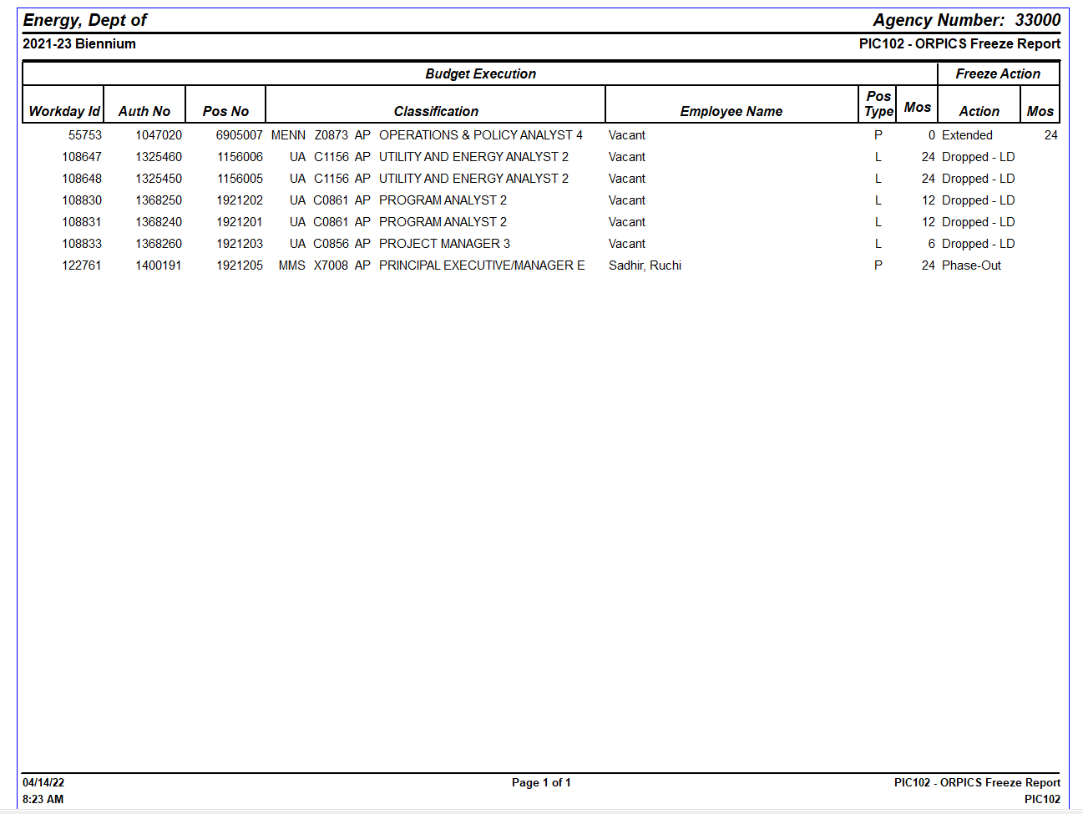
ORPICS Start-up / Current Service Level (CSL)

Slide 8
ORPICS Start-up / Current Service Level (CSL)
ORPICS 2027-29
Allowable Changes During Start-Up:
DCR changes that are within the same SCR
DCR changes that cross SCRs must have CFO Analyst approval
Adjustments to seasonal position budget rates (returning employee Step rates)
Changes to permanent part-time phased-in positions
Any exceptions discussed with, and approved by, your agency CFO Analyst
Please ensure that all position/segment of positions are not allocated for less than one month
ORPICS editing will be locked down by close of business May 08, 2026
SABRS staff audits all changes and obtains CFO analyst review and approval.
Once Start-Up audits are complete, ORPICS will be opened for CSL actions and agencies will be notified.

Slide 9
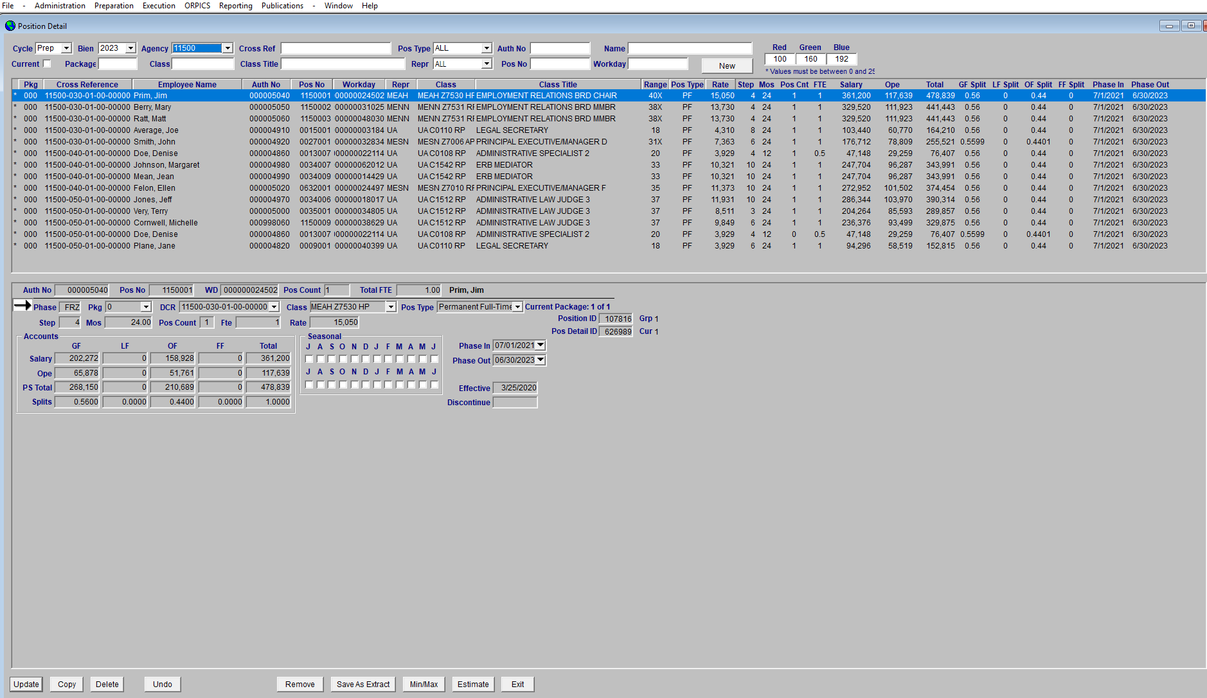
ORPICS Start-up / Current Service Level (CSL)

Slide 10
ORPICS Start-up / Current Service Level (CSL)
The ORPICS Reports
Available under the ORPICS drop down menu on the menu bar at the top of the screen in ORBITS
PIC100 Position Budget Report: This report lists all positions by Detail Cross Reference Number based on the phase selected. The first page is the Agency wide summary of Salaries and OPE by Fund Type.
POS116 Net Package Fiscal Impact Report: This report lists all positions actions performed in a package reflecting the total Salary and total OPE costs by fund type.
PIC102 ORPICS Freeze Report: This report lists positions that were extended, dropped, etc. during the Freeze process with an “Action” column describing the action that changed the position.
PIC130 Position Count by Agency: This is a summary report listing all positions for an agency, it does not include Cross Reference numbers for the positions.
POS100 PICS Budget Ledger Report: This report shows all package records for a select phase from Base through LAB and the entries that were passed into the ORBITS Budget table.
POS120 Net Package Fisal Impact Report: This report shows all position changes by DCR/SCR, Package, and Fund for all phases.

Slide 11
ORPICS Start-up / Current Service Level (CSL)
2027-29 ORPICS CSL Process
Agencies begin the 2027-29 Current Service Level (CSL) budget build
ORPICS CSL adjusting entries are restricted to the following essential packages:
021 – Phased in Programs and/or Positions
022 – Phased out Programs and/or Positions
040 – Mandated Caseloads / requires CFO Analyst approval
050 – Fund Shifts
060 – Technical Adjustments / must result in Net Zero change

Slide 12
ORBITS Essential Pkgs, CSL, Reports, Revenue Forecasts
ORBITS Presentation Topics
Base Budget Column
What is it
What can I do
Re-Spin of Non-ORPICS accounts
Essential Packages Column
What are they
How can I use them
ORBITS Reports – Audit & Reconcile

Slide 13
ORBITS Essential Pkgs, CSL, Reports, Revenue Forecasts
Base Budget Column
ORPICS Driven accounts are populated based on the ORPICS Freeze process.
Changes during ORPICS Start-Up affect the ORBITS Base Budget column.
The Base Budget Column and CSL packages will be opened after Start-up
Beginning Balances were loaded into the BASE column from the 2025-27 Leg. Approved Budget. Please update these values based on current 25-27 estimated ending balances.
ORBITS Base Budget column comes from the Bien 27 M01 version, 2025-27 Leg Approved Budget (LAB) for the following account categories:
Revenue accounts excluding beginning balances
Non-ORPICS expenditure accounts (excluding payroll-related accounts)
Services & Supplies
Capital Outlay
Special Payments
Debt Service
Capital Construction

Slide 14

ORBITS Essential Pkgs, CSL, Reports, Revenue Forecasts
Base Budget Column
Agencies may re-shuffle expenditure accounts in the BASE column within the same SCR, Budget Category and Appropriated Fund also known as Re-Spin. The following protected accounts may not be changed:
Note: If you need to move protected accounts across DCR’s please use a package 060.
ORPICS-driven accounts (salaries, PERS, etc.)
Acct 3260 – Mass Transit Tax
Acct 3455 – Vacancy Savings
Acct 4225 – State Govt. Service Charges
Acct 4300 – Professional Services
Acct 4315 – IT Professional Services
Acct 4325 – Attorney General
Acct 4425 – Facilities Rental and Taxes

Slide 15

ORBITS Essential Pkgs, CSL, Reports, Revenue Forecasts
Base Budget Column
Re-spin of Non-ORPICS Accounts
Allowable accounts
acct 3160 – Temps
acct 3170 – Overtime
accts 3180 & 3190 – Shift & Other Differentials
acct 3240 – Unemployment
Audit requirement
The re-spin calculations must include the appropriate 2027-29 OPE values on ORBITS and balance by SCR/appropriated fund types

Slide 16
ORBITS Essential Pkgs, CSL, Reports, Revenue Forecasts
Essential Packages
Where to start…
Essential Packages:
010 – Non-ORPICS Personal Services
021/022 – Phase-In / Phase-Out
031 – State Govt Service Charges / Standard Inflation
032 – Non-Standard Inflation (Analyst Approved)
033 – Exception Committee Approved
040 – Mandated Caseloads
050 – Fund Shifts
060 – Technical Adjustments (net zero)
Versions
A-01 Agency working (DCR level)
S-01 Agency Pre-audit (SCR level only)
Screens
Data entry window (base budget column)
Package data entry window

Slide 17
ORBITS Essential Pkgs, CSL, Reports, Revenue Forecasts
Essential Packages
Package 010 – Vacancy Factor and Non-ORPICS Personal Services:
Salaries and Wages
Calculated based on standard inflation of 4.9%
Temporary wages (acct 3160)
Overtime (acct 3170)
Shift Differentials (acct 3180)
Other Differentials (acct 3190)
Unemployment (acct 3240)
Mass Transit Tax (acct 3260) see calculation next slide
Vacancy Savings (acct 3455)
Calculated differences between the control value and base budget amount:
Mass Transit calculation (acct 3260) calculation example
Account | Appropriated Fund Type | 2027-29 Base Budget | 2027-29 MT | Package 010 Entry
Mass Transit | 3400 - OF | $10,150 | $11,500 | $1,350

Slide 18
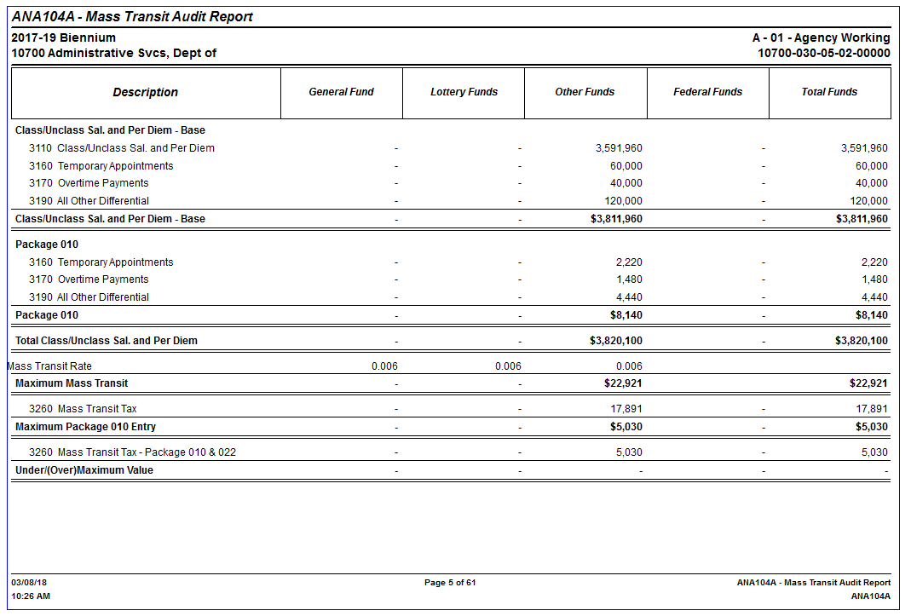
ORBITS Essential Pkgs, CSL, Reports, Revenue Forecasts
Mass Transit Tax Calculation
Once package 010 is populated use the ANA104A – Mass Transit Audit Report to verify the budgeted amount for Mass Transit Tax.
Adjust Mass Transit Tax (account 3260) as necessary to balance.
Mass Transit is calculated at .006 of Total Salaries and Wages by Fund Type, excluding Federal Funds. See OAM 50.60.00 PO for more details

Slide 19
ORBITS Essential Pkgs, CSL, Reports, Revenue Forecasts
Essential Packages
Package 021 / 022: Phase-In’s, Phase-Out’s
Used to add/remove funding, expenditure limitation and program costs that were approved as “one-time” or for only a portion of the biennium.
Audit Tip: Make sure you enter your Pkg 022 phase-out values first. Standard Inflation is calculated on Base minus Package 22.
Package 031: Standard Inflation
Most S&S, Capital Outlay and Special Payments accounts inflated @ 4.9%
Professional Services (accounts 4300 & 4315) inflated @ 9.3%
Attorney General (acct 4325) @ 9.3%
Rent- Published rates for both uniform and non-uniform rent
(agencies may inflate up to the amount in the published price list in package 31. Anything above that needs to be in package 33 and approved by their analyst)
State Govt Service Charges need to balance to the On-Line Price List*
*Appendix A of the Price List document has been updated for the non-DAS assessments and the dropdown has been updated as well.

Slide 20
ORBITS Essential Pkgs, CSL, Reports, Revenue Forecasts
Automated Inflation Calculation Routine
SABRS has a process to auto-populate Packages 010 and 031 with the standard inflation values into ORBITS
Base Budget minus Package 022 Phase Out values
Standard Inflation rates
Automated Inflation procedure is optional:
Contact ORBITS.help@DAS.Oregon.gov when you are ready to have this procedure run for your agency.
NOTES:
This procedure may only be run once per agency.
Clears the 010 and 031 Packages before it populates. So run this before making any other adjustments to these packages.

Slide 21
ORBITS Essential Pkgs, CSL, Reports, Revenue Forecasts
Essential Packages…
Package 032: Above Standard Inflation with CFO Analyst Approval
Medical inflation – maximum inflation @ 6.5%
1.6% calculated inflation is recorded in this package (The 4.9% standard inflation is recorded in package 031)
Non-state employee personnel costs as applied to Special Payments maximum inflation @ 9.3%
4.4% calculated inflation is recorded in this package (The 4.9% standard inflation is recorded in package 031)
Price List items that are usage-based costs such as printing services
Marginal inflation above the 4.9% is recorded in this package
Package 033: Above Standard Inflation with Exception Committee Approval or Statewide Exception
Amounts above Standard with documented exception request

Slide 22
ORBITS Essential Pkgs, CSL, Reports, Revenue Forecasts
Essential Packages…
Package 040: Mandated Caseloads
Refer to the eligible agencies/programs listed on page 38 of the 2027-29 Budget & Legislative Concepts instructions
Based on caseload changes for programs required by the federal government, state constitution, or court actions.
Agency must request establishment of this package through your assigned CFO Analyst before it is available for use in ORBITS or ORPICS
Package 050: Fund Shifts
Used to change fund type on expenditures and/or restore original funding source of a one-time change approved in the past
Change must be net-zero at the Total Funds level
Your CFO Analyst must be aware of and in agreement of your intended use of this package prior to submitting your audit transmittals to SABRS

Slide 23

ORBITS Essential Pkgs, CSL, Reports, Revenue Forecasts
Essential Packages…
Package 060: Technical Adjustments
Used for Technical Adjustments; result must net zero
Examples of technical adjustments for package 060:
Moving programs or accounts from one SCR to another SCR
Re-aligning expenditures across budget categories or protected S&S accounts
Shifting a Special Payment expenditure to a revenue transfer
Discuss the intended use of this package with your CFO Analyst and receive their approval prior to submitting your agency audit transmittals for ORPICS or ORBITS

Slide 24
ORBITS Essential Pkgs, CSL, Reports, Revenue Forecasts
ORBITS Reports
Audit Reports
AUD 100 – Audit Error Report (ran from the S version)
AUD004 – Transfers and Special Payments (ran from the A version)
Budget Development
BDV001A - Agency Worksheets – Revenues & Expenditures
BDV002A – Detail Revenues & Expenditures – Requested Budget
BDV004B – Detail Revenues & Expenditures – Essential/Policy Packages
BDV104 – Biennial Budget Summary (aka Summary of 2027-29 Budget)
Analysis & Comparison
ANA100A – Version/Column Comparison Report
ANA102A – Inflation Forecast Report*
*Useful report in determining inflation amounts (must have data loaded in the Base Budget column and in essential package 022)
ANA103A – Inflation Analysis Report
ANA104A – Mass Transit Audit Report

Slide 25

ORBITS Essential Pkgs, CSL, Reports, Revenue Forecasts
Revenue Projections
Revenue data in the 2027-29 Base Budget column is copied from the 2025-27 Legislatively Approved Budget column
Agencies should analyze, re-project and modify revenues as appropriate for their programs
Total revenues must cover requested expenditures
For agencies that produce General Fund Revenues; these values must be consistent with the May 2026 state revenue forecast
SABRS will audit these values to the data provided by the Office of Economic Analysis

Slide 26
ORBITS Essential Pkgs, CSL, Reports, Revenue Forecasts
Revenue Categories
Federal Funds (FF)
Most FF revenues are received on a reimbursement basis
Total FF revenues generally equal total requested FF expenditures
FF revenues are normally entered in the Base Budget column and in the Essential/Policy package(s)
Lottery Funds (LF)
Recipient agencies will be provided specific revenue values by DAS and/or OWEB
LF revenues should be entered in the Base Budget column and in the Essential package(s)
Agencies requesting additional LF revenues in Policy packages are directed to use the generic Transfer In Lottery Proceeds account (1040)

Slide 27

ORPICS & ORBITS ARB
Agency Request Budget Topics:
ORPICS ARB
ORBITS ARB Building
ORBITS Policy Packages

Slide 28
ORPICS & ORBITS ARB
2027-29 ORPICS ARB
The ORPICS 2027-29 Agency Request Budget consists of ORPICS Base Budget, Essential Packages and Policy Packages
Position changes in ORPICS update the Personal Services accounts in the ORBITS A01 Version
This includes Salaries & Wages, ORPICS-driven OPE, and position & FTE counts
Approved Policy Packages can be used to request new positions or make changes to existing positions
New positions are added to ORPICS at the fifth step of the classification’s salary rate…OR
New positions may be added to ORPICS at a higher step but will require written approval from your CFO Analyst

Slide 29
ORPICS & ORBITS ARB
ORPICS Packages
The ORPICS “PKG” data field is used to key in the number of the package driving the need for entry into ORPICS (e.g. PKG 040, 060, 101, etc.). The PKG field must be updated for each position action.
There may be instances where a position is impacted by actions from multiple packages. This is allowed in ORPICS.
One example would be a DCR change as a Technical Adjustment in Pkg 060 at CSL and then reclassing the same position in a Policy Option Package (POP). This is achieved in ORPICS by selecting the Pkg 060 record, using the “Copy” button and then assigning the correct POP package number in the PKG field. Then update the record with the POP changes so the end result is the combination of changes from Pkg 060 and the POP. Finish by using the “Update” function.

Slide 30

ORPICS & ORBITS ARB
27-29 ORBITS ARB
Building the ARB in ORBITS:
Base Budget Column
2027-29 Base Budget is copied from the 2025-27 Legislatively Approved Budget column
Position changes during ORPICS Start-up effect the Base column
Essential Packages Column
Packages 010 - 060 contain the building blocks necessary to maintain programs at the Current Service Level (CSL)
Policy Packages Column
Agency Policy Packages are used to request budget authority beyond the CSL
Calculations for package 070 (revenue reduction) is also in this column
Column will be opened after ORPICS CSL Audit

Slide 31

ORPICS & ORBITS ARB
ORBITS Policy Packages
Establishing Policy Packages
Agencies must provide the following data to establish a Policy Package
Policy Package number is determined by the agency. Numbers 100 through 499 are reserved for agency use
Package titles (45 characters maximum including spaces) are determined by the agency
SCR(s) assigned to the package
All policy packages must be requested through and approved by your CFO Analyst
No negative ending balances in ARB column
Account 4225- Do not include SGSC changes (at CSL these values will balance to the Price List and should not be updated at this point/updated at GRB)
Run the AUD100 and AUD004 reports to check for errors before submittal (see ORBITS Manual Appendix G for more detail on error messages)
Prior to submitting for audit copy the A01 to the S01
Use the 27-29 ARB Audit Points as a guide and checklist

Slide 32
ORPICS & ORBITS ARB
ORBITS Policy Packages
Policy Package and Other Considerations
Reflect policy and program changes affecting an agency's budget from CSL
Policy Packages 081 and 082 are for E-board actions after April
Amounts are biennialized and inflated using standard inflation rates
Deferred Maintenance & Capital Budgeting
ORS 291.215: Agencies that own state buildings and infrastructure should request policy packages that bring the agency’s total deferred maintenance and capital improvements budget at a minimum to a level of two percent of the current replacement

Slide 33
ORPICS & ORBITS ARB
ORBITS Policy Packages
Policy Package Examples
Form new programs or expand existing ones
Implement partnership programs among agencies (This includes actions to formalize)
Interagency program coordination efforts
Transfer programs between agencies, if the transfer has not been legislatively approved
Shift from one fund type to another, if the shift does not match past budget policy (work with SABRS and CFO Analyst)
Establish or increase fees
Request new debt service authority
See Budget Instructions pg. 41 for more detail on packages and examples

Slide 34
Special Payments and Transfers Between Agencies
ORBITS Phases
Generally, the agency sending the funds determines the transfer amount, however all agencies affected with the amounts should be included in the conversation
Prior transfers might not continue unchanged into the next biennium, but it is important to check with all parties to ensure that is still the case
Some things to remember about Special Payments and Transfers adjustments between agencies may be:
Special Payments in Base
Shifting between accounts is allowed as long as there is a net zero change within the Special Payments Category
Transfers should always be made in Base. Special Payments maybe adjusted in Base, CSL packages, or ARB Packages
Special Payments in CSL
One-time Special Payment or Transfers? Will this affect another agency’s CSL packages?
Standard inflation, above standard inflation, or expectational inflation
Does the sending agency agree?
Does the sending agency have the revenues to cover the increase? Or will they need a POP? If it requires a POP, is it included in the POP narrative?
Special Payments in ARB
Is this a new Special Payment between agencies?
Is this related to another agency’s CSL Package or POP? Is it the impact to other agencies included in the POP narrative?
Will the Special Payment POP need an accompanying POP by the other agency or is it within the sending agencies resources?

Slide 35
Closing
Helpful Hints & Other Useful Information
2027-29 Budget Schedule
Early Submittal Agencies
Resources and Contact Information
ORPICS 2027-29 Budget Build
Office hours Wednesdays beginning 4/29

Slide 36
Closing
2027-29 Budget Schedules
March
03/25 – Feb Session Actions
03/25 – ORPICS Permanent Finance Plans
03/31 – SCR/DCR Changes
Revenue Estimates
CSL Exception Requests
April
04/24 – ORPICS Freeze
04/24 – ORPICS Start-Up Begins
May
05/29 – ORPICS CSL Due/All Agys
June
06/26 – ORPICS ARB Due / All Agys
ORBITS CSL Due/All Other Agys
ORBITS ARB Due/Early Agys
July
07/31 – ORBITS ARB Due/All Other Agys
TBD
GRB Audit Requests Due
LAB Audit Requests Due
05/08 – Start-Up Transmittals Due
04/24 forward – ORPICS & ORBITS CSL Open for agencies with Start-Up completed
ORBITS CSL Due/Early Agys

Slide 37
Closing
Early Submittal Agencies
Accountancy (120)
Advocacy (131)
Aviation (109)
Commission for the Blind (585)
Chiropractic Exam (811)
Licensed Clinical Soc. Workers (124)
Columbia River Gorge (350)
Construction Contractors (915)
Consumer & Bus Svcs. (440)
Criminal Justice (213)
Dentistry (834)
District Attorneys (196)
Emergency Management (258)
Employment (471)
Employment Relations (115)
Energy (330)
Geology & Mineral (632)
Govt. Ethics (199)
Health Related Licensing (833)
Labor & Industries (839)
Land Conservation & Dev (660)
Land Use (662)
Library (543)
Liquor Control (845)
Marine Board (250)
Medical Board (847)
Mental Health Regulatory (108)
Military (248)
Nursing (851)
Parole/Post Prison Supervision (255)
Pharmacy (855)
Psych Sec Review (399)
Public Employee Retirement (459)
Public Records Advocate (104)
Public Safety Standards/Trng. (259)
Public Utility (860)
Racing Commission (862)
Real Estate (919)
State Lands (141)
Tax Practitioners Board (119)
Teacher Standards/Pract. (584)
Veteran’s (274)
Water Resources (690)

Slide 38

QUESTIONS & RESOURCES
SABRS
HELP
What do you need? | Resource: | How you access this resource:
ORBITS reports | ORBITS system, through CITRIX | https://orbits.das.oregon.gov Contact your agency computer support for installation.
ORBITS or CITRIX password reset | ORBITS Help | ORBITS.Help@DAS.Oregon.gov
ORPICS data entry guidelines | ORPICS Quick Start Guide | https://www.oregon.gov/das/Financial/Documents/ORPICS Data Entry Guide.pdf
ORBITS end user help | ORBITS Reports Manual | http://www.oregon.gov/das/Financial/Documents/ORBITS_Reports_Manual.pdf
ORBITS end user help | ORBITS User Manual | https://www.oregon.gov/das/Financial/Documents/ORBITS User manual.pdf
SABRS Forms | Check the “Development” and “Execution” sections of the SABRS website. | http://www.oregon.gov/das/Financial/pages/SABRS.aspx
POP Setup | POP Setup Request Form – Under Budget Prep\Forms | https://www.oregon.gov/das/Financial/Pages/SABRS.aspx
Introduction to State Budget | Background information for new agency budget staff | Oregon's Budget Process
Other questions | The SABRS team! | ORBITS.Help@Oregon.gov
34

Slide 39
Closing
SABRS Contact Information
Shawn Miller, SABR Manager 971-719-3181
Jennifer Friesen, Senior SABR Auditor 971-453-1621
Patrick Sevigny, SABR Auditor 971-719-3510
Breanna McGehee, SABR Auditor 971-719-3559
Greg Budreau, Budget Systems Manager 971-719-3077
John Poitras, SABR Programmer
Email: Orbits.Help@DAS.Oregon.gov
Website: http://www.oregon.gov/das/Financial/pages/SABRS.aspx

