Slide 1
Statewide Budget Staff Training
101
Director of Budget Services

Slide 2
Agenda
01 Basic Budget Terminology
02 Building the Base Budget
03 CSL and POP Overview
04 Key Budget Deadlines

Slide 3
Basic Budget Terminology
LAB (Legislatively Adopted/Approved Budget)
  Adopted: The budget approved by the legislature during the regular legislative session. It sets maximum spending and staffing levels. It can be modified by actions of the Emergency Board or special sessions
  Approved: The legislatively adopted budget as modified by Emergency Board or other legislative action
GRB (Governor’s Recommended Budget)
  The constitutionally required budget recommended to the legislature by the Governor. The Governor first reviews and decides on agencies’ requests for funding. The Governor’s Budget must be submitted by December 1 of even-numbered years. A newly elected Governor has until the following February 1 to publish a budget
ARB (Agency Request Budget)
  The constitutionally required budget recommended to the Governor. This is a combination of CSL plus agency Policy Option Packages
CSL (Current Service Level)
  A projected expenditure level representing the estimated cost of providing currently authorized services in the following biennium. It is calculated using current appropriations, legislative intentions assumed in existing appropriations (costs or savings), Emergency Board actions through May and adjustments for trends, inflation and other mandatory expenses, less one-time costs, program phase-outs.

Slide 4
Basic Budget Terminology
Appropriation
  An amount of money from the General Fund approved by the Legislature for a certain purpose
Limitation
  A spending limit set by the legislature identifying the maximum amount of Lottery Funds, Other Funds, or Federal Funds an agency may spend in an agency’s budget. If an agency wishes to spend more than their limitm, they must obtain an increase in their expenditure limitation from the Legislature or the Emergency Board in order to spend the revenue.
  Empty Limitation
    Limitation that exceeds available revenues (i.e. cash).
  Cash
    The revenue collected by a program. An agency may have more revenue that the authorized spending limit, but cannot spend beyond the limit without approval by the Legislature

Slide 5
Basic Budget Terminology
Current Service Level (CSL) Packages –
  Packages developed by the agency to request standard changes to the budget, such as inflation, phase-ins/outs, or changes to caseload
Policy Option Packages (POPs) –
  Packages developed by the agency to request additional resources for programs or to enact proposed legislation
Fiscal Impact Statements –
  Agency – Statement of the financial and/or staffing impact of potential legislation on the agency
  LFO – Compiled statement of the financial and/or staffing impact of potential legislation on all state agencies

Slide 6

Building the Base Budget

Slide 7
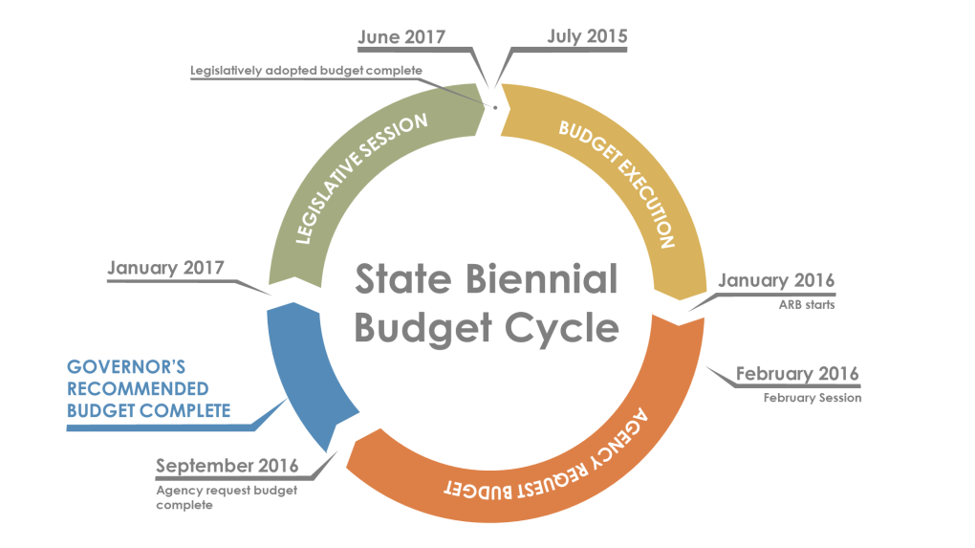
PHASES OF THE BUDGET PROCESS
The budget development process has three major phases:
Agency Request Budget (ARB)
Governor’s Budget
Legislatively Adopted Budget (LAB)
During the interim between ARB and LAB there are a number of budget execution tasks and many opportunities for adjustments (e.g., Emergency Boards).
June 2023
July 2023
January 2025
January 2024
February 2024
September 2024

Slide 8
Building the Base Budget
Budget Startup –
  Typically starts in January of even-numbered years for the Agency Request Budget
  Historical Data – reconcile the previous biennia's actual expenditures in ORBITS
  Review and make changes to program units, if necessary and clean-up DCRs not used
  Revenue Projections – look at projected ending cash balances for all Other Funds accounts for submission to DAS and LFO;

Slide 9
Budget Development Timeline
(Budget Startup Continued)
  Revenue Projections – look at projected Federal Fund awards to determine if we’ll have sufficient federal moneys for program needs
  Monitor outstanding issues that may require additional funding over and above the current limitations authorized. These may be included in POPs that the agency puts forward.
  Exception Requests – the agency may request exceptions to the standard budget process for things such as inflation on certain line items, fund shifts, etc.

Slide 10
Budget Development Timeline
Develop Base Budget –
  Typically March/April of even-numbered years. Includes specific Essential Packages:
  Base for Personal Services runs through the PICS system.
  ORPICS will “freeze” position funding about April 15 of even-numbered years.
    Looks at what positions are filled and at what step, and estimates future step increases to the end of the current biennium.
    Budgets vacant positions at step 2.
  Base for Services & Supplies, Capital Outlay, and Special Payments is the current legal limitation through April E-Board.

Slide 11

CSL and POP Overview

Slide 12
CSL and POP Overview
Develop Current Service Level (CSL) –
  Typically starts in May-June of even-numbered years. Includes specific Essential Packages:
  010 – Vacancy Factor & Non-PICS Personal Services
  021 – Costs of Phased-in programs to 24-months
  022 – Costs of Phased-out programs and one-time costs
  031 – Standard Inflation & State Government Service Charges
  032 – Above standard inflation with CFO Analyst approval
  040 – Mandated Caseload costs
  050 – Fund Shifts
  060 – Technical Adjustments

Slide 13
CSL and POP Overview
Develop Modified Current Service Level (CSL) –
  070 – Revenue Shortfalls
    CSL is estimated cost of continuing current programs into the next biennium, as required by law.
    Package 070 reduces current service level expenditures to accommodate available Other Funds and Federal Funds Revenues.
    If a request is being made to backfill revenue shortfalls with General Fund, it must be made in a Policy Option Package.

Slide 14
CSL and POP Overview
Develop Policy Option Packages (Jan – June) –
  A POP should be developed if programs intend to:
  Form New programs or expand existing ones;
  Reduce or end programs;
  Shift from one fund type to another, if the shift does not match past budget policy;
  Establish or increase fees;
  Implement reorganization proposals, including establishing, abolishing and reclassifying positions;
  Fund legislative concepts to be considered in the upcoming Legislative Session;
  Implement or expand Information Technology-related projects/initiatives.

Slide 15
CSL and POP Overview
January to March – Offices should begin thinking about potential insufficiencies that may warrant the request for additional funding
  General Fund request for existing program enhancement or expansion;
  General Fund request for backfill of declining federal revenues that help support State priorities;
  Requests for additional or expanded programs, new grants, or additional positions.
  Requests to implement proposed legislation or changes to current statutes that have fiscal impacts.
February to June – Analysts should work with their programs on pricing POP scenarios to assist Management Team on deciding which requests move forward.

Slide 16

Key Budget Deadlines

Slide 17
Key Budget Deadlines
March (even years) –
  Actuals audit transmittals due to SABRS
  Agency Budget kickoff Meetings
  February Legislative Session actions due to SABRS
  SCR/DCR changes due to CFO – consensus with CFO/LFO
  PDs for ARB position requests due to HR for classification review
April (even years) –
  Legislative Concepts due to DAS for Governor’s decision
  PICS Freeze
  SABRS kickoff meeting - PICS and ORBITS systems are opened for data entry
  CFO approval on CSL exception requests
  Performance Measure change requests due to CFO/LFO

Slide 18
DAS Key Budget Deadlines
May (even years) –
  ORPICS start-up transmittals due – Base positions frozen for all agencies
  Article XI-Q Bond and Lottery Revenue Bond Financing request forms due to DAS for consideration
  ORPICS CSL information and audit transmittal due by EOM
  HR reviews for ARB position requests finalized
  Draft POP concepts to State Board of Education for review and comments
June (even years) –
  ORPICS ARB audit transmittal due by EOM
  ORBITS CSL audit transmittal due by EOM

Slide 19
DAS Key Budget Deadlines
July (even years) –
  POP concept narratives finalized for budget document
  Budget document draft for internal review
  Final comments/recommendations from State Board of Education
  ORBITS ARB audit transmittal due by EOM
August (even years) –
  Finalize ARB narrative and budget document for submittal on September 1 (statutory deadline)
September (even years) –
  Submit ARB budget on 9/1
  Respond for requests for information from CFO/Governor’s Office

Slide 20
DAS Key Budget Deadlines
October (even years) –
  Appeal GRB actions if appropriate
  Respond for requests for information from CFO/Governor’s Office
November (even years) –
  Respond for requests for information from CFO/Governor’s Office
  Reconcile GRB changes in ORBITS/PICS
December (even years) –
  Finalize GRB changes in document and produce Governor’s Recommended Budget
February to July (odd years)
  Legislative Session

Slide 21
Closing slide
Contact information:
Name
Email
Phone
Website

