Slide 1
CHRO Presents - Protected Leaves
January 2024

Slide 2
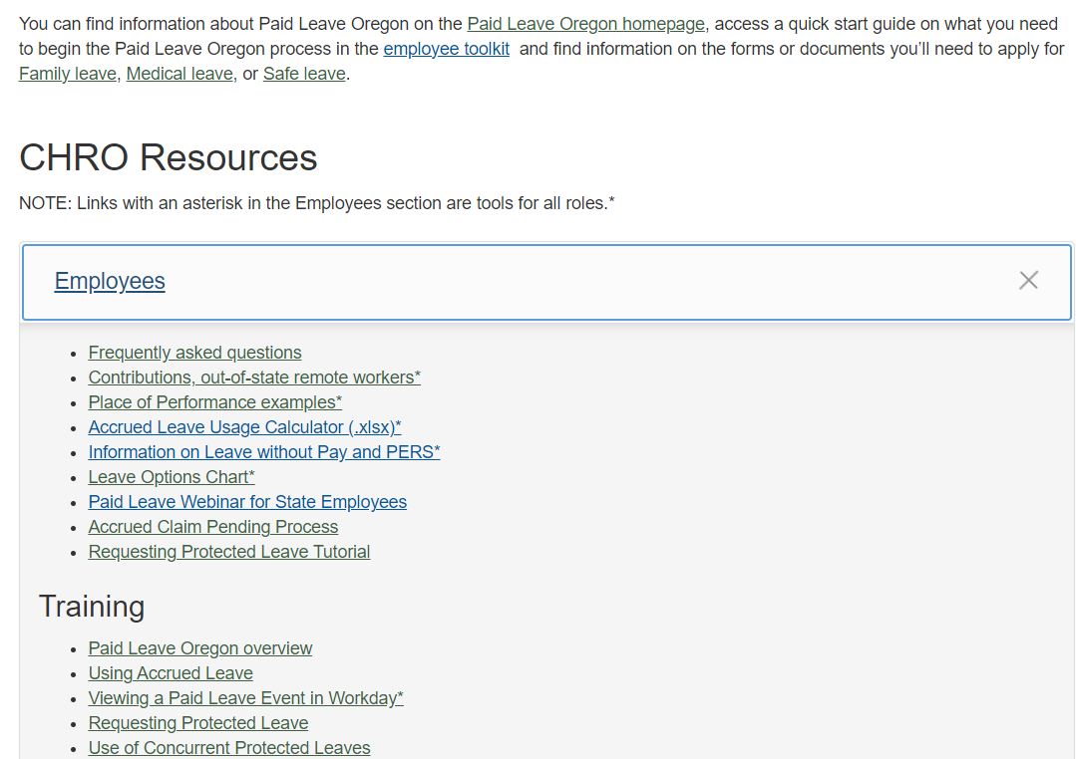
CHRO Paid Leave Oregon Website
FAQs
Resources
Training
Knowledge Articles
www.oregon.gov/das/HR/Pages/Paid-Leave-CHRO.aspx
Please explore and visit often!

Slide 3
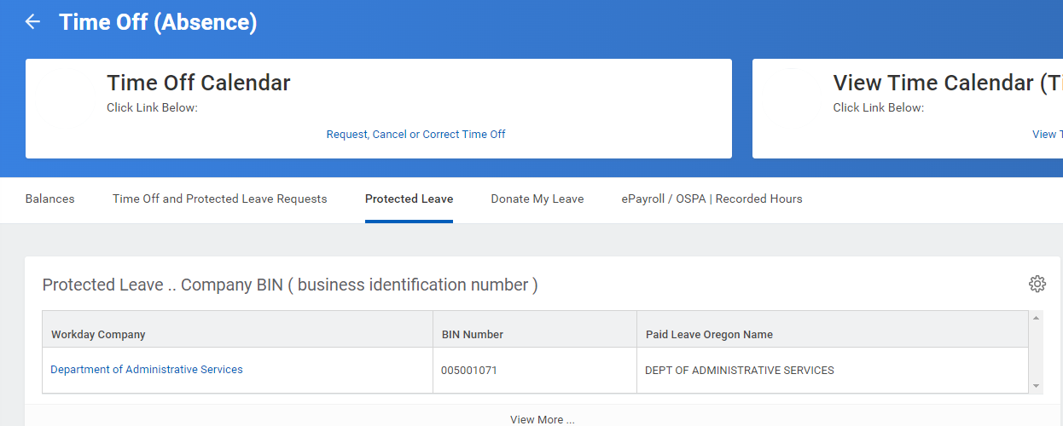
Frances Online – Application Tips
BIN in Workday
Use the search function to find the name of your agency
Do not change the address
Find the job category

Slide 4
Use of accrued leave
“Employees may choose to use sick, vacation, personal business, compensatory time or straight time leave in any increment, up to their normally scheduled hours, while receiving Paid Leave Oregon.”
Paid Leave Oregon benefits are not state paid wages
Any amount of paid or unpaid leave may be used, in any combination on days you receive Paid Leave Oregon benefits (full-days only)
You must notify your manager if the day will be covered by Paid Leave Oregon

Slide 5
Use of Accrued Leave
I work an 8-hour day. May I use 2 hours of Sick Leave and 6 of leave without Pay? – YES
I work a 10-hour day. May I use 10 hours of Vacation Leave? – YES
I work a 4-hour day. May I use 1 hour of Sick Leave, 1 hour of Comp Time, 1 hour Vacation Leave and 1 hour of Leave Without Pay? – YES
I work an 8-hour day. May I use 10 hours of Vacation Leave? – NO

Slide 6
Recording Paid Leave Oregon in Workday
Two Absences Requests –
1. One for the paid/unpaid leave
2. One for the protection

Slide 7
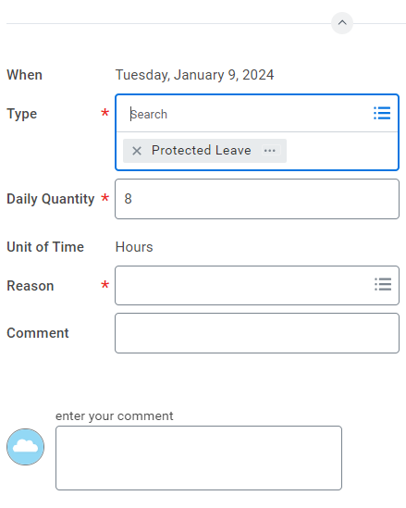
Recording Protected Leave in Workday
Time off Type -
Protected Leave

Slide 8
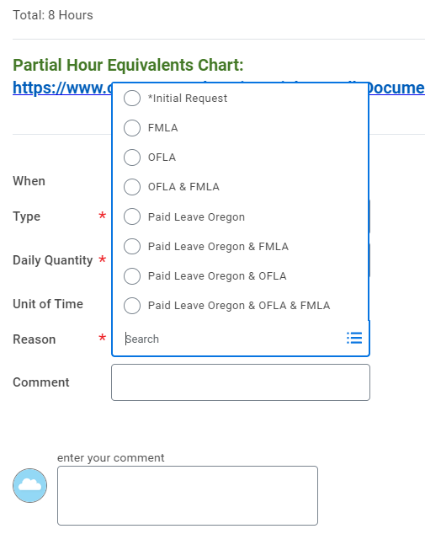
Recording Protected Leave in Workday
Protected Leave –
Reasons

Slide 9
Additional Data in Workday

Slide 10
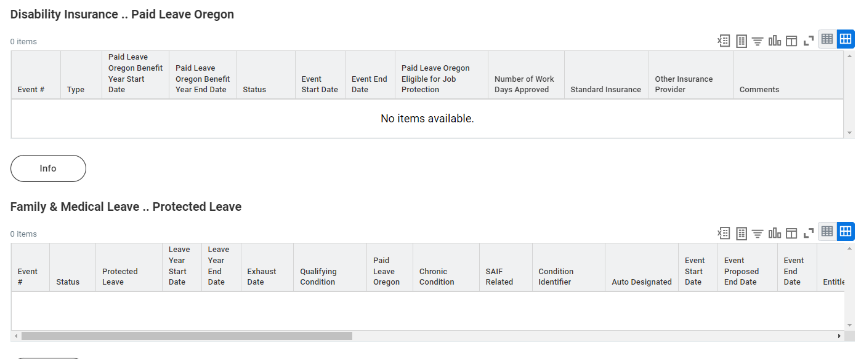
Additional Data in Workday

Slide 11
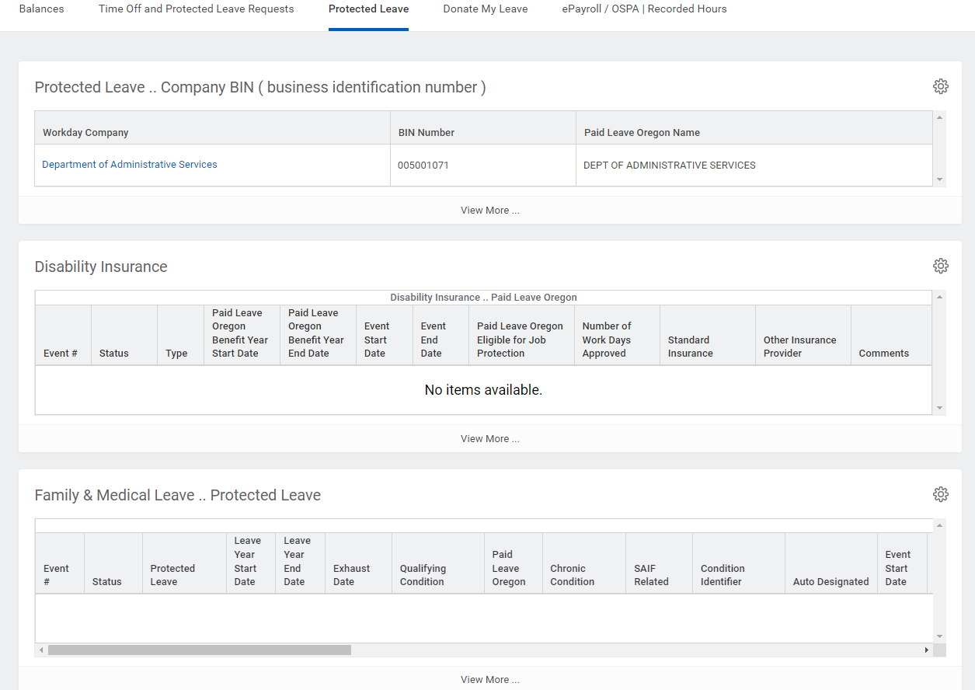
Additional Data in Workday

Slide 12
Additional Data in Workday

Slide 13
FMLA/OFLA Leave Year
The leave year begins 52-weeks from the Sunday immediately preceding the first day of the leave.

Slide 14
Eligibility is run monthly as employee continues to need intermittent leave
Jan. 1, 2024
June 1, 2024
Dec. 1, 2024
May 25, 2025
Nov. 30, 2025
Employee requests FMLA/OFLA for a new, ongoing condition and does not meet eligibility
Employee meets eligibility requirements for OFLA
Employee meets eligibility requirements for FMLA
FMLA Leave Year Ends November 30, 2025
OFLA Leave Year Starts:
May 26, 2024
Employee may use up to 12 weeks of OFLA leave for this and any new condition
OFLA Leave Year Ends May 25, 2025

Slide 15
Eligibility is run monthly as employee continues to need intermittent leave
Sept. 3, 2023
Jan. 8, 2024
May 15, 2024
Sept. 1, 2024
Jan 4, 2025
May 11, 2025
Employee begins Paid Leave Benefit Year.
Employee has first need of OFLA Leave.
OFLA Leave Year Starts Jan. 7, 2024
Employee has first need of FMLA Leave.
FMLA Leave Year Starts May 12, 2024
Paid Leave Benefit Year Ends Sept. 1, 2024
FMLA Leave Year Ends May 11, 2025
OFLA Leave Year Ends January 4, 2025
The amount of leave in any combination of Paid Leave and OFLA that can be used in a Paid Leave benefit year is 16 weeks (18 weeks for pregnancy disability).

Slide 16
PAID LEAVE CLAIM PENDING 2024
Continuous Leave |  | Intermittent Leave
EMPLOYEE INDICATES USE OF LEAVE IN WORKDAY
Employee enters accrued leave or Leave Without Pay in Workday
EMPLOYEE DOES NOT INDICATE USE OF LEAVE IN WORKDAY
Agency sends employee a form to indicate leave type.
Employee enters their accrued leave/Leave Without Pay into Workday for full day absences.
Retroactive Changing of Leave Type
IF LEAVE IS USED
Employee receives any payment for accrued leave on their regularly scheduled payday.
Agency places employee on a leave of absence in Workday pending notification from employee on the use of accrued leave.
LEAVE WITHOUT PAY TO ACCRUED LEAVE
ALLOWED
ACCRUED LEAVE TO LEAVE WITHOUT PAY
NOT ALLOWED
NO RESPONSE
Employee remains on leave of absence in Workday.
EMPLOYEE INDICATES DESIRE TO USE ACCRUED LEAVE
Agency applies accrued leave and provides any monies owed from previous pay period(s) within three business days.
If during a payroll blackout date, payment will be made within three business days after the blackout dates.
If employee chose to use Leave Without Pay while claim pending or while receiving benefits and later changes to use accrued leave, agency applies accrued leave and provides payment to employee within three business days.
If employee chose to use Accrued Leave while claim pending or while receiving benefits and later wishes to change to Leave Without Pay, request to change will not be accepted.
Employees may use any amount of accrued leave/Leave Without Pay on days they receive Paid Leave benefits up to their scheduled work hours.

Slide 17
Other information
Use of leave without pay may affect your PERS time of service
Paid Leave Oregon benefits are not PERS subject salary
Paid Leave Oregon does not affect an employee’s seniority, eligibility for salary increases or the employee’s recognized service date (continuous service date)
Paid Leave Oregon does not count as time worked for overtime purposes.
Employees still receive pay for the holiday while receiving Paid Leave Oregon.

Slide 18
Protected Leave
Questions and Answers

