Slide 1

Case Management Update

Slide 2

Workday Case Management Update
4 months remaining
Open Case Management to DAS HR Staff
Q4 2023
CHRO Class and Comp Consultants assign and act on cases
Deliver Case Management Training at Class Comp Statewide + Workday Wednesday
Q1 2024
Open Case Management to all Enterprise HR Staff
Requests no longer accepted outside of Workday after 12/31/2024
We are here

Slide 3

Workday Case Management Update
Bureau of Labor and Industries
Construction Contractors Board
Department of Administrative Services
Department of Agriculture
Department of Consumer & Business Services
Department of Corrections
Department of Early Learning and Care
Department of Energy
Department of Environmental Quality
Department of Fish and Wildlife
Department of Human Services
Department of Justice
Department of Public Safety Standards and Training
Department of Revenue
Department of State Lands
Department of Transportation
Department of Veterans Affairs
Employment Department
Forestry Department
Higher Education Coordinating Commission
Land Conservation and Development Department
Occupational Therapy Licensing Board
Office of Public Defense Services
Oregon Business Development Department
Oregon Department of Education
Oregon Health Authority
Oregon Housing and Community Services
Oregon Liquor & Cannabis Commission
Oregon State Department of Police
Oregon State Treasury
Oregon Youth Authority
Parks and Recreation Department
Public Employees Retirement System
Public Utility Commission
State Board of Examiners for Speech-Language Pathology and Audiology
State of Oregon Military Department
Water Resources Department
240+ Cases successfully submitted so far.
Report available for use: CM | Class Comp Help Cases.
Please continue to send Pay Equity related cases to Pay Equity inbox.
Every agency has a Help Workspace already, submit requests to Workday Oregon for Case Solver role assignment.
List of Agencies with at least (1) General HR Case Solver ->

Slide 4
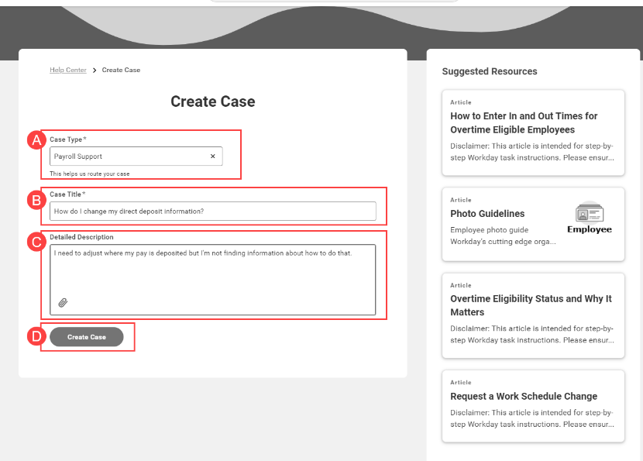
How to Become a Case Solver
Creating a Help Case - Employee Instructions
Submit a Help Case as an employee to request Case Solver role
A minimum of two Case Solvers is ideal.

Slide 5
Workday Case Management Submission Template
Title Line Naming Convention:
  “Action Item Type, (WD/PPDB ID), (Incumbent or Classification if Vacant)”
Detailed Message Text Field Template:
  Action Item Type:
  Agency
  Requested by/ Supervisor
  Workday Position Number (“TBD” if unavailable)
  PPDB Position Number (“TBD” if unavailable)
  Current Classification
  Proposed Classification
  Case to be shared with:

Slide 6
Case Solver Resources
DAS - WD - Case Management Overview
Solver Perspective: Working with Your Cases
Who should be a Case Solver in Workday?
Solver Perspective: Getting to Know Case Management
Case Types for Workday Help/Case Management

Slide 7
Case Management
Contact information:
DAS CHRO Classification & Compensation Team
chro.cnc@das.oregon.gov
https://www.oregon.gov/das/HR/Pages/cc.aspx

