Slide 1


A new program that allows employees in Oregon to take paid time off for some of life’s most important moments that impact our families, health and safety.

Slide 2



What is Paid Leave Oregon?
Family Leave
Medical Leave
Safe Leave

Slide 3

Paid Leave Eligibility
You are employed and your work is located in Oregon.​
You earned at least $1,000 in wages in the year prior to your qualifying event.​
You contributed to Paid Leave through payroll deductions. ​
You experience a qualifying event.​

Slide 4


Examples of Qualifying & Non-Qualifying Events
Qualifying
Disability due to miscarriage or stillbirth.​
Caring for and bonding with a child after birth, adoption, or foster care placement. ​
To care for a family member with a serious health condition.
Non-Qualifying
Non-serious illness
Bereavement ​
Military Leave

Slide 5
Verification of Qualifying Events
Leave type verification | OAR/ORS reference
Family Leave (to care for or bond with a child) | 471-070-1110
Medical Leave, (serious health condition) | 471-070-1120
Safe Leave | 471-070-1130
To be eligible for leave, a patient must have a qualifying event that can be verified.
Our Employee guidebook lists how each type of leave must be verified starting on page 22

Slide 6

Leave Increments, Duration, and Benefit Period
Leave may be taken in days or weeks and may be taken intermittently
Benefit years are a 52-week period commencing the Sunday prior to your leave
Separate claims must be filed for separate qualifying events in a single year
For chronic conditions, a new application must be filed at the start of a new benefit year

Slide 7
Leave Durations Compared
LEAVE DURATION AND BENEFIT PAYMENTS | Paid Leave Oregon | OFLA | FMLA | Oregon Sick Leave
Leave duration (most cases) | 12 weeks in a one-year period | 12 weeks in a one-year period | 12 weeks in a one-year period | 40 hours in a one-year period
Maximum leave duration (for certain combinations of leave types) | 14 weeks in a one-year period | 36 weeks in a one-year period | 26 weeks in a one-year period | Employers may cap use at 40 hours per year
Payment | Paid Leave | Unpaid Leave | Unpaid Leave | Paid Leave for employers with 10 or more employees (6 or more in Portland)
Benefit amount | Varies based on employee’s average weekly wage. Up to 100% for lower-income workers. | n/a | n/a | 100% of regular wages

Slide 8

How to Apply for Benefits
Documentation
Gather your documentation
Decide the amount and schedule of leave you’re applying for
Notify your Employer
30 days for foreseeable leave
24-hour emergency notice + written notice within 3 days
Apply for Benefits
Set up your Frances Online Account
Update your Application
Notify OED of any changes within 10 days
*Paper applications will be available on the website
Apply no earlier than 30 days before leave

Slide 9
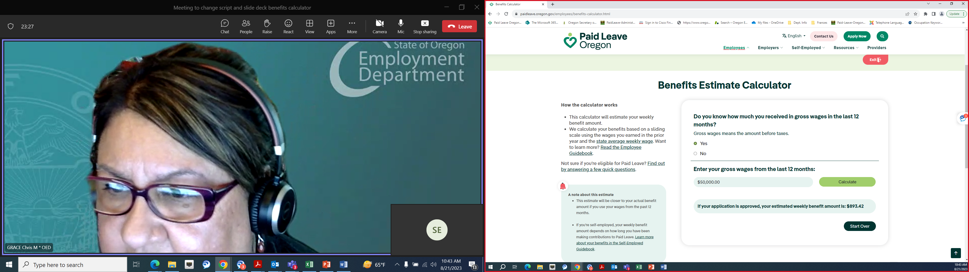
Benefits Calculator

Slide 10

Taxability
Paid Leave Oregon contributions are taken out after-tax and will not reduce your taxable income.
Paid Leave Oregon benefits are taxable.
Taxes will not be automatically withheld from benefits.
The Oregon Department of Revenue provided detailed information about the tax treatment for contributions and benefits in a memo, posted on the Paid Leave website.

Slide 11

Job Protections
The employee’s job is protected if they have worked for the employer more than 90 days
Job protection applies regardless of employer size
Return employee to equivalent position (or similar, if small employer and position no longer exists)
Continue health benefits while employees are
on leave
No discrimination or retaliation for employees taking or inquiring about Paid Leave

Slide 12
Updating, Amending, Or Cancelling a Claim
Claimants must notify the department within 10 days of changes to a claim.​
A claim may be amended for reasons that do not require additional verification, such as adding an employer or reducing the amount of leave.​
A new application must be submitted if an update to the claim requires additional verification, such as a change in the date of a medical procedure.​
A claim may be cancelled if an applicant requests, benefits have not been paid, and there have been no disqualifications.

Slide 13
Appeals, Complaints and Waivers​
Appeals – Request a hearing for a decision the applicant does not agree with​
  Appeal Weekly Benefit Amount​
  Length of Leave Approved​
  Dates of Leave Approved​
  Denial of a Claim​
Complaints – Complaints against an employer​
  Punish Employee for taking Paid Leave​
  Discrimination against Employee for Asking About or Taking Paid Leave​
Waivers ​
  For waiving the 25% Benefit Reduction for not providing your employer timely notification of Paid Leave.

Slide 14
Summary
The employee guidebook has everything you need to know!
Benefits began September 3 ​
You can apply online or by mail​
Benefit years are a rolling 52-week period from initial application​
Leave can be taken in daily or weekly increments and may be intermittent or consecutive
Your job and your healthcare benefits are protected if you have worked for your employer for 90 consecutive days

Slide 15
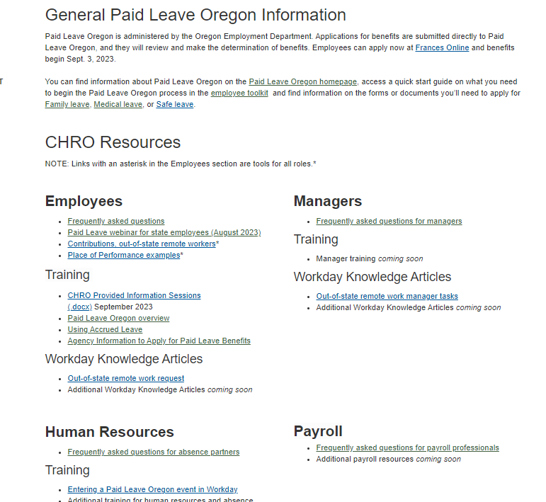
CHRO Paid Leave Oregon Website
FAQs
Resources
Training
Knowledge Articles
www.oregon.gov/das/HR/Pages/Paid-Leave-CHRO.aspx
Please explore and visit often!

Slide 16
Use of accrued leave
Through December 31, 2023:
  Any amount of paid or unpaid leave may be used, in any combination
  Only on the days you receive Paid Leave Oregon benefits (full-days only)
  Accrued leave may not be used to exceed 100% of your state paid wages
  You must notify your manager if the day will be covered by Paid Leave Oregon
  Use of accrued leave while receiving Paid Leave Oregon in 2024 is being discussed.

Slide 17
Use of Accrued Leave
I work an 8-hour day. May I use 2 hours of Sick Leave and 6 of leave without Pay? – YES
I work a 10-hour day. May I use 10 hours of Vacation Leave? – YES
I work a 4-hour day. May I use 1 hour of Sick Leave, 1 hour of Comp Time, 1 hour Vacation Leave and 1 hour of Leave Without Pay? – YES
I work an 8-hour day. May I use 10 hours of Vacation Leave? – NO

Slide 18
Recording Paid Leave Oregon in Workday
All scheduled hours must be accounted for
There is not a Paid Leave Oregon leave option
Add “Paid Leave Oregon” in the Comments section of the leave request

Slide 19
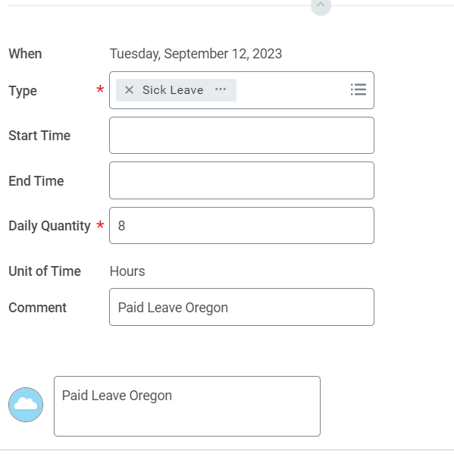
Recording Paid Leave Oregon in Workday
Example

Slide 20
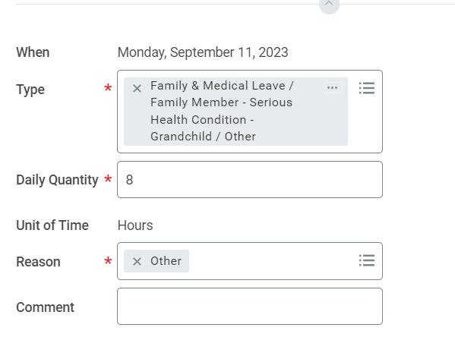
Recording OFLA in Workday
Expanded Definition of Family Member
Employees must use OFLA when receiving Paid Leave Oregon

Slide 21
Other information
Use of leave without pay may affect your PERS time of service
Paid Leave Oregon benefits are not PERS subject salary
Paid Leave Oregon does not affect an employee’s seniority, eligibility for salary increases or the employee’s recognized service date (continuous service date)

Slide 22
CHRO Paid Leave Oregon
Questions and Answers

Slide 23

PEBB
Why would I want to keep The Standard Short-term Disability (STD)
I live and work outside of Oregon
  For example, I live and work in Texas and payroll doesn’t withhold Paid Leave Oregon from my paycheck
I earn more than $10,000 per month
  Paid Leave Oregon will cover earnings up to $10,000 per month but if you earn more you might want the additional coverage
I might use more than 12 weeks of leave in a year with two separate occurrences
  For example, you go out on leave in January and use your full 12 weeks of Paid Leave Oregon and then have to go out again in July for another occurrence which affects you with injury/illness

Slide 24
PEBB
Which is primary?
The Standard will be secondary to Paid Leave Oregon
  This means The Standard will assume you have Paid Leave Oregon as primary and pay out accordingly as secondary coverage (unless you can show you already used your full benefit with Paid Leave Oregon)
  The benefit with The Standard might equate to $25 per week while you are using your Paid Leave Oregon benefit as primary
  The Standard will pay out as primary if you have already fully used your Paid Leave Oregon benefit and qualify and are approved for the additional second occurrence which affects you with injury/illness
  These must be 2 separate occurrences and not combined
    For example, you are out due to a long-term illness and fully use your Paid Leave Oregon benefit but still need time off. In this scenario, you would then need to use Long-term Disability (LTD) with The Standard for the additional time since this is one occurrence. You would not file an additional STD claim with The Standard.

Slide 25
PEBB
So, why should I keep STD with Then Standard and PEBB?
The Standard STD premiums were decreased by almost 80% effective September 1st
The Standard STD will cover you as primary if you have more than one occurrence due to injury/illness for yourself in the plan year and it is approved with The Standard
If you earn more than $10,000 per month then The Standard will supplement over the Paid Leave Oregon amount to give you a full benefit if you are out due to injury/illness for yourself
If you live and work outside of Oregon and payroll doesn’t deduct Paid Leave Oregon from your check

Slide 26

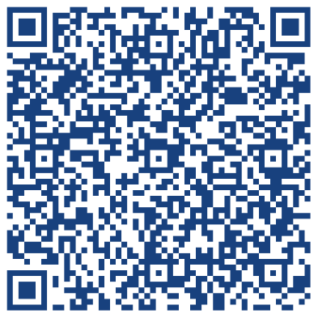

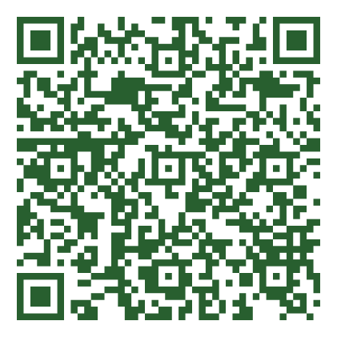

^{One-on-One with The Standard}
Questions about Short- or Long-Term Disability?
Ask The Standard in a 15-minute Live Phone Call
October 17 & 23 @ 2:00-5:30pm PT
calendly.com/ryan-anthony-morgan/the-state-of-oregon-by-and-through-its-public-employees-benefit-board
^{October 27 @ 11:00-2:30pm PT}
https://calendly.com/standardenrollmentconsultation/the-state-of-oregon-pebb

Slide 27



Have Suggestions, Questions, or Concerns?
Website: PaidLeave.Oregon.gov
Email: paidleave@oregon.gov
Phone: 833-854-0166
Subscribe to our mailing list
Accommodations, including interpreters, are available
Follow us on social media:
facebook.com/paidleaveoregon
twitter.com/paidleaveoregon
instagram.com/paidleaveoregon

