Slide 1
Project Management Users Group (PMUG)
SMARTSHEET - Update
3/18/2026
Joey Razzano
ODHS Performance System Administrator

Slide 2
What I’ll be covering
Intro to Joey Razzano
Intro to Smartsheet
OSMART (Oregon State Smartsheet User Group)
Smartsheet Sessions
Smartsheet University
Security Issues
Integration with Microsoft
Agencies using Smartsheet
Early Adopter Program
Smartsheet Community
AI Use/Claude
Q&A
Smartsheet Premium Apps
Integrations/Connectors
Live Demonstration

Slide 3
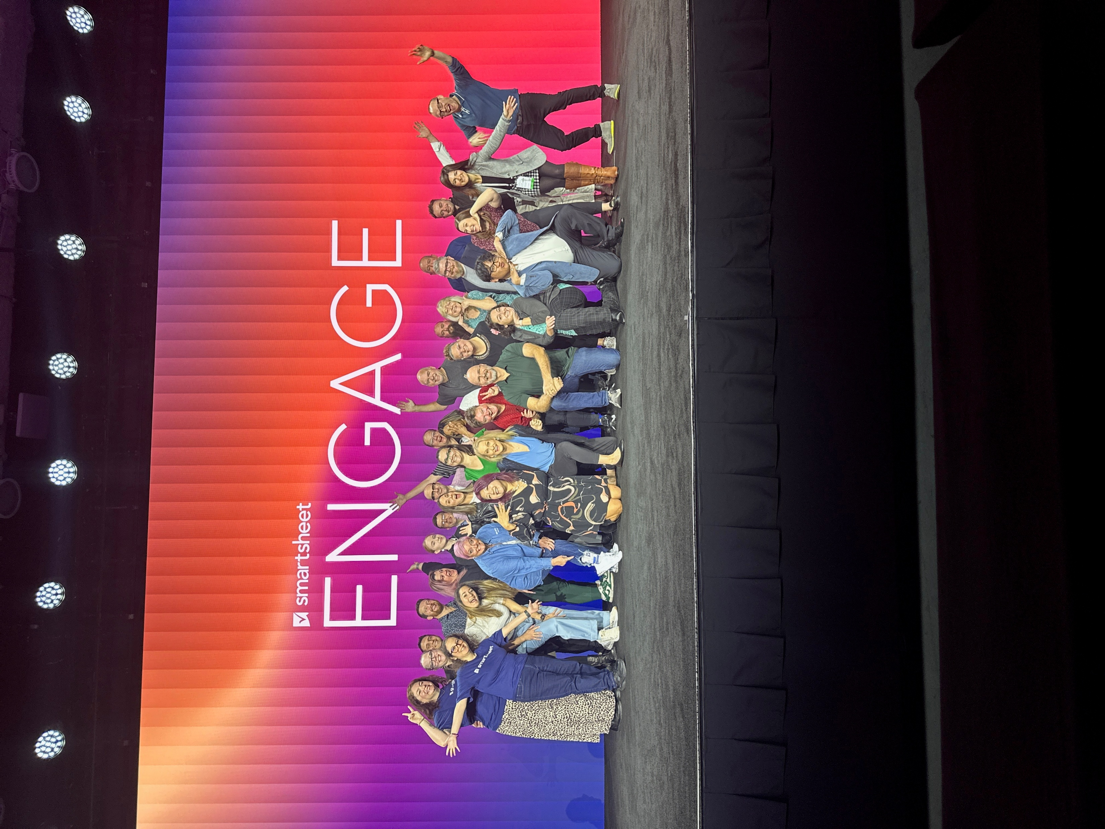
Intro to Joey Razzano
Performance System Administrator, ODHS, 2024-present
Accreditation & Accountability Coordinator/Collaboration Strategist, PHD 2016-24
Smartsheet Core (Certified 2022)
Smartsheet System Administrator (Certified 2022)
Smartsheet Project Management Certified (Certified 2023)
Early Adopter Program
Smartsheet Portland Area User Group presenter 2019-2022
Smartsheet Overachiever, 2025-2027
https://www.linkedin.com/in/joey-razzano-a56861202/

Slide 4
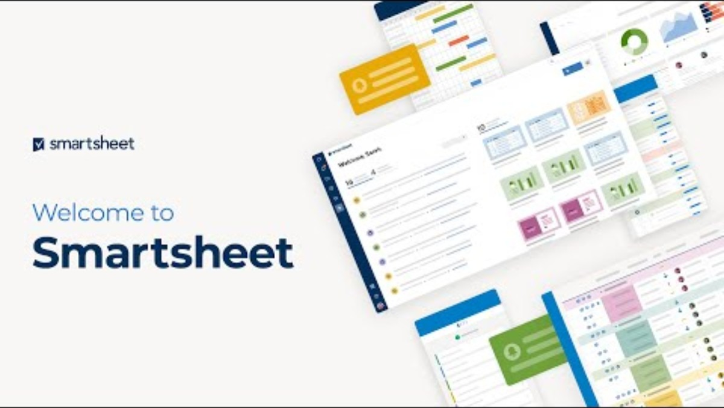
Intro to Smartsheet (Video)

Slide 5
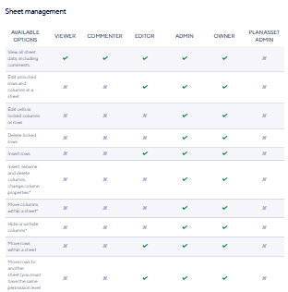
Intro to Smartsheet
Unique Permission Structure/Features/Pros and Cons
https://help.smartsheet.com/articles/2483288/sharing-permission-levels
Majority of users do not need a license
Looks like Excel but acts like a combination of Access, Outlook, Power Automation, Excel, Adobe and Teams
Works well with external collaborators

Slide 6
Smartsheet Premium Apps
Control Center
Resource Management
Brandfolder
Dynamic View
Workapps
DataTable
Data Shuttle
Bridge
DataMesh
Calendar
Pivot
Jira Connector
Salesforce Connector
https://help.smartsheet.com/premium-features
https://help.smartsheet.com/learning-track/integrations-and-add-ons

Slide 7
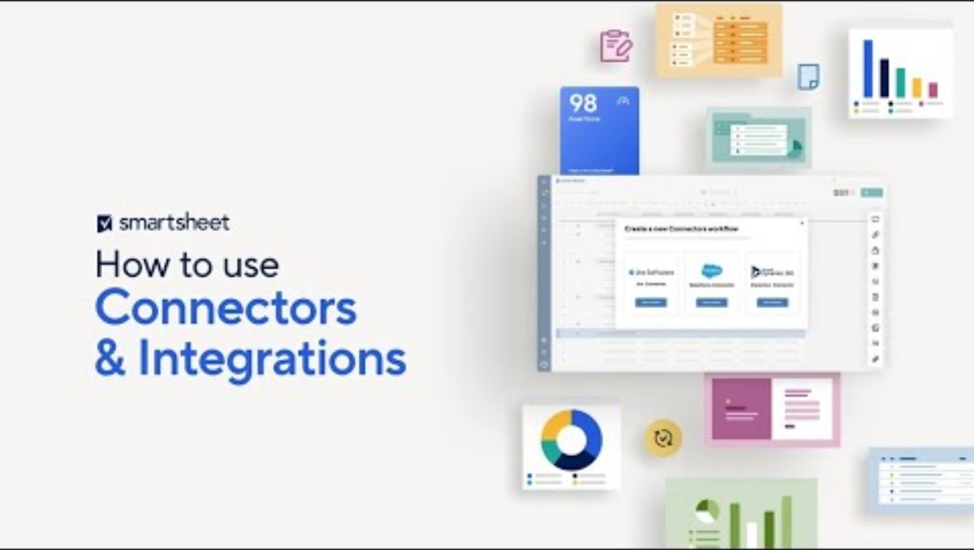
Integrations/Connectors

Slide 8
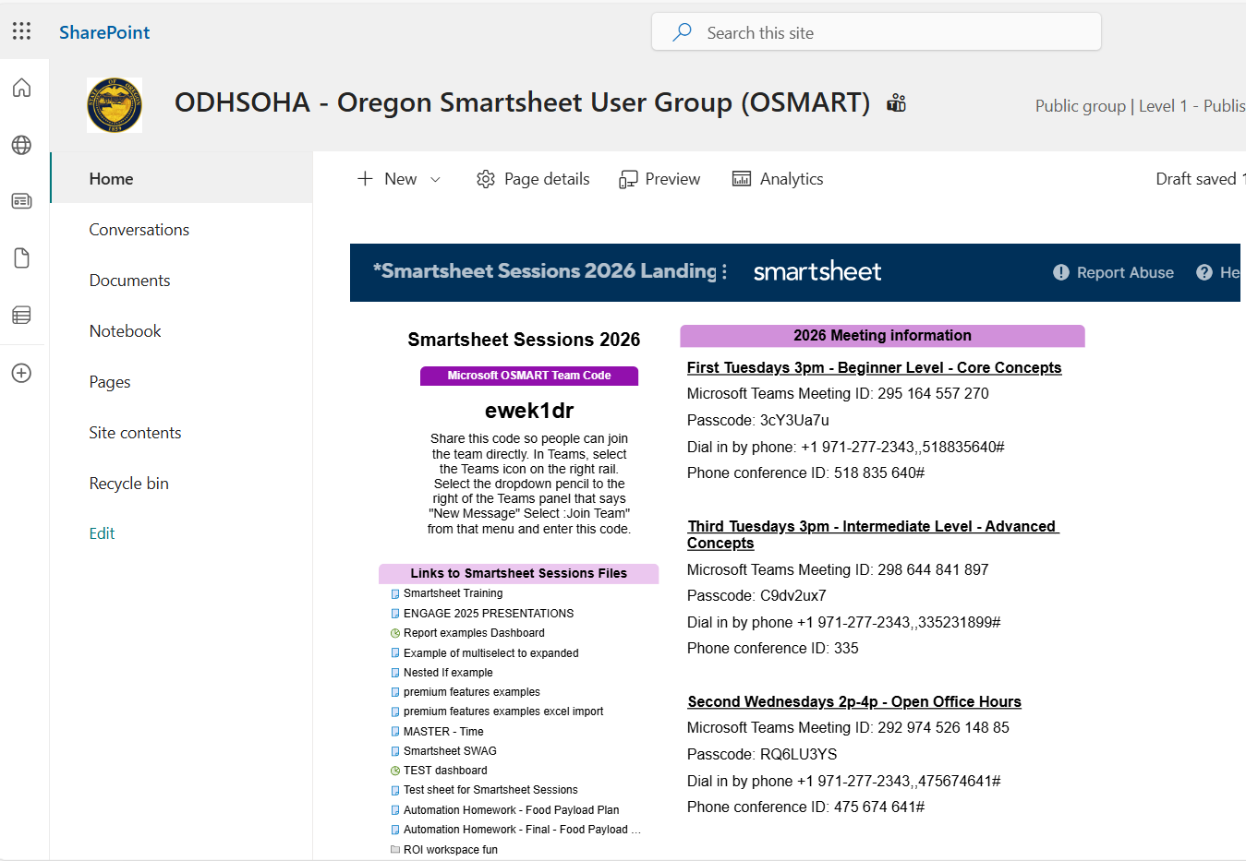
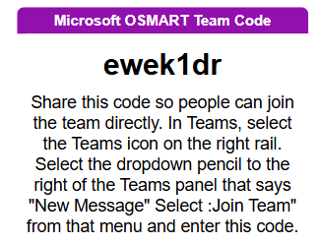
OSMART (Oregon State Smartsheet User Group)
https://dhsoha.sharepoint.com/teams/ODHSOHA-OregonStateAgencySmartsheetUserGroupOSMART

Slide 9
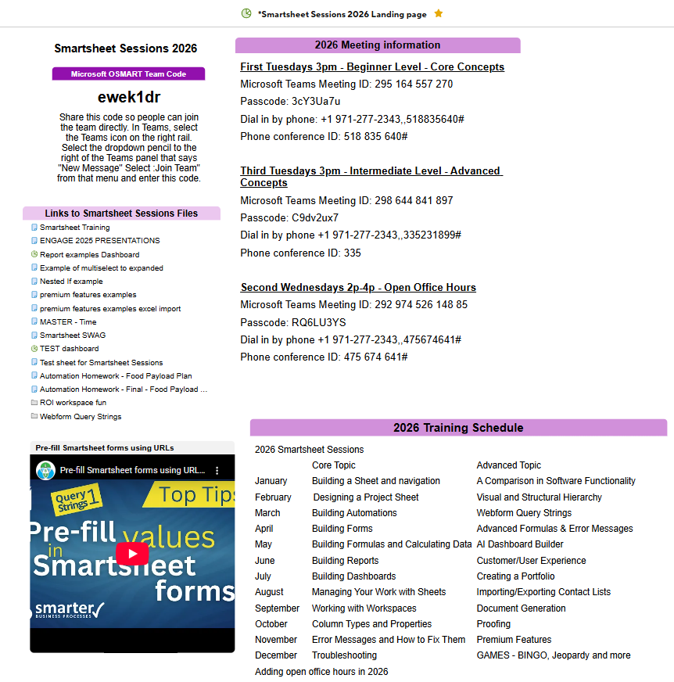
Smartsheet Sessions
https://app.smartsheet.com/dashboards/QGH3MgfjgPP9fXx7XfR8X74VwRwvgxFp7w4gwcQ1

Slide 10
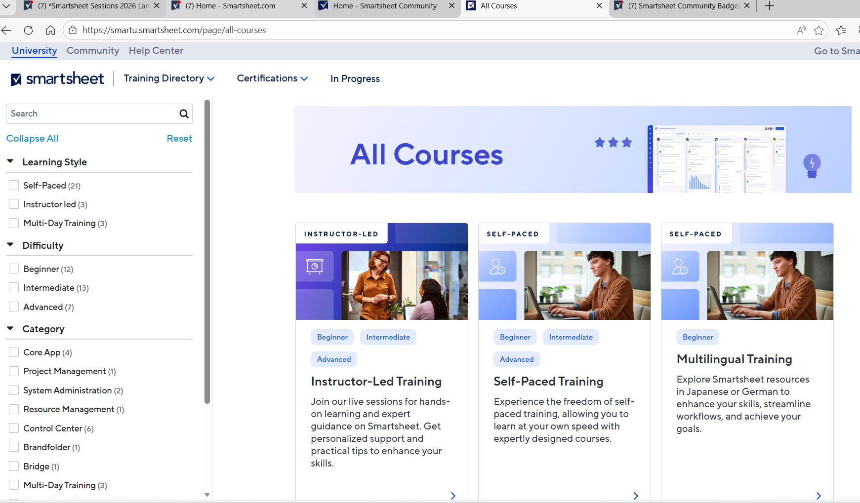
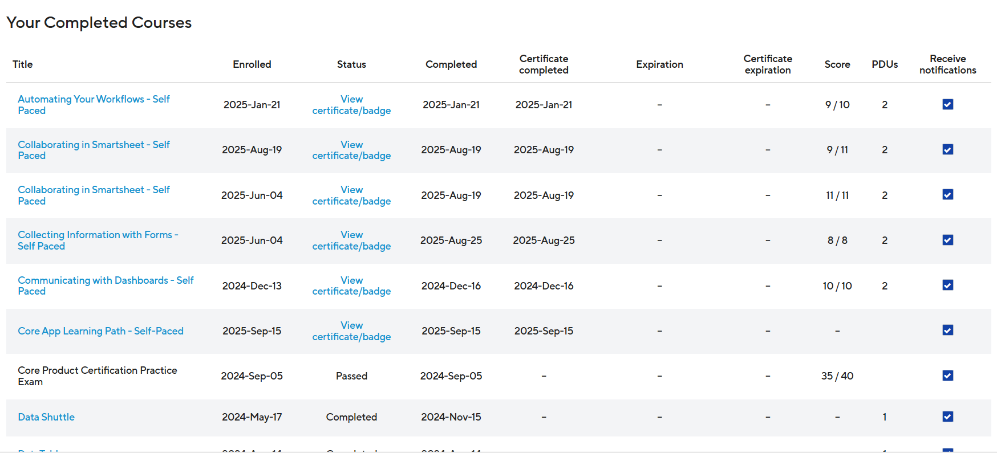
Smartsheet University
https://smartu.smartsheet.com/

Slide 11
Security Issues
Need FedRamp level security, level 3?
Smartsheet.gov
Need PHI/PII security, level 3?
Smartsheet.com

Slide 12
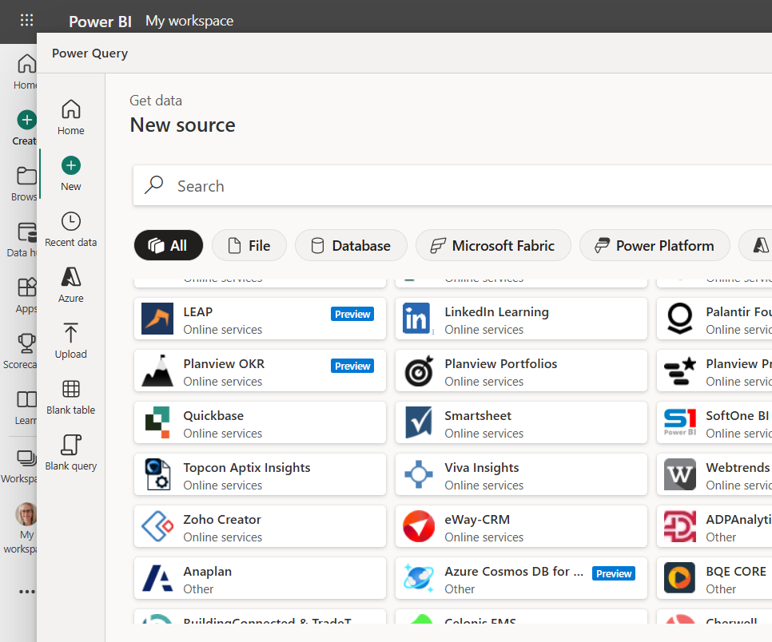
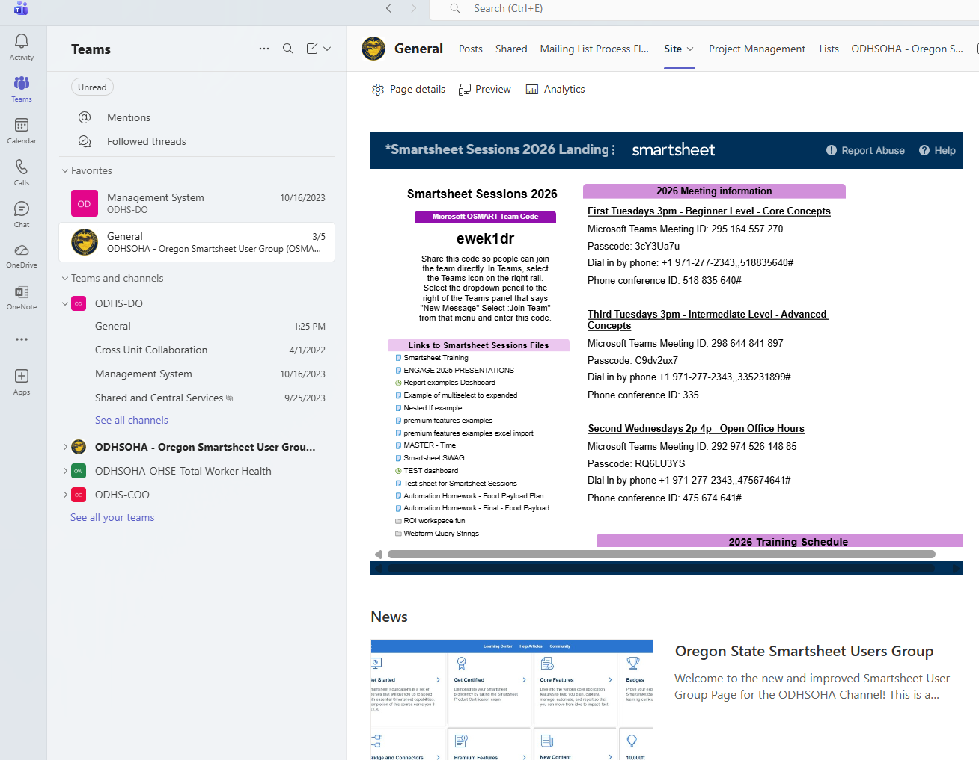
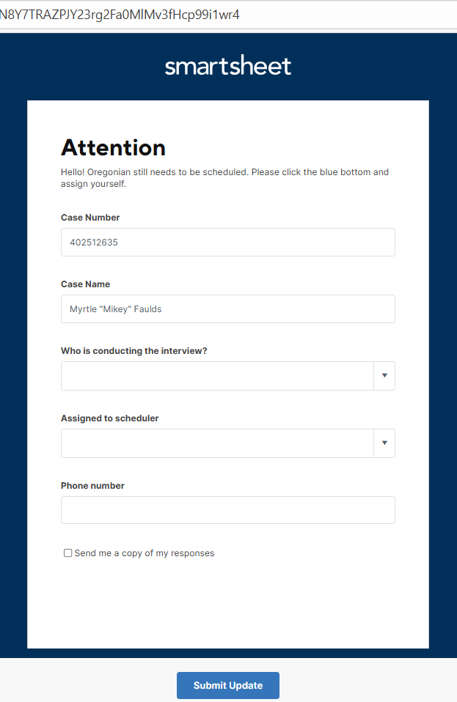
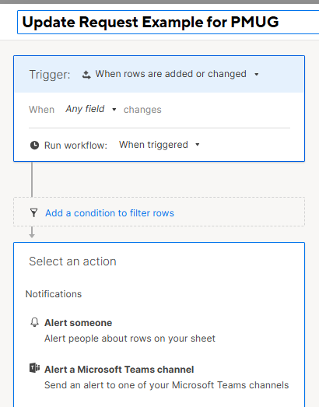
Integration with Microsoft
Power BI
Teams
Outlook
Connectors

Slide 13
Agencies using Smartsheet
OHA OR Health Authority
ODHS OR Department of Human Services
ODE OR Department of Education
OED OR Employment Division
SOS Secretary of State
OGEC OR Governor’s Ethics Commission
ODOT OR Department of Transportation
ODFW OR Department of Forestry and Wildlife
OIS Office of Information Services
DEQ Department of Environmental Quality
Oregon Youth Authority
Department of Corrections
Department of Justice
Oregon Lottery
Department of Administrative Services
Washington County
Clackamas County
Metro
OHCS Oregon Housing & Community Services
DCBS Department of Consumer and Business Services
DAS Department of Administrative Services
Business Oregon

Slide 14
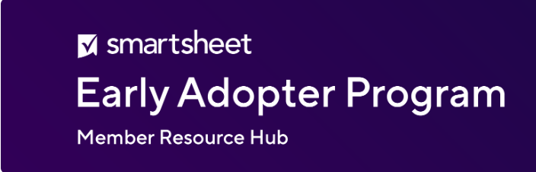
Early Adopter
Program (EAP)
Currently in EAP
• Enhanced Charts**
• Dashboard Filters**
• Open link sharing
• Continuous Save for Mobile
• Table Reports
• Smart Assist*
• Scenario Planning***
• AI Dashboard Builder*
• Natural Language Queries***
• Portfolios***
Upcoming
• Static Filters for Linked Dropdowns
Notes:
https://app.smartsheet.com/b/publish?EQBCT=19052ea5c7e641378094f76f71e17ed4&utm_source=marketo&utm_medium=email&utm_campaign=eap-weekly-insights&utm_content=link&mkt_tok=NDY0LU9OTS0xNDkAAAGgh57OtCCaCorFkVxQmQqF0pzd5FYmWNQHGqkBPmk_-WuRP3iy_OtM6dQvUiVd4YzfSP2wRSrCtIIH_yqzcIB0TvfMDjNQve1VU-vXCA2-_tk9Cc8iRos

Slide 15
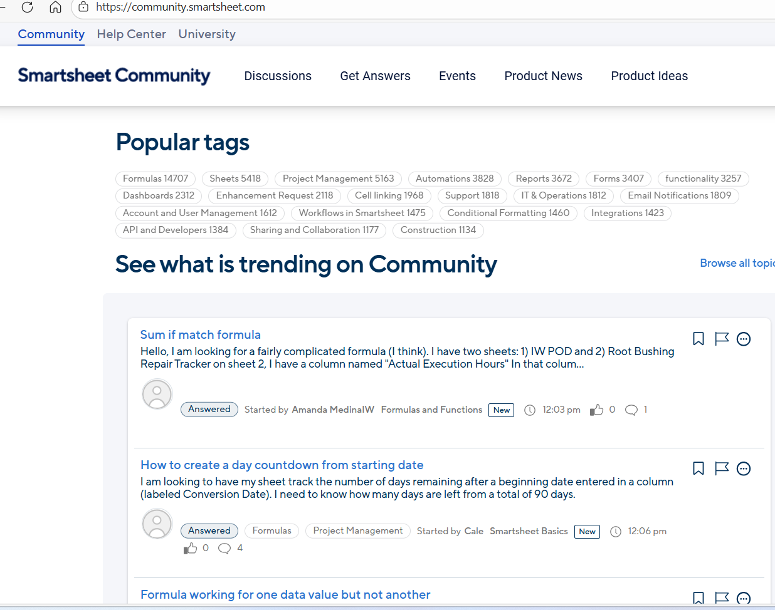
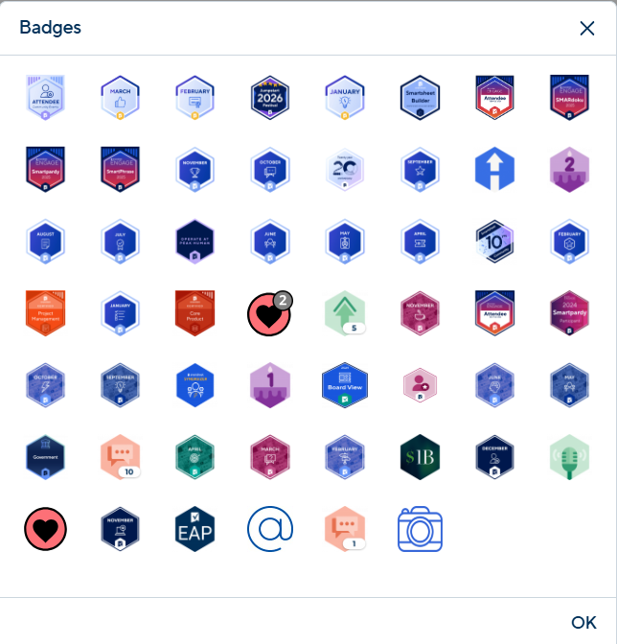
Smartsheet Community
https://community.smartsheet.com/
Notes:
BADGE Dashboard: https://app.smartsheet.com/b/publish?EQBCT=e52c154bdc2946baa6588eb78f23c575

Slide 16
AI Use/Claude – let’s talk about it

Slide 17
Live Demonstration
Let’s GO!
Notes:
ITAM form: https://app.smartsheet.com/b/form/7e3f2fc4a72b4f1ebba624c24faa8f75

Slide 18
Q&A
Contact Info:
Joey.w.razzano@odhs.oregon.gov
503-421-0960

