Slide 1


OPMCP: Course Feedback
2025 Review

Slide 2
Student Testimonials
Direct feedback and impact from OPMCP course participants
format_quote
“I really enjoyed this course. Much of the predictive process comes naturally to me, but I lacked the professional vocabulary to be taken seriously when I raised project concerns. Now I have the words to get attention, and tools/resources to back the process. I believe, in large part due to this course, I am now in a job rotation for an agile software project. Doors are opening for me!”
— OPMCP Graduate & Agile Software Team Member

Slide 3
Methods of Survey Analysis
Evaluation framework, Likert scale measurement, and target questions
Survey Methodology
All OPMCP students completed the same survey to measure module experience and teaching quality.
Measurement Scale: Five options from Strongly Disagree to Strongly Agree. Only positive responses are counted as favorable.
Survey Questions (01 - 09)
Questions 01-04: Classroom material, goals, and intellectually challenging experience.
Questions 05-09: Instructor preparation, engagement, and integration of practical applications.
Q1Goals and objectives of this module were clearly stated.
Q2The module time was spent on material that helps me be more productive.
Q3The module increased my knowledge of the subject matter.
Q4The module was intellectually challenging.
Q5The lecture and exercise(s) held my attention.
Q6Instructor appeared to be well prepared for the module.
Q7Instructor encouraged expression of diverse viewpoints.
Q8Instructor integrated practical applications into the module.
Q9Your overall impression of the instructor.
Strongly Agree
Agree
Neutral
Disagree
Strongly Disagree

Slide 4

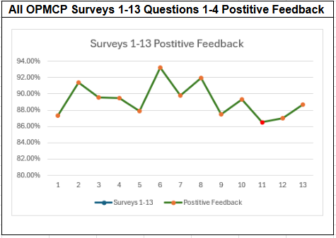
OPMCP: Course Curriculum & Feedback
Overview of covered modules and historical student survey feedback
Course Curriculum
Survey Positive Feedback
01. Overview of Project Management
02. PM Principles, Processes, & Scope
03. Project Approaches: Predictive/Adaptive
04. Project Roles & Responsibilities
05. Business Analysis Roles & Responsibilities
06. Gathering and Writing Requirements
07. Project Planning
08. Work Breakdown & Scheduling
09. Quality, Risk, & Project Controls
10. Iteration Planning & Adaptive Controls
11. Adaptive Stories & Definition of Done
12. Project Execution & Problem Solving
13. Project Closure
14. Wrap-up & Assessment Review

Slide 5
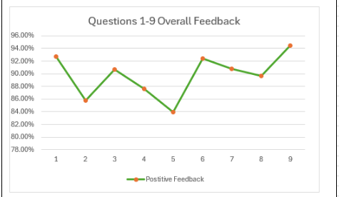
Survey Insights: Instructor Feedback
Analysis of student feedback across OPMCP surveys 1-13
Key Survey Insights
Highest Performing Area
Question 09 asking “Your Overall Impression of the Instructor” saw the highest positive feedback at 94.47%.
Lowest Performing Area
Question 05 “The lecture and exercises held my attention” scored the lowest positive feedback at 83.90%, being the only question to score below the 85% target.
Positive Feedback Trend (Q5 - Q9)

Slide 6
2026: Identifying Ways to Improve
Strategic targets and action plans based on survey insights
Target Areas
MODULES 11 & 12
Identified as the lowest performing course modules in curriculum surveys.
QUESTION 05
The lowest performing survey question: "The lecture and exercises held my attention."
Actionable Goals
GOAL 1 Curriculum Overhaul: A specific focus on revising Modules 11 and 12 during the PMBOK 8th edition overhaul.
GOAL 2 Practical Exercises: Revision of current exercises to reflect more practical exercises which hold classroom attention.

Slide 7
Adaptive Planning:
Concept and Experience
Project Managment Users Group
September 16, 2026
Christopher L. Dennis

Slide 8
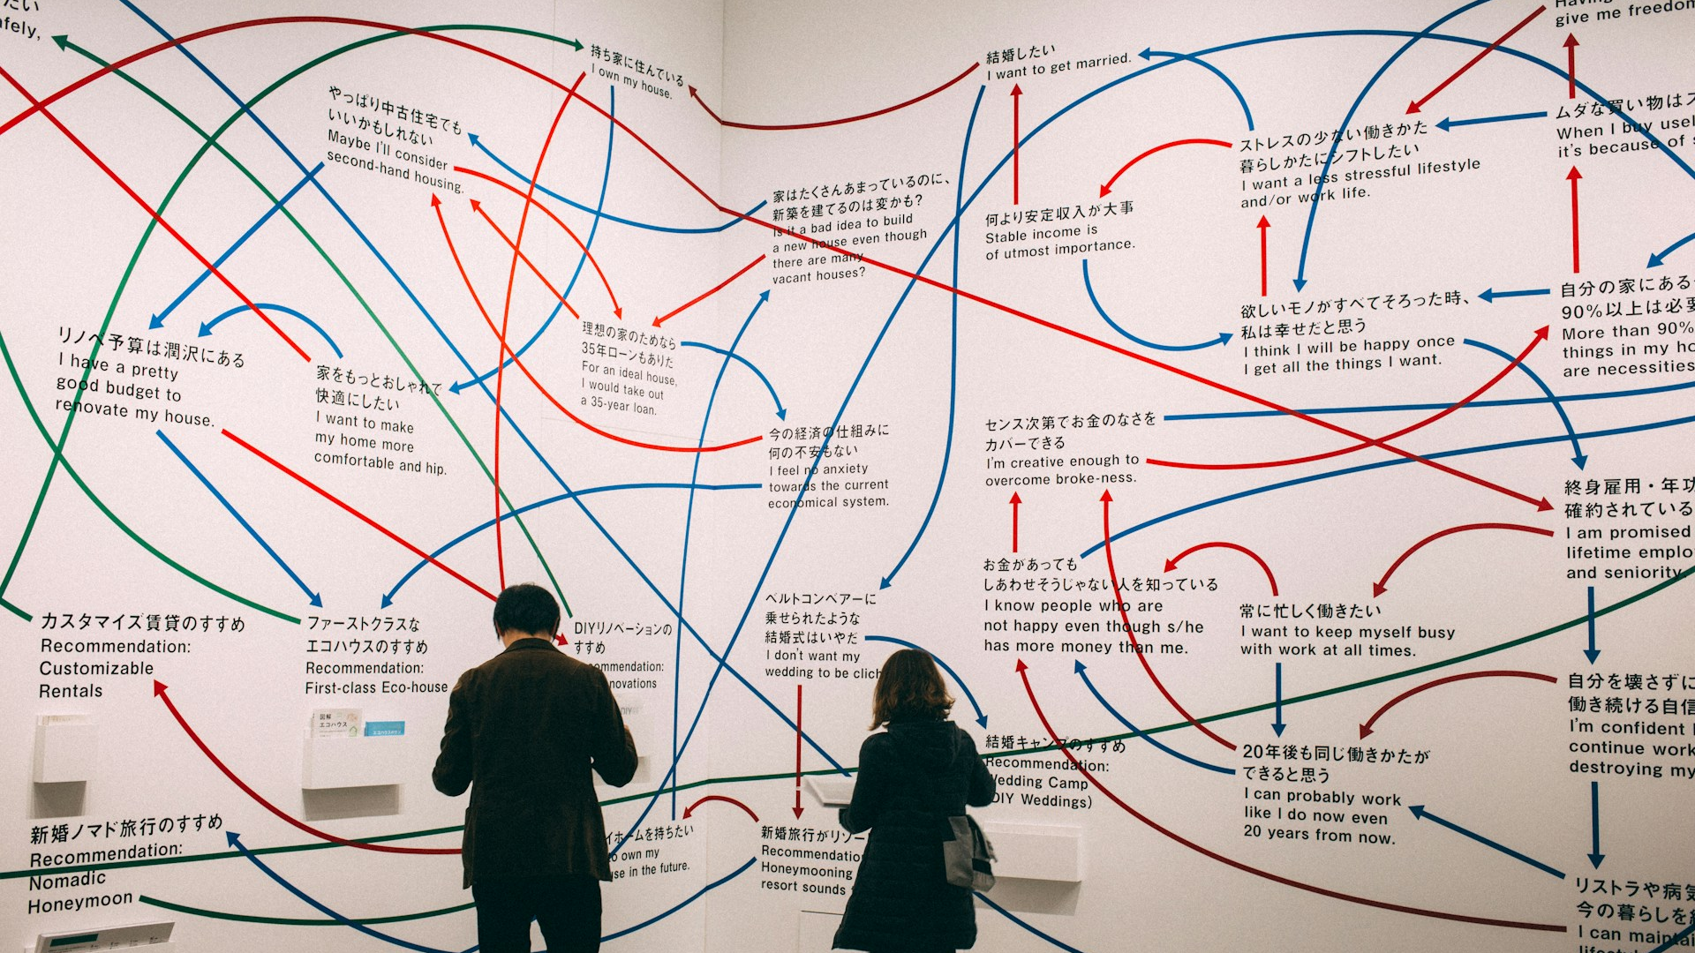
What’s Happening Next
Get ready: pick a project you’re familiar with
Learn: adaptive roles and adaptive planning
Experience: test-drive adaptive planning
Context: a typical planning practice
What’s new: PMBOK 8th Edition & OPMCP
Notes:
Adaptive action: Photo by charlesdeluvio on Unsplash--https://unsplash.com/photos/a-couple-of-people-standing-in-front-of-a-wall-OWkXt1ikC5g

Slide 9

Get Ready for Today’s Adaptive Experience
Goal:
Taste adaptive planning
Things You Need:
An ongoing project with which you are familiar
  Younger is better
  Smaller is better
  A portion/phase of a project is fine
MS Word
A sense of adventure
Flexibility
Your Project — Questions To Answer (2 min, Part 1):
Choose a familiar, ongoing project (work, volunteer, home, etc.)
What is the working title for the project?
What value will the project deliver? What good will it do?
  Said differently, what does success look like for this project?
Notes:
Two doors: Photo by Letizia Bordoni on Unsplash--https://unsplash.com/photos/woman-with-jacket-on-front-of-concrete-building-IZGNcO_8CDg

Slide 10
What’s Happening Next
Get ready: pick a project you’re familiar with
Learn: adaptive roles and adaptive planning
Experience: test-drive adaptive planning
Context: a typical planning practice
What’s new: PMBOK 8th Edition & OPMCP
Notes:
Adaptive action: Photo by charlesdeluvio on Unsplash--https://unsplash.com/photos/a-couple-of-people-standing-in-front-of-a-wall-OWkXt1ikC5g

Slide 11

A Key Realization for Small Adaptive Projects:
There Is No Project Manager!
I’m the Product Owner!
I’m in empathy with the customers and help prioritize work
I’m the Agile Coach!
Some PM functions are split between two roles
Teams self-organize
  Who does what
We expect planning to evolve constantly
  High rate of scope/mind/ environmental change
  Frequent reprioritization
When asked, I help address barriers to success
Pro Tip:
In some large adaptive projects, PMs have a role.
Notes:
Tie guy: https://pixabay.com/en/people-silhouette-avatar-2388584/
Beardo and Curly: https://pixabay.com/en/avatar-clients-customers-icons-2155431/

Slide 12
A Common Adaptive Method: Planning Focus
Wishlist:
Detailed and reprioritized at will
Product Owner (PO) and customers
May collaborate w/project team
Selection:
PO IDs priority items
Fit Capacity:
Team decides right-size work (Not PO)
Daily Planning:
Team self-organizes
Actionable Detail:
PO and team refine and detail
Agile Coach may facilitate
Agile Coach:
Team can invite facilitation
Wish n
Wish n
Wish n
Wish J
Wish n
Wish n
Wish G
Wish H
Wish n
Wish n
Wish U
Wish V
More
Detailed
A
B
C
D
E
F
H₄
H₄
Wish n
Wish n
Wish W
Wish M
Wish N
H₃
H₃
F₂
H₂
F₂
H₂
H₂
Less
Detailed
C
F
Wish H
C
F₁
H₁
C
F₁
H₁
C
F₁
H₁
Product Backlog Refinement
Proposed Iteration Backlog
Iteration Backlog Refinement
Commitment
Execution

Slide 13
What’s Happening Next
Get ready: pick a project you’re familiar with
Learn: adaptive roles and adaptive planning
Experience: test-drive adaptive planning
Context: a typical planning practice
What’s new: PMBOK 8th Edition & OPMCP
Notes:
Adaptive action: Photo by charlesdeluvio on Unsplash--https://unsplash.com/photos/a-couple-of-people-standing-in-front-of-a-wall-OWkXt1ikC5g

Slide 14
Practice Adaptive Planning: Worksheet 4, Part 2
1. Dream like a Product Owner/Org.
5 minutes
Make a wish list (backlog) for your project
  As many items/features as you can
To make this richer, who would you talk to?
2. Refine like a Product Owner
3 minutes
Prioritize the backlog
Rewrite/break down top three priorities
Who would you talk with to set priorities?
B
Wish G
Wish H
F
Wish n
Wish N
Wish U
Wish V
Wish V
Higher
Priority
A
B
C
D
E
F
Wish U
Wish n
Wish n
Wish H
Wish M
Wish W
Wish W
Wish M
Wish N
Lower
Priority
A
Dreaming
(5 min)
Product Backlog Refinement
(3 min)

Slide 15
Practice Adaptive Planning: Worksheet 4, Part 3
Not Practical for Today
3. Select like a Product Owner
1 minute
Copy the two most important items to the Iteration Backlog
4. Collaborate like a Product Owner
0 minutes
Break down the work
ID acceptance criteria
5. Communicate like a Product Owner
4 minutes
Help the team understand the work
6. Commit like an Adaptive Team
1 minute
Can you do this in two weeks?
What can you do in two weeks?
We hope you can…
Yes, this part…
C
F
Pair Up
PO
Team
PO
Team
Pick a Two-Item
Iteration Backlog
(1 min)
[Skipped for time]
Item Detail and Acceptance Criteria
(0 min)
Explain the Work
(4 min)
Fit the Iteration to the Team
(1 min)
Change Roles

Slide 16

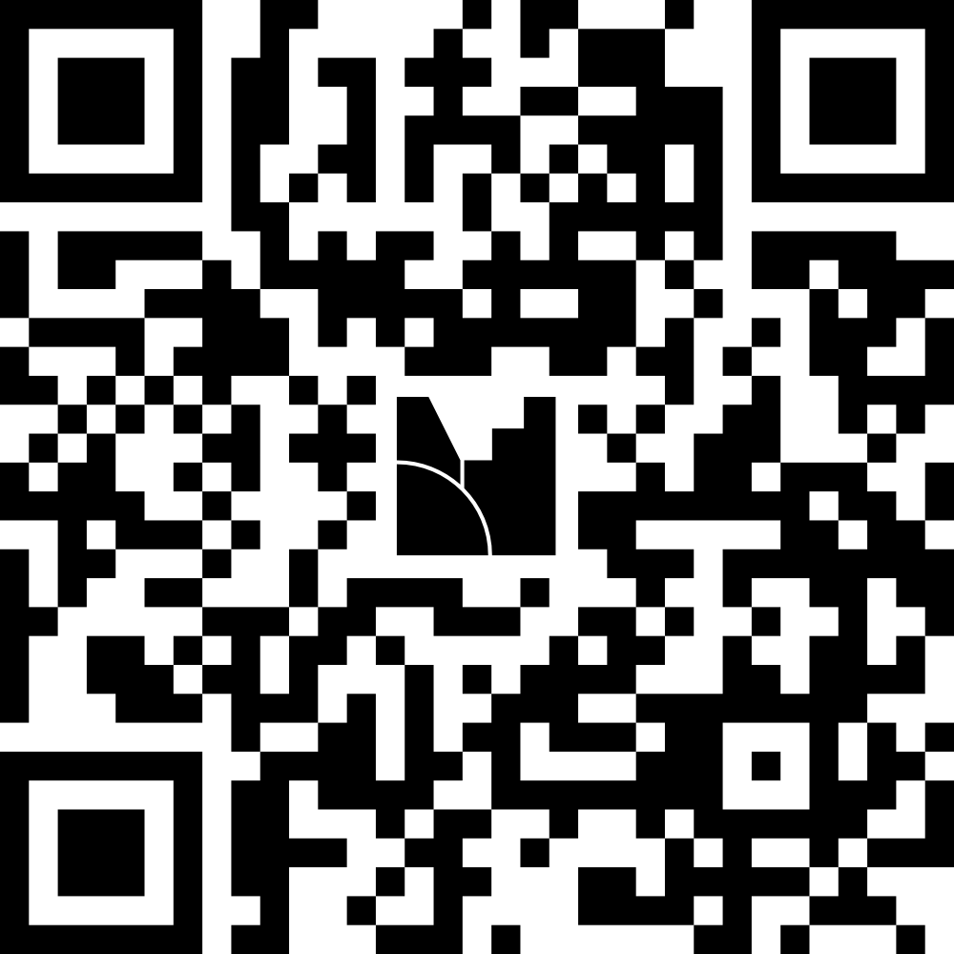
A Survey: In Place of Negotiating with the Team
Assuming a two-week iteration (work period)
The link is in the chat:
  https://www.menti.com/al5ba4ddjojw
Or click the QR code with your phone

Slide 17
What’s Happening Next
Get ready: pick a project you’re familiar with
Learn: adaptive roles and adaptive planning
Experience: test-drive adaptive planning
Context: a typical planning practice
What’s new: PMBOK 8th Edition & OPMCP
Notes:
Adaptive action: Photo by charlesdeluvio on Unsplash--https://unsplash.com/photos/a-couple-of-people-standing-in-front-of-a-wall-OWkXt1ikC5g

Slide 18
Typical Calendar for 4-Week Iteration
Monday | Tuesday | Wednesday | Thursday | Friday
16 | 17 | 18 Sprint Planning (Sprint 1) | 19 Daily standup | 20 Daily standup
23 Daily standup | 24 Daily standup | 25 Daily standup Product Backlog Refinement | 26 Daily standup | 27 Daily standup
30 Daily standup | 31 Daily standup | 1 Daily standup Product Backlog Refinement | 2 Daily standup | 3 Daily standup
4 Daily standup | 5 Sprint Review (Sprint 1) Sprint Retrospective (Sprint 1) | 6 Sprint Planning (Sprint 2) | 7 | 8
Product Owner,
As Needed Project Team Participation
Product Owner,
As Needed Dev Participation
Team’s daily planning
Some teams put a day or two between iterations
After: “Sprint Schedule Template.” AgileUprising, 1 Jan. 2017, www.agileuprising.com/2017/01/01/sprint-schedule-template/. Accessed 26 Aug. 2024.
Notes:
Here is a typical pattern for a 4-week iteration.
In the background is a standard calendar and the iteration is highlighted in green with dashes.
Let’s focus on the beginning of the iteration on the 18th. The team dedicates a day to sprint planning. The product owner suggests a sprint backlog and the team works together to detail it and decide which elements fit their capacity. Planning finishes the same day it starts.
Much of the rest of the sprint—the 19th through the 4th of the next month--is primarily working time, with the team laboring to fulfill the sprint backlog they committed to on the 18th. Each day has a daily planning and adjustment period referred to here as ”Daily standup.” Historically, this meeting was done in person, standing, to promote focus, close connection, and speed.
On the 5th, the day is split into two parts. First comes the sprint review, where the team’s work from the sprint that’s ending is reviewed by the Product Owner and perhaps other customer experts. If the work is acceptable, then the sprint has a useable increment and the increment (from the previous slide) grows. Regardless of whether there is a usable increment, in the second part of the day, the team performs a retrospective, reflecting on the lessons learned from the most recent sprint.
[Build 1] You’ve surely noted the purple text on the 25th and 1st. Those represent focused time for the Product Owner to groom the product backlog. Sometimes members of the project team are called in to assist with that work, reducing the capacity of the team on those days.
[Build 2] This plan shows the 2nd sprint starting the day after 1st sprint ends. That’s a common practice, and sometimes a day or two is put between sprints, especially if significant work needs to be done on the product backlog.

Slide 19
Fast Work: One Day or Less
Actionable Detail:
PO and team refine and detail
Agile Coach may facilitate
Fit Capacity:
Team decides right-size work (Not PO)
Agile Coach:
Team can invite facilitation
H₄
H₄
H₃
H₃
F₂
H₂
F₂
H₂
C
F
Wish H
C
F₁
H₁
C
F₁
H₁
Proposing Iteration Backlog
Iteration Backlog Refinement
Commitment

Slide 20
What’s Happening Next
Get ready: pick a project you’re familiar with
Learn: adaptive roles and adaptive planning
Experience: test-drive adaptive planning
Context: a typical planning practice
What’s new: PMBOK 8th Edition & OPMCP
Notes:
Adaptive action: Photo by charlesdeluvio on Unsplash--https://unsplash.com/photos/a-couple-of-people-standing-in-front-of-a-wall-OWkXt1ikC5g

Slide 21
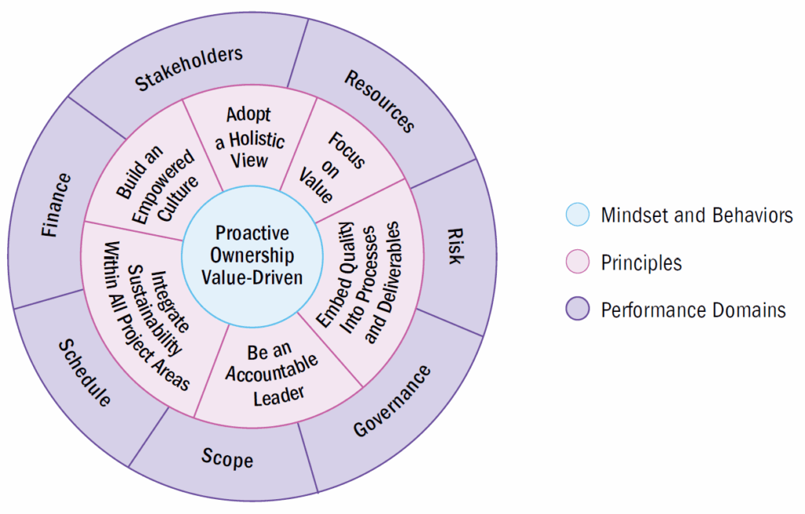
PMBOK 8th Edition—Released Nov. 2025
A Visualization
Significant Changes
Fewer principles: 6
Fewer performance domains: 7
Fewer processes: 40
  Aligned with performance domains
“Process groups” -> “Focus Areas”
  Initiating, Planning, Executing, Monitoring/Controlling, Closing
Now appendixes:
  AI (new)
  Procurement (demoted)
Test question format
Roberts, M. (2025, November 17). PMBOK® guide 8th edition: Key updates. Millpond. https://millpond.group/blog/pmbokv8/. Last accessed 9/9/2026.

