Slide 1

Telling Stories with Your Data
Michael Metiva
Research Analyst 4
Taxpayer Advocate Office
Oregon Department of Revenue

Slide 2
Scientific Writing
Key features:
Uniform structure
Focus on “objectivity”
Exactly what you did, how, why
Communication issues:
Inaccessible to non-specialists
Bogged down in technical detail
Value of work is lost on the public
ABSTRACT
INTRODUCTION
METHODS
RESULTS
CONCLUSION
Notes:
Start by talking about one kind of story – scientific story, told using scientific writing. My background…
That’s not really the kind of story we want to tell – language used to analyze and study isn’t the same as language used to explain.
As analysts and project managers, especially working for the government, we’re writing for a different purpose.

Slide 3

Why Stories Matter
You are writing so someone else will read it –
that person needs to care!
“Great storytelling is about making readers care about your
characters, the choices they make, and what happens to them.”
- Chuck Wendig
PMUG 3/19/2025
Notes:
We write or give presentations so people will care, give funding, make changes.
“Data has no value on its own” – Dr. Alex Gurvich
Spend a lot of time working on projects, but taking the time to optimize writing/presentation can amplify the value of that time spent.
Your stories include the people you serve, the choices our leaders make, and what happens to all of us as a result.

Slide 4

Principles of Storytelling
Match your style to the audience
You have a perspective – use it!
Use just enough detail to get the information across
Smooth and logical flow of info
Notes:
So getting started with some principles that make a good storyteller or a good story…
Expanding on the first point…

Slide 5
Matching Style to Audience (1)
What information does the audience need and why?
Analysts and managers need to know A, B, C to check or reproduce my work
Public needs to know L, M, N so they can care/vote about this
Leaders need to know X, Y, Z so they can make a decision/plan
Reproducing work =
business need, methods
Learning about topic =
background, impact
Making a decision =
business need, impact
PMUG 3/19/2025
Notes:
The first thing to ask when outlining is…

Slide 6
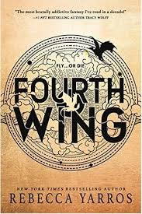

Matching Style to Audience (2)
What does audience respond to?
Invested in the emotional side?
Use case studies to hook people, then use data to expand view
Decisions relying on data only?
Use graphics to make key points clearly (looks very data-y)
PMUG 3/19/2025
Notes:
You also want to know…
This is how this person was affected, now look how many people are affected by this issue.
If they respond well to pretty charts, make some pretty charts for them.
Just like the audience has a perspective…

Slide 7
Using Your Perspective (1)
Nothing and no one is unbiased!
Your writing is shaped by:
Your job duties
Your personal beliefs and values
How you balance business needs
Own your position: make it clear to the reader what you value
Positionality statement
Why do you think the issue is worth discussing?
Whose voice are you trying to include in the conversation?
PMUG 3/19/2025
Notes:
…You have yours, and it’s extremely valuable.
Science is biased by what research gets funded – better food choices vs more corn for more cows
Even technical manuals are biased by their writers – what to include, word choice… What you value: this is an issue of fairness, this process is deficient, I’m working on behalf of this group.
Making your values clear to a reader will help them see things from your point of view.

Slide 8

Using Your Perspective (2)
Don’t let your perspective blind you to the story the data tells
(or worse, lead to Mark Twain’s ‘lies, damned lies, and statistics’)
“As you write a story, if you can let it become itself, tell itself fully and truly, you may discover what it’s really about, what it says, why you wanted to tell it. It may be a surprise to you. You may have thought you planted a dahlia, and look what came up, an eggplant!” - Ursula K. Le Guin
PMUG 3/19/2025
Notes:
This section comes with a warning label, however.
Taking that winding path is all well and good while you’re analyzing data, but…

Slide 9
Detail vs. Concision
Does this contribute to my point or overall message?
If no, it doesn’t need to be there
Can my audience understand and follow the logic?
If no, simplify the writing OR add detail/specificity if you must
Exercise: Write a one-page Executive Summary first
Relevant background
Plain language
Active voice
Graphics with
clear, relevant points
PMUG 3/19/2025
Notes:
…You can’t wander when communicating your data – wastes people’s time.
Now this is what I struggle most with coming from a science background. You’re meant to pack in details…
Two questions that help me when editing down -
Executive Summary really helps dial in what needs to be there, what is tough to cut, what is just extra fat.
Broadening our scope to the story as a whole…

Slide 10



Writing Smoothly (1)
Guidelines for reports:
Most leaders will only read the title and Executive Summary
Make point from those alone!
Questions to ask as you write
Can I feel a drag or disconnect between paragraphs or sections?
If I didn’t work on this, would I care about the point being made? Would I care what comes next?
PMUG 3/19/2025
Notes:
…You must still write smoothly and logically so people can follow.
The Greatest Invention – unreadable, constant tangents and breaks in the flow.
Tasks, needs, format will vary greatly, so hard to make general rules. Some things to think about when writing reports:
You want this product as polished as possible – it’s equally important as the work that led to it.

Slide 11
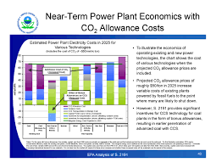


Writing Smoothly (2)
Presentation guidelines:
Keep slides simple
Large font = no space to waste!
Make one solid point per slide
Keep style/format consistent
Hook people early – make them wonder, make them care
Kishotenketsu as a guide…
PMUG 3/19/2025
Notes:
Same goes for presentations, the time spent is worthwhile.
Guidance is similar, but with added visual aspect.
You’ve also got a captive audience. All eyes on you. You can be more human.
You may say, stories have good guys and bad guys, a big CGI climax – Kishotenketsu is a model of storytelling without needing conflict

Slide 12
Writing Smoothly (3)
Ki 起 (introduction)
rouse, wake up
Shō 承 (development)
listen, be informed
Ten 転 (twist)
change, turn around
Ketsu 結 (conclusion)
consequence, effect, bear fruit
Intro to characters and ideas – a hook to engage the audience
Logical flow from the premise – more info to draw you in
New information, analogy – a surprise, expanded thinking
Drawing together a logical end – good or bad consequences
PMUG 3/19/2025
Notes:
Introduction could grab attention by stating a problem, identifying good and bad actors.
Development could detail consequences of issue, what was done to fix it.
Twist could show how it was addressed (relieved), or shocking problems from a lack of action.
Conclusion stating how good a job we did or how much we need action in this area.
Read example.

Slide 13
Example: Returned Mail Report
Original Structure
Title: Financial & Social Costs of Returned Mail & Rec. Solutions
Problem Summary
Comparison of DOR vs IRS
Financial Costs
Social Costs
Recommended Solutions
Improved Structure
Title: Bad Address Mailing
Costs & Solutions
Executive Summary
Bad Address Mailing
Financial Costs
Social Costs
Recommended Solutions
PMUG 3/19/2025
Notes:
To quickly illustrate some of these points, we can improve on a report I wrote a couple years ago…
Turns out, most of my focus was on mailing to addresses that mail had already been returned from...
Most recommendations were around correcting known bad addresses.
Comparison of DOR vs IRS procedures around returned mail only yielded one recommendation but took half a page.
Can consolidate, suggest as a solution as before and back up by saying “IRS does this.” Don’t need whole comparison.

Slide 14
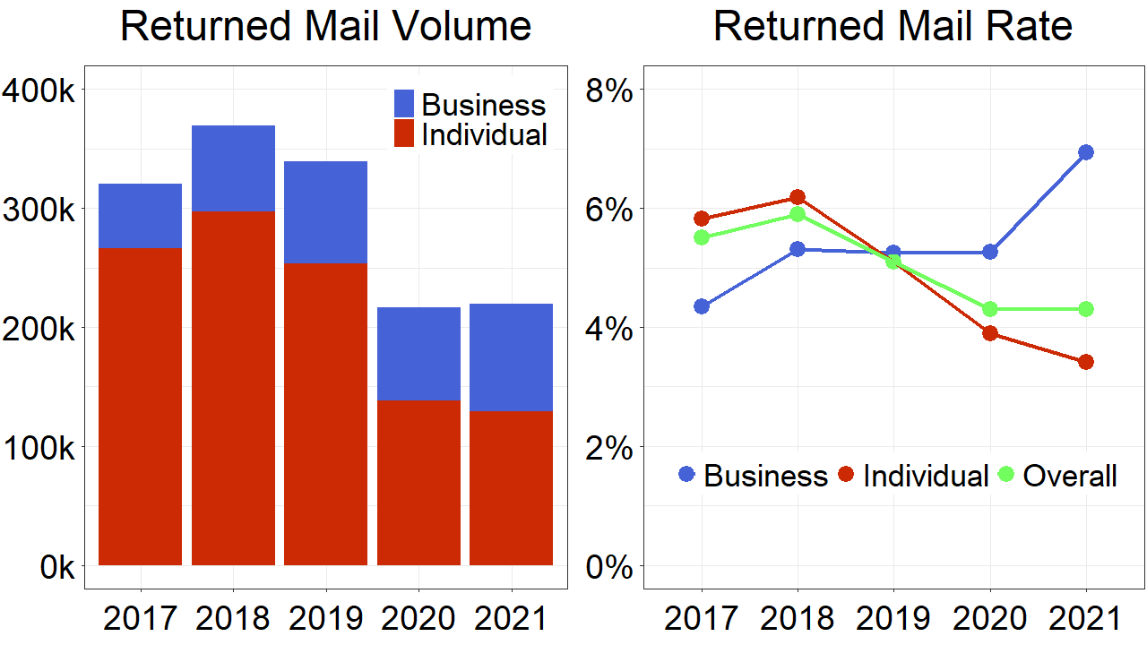
A Chart In Need of Fixing
Titles describe exactly what is shown, but not the story
Business vs Individual – discussed nowhere else
Rate of returned mail – discussed nowhere else
Lots of data/colors, good for analysts but too much information for a reader
PMUG 3/19/2025
Notes:
Here’s a chart from the Executive Summary of that report. Really didn’t help at all.

Slide 15
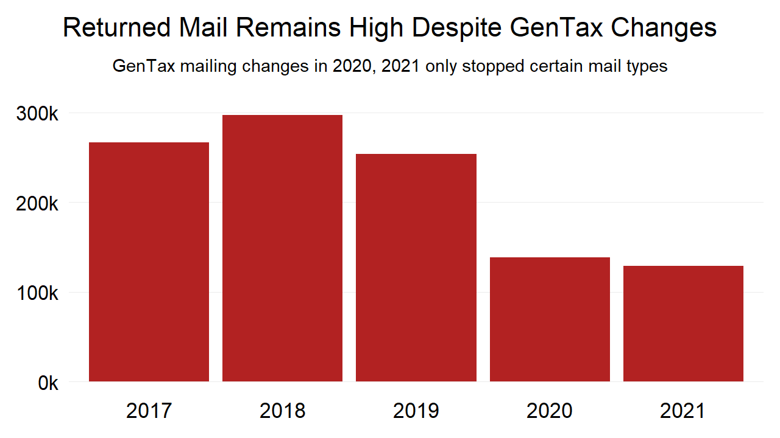
A Chart with a Story
Title and subtitle outline the story, and the graph provides specific numbers
Focus on individuals aligns with other arguments
“Only certain mail types? What kinds of GenTax changes? Would more mailing changes get those numbers under 100k?”
PMUG 3/19/2025
Notes:
Changes made – Narrowed data used, descriptive title, axis lines/grid lines can usually go.
The message here is clear, but details and extension of argument can be found by reading.
Still leaves with questions, but not about what is shown.
Also removed a lot of visual clutter – leaders can see volume at a glance.

Slide 16
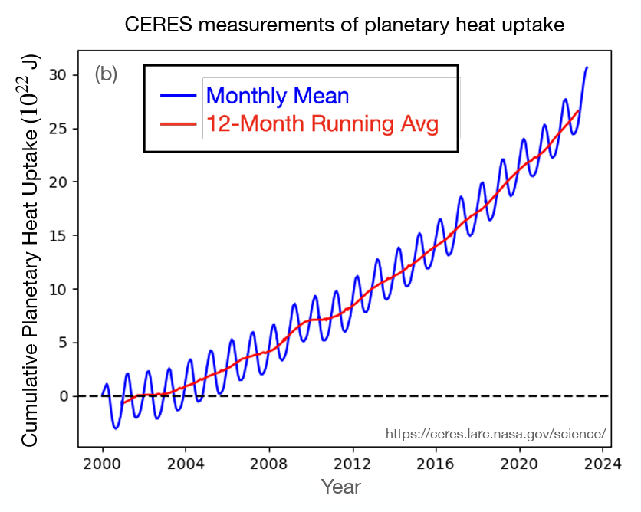
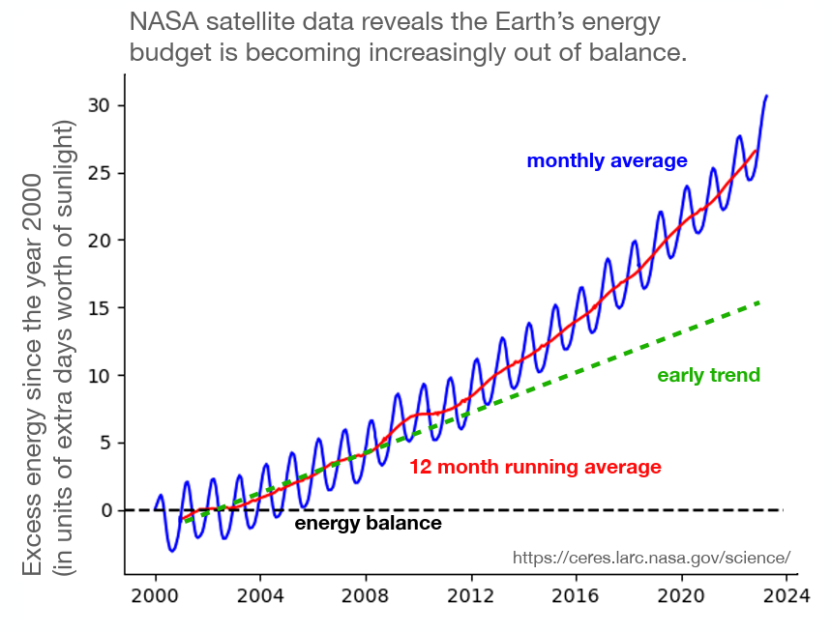
Effective Charts
From “Storytelling with data at NASA’s Earth Information Center” – presentation by Alex Gurvich, Ph.D.
Start with a goal written down
What story do you want to tell
Where do you want to direct the reader’s attention
Show only what is relevant to what you write/talk about
Minimize jargon/clutter so your audience understands
“Data can’t speak for itself!”
PMUG 3/19/2025
Notes:
Start with a goal, maybe even title.
Put desired takeaway in title, then reader can look for the supporting evidence in the plot
You have to speak for the data. Don’t be coy! Use your perspective, make your point.

Slide 17
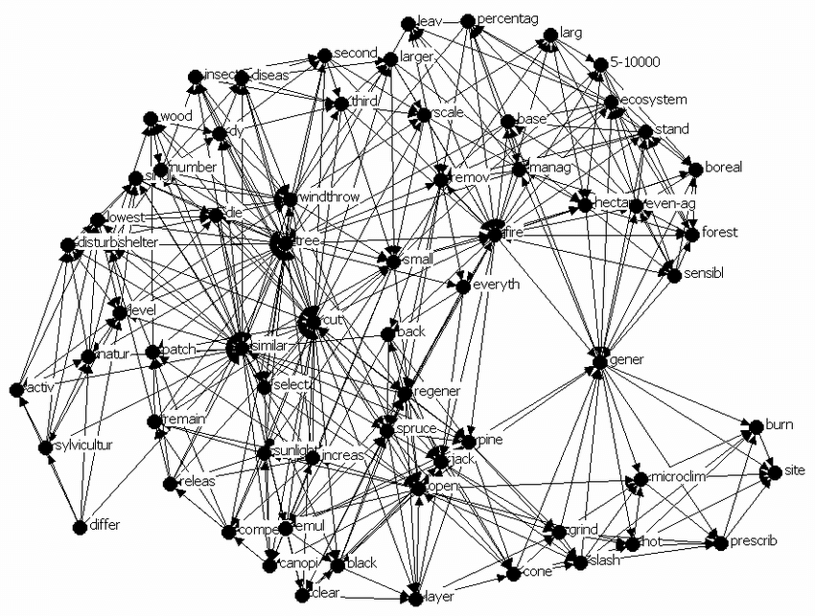


General Chart Tips…
Size, shape, angle make things distinct from the group
Guide readers to make the desired comparisons
Minimize looking back and forth
Think about how your audience would draw the figure from memory after your presentation
Use recognizable chart types!
PMUG 3/19/2025
Notes:
Resist the urge to get fancy with it.

Slide 18
Final Wrap-Up
You need to speak for your data – data can’t speak for itself
Think about what interests your audience and hook ‘em with it
Write from your personal position – if you don’t care, others won’t
Always ask if this sentence, graphic, etc. is contributing enough
Use story structures to keep your audience engaged
You are writing so someone else will read it –
that person needs to care!
PMUG 3/19/2025

Slide 19





Thanks!
Storytelling with Data at NASA's Earth Info Center: https://alexbgurvi.ch/media/gurvich_swd_nasa.pdf
Using Visual Perception to Find Patterns in Data and Drive Insight https://youtu.be/4u8ZipDSHeI
What Not to Do: A Walk through the Bad DataViz Hall of Shame https://youtu.be/KluzR75S6U0
Book recs: Jade City by Fonda Lee, The Wager by David Grann, Parable of the Sower by Octavia Butler, A Psalm for the Wild-Built by Becky Chambers, The Spear Cuts Through Water by Simon Jimenez
PMUG 3/19/2025
Notes:
The best way to become a better writer is by reading.

