Slide 1
Accounts Payable Daily OregonBuys to R*STARS Reconciliation Process
By James Reed and Mark Clarkson
Oregon Department of Forestry

Slide 2
Why the need for a daily reconciliation?
To confirm that payments have correctly interfaced for payment.
Correct any Accounting Coding issues if not done with a change order in OregonBuys (OB); specifically incorrect object codes. Note: this is needed if having more than one invoice on an RPA and need to change coding.
Change any Mail Codes (MC) for checks that need returned to the Agency, switch them to RA.
Review batch for Assignment vendors, correct to the proper MC; typically, MC 410.
Reviewing Misc./Freight charges added by AP.
Garnishments: review for any garnishment situations and correct MC if required.
Foreign Vendors: review for any Foreign Vendors and take appropriate steps.

Slide 3
Links/Systems Required
To perform a daily reconciliation AP will need both a user class 28 and 17 in R*STARS (SFMS) to process any changes needed.
R*STARS system: Access via internal method.
Department of Administrative Services Mainframe Access for Batch Reports.
DASWHSGN: DAS Web-to-CICS Signon (state.or.us)
OregonBuys Production Environment
OregonBuys
Internal Excel Tracking Spreadsheet

Slide 4
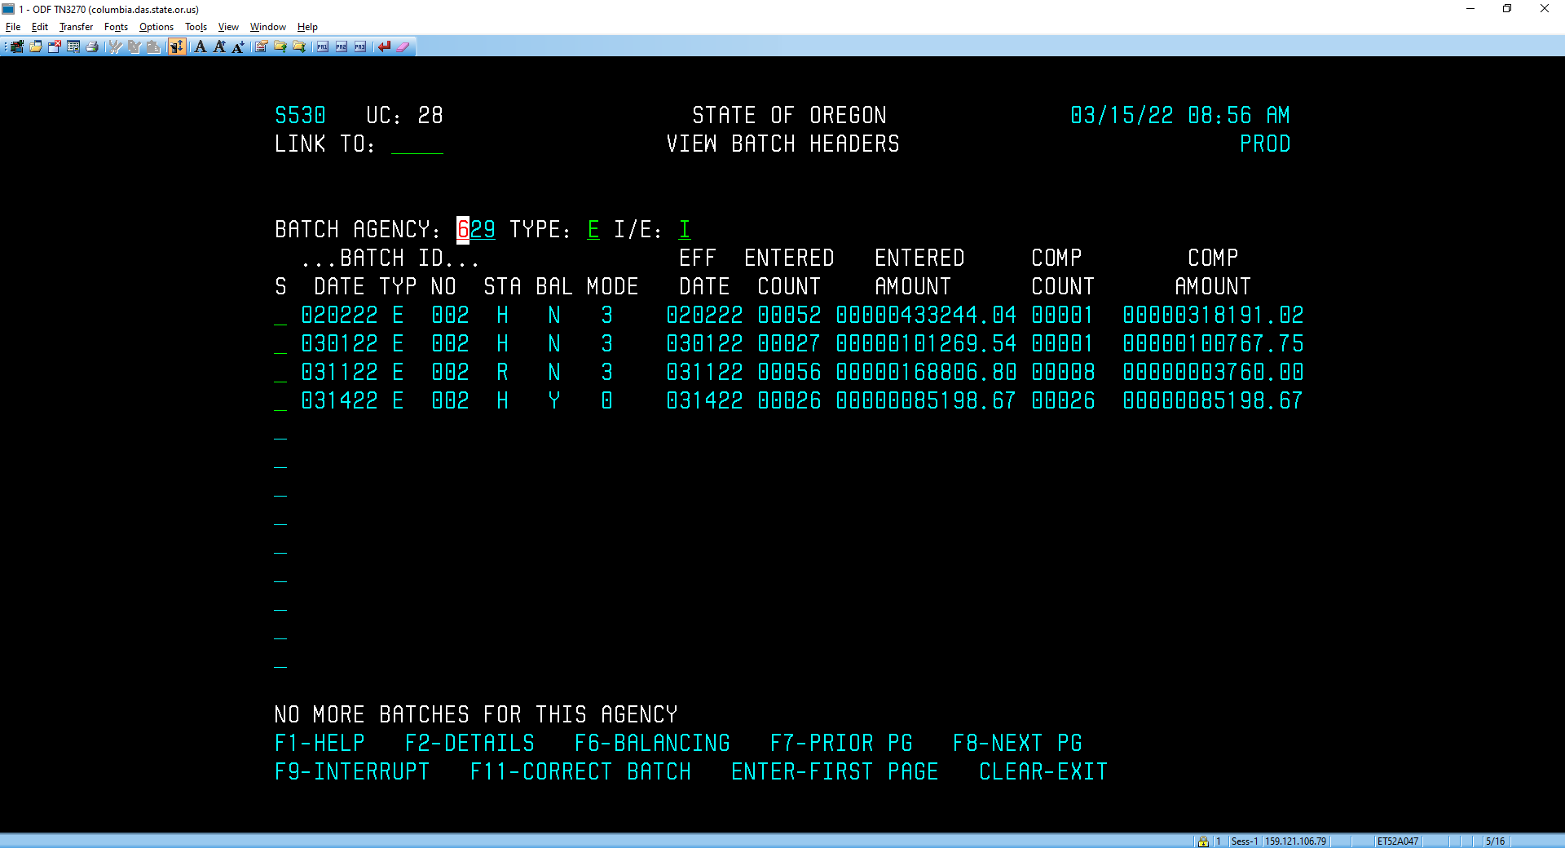
Process Step 1
The first step is for the AP user to log into R*STARS.
Go to the 530 Screen and sort by Type E batch. All the payments are interfaced from OB to R*STARS as an E batch.

Slide 5
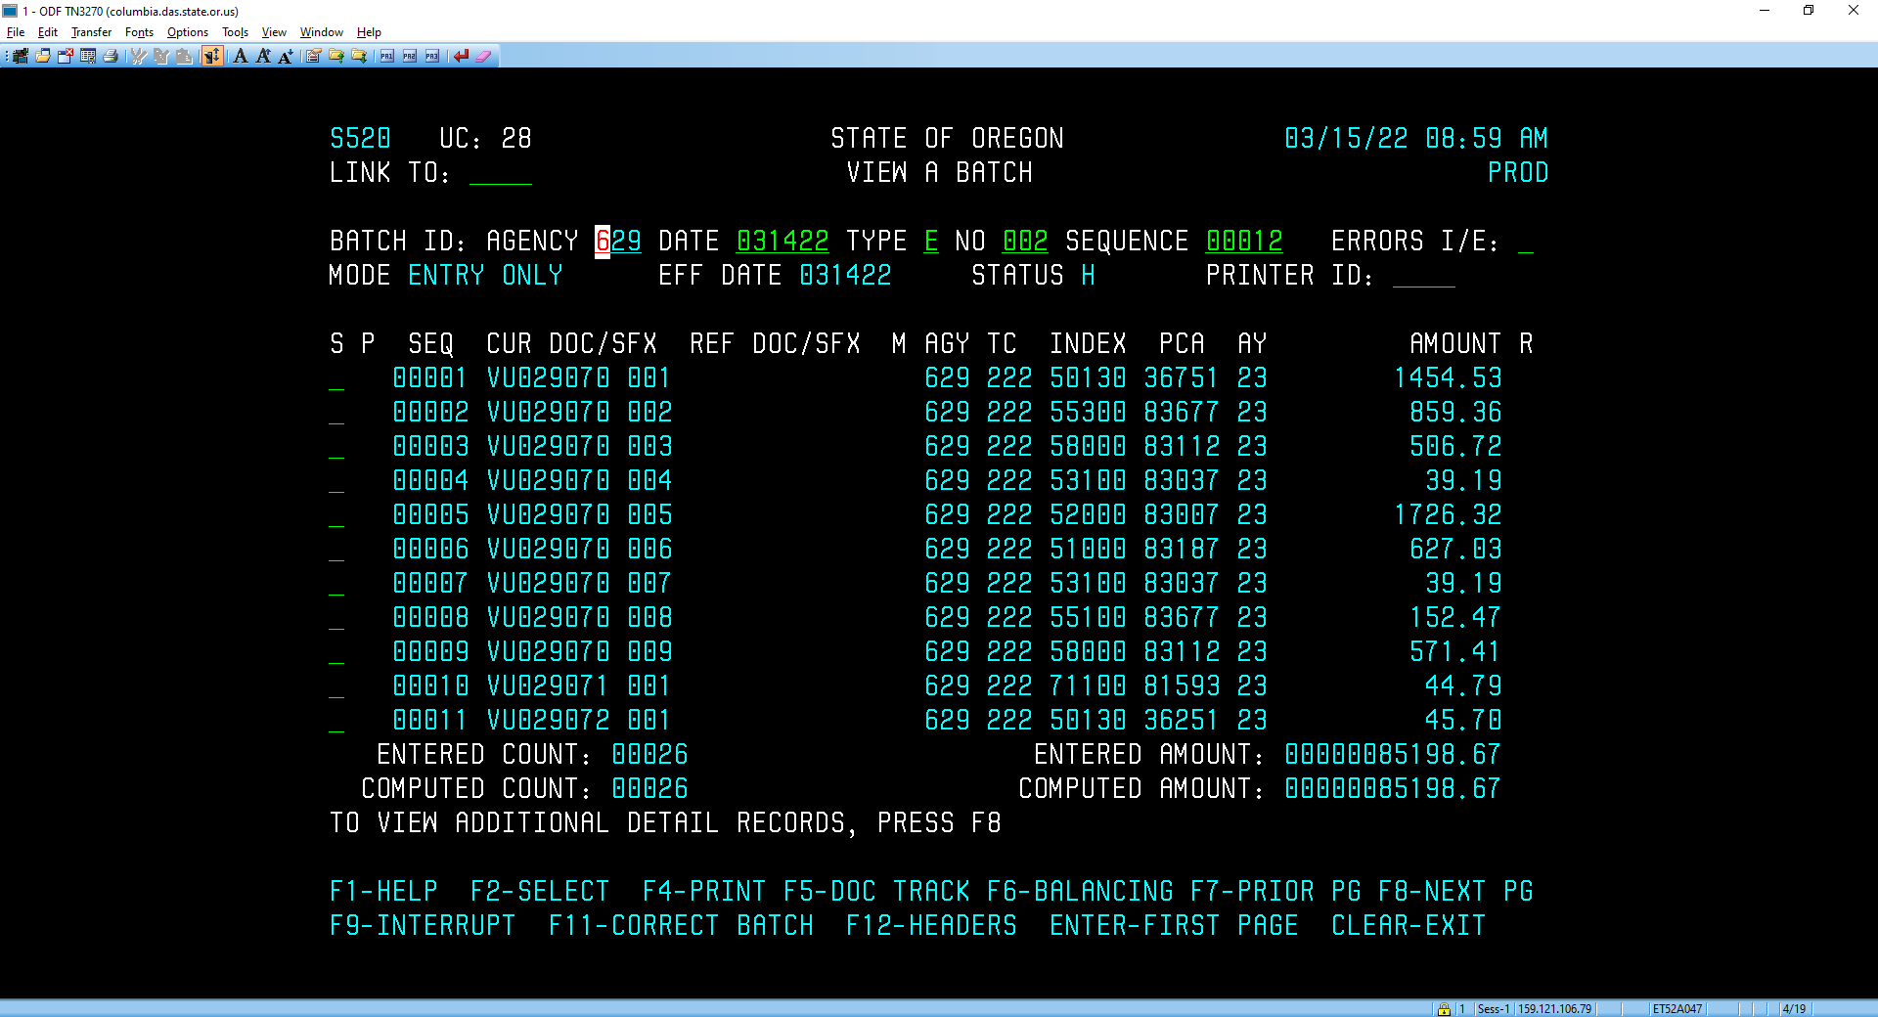
Process Step 1
Select the correct daily batch
Current Doc number VU is the Alternate ID number in OB with the VU replacing the first zeros.

Slide 6
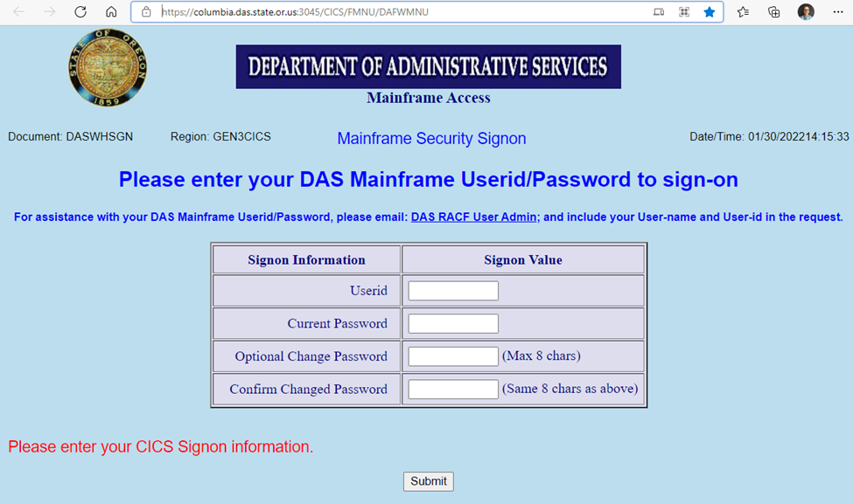
Process Step 1
Sign on to the DAS Mainframe to obtain “Print Batch report”

Slide 7
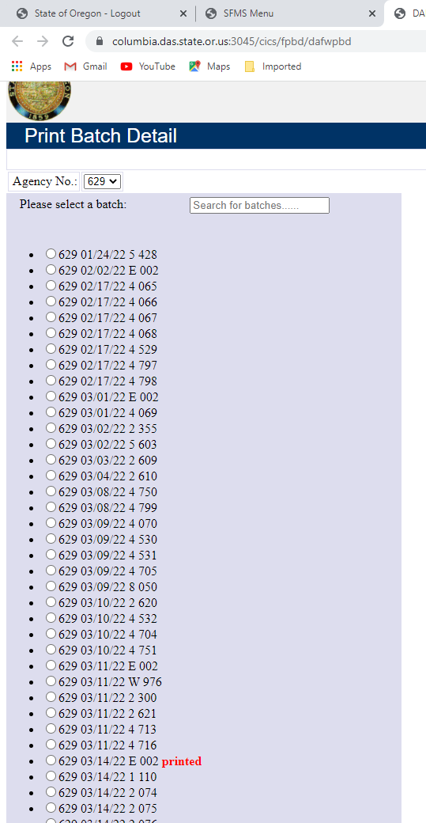
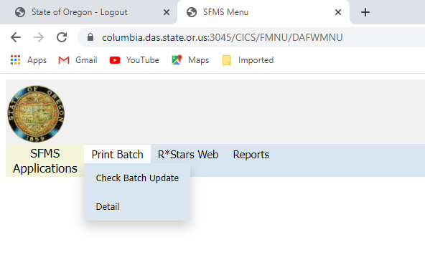
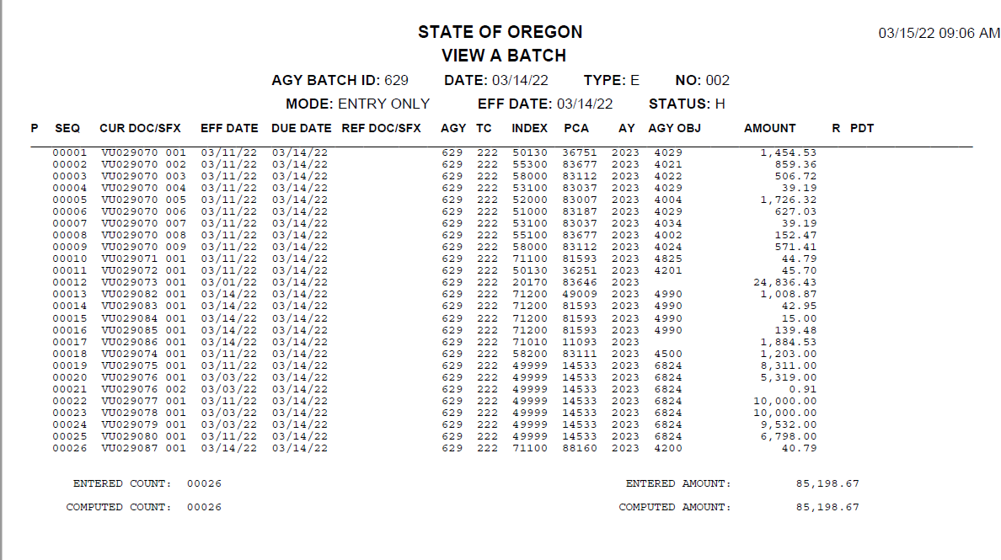
Process Step 1
Selected the print batch menu.
Select the Detail option; this will bring up a list of the available Print Batch Detail batches.
Select the correct batch, this will set to printed and bring it up in Adobe as a PDF. This allows the user to either print or save the report.

Slide 8
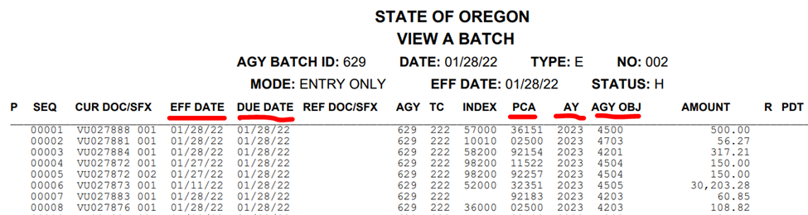
Process Step 1: The Print Batch
Part of this process requires the reviewer to check key items in the batch.
Effective date column should all be in the current month if the prior month accounting period is closed.
Due date column, look for any future dates. If found, should be changed if required.
PCA column, look for any missing, change code if required.
Agency Object column, look for any missing, cannot be blank. Change if required.

Slide 9
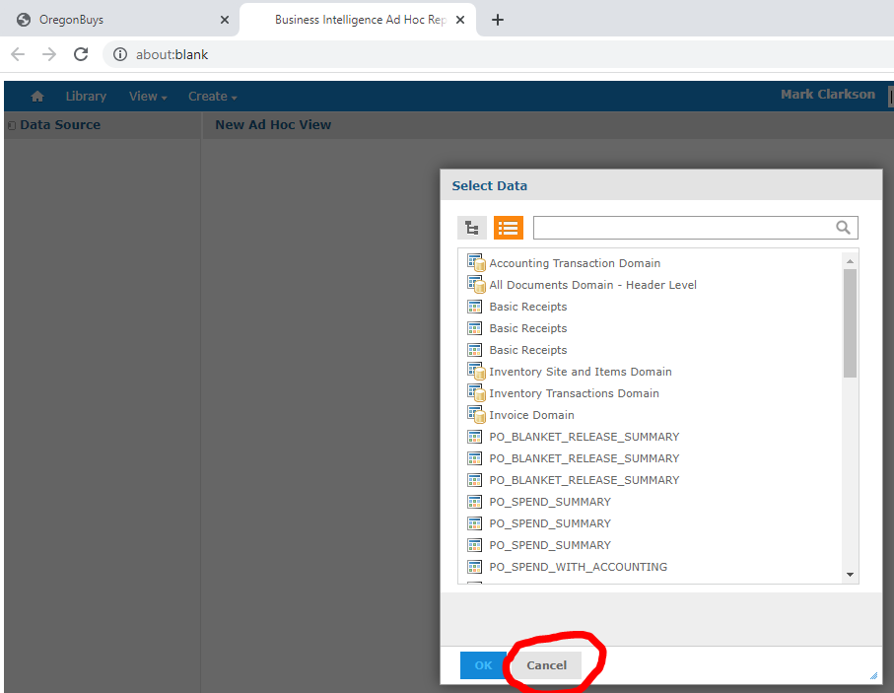
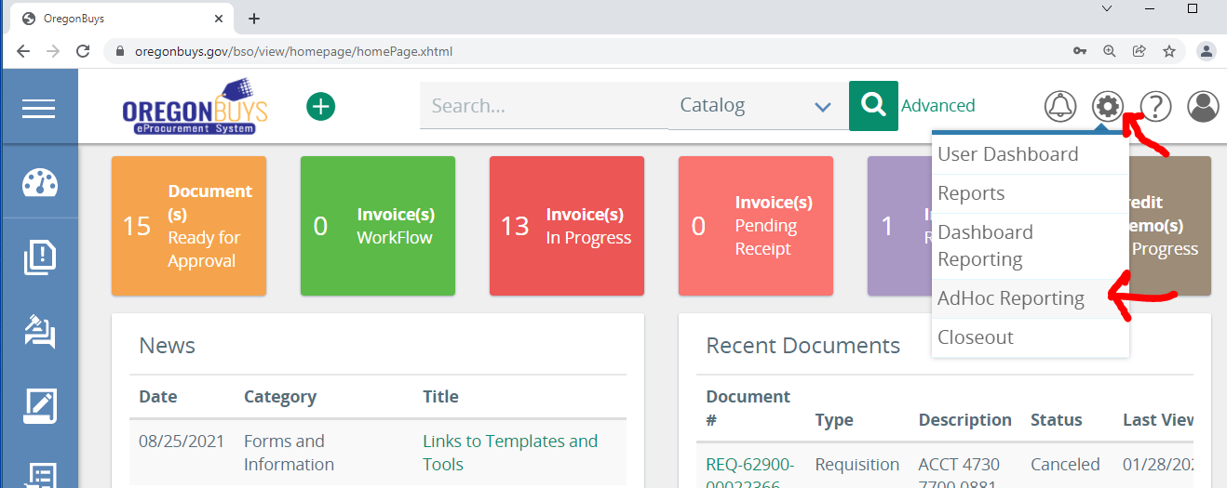
Process Step 2: OregonBuys Report
A report will need to be made or utilize one of the pre-made reports in OB.
Log into OB.
Go to the AdHoc Reporting; located at the top right of OB under the gear symbol.
At this point select the cancel button if the report is already created.

Slide 10
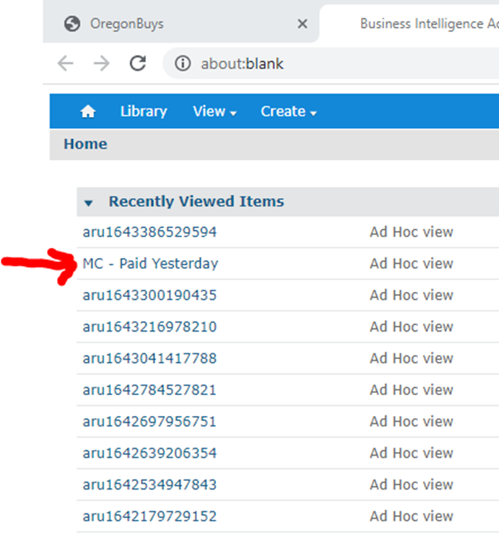
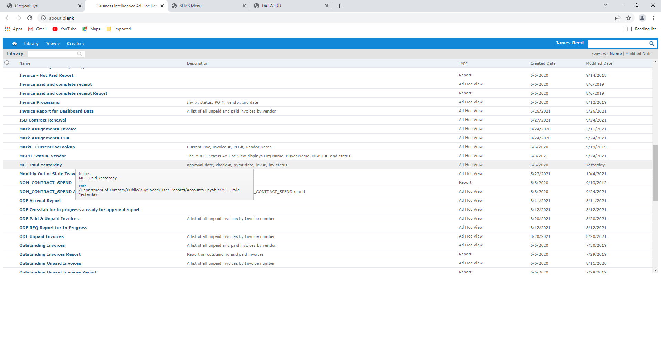
Process Step 2: OregonBuys Report
Two ways to access already made reports:
Go to the Library under the reports tool and select report.
Select report from “Recently Viewed Items”.

Slide 11
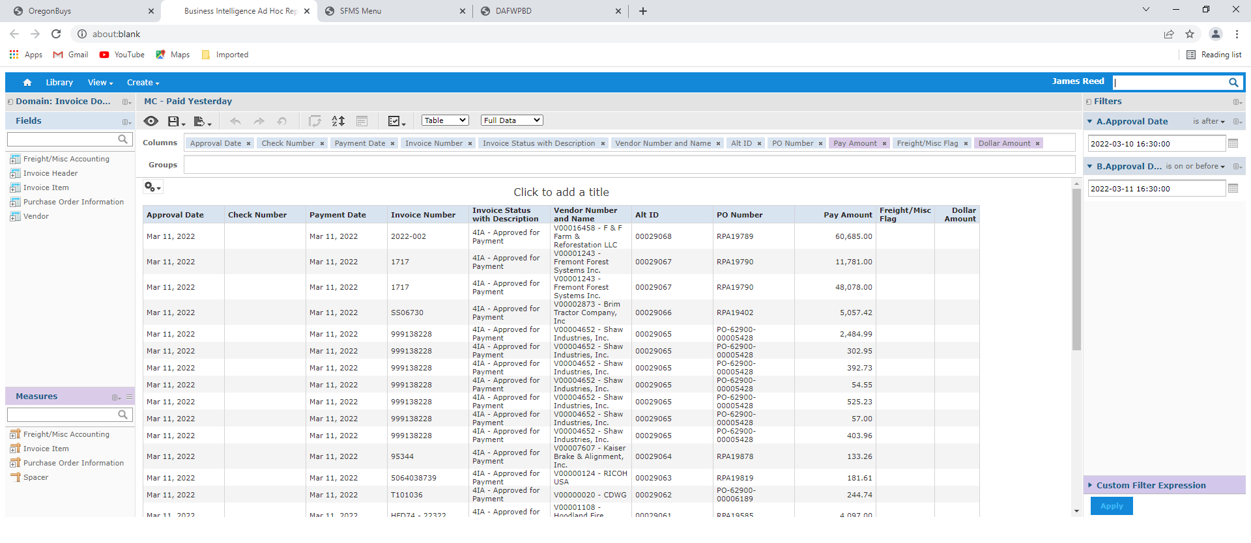
Process Step 2: OregonBuys Report
Select report and update filter fields.
With the filter at the top right, select the correct date so that you just pull items for one specific day.
Apply the filter selection. Once the report is generated, look at the approval date to make sure it is correct.
Scroll to the bottom of the report and verify the total. The total should match the R*STARS total.

Slide 12
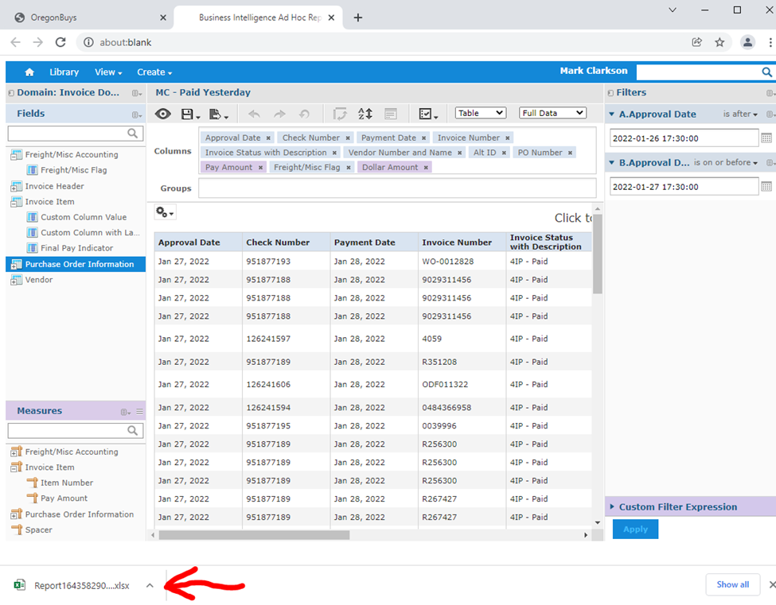
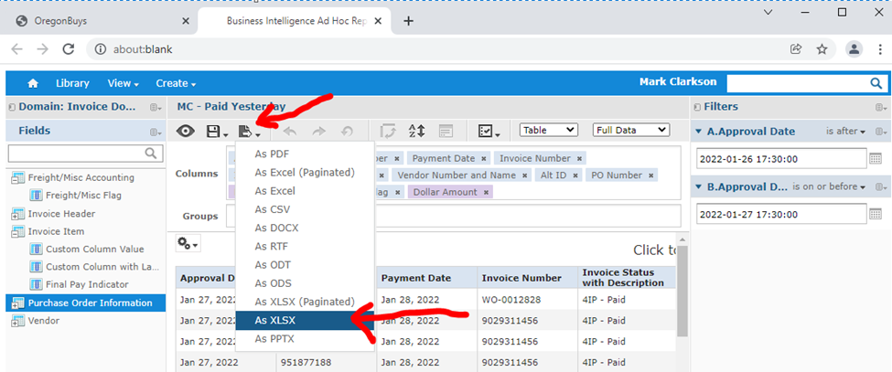
Process Step 2: OregonBuys Report
Final Step: Saving Report to Excel
Select the Export menu and select the “As XLSX” option.
Open the Excel report at the bottom, sometimes will be at the top.

Slide 13
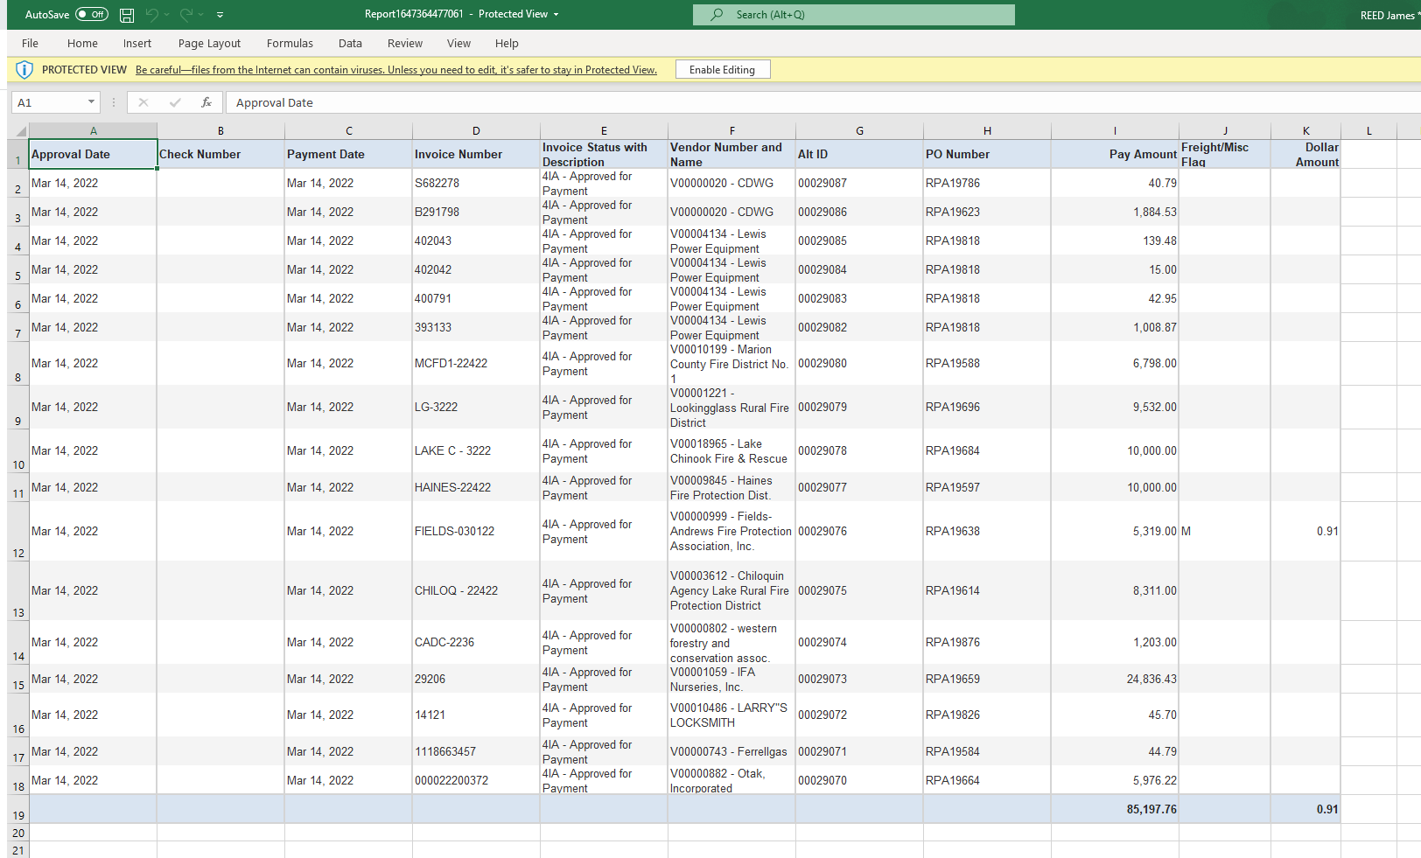
Process Step 2: OregonBuys Report in Excel
Excel Version of Report
AP Reviewer verifies the totals with R*STARS.

Slide 14
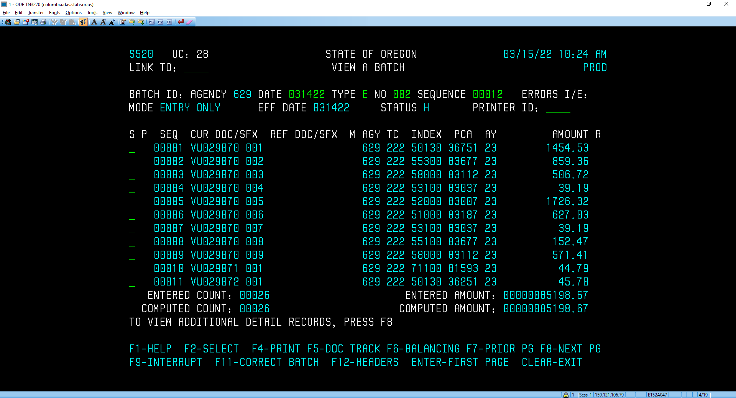
Process Step 2: OregonBuys Report in Excel
Example: This batch had a Misc. charge of$.091. Which will not match on the R*STARS total. AP reviewer must add in the Misc. charge together with the total on the OB report.
R*STARS total = $85,198.67
OB Total = $85,197.76 + $.091 = $85,198.67

Slide 15
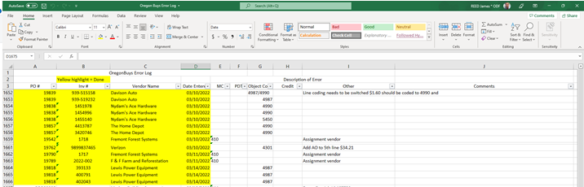
Process Step 3: OregonBuys Error Log in Excel
Part of the process of this reconciliation is to update the batch for various changes that need to be made. One tool used is an error log that the AP reviewer can use for these changes.
AP role doing the first step in OB updates log with changes that can’t be made in OB.
UC 17 will need to update the batch in R*STARS for any changes.
Changes are next highlighted to indicate they have been updated.

Slide 16
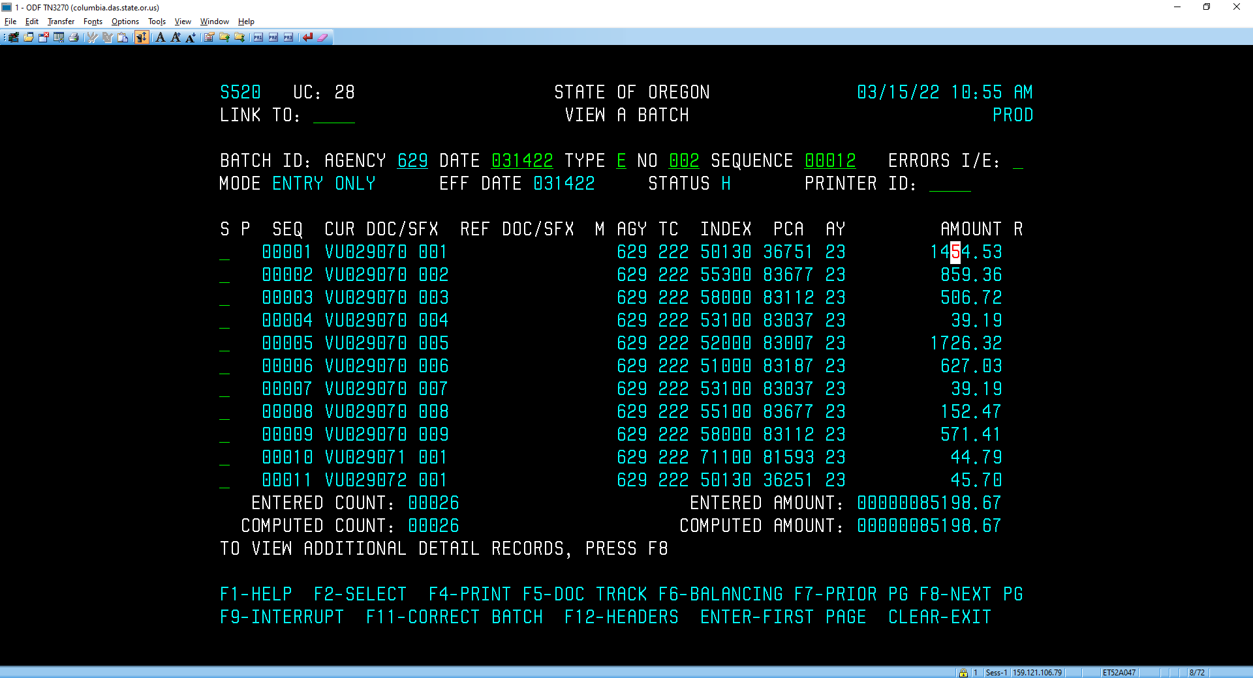
Process Step 4: Release Batch in R*STARS
All changes are made to update R*STARS
Final verification should be done by UC 28 in R*STARS before batch is released.

Slide 17
Process Step 5: Saving reports
Best practices is to save all the reconciliation reports and documentation.

Slide 18
Summary
Utilizing a structured reconciliation process allows for payments to be monitored to verify that they have interfaced correctly from OB to R*STARS.
This reconciliation process also accommodates any changes that need to be manually done in R*STARS.
This process also provides a detailed audit record.

