Slide 1



DAS Procurement
Services
Presents
State Vehicle Contracts

Slide 2
Acquiring your new vehicle
Download: BUYERS GUIDE FOR FLEET Vehicles attached to the price agreement
Use the Excel spread sheet as a reference
Locate Vehicle type
Evaluate base model contract pricing
Determine best dealer; USE BVA

Slide 3
What's on contract
All current model year passenger cars, light trucks, cab/chassis trucks, passenger/cargo vans and wagons, police vehicles, sport utility, alternative fuel vehicles, and all Electric Cars – currently under production or placed in future production by a vehicle manufacturer.

Slide 4
State price agreement holders
5556 Bruce Chevrolet - Kyle Olinger (503) 619-8324 kyle@brucechevrolet.com
5559 DSU Peterbilt - Brian Heinrich (503) 535-3025 bheinrich@dsutrucks.com
5561 ERide Ind - John Herou (763) 389-9139 jherou@e-ride.com
5560 McCoy Freightliner - Kevin Dripps (503) 283-0345 kevindripps@pdxftl.com
5551 Gresham Ford - Paul Blankenship (503) 490-6510 paul@greshamford.com

Slide 5
5555 Hubbard Chevrolet - John Boyer (800) 247-4336 johnboy@hubbardchevrolet.com
5550 Landmark Ford - Lisa OKeefe (503) 639-1131 ext709 GovtSales@landmarkford.com
5549 Northside Ford - Sharon Tucker (503) 282-7777 stucker@northsidetrucks.com
5558 Power Chevrolet - Jim Church (503) 769-7777 jimc@powerchevrolet.com

Slide 6
5554 Power Chrysler, JEEP, DODGE - Don Kasinger (503) 871-0703 dpkasinger@aol.com
5548 Power Ford Lincoln - Don Kasinger (503) 871-0703 dpkasinger@aol.com
5557 Suburban Chevrolet - DJ Anderson (503) 454-4960 dj@suburbanautogroup.com
5552 Tonkin Dodge - Chuck Baggs (503) 258-5704 cbaggs@tonkin.com
5563 Tonkin Nissan - Jon Geffen (503) 258-6257 jgeffen@tonkin.com
5564 Tonkin Toyota - Jon Geffen (503) 258-6257 jgeffen@tonkin.com
5553 Withnell Dodge - Matt McCowan (503) 364-0184 matt@withnellauto.com

Slide 7
Acquiring your new vehicle
Contact at least three different suppliers via phone, e-mail or fax with requirements
Request these suppliers to provide quotes for specific Goods and Services needed. Suppliers must respond to Authorized Purchaser with a quote. Don’t rely on the spread sheet
Determine which supplier provides the best value for Authorized Purchaser based on the Best Value Analysis

Slide 8
Over Spec Hazards
Potential Cost Increase
No Cost Reductions
Loss of “Rapid Spec”
Sole Source Condition
Vehicles on Contract were only based on the State need.
Be as wide-ranging as possible

Slide 9
Rapid Spec Example -- How it Works:

Slide 10
Achieving your best price
Situation | You should be able to answer questions such as...
Trends in supply and demand | When did past acquisitions take place? Is there any indication of prevailing market conditions at that time?
Pattern of demand | What quantities were solicited for each acquisition? What quantities were acquired?
Trends in prices | What was the contract price? How did the unsuccessful offers compare with the successful offer?
Start-up costs and pricing strategy | Did the contract price include one-time engineering, tooling, or other start-up costs? Should future contracts include similar or related costs? Were necessary start-up costs paid for in a manner separate from the price for the item or service?
Sources of supplies or services | How many sources were solicited for the prior acquisition? What specific sources were solicited? How many sources made offers or proposals? What specific sources made offers or proposals?
Product characteristics | Are there any significant differences between the requirements documents for the prior contract and the current requirements?
Delivery/ performance terms | What was the delivery or performance period in days, weeks, months, or years? In what month(s) were the supplies to be delivered or the service to be performed? Did the supplier meet the delivery targets? What was the FOB point? Was premium transportation required for timely delivery?
Ownership costs | What costs of ownership were associated with the acquisition?
Acquisition Method | What acquisition method was employed for past acquisitions?
Contract terms and conditions | What were the general terms of past contracts? Are there any significant differences between terms of the last contract (e.g., packing requirements, type of contract, and the like) and those recommended for this acquisition?
Problems | What problems were encountered during contract performance?

Slide 11
Vehicle Market
Total Cost of Ownership (TCO)
Some case 200%
Pricing should be very tight
Hard to verify cost, without competitive environment
No way to verify exact bid assistance
Very competitive, national consortiums

Slide 12
Other big cooperatives
Explain how your company plans to market the Master Agreement to existing government customers and transition these customers to the Master Agreement. Please provide the amount of purchases of existing public agency clients that your company will transition to the XXXXXXXXXXX contract for the initial three years of the contract in the following format within your proposal.
  $ .00 will be transitioned in year one.
  $ .00 will be transitioned in year two.
  $ .00 will be transitioned in year three.
  Then they increase administration fees

Slide 13
Revised old process
Process only allows amendment changes
Required renewals
Labor hours, roll over time
3-6 months to get a new vehicle on contract
Delivery charges

Slide 14
Customer Focus
DAS’ strategic sourcing team, based on Agency and ORCPP member input, helped determine customer needs for more flexibility in the terms, conditions and specifications for the evaluation of the best value available to them.

Slide 15
Why BVA
FAR and grant compliance
Being fiduciary responsible
Where is our money going
Guarantees best price

Slide 17
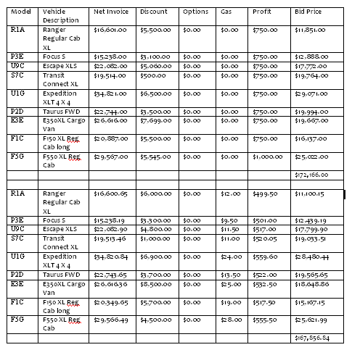
Vehicle Comparison Info

Slide 18
Cost Reduction Opportunities
Volume (ask other agencies)
Negotiate:
  Bid Assistance
  Profit
  Hold Back
Pre-packaged deals (no added options)
All dealers bid at 5% range
Don’t over spec
Just ask, call us.

Slide 19
Other areas
Order Cycles:
- Static Model Year pricing, beginning of Model Year.
- Real time pricing at time of order.
Dealers have units on Lot for better price w/more options.
No one wants to miss Orders (not to one another or other manufacturers).
Wait until model close out
User input.

Slide 20
questions
Dustin Sculatti
Dustin.M.SCULATTI@oregon.gov
503-378-2048
Greg Smith
Greg.F.SMITH@oregon.gov
503-378-5789
Rachel Smith
Rachel.R.SMITH@oregon.gov
503-373-1058
Dave Reynolds
David.Reynolds@oregon.gov
503-378-4643

