Slide 1

Oregon Forward Cadre Meeting
4/21/26

Slide 2
Agenda
Icebreaker
OFP Updates
Meeting Topics

Slide 3
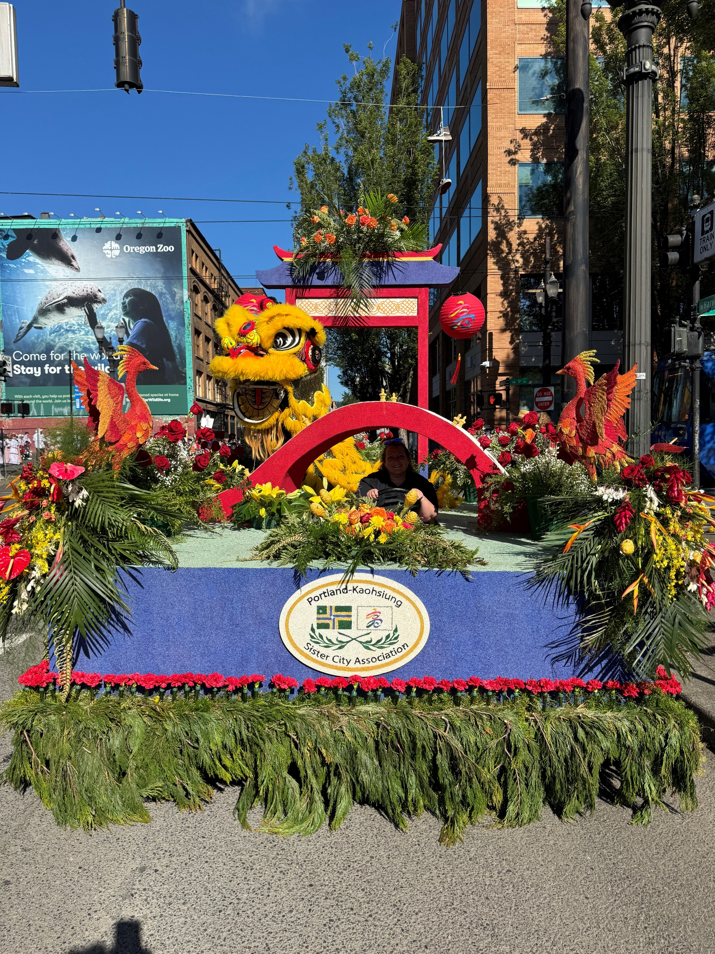
Icebreaker
What is your favorite spring holiday or festival?

Slide 4

OFP Updates
Roadshows- Will be scheduled
Costing Workbook Software- Still looking
Procurement List-Send Updates

Slide 5

Meeting Topics

Slide 6

Working without a Contract….
DOJ- “If no contract, public agencies do not have to pay for the work being done.” Get it is writing

Slide 7
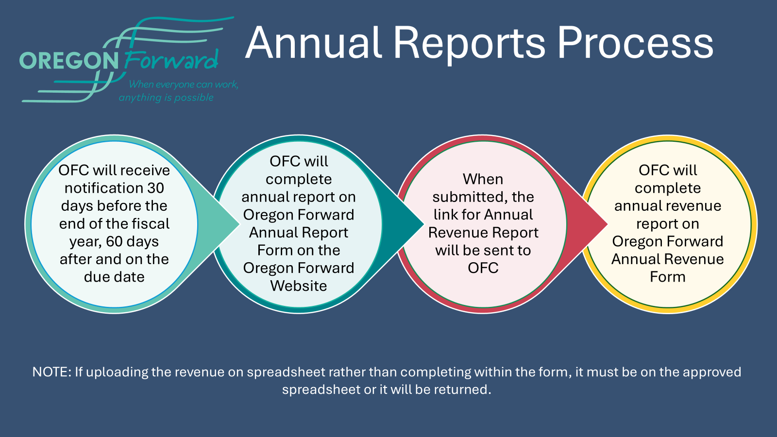
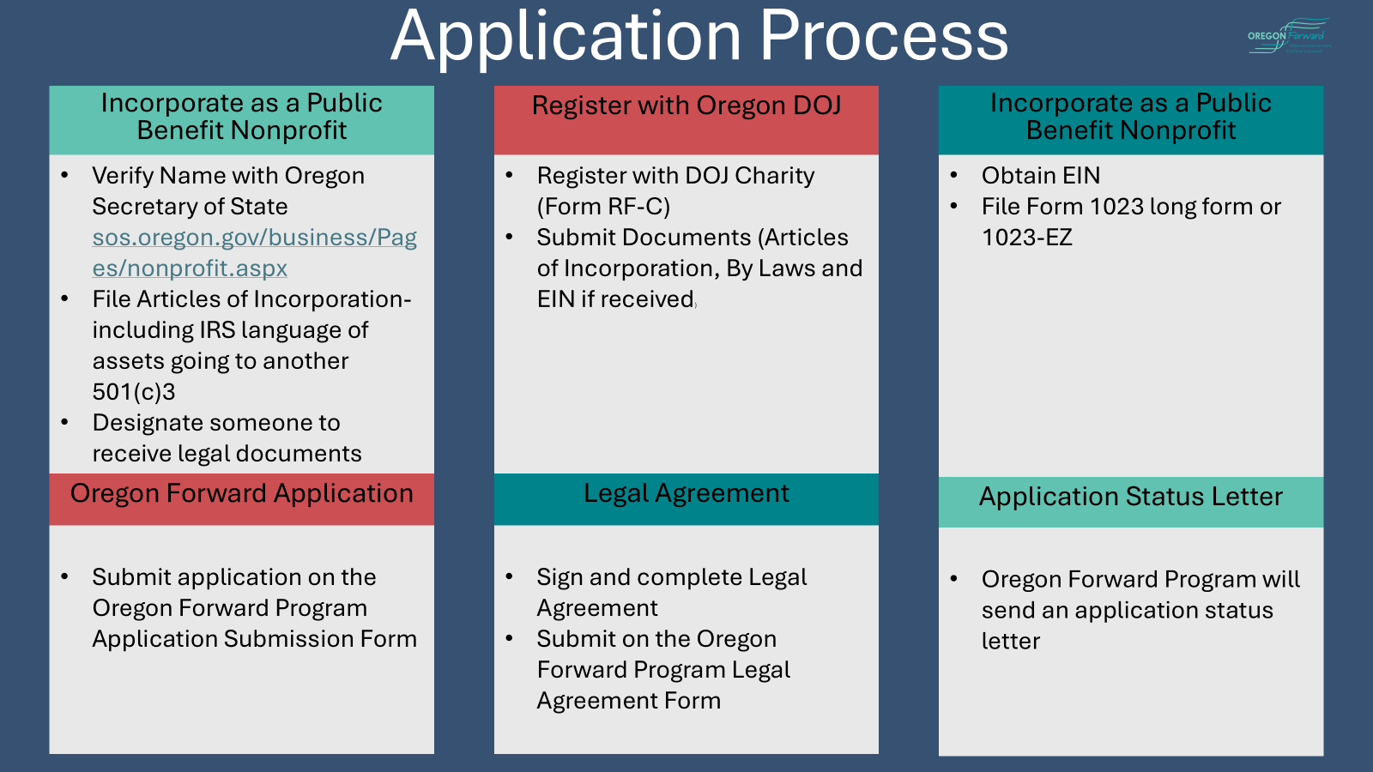
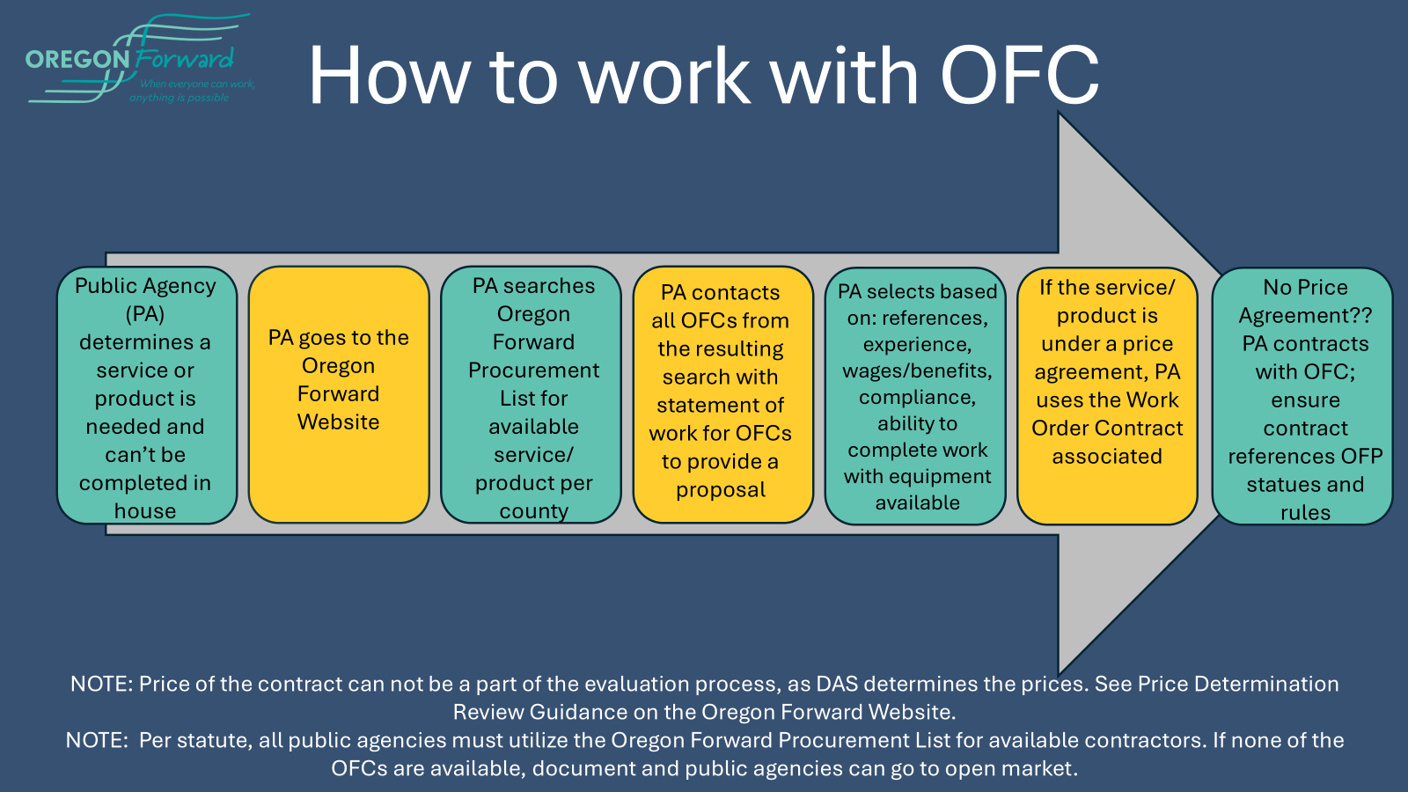
Visual Processes
Annual Reports Process- OFC Resources
Application Process- OFC Resources
How to work with OFC- PA Resources

Slide 8
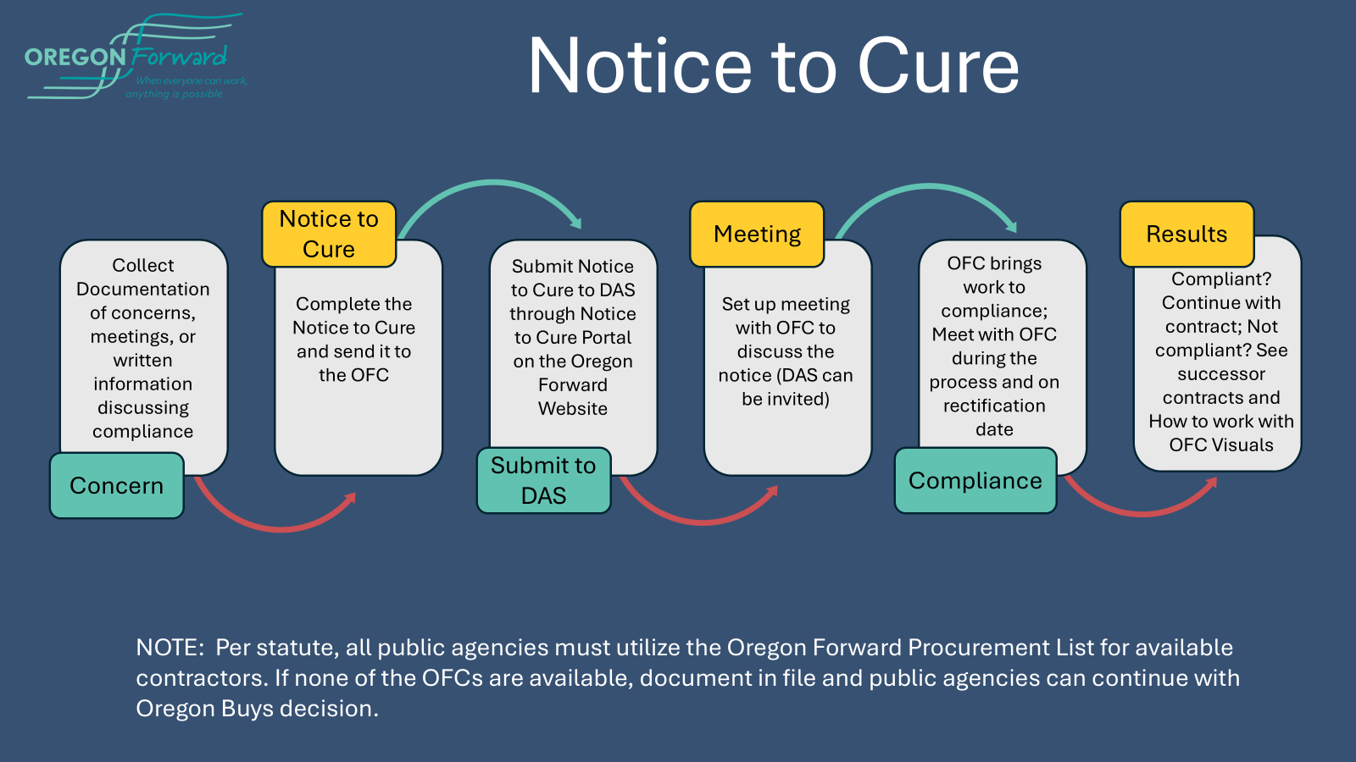
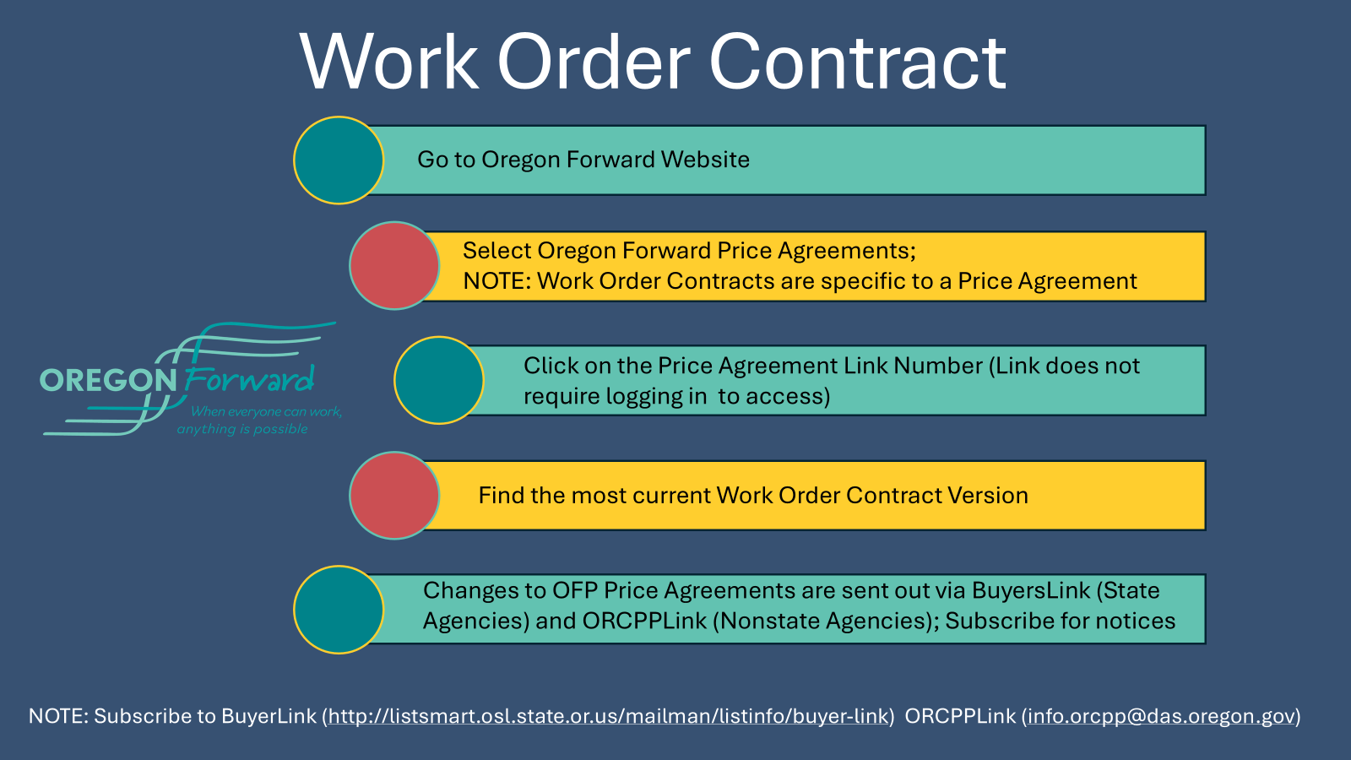
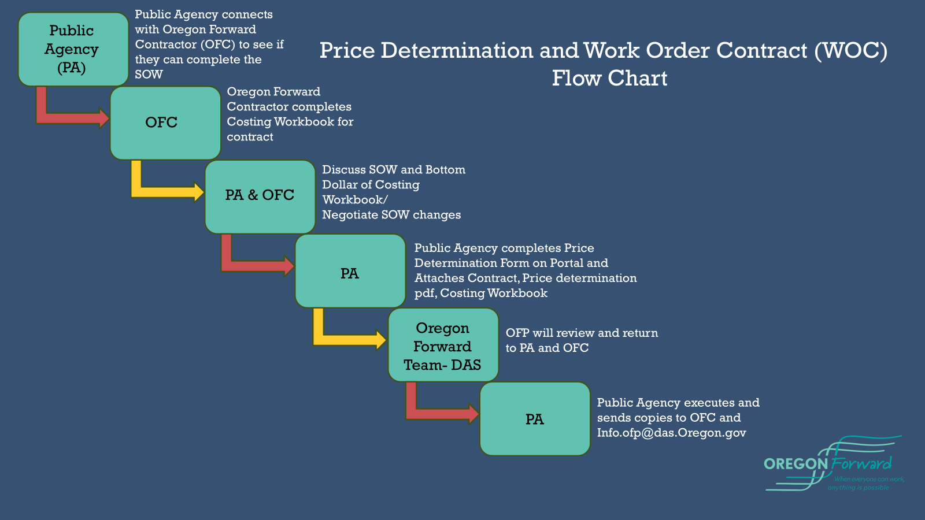
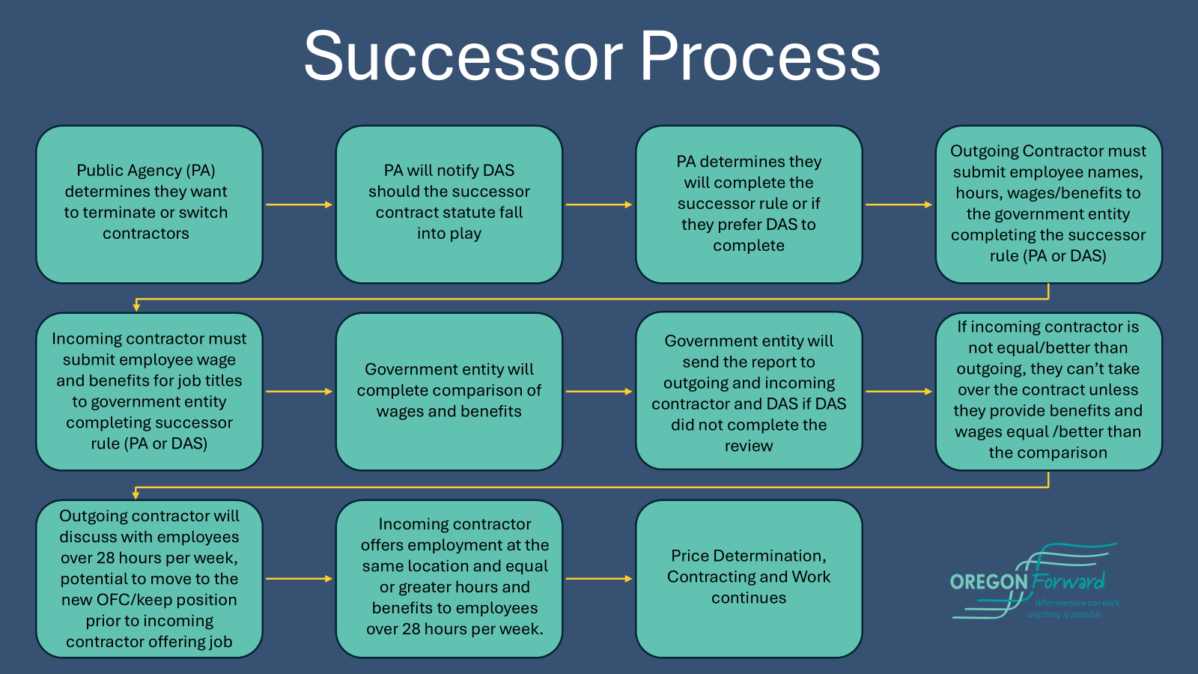
Visual Processes Continued
Notice to Cure- PA Resources
Price Determination- OFC & PA Resources
Successor Process- OFC & PA Resources
Work Order Contract- PA Resources

Slide 9
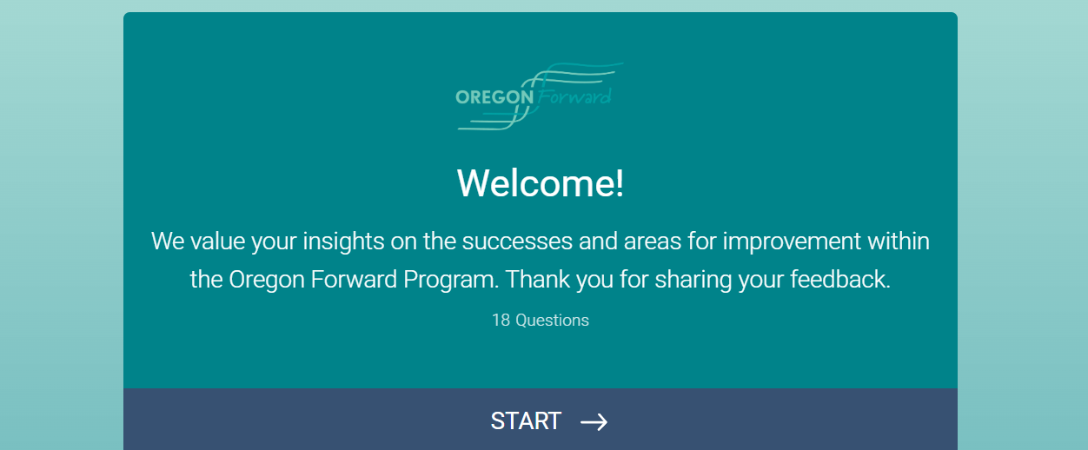
OFC Ongoing/Follow Up Survey- Under Surveys on OFP Website

Slide 10
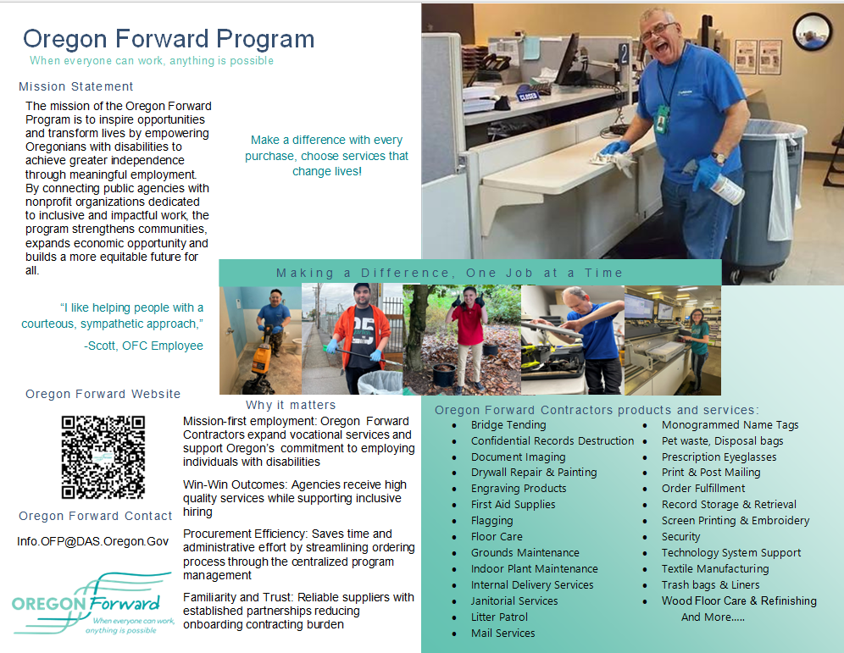

OFP Brochure

Slide 11

Question

