Slide 1

Oregon Forward Cadre Meeting
10/6/26

Slide 2
Agenda
Icebreaker
OFP Updates
Meeting Topics
Training

Slide 3

Icebreaker
What’s the worst Halloween candy?

Slide 4

OFP Updates
Cadres:
January 5, 2027
April 6, 2027
July 6, 2027
October 5, 2027

Slide 5

Meeting Topics

Slide 6
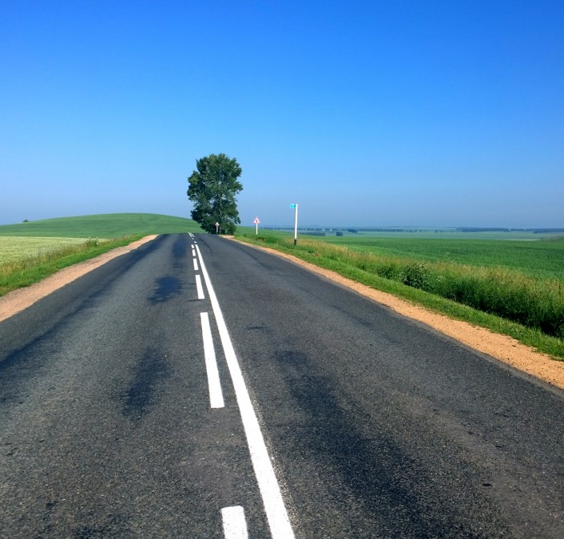
OFP Regional Trainings
2026
Umatilla/Union/Wallowa: Nov 3
Baker/Grant: Nov 4
Harney/Malheur: Nov 5
Lane: Nov 16

Slide 7
Regionals Continued
2027
Multnomah: Jan 11 (Jan 12 if need)
Clackamas: Feb 3 (Feb 4 if need)
Linn Benton: Feb 17
Yamhill/Polk/Marion: Feb 18
Clatsop/Columbia: Mar 3
Tillamook/Lincoln: Mar 4
Hood River/Wasco: Mar 9
Sherman/Gilliam/Morrow/Wheeler: Mar 10
Washington: Apr 7 (April 8 if need)

Slide 8
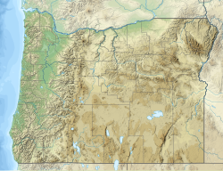
OFP Regional Training Registration for Public Agencies
https://app.smartsheet.com/sheets/52FGJWffrp65rgj7XgG53rG6Rx9HJww6fCP75Fv1/forms/3011410383253

Slide 9

Staff Changes??? Contact Info?
Have you had staffing changes?
Would the cadre and regional trainings be beneficial for others?
Do you know of organizations or conferences we should reach out to?

Slide 10

New Oregon Forward Contractor
Janitorial & Floor Care

Slide 11
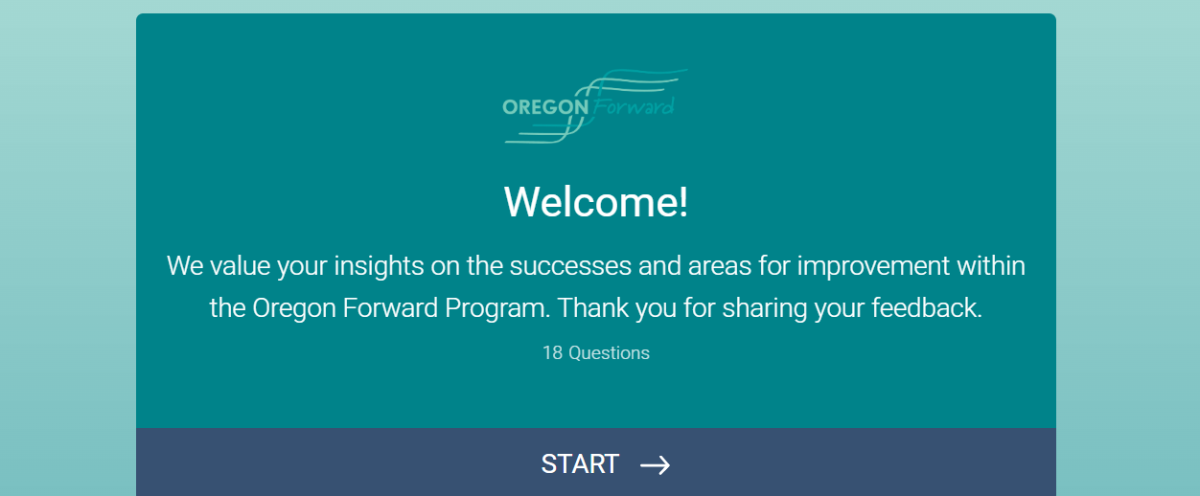
OFP Ongoing/Follow Up Survey- Under Surveys on OFP Website

Slide 12

OAR Rewrite
Are there parts that could be clearer?
Rewrite coming in November
This Photo by Unknown Author is licensed under CC BY-SA

Slide 13

Temporary Staffing Invoices
Employee numbers are now being provided on invoices
Contractor can supply a list of employee numbers connected to names
Do not load names into Oregon Buys

Slide 14
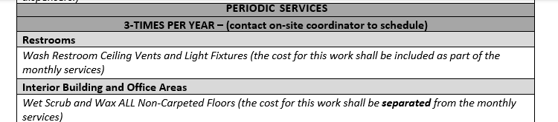
Is periodic services part of the monthly payment?

Slide 15

Training

Slide 16
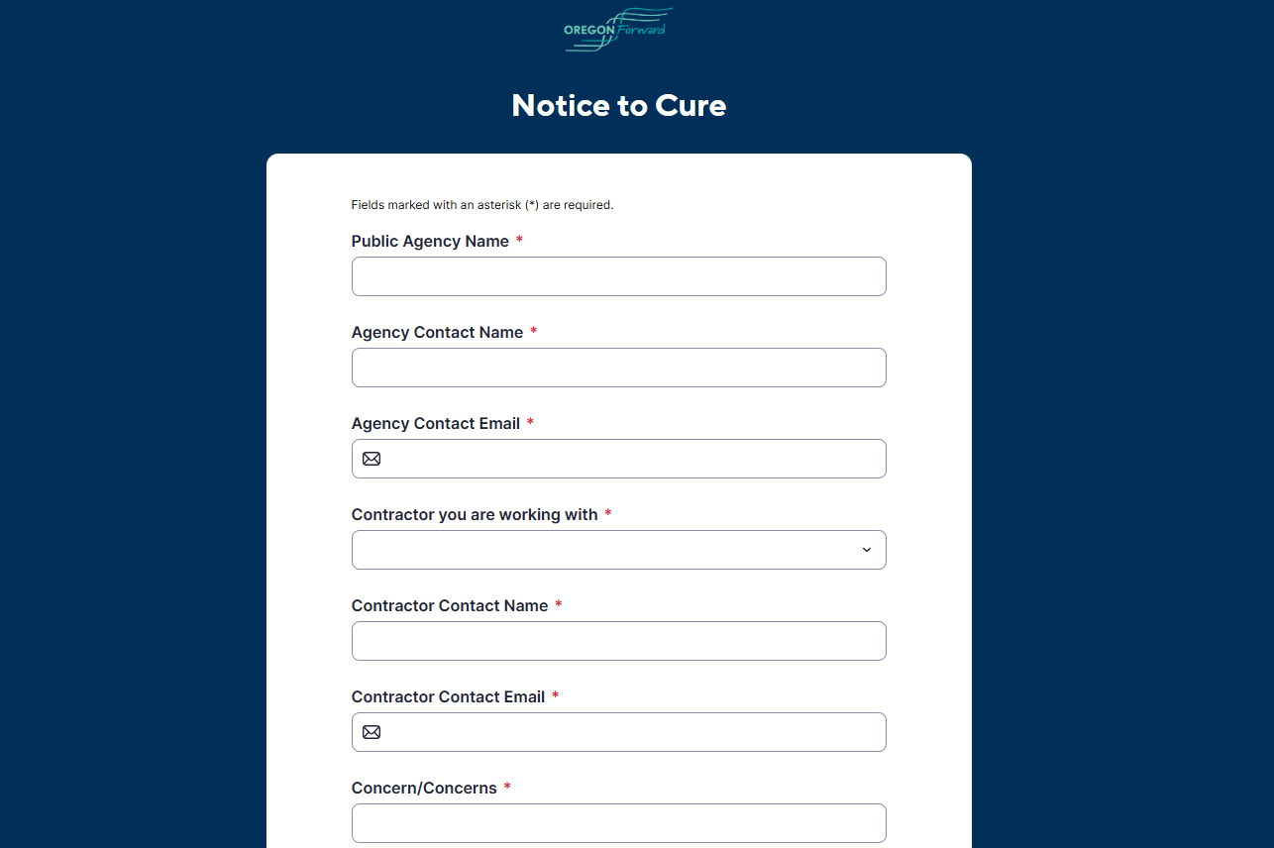
Notice to Cure Portal
Notes:
Lisa
Link to smartsheets portal

Slide 17

Price Determinations and Work Order Contracts Submissions Portal
Price Determinations
Work Order Contracts
Public Agency Contact Information
Contractor Contact Information
File Upload:
  Contract with Scope of Work
  Costing Workbook
  Price Determination PDF
Public Agency Contact Information
Contractor Contact Information
File Upload:
  Work Order Contract in word or PDF for review signature

Slide 18

Evaluation Factors Sheet- Coming Soon
This Photo by Unknown Author is licensed under CC BY-SA

Slide 19

Kudos Quarterly WOCs
Scott Lommers,
  Oregon State University
Lindsey Bergerson,
  City of Salem
Stacie Pippert,
  Oregon Health Authority

Slide 20

Questions

