Slide 1


Department of Administrative Services
Oregon Forward Program Public Agencies
Cadre Meeting
4/7/26

Slide 2
Agenda
Agenda
01 Ice Breaker
02 OFP Updates
03 Meeting Topics
04 Training

Slide 3

Ice Breaker What is your favorite flower?

Slide 4

OFP Updates- Quarterly Cadres Discussion/Poll Costing Workbooks were updated; look for Form version 2/26

Slide 5
OFP Reminders:
Public agencies submit The WOCs and Price Determinations For reviewed (Electronic Submission)
If Contracts are not on DAS Template, the contract needs to be under OFP Statutes and Rules
Review prices/costing workbooks biannually or annually- don’t wait 3+ years
Contacting the Program- Email info.ofp@das.Oregon.gov

Slide 6

Meeting Topics

Slide 7
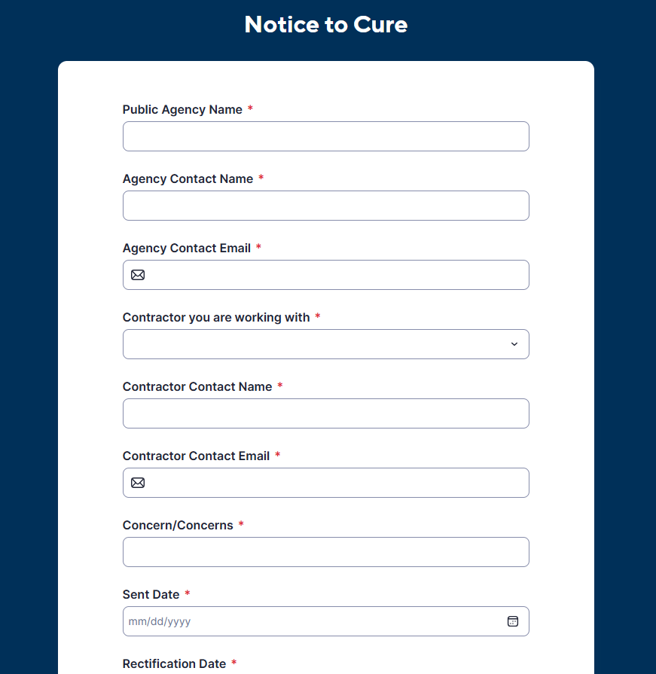
Notice to Cure
Notice to Cure Submission
Oregon Forward Website> Oregon Forward Public Agency Forms> Notice to Cure Submission
Submit the Notice to Cure File

Slide 8

Training
This Photo by Unknown Author is licensed under CC BY-SA

Slide 9
Prevailing Wage
Welcome Ray Badalich!

Slide 10
WOCs
WOCs do not need to be in Oregon Buys
WOCs need reviewed by the Oregon Forward Program
Submit through portal: Price Determination and WOC Submission Portal

Slide 11
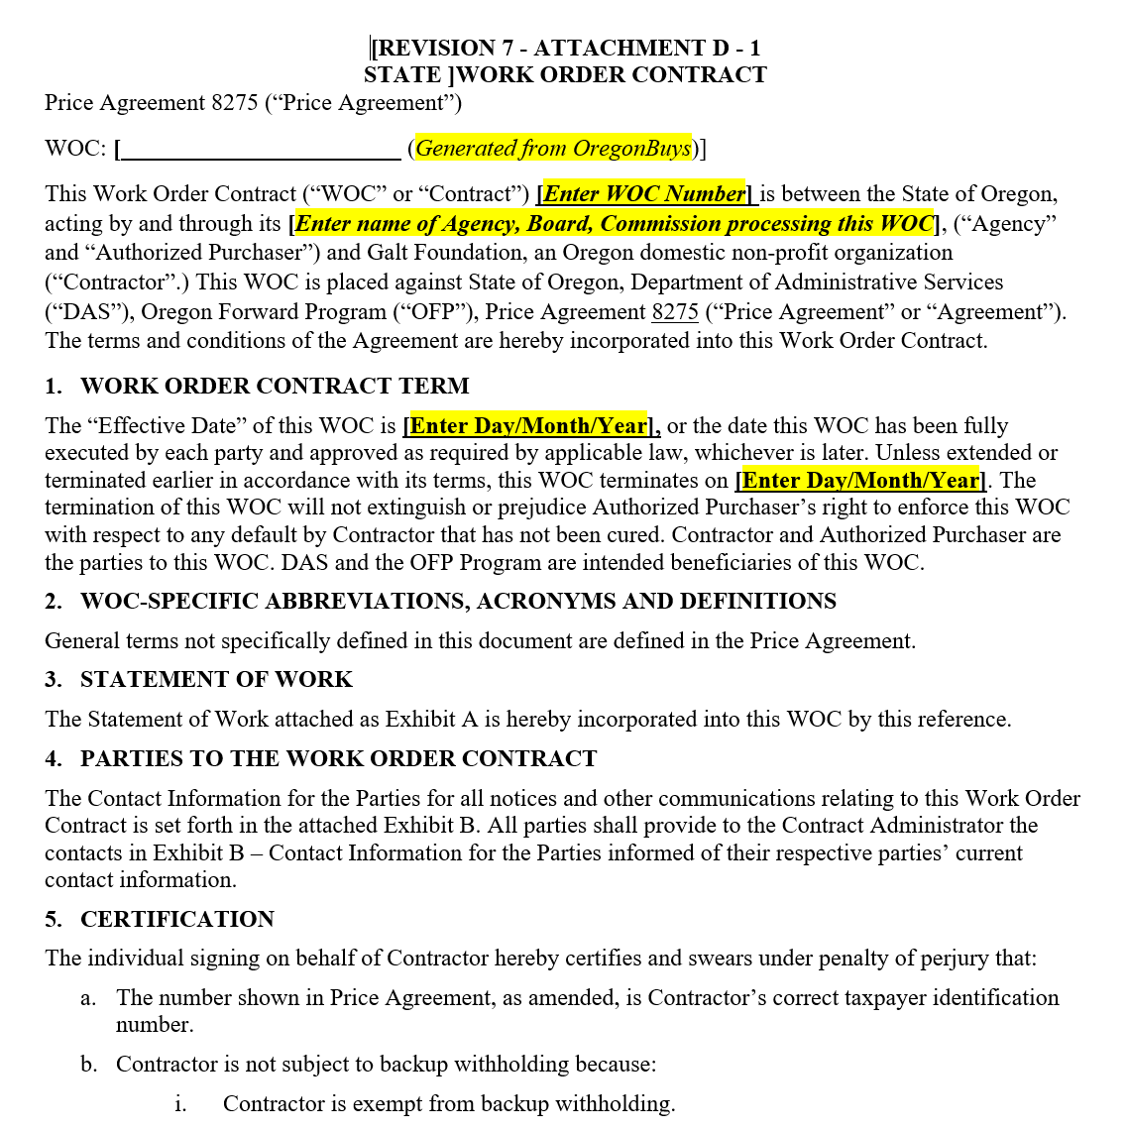
Effective Dates
WOCs do not need to be in Oregon Buys
WOCs need reviewed by the Oregon Forward Program
D1 for State Agencies
D2 for Other Public Agencies
Submit through portal: Price Determination and WOC Submission Portal
EFFECTIVE DATE: Date the WOC has been fully executed; unless otherwise stated in the WOC

Slide 12

Kudos Quarterly
Barbara Pena- Western Oregon University
Mark Roberts- Enterprise Asset Management (DAS)
Amy Simon- Oregon Liquor & Cannabis Commission
Barbi Hemmer- Jefferson School District
Brenda Bravo- City of Woodburn
Tamera Bowser- Department of Corrections

Slide 13
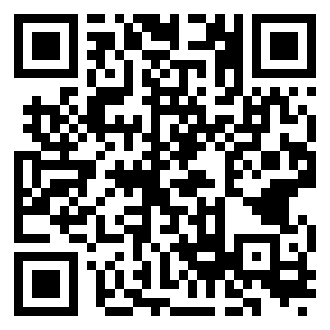
Next Steps for Public Agencies
Oregon Forward Program Continuous Follow Up Survey for Public Agencies

Slide 14
REMEMBER
Next Quarterly July 7, 2026
The Oregon Forward Program (Lisa and Rena) are always here to help. If you have questions, need help negotiating, etc, don’t hesitate to reach out!
Info.ofp@das.Oregon.gov

Slide 15

Questions?

