Slide 1
Process for Reviewing/Reimagining/Revising
DAS Procurement Templates
Procurement Template Initiative
Clear, Current, and Consistent Documents…Every Time!
Jennifer Godfrey
6/22/26
Department of Administrative Services

Slide 2
The Details
What We Are Doing
Why We Are Doing It
Who Is Involved
When We are Doing It
Standardized Templates
Formalizing Edit/Approval Process
Working the Priority List
Agencies using outdated or own DOJ-approved versions
Inconsistent risk language and form language
DAS SPS/ Risk
Agency DPOs
and SMEs
DOJ
CPO
June 24 kickoff
July Workgroup
Monthly Sessions
Finalize Q2 2027

Slide 3
The Process
Submit Current Template Versions
Nominate SMEs for Workgroup
Review Drafts, Find Gaps, Ensure Usability
DOJ Approval and Agency Validation
Lock, Launch, and Ensure Adoption
Notes:
1. Submit Your Current Templates
Agencies provide the versions they use today, including any DOJ‑approved versions they may have worked on independently as an agency.
2. Nominate Your SMEs
Agencies choose staff to represent their needs in the Template Workgroup. Ask SPS Managers to nominate staff to be on workgroups, if desired.
3. Help Shape the New Templates
SMEs work with Jennifer to review collected drafts, identify preferences among inconsistencies, to eliminate unnecessary clauses, to ensure WCAG and Plain Language compliance, and to ensure the final version works for real‑world use.
4. Review & Validate Final Drafts
Agencies participate in a focused review session to review, finalize, and approve the statewide template.
5. Adopt the Official Templates
Once approved by DOJ and CPO, agencies use the new standardized versions, ensuring consistency, predictability, and reduced DOJ cost. DPOs work with Change Management Practitioners to socialize and ensure buy-in.

Slide 4
Timeline
Q3 2026
Q4 2026
Q1 2027
Q2 2027
DPO Kickoff
Agency Template Submission
Language Consolidation
SME and DOJ Consultation
Agency Review & Finalize
Lock & Launch
Notes:
Always add alt text: Click “Review” > “Check Accessibility” > “Alt Text”. Thoroughly describe all parts of the design on the page. Refer to the “Alt Text Guide” instructional slide for more details.

Slide 5
What I Need:
1
2
3
4
5
Nominate SMEs for Template Workgroup
Aim for program and procurement perspective
Identify Pain Points
Tell us what isn’t working/ what you need
Participate in Review Sessions
Review drafts to ensure they work with your processes
Prepare Staff to Adopt
Work with your Change Management Practitioner/Team
Submit Your Current Template
Note last DOJ approval date

Slide 6
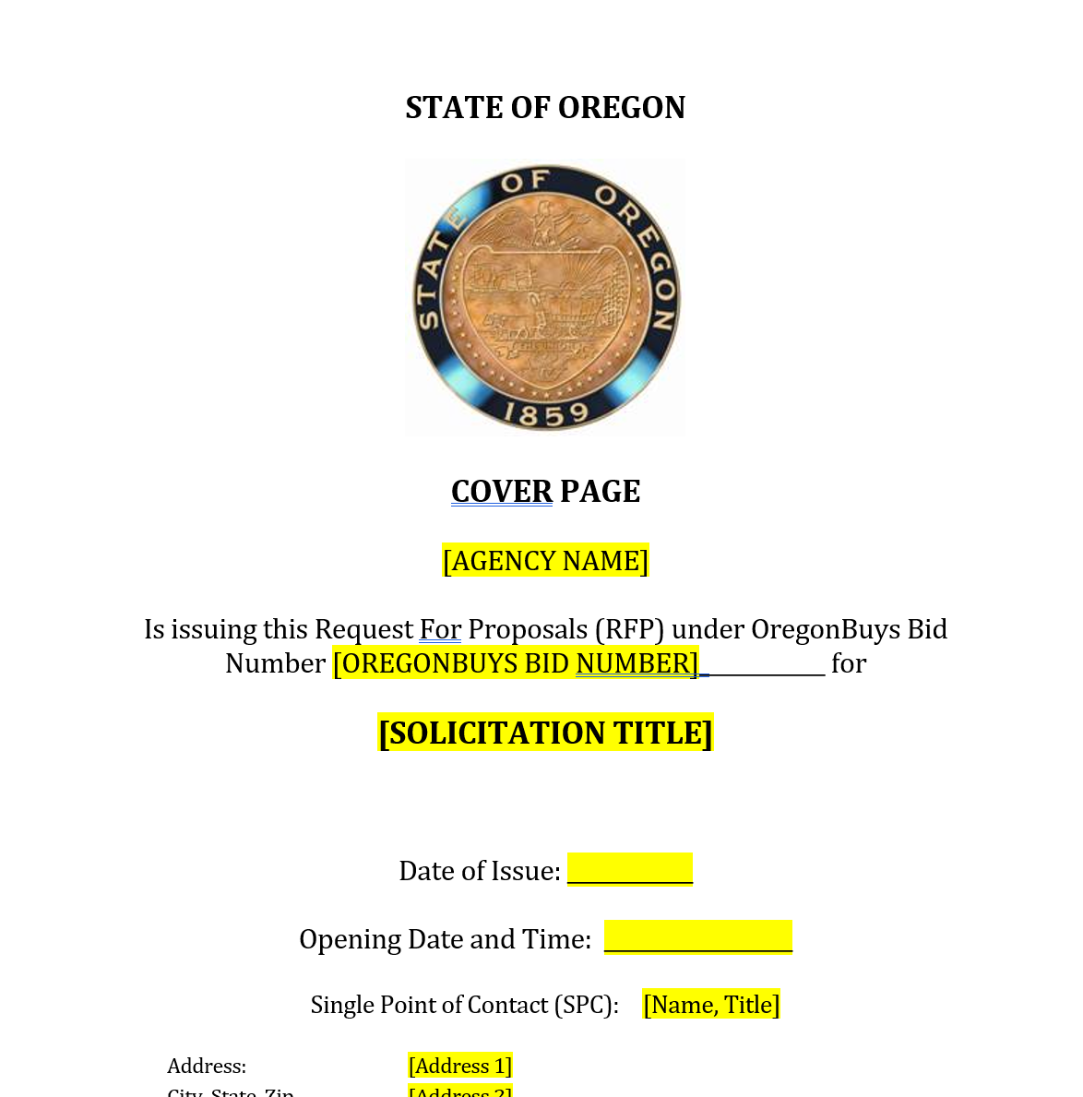
First Item:
Competitive Sealed Proposal (RFP)

Slide 7
What is in the queue:
First Priority
2nd Priority
3rd Priority
4th Priority
Purchase Order
Competitive Sealed Proposal (RFP)
Services Contract
Competitive Sealed Bid (ITB)
5th Priority
Intergovernmental Agreement (IGA)
Notes:
Always add alt text: Select the entire SmartArt design, then click “Review” > “Check Accessibility” > “Alt Text”. Thoroughly describe all parts of the SmartArt. Refer to the “Alt Text Guide” instructional slide for more details.

Slide 8
Please send your RFP sample document and SME nominees to:
Jennifer Godfrey
Procurement Impact Unit
jennifer.r.godfrey@das.oregon.gov

