Slide 1

Personal Property Management System Searching for and requesting property in PPMS
The GSA PPMS is the Personal Property Management System, an online platform used by the General Services Administration (GSA) for managing the federal government's excess and surplus personal property.
Federal agencies use PPMS to report property they no longer need, making it available for other agencies to acquire.
Qualifying agencies can use PPMS to search for and request property that has been reported as excess by other agencies, essentially acting as a marketplace for reutilizing federal assets.

Slide 2
How to Gain Access to PPMS
To obtain View Only search credentials in PPMS send an email to:
Don.Tesdal@DAS.Oregon.Gov
Once registered you will receive an automated email from PPMS_noreply@gsa.gov
Follow the guidance given in the email
Sample of what you will receive
You have been registered on PPMS with YourEmail@YourDomain.org
We have provided you with a temporary password. Please use this temporary password to log into PPMS. Then, update the temporary password to a password of your choice. Temporary Password: 86cE&v%S&byM To complete the registration process, please click https://ppms.gov and follow the instructions. New Permissions:

Slide 3
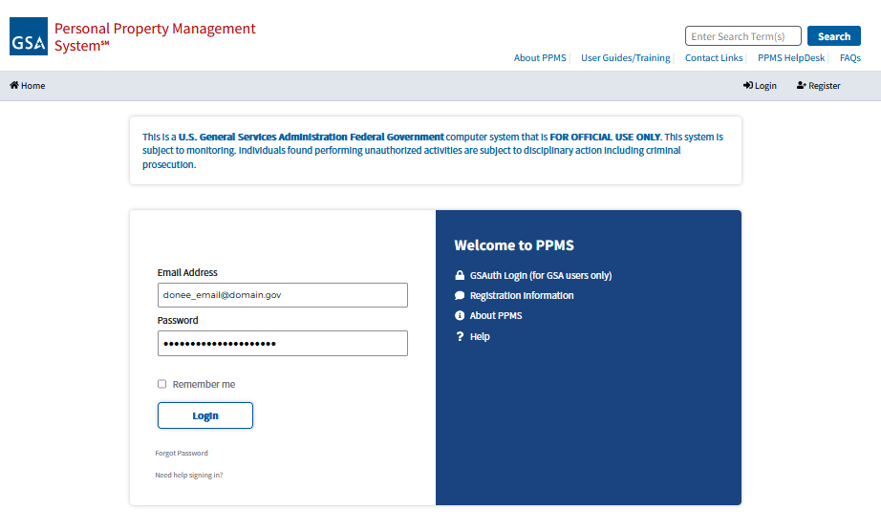
Logging in to PPMS Log in to PPMS at https://ppms.gov/login

Slide 4
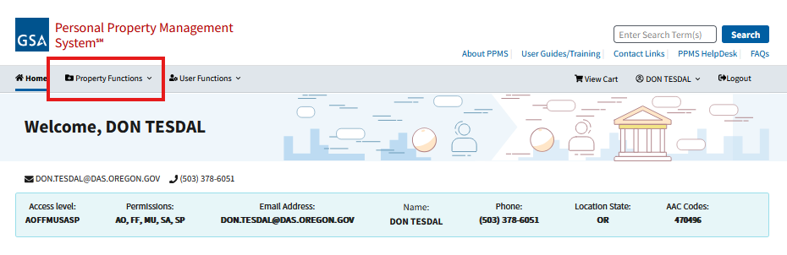
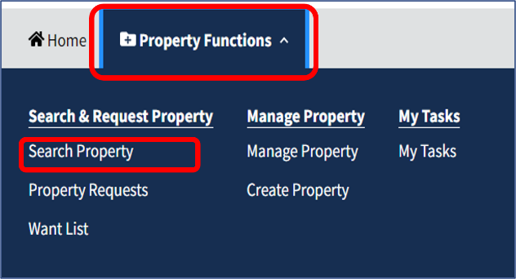
From the Homepage
Go to Property Functions > Search Property
Choose “Want List” to enter specific search criteria and you will receive an email when that is listed.
Note: PPMS works best in the Google Chrome Browser

Slide 5
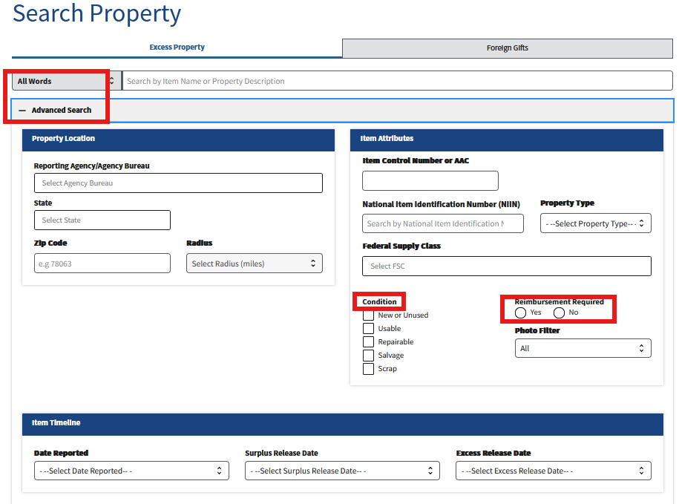
Search for an item
You can use keyword or advanced search
Advanced search lets you search by multiple attributes
State
Federal Supply Class
Condition
Reimbursement Required
Reported Date
ERD/ SRD
Photo Filter
Zip Code

Slide 6
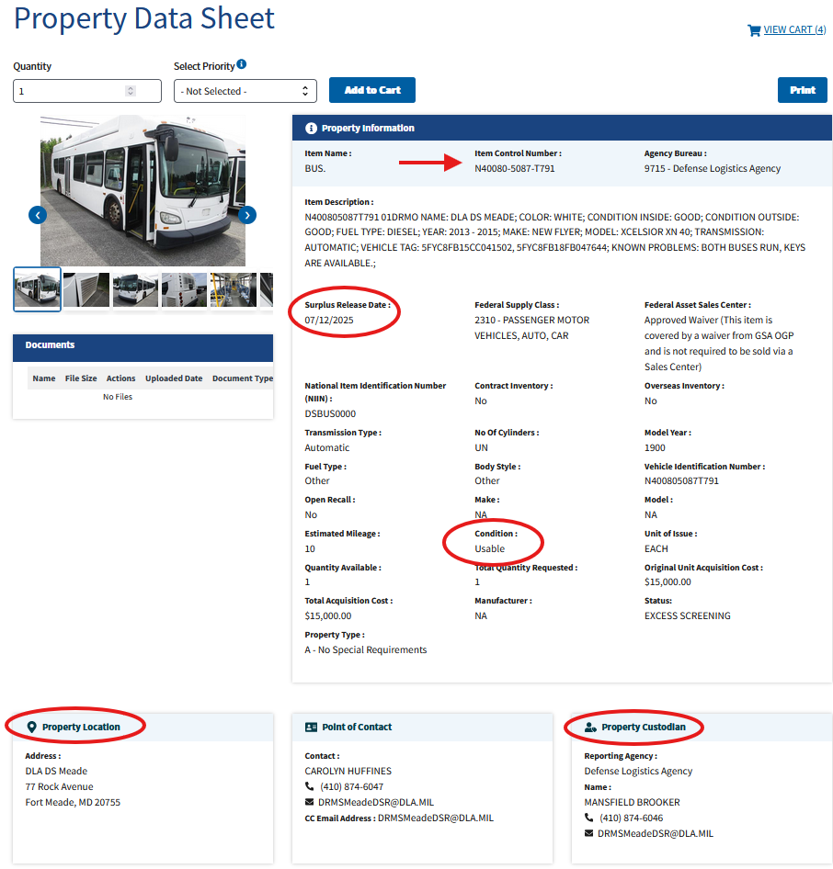
View Your Results
At a glance you can easily view the item description, property location, condition, available QTY, and the Surplus Release Date.
You can also see what qty has been requested by others to get a sense of your likelihood of receiving the item.

Slide 7
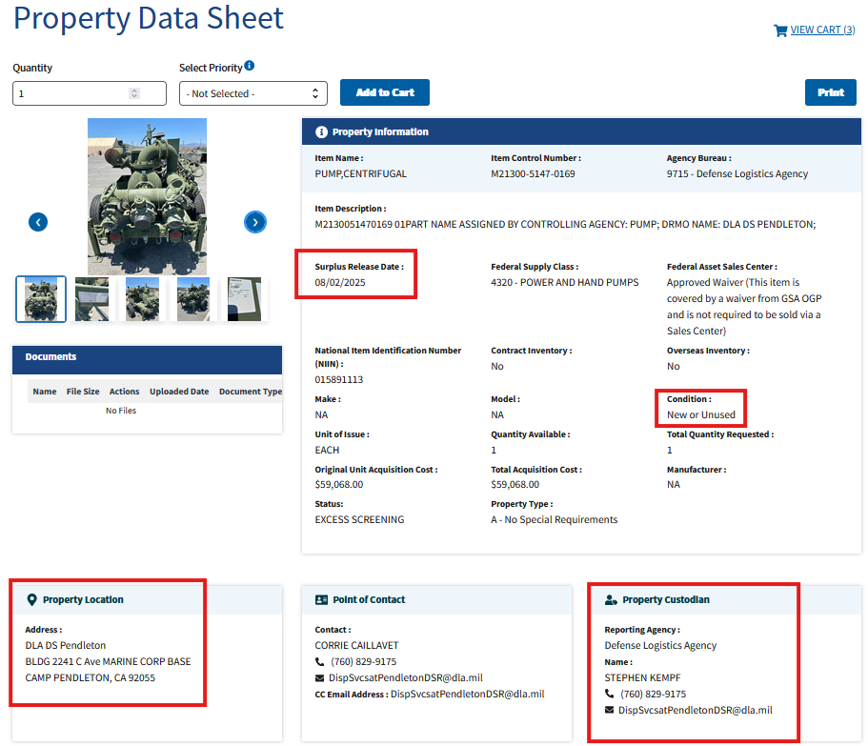
Consider this:
Surplus Release Date - You must request the property before the SRD.
Condition – New/Unused, Repairable, Scrap?
Location – Shipping property from across the country is expensive. Look closer to home.
Property Custodian – Do you need more information about the property? Email and call the custodian and Point of Contact for a photo or turn-in document.

Slide 8
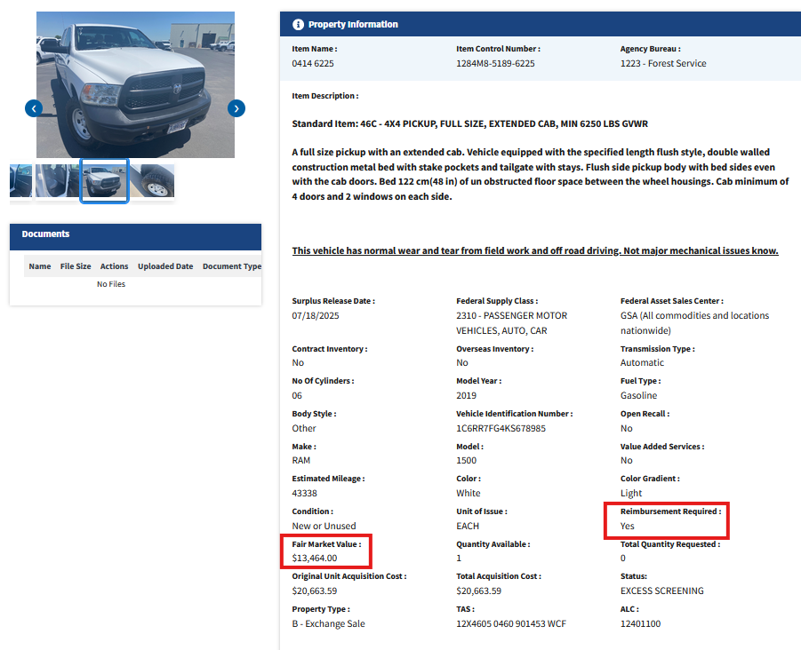
Reimbursement Required?
Some property is listed as reimbursement required.
When this is the case, you will also see a listed Fair Market Value.
This means the listing agency is asking to be reimbursed for this property.
The fair market value is what you will pay them.
In addition, you will be invoiced 5% of the agreed upon FMV to Oregon Surplus Property for our services.

Slide 9
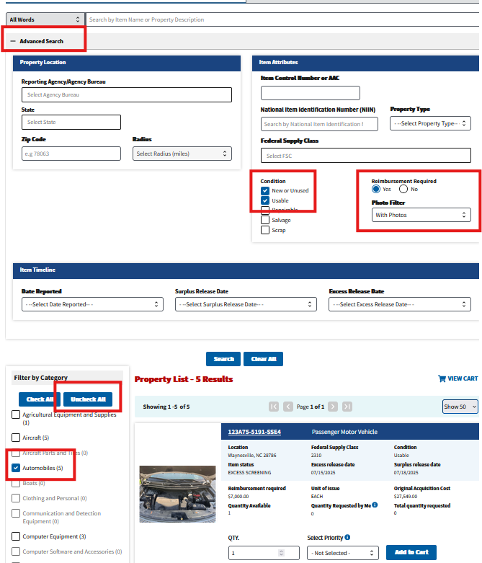
How do I find Vehicles?
Select Advanced Search
Choose your desired attributes
Select Uncheck All
Select your desired category

Slide 10
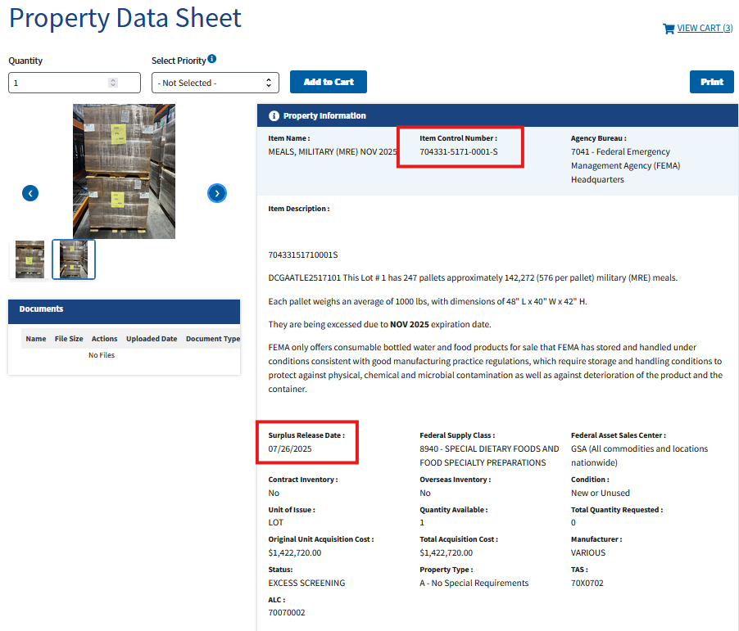
I want this – What do I do?
You’ve done your homework and are ready to request property, but how?
Send an email to: Don.Tesdal@DAS.Oregon.gov
In the subject line type:
Property Request and copy/paste the Item Control Number.
In the body of the email you can provide a screenshot of the splash page or simply let me know you’d like to request this ICN.

Slide 11
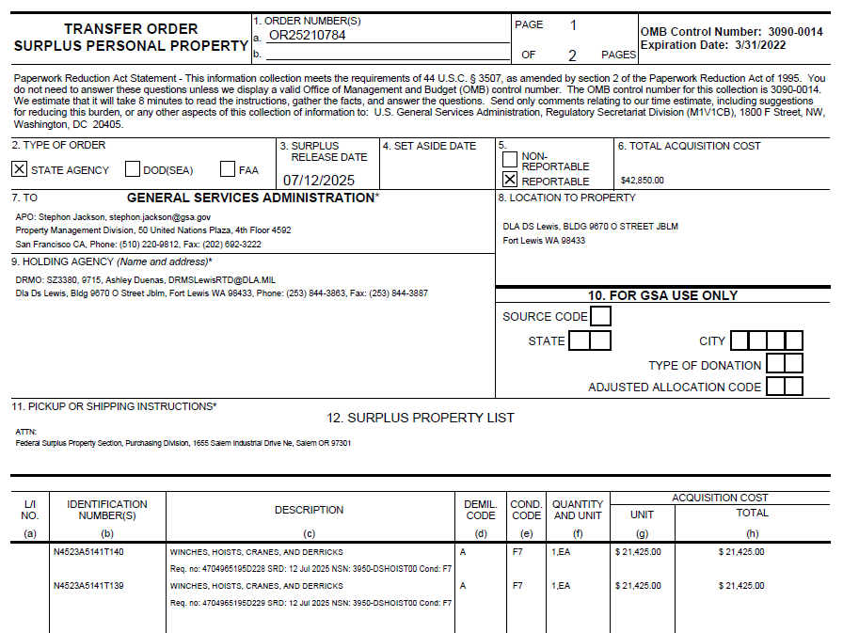
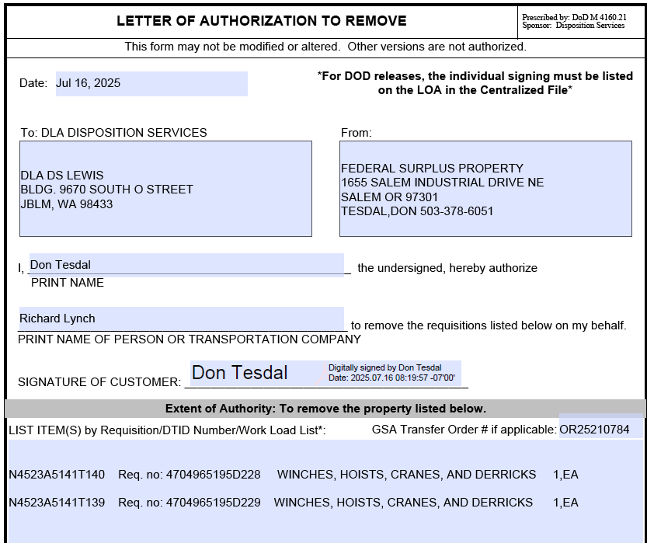
You’ve requested Property – What’s next
You will receive an email with your direct service charge quote.
The quote is based on you arranging the shipping directly to your location.
You must reply to the quote and confirm your intent to continue with the acquisition or decline.
When you’ve agreed to the quote your property will be requested, and we wait for the SRD.
If allocated the property we will receive notification from GSA in the form of a transfer order.
The GSA transfer order and a Letter of Authorization to Remove will be sent to you and the property custodian.
It will be up to you to coordinate shipping with the property custodian and your chosen shipping vendor.

Slide 12
Let's wrap it up
You received your property – Email Jennifer.Beyer@DAS.Oregon.gov AND Don.Tesdal@DAS.Oregon.gov to let them know you have your property. Jennifer will send out your invoice and Don will send you a compliance and utilization form.
Compliance? – Yes, anything with an original acquisition cost (OAC) less than $5K has a 12-month restriction period (Don’t sell it or lose it). Anything with an OAC greater than $5K has an 18-month restriction period.
Returns – You received your item and it’s not what you thought or not as described or does not work. You can return it to us for a refund of your service charge, but not your shipping costs.
Return it within 30 days for a full 100% return on the service charge
Return it within 31-60 days for a 50% return on the service charge.
After 60 days it is yours to keep and falls under the above-mentioned compliance terms.

Slide 13
PPMS Login: https://ppms.gov/login
Oregon State and Federal Surplus Property
Staff Directory
State and Federal Surplus Property
1655 Salem Industrial Drive NE
Salem, OR 97301
​​​​​​Phone: 503-378-6020
Login Credentials – Property Requests – Compliance: Don.Tesdal@DAS.Oregon.gov
​​​​​​ Invoicing – Warehouse Inventory: Jennifer.Beyer@DAS.Oregon.gov
Eligibility: Carla.Jeannette@DAS.Oregon.gov
Manager: Sven.Anderson@DAS.Oregon.gov

