Slide 1
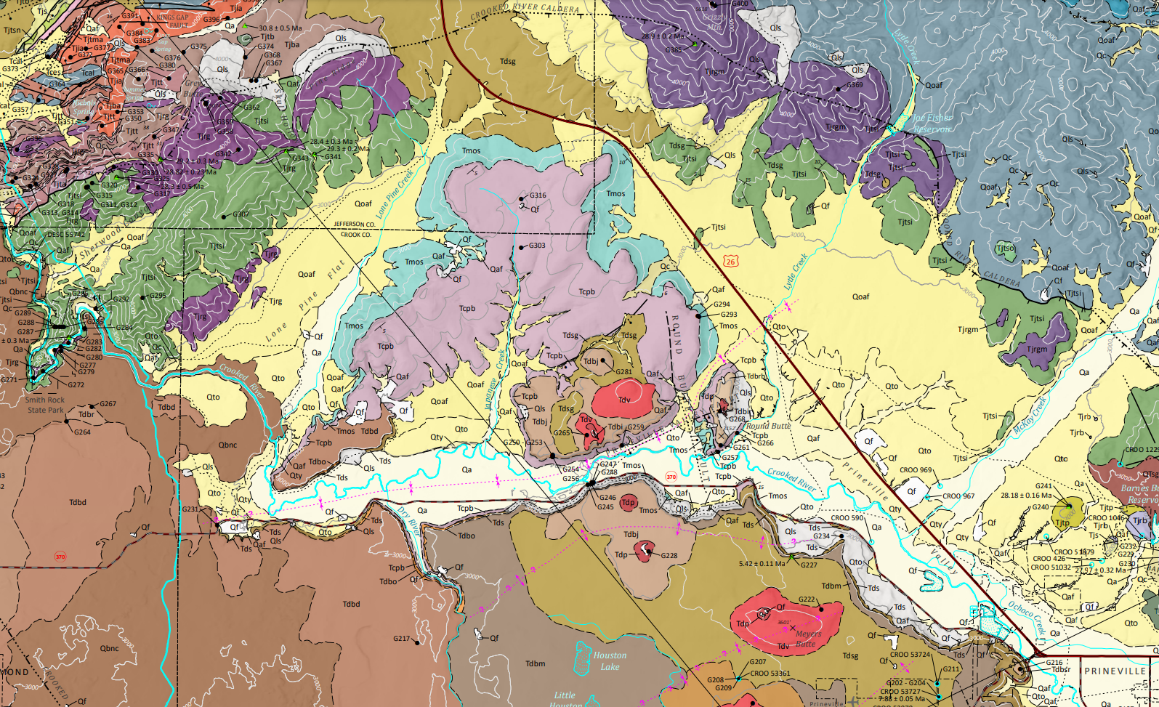
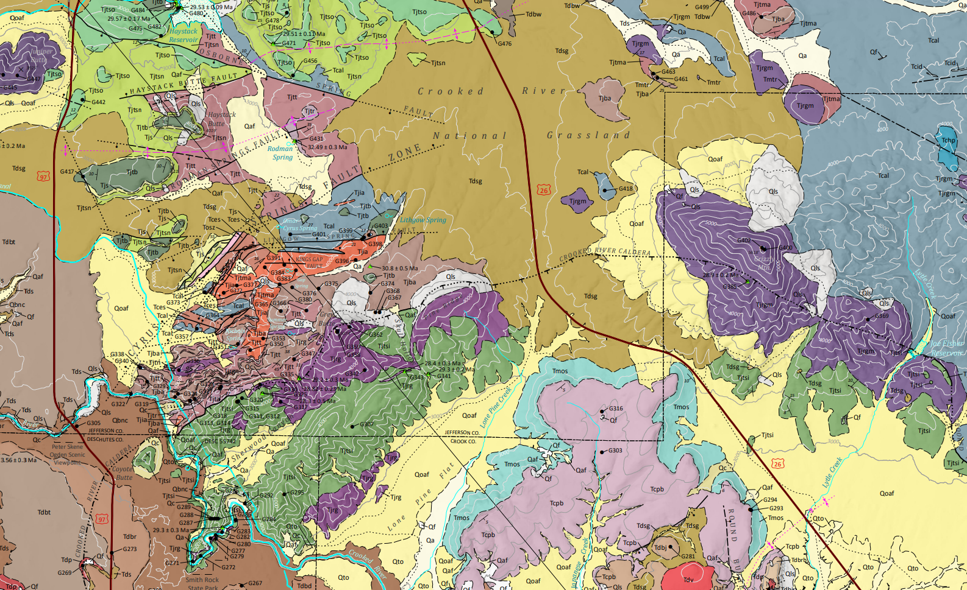
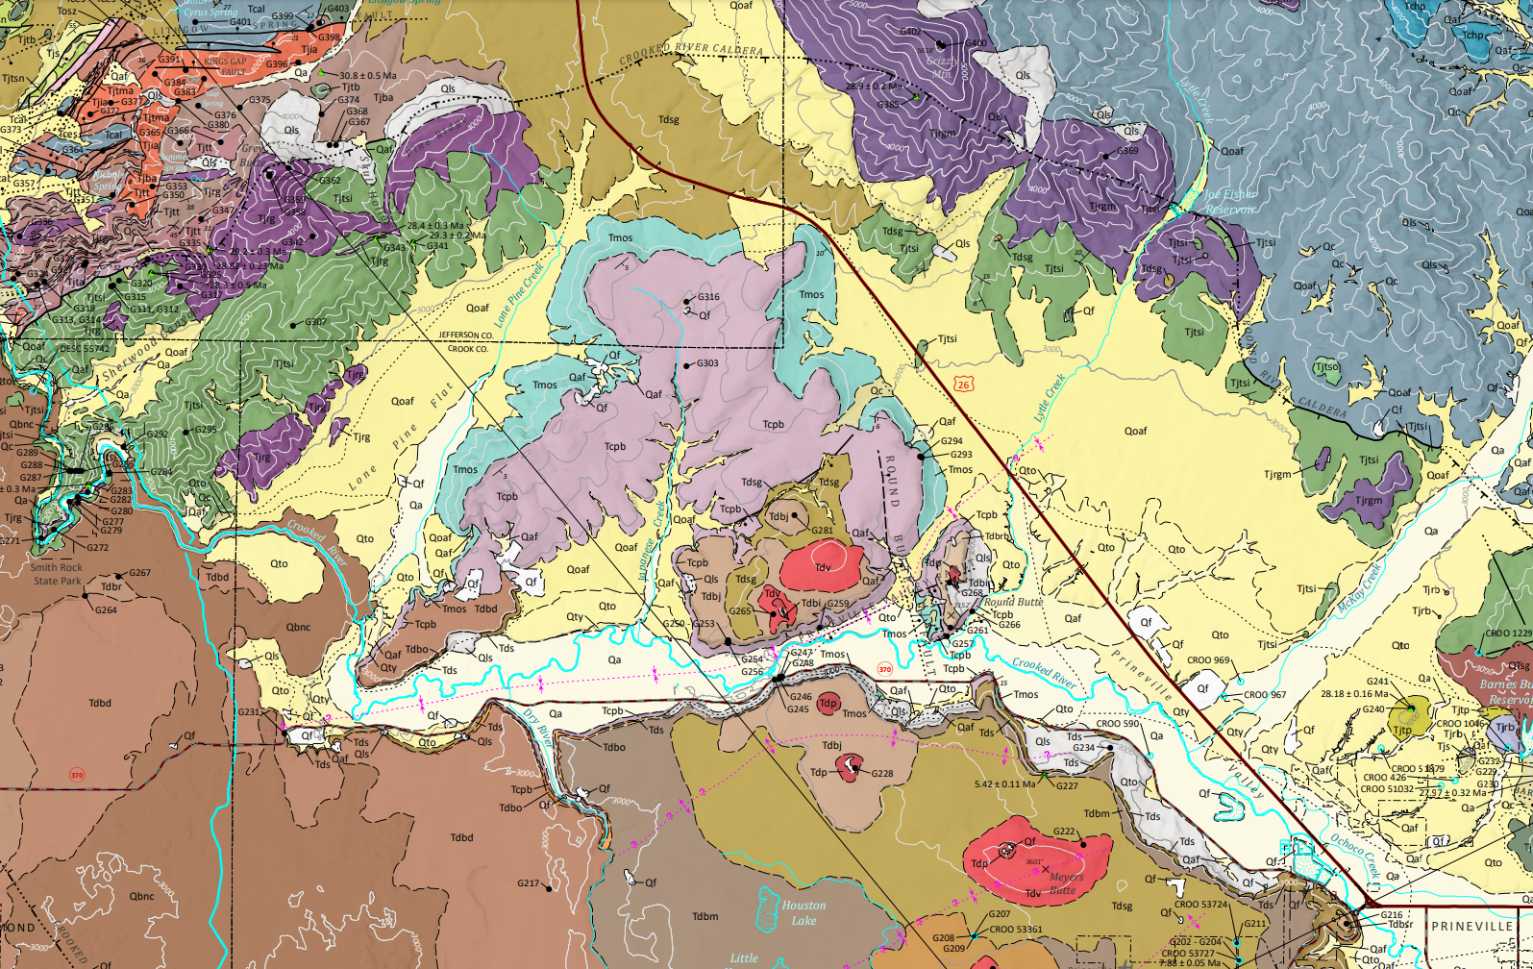
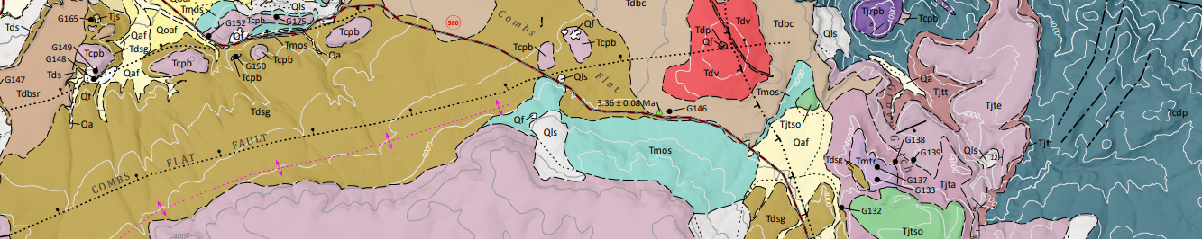


Grassy Mountain Technical Review Team (TRT) Meeting
Oregon Department of Geology and Mineral Industries
February 2, 2023

Slide 2
Status of Consolidated Permit Completeness

