Slide 1
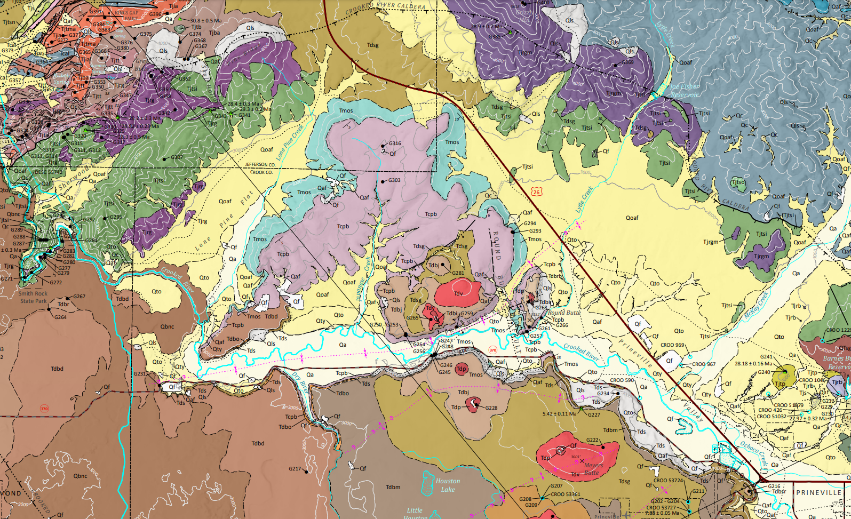
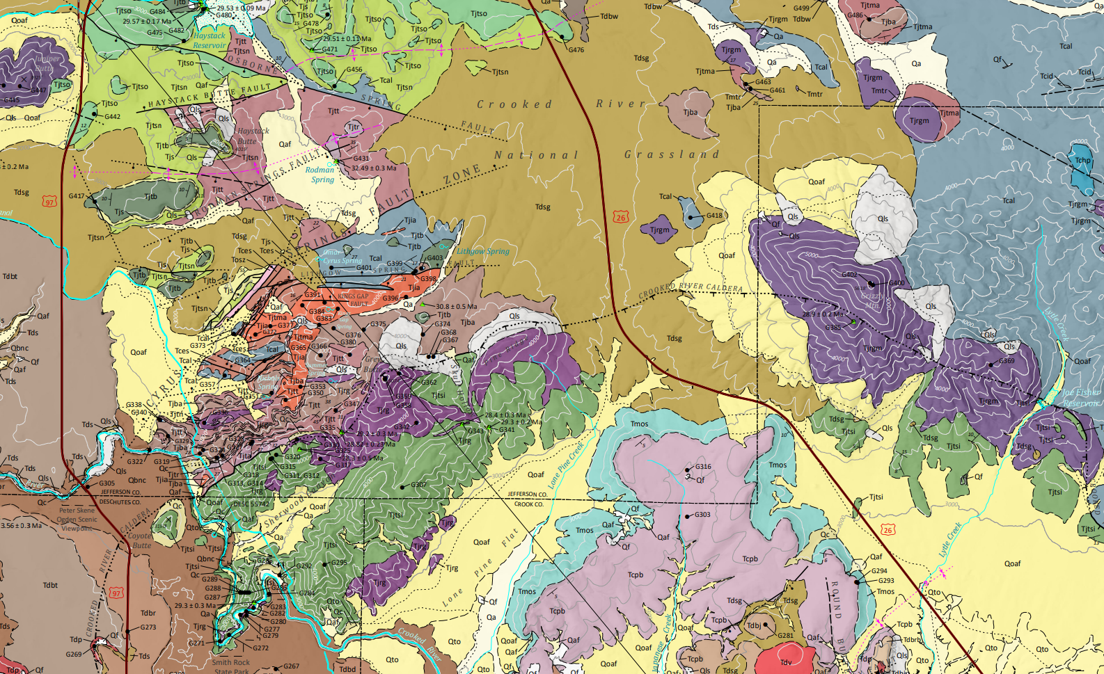
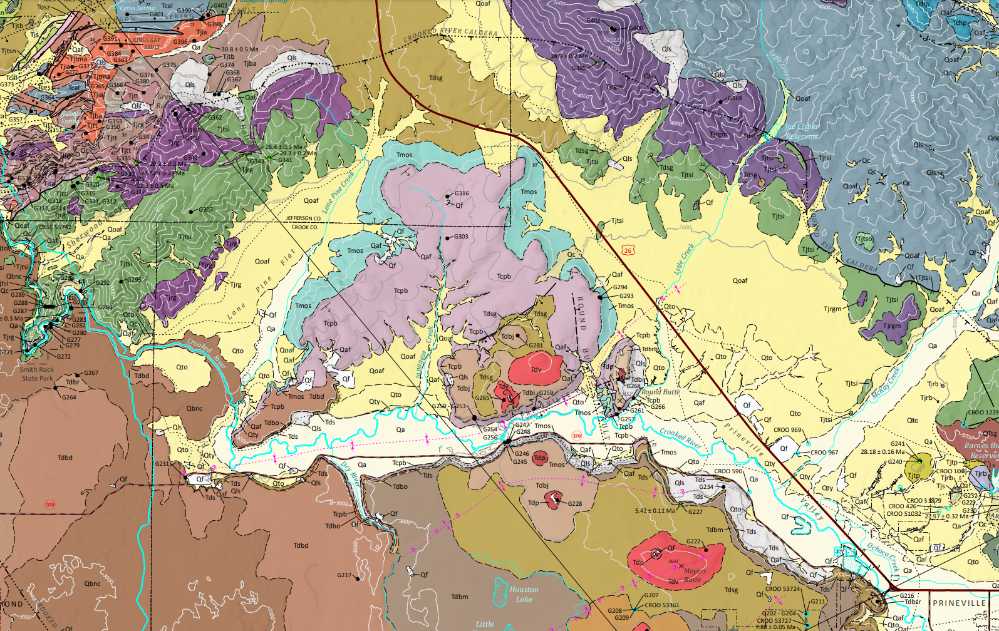
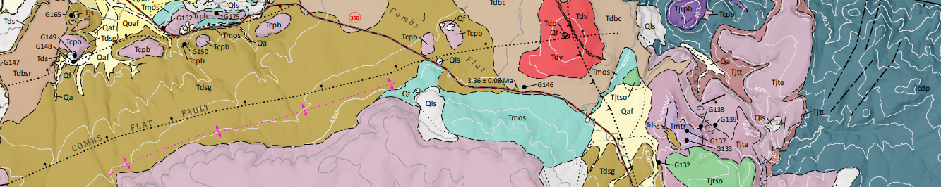


Grassy Mountain Technical Review Team (TRT) Meeting
Oregon Depart of Geology and Mineral Industries
June 01, 2023
Dayne Doucet
Consolidated Mining Permit Lead

Slide 2
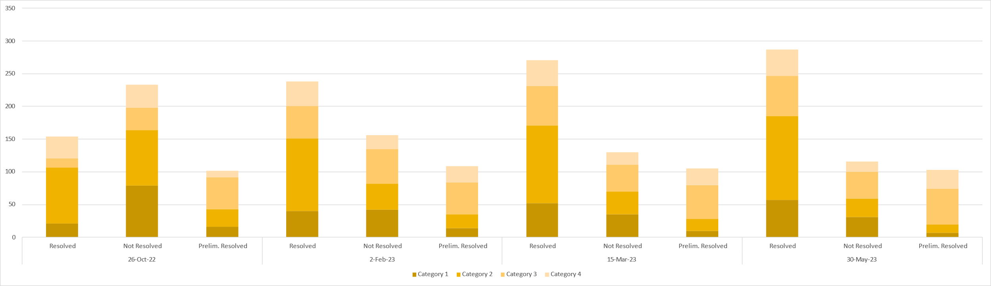
Consolidated Permit Application (CPA) Comments

Slide 3
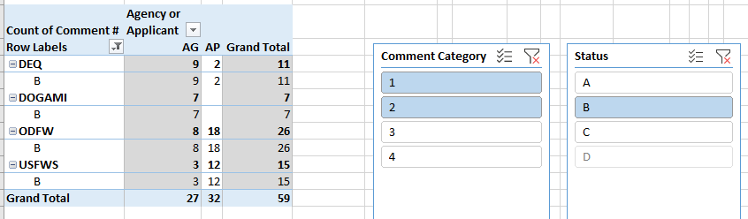
Consolidated Permit Application (CPA) Comments

Slide 4
Public Comments
The comments have been shared with the TRT, DOGAMI’s technical consultant Stantec, and the applicant.
Truck route
Groundwater
Blasting
Wildlife
Future Plans / Alternatives Analysis

Slide 5
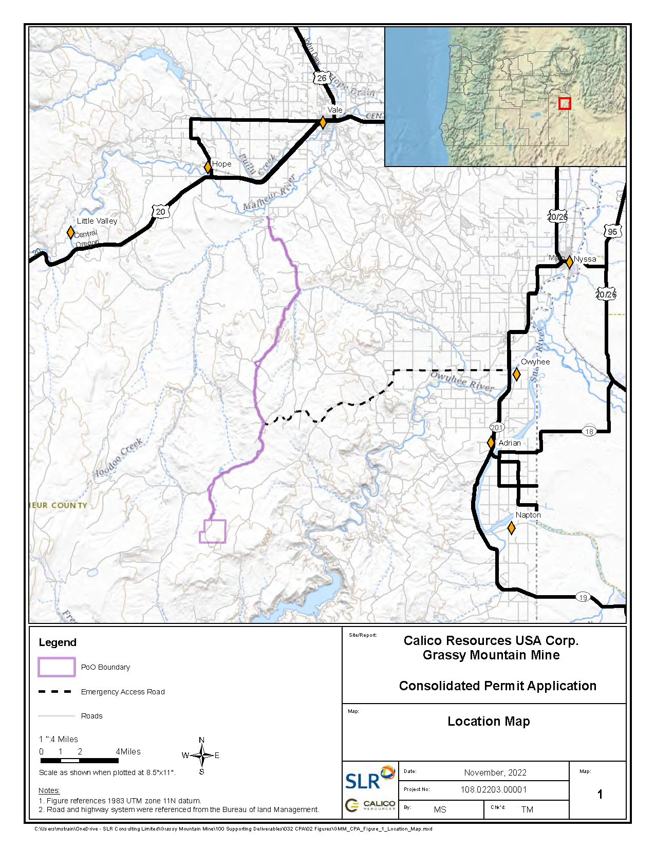

Slide 6
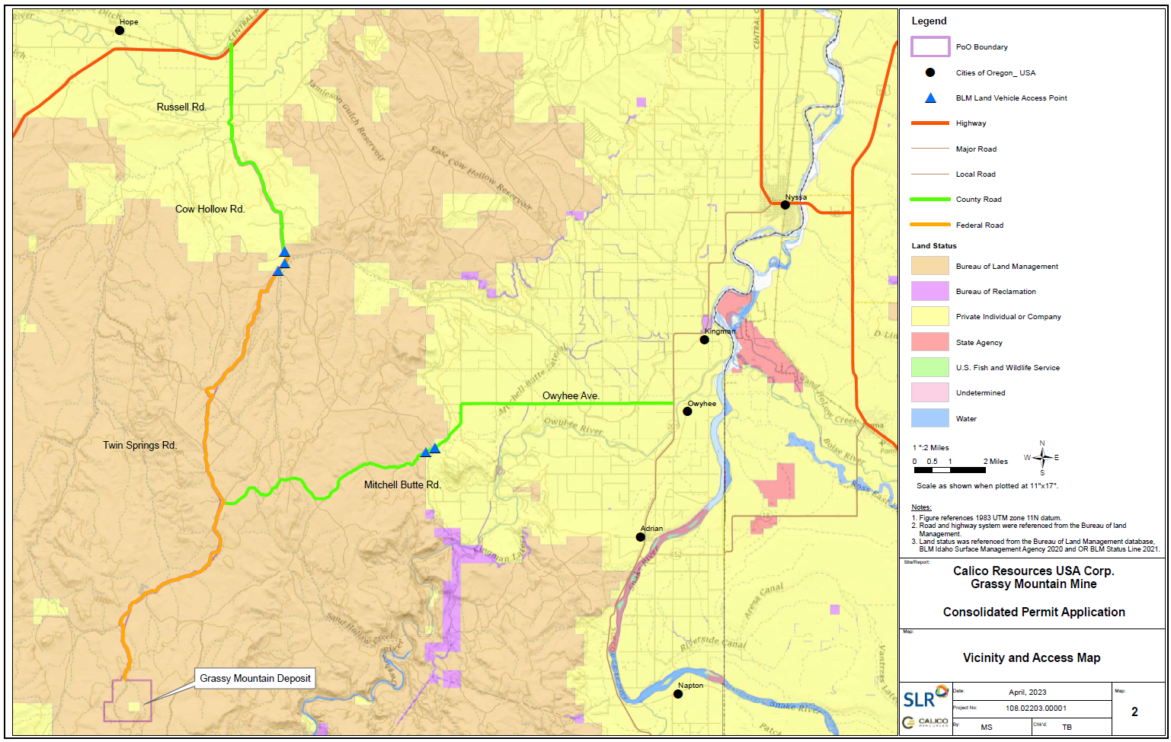

Slide 7
Groundwater
Total annual allocation rate for Owyhee basin is 14,204 Cubic Feet per Second (CFS).
Calico’s water right is a maximum of 2.0 CFS (0.014%).
Anticipated impacts to groundwater from the proposed mining operation, at a maximum, will be limited to the few local springs within the study area.
No significant effects to the free-flowing character of the Owyhee River or any of its tributary streams.
Groundwater data will continue to be collected and monitored.

Slide 8
Wildlife
All open ponds will be maintained in a condition that is not toxic to wildlife.
Amphibians were surveyed according to approved protocols.
Additional information is available in the Wildlife Protection Plan and Wildlife Mitigation Plan.
Wildlife protection standards employed by the proposed mine will be designed to meet the objectives of zero wildlife mortality.

Slide 9
Blasting
It is anticipated there will be 30 days of blasting during the 2-year construction period.
Surface blasting will be limited and conducted during the daytime, generally around mid-day.
Blasting of the quarry is a discrete event of a few seconds and will be attenuated to 55 dB within 2 km of the source.
The Grassy Mountain range is a natural barrier to noise.

Slide 10
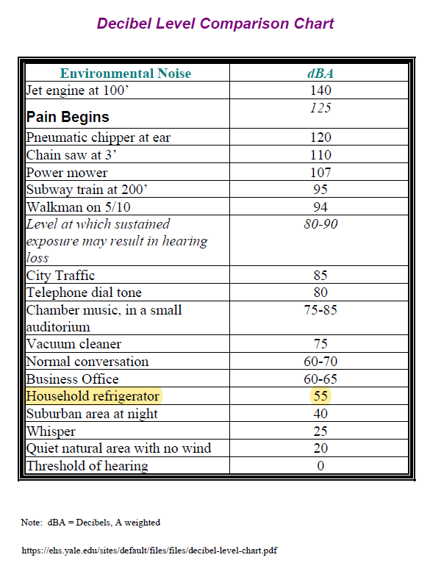

Slide 11
Future Plans / Alternatives Analysis
Applicant does not intend to convert the underground mine operation into an open pit scenario (nor would it be approved to do so as part of the existing consolidated permit application).
No other gold mining projects are currently proposed or anticipated.
An additional Alternatives Analysis will be performed as part of the Environmental Evaluation.

Slide 12
Environmental Evaluation (EE)
OAR 632-037-0085
(1) The purpose of an environmental evaluation shall be to address specific impacts of a mining operation in order to allow affected agencies to make decisions on whether to issue or deny a permit and develop permit conditions.
It shall provide full and fair discussion of significant environmental impacts and shall inform decision makers and the public of reasonable alternatives that would avoid or minimize adverse impacts and/or enhance the quality of the human and natural environment.
An environmental evaluation shall focus on significant environmental issues and alternatives.

Slide 13
Environmental Evaluation (EE)
OAR 632-037-0085
(3) The Department shall direct staff or hire a third party contractor to prepare an environmental evaluation.
The applicant shall pay costs of hiring a third party contractor.
The scope of the environmental evaluation shall be determined by the technical review team following consultation with the project coordinating committee.

Slide 14
Environmental Evaluation (EE)
OAR 632-037-0085
The initial scope was shared with the Project Coordinating Committee (PCC) and TRT in 2018
The scope was shared with the TRT again in 2022
The TRT scope was modified based on comments from the TRT and finalized earlier this year.

Slide 15
Environmental Evaluation (EE)
OAR 632-037-0085
(4) An environmental evaluation shall be completed by Department staff or a third party contractor at least 60 days before the issuance of any draft permits.
Upon receipt of a complete environmental evaluation, the Department shall provide public notice in accordance with OAR 632-037-0030 stating that the environmental evaluation is complete and receive written comments for a period of 14 calendar days after the notice is given.

Slide 16
Environmental Evaluation (EE)
OAR 632-037-0085
(5) A complete environmental evaluation shall include the following sections:
(a) Impact Analysis;
(b) Cumulative Impact Analysis;
(c) Alternatives Analyses.

Slide 17
Alternatives Analysis
OAR 632-037-0085(8)
a) An alternatives analysis shall include a review and analysis of the following:
(A) All alternatives analyzed by the applicant or applicant's contractor in accordance with OAR 632-037-0045(6); and
(B) Any reasonable alternatives identified by the technical review team to ensure that all alternatives within the authority of each permitting or cooperating agency are reviewed and analyzed. The alternatives identified by the technical review team may include, but not be limited to, the following:
(i) Alternative locations for mine facilities, including heap leach pads, roads, impoundments, ponds, ore storage areas and waste disposal areas;
(ii) Alternative designs, processes (including chemical processes), operations and scheduling for mine facilities and operations, including heap leach pads, roads, impoundments, ponds, ore storage areas and waste disposal areas;
(iii) Alternative water supply;
(iv) Alternative power supply; and
(v) Alternative reclamation procedures.

Slide 18
Alternatives Analysis
OAR 632-037-0085(8)
b) The review and analysis required under subsection (a) of this section shall:
(A) Explore and evaluate the environmental impacts of all reasonable alternatives, and include a brief discussion of reasons a particular alternative was eliminated by the applicant;
(B) Include sufficient detail in the description of each alternative so that affected agencies and the public may evaluate the comparative merits of each alternative; and
(C) Discuss the systematic procedure used to arrive at the preferred alternative, including the decision criteria used and the information considered.

Slide 20
Cumulative Impact Analysis
OAR 632-037-0085(7)
The minimum requirement for the geographic scope of the cumulative impact analysis is the “study area” [means those areas determined by the technical review team for which baseline data must be collected and an environmental evaluation and socioeconomic impact analysis must be developed].
Different resources may have different study areas, so one would choose the largest of the study areas for the cumulative impact analysis. The analysis must at a minimum look at actions taken within the study area (including “reasonably foreseeable” future actions), and consider, for each category of impacted resources, the cumulative impact of those actions on the impacted resources. OAR 632-037-0085(7)(a)(C).
The TRT may go beyond these minimum requirements. OAR 632-037-0085(7)(a) provides that the analysis “shall include but is not limited to” the minimum requirements.

Slide 21
Cumulative Impact Analysis
OAR 632-037-0085(7)
The TRT must consider “reasonably foreseeable” future mines within the study area. The TRT may consider reasonably foreseeable future mines outside the study area, if the TRT has a rational basis for extending the cumulative impact analysis area. For example, a future mine located outside the study area might nonetheless have cumulative impacts on wildlife depending on the habitat needs of the species.
The TRT should also provide reasoning for what future actions are considered to be reasonably foreseeable.

