Slide 1
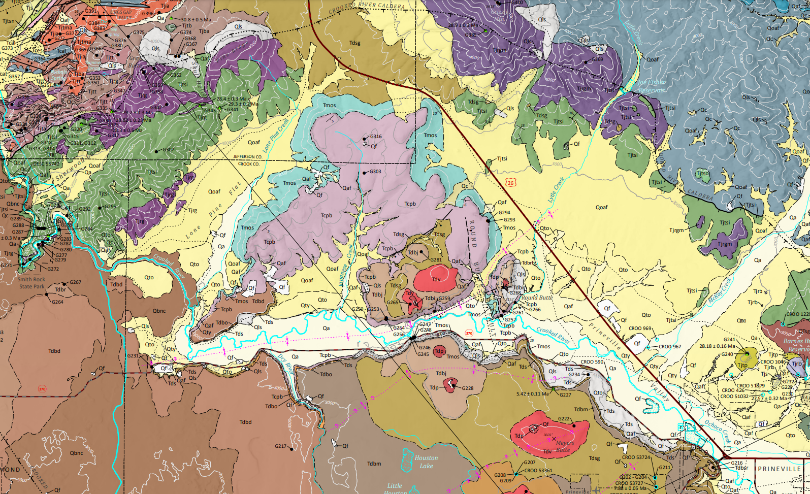
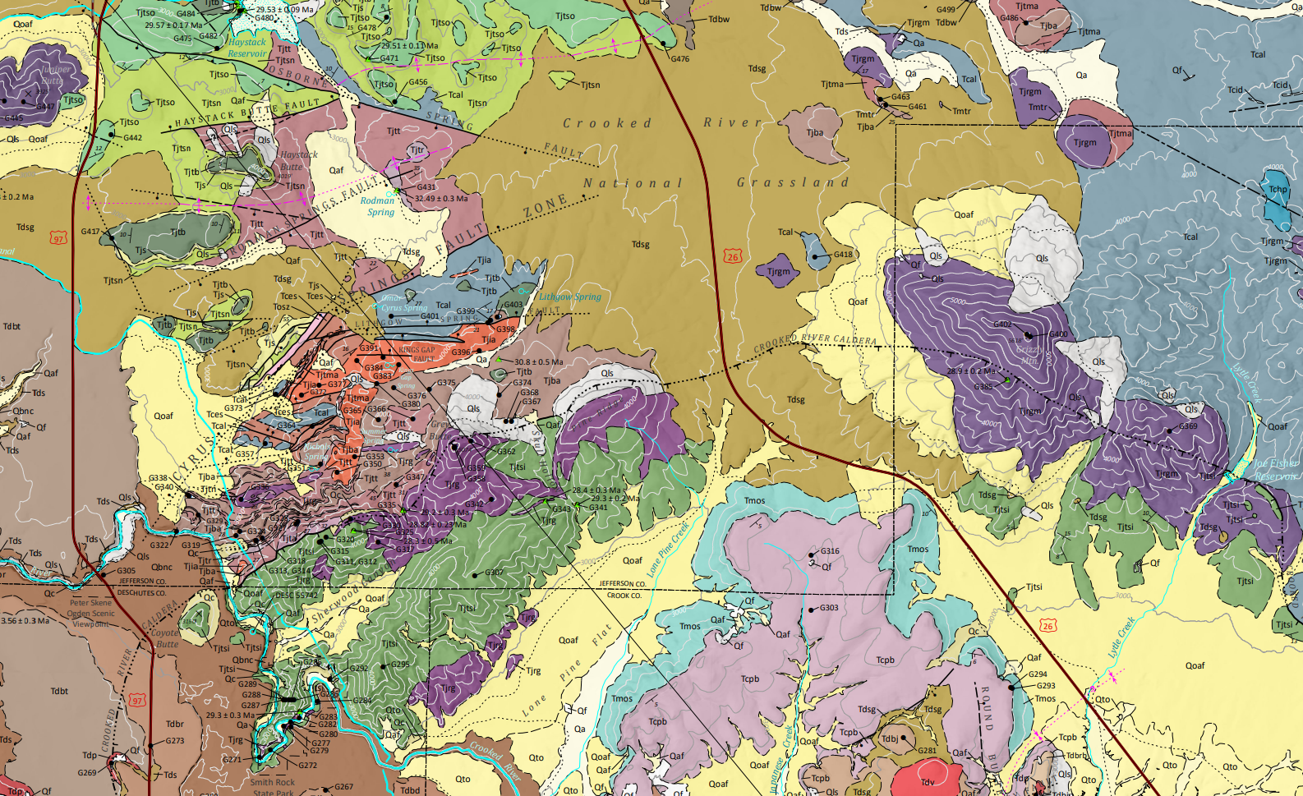
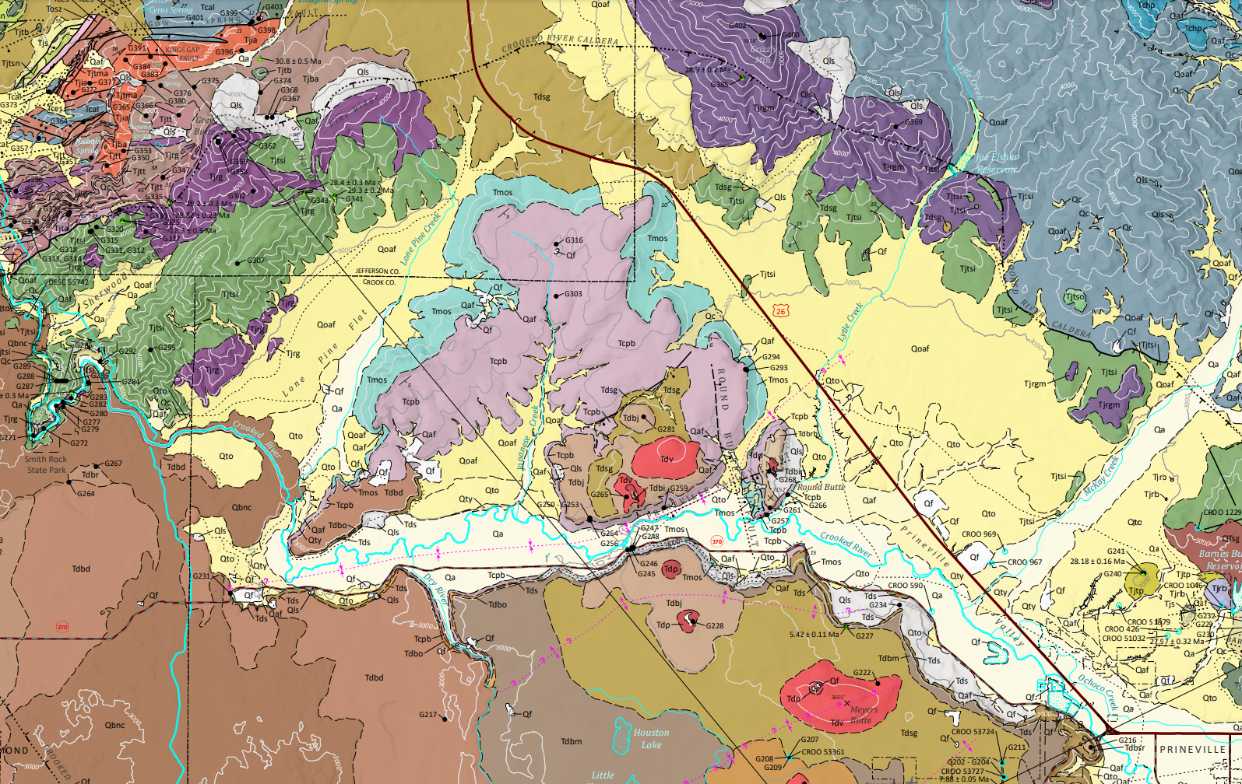
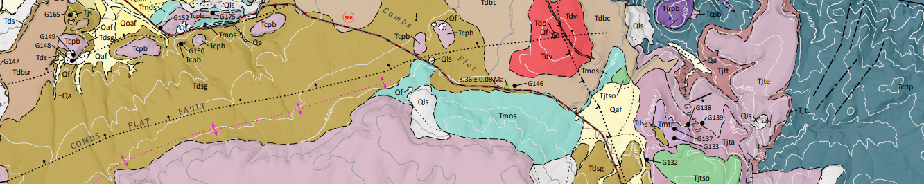


Grassy Mountain Technical Review Team (TRT) Meeting
Oregon Department of Geology and Mineral Industries
August 24, 2023
Dayne Doucet
Consolidated Mining Permit Lead

Slide 2
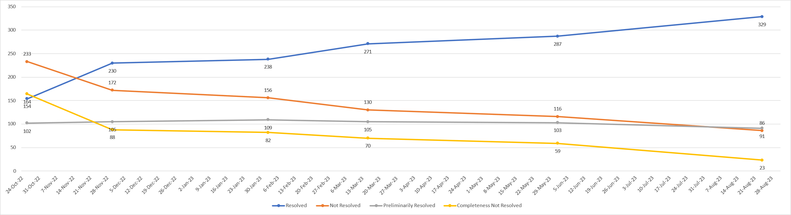
Consolidated Permit Application (CPA) Comments

Slide 3
Consolidated Permit Application Comments
Unresolved Comments Necessary for Completeness
Agency | # Agency | # Applicant | Total (as of 8/3/23)
DEQ | 11 | 1 | 12
ODFW | 0 | 6 | 6
USFWS | 0 | 11 | 11
TOTAL | 11 | 17 | 29

Slide 4
Consolidated Permit Application Comments
Unresolved Comments Necessary for Completeness
Agency | # Agency | # Applicant | Total (as of 8/23/23)
DEQ | 12 | 0 | 12
USFWS | 11 | 0 | 11
TOTAL | 23 | 0 | 23

Slide 5
Study Areas
Notes:
During the last TRT meeting, we discussed study areas; however, I only shared a map outlining the permit area. While many of the study areas match the permit area, some do not. Therefore, I would like to show the various study areas now.

Slide 7
February 19, 2020 letter to Calico
Scope of Completeness Review
Function of the completeness review
  Ensure permit is not denied simply for lack of information
Clear and thorough guidance
  Permitting Agencies
  Cooperating Agencies
Notes:
The function of the completeness review within the Consolidated Permitting Process for Chemical Process Mining is to help ensure that a permit is not denied simply for lack of information. Information required by statue or rule, and information requested from the applicant during the pre-application phase, must be both present and sufficient for the CPA to be complete.
DOGAMI provided clear and thorough guidance to permitting and cooperating agencies for their evaluation of the completeness of the submitted CPA. Permitting agencies were requested to review the CPA for the presence of information sufficient to make a permitting decision. Cooperating agencies were requested to review the CPA for information sufficient to draft conditions for inclusion in the consolidated permit.

Slide 8
February 19, 2020 letter to Calico
Scope of Completeness Review
  DOGAMI conducted independent review
    Category 1
    Category 2
    Category 3
    Category 4
Notes:
DOGAMI also conducted an independent review of the application for completeness, and collected and organized comments from agencies using a common framework for categorization:
• Category 1: missing required information.
• Category 2: incomplete elements, lack of detail, or contradictory information.
• Category 3: technical aspects of the application or project of concern but beyond the scope of the completeness review that may be addressed now or during permit drafting.
• Category 4: organizational issues or confusing elements that hinder DOGAMI and its partner agencies’ ability to assess the project.

Slide 9
February 19, 2020 letter to Calico
Primary Concerns
  Baseline Data Reports
  Reclamation and Financial Security
  Tailings and Waste Rock
  Water Resources
  Hazardous Materials, Safety, Accident Prevention, and Emergency Response
  Project Description
  Wildlife and Vegetation

Slide 10
CPA Completeness
The CPA will be considered complete once all Category 1 and 2 comments are resolved.
DOGAMI will begin drafting the Notice to Proceed (NTP) and share a draft at the next TRT meeting.
The NTP will have language concerning the stopping of the 225-day and 1-year clock if additional information is required from the applicant.
The TRT will have an opportunity to formally accept the CPA as complete and review the NTP before it is issued.

