Slide 1
How to Make a Hazardous Substance Payment
Presentation to taxpayers and tax preparers
2023

Slide 2
Payment Options for Hazardous Substance
To learn about the payment you wish to use, select the link to jump directly to that payment method.
Checking or Savings
Credit/Debit Card
Mailing
Notes:
To change graphic icon, click on the icon, then right-click, select “Change Graphic” and select “From Icons,” choose your new icon and insert it into the slide.

Slide 3
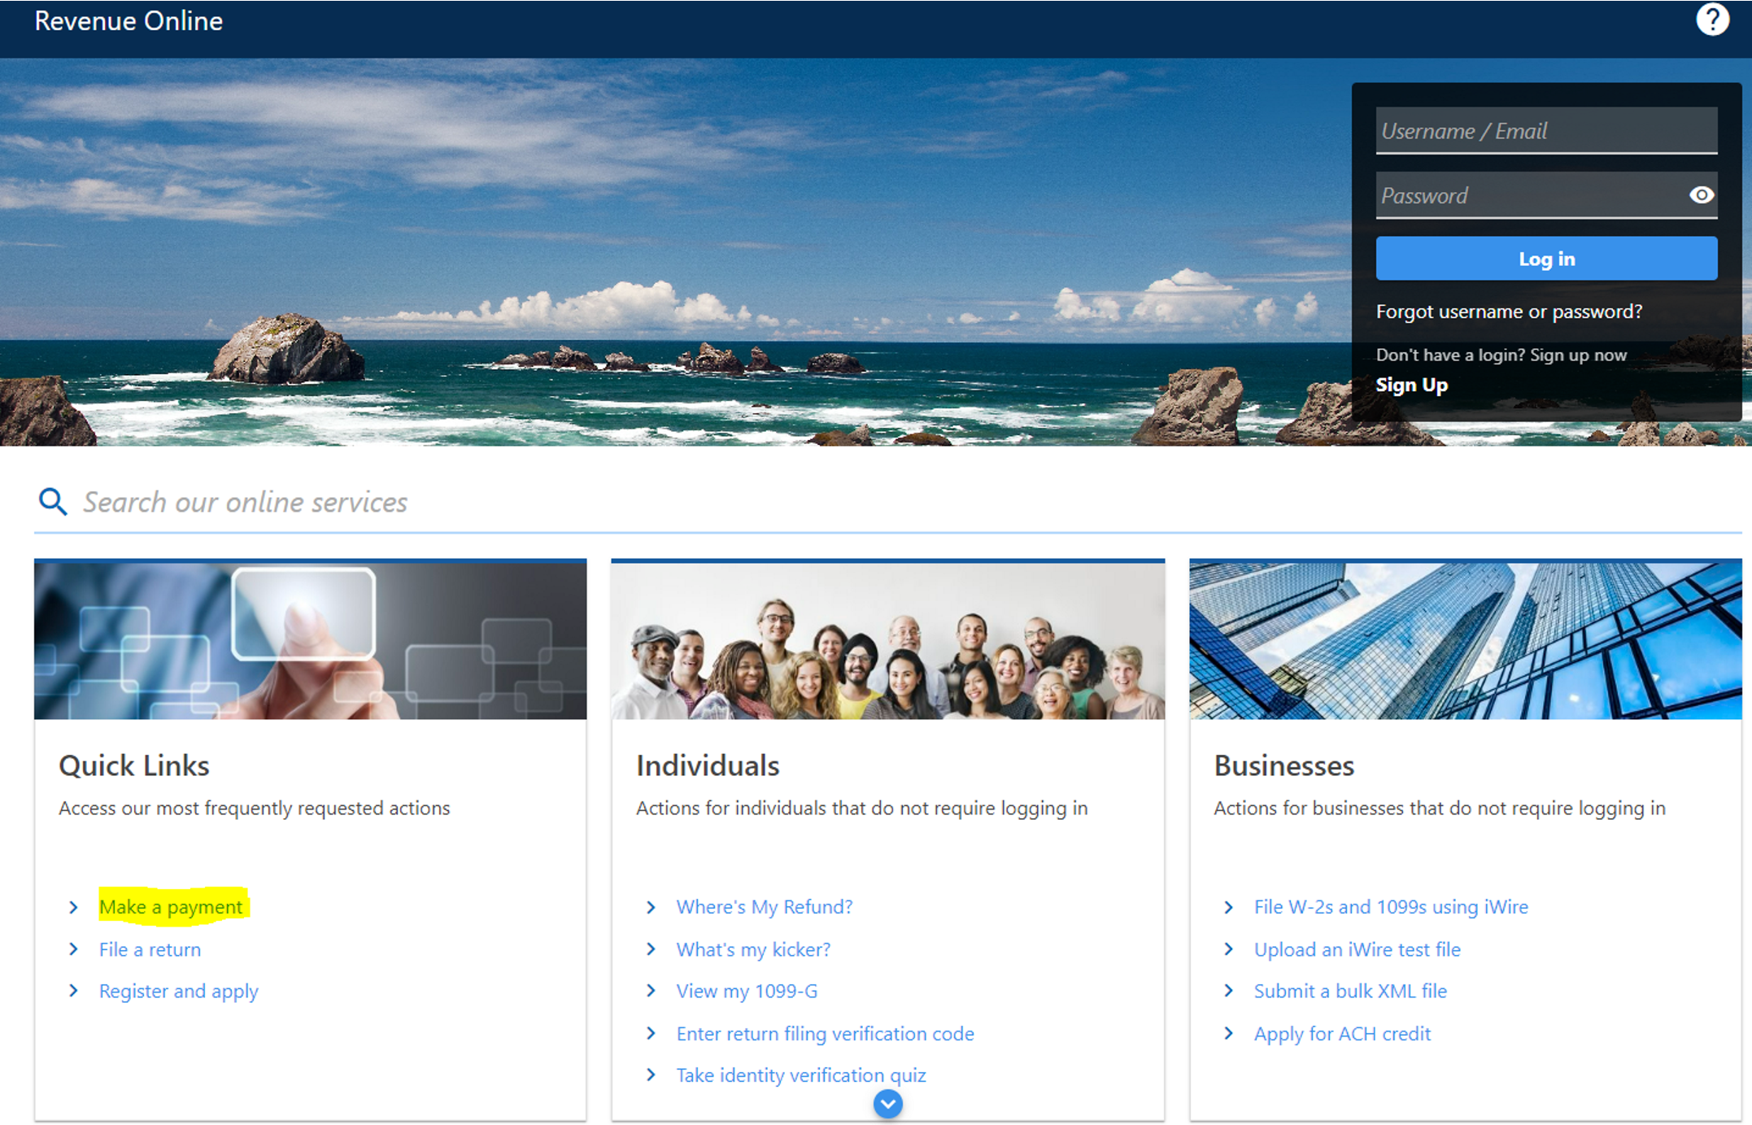
Payment by Checking or Savings
Select Make a payment link on the Revenue Online home screen.
Notes:
To change graphic icon, click on the icon, then right-click, select “Change Graphic” and select “From Icons,” choose your new icon and insert it into the slide.

Slide 4
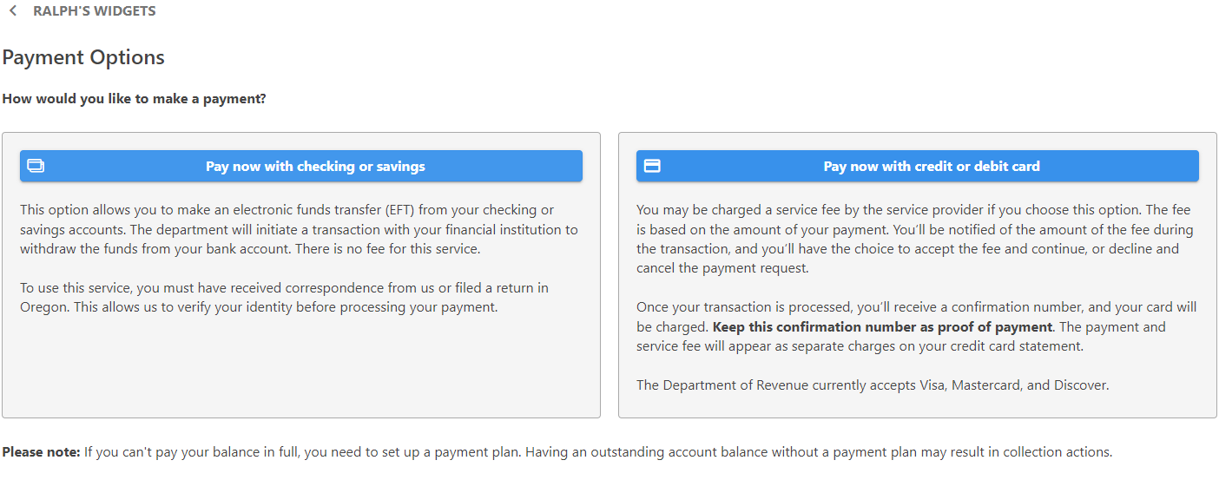
Checking or Savings Payment Option
To make a payment with your checking or savings account select Pay now with checking or savings.

Slide 5
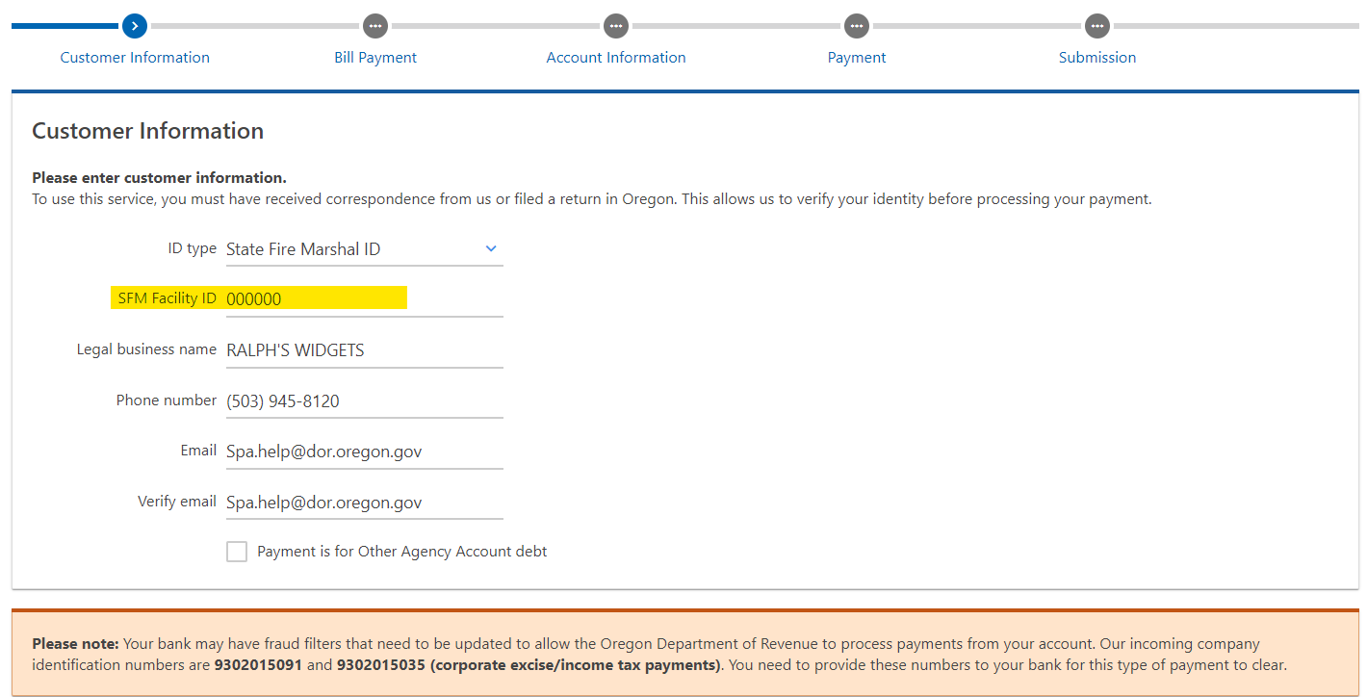
Customer Information
Use your State Facility ID number or your Federal Employee Identification Number (FEIN).
NOTE: Your bank may have fraud filters that need to be updated to allow the Department of Revenue to process payments from your account. Please provide your bank our incoming company identification number. The number for Hazardous Substance is 9302015091.

Slide 6
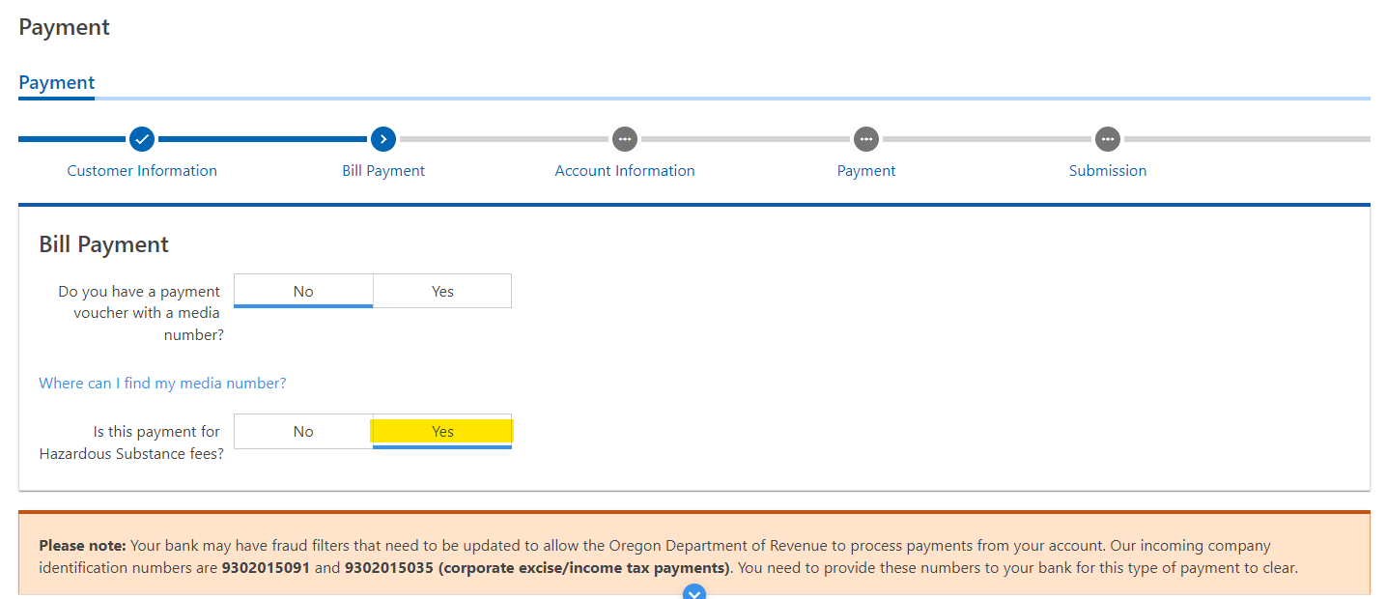
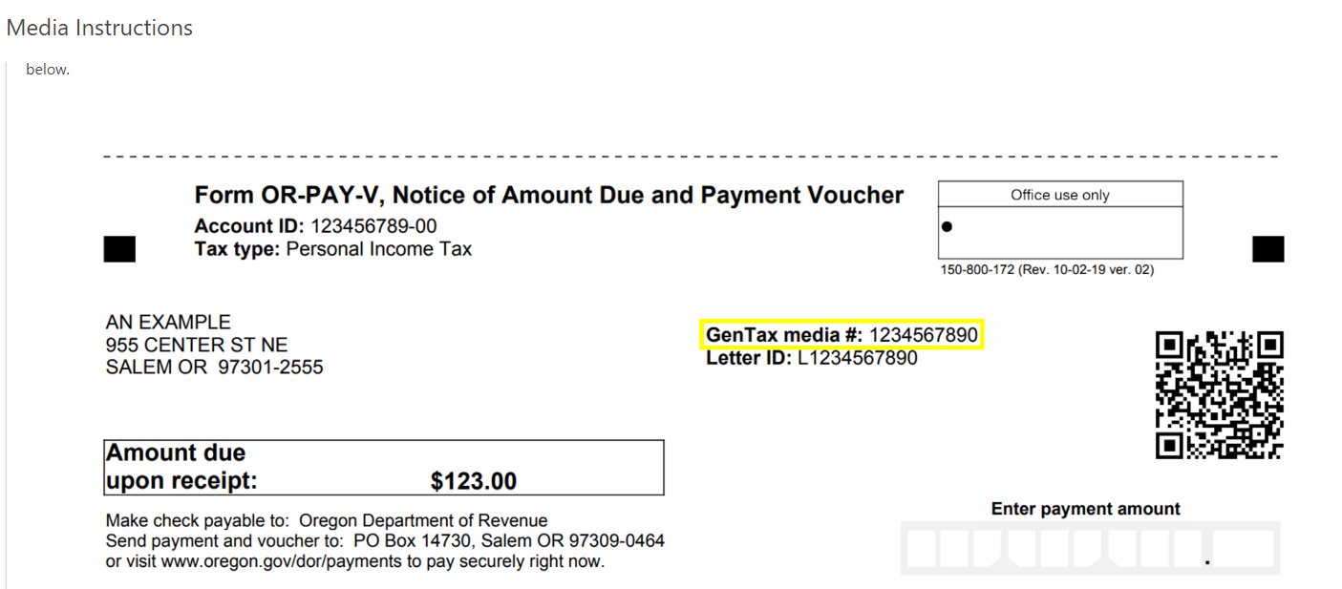
Bill Payment
If you don’t have your media number, you can still process your payment.
Select Yes, for a Hazardous Substance Fee Payment.
Your Gentax media number is found on your payment voucher.

Slide 7
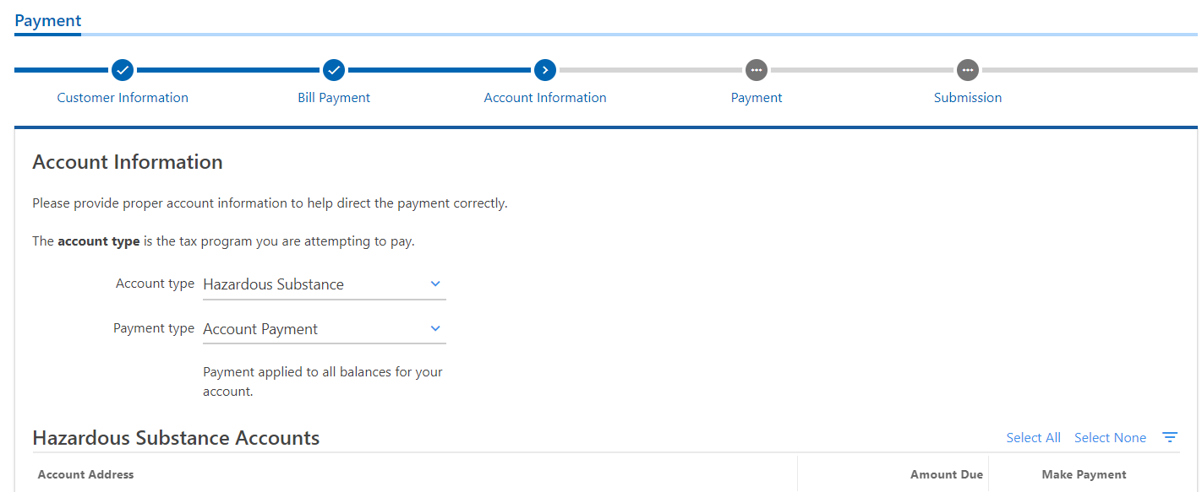
Account Information
Select Account Payment as your payment type.
The checking and savings payment method allows you to view and make payment(s) on one or multiple facilities. A list of facilities will be provided below under Account Address.

Slide 8
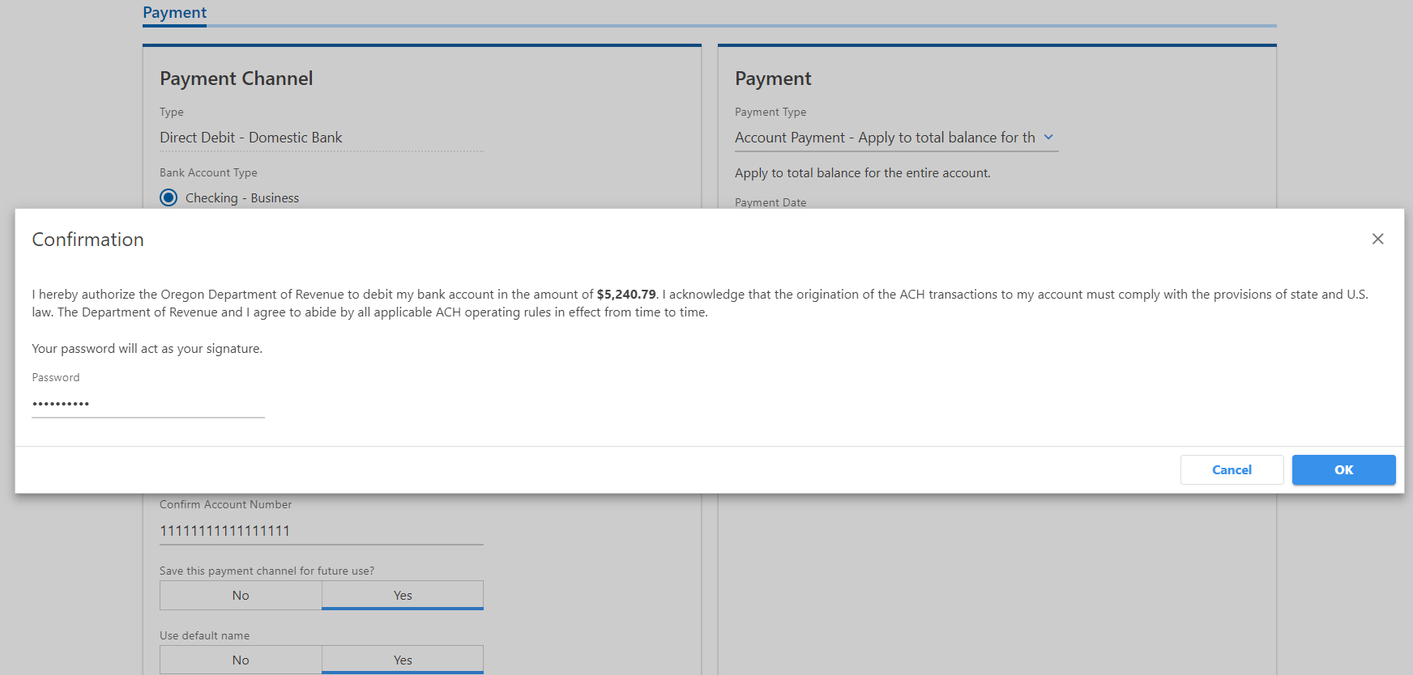
Payment and Confirmation
Enter your payment account information in the Payment Channel. Once entered you will submit the payment. You will receive a confirmation number once your credit card payment has been submitted.

Slide 9
Payment by Credit or Debit Card
Select Make a payment link on the Revenue Online home screen.
Notes:
To change graphic icon, click on the icon, then right-click, select “Change Graphic” and select “From Icons,” choose your new icon and insert it into the slide.

Slide 10
Credit or Debit Card Payment Option
To make a payment with your credit or debit card select Pay now with credit or debit card.

Slide 11
Customer Information
Use your State Facility ID number or your Federal Employee Identification Number (FEIN)
NOTE: Your bank may have fraud filters that need to be updated to allow the Department of Revenue to process payments from your account. Please provide your bank our incoming company identification number. The number for hazardous substance is 9302015091.

Slide 12
Bill Payment
The media number is not required to make a payment. If you don’t have one, select no.
Your GenTax media number can be found on your voucher.

Slide 13
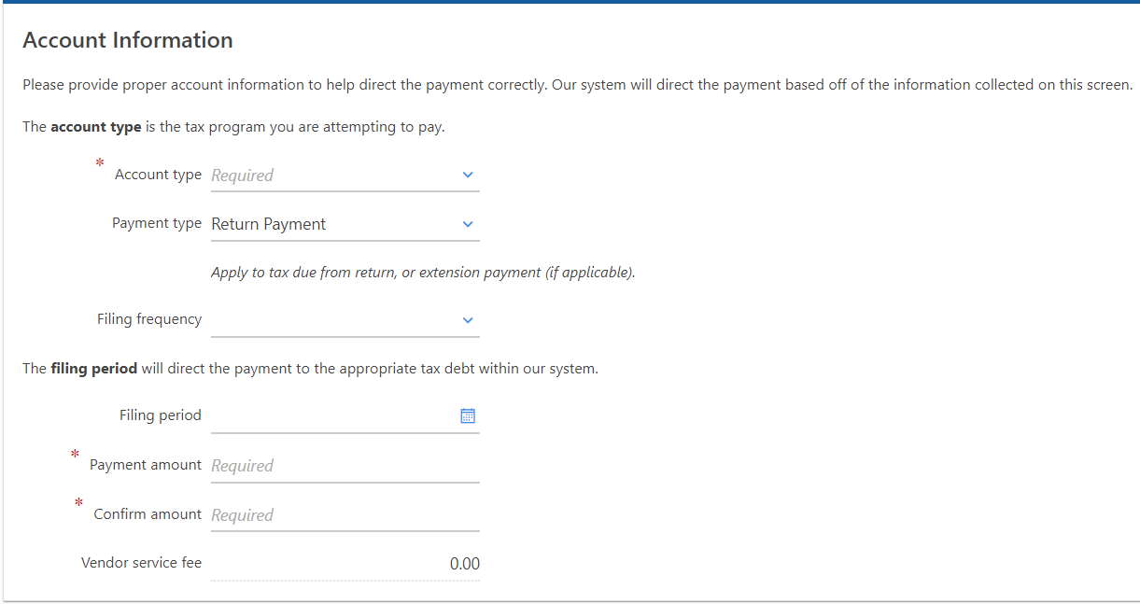
Payment Information
Account type – select Hazardous Substance.
Filing Period – will be found on your letter.
Enter the Payment amount and then confirm the payment by entering the payment again in Confirm amount.

Slide 14
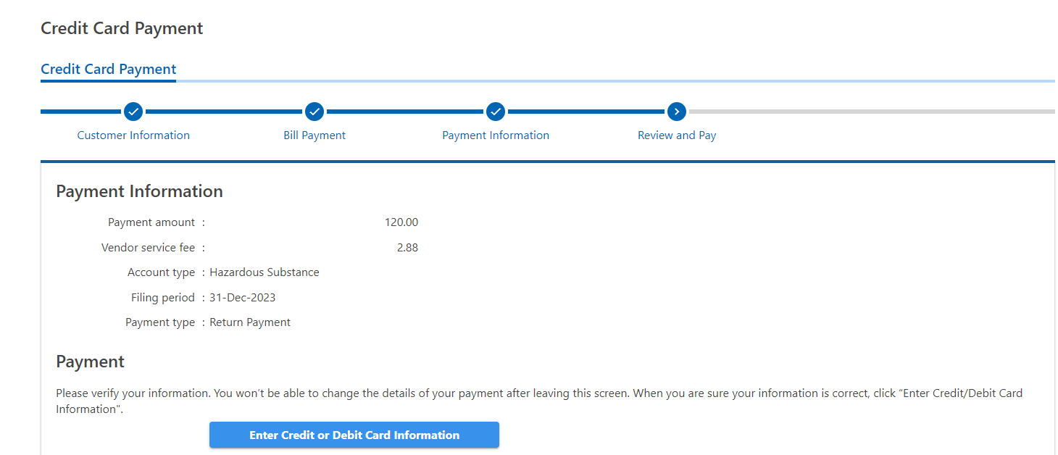
Review and Pay
There is a vendor service fee for credit/debit card payments. Currently, the fee is 2.4%.
Enter your payment account information in the Payment Channel. Once entered you will submit the payment.

Slide 15
Confirmation
You will receive a confirmation number once your credit card payment has been submitted.

Slide 16
Mailing
Use the voucher provided from the statement of account to submit with your payment.

Slide 17
Multiple Facilities
If you are paying for multiple sites, you’ll need to submit a spreadsheet with the following information:
Each site’s location/address.
Each site’s Oregon State Fire Marshal facility ID number.
Fee amount you’re paying for each site.
Total amount of your payment.

Slide 18
Mailing Address and Questions
Mail your payment to :
Department of Revenue
PO Box 14725
Salem OR 97309-5018
If you have additional questions, please contact us:
Email: Spa.help.dor@oregon.gov
Phone: 503-945-8120
Available between 8 a.m. and 4 p.m. Monday – Friday

