Slide 1




Best Practice in Addiction Treatment
The Continuum of Care Model
Presented by Director of Operations Eli Kinsley, MSW, LCSW, CADC III, CAGC II

Slide 2
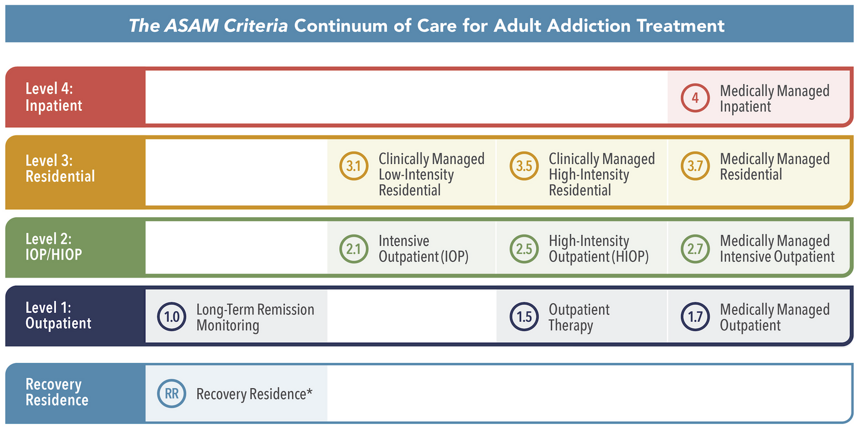
What is a Coninuum of Care in Addiction treatment?
The continuum still includes four broad treatment levels (1 through 4).
  Outpatient
  Intensive Outpatient
  Residential
  Inpatient

Slide 3
Why is the Continuum of Care the best practice?
Individualized Treatment:
Comprehensive Approach
Reduced Risk of Relapse:
Better Engagement:
Holistic Support:
Evidence-Based Outcomes:
A continuum of care allows for personalized treatment plans that can adapt to an individual's changing needs throughout their recovery journey. This flexibility helps ensure that patients receive the appropriate level of care at each stage.
Addressing the multifaceted nature of addiction—medical, psychological, and social—helps to treat the whole person rather than just the symptoms of addiction. This comprehensive approach can lead to more effective outcomes.
Continuous support and care help to maintain engagement in recovery, reducing the likelihood of relapse. Aftercare and ongoing support are critical for individuals transitioning back into everyday life.
A continuum of care fosters ongoing engagement with treatment services, making it easier for individuals to access help when they need it most. This reduces barriers to treatment and encourages individuals to stay connected with support systems.
A continuum of care fosters ongoing engagement with treatment services, making it easier for individuals to access help when they need it most. This reduces barriers to treatment and encourages individuals to stay connected with support systems.
Research indicates that individuals who receive a continuum of care experience better treatment outcomes, including higher rates of sobriety and improved quality of life.

Slide 4




An even better best practice...
Integrated co-occurring treatment model
Addresses multiple behavioral health disorders, such as substance use and mental health conditions, simultaneously within a single framework, rather than in separate, disconnected treatment plans.
Addiction
Mental Health
Co-Occurring
21.5Million
Adults in the United States have a co-occurring disorder.
6%
Only 6% of those with co-occurring disorders received integrated care.
4 out 5
Oregonians who need treatment for a substance use disorder do not receive it.

Slide 5









Bridgeway’s COC
Medically Managed Withdrawal (Detox)
LOC 3.7
We also offer :
  Primary Care
  Dental Care
  Mental/Co-occurring Care
Residential Care
3.1 LOC
Intensive Outpatient
LOC 2.1
Outpatient
LOC 1
Recovery Residences

Slide 6


