Slide 1


Addiction Treatment, Workforce Successes & Challenges
Sommer Wolcott, LPC, CRC Executive Director, Continuum
Formerly OnTrack Rogue Valley

Slide 2
Agency Overview
We are currently changing our name from OnTrack to Continuum.
We are a non-profit, located in Southern Oregon, serving Jackson and Josephine County.
Approximately 180 employees spread across our multiple sites
Staffing is approximately 25 peers, 30 CADC, 12 QMHP, 5 Child Care teachers, 60+ direct care/milieu staff, and a sprinkle of admin, facilities, IT, and other roles.

Slide 3


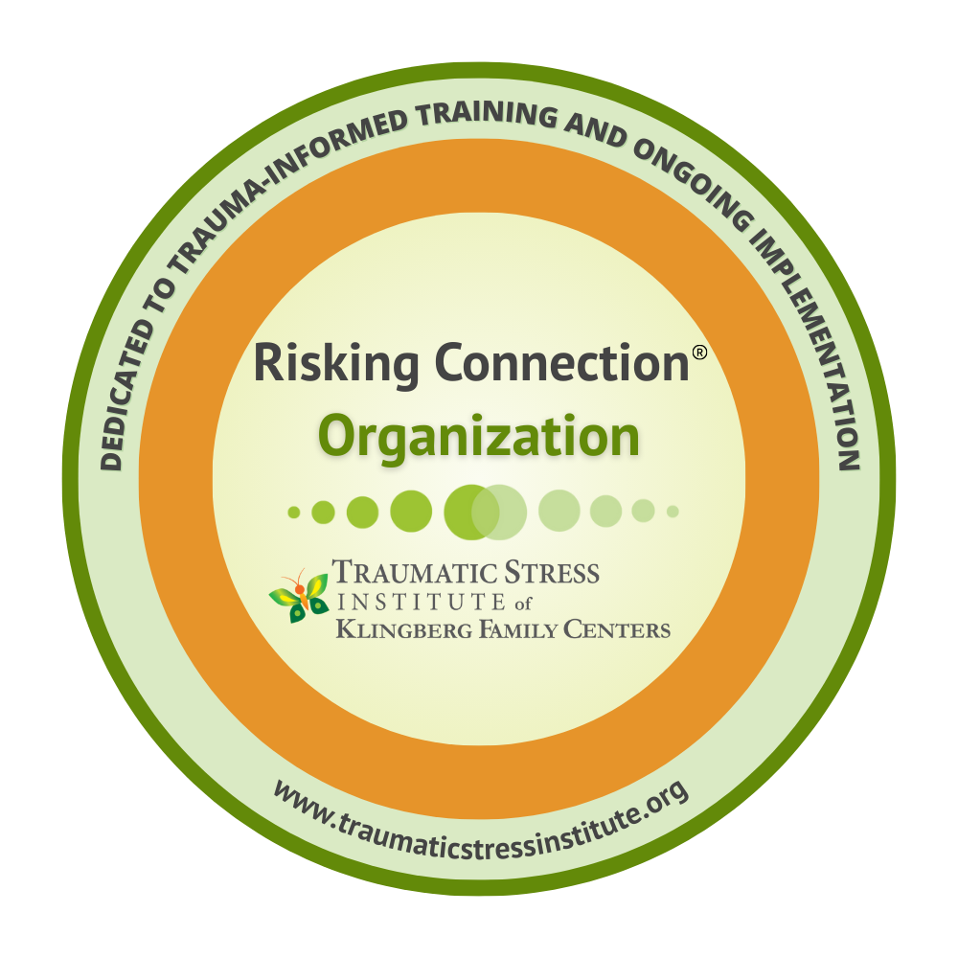
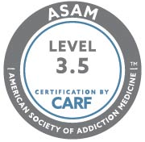

Certifications and Accreditation
Program Quality & Compliance
Employee Perspective
Treatment Philosophy & Culture

Slide 4
Programs & Services
School Based Prevention
Mobile Outreach, Intake, and Assessment (jails, hospitals, etc.)
DUII, MIP, Anger Management Classes
Outpatient & Intensive Outpatient for SUD, Mental Health, & Co-occurring for Teens and Adults
  Three Clinics (Medford, Grants Pass, Cave Junction)
  Child watch on site
Day Treatment for people with severe mental illness, SUD, and Forensic involvement (aid & assist)
Three SUD Residential Treatment Programs:
  21 Mom’s with children ages 0-5 with licensed childcare center on site.
  10 Dad’s with children ages 0-5
  16 Adults-all genders
Latino/Spanish services : Peer Support, DUII, Outpatient, intensive outpatient, child watch, emergency lodging, transitional housing, permanent housing. Residential is coming soon.

Slide 5
Programs & Services Continued
Emergency Lodging: For people who are unhoused and on waitlist for residential treatment or detox
  Four locations totaling 40 single occupancy beds
  Low barrier, does not require abstinence
Transitional Housing for adults and moms & dads with children
  For people graduating from residential treatment
  Four houses plus 2 apartments totaling 30 beds
Second Chance, affordable, permanent housing
  9 locations 187 units

Slide 6
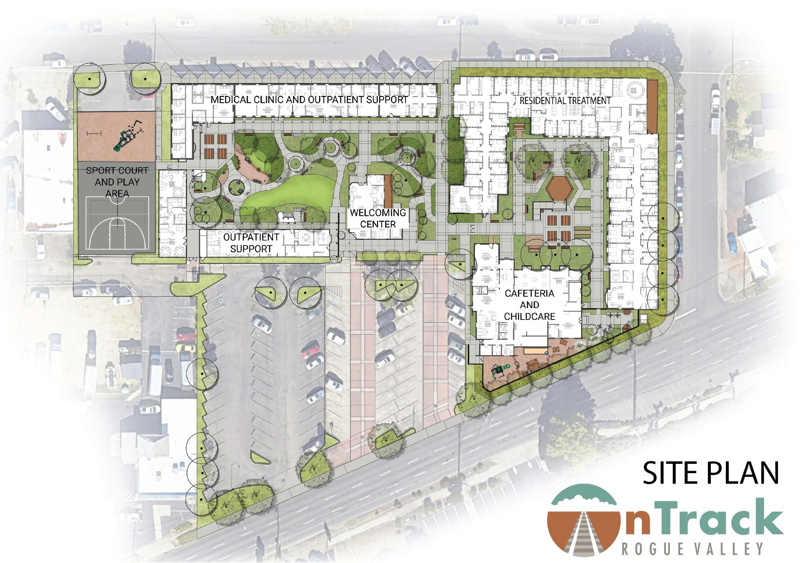
Family Treatment campus
Whole campus/whole family approach to interrupt the intergenerational cycle.
Residential treatment for mothers (28) and fathers (16) with children
Licensed childcare
Full continuum of family centered outpatient support including early childhood, parenting, family reunification, SUD, MH, psychiatry, and MAT
Oasis clinic on site for primary care, pediatrics, prenatal, and MAT support
Opening Fall of 2026

Slide 7
OnTrack Peer and Counselor Education: On-PACE
In 2021 we were fully operating and open (in-person) and had 50% of our positions open. We were desperate and created a workforce training program to attract people to our direct care staffing roles (residential treatment).
No experience needed, work full time in one of our programs, then you can apply for On-PACE.
If accepted, we provide all the classroom training, treatment manuals, and supervision needed to become a CADC.
They earn full time salary and benefits and have support in gaining credentials.
It worked. Almost every applicant for non-credentialed roles from reception/office support to direct care are all interested in On-PACE.

Slide 8
Basics
Work 90 days in current role, apply for On-PACE.
New cohorts start every 6 months (Spring and fall).
First 6 months, continue working current role in current program, with an adjusted schedule that allows for trainings all day on Wednesdays.
Trainings are core/foundation CADC trainings facilitated by local community experts and leaders.
  Clinical directors and leaders from La Clinica, Kolpia, Phoenix Counseling, Community Justice, Oasis, Kairos, Jackson Care Connect, Private Practice counselors, etc. The community was all in for training.
End of 6 months, performance evaluation, move to clinical experience placement in either outpatient or residential.
Attend Trainings every other Wednesday. Trainings shift to focusing on clinical skills and modalities.
End of that 6 months, performance evaluation, move to new clinical placement (either outpatient or residential.

Slide 9
Basics Continued
Each participant works as a CADC-R approximately 6 months in Residential and 6 months Outpatient to give them broad experience.
80% of participants also have an off-site placement 1 day per week for at least 6 months. Placement sites include low barrier medical clinics, public health, schools, and community justice locations.
Cohorts have monthly clinical supervision meetings facilitated by a wide range of clinical supervisors.
Graduation ceremonies are held every March and October.

Slide 10
It works!
Cohort 6 is graduating in October, Cohort 7 and 8 are working as CADC-Rs in their placements (there are always 3 going at the same time). 37 people are currently enrolled in the program with 18 of them working as CADC-Rs.
Our 9th Cohort Just met for orientation
25 people have passed their CADC exam (24 passed on their first attempt).

Slide 11
Demographics and Data
Demographics
BIPOC | 27%
Hispanic | 23%
LGBTQ+ | 19%
Bilingual (Spanish) | 9%
None of above | 50%
Total Participants | 64
Previously unhoused | 43 | 67%
Lived experience SUD | 47 | 73%
Lived Experience MH | 46 | 72%
Both MH & SUD | 36 | 56%
None of the above | 4 | 6%
Convicted of a crime | 30 | 47%

Slide 12
Community partner participation
Total Scholarships | 13
Previously unhoused | 9 | 69%
Previously SUD | 10 | 77%
Previous MH | 12 | 92%
None of the above | 1 | 8%
BIPOC | 4 | 31%
Hispanic | 3 | 23%
LGBTQ+ | 4 | 31%
All classes are open to outside participants for CEUs at a very low cost. Classes are attended by mental health counselors, school counselors, and CADCs.
We had grant funding to offer scholarships to community partner agencies staff. This funding was cut from this round of M110.
13 total scholars received all the classes, text books, treatment manuals, and a stipend. Demographics were consistent and similar.

Slide 13
Lessons Learned/What worked well?
Key components of our program that are highly successful:
  Mapping classes to MHACBO requirements for CADC and creating a cross walk for participants.
  Tapping into community leaders to facilitate classes so people learn the clinical skills, not just how to be an employee at our agency.
  Provide corresponding manuals/books (Diagnosis class=participants get DSM V).
  MHACBO approved CEU’s allows internal staff and community partners to attend classes for CEUs.
  Intensive supervision at placement sites, group supervision from agency leaders, and a dedicated training coordinator.
  Offering each training/class 2x per year.
  Formal graduation ceremonies where family is invited, we get them graduation caps and have instructors speak, etc. Many of the graduates haven’t had the opportunity to “graduate” from something like this in the past.

Slide 14

Struggles/Challenges for implementation
Online, non-interactive trainings are not a substitute for in-person classes. People who miss the in-person classes quickly fall behind on their clinical skills even when taking make up trainings online.
It is costly to hire trainees since most can’t work independently for several months.
Supervision is intensive and difficult to schedule in our fee-for-service programs (meeting with trainees means the supervisor and trainee are not billing).
You really need a dedicated person to schedule trainers, wrangle to trainees, and manage the calendars.
Low wages for supervisors and managers means our clinical supervisors have limited experience and these are some of our highest turnover positions.
Offering the classroom trainings without the clinical supervision/practical hours creates issues as many agencies can’t support the trainees with clinical supervision.

Slide 15
Registered apprenticeship is all cost/no benefit.
The registered apprenticeship through BOLI is out of sync with behavioral health and so cumbersome that we will not apply for any funding that requires we stay in the registered apprenticeship. We left 150k per year for the next 4 years on the table rather than continue having the added cost of the apprenticeship.
The standards and portals are very difficult to use and require a dedicated staff to learn how to translate minutes and actions into codes. My smartest, most competent staff describe it as the most cumbersome, time consuming, busy work they have experienced.
Data entry requirements are extensive and not relevant.
Developing standards that are separate from policies and procedures and categorizing them to fit into a system that was designed for the construction trades is challenging and problematic.
It is not designed for agencies that are the employer and the training agent. Since we are both, it is incredibly confusing for the participants and staff. Training agents have to be supervisors, employees are not supposed to be training agents, and our supervisors are employees. The requirements for committee meetings mean delays and confusion for trainees.
To become a CADC, people need 1000 hours, but the apprenticeship requires 2000 hours. It also requires a committee to meet, put the trainee on “hold” then approve them to register to test. If people are ready to test before having their 2000 hours, they have to drop out of the apprenticeship and dropouts impact our standing.
For our trainees that are advanced/skilled, I pull them out of the On-PACE program so they can avoid the 2000-hour apprenticeship. They attend all the trainings but are not officially in the program, so they are not delayed in their testing.

Slide 16
Biggest Barriers for Behavioral Health Workforce:
1. Pay. We can’t keep pace with inflation and pay a professional level salary. We can hire entry level staff, but we can’t hire managers or compete with private practice for licensed providers.
2. We need predictable, sustainable funding to hire enough staff to provide reasonable work hours and work loads.

Slide 17
Biggest impact changes:
Medicaid rate increases.
The last increase was in 2022 and that caught us up to barely breaking even.
Inflation, wages, benefits have all increased and we operated at a loss last year.
Increases should be focused on core services even if hard decisions have to be made regarding add-ons (like HRSN)
M110/OAC:
Funding decisions were a missed opportunity to invest millions of dollars strategically. Waiting four years to intervene may not be possible.
CCO Reform & Accountability is critical to sustainable programs.
  They each require their own separate process for reporting on:
  THWs
  Language access
  Provider lists
  Credentialing and which providers they will allow
  DMAP Billing codes that they will pay
  Utilization
  Notification of treatment
  Annual trainings
  The CCO problem is impacting workforce, increasing cost, and having a detrimental impact on programs.

Slide 18
Thank you!
Please save the world and fix everything.

