Slide 1

Mental Health Landscape in Oregon
Amy Baker, MSW
Behavioral Health Initiative Director

Slide 2

Continuum of Mental Health Care in Oregon
Oregon State Hospital
(Forensic & most intensive care)
Acute inpatient
(Hospital psych units, crisis stabilization)
Residential & Subacute
(Foster homes, subacute youth, secure treatment, residential home/ facility)
Intensive Outpatient & Wraparound
(ACT, IOP, PHP, youth wraparound)
Crisis Services
Community-Based Outpatient
(Therapy, psychiatric medical care, peer support)
Prevention & Promotion
(Crisis lines, school supports, primary care screening)

Slide 3
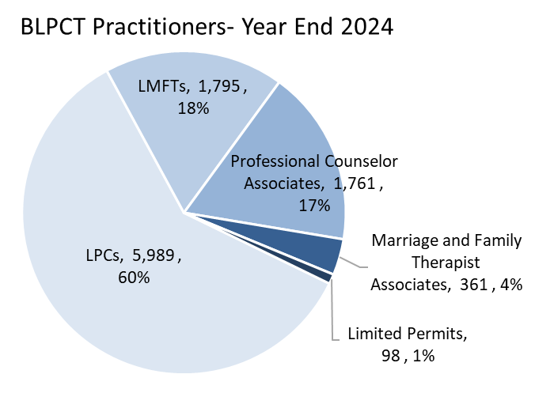
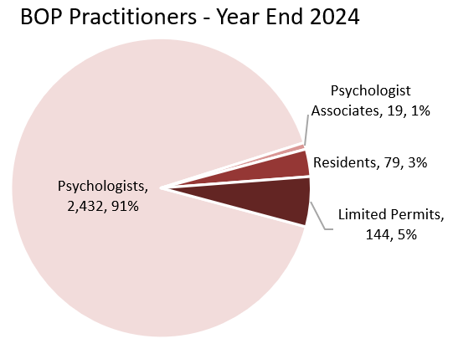
Practitioners by Type

Slide 4
Licensure Qualifications
 | Education | Experience | Examination
Psychologist | Doctoral Degree in Psychology | Pre-Degree: Supervised Practicum + Internship (1 year, 1,500 hours) Post-Degree: Residency (1 year, 1,500 hours) | Examination for Professional Practice in Psychology Oregon Jurisprudence Exam
Licensed Professional Counselor (LPC) | Master’s Degree | Supervised Experience (3 years, 1,900 direct client contact hours) 1 year and 400 hours of the above may be pre-degree | National Counselor Examination or National Clinical Mental Health Counselor Examination or Certified Rehabilitation Counselor Exam Oregon Law & Rules Exam
Licensed Marriage and Family Therapist (LMFT) | Master’s Degree | Supervised Experience (3 years, 1,900 direct client contact hours) 1 year and 400 hours of the above may be pre-degree | Marital and Family Therapy examination (AMFTRB) or California BBS MFT Written Clinical Examination Oregon Law & Rules Exam

Slide 5
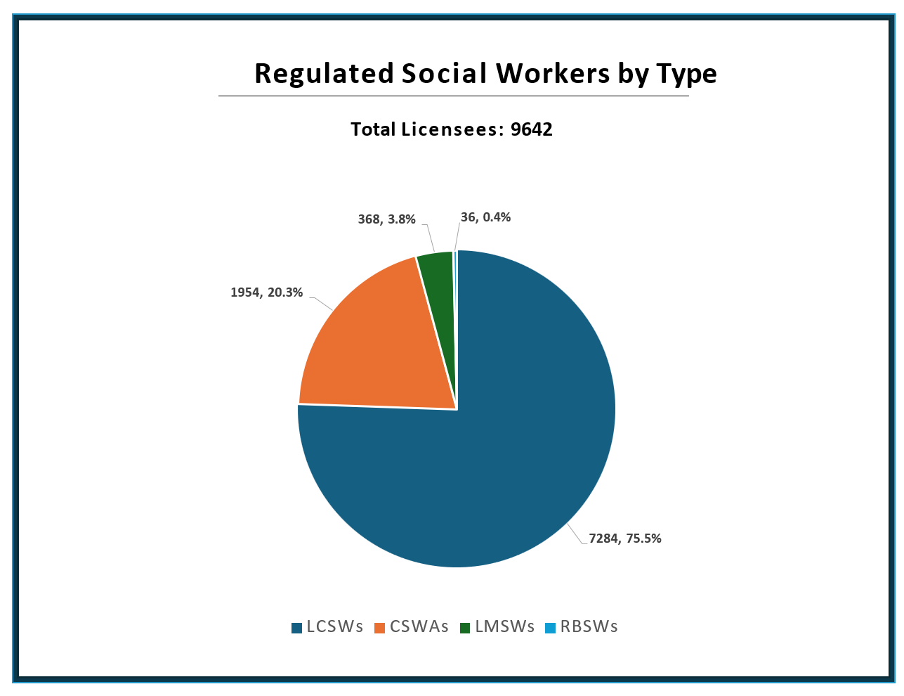

Slide 6
Licensing Requirements
LCSW:
Master’s degree in social work
Post MSW clinical experience:
100 supervision hours
3500 practice hours, including 2000 direct contact hours
Passing exam scores:
Oregon rules and laws exam
ASWB clinical exam
Background check
Application and associated fees
CSWA:
Master’s degree in social work
Board approved plan of supervision
Passage of Oregon rules and laws exam
Background check
Application and associated fees

Slide 7
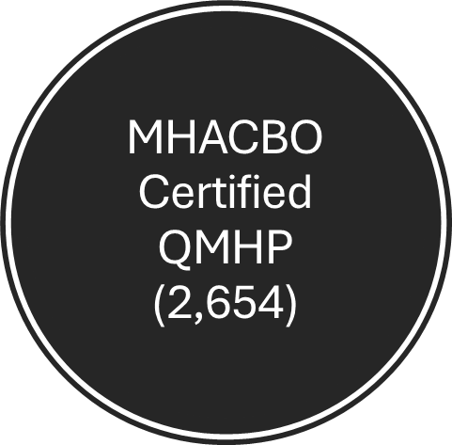
QMHP | QMHP-R (Registered Intern) Masters Degree in Behavioral Health (or RN license) Supervisory Competency Assessment | QMHPC 1,000 Supervised Clinical Hours Supervisory Comprehensive Competency Assessment NBBHP Professional Psychometric Exam

Slide 8
MHACBO Certified QMHA (6,101)
QMHA | QMHA-R (Registered Intern) A Bachelors degree in behavioral or an equivalent combination of education and experience Supervisory Competency Assessment | QMHA-I 1,000 Supervised Clinical Hours Supervisory Comprehensive Competency Assessment NBBHP Professional Psychometric Exam | QMHA-II 4,000 Supervised Clinical Hours Supervisory Comprehensive Competency Assessment NBBHP Advanced Practice Professional Psychometric Exam

Slide 9
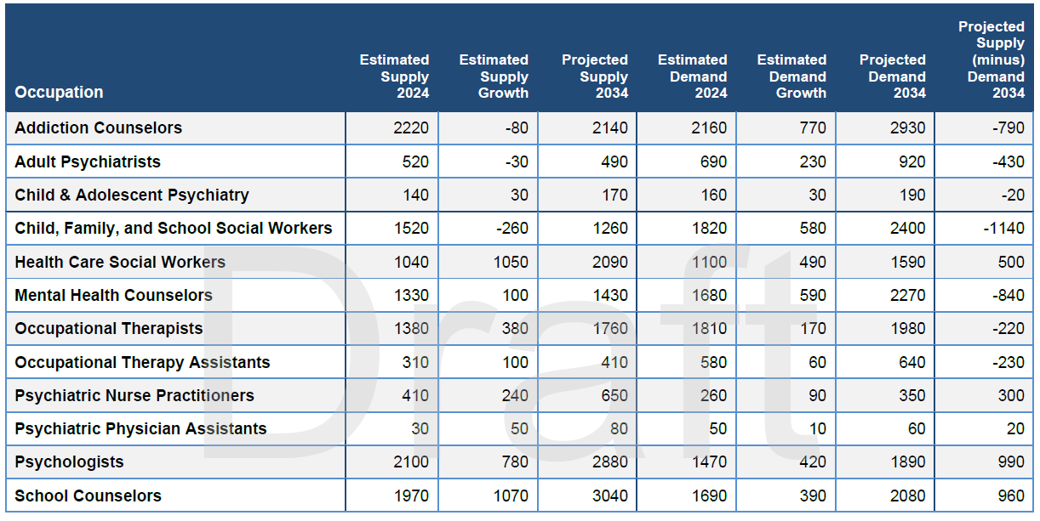
Supply and Demand for Selected BH Occupations

Slide 10
Questions?

