Slide 1
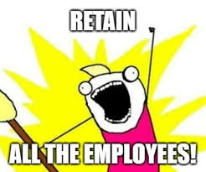
New Narrative Successful Personnel Strategies BHTC Council Meeting 10.9.25
Notes:
Good afternoon everyone. For those of you who don’t know me, my name is Julie Ibrahim, she/her prounouns, and I’m the CEO for New Narrative as well as the Co-Chair for this Council’s Recruitment & Retention Subcommittee.
Today, I’m going to share a few of the strategies that we have found to be successful in retaining employees. I’m focusing on retention because we’ve found that successful retention leads to successful recruitment. Many of our new hires come to NN because of word of mouth about our culture, and I'll talk about that in a minute.
But first, a little bit about NN

Slide 2
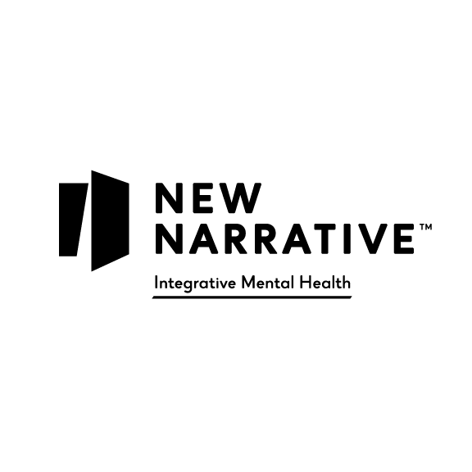
New Narrative: Introduction
Who we are: New Narrative is a non-profit mental health agency providing mental health treatment, peer support, and housing services as well as residential treatment, transitional, supported and independent housing for adults age 18 and older for over 48 years.
Who we serve: Adults and transition age youth with moderate to severe mental health challenges, most of whom receive Medicaid through Care Oregon and Trillium.
Where we operate: Washington and Multnomah Counties

Slide 3
New Narrative: By the Numbers
Number of participants serviced this past year: approx. 2,000
Total beds in residential portfolio: 340
Operating sites: 43 sites spanning from Cornelius in Washington County to Gresham in Multnomah County.
Total staff: 260+
Staff diversity:
Lived experience: 40%
LGBTQIA+: 27%
BIPOC: 44%
Operating budget: $40 million
Notes:
I'll share a few key numbers to give you a sense of our size and scope
We currently service about 2,000 participants each year
We have 340 beds in our residential portfolio spanning almost the entire housing continuum
We have a total of 43 sites spanning from Cornelius in Wash Co to Gresham in Mult Co
Total staff count right now is about 260+
Our staff diversity as voluntarily reported: Lived experience 40%; LGBTQIA+ 27%, and BIPOC 44%. And I'm sure those numbers are larger because some employees chose not to identify with any group

Slide 4
New Narrative: Cultural Transformation
Parent-Child Culture
Fear-based
Authoritarian
Lack of trust in Leadership
No feedback to Leadership or each other
Negativity
High turnover: over 50%
Team Culture
Inclusive and safe
Power sharing
Trust that Leadership has their backs!
Increase in feedback to Leadership & each other
Positivity
Decrease in turnover: Currently at 36%
Notes:
One of the first things I did with my Exec Team when I became CEO was to assess company culture. When I first started at NN (formerly Luke-Dorf) we had what I call a Parent-Child culture characterized by fear, authoritarian leadership, lack of trust in leadership, no feedback to leadership, a lot of negativity and turnover rates over 50%.
So for the last 4 years we’ve been working to transform our culture which has led to a significant decrease in turnover. I call it team culture – with the objective of being inclusive and safe, power sharing, employees trust that leadership has their backs, a significant increase in feedback, much more energy and positivity and a decrease in turnover – to date this year it’s 36%. I still don’t love that number but it’s quickly moving in the right direction

Slide 5
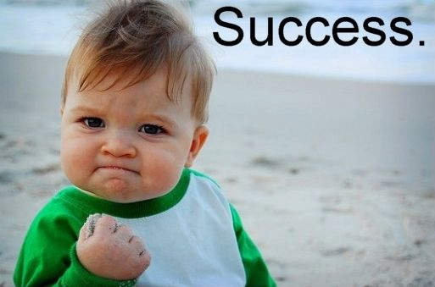
New Narrative: Success Strategies
Employee Support
Communication & Feedback
Relieving Administrative Burden
Team Culture Investments
Notes:
Today I'm going to talk about the three success strategies that I think have contributed to our cultural transformation and employee retention – in the areas of employee support, communication and feedback and relieving administrative burden

Slide 6

New Narrative: Employee Support
Acknowledge that anxiety is prevalent in today’s workforce:
Increase in anxiety by age between 2010-2020*:
Ages 18-25: 139%
Ages 26-34: 103%
Ages 35-49: 52%
Acknowledge and address the sources:
National and world geo/political events
Cost of living
Systemic racism & oppression of marginalized groups
Budget cuts: Federal, State, County
*Source: “The Anxious Generation” by Jonathan Haidt
Notes:
So we started with understanding and acknowledging key things about what I will call the new workforce. And I’ve done a lot of reading/research on this.
A really important thing to know about today’s workforce is that anxiety is prevalent and often all-consuming. The statistics you see here are increases in self-reported anxiety over the decade between 2010 and 2020. This is from the book The Anxious Generation. I was rather stunned by these numbers and it helped me start to understand why our workforce seemed so burdened.
We realized from staff feedback that it is important to today’s workforce to acknowledge and address the sources of their anxiety and how your agency is responding. That these issues actually impact their mental health and performance at work.
[read off]

Slide 7

New Narrative: Employee Support
Support employee identity, inclusion and social needs
New Narrative Affinity Groups:
LGBTQIA+ = 27%
BIPOC = 44%
Lived Experience = 40%
Equity-in-Action (EIA) Committee
Consultants for training re: equity issues
Executive listening sessions with Affinity groups and EIA Committee
Include middle management in strategic planning
Company events that are just about fun!
Notes:
So we quickly came to the conclusion that we needed to support our workforce in a more wholistic way – we found from extensive feedback that employees want support for their identity, they want to be included in decision making and they have a need for community in the workplace.
Especially for our employees of marginalized groups – so we started there
So we have set up affinity groups for LGBTQIA+, BIPOC, and Lived Experience and made it policy that supervisors have to allow employees time to attend these groups
We also set up and Equity in Action Committee to advise on policy and procedures and communications to make sure we're in alignment with our values and equity statement
We held extensive listening sessions with our Affinity groups and the EIA Committee to hear their concerns and to respond with action items such as bringing in consultants for training re equity issues
Another really important step toward creating an inclusive culture was to include middle management in strategic planning – we just started that this past year. And the results have great – not only are we getting more robust input to strategic plans, but the Exec Team is getting much needed help on implementation.
And we also established 2 annual all-team in-person events that are just about having fun, both of which can be attended by family members as well.

Slide 8
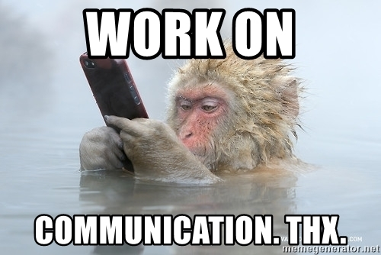
New Narrative: Communication
Significant increase in communications from Leadership
Multiple modes of communication & Repeat! Repeat!
Tackle the “hard” subjects; transparency = trust
Include celebratory, inspirational, and fun elements
Notes:
A huge component of our cultural transformation has been communication
We communicate exponentially more than in previous years with multiple modes of communication and repeating important themes such as strategic initiatives and response to ongoing events (such as ICE raids) that impact our operations and employees
We tackle the "hard" subjects with transparency to instill trust. For example I've spoken openly about the budget challenges we'll be facing in the coming years and how we're preparing.
I don't respond to all political events – particularly wars in other countries, but I do comment on events that have an impact on our agency and community.
We try to balance our communications with content that is celebratory, inspiration and just plain fun

Slide 9
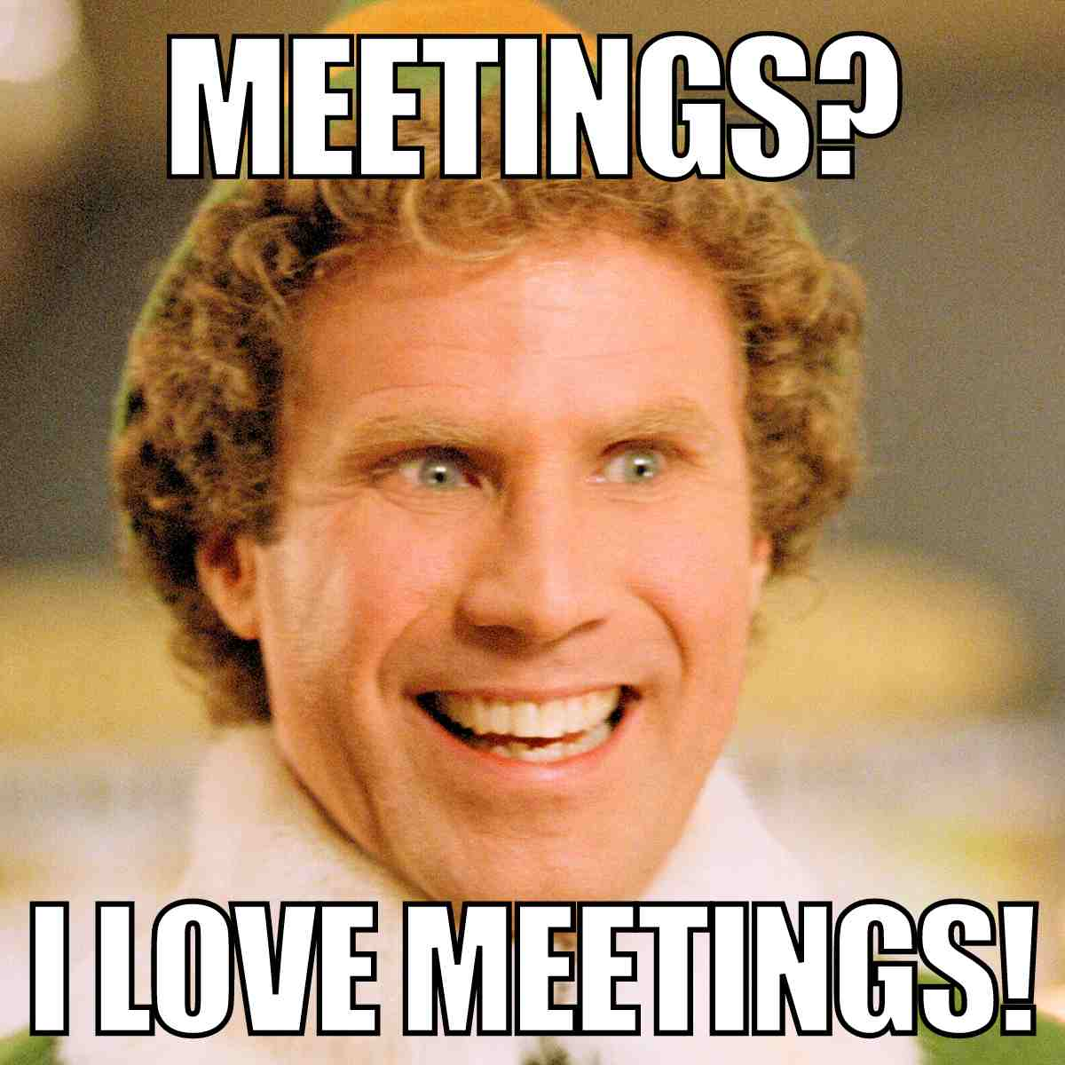
New Narrative: Communication - EXAMPLES
All-Team meeting every quarter (virtual)
Strategic initiatives
Financials
Address team anxieties – very important
Specific program highlights
Gratitude; Shout-Outs
Q&A – “ASK ANYTHING!”
All-Leadership meeting every quarter (in-person)
Strategic initiatives
Financials
Specific program highlights
Group bonding activities with elements of fun
Expressions of gratitude
Notes:
Here are some examples of communication strategies that have been successful
Every quarter we have a virtual all-team meeting and an in-person all-leadership meeting and we cover similar topics in both.

Slide 10
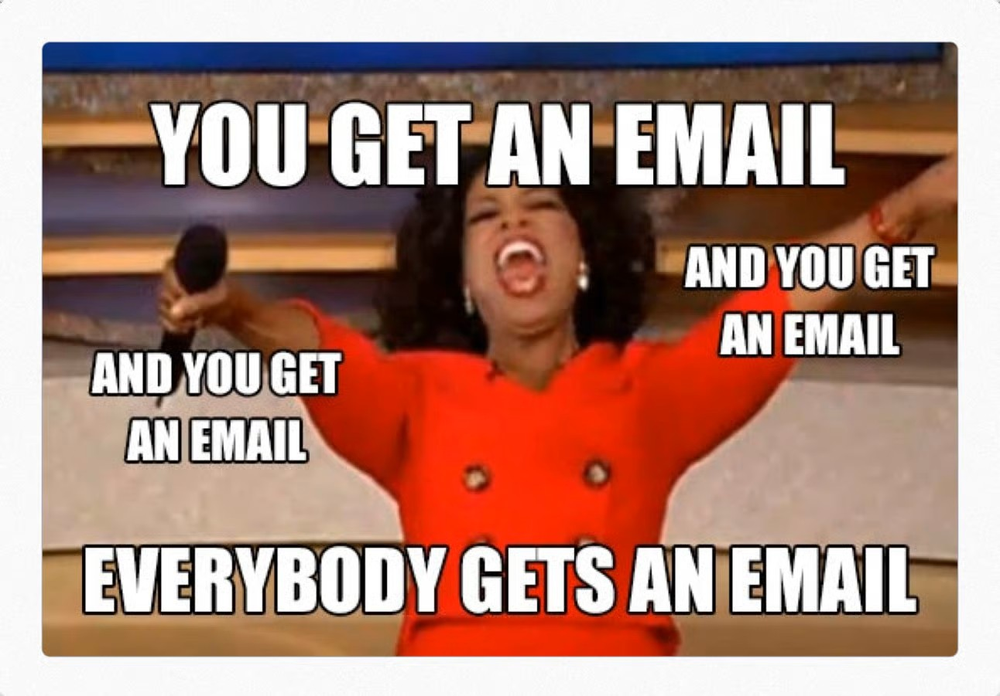
New Narrative: Communication – EXAMPLES
Email to all team members from the CEO every Friday
Gratitude; shout-outs
Announcements
Program spotlight
My thoughts, inspiration, humor
60% to 75% of workforce read every week
Notes:
One communication tool that been surprisingly effective is an email that I send out to my entire workforce every Friday.
[share content]
Feedback is that this email helps them feel connected to the agency and appreciate that I take the time to do it every week – they see it as an expression of appreciation – that they are seen.

Slide 11
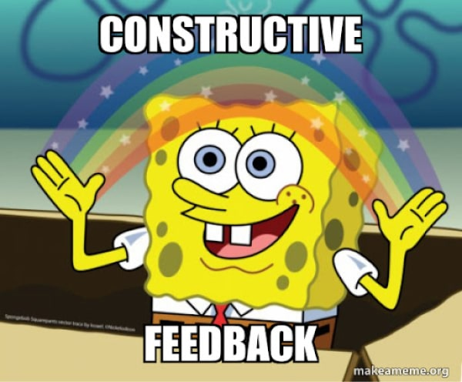
New Narrative: Feedback !!
Creating a culture of feedback
Feedback with consistent response and action
Notes:
A very important element in our transformation journey has been to create a culture of feedback

Slide 12
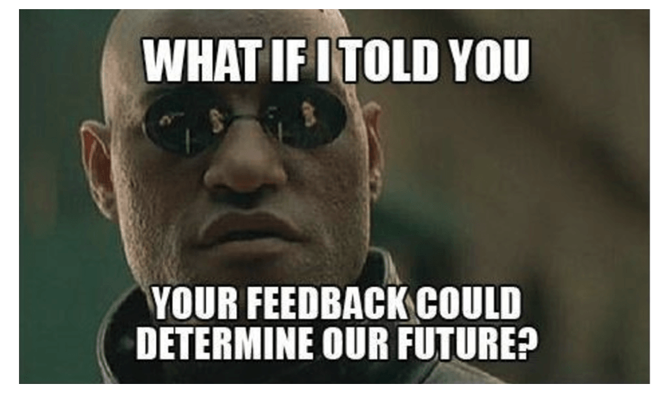
New Narrative: Feedback - EXAMPLES
Annual All-Team Survey
44 questions
Change Mgmt / Communication
Culture
Burnout / Wellness
Leadership
Team-Based Care
Professional Development
Job Satisfaction
Safety
Response rate: grew from 31% to 78% since inception 7 yrs ago
Comprehensive reporting and analysis
Follow-up, in-person meetings with each department to help validate results and get even more qualitative feedback
All-Team announcements about actions taken as result of survey
Notes:
Here are some examples:
We conduct a very comprehensive all-team on-line survey with 44 questions across 8 categories. We follow-up with in-person meetings with each department to help validate results and get even more qualitative feedback
We've been doing this for 7 years and the response rate has grown from 31% to 78% -- and the reason is because we take action on suggestions from the survey and publish the results.

Slide 13
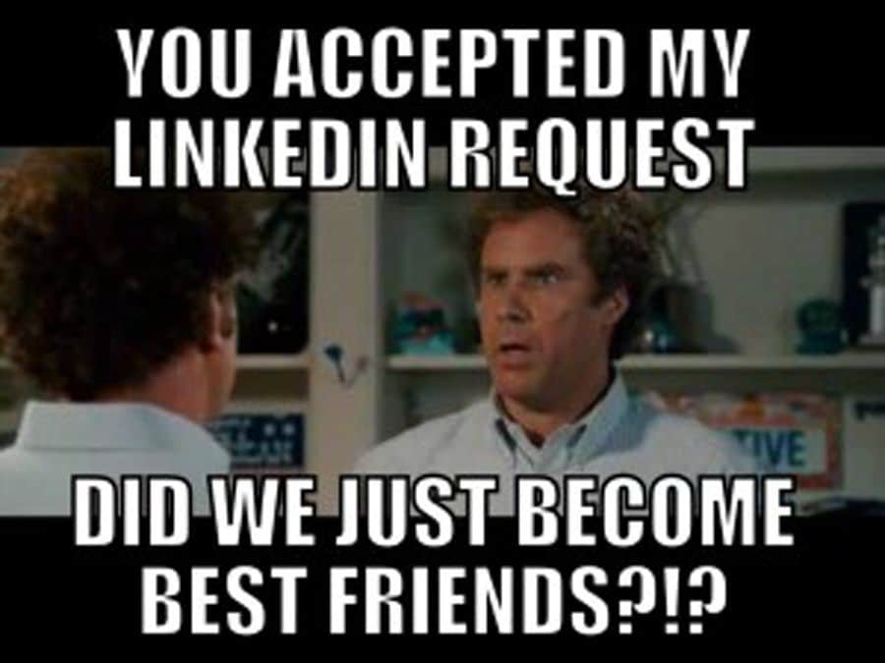
New Narrative: Feedback - EXAMPLES
“Suggestion Ox” – an on-line suggestion box for anonymous feedback
I read every one – directly respond to some; delegate some
Respond within 24-48 hrs
Sometimes they lead to action; sometimes folks just want to be heard
A meeting with the CEO – I’ll meet with anyone in my workforce
Executive listening tours – sites every qtr
Pop-up surveys on hot topics
360 feedback included in annual performance reviews
FIT and Participant surveys
Notes:
Here are some other examples

Slide 14
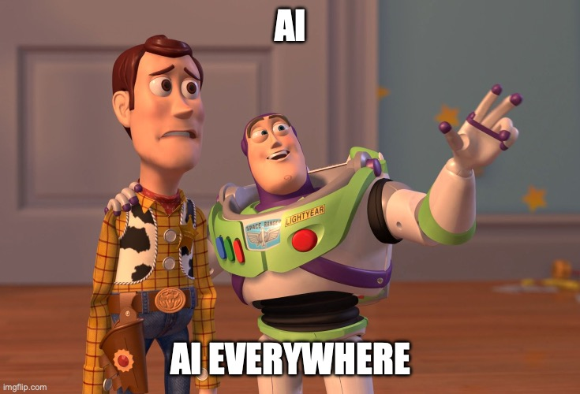
New Narrative: Reducing Administrative Burden
Charting using A.I. – a game changer!
Eleos Health software
Compatible with most EHRs; HIPPA compliant
Excellent training and customer service
Beyond transcription: produces high-quality clinical note
Generated note based on evidence-based practices
Provides analytics: clinical modalities used by clinician
Users: QMHP, QMHA (outptient/PSRB/ICM)
Benefits:
Notes completed on time & reduced time to complete documentation – from 15 mins down to 7 mins
Increased staff capacity
Reduced staff anxiety and increased staff morale
Notes:
One of the consistent complaints we get from employees is administrative burden, particularly documentation.
For the last couple of years we've been installing software tools to help ease administrative burden and facilitate communication.
We installed MS365 and utilize teams and sharepoint extensively.
But the real game changer for our clinicians has been using AI to write their session notes.
A few years ago we got a grant to purchase a BH AI platform from Eleos Health. They have been around for I think almost 2 decades and have a lot of BH intelligence accumulated in their software.
Go to list

Slide 15
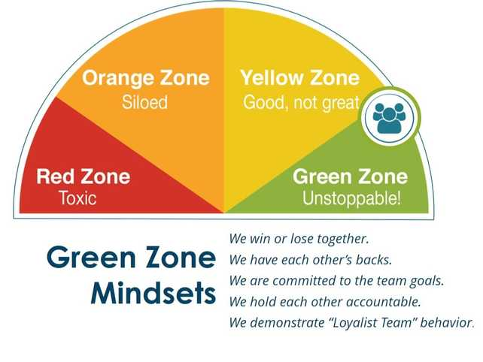
New Narrative: Team Culture Investments
“Loyalist Team” training:
Be for each others’ success
Talk to each other, not about each other
Challenge each other toward excellence
Assume positive intent
Notes:
I know I'm short on time so real quick: We train our teams on the Loyalist Team culture based on the book The Loyalist Team

Slide 16
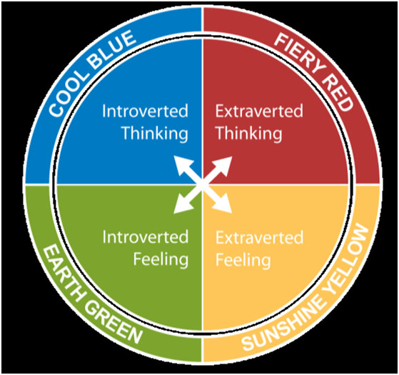
New Narrative: Team Culture Investments
“Insights Discovery” training with OCBH:
Rooted in Jungian Psychology
Four Color Energies: Red/Blue/Green/Yellow
Enhances Self-Awareness & Communications.
Widely Adopted by organizations
Practical & actionable
Notes:
And we've put most of our Leadership group through Insights training with OCBH. Insights is a personality assessment tool similar to Meyers Briggs only it's more simple.
This has really helped our teams value each other strengths and learn how to better communicate and work together.

Slide 17


