Slide 1

Behavioral Health Workforce Development Efforts ​ ​
Laura Bridges, LCSW, MPH
October 2025
OcOC
Notes:
La Clinica has grown from a single clinic in Phoenix to a network of locations that provide culturally appropriate, accessible, and affordable quality health care. We’re dedicated to meeting people where they are physically and emotionally, and connecting with them to help guide their personal journey to wellness.
School-based health centers-little health centers located on school campuses throughout the county They are staffed by nurse and nurse practitioners as well as mental health therapists.
Students can be excused from class to be seen right on site instead of missing school or parents missing work for an outside appointment. Any child (2-17) can be seen at any school district as long as we have a SBHC in that district.
Our mobile health center travels to reach remote or vulnerable community members, including people who are homeless.
Dental clinic helps meet the huge need in a community where many have inadequate or no insurance coverage for dental care.

Slide 2


OUR MISSION
We serve the people who need us most through exceptional, affordable, and compassionate care, inspiring all those we touch to lead full and healthy lives.
Notes:
We are a mission-driven organization, and mission is a large draw for many of our employees.
Our mission is to reach out to those who are at 200% of the federal poverty level (around $50,000 for family of 4, according to guidelines published in the Federal Register in January 2018).
We serve more than 1 in 10 Jackson County residents.

Slide 3
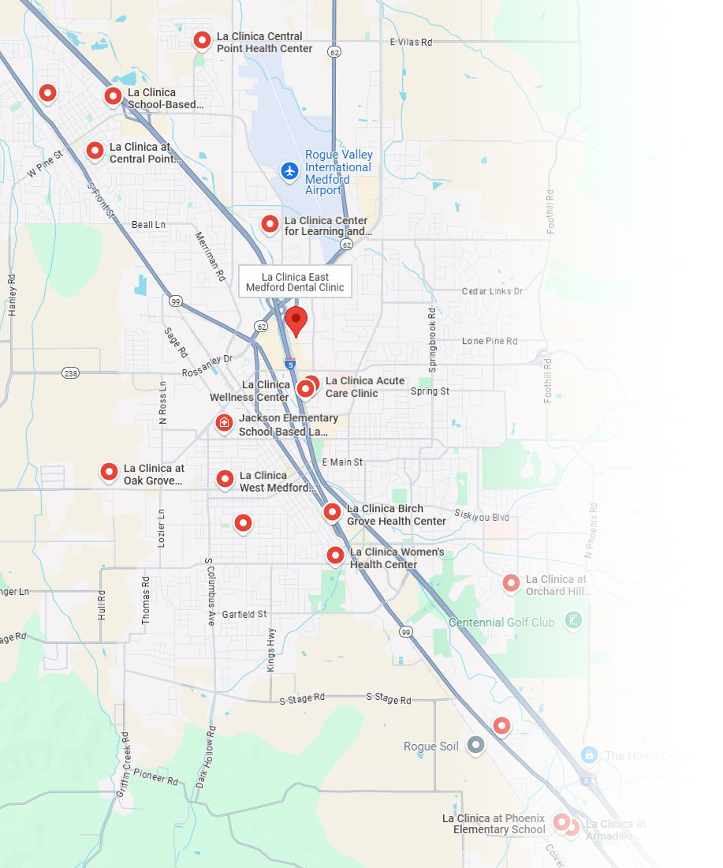
La Clinica locations
Six community health centers—Birch Grove, Central Point, Phoenix, West Medford, Wellness, and Women's health centers
Acute Care Clinic—Drop-in urgent medical care
One dental clinic—East Medford Dental Clinic (plus dental care at Central Point Health Center)
20 school-based health centers—in Central Point, Medford, Phoenix-Talent school, Ashland and Rogue River districts
Student Health and Wellness Center at SOU
La Clinica at OHRA Center—care at resource center and shelter
Community Pharmacy
Center for Learning and Innovation—Workshops, classes, and grief groups
La Clinica Mobile Health Center—returning in 2025
Notes:
33 sites
La Clinica has grown from a single clinic in Phoenix to a network of locations that provide culturally appropriate, accessible, and affordable quality health care. We’re dedicated to meeting people where they are physically and emotionally, and connecting with them to help guide their personal journey to wellness.
School-based health centers-little health centers located on school campuses throughout the county They are staffed by nurse and nurse practitioners as well as mental health therapists.
Students can be excused from class to be seen right on site instead of missing school or parents missing work for an outside appointment. Any child (2-17) can be seen at any school district as long as we have a SBHC in that district.
Our mobile health center travels to reach remote or vulnerable community members, including people who are homeless.
Dental clinic helps meet the huge need in a community where many have inadequate or no insurance coverage for dental care.

Slide 4
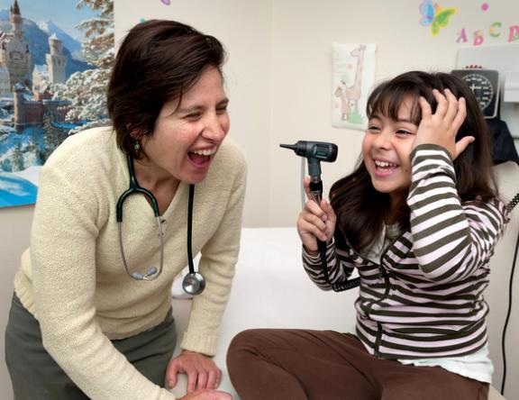
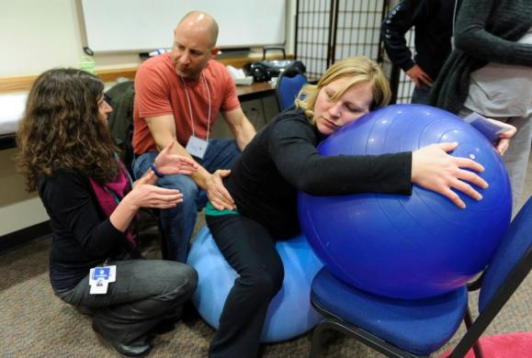
Staff
525 employees
123 Bilingual Staff
54 Certified/Qualified Interpreters
47 medical providers
(Family physicians, OB/GYN, nurse practitioners, physician assistants, certified nurse midwives)
39 behavioral health providers
9 dentists and 1 denturist
As of Dec. 31, 2024
Notes:
As more people are covered by OHP, our staff continues to grow to support the increased patient volume.
Mental health: We also employ several behavioral health clinicians.

Slide 5
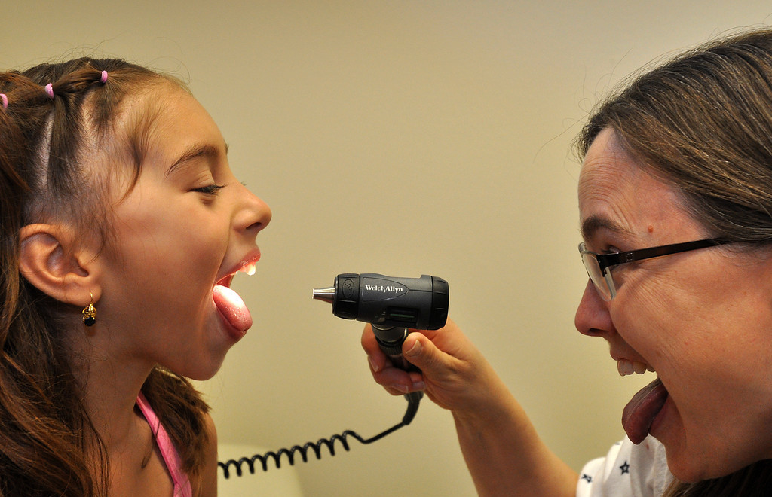
Our Services
Primary Care
Dental Services
Behavioral Health
Pharmacy
Learning Well

Slide 6
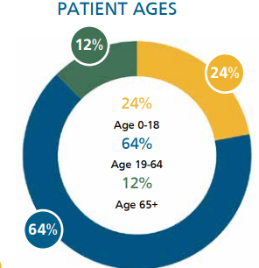
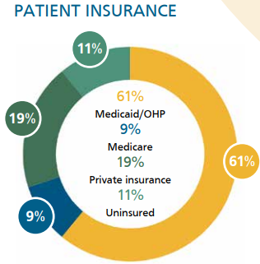
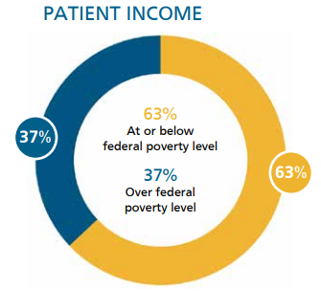
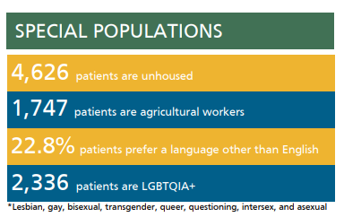
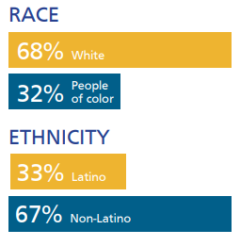
Who we served in 2024
• 29,268 patients • 121,429 patient visits and interactions

Slide 7
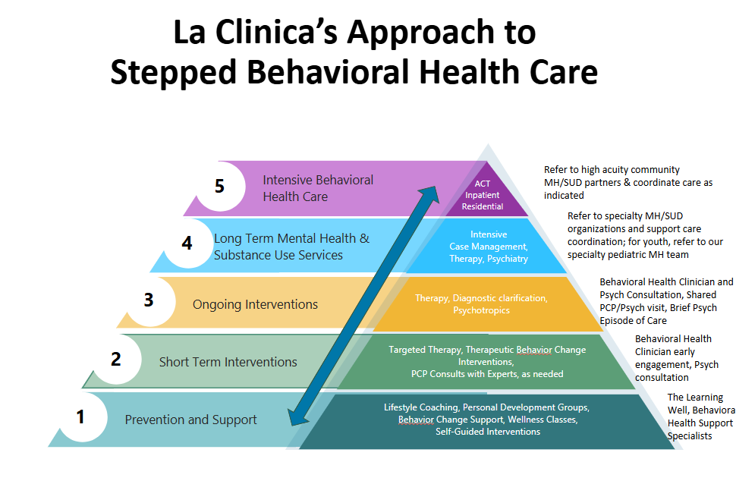
The Learning Well, Behavioral Health Support Specialists

Slide 8
Challenges We’ve Faced
Recruitment and development of bilingual behavioral health staff
Level of training/support our new integrated BHCs need to learn primary care behavioral health and a team-based approach to care
Recruitment and retention of behavioral health clinicians (BHCs)
Notes:
- Particularly in the integrated behavioral health model
- Once licensed, often move to private practice

Slide 9
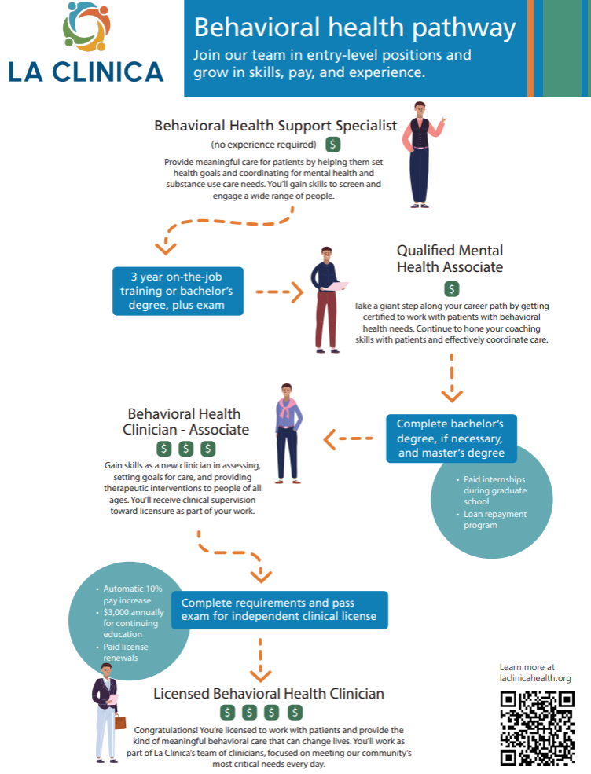
Our Approach:
“Grow Our Own”

Slide 10
Pathways to BH Growth: QMHA Development
Integrated Behavioral Health Care:
Hire and train team members with an interest in behavioral health, no experience required.
Strong pathway for growing bilingual behavioral health workforce.
Targeted training
Pediatric Mental Health Care:
Support QMHA-R eligible candidates through micro-credentialing in school mental health through Southern Oregon University.
Other targeted training
Pediatric Substance Use Screening & Brief Intervention Services:
Supported two CADC-R candidates with OnPace training via Continuum and coordinated experience hours through local substance use providers.
Targeted training in Teen Intervene
Notes:
Bilingual BH Support Specialist team members often become certified interpreters.
. Supported effort with scholarship from Continuum.

Slide 11

Pathways Cont.: BHC Interns
Placements in school-based specialty mental health and integrated behavioral health settings
Paid internship opportunities​
Pediatric BHC interns can bill as part of a COA​; integrated BHC Interns cannot, rely on grant funding ​
"Thank you" payments for clinical supervisors
Shared learning and training opportunities
​
https://laclinicahealth.org/careers/behavioral-health-internships/
Notes:
Suicide risk assessment and documentation training
Psychiatric diagnostic evaluation training rotation with ourIntegrated Psychiatric Team
EDI training efforts

Slide 12
Pathways Cont.: Post-Masters Fellowship Program
Advanced Practice Provider Residency began in 2023
Embedding an integrated behavioral health fellowship within the residency July 2026.​
Program Structure:​
Mentor rotations​
Community partner shadowing to learn levels of care​
Precepted clinics​
Weekly didactics and clinical supervision toward licensure​
Goal: Shared learning and training IBH fellows and advanced practice residents in delivering team-based primary care services to our community
Notes:
Fellows will:
Continue learning in a clinical setting with a socially and medically diversepatientpopulation and experienced team members to mentor them.
Grow confidence in their clinical skills, cultural competencies, and tools toreduceburnout while maintaining professional development.

Slide 13
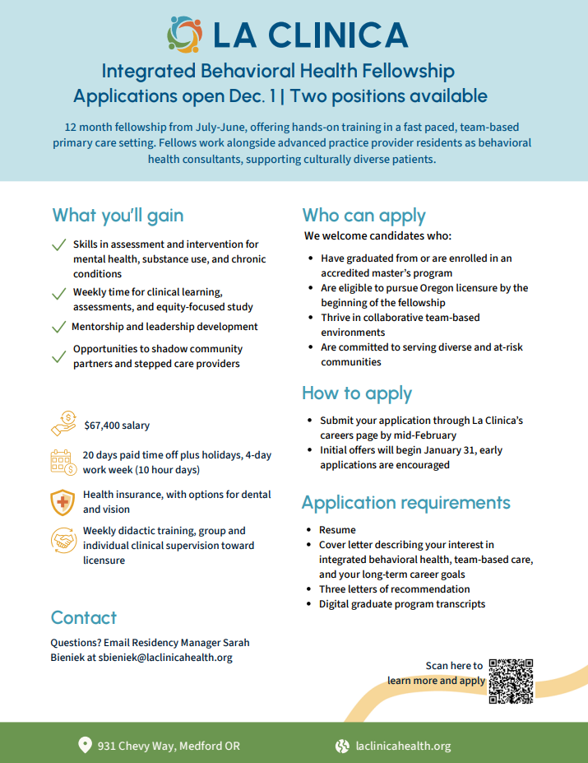
Our IBH Fellowship:
Go Live Date in July 2026

Slide 14

Questions?

