Slide 1

Substance Use Disorder and Process Addiction Treatment Landscape
Overview
Amy Baker BHI Director

Slide 2
Outpatient Overview
ASAM Level | Description of Service | Typical Patient Profile
0.5 Early Intervention or Pre-treatment Engagement | Brief education, screening, and motivational counseling, peer engagement | At-risk individuals, not yet diagnosed, peer engagement to encourage into services.
1.0 Long-Term Remission Monitoring | Quarterly services at minimum, recovery and remission management services | SUD diagnosis is stable, stable living environment
1.5 Outpatient Services | <9 hours/week of counseling (individual/group), relapse prevention, peer support, recovery support | Mild SUD, stable environment, low risk of withdrawal
1.7 Medically Managed Outpatient | Direct withdrawal management and biomedical services, Psychiatric care, psychosocial services, peer support, recovery support | Individuals experiencing mild to moderately severe withdrawal symptoms. Require extended medical management and/or nursing care

Slide 3
Intensive Outpatient Overview
ASAM Level | Description of Service | Typical Patient Profile
2.1 Intensive Outpatient (IOP) | ≥9 hours/week, structured therapy, skill-building, peer support and engagement, recovery support | Moderate SUD, needs more support but can live independently
2.5 High-Intensity Outpatient | ≥20 hours/week, structured therapy, skill-building, peer support and engagement, recovery support | Moderate to High SUD, structure, and daily oversight for Individuals who need daily monitoring, but not 24/7 care
2.7 Medical Managed Intensive Outpatient | Direct withdrawal management and biomedical services, Psychiatric care, psychosocial services, peer support, recovery support | Moderate to High SUD, structure, and daily oversight for Individuals who need daily monitoring, but not 24/7 care

Slide 4
Residential & Inpatient Overview
ASAM Level | Description of Service | Typical Patient Profile
3.1 Low-Intensity Residential | 24-hour living support, ~5 hours/week of treatment, peer support, recovery support | Early recovery, needs structured environment
3.5 Medium-High Intensity Residential | 24-hour care, intensive therapy, peer support, peer support, recovery support | Severe SUD, unstable living, high relapse risk
3.7 Medically Monitored Inpatient | 24-hour nursing, psychiatric oversight, withdrawal management, peer support, recovery support | Severe SUD with medical/psychiatric complications
4.0 Medically Managed Intensive Inpatient | 24-hour medical care, physician-led treatment, Withdrawal Management, peer support, recovery support | Acute withdrawal, life-threatening conditions, Individuals often have dual diagnosis

Slide 5
Co-occurring Dual Credentialing Data

Slide 6

MHACBO Certified CADC (6,441)

Slide 7
CADCs (6,441) are the most cross-trained workers: 46.9% are dual credentialed in mental health (QMHA, QMHP, LPC, LMFT, LCSW, Psychologist)

Slide 8
MH State License/Certification with Additional Oregon CADC Certification (note: some licensed mental health professionals have additional addiction certification with out-of-state national boards/associations)
Amy Baker BHI Director

Slide 9
MHACBO Certified CGAC (250)

Slide 10
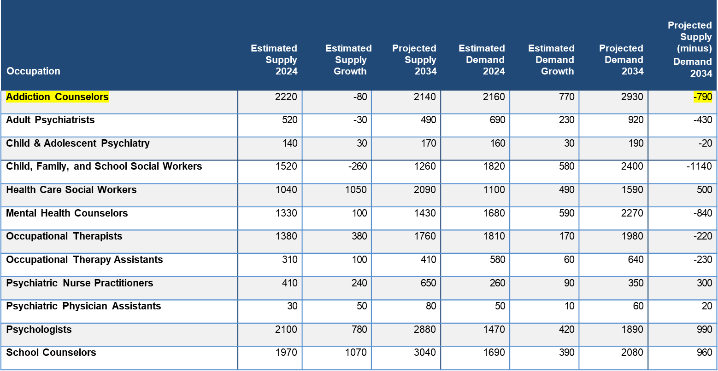
Oregon Behavioral Health Talent Assessment
Supply and Demand for Selected Behavioral Health Occupations 2,3
² Supply and demand data were not available for community health workers, marriage and family therapists, mental health and substance abuse social workers, occupational therapy aides, psychiatric aides, or psychiatric technicians.
³ From AHP, 2025, Oregon Behavioral Health Talent Assessment, p. 24, Table 5. HECC. www.oregon.gov/highered/strategy-research/Documents/Reports/2025-Oregon-Behavioral-Health-Talent-Assessment-Report-final.pdf

Slide 11

Questions?

