Slide 1
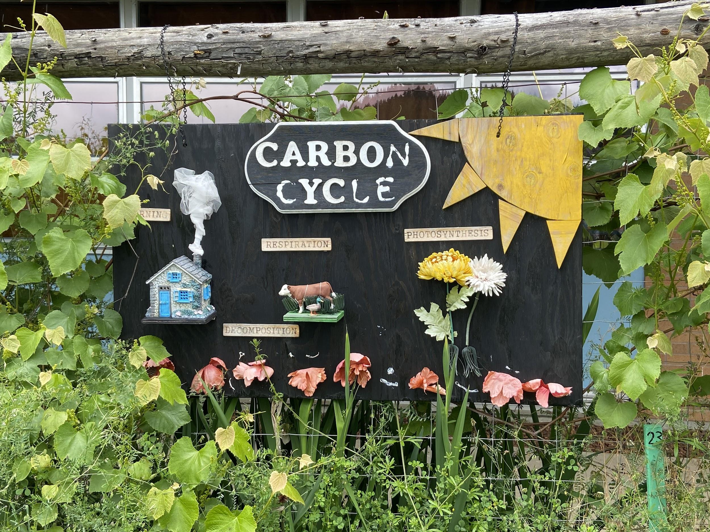

www.UVF2S.org
Douglas County, Oregon

Slide 2
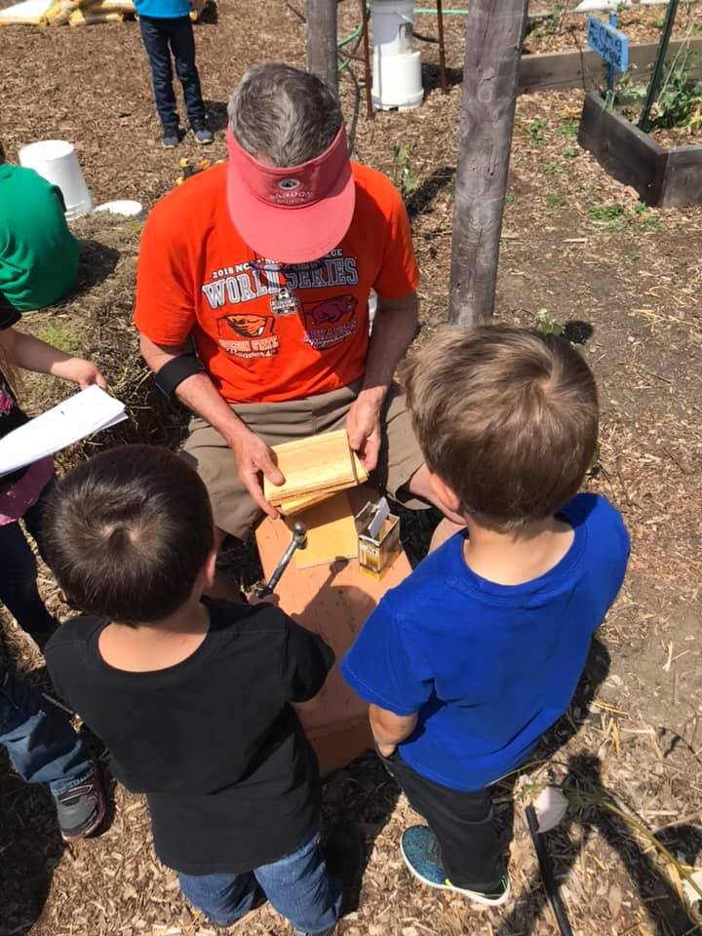
UVF2S Mission
Mission Statement
We believe food security begins with a strong community connection to the land and its food. By supporting local food systems and providing education to Douglas County youth, UVF2S cultivates skills and passion to build food-community connections. UVF2S aims to achieve an equitable and sustainable food system that nurtures and strengthens Douglas County’s people and economy.

Slide 3

Specialty Crop Block Grant
Farm to Fork:
Building On-Farm Experiences

Slide 4
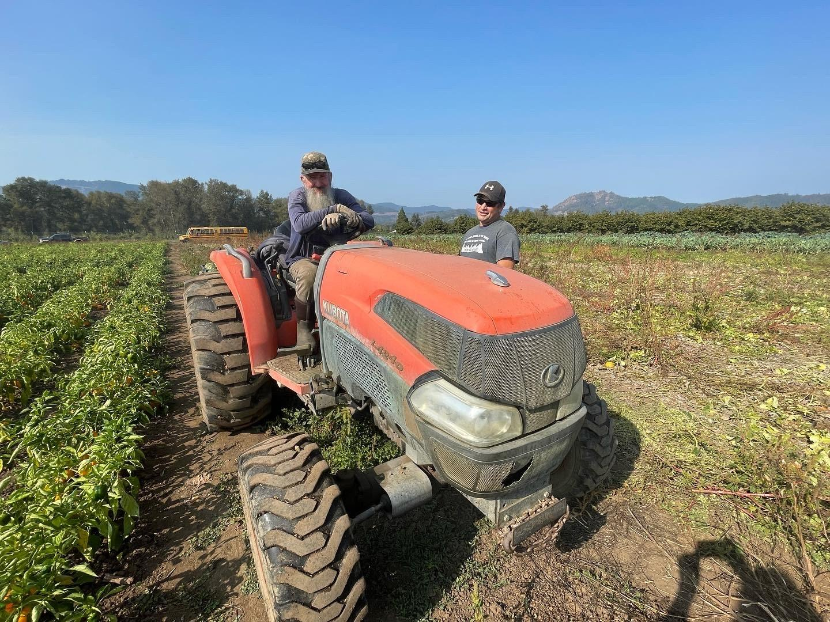
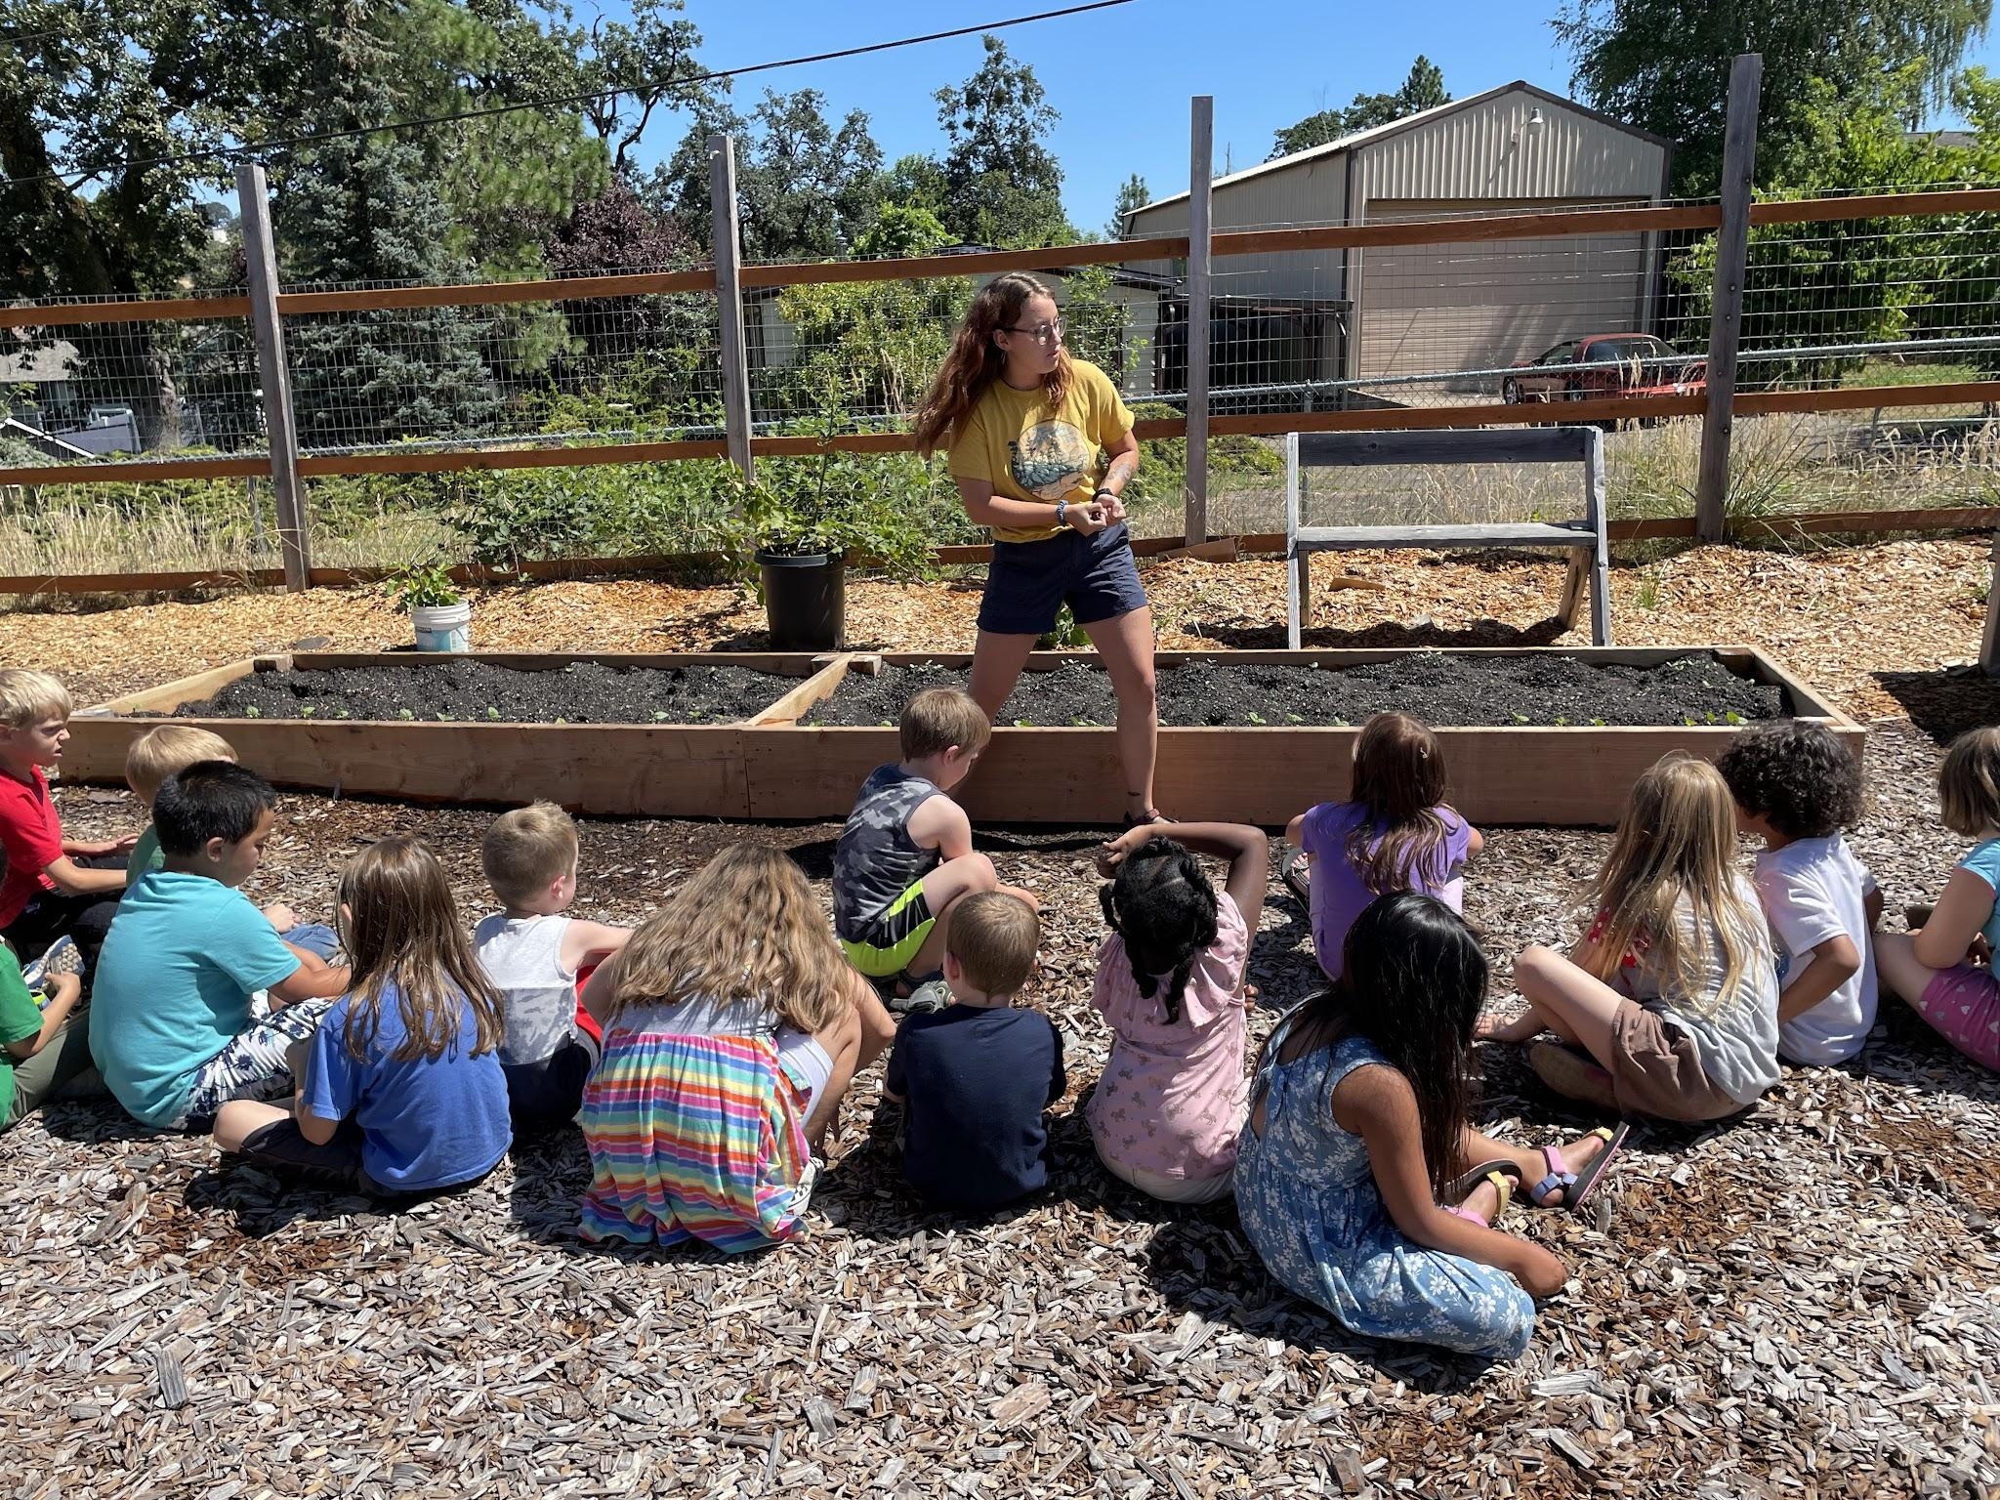
UVF2S Background
Notes:
UVF2S rebranded and expanded into farm to school in 2019. Erin Maidlow had been the Regional Procurement and Ed Coordinator for the statewide OFSSGN for many years prior in a previous role, and was fortunate to create UVF2S to focus more on farm to school in Douglas County. We’ve worked with 21 schools and organizations in Douglas County to bring local products into school meals. Several sites such as Reedsport, Oakland, Sutherlin, and Roseburg School Districts have formed partnerships with local farms to purchase on a routine basis using their ODE Farm to CNP noncompetitive funds, then applying for additional competitive funds to purchase more. Others need more assistance still, which we are happy to offer.
As the Education Coordinator for our region, we provide technical assistance to schools and organizations in areas such as school garden consultations, grant writing, resource sharing, trainings, curriculum, and school garden policy. We hold quarterly Garden Hub Gatherigns where all educators are welcome to attend to tour other school gardens and share resources.

Slide 5
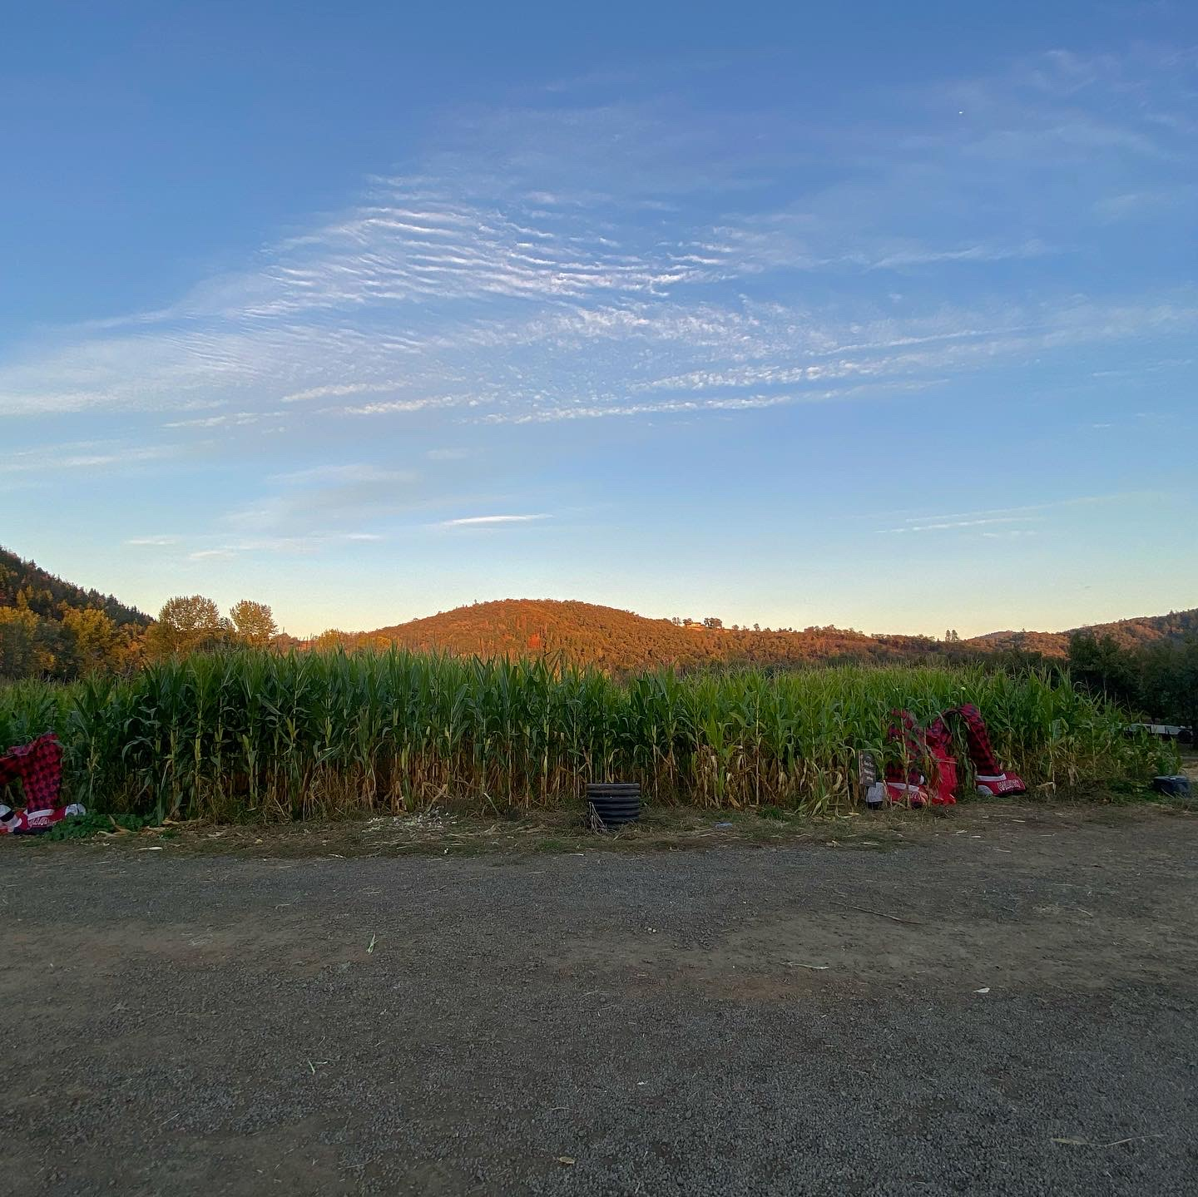
Project Goals
Build an on-farm program for use with the Farm to School Program in local schools in Douglas County
Design farm field trips where students gain hands-on experience planting and harvesting vegetables
Provide technical assistance for farmers around F2S
Increase market opportunities for local farms
Increase capacity of UVF2S in order to sustain the Farm to School program and provide farmer trainings
Notes:
Building farm field trips where students gain hands-on experience planting and harvesting vegetables
This will increase fruit and vegetable consumption
Increase sales of local produce by the community
Provide trainings for farmers in the following areas:
Field trip and food safety including liability insurance requirements and equipment and supply needs
Best practice and requirements for selling to schools including food safety and washing, and transportation and packaging
Age-appropriate activities and curricula for field trips

Slide 6
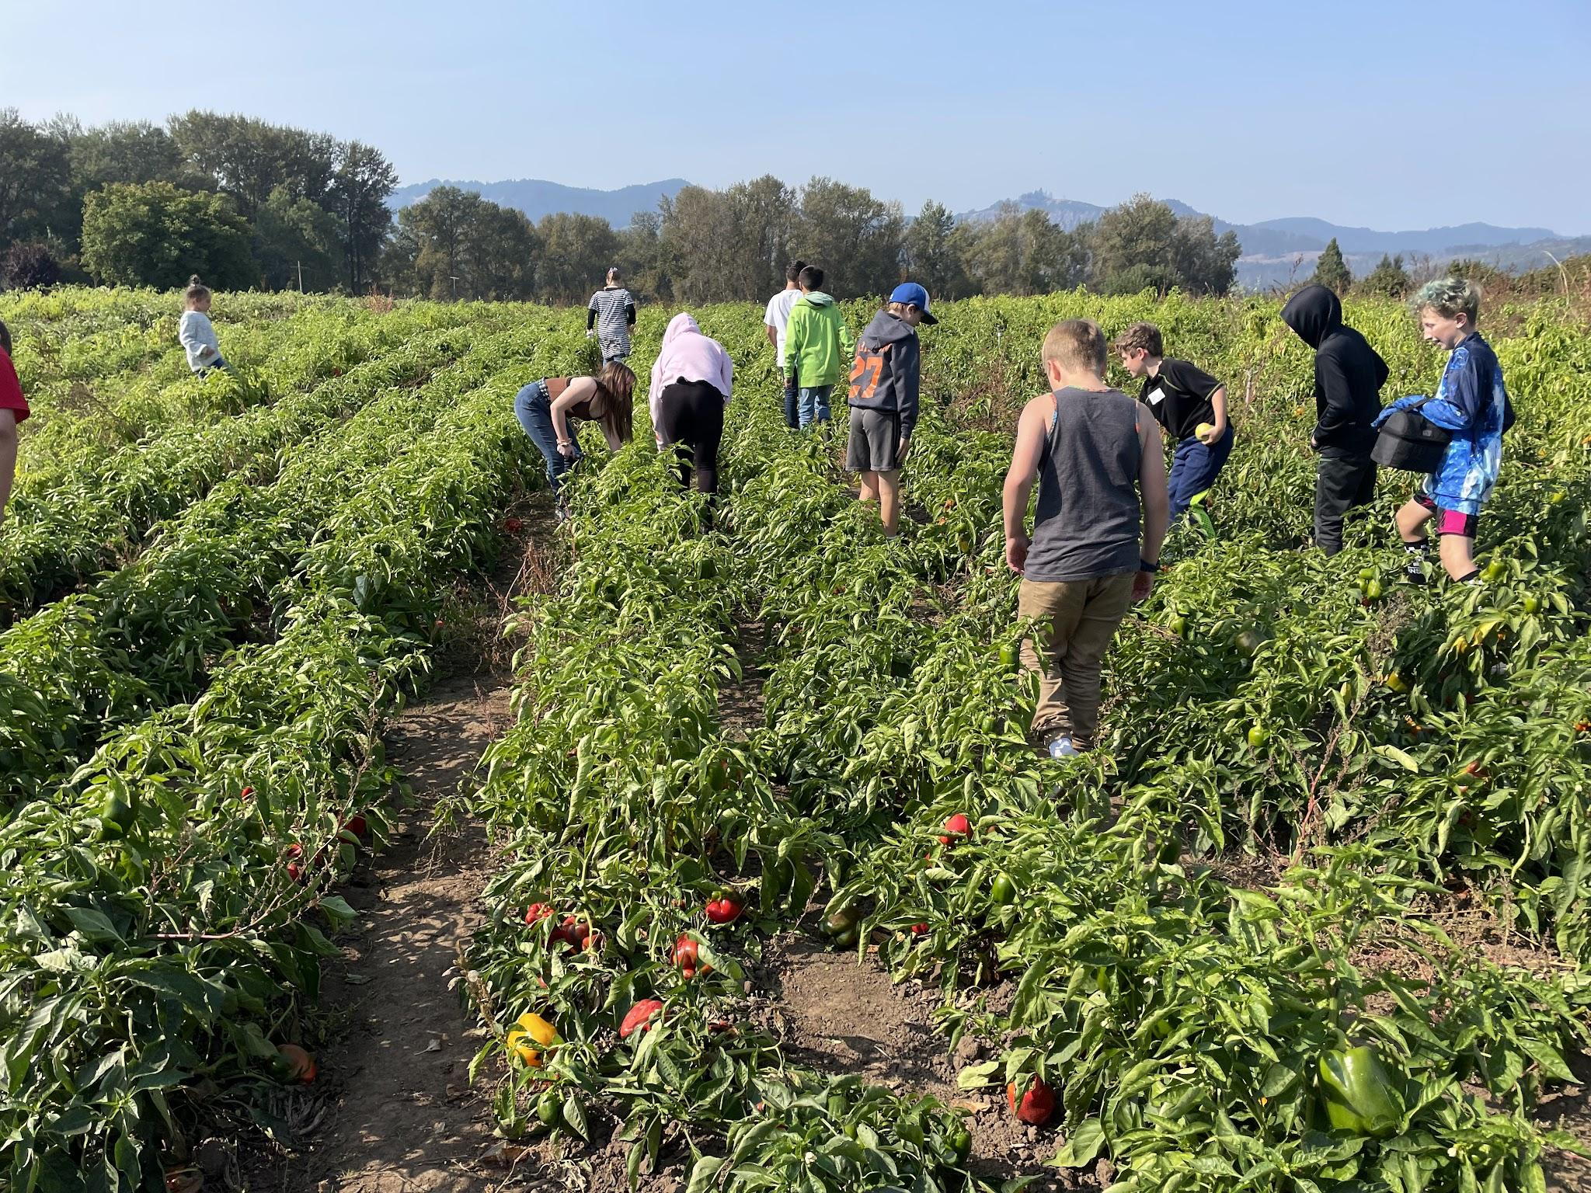
Farm Field Trips
Build an on-farm program for use with the Farm to School Program in local schools in Douglas County by building relationships with farms and schools
Building farm field trips where students gain hands-on experience planting and harvesting vegetables
  This will increase fruit and vegetable consumption
  Increase sales of local produce by the community
Provide trainings for farmers in the following areas:
  Field trip and food safety including liability insurance requirements and equipment and supply needs
  Age-appropriate activities and curricula for field trips
Notes:
One of the goals of building these farm field trips was to create a sustainable program for UVF2S while also assisting farms in developing a plan to provide or strengthen their own farm field trips, outside of what UVF2S provides. UVF2S walked through liability requirements with farms before arranging field trips and discussed what coverage schools provide for students and employees while on field trips. We also created agendas for field trips with detailed instructions so that farms could use the info when discussing insurance coverages with their providers.
UVF2S did, and still does provide curriculum that is age appropriate for farm field trips whether we are hosting them or not. This is an area we noticed farms typically do not have capacity for which we can easily assist with.
Since our original field trips in 2021, several farms have hosted their own field trips without our assistance. UVF2S has shared a list of farms and what they offer for field trips with schools so that schools can reach out on their own to schedule field trips.

Slide 7
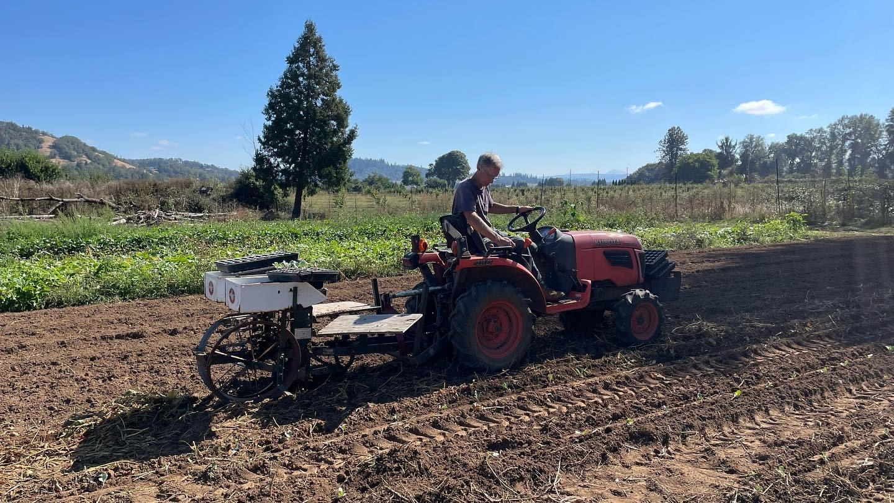
Virtual Farm Field Trips
Notes:
When we wrote this SCBG, we were in the midst of the pandemic and students were distance learning. We learned quickly to adapt in order to keep fresh produce coming to families, school gardens thriving, and kids engaged in agriculture. UVF2S became pros at creating video lessons and activity kits for youth to do at home. Once students were back in-person, some folks were still unsure about hosting field trips as we had originally planned. That became one of our first challenges with this grant- we were unable to work with one of the farms who we had originally partnered with. So, we made a video of a field trip that we took students on so we could share it with more classrooms than we could reach on the farm. This field trip was filmed over the course of two days at Lehne Farm in May 2022 with 4th graders who later attended as 5th graders to see the change in the farm.

Slide 8
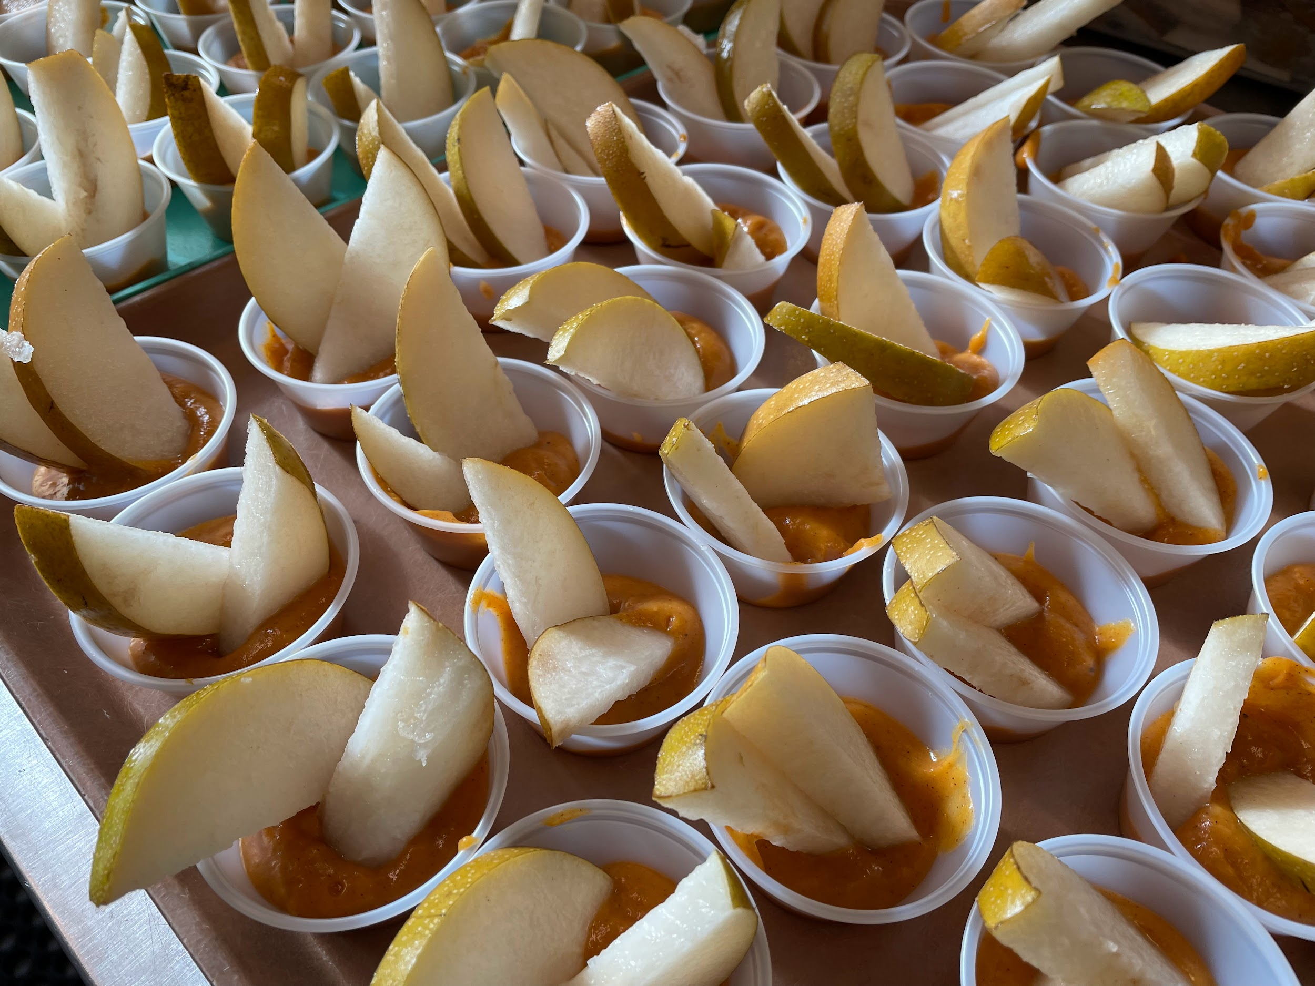
Producer Gatherings
Increase markets for farms by creating a purchasing program for seeds and crops by school districts to be used in school meal programs and school gardens
Notes:
UVF2S held a Producer-Buyer Gathering at Rainbow Kitchen in January 2023 at the end of the project cycle after many one on one meetings with producers and buyers to determine the needs of such a gathering. We had 20 attendees from schools, restaurants, and farms in attendance and producers brought samples of their goods. ODA and our county health inspectors were present to answer questions, and we had handouts with insurance requirements, sample invoices, a Harvest of the Month calendar and spreadsheet, and opportunities for networking. Several producers and buyers did make lasting connections and more were interested in additional gatherings, which we’ve since hosted. We anticipate a buyer-focused gathering in the coming months to draw in more restaurants and institutions who are interested in buying local specialty crops as that seemed to be one sector that was not represented equally to producers.
UVF2S did not see a need for seed purchasing from local farms as our seed growers are not specialty crops and not something schools could easily grow for consumption. We did build connections with several local farms who donate excess seedlings to our program to be grown in school gardens which has given students an opportunity to learn what crops each farm grows, and experiment with growth rates compared to the farms.

Slide 9
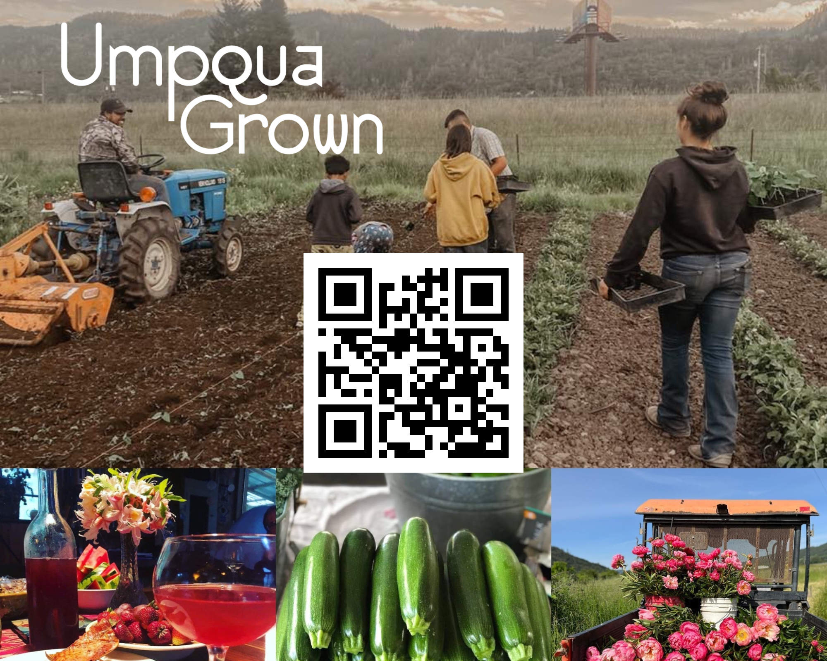
Increased Marketing and Visibility
Umpqua Grown Guide
Umpquagrown.com
Notes:
The Umpqua Grown Guide is an annual publication designed in partnership with UVF2S, Thrive Umpqua, Feeding Umpqua, Rogue Food Unites,
and OSU Extension Douglas COunty. 7500 copies of the guide were printed in 2022 and distributed throughout the county and beyond, and a website was created to highlight specialty crop growers in the Umpqua basin, as well as wineries, breweries, restaurants, and specialty stores who use local products, as well as educational and social services resources such as WIC and food pantries. The website links directly to local farms who’ve registered and both the print guide and website have lists of U-pick farms, CSA providers, and more. This was a huge step in promoting specialty crops in and outside of Douglas County as a way to bring agritourism to our area and increase participation in our local food system. This year, we distributed nearly all 7500 copies of the guide within two months.
Our next publication will include cycling maps that stop at local farms and wineries, and we anticipate building a local farm tour, similar to the Rogue Farm Tour in Jackson and Josephine Counties.

Slide 10
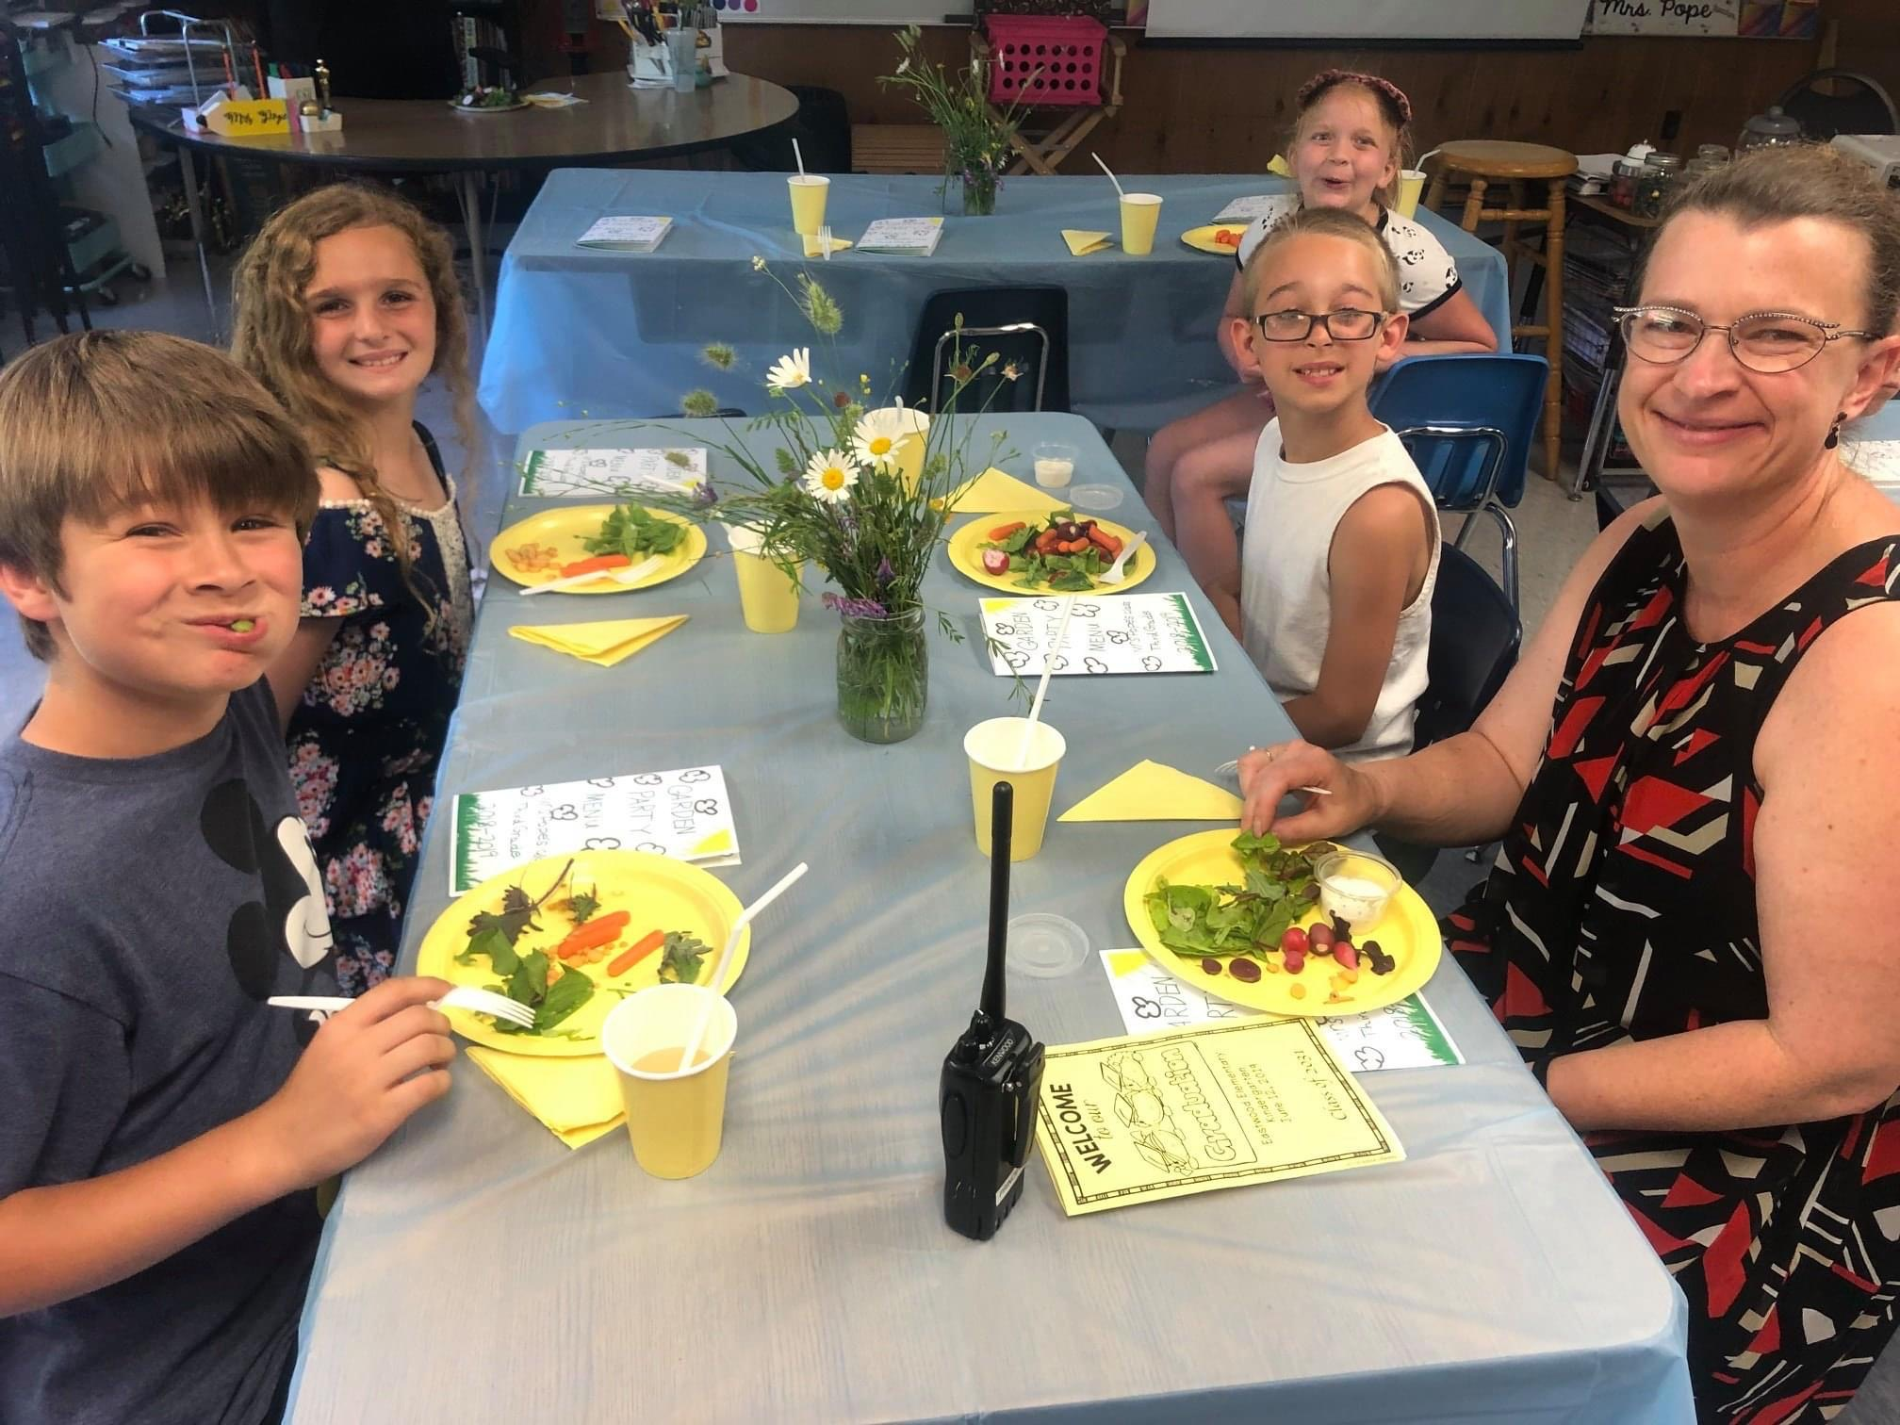
Increased Consumption of Specialty Crops
UVF2S surveyed 365 students who attended farm field trips and asked the questions indicated in the indicators. Of those 365 students, the following outcomes were observed:
314 students stated that they learned what specialty crops were and tried a new specialty crop.
289 students stated that they will eat more specialty crops in the future
326 stated that they had eaten more specialty crops since this project began

Slide 11
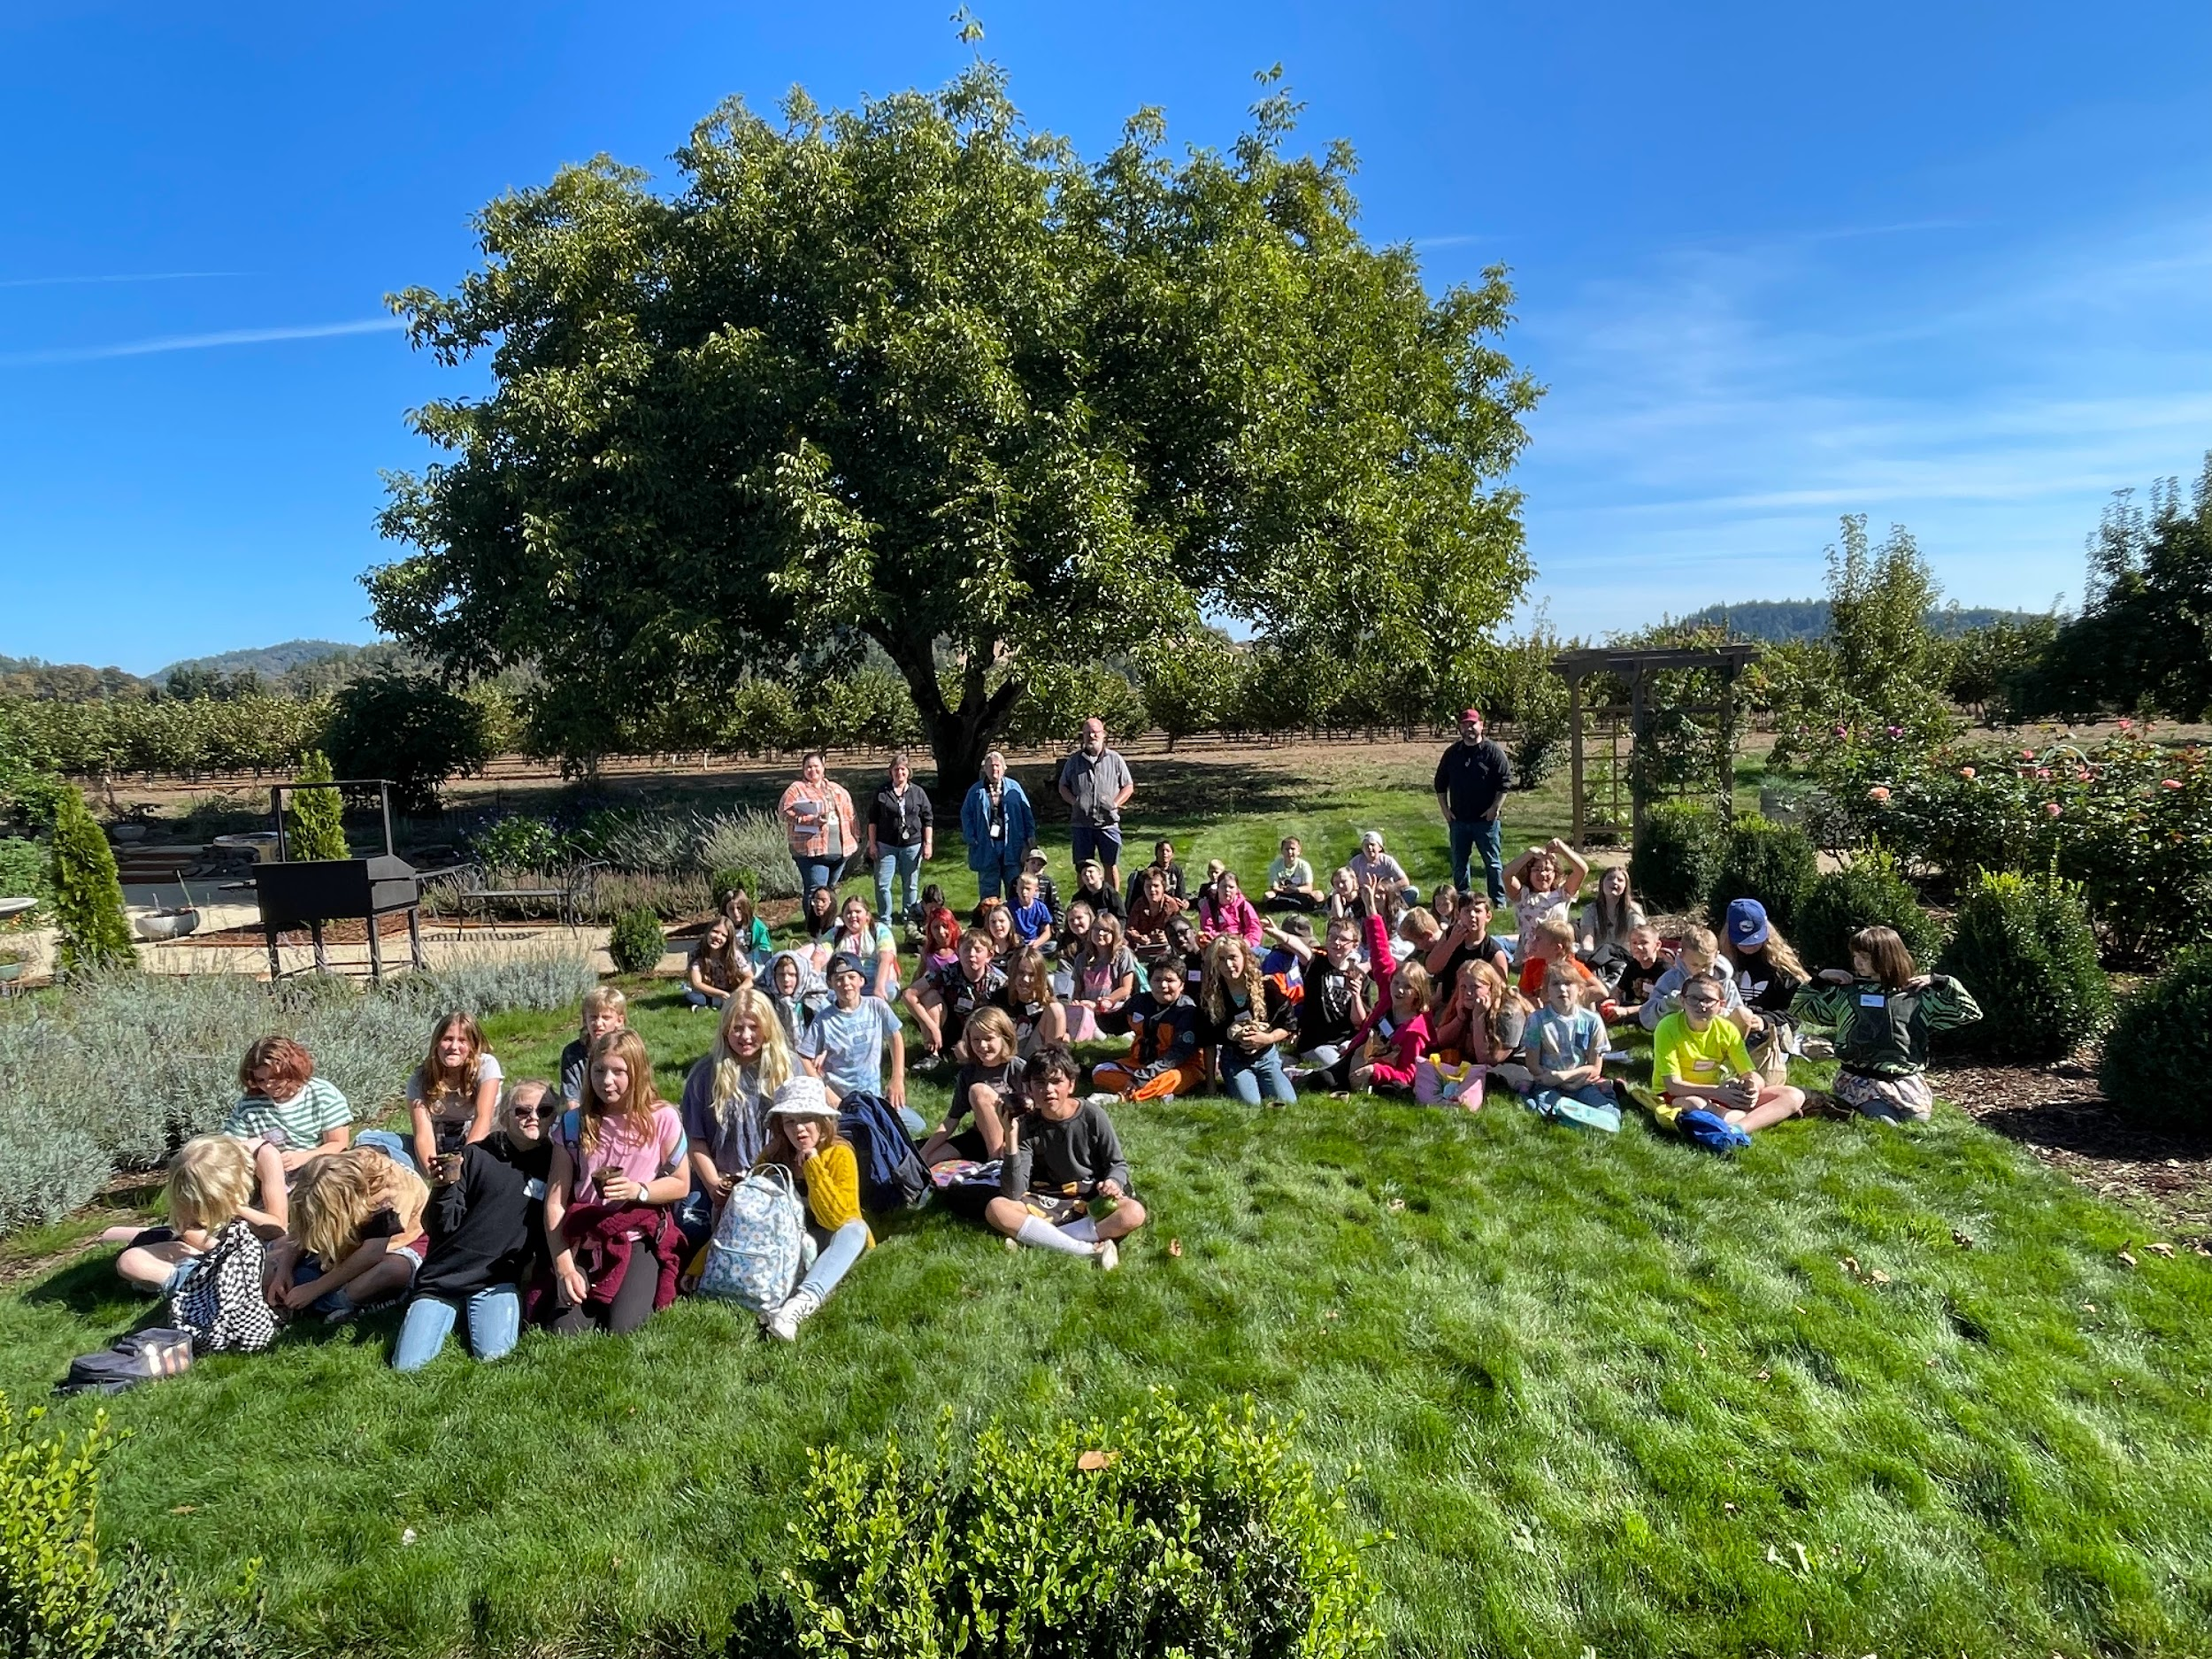
Increased Capacity of UVF2S
Notes:
This is what I consider the biggest achievement of this project. When this was written, it was 2019 and we were a very small organization still, only providing virtual lessons due to the pandemic but also due to only being myself running the org and teaching lessons. Since then, we have hosted 5 AmeriCorps members, hired two employees, and are geared up to move away from Americorps members and hire permanent employees. We started at three schools in 2019 and have expanded to direct education at nine schools, seeing over 2000 students per year with over 8000 engagements with students. Field trips gave our students something to look forward to after the pandemic and were the first field trips most of them had been on since being at home.
Since the end of the SCBG, we have hosted 15 field trips and schools and farms have arranged and hosted their own.

Slide 12
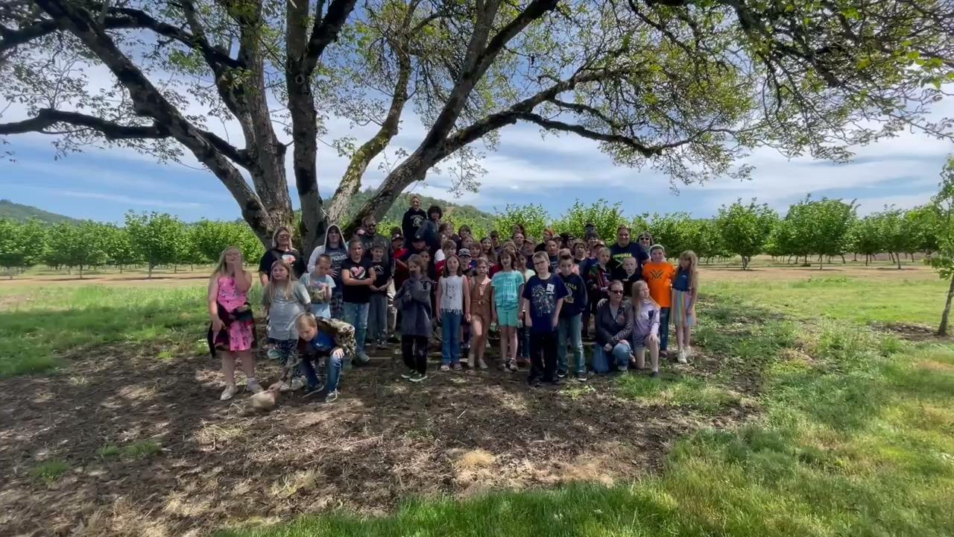
Questions?
Thank you!

