Slide 1
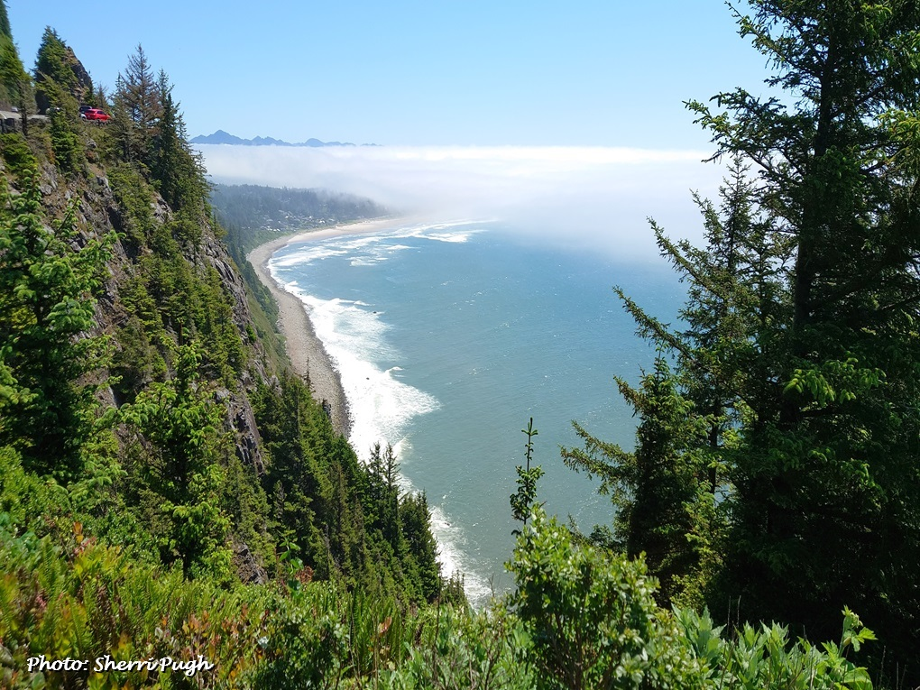
Seasonal Climate Forecast Verification August – October 2025 Issued: December 1, 2025* *(Delayed by Federal Government Shutdown)
Contact: Pete Parsons, ODF Lead Meteorologist
503-945-7448 or peter.gj.parsons@odf.oregon.gov
Production - ODA: Andy Zimmerman; Jenn Ambrose; Laura Passage Production - ODF: Julie Vondrachek; Kristin Cody; Gary Votaw; Sherri Pugh

Slide 2
Format and Purpose:
A side-by-side comparison of the “Seasonal Climate Forecast” vs. what (Actually Occurred) is done for both the 1-month & 3-month forecasts.*
The accuracy of each forecast is reviewed, and the need for analog-year updates is examined.
This is part of an ongoing assessment of the utility of this forecast method.**
*Utilizes 1991-2020 long-term averages
**See “Forecasting Methods…” at:
https://www.oregon.gov/oda/natural-resources/pages/weather.aspx

Slide 3
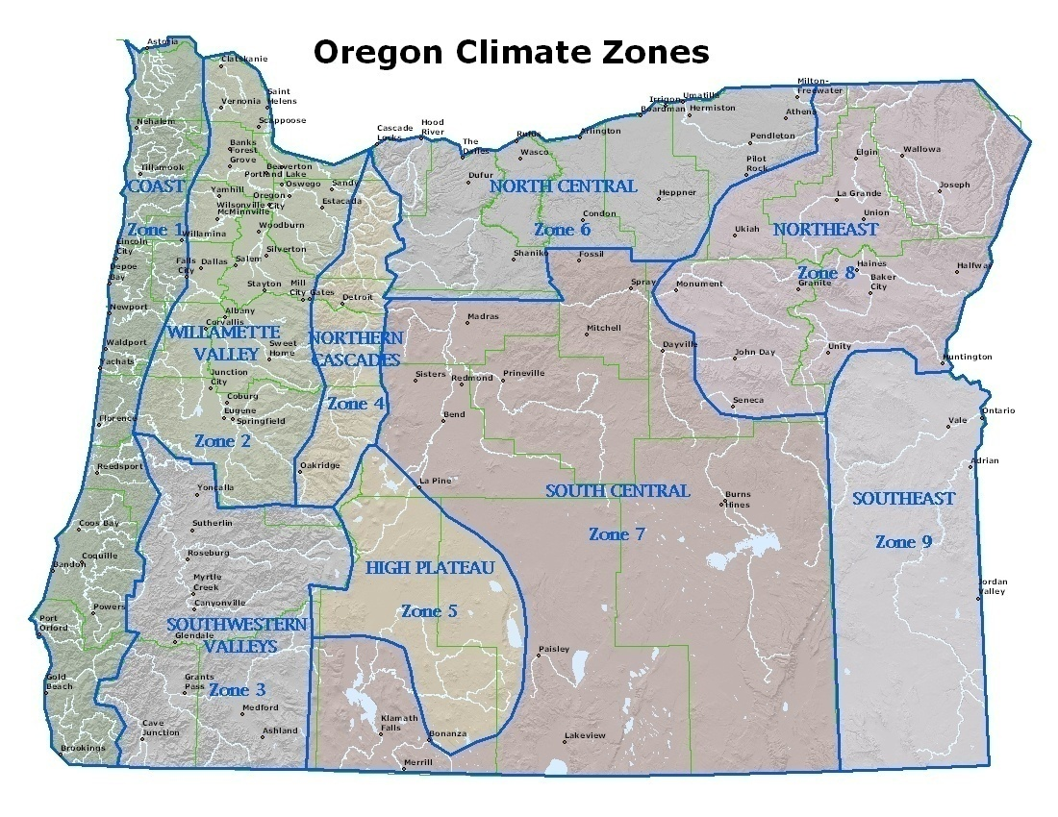

Slide 4
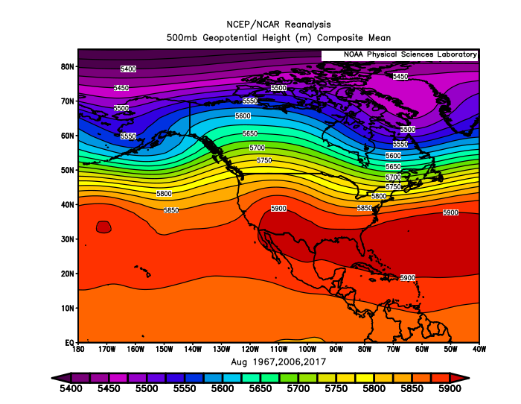
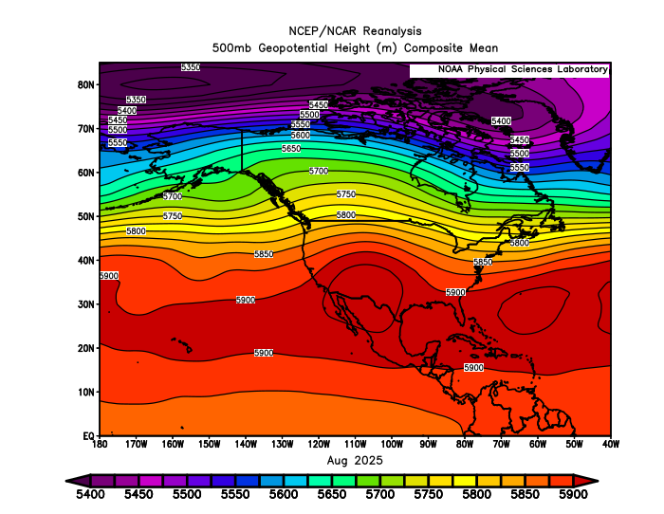
August 2025 (Forecast Issued July 17, 2025)/(Actual)
Forecast Upper-Air Pattern
Actual Upper-Air Pattern
The forecast (left) and the observed pattern (right) both showed stronger ridging than average from the Pacific NW to the Rockies. The 1967 & 2017 analog years both exhibited this general pattern. A “forecast hit.”

Slide 5
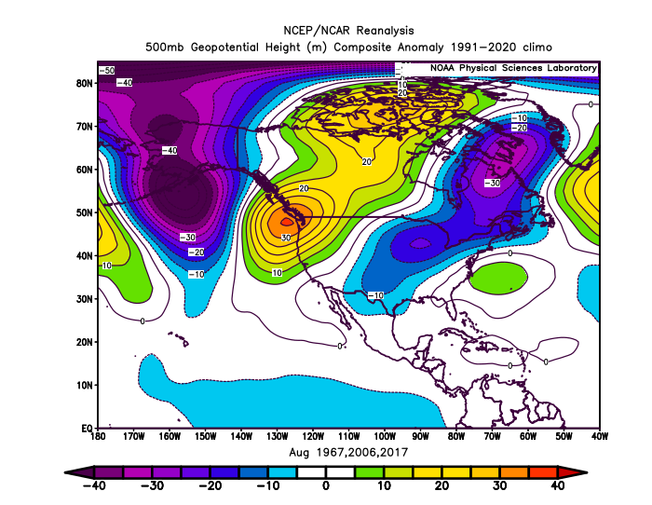
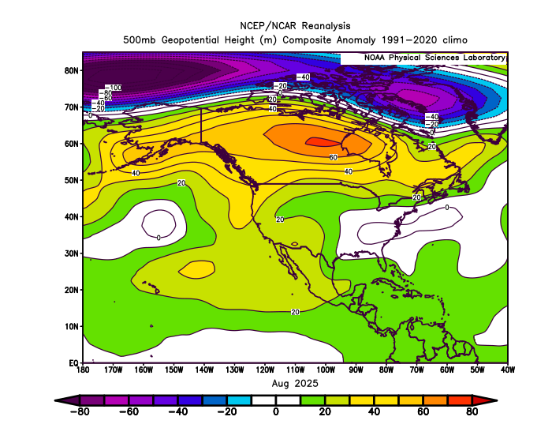
August 2025 (Forecast Issued July 17, 2025)/(Actual)
Forecast Upper-Air Anomalies
Actual Upper-Air Anomalies
Positive (warm) anomalies covered the Pacific NW in both the composite analog forecast (left) and the observed pattern (right). A “forecast hit.”

Slide 6
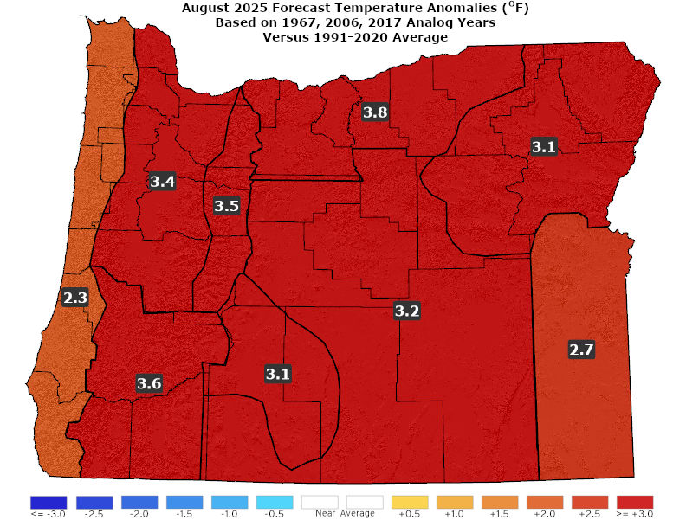
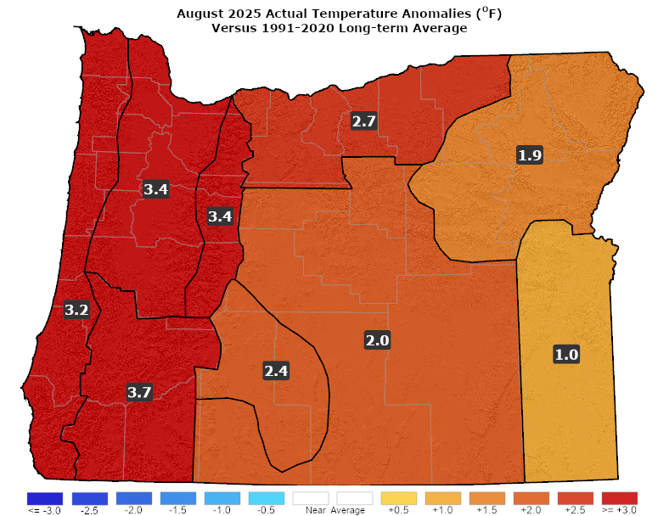
August 2025 (Forecast Issued July 17, 2025)/(Actual)
Forecast Temperatures
Actual Temperatures
Data courtesy of the National Centers for Environmental Information (NCEI)
Notes:
Temp Data: ftp://ftp.ncdc.noaa.gov/pub/data/cirs/drd964x.tmp.txt Precip Data: ftp://ftp.ncdc.noaa.gov/pub/data/cirs/drd964x.pcp.txt

Slide 7
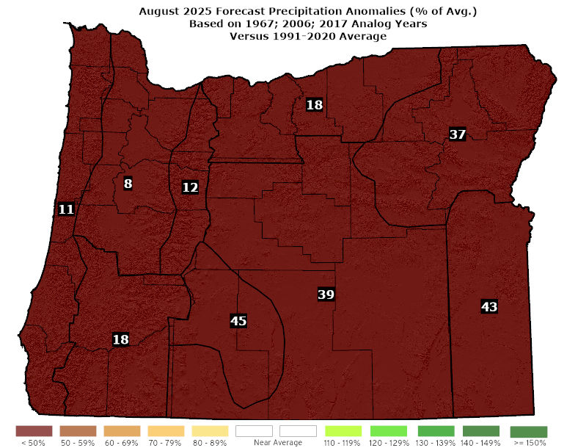
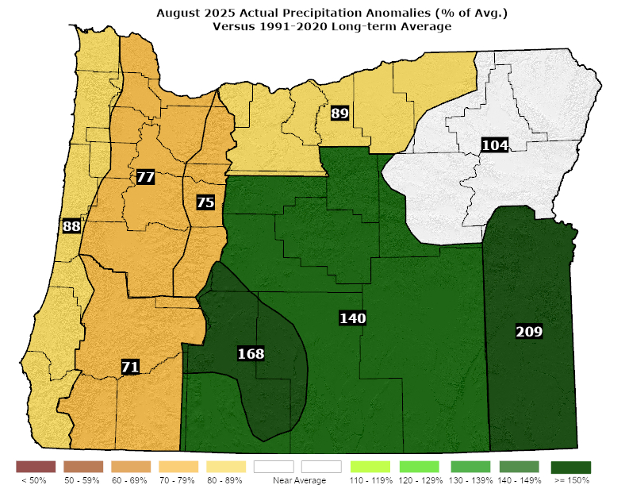
August 2025 (Forecast Issued July 17, 2025)/(Actual)
Forecast Precipitation
Actual Precipitation
Data courtesy of the National Centers for Environmental Information (NCEI)
Notes:
Temp Data: ftp://ftp.ncdc.noaa.gov/pub/data/cirs/drd964x.tmp.txt Precip Data: ftp://ftp.ncdc.noaa.gov/pub/data/cirs/drd964x.pcp.txt

Slide 8
August 2025 (Forecast Issued July 17, 2025)/(Actual)
Both the 1967 & 2017 analog years had unusually hot weather with multiple days of 100+°F heat in the valleys. In contrast, 2006 was moderate. (A moderate first week was followed by a couple of hot spells with western valley temperatures exceeding 100°F. Parts of central and NE Oregon also touched the century mark at times.) A “forecast hit.”
The analogs years varied from slightly drier than average to much-drier than average. (Western zones were drier than average but eastern areas had near-to-above-average rainfall.) A “partial forecast hit.”

Slide 9
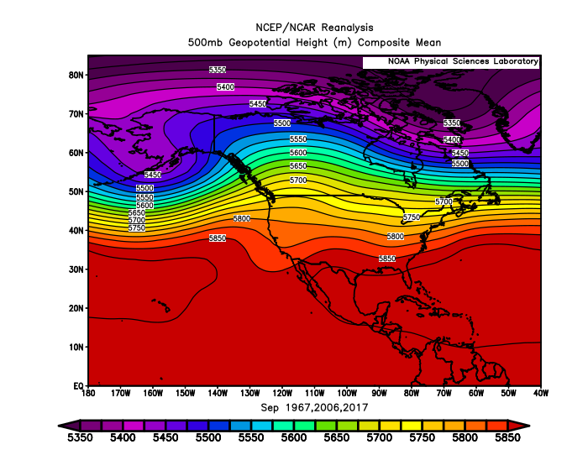
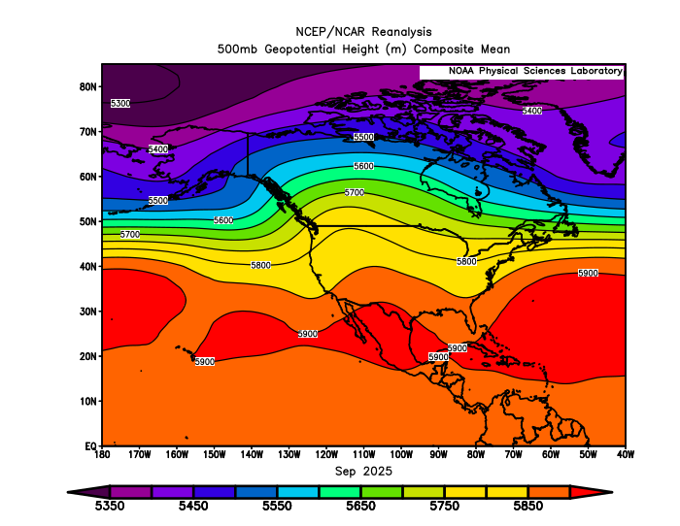
September 2025 (Forecast Issued August 21, 2025)/(Actual)
Forecast Upper-Air Pattern
Actual Upper-Air Pattern
The analog composite (left) and 2025 pattern (right) showed upper-level ridging centered just east of the Pacific NW with predominant W-SW flow aloft over Oregon. A “forecast hit.”

Slide 10
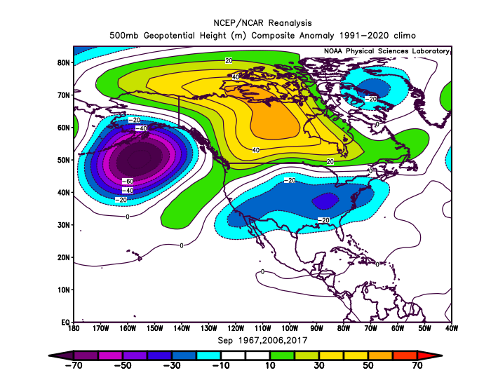
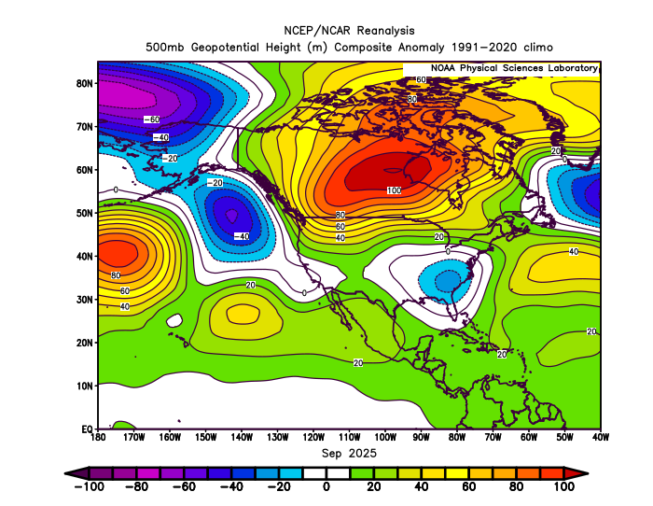
September 2025 (Forecast Issued August 21, 2025)/(Actual)
Forecast Upper-Air Anomalies
Actual Upper-Air Anomalies
Both the analog forecast (left) and the September 2025 pattern (right) had a broad area of positive (warm) anomalies centered over central Canada extending southwestward, to over the Pacific NW. A “forecast hit.”

Slide 11
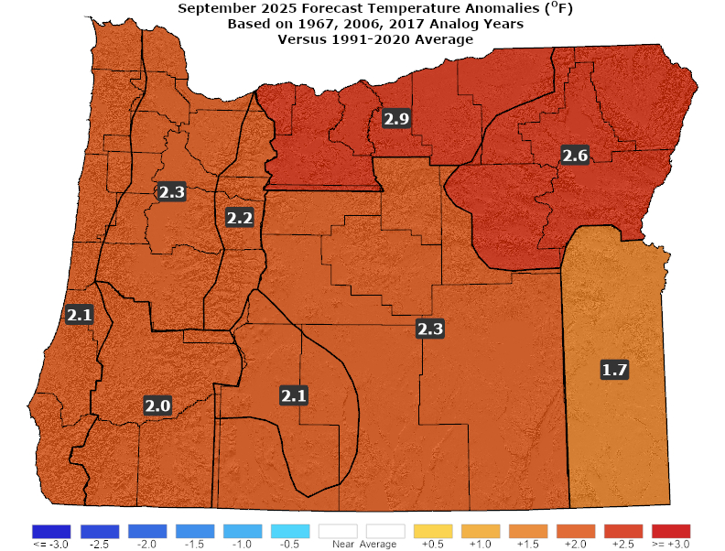
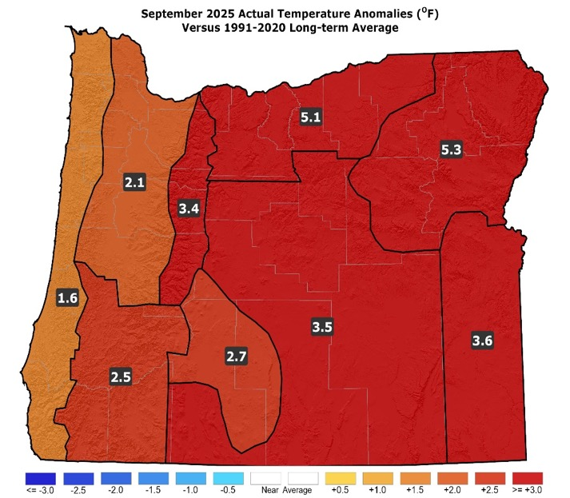
September 2025 (Forecast Issued August 21, 2025)/(Actual)
Forecast Temperatures
Actual Temperatures
Data courtesy of the National Centers for Environmental Information (NCEI)
Notes:
Temp Data: ftp://ftp.ncdc.noaa.gov/pub/data/cirs/drd964x.tmp.txt Precip Data: ftp://ftp.ncdc.noaa.gov/pub/data/cirs/drd964x.pcp.txt

Slide 12
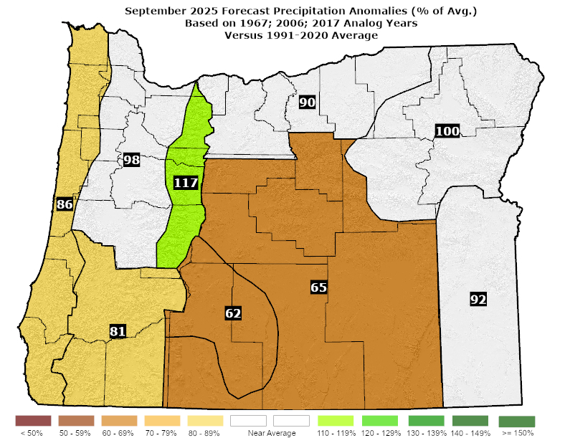
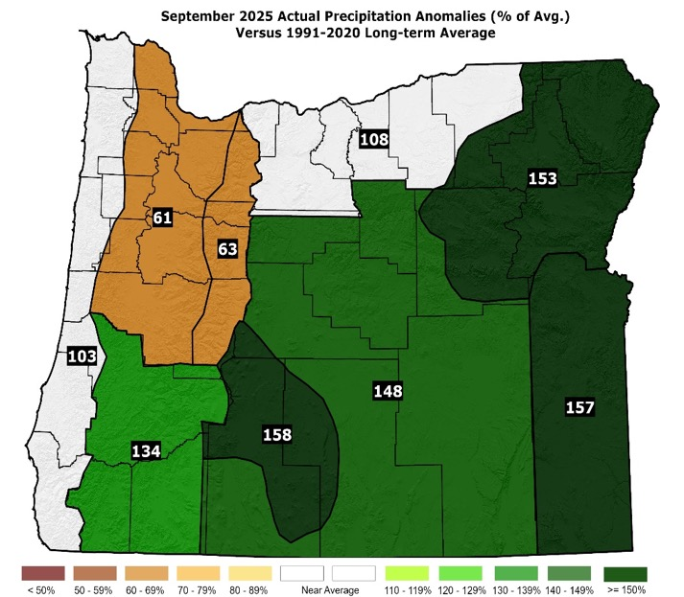
September 2025 (Forecast Issued August 21, 2025)/(Actual)
Forecast Precipitation
Actual Precipitation
Data courtesy of the National Centers for Environmental Information (NCEI)
Notes:
Temp Data: ftp://ftp.ncdc.noaa.gov/pub/data/cirs/drd964x.tmp.txt Precip Data: ftp://ftp.ncdc.noaa.gov/pub/data/cirs/drd964x.pcp.txt

Slide 13
September 2025 (Forecast Issued August 21, 2025)/(Actual)
Above-average temperatures with enhanced chances for 100+°F heat in some western valley and eastern basin sites through mid-month. (Temperatures were above normal statewide...with highs climbing into the 90s at times in both the western valleys and the eastern basins.) A “forecast hit.”
Precipitation near or below average. Drier analogs of 1967 & 2006 were countered by a wetter 2017. All analog years had at least some shower activity. (Upper-level troughs brought showers to much of the state at mid-month and again at month’s end. Rainfall was below average in the NW zones but near or above average elsewhere, in what is typically one of the drier months of the year statewide. A “partial forecast hit.”

Slide 14
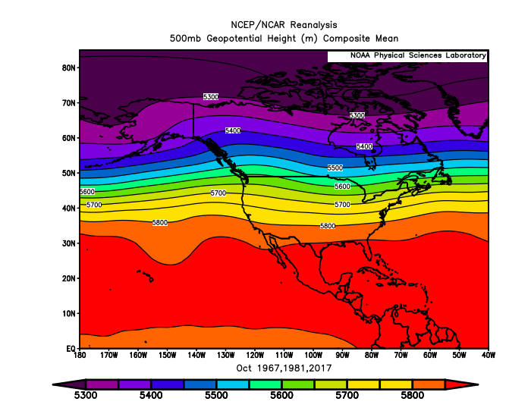
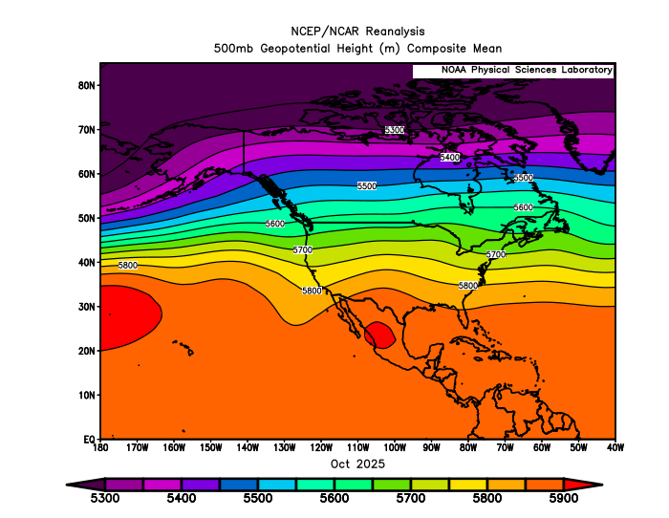
October 2025 (Forecast Issued September 18, 2025)/(Actual)
Forecast Upper-Air Pattern
Actual Upper-Air Pattern
Both the analog blend (left) and the October 2025 observed pattern (right) had prevailing westerly flow aloft over Oregon...ranging from more SW flow, in 1967, to more W-NW flow, in 2017. A “forecast hit.”

Slide 15
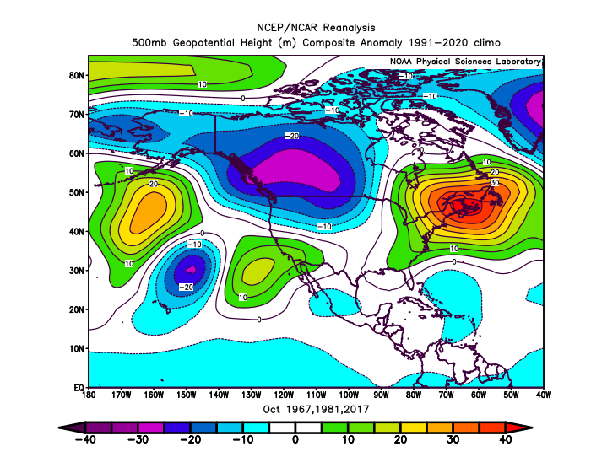
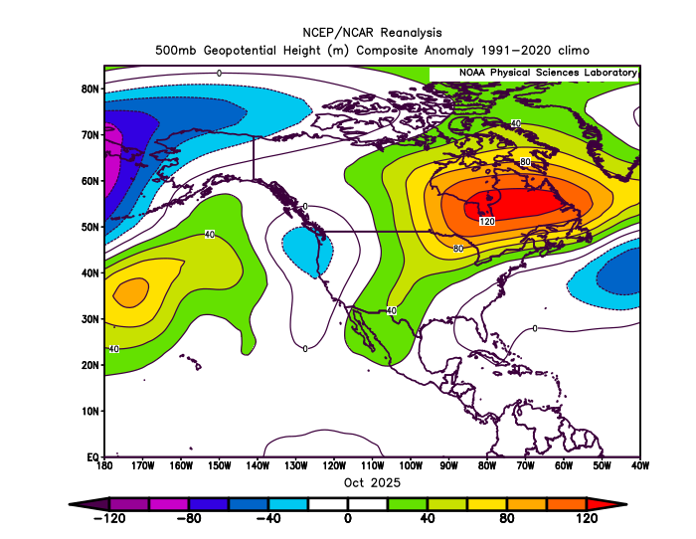
October 2025 (Forecast Issued September 18, 2025)/(Actual)
Forecast Upper-Air Anomalies
Actual Upper-Air Anomalies
Analogs (left) ranged from anomalous troughing in 1981 to ridging in 2017, with the blend favoring troughing. 2025 (right) had anomalous troughing. A “forecast hit.”

Slide 16
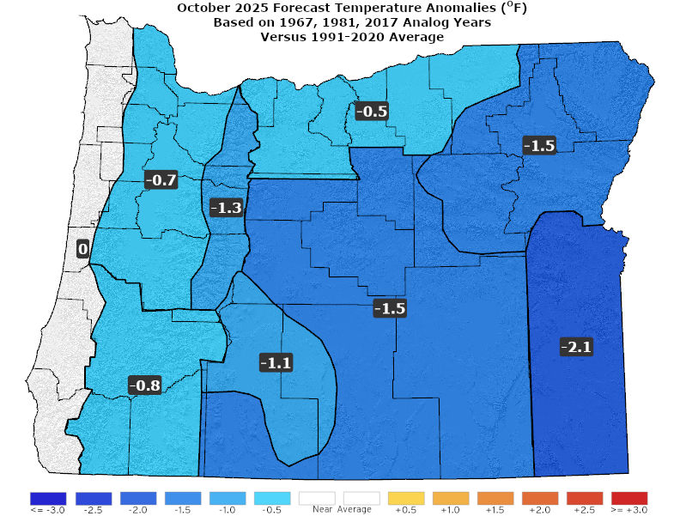
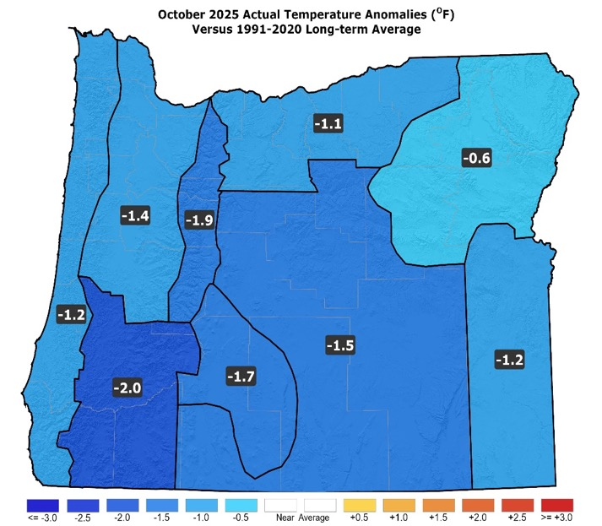
October 2025 (Forecast Issued September 18, 2025)/(Actual)
Forecast Temperatures
Actual Temperatures
Data courtesy of the National Centers for Environmental Information (NCEI)
Notes:
Temp Data: ftp://ftp.ncdc.noaa.gov/pub/data/cirs/drd964x.tmp.txt Precip Data: ftp://ftp.ncdc.noaa.gov/pub/data/cirs/drd964x.pcp.txt

Slide 17
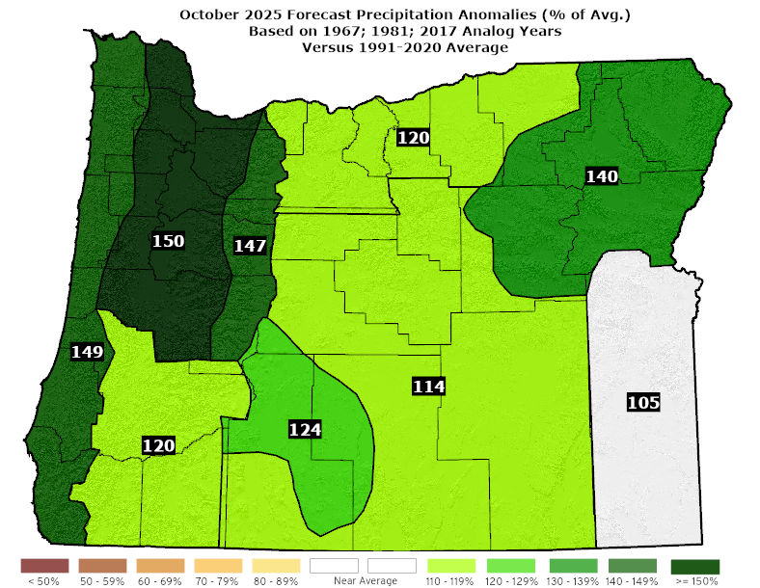
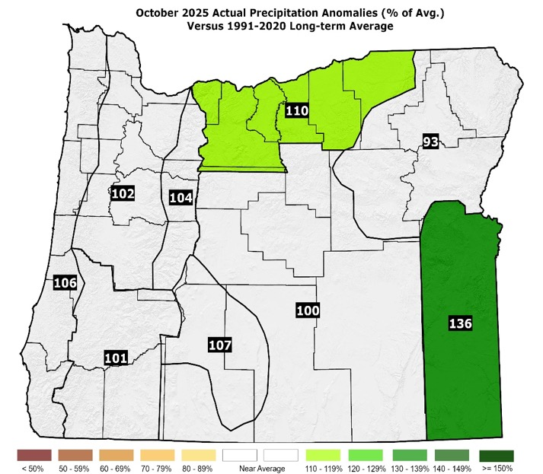
October 2025 (Forecast Issued September 18, 2025)/(Actual)
Forecast Precipitation
Actual Precipitation
Data courtesy of the National Centers for Environmental Information (NCEI)
Notes:
Temp Data: ftp://ftp.ncdc.noaa.gov/pub/data/cirs/drd964x.tmp.txt Precip Data: ftp://ftp.ncdc.noaa.gov/pub/data/cirs/drd964x.pcp.txt

Slide 18
October 2025 (Forecast Issued September 18, 2025)/(Actual)
Despite differing upper-air patterns, the analogs had average or slightly below average temperatures. (October 2025 brought a marked shift from well-above-average temperatures to below-average temperatures.) A “forecast hit.”
Above-average precipitation with some snow on the mountain passes by month’s end. (October 2025 had near-average or above-average precipitation. The mountain passes saw brief snow.) Mostly a “forecast hit.”

Slide 19
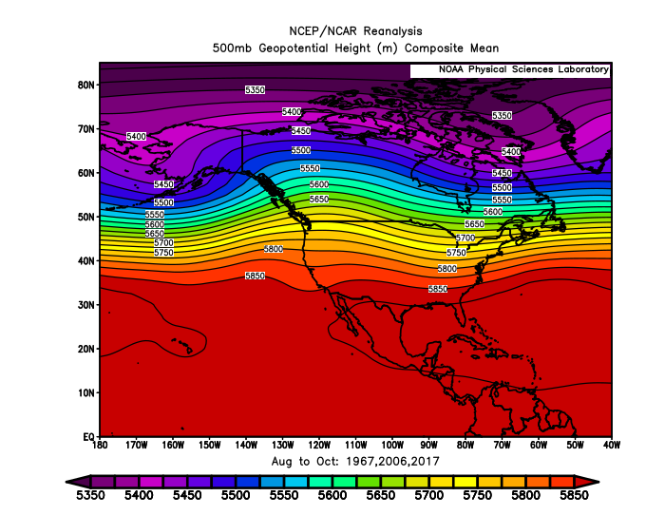
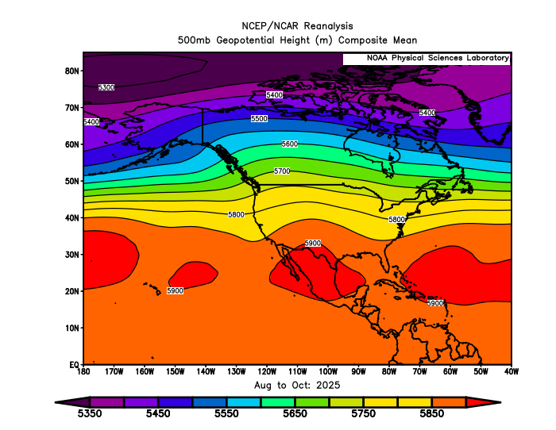
August – October 2025 (Forecast Issued July 17, 2025)/(Actual)
Forecast Upper-Air Pattern
Actual Upper-Air Pattern
A composite of the analogs (left) and the actual 2025 upper-air pattern (right) were a very close match over the Pacific NW. A “forecast hit.”

Slide 20
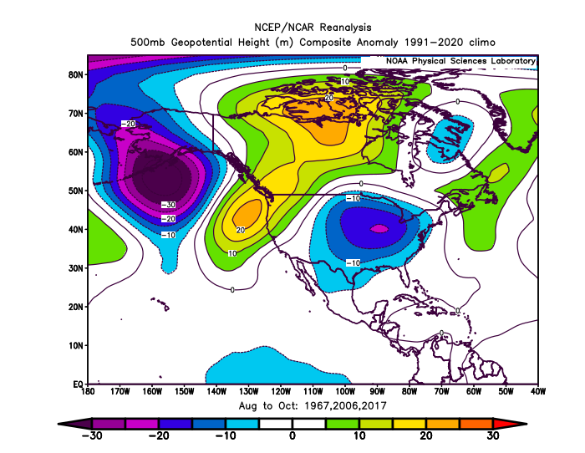
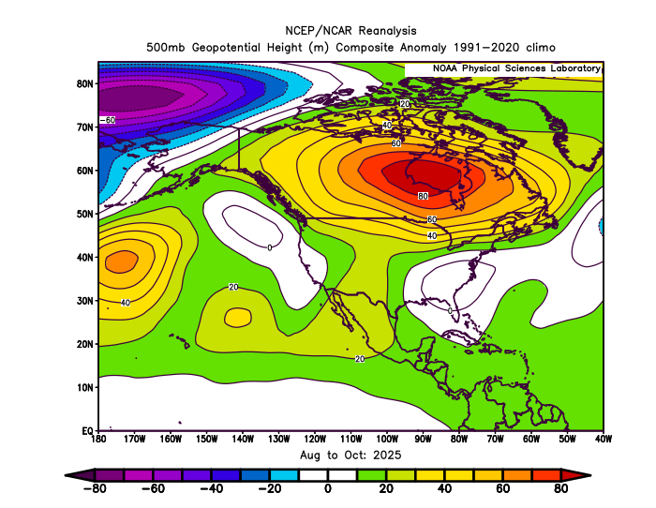
August – October 2025 (Forecast Issued July 17, 2025)/(Actual)
Forecast Upper-Air Anomalies
Actual Upper-Air Anomalies
Both the forecast analogs (left) and the actual 2025 pattern (right) maintained anomalous ridging over the Pacific Northwest, despite anomalous troughing in October. A “forecast hit.”

Slide 21
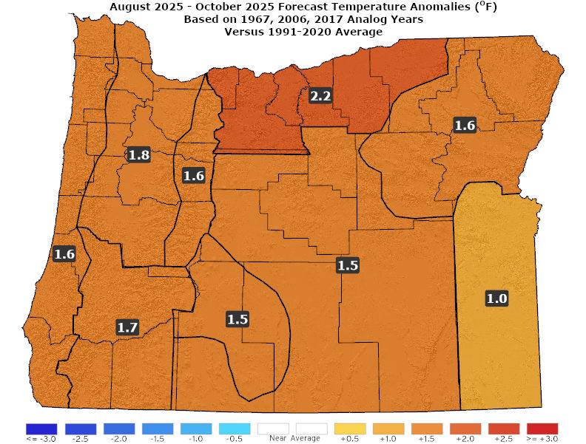
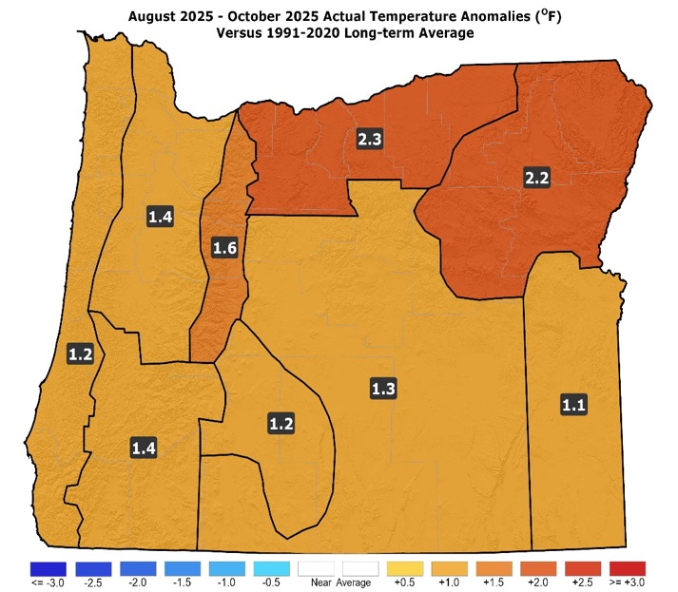
August – October 2025 (Forecast Issued July 17, 2025)/(Actual)
Forecast Temperatures
Actual Temperatures
Data courtesy of the National Centers for Environmental Information (NCEI)
Notes:
Temp Data: ftp://ftp.ncdc.noaa.gov/pub/data/cirs/drd964x.tmp.txt Precip Data: ftp://ftp.ncdc.noaa.gov/pub/data/cirs/drd964x.pcp.txt

Slide 22
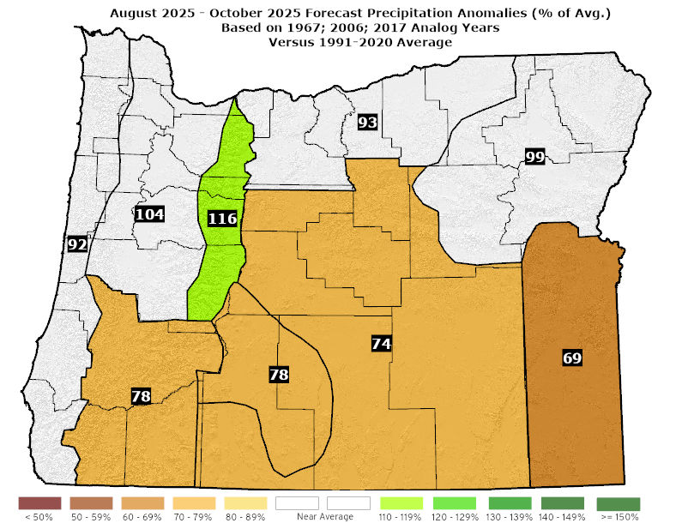
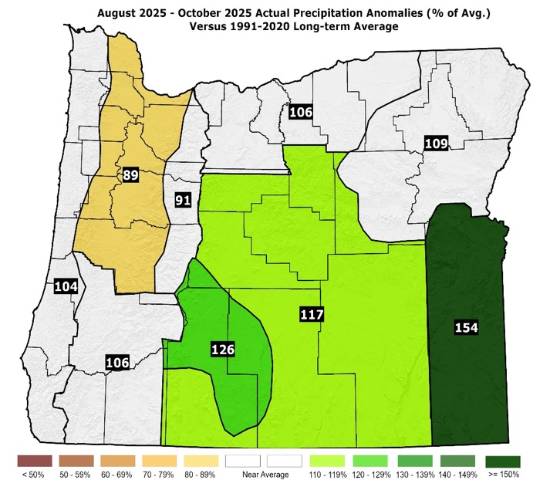
August – October 2025 (Forecast Issued July 17, 2025)/(Actual)
Forecast Precipitation
Actual Precipitation
Data courtesy of the National Centers for Environmental Information (NCEI)
Notes:
Temp Data: ftp://ftp.ncdc.noaa.gov/pub/data/cirs/drd964x.tmp.txt Precip Data: ftp://ftp.ncdc.noaa.gov/pub/data/cirs/drd964x.pcp.txt

Slide 23
August – October 2025 (Forecast Issued July 17, 2025)/(Actual)
Warmer than average weather through September, then a marked shift to average or slightly cooler-than-average conditions in October. (Above-average temperatures were experienced through September, with a switch to cooler-than-average conditions in October.) A “forecast hit.”
Drier than average conditions, especially south. Heightened chances for lightning episodes. (August was dry in the west but produced considerable thundershower activity from the Cascades eastward. September was drier than average for the NW zones, but the remainder of the state had near or above-average rainfall. October saw mostly near-average rainfall.) A “partial forecast hit.”

Slide 24
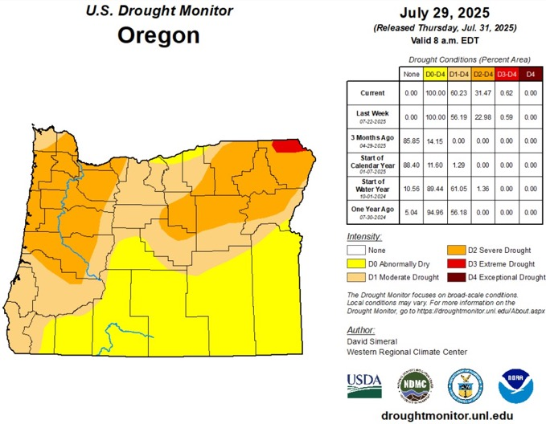
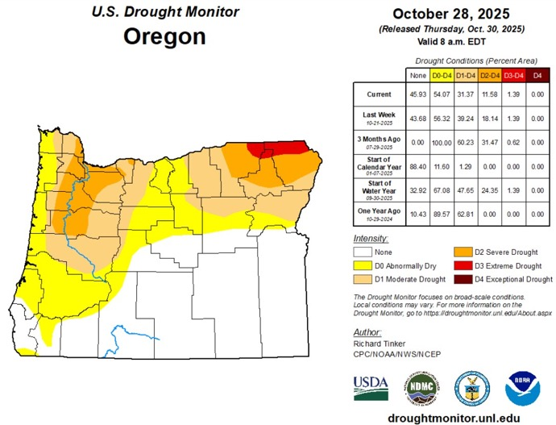
Oregon Drought Status
(Minor Improvement Most Areas)
July 29, 2025
October 28, 2025
Courtesy: National Drought Mitigation Center (NDMC)
https://droughtmonitor.unl.edu/

Slide 25
Forecast Resources
ODA Seasonal Climate Forecast Home:
https://www.oregon.gov/oda/natural-resources/pages/weather.aspx
CPC Official US Three-Month Forecasts (Graphics):
https://www.cpc.ncep.noaa.gov/products/predictions/long_range/seasonal.php?lead=01
CPC US 30-Day & 90-Day Forecasts (Discussions):
https://www.cpc.ncep.noaa.gov/products/predictions/long_range/fxus07.html
CPC Weekly & Monthly ENSO Discussions: https://www.cpc.ncep.noaa.gov/products/analysis_monitoring/enso_advisory
Australian Government Climate Model Summary:
http://www.bom.gov.au/climate/model-summary/#region=NINO34&tabs=Overview
Australian Government ENSO Wrap-Up:
http://www.bom.gov.au/climate/enso
IRI ENSO Quick Look:
https://iri.columbia.edu/our-expertise/climate/forecasts/enso/current/

Slide 26
Water Supply / Fire-Potential Outlook
CPC U.S. Seasonal Drought Outlook:
https://www.cpc.ncep.noaa.gov/products/expert_assessment/season_drought.png
NRCS Snow Water Equivalent Oregon Map:
https://www.wcc.nrcs.usda.gov/ftpref/data/water/wcs/gis/maps/or_swepctnormal_update.pdf
NRCS/USDA Snow Water Equivalent Products:
https://www.nrcs.usda.gov/wps/portal/wcc/home/snowClimateMonitoring/snowpack/
NDMC U.S. Drought Monitor:
https://droughtmonitor.unl.edu/
NIDIS North American Drought Portal:
https://www.drought.gov/nadm/content/percent-average-precipitation
WRCC WestWideDroughtTracker:
https://www.wrcc.dri.edu/wwdt/
NWCC Northwest Interagency Coordination Center (video)
https://gacc.nifc.gov/nwcc/predict/outlook.aspx

Slide 27
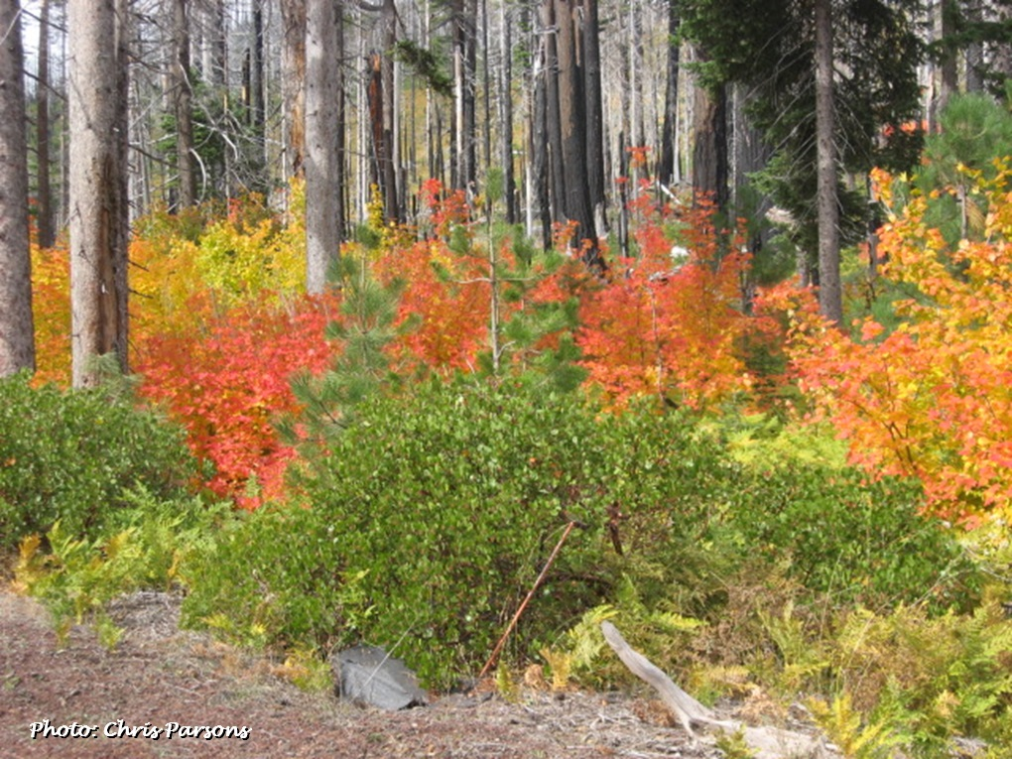
Updated Mid-Month
Your Feedback is Welcome!
Sign-up for Email notification of updates at:
https://public.govdelivery.com/accounts/ORODA/subscriber/new?topic_id=ORODA_14
Contact: Pete Parsons, ODF Lead Meteorologist
at 503-945-7448 or peter.gj.parsons@odf.oregon.gov

