Slide 1
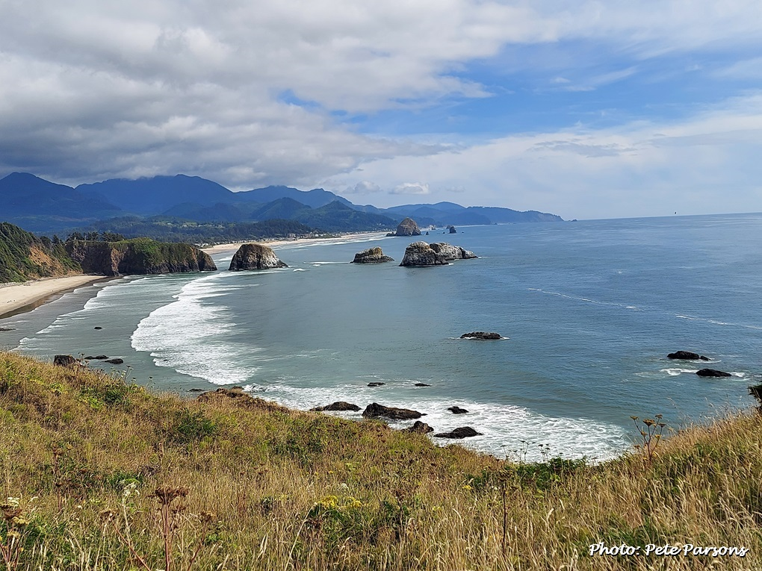
Seasonal Climate Forecast Verification
September – November 2025
Issued: December 11, 2025
Contact: Pete Parsons, ODF Lead Meteorologist
503-945-7448 or peter.gj.parsons@odf.oregon.gov
Production - ODA: Andy Zimmerman; Jenn Ambrose; Laura Passage Production - ODF: Julie Vondrachek; Kristin Cody; Gary Votaw; Sherri Pugh

Slide 2
Format and Purpose:
A side-by-side comparison of the “Seasonal Climate Forecast” vs. what (Actually Occurred) is done for both the 1-month & 3-month forecasts.*
The accuracy of each forecast is reviewed, and the need for analog-year updates is examined.
This is part of an ongoing assessment of the utility of this forecast method.**
*Utilizes 1991-2020 long-term averages
**See “Forecasting Methods…” at:
https://www.oregon.gov/oda/natural-resources/pages/weather.aspx

Slide 3
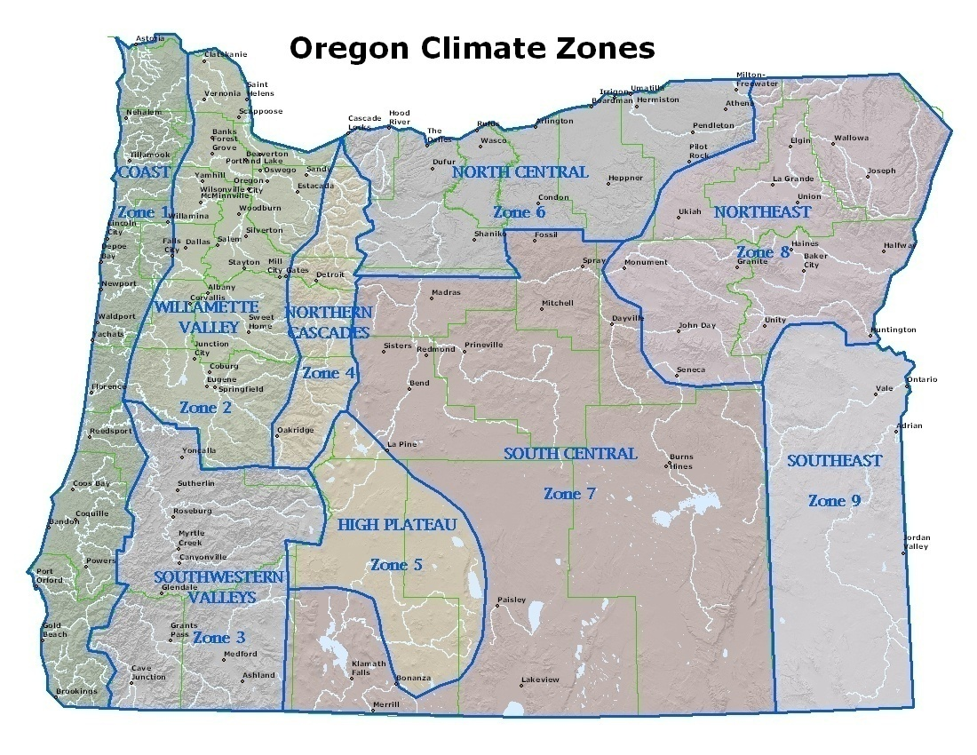

Slide 4
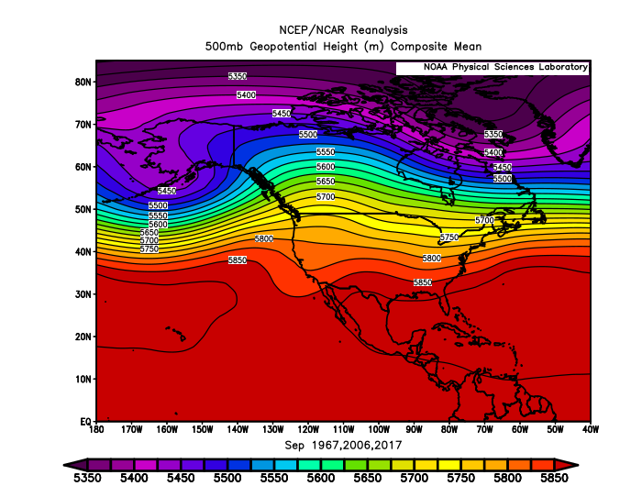
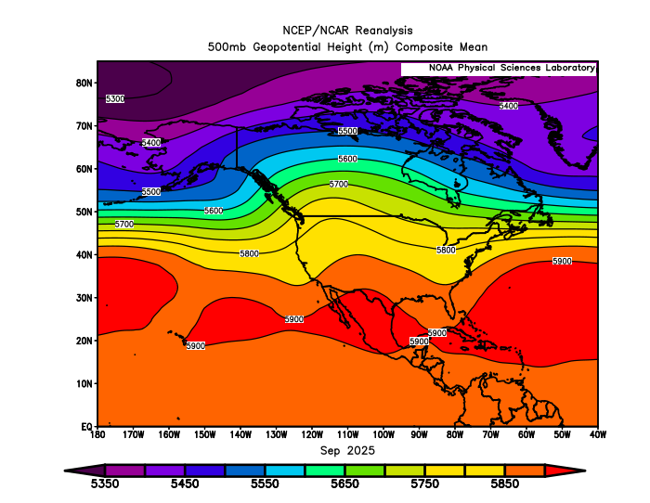
September 2025
(Forecast Issued August 21, 2025)/(Actual)
Forecast Upper-Air Pattern
Actual Upper-Air Pattern
The analog composite (left) and 2025 pattern (right) showed upper-level ridging centered just east of the Pacific NW with predominant W-SW flow aloft over Oregon. A “forecast hit.”

Slide 5
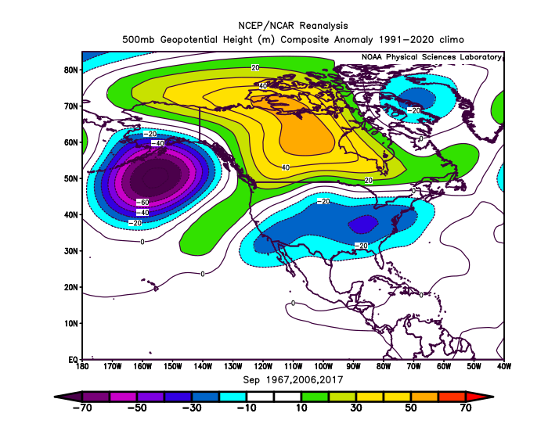
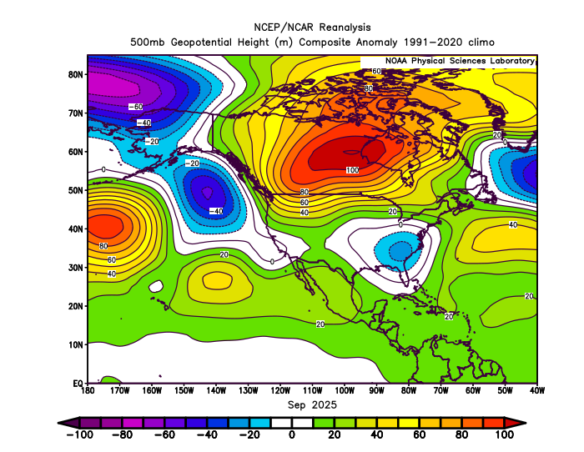
September 2025
(Forecast Issued August 21, 2025)/(Actual)
Forecast Upper-Air Anomalies
Actual Upper-Air Anomalies
Both the analog forecast (left) and the September 2025 pattern (right) had a broad area of positive (warm) anomalies centered over central Canada extending southwestward, to over the Pacific NW. A “forecast hit.”

Slide 6
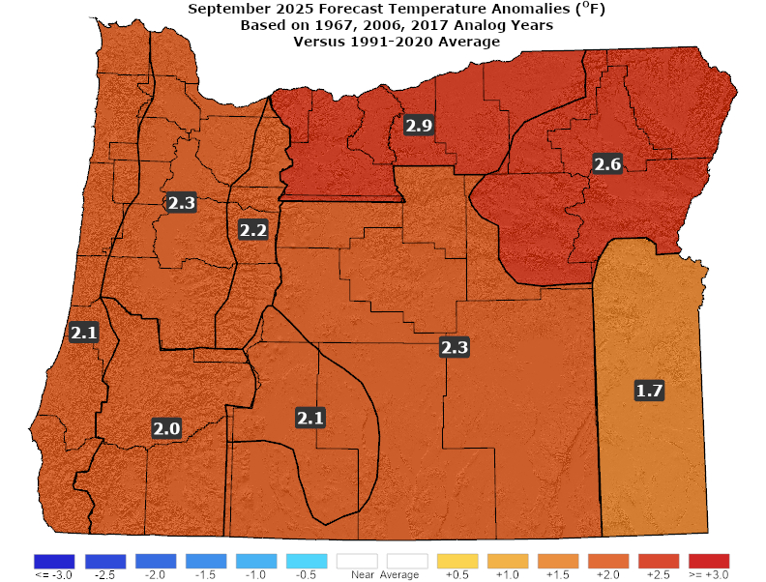
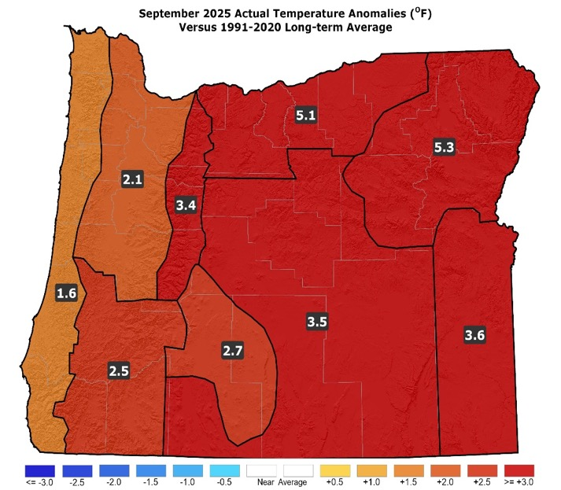
September 2025
(Forecast Issued August 21, 2025)/(Actual)
Forecast Temperatures
Actual Temperatures
Data courtesy of the National Centers for Environmental Information (NCEI)
Notes:
Temp Data: ftp://ftp.ncdc.noaa.gov/pub/data/cirs/drd964x.tmp.txt Precip Data: ftp://ftp.ncdc.noaa.gov/pub/data/cirs/drd964x.pcp.txt

Slide 7
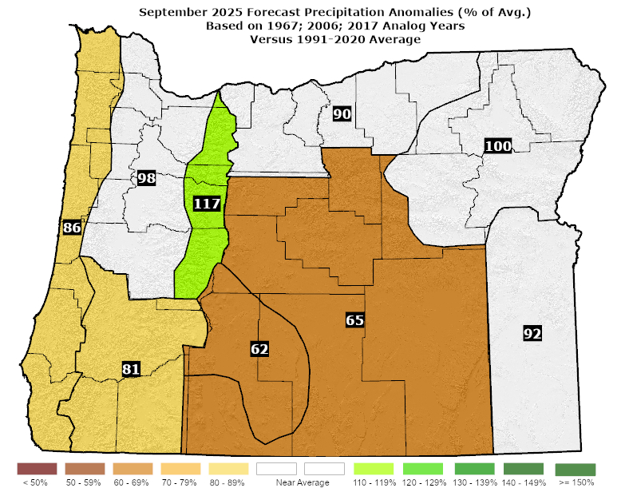
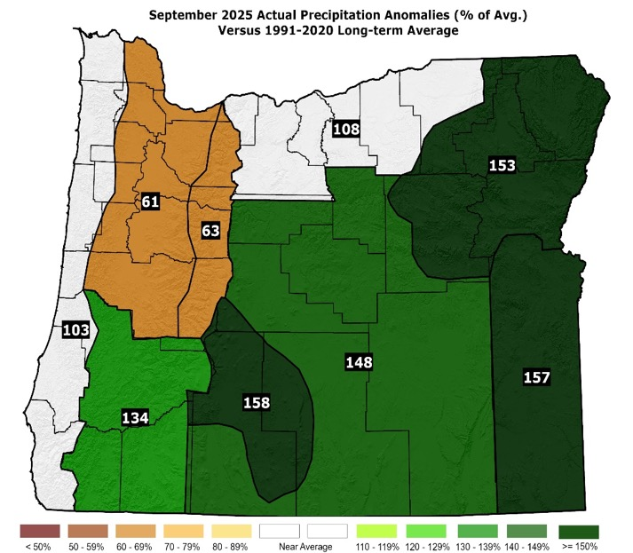
September 2025
(Forecast Issued August 21, 2025)/(Actual)
Forecast Precipitation
Actual Precipitation
Data courtesy of the National Centers for Environmental Information (NCEI)
Notes:
Temp Data: ftp://ftp.ncdc.noaa.gov/pub/data/cirs/drd964x.tmp.txt Precip Data: ftp://ftp.ncdc.noaa.gov/pub/data/cirs/drd964x.pcp.txt

Slide 8
September 2025
(Forecast Issued August 21, 2025)/(Actual)
Above-average temperatures with enhanced chances for 100+°F heat in some western valley and eastern basin sites through mid-month. (Temperatures were above normal statewide...with highs climbing into the 90s at times in both the western valleys and the eastern basins.) A “forecast hit.”
Precipitation near or below average. Drier analogs of 1967 & 2006 were countered by a wetter 2017. All analog years had at least some shower activity. (Upper-level troughs brought showers to much of the state at mid-month and again at month’s end. Rainfall was below average in the NW zones but near or above average elsewhere, in what is typically one of the drier months of the year statewide. A “partial forecast hit.”

Slide 9
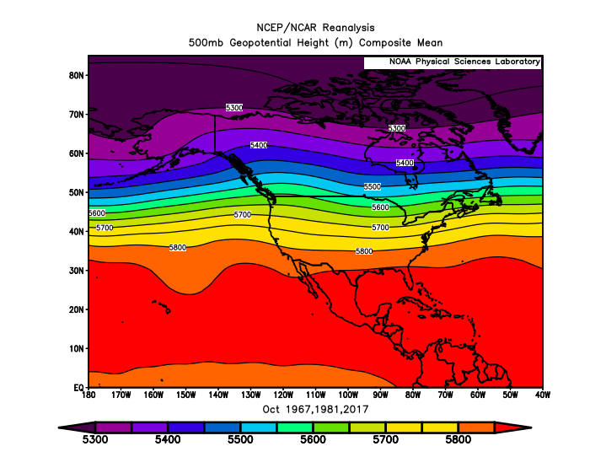
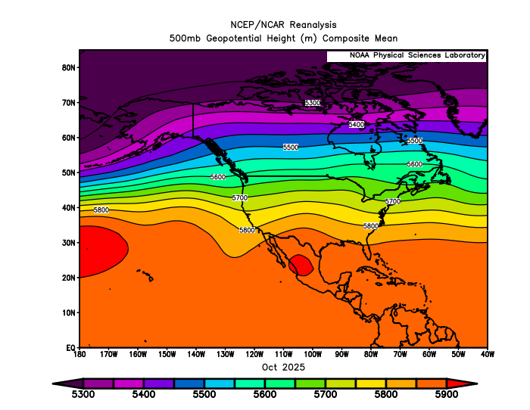
October 2025
(Forecast Issued September 18, 2025)/(Actual)
Forecast Upper-Air Pattern
Actual Upper-Air Pattern
Both the analog blend (left) and the October 2025 observed pattern (right) had prevailing westerly flow aloft over Oregon...ranging from more SW flow, in 1967, to more W-NW flow, in 2017. A “forecast hit.”

Slide 10
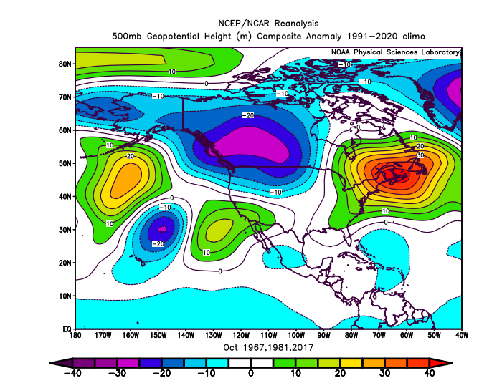
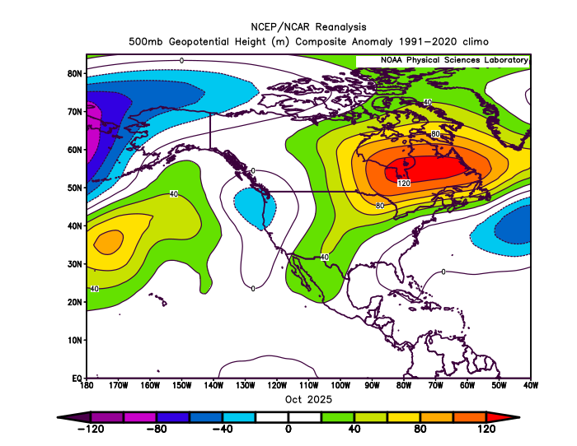
October 2025
(Forecast Issued September 18, 2025)/(Actual)
Forecast Upper-Air Anomalies
Actual Upper-Air Anomalies
Analogs (left) ranged from anomalous troughing in 1981 to ridging in 2017, with the blend favoring troughing. 2025 (right) had anomalous troughing. A “forecast hit.”

Slide 11
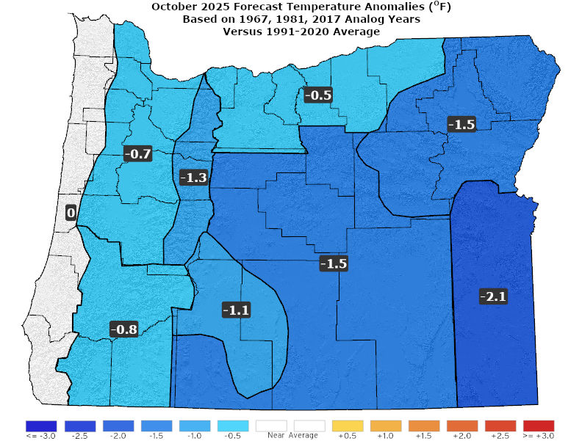
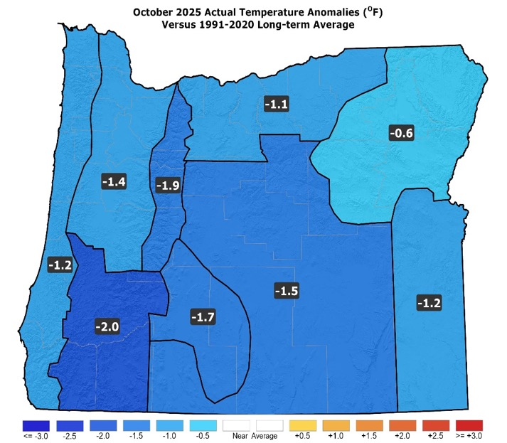
October 2025
(Forecast Issued September 18, 2025)/(Actual)
Forecast Temperatures
Actual Temperatures
Data courtesy of the National Centers for Environmental Information (NCEI)
Notes:
Temp Data: ftp://ftp.ncdc.noaa.gov/pub/data/cirs/drd964x.tmp.txt Precip Data: ftp://ftp.ncdc.noaa.gov/pub/data/cirs/drd964x.pcp.txt

Slide 12
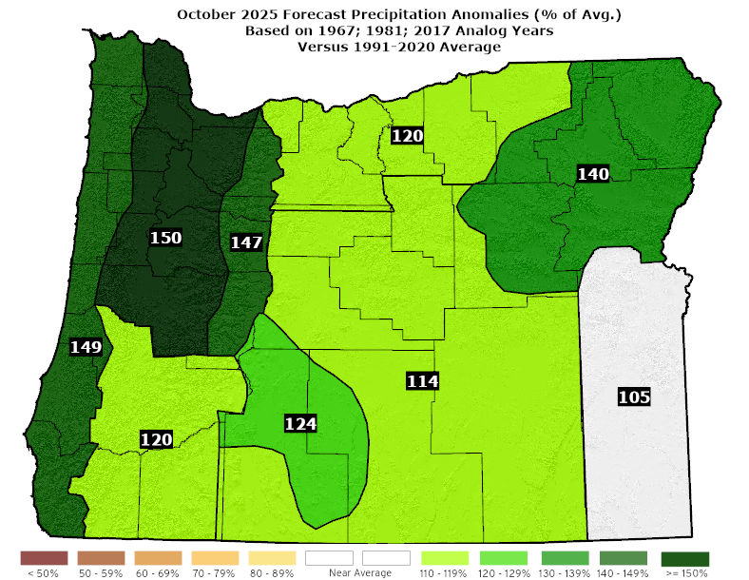
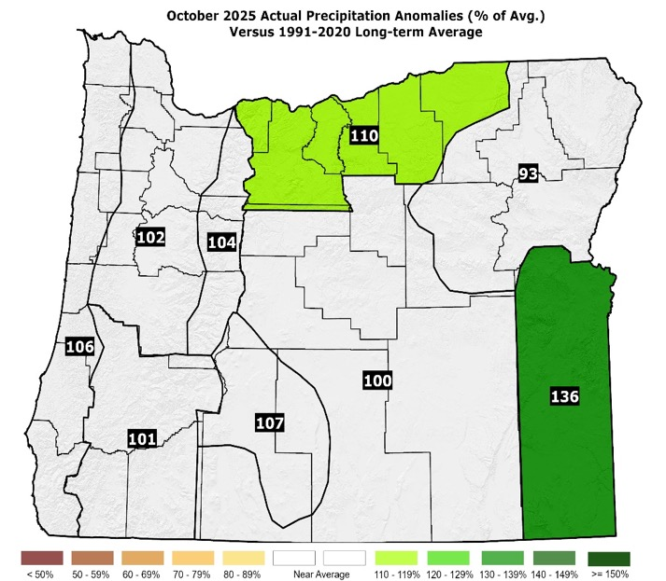
October 2025
(Forecast Issued September 18, 2025)/(Actual)
Forecast Precipitation
Actual Precipitation
Data courtesy of the National Centers for Environmental Information (NCEI)
Notes:
Temp Data: ftp://ftp.ncdc.noaa.gov/pub/data/cirs/drd964x.tmp.txt Precip Data: ftp://ftp.ncdc.noaa.gov/pub/data/cirs/drd964x.pcp.txt

Slide 13
October 2025
(Forecast Issued September 18, 2025)/(Actual)
Despite differing upper-air patterns, the analogs had average or slightly below average temperatures. (October 2025 brought a marked shift from well-above-average temperatures to below-average temperatures.) A “forecast hit.”
Above-average precipitation with some snow on the mountain passes by month’s end. (October 2025 had near-average or above-average precipitation. The mountain passes saw brief snow.) Mostly a “forecast hit.”

Slide 14
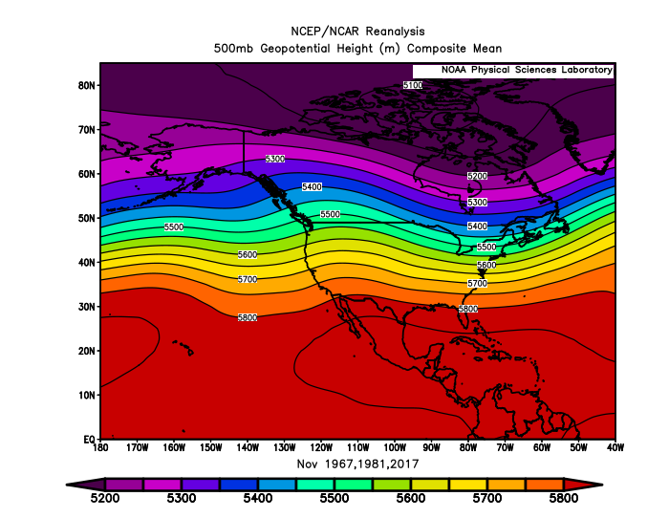
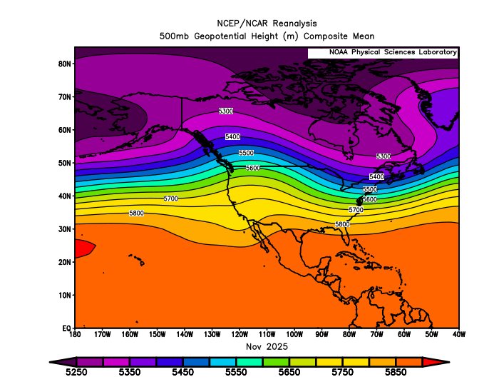
November 2025
(Forecast Issued October 16, 2025)/(Actual)
Forecast Upper-Air Pattern
Actual Upper-Air Pattern
The forecast (left) and the observed pattern (right) both showed mean ridging over the Rockies with prevailing SW flow aloft over Oregon. A “forecast hit.”

Slide 15
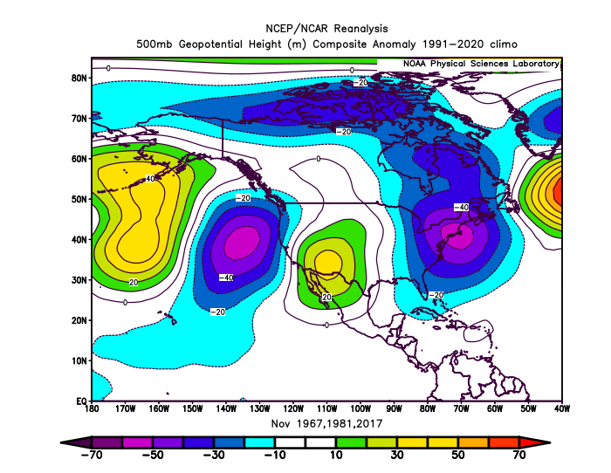
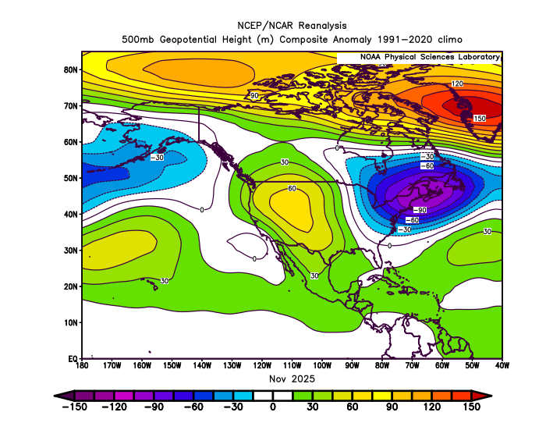
November 2025
(Forecast Issued October 16, 2025)/(Actual)
Forecast Upper-Air Anomalies
Actual Upper-Air Anomalies
The analog composite (left) had stronger anomalous troughing offshore than was observed (right), but both had anomalous ridging over the Rockies. A “partial forecast hit.”

Slide 16
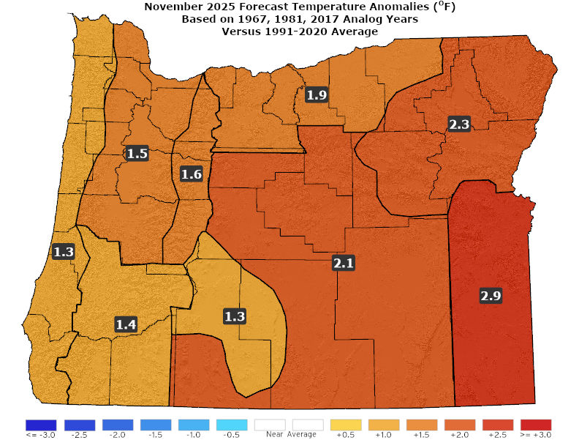
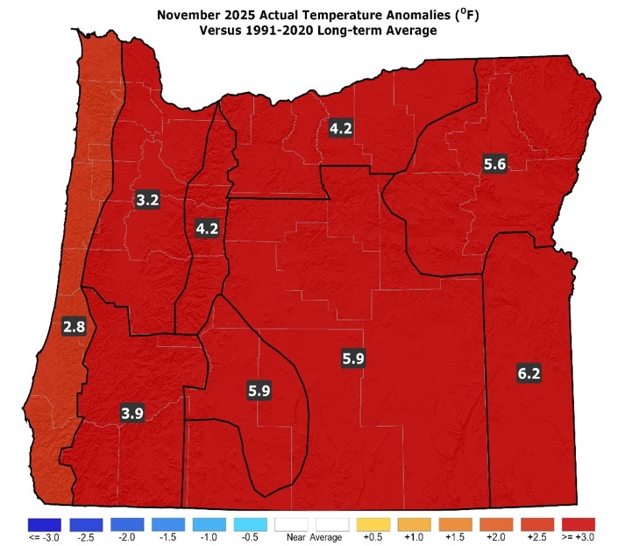
November 2025
(Forecast Issued October 16, 2025)/(Actual)
Forecast Temperatures
Actual Temperatures
Data courtesy of the National Centers for Environmental Information (NCEI)
Notes:
Temp Data: ftp://ftp.ncdc.noaa.gov/pub/data/cirs/drd964x.tmp.txt Precip Data: ftp://ftp.ncdc.noaa.gov/pub/data/cirs/drd964x.pcp.txt

Slide 17
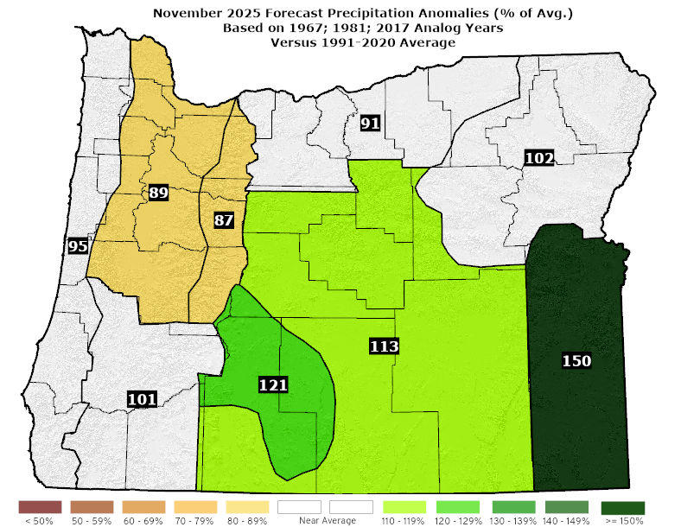
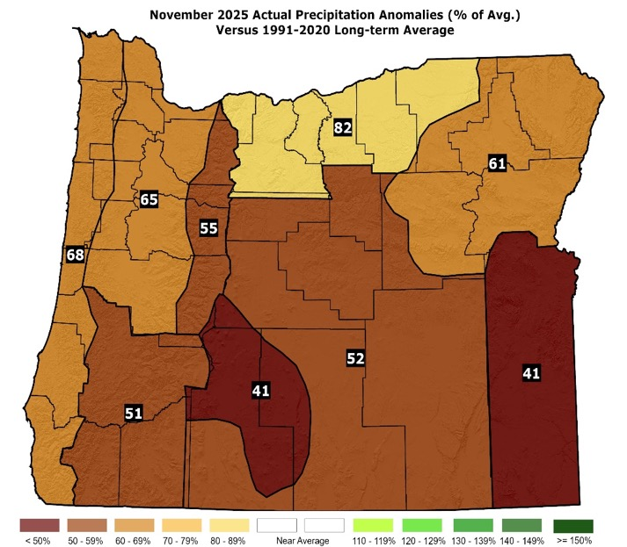
November 2025
(Forecast Issued October 16, 2025)/(Actual)
Forecast Precipitation
Actual Precipitation
Data courtesy of the National Centers for Environmental Information (NCEI)
Notes:
Temp Data: ftp://ftp.ncdc.noaa.gov/pub/data/cirs/drd964x.tmp.txt Precip Data: ftp://ftp.ncdc.noaa.gov/pub/data/cirs/drd964x.pcp.txt

Slide 18
November 2025
(Forecast Issued October 16, 2025)/(Actual)
Analogs exhibited above-average temperatures. 1981 had a significant windstorm (south winds) across the western zones. (Temperatures were well-above average statewide. There were stormy periods, especially along the coast and across the SW interior. Strong SSE winds, gusting to 82 mph, were observed in the Siskiyou Mountains SW of Ashland on the 13th.) A “forecast hit.”
Lower confidence in the precipitation forecast, with 1967 being quite dry and the other analogs years having near or above-average rainfall. (Rainfall was below average and less than predicted statewide...closest match was 1967.) A “partial forecast hit.”

Slide 19
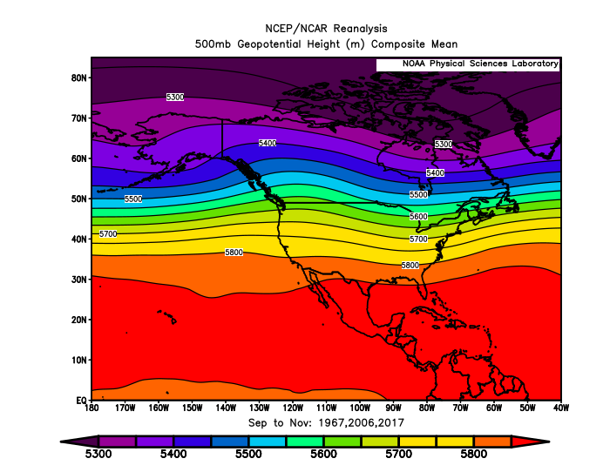
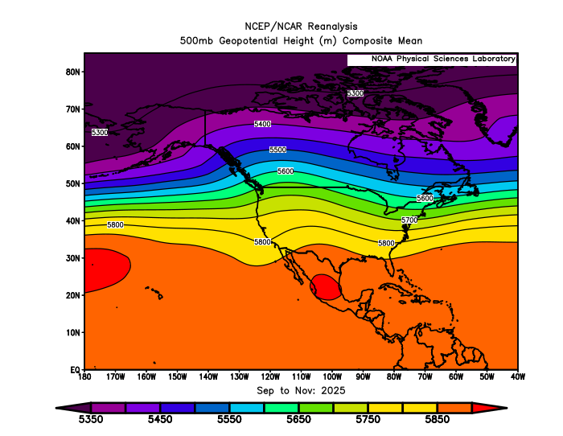
September – November 2025
(Forecast Issued August 21, 2025)/(Actual)
Forecast Upper-Air Pattern
Actual Upper-Air Pattern
A composite of the analogs (left) and the actual 2025 upper-air pattern (right) both showed mean ridging centered over the Rockies. A “forecast hit.”

Slide 20
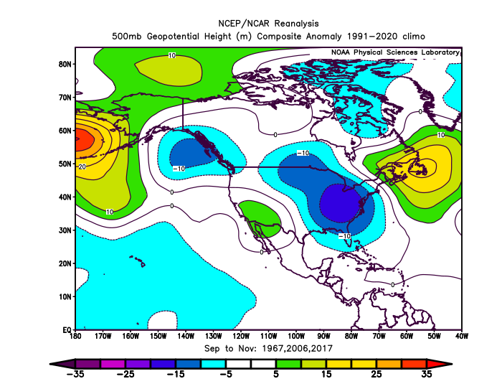
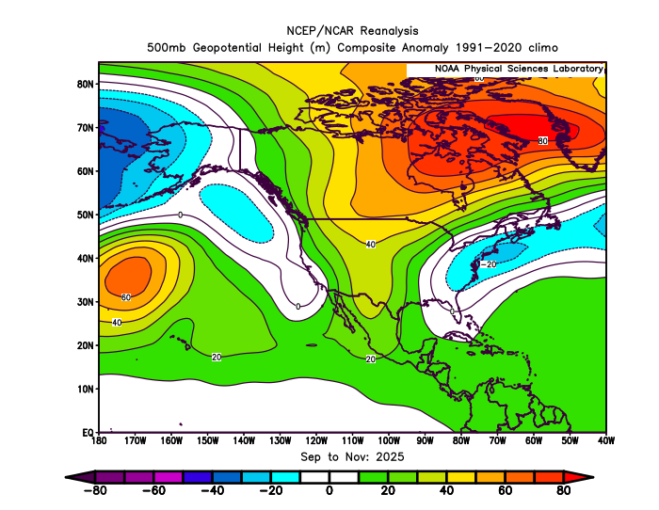
September – November 2025
(Forecast Issued August 21, 2025)/(Actual)
Forecast Upper-Air Anomalies
Actual Upper-Air Anomalies
Analogs ranged from weak anomalous ridging (1967) to weak anomalous troughing (2006) over Oregon. Their blend (left) had minimal anomalies, but 2025 had weak anomalous ridging extending over Oregon. A “partial forecast hit.”

Slide 21
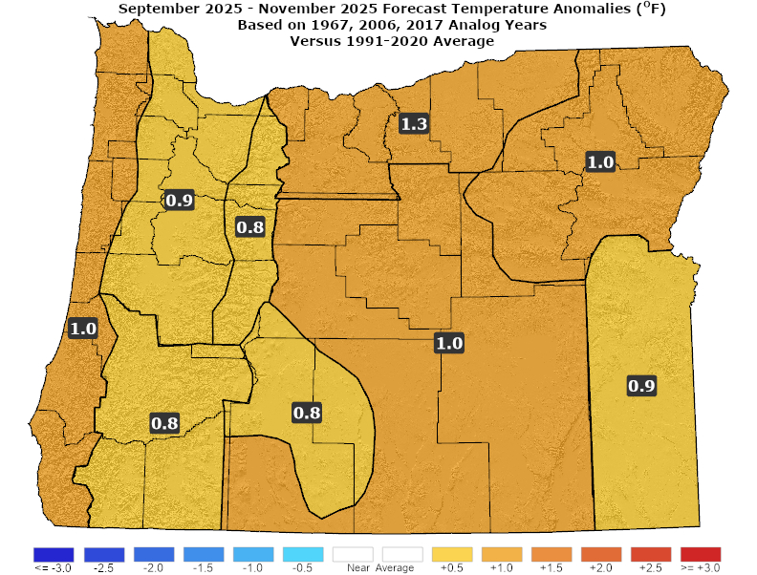
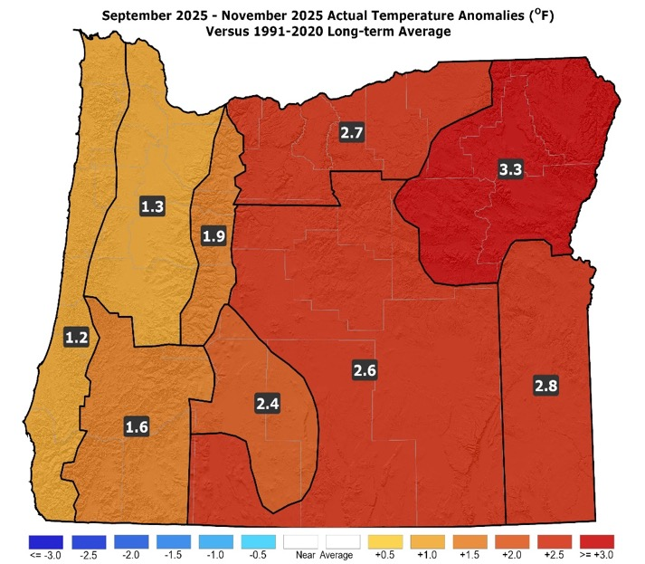
September – November 2025
(Forecast Issued August 21, 2025)/(Actual)
Forecast Temperatures
Actual Temperatures
Data courtesy of the National Centers for Environmental Information (NCEI)
Notes:
Temp Data: ftp://ftp.ncdc.noaa.gov/pub/data/cirs/drd964x.tmp.txt Precip Data: ftp://ftp.ncdc.noaa.gov/pub/data/cirs/drd964x.pcp.txt

Slide 22
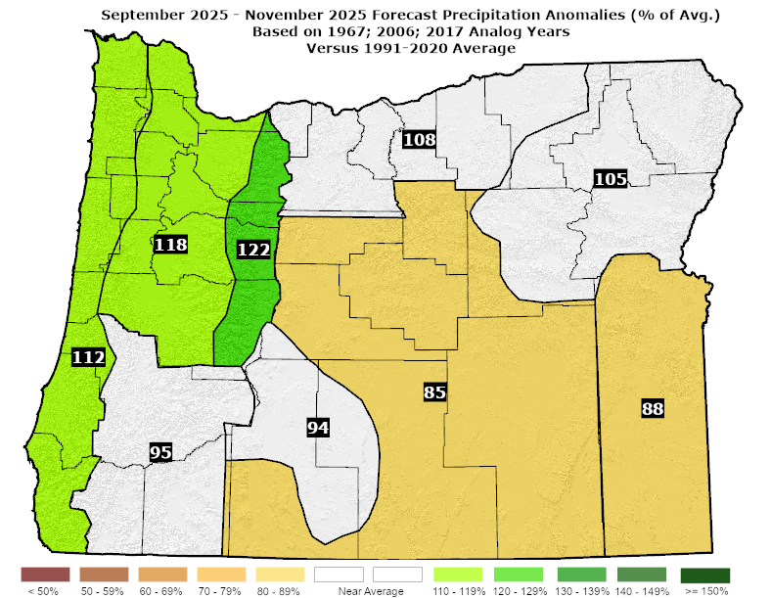
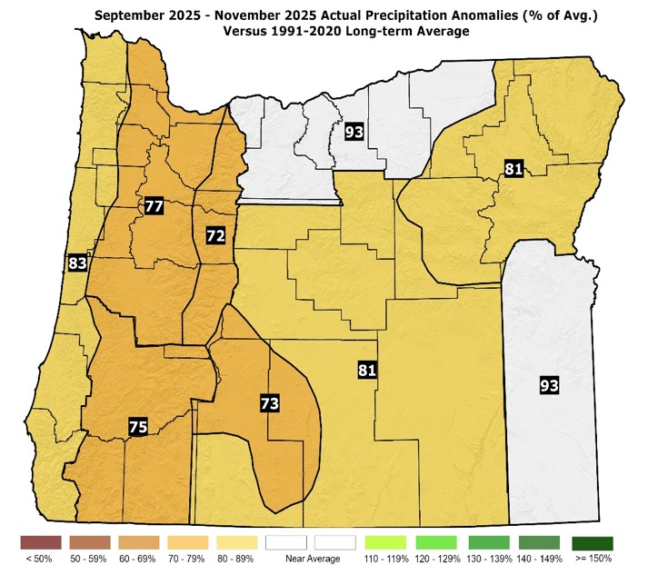
September – November 2025
(Forecast Issued August 21, 2025)/(Actual)
Forecast Precipitation
Actual Precipitation
Data courtesy of the National Centers for Environmental Information (NCEI)
Notes:
Temp Data: ftp://ftp.ncdc.noaa.gov/pub/data/cirs/drd964x.tmp.txt Precip Data: ftp://ftp.ncdc.noaa.gov/pub/data/cirs/drd964x.pcp.txt

Slide 23
September – November 2025
(Forecast Issued August 21, 2025)/(Actual)
Warmer than average weather through September, then a marked shift to average or slightly cooler-than-average conditions in October, followed by a mild November. (Above-average temperatures were experienced in September, with a switch to cooler-than-average conditions in October. November turned quite mild and stormy.) A “forecast hit.”
Lowered confidence in the precipitation forecast due to wide-ranging analog solutions. (September was drier than average for the NW zones, but the remainder of the state had near or above-average rainfall. October saw mostly near-average rainfall. November was drier than average statewide.) A “partial forecast hit.”

Slide 24
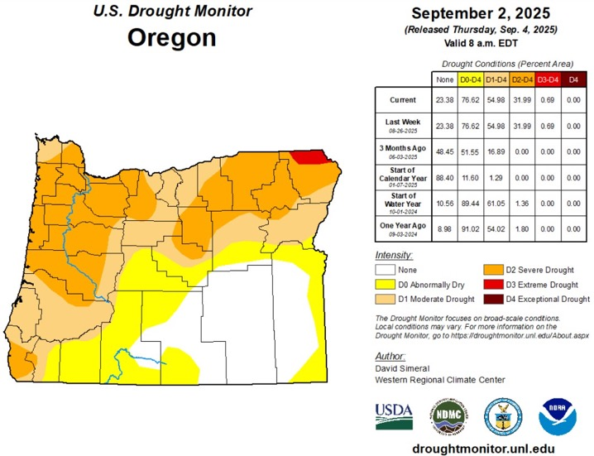
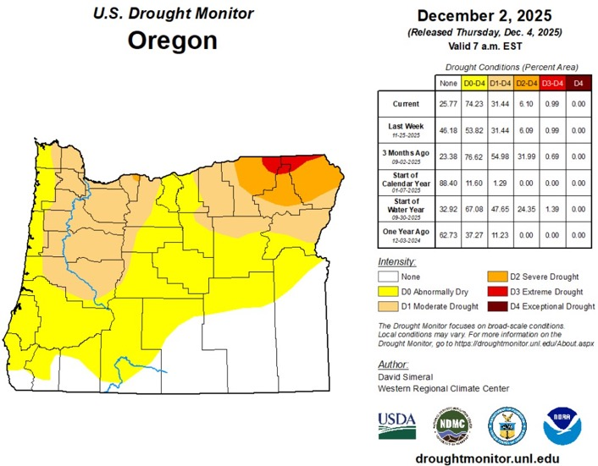
Oregon Drought Status
(Minor Improvement Most Areas)
September 2, 2025
December 2, 2025
Courtesy: National Drought Mitigation Center (NDMC)
https://droughtmonitor.unl.edu/

Slide 25
Forecast Resources
ODA Seasonal Climate Forecast Home:
https://www.oregon.gov/oda/natural-resources/pages/weather.aspx
CPC Official US Three-Month Forecasts (Graphics):
https://www.cpc.ncep.noaa.gov/products/predictions/long_range/seasonal.php?lead=01
CPC US 30-Day & 90-Day Forecasts (Discussions):
https://www.cpc.ncep.noaa.gov/products/predictions/long_range/fxus07.html
CPC Weekly & Monthly ENSO Discussions: https://www.cpc.ncep.noaa.gov/products/analysis_monitoring/enso_advisory
Australian Government Climate Model Summary:
http://www.bom.gov.au/climate/model-summary/#region=NINO34&tabs=Overview
Australian Government ENSO Wrap-Up:
http://www.bom.gov.au/climate/enso
IRI ENSO Quick Look:
https://iri.columbia.edu/our-expertise/climate/forecasts/enso/current/

Slide 26
Water Supply / Fire-Potential Outlook
CPC U.S. Seasonal Drought Outlook:
https://www.cpc.ncep.noaa.gov/products/expert_assessment/season_drought.png
NRCS Snow Water Equivalent Oregon Map:
https://www.wcc.nrcs.usda.gov/ftpref/data/water/wcs/gis/maps/or_swepctnormal_update.pdf
NRCS/USDA Snow Water Equivalent Products:
https://www.nrcs.usda.gov/wps/portal/wcc/home/snowClimateMonitoring/snowpack/
NDMC U.S. Drought Monitor:
https://droughtmonitor.unl.edu/
NIDIS North American Drought Portal:
https://www.drought.gov/nadm/content/percent-average-precipitation
WRCC WestWideDroughtTracker:
https://www.wrcc.dri.edu/wwdt/
NWCC Northwest Interagency Coordination Center (video)
https://gacc.nifc.gov/nwcc/predict/outlook.aspx

Slide 27

Updated Mid-Month
Your Feedback is Welcome!
Sign-up for Email notification of updates at:
https://public.govdelivery.com/accounts/ORODA/subscriber/new?topic_id=ORODA_14
Contact: Pete Parsons, ODF Lead Meteorologist
at 503-945-7448 or peter.gj.parsons@odf.oregon.gov

