Slide 1
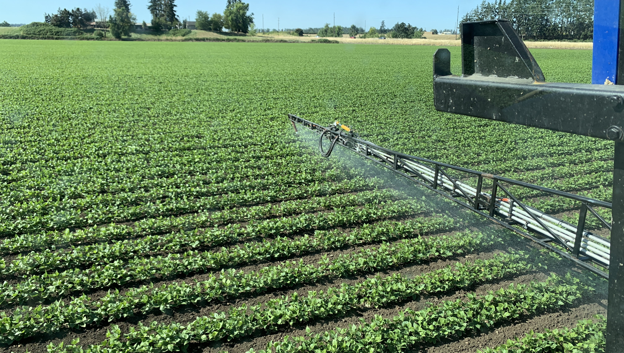
Worker Protection Standard
Photo by Patrick R. ODA

Slide 2
Agenda
What is WPS?
Why is important?
When to train?

Slide 3
WPS
What is WPS?
Why is important?
When to train?

Slide 4

1.What is Worker Protection Standard?
Worker Protection Standard (WPS) is a federal program designed to protect agricultural workers.

Slide 5

Target Audience: AG workers
Employees that work producing agricultural plants in agricultural establishments:
Farms
Forests
Nurseries
Enclosed space production
Notes:
Agricultural establishment
any farm, forest operation, nursery, or orchard involved in the outdoor or enclosed-space production of agricultural plants; any establishment that produces for transplant or uses agricultural plants (in part or their entirety) in another location instead of purchasing the agricultural plants. Enclosed-space examples: Greenhouses, mushroom houses, hoop houses, high tunnels, and grow houses.
Agricultural plants
plants grown or maintained for commercial or research purposes. Examples are food, feed, and fiber plants; trees; turfgrass; flowers, shrubs, ornamentals; and seedlings.

Slide 6

Groups protected under WPS
Agricultural Pesticide
Workers Handlers

Slide 7
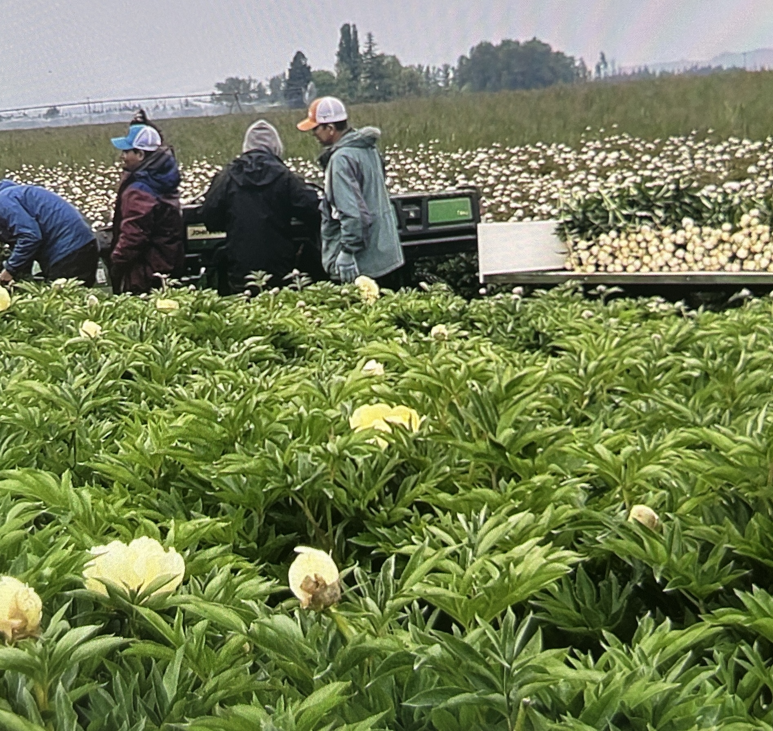
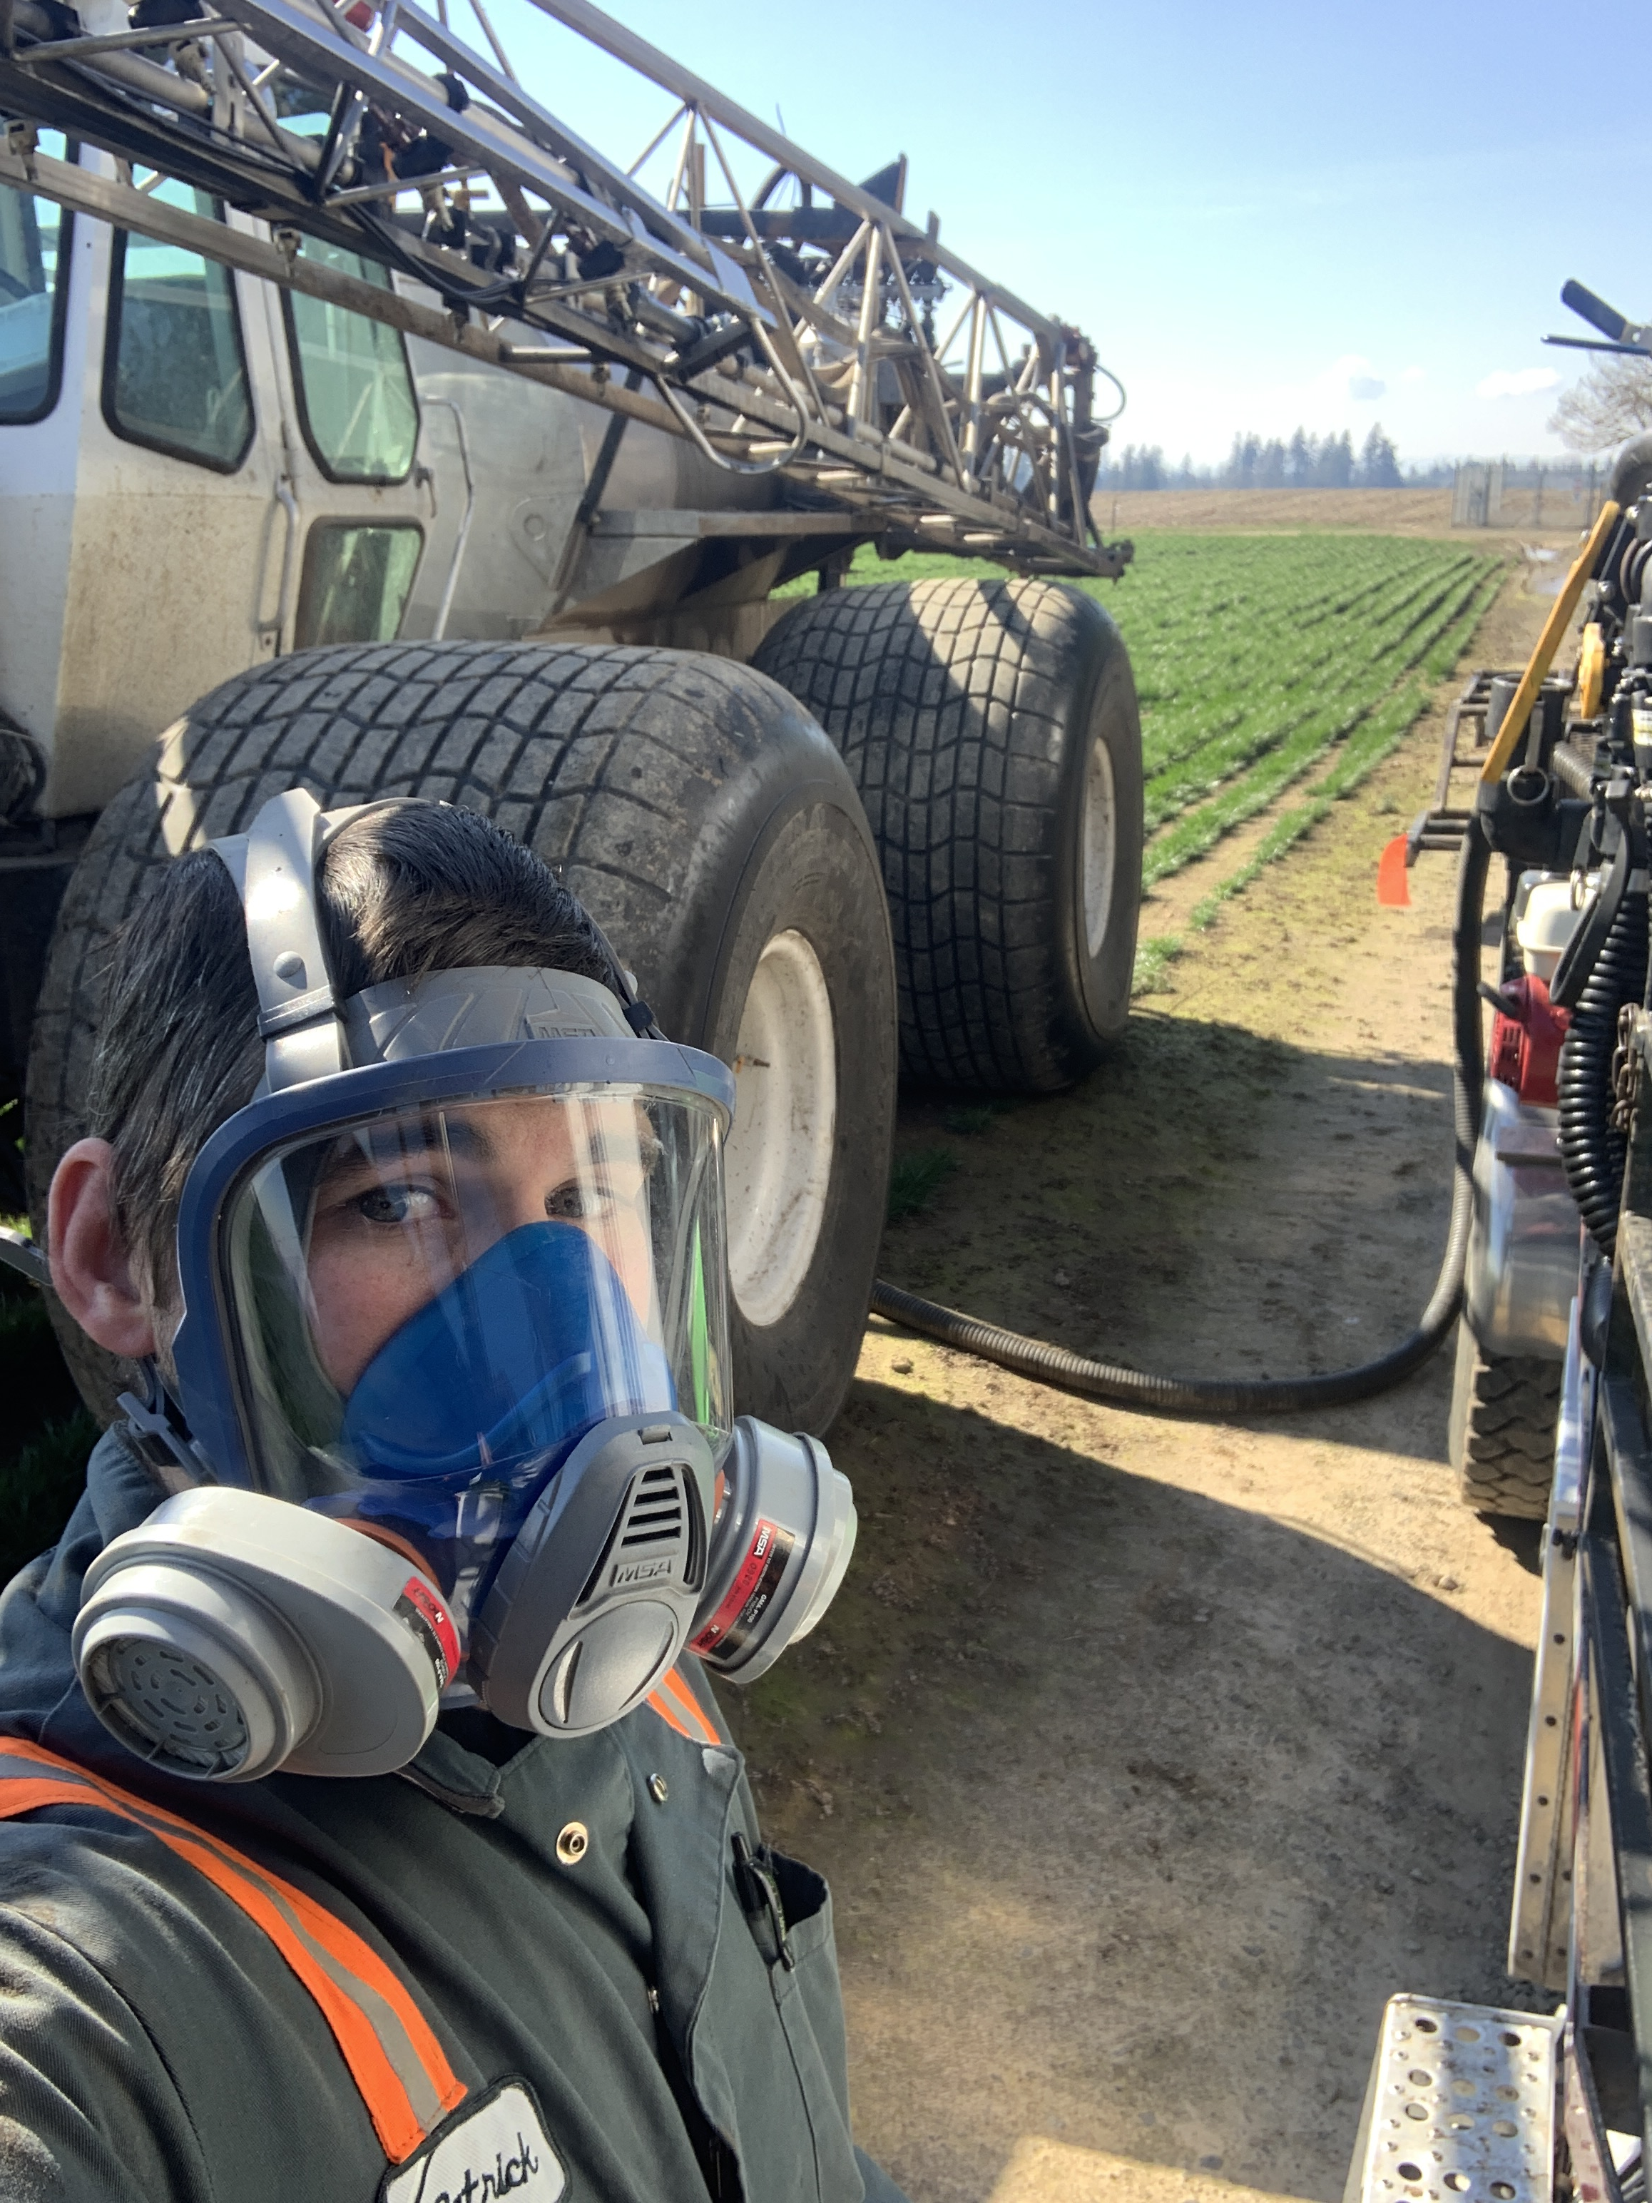
Groups protected under WPS
Agricultural Workers
Pesticide Handlers
Photo by Vanessa V. ODA
Photo by Patrick R. ODA
Notes:
Workers include anyone employed for any type of compensation (including self-employed) doing tasks such as:
carrying nursery stock;
repotting plants;
watering; or
other tasks directly related to the production of agricultural plants on an agricultural establishment.*
Pesticide Handlers:
mix, load, or apply agricultural pesticides;
clean or repair pesticide application equipment; or
assist with the application of pesticides.

Slide 8
WPS
What is WPS?
Why is important?
When to train?

Slide 9
2. Why is important?
Regardless of working conditions…
Due to exposure to hazardous factors, agriculture has been ranked as one of the most hazardous industries.

Slide 10
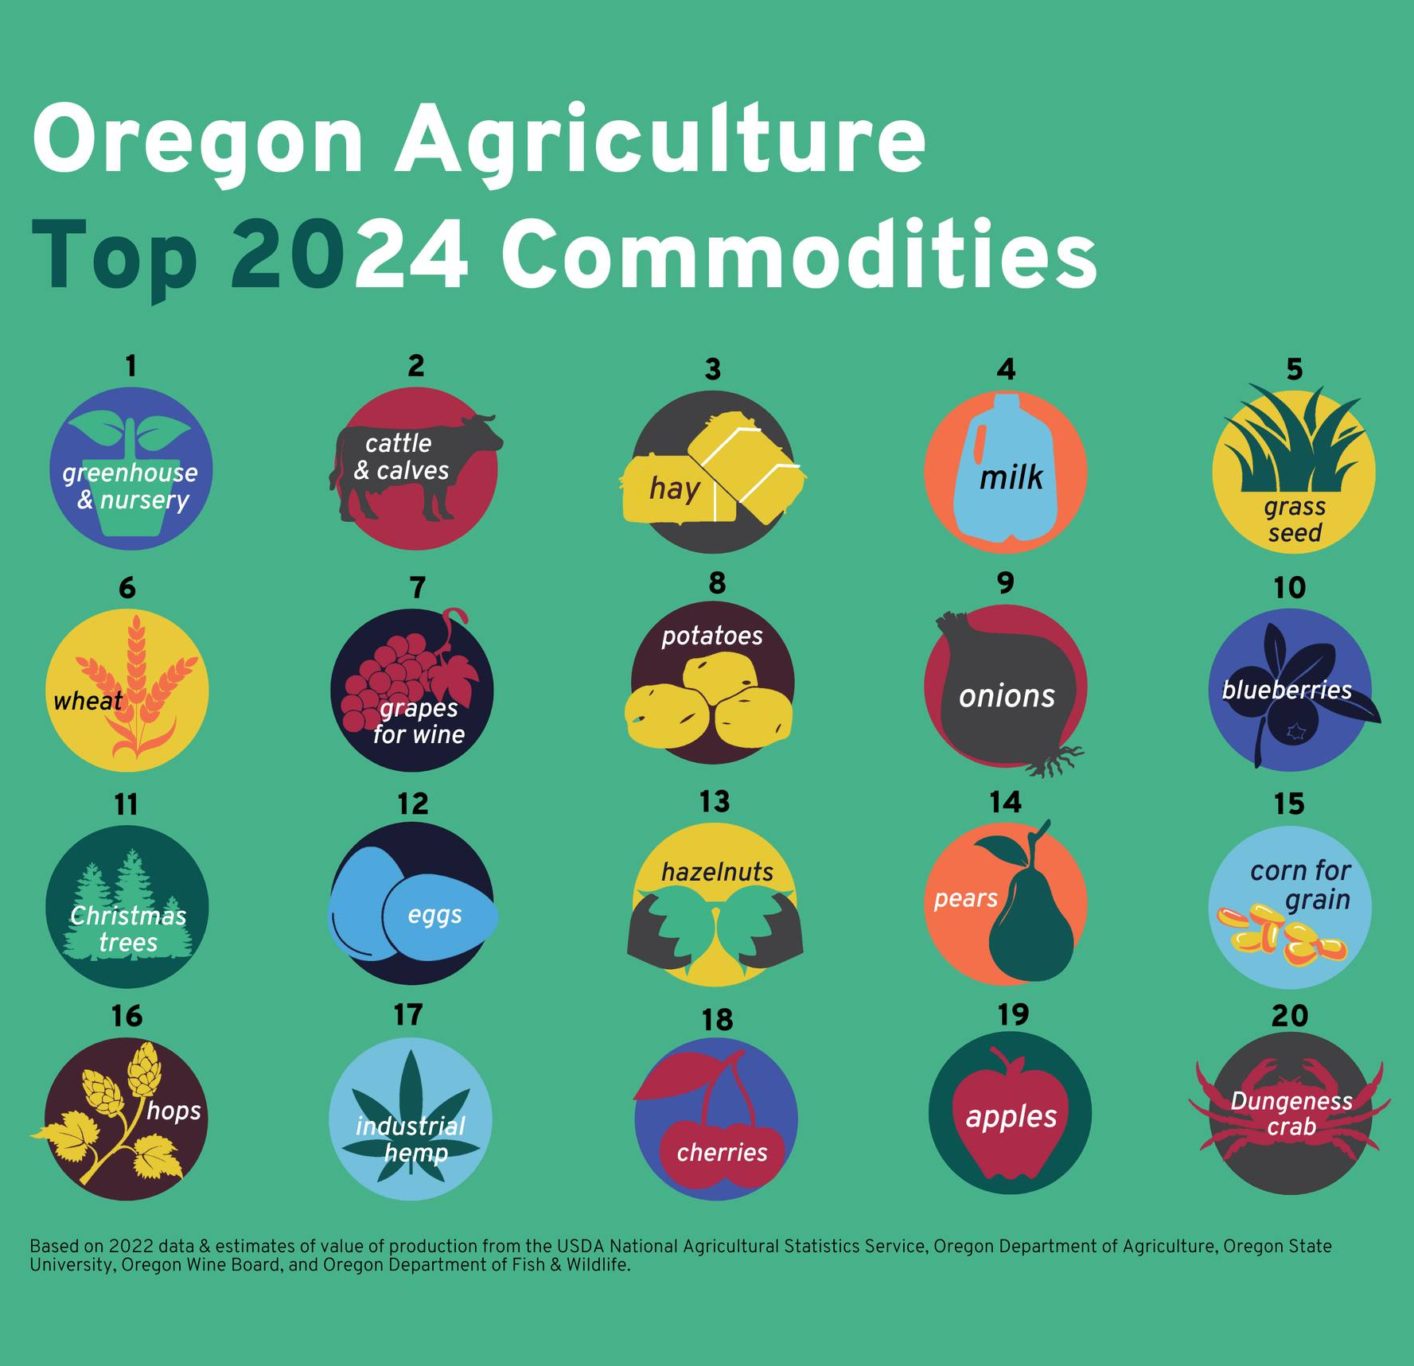
Why?

Slide 11
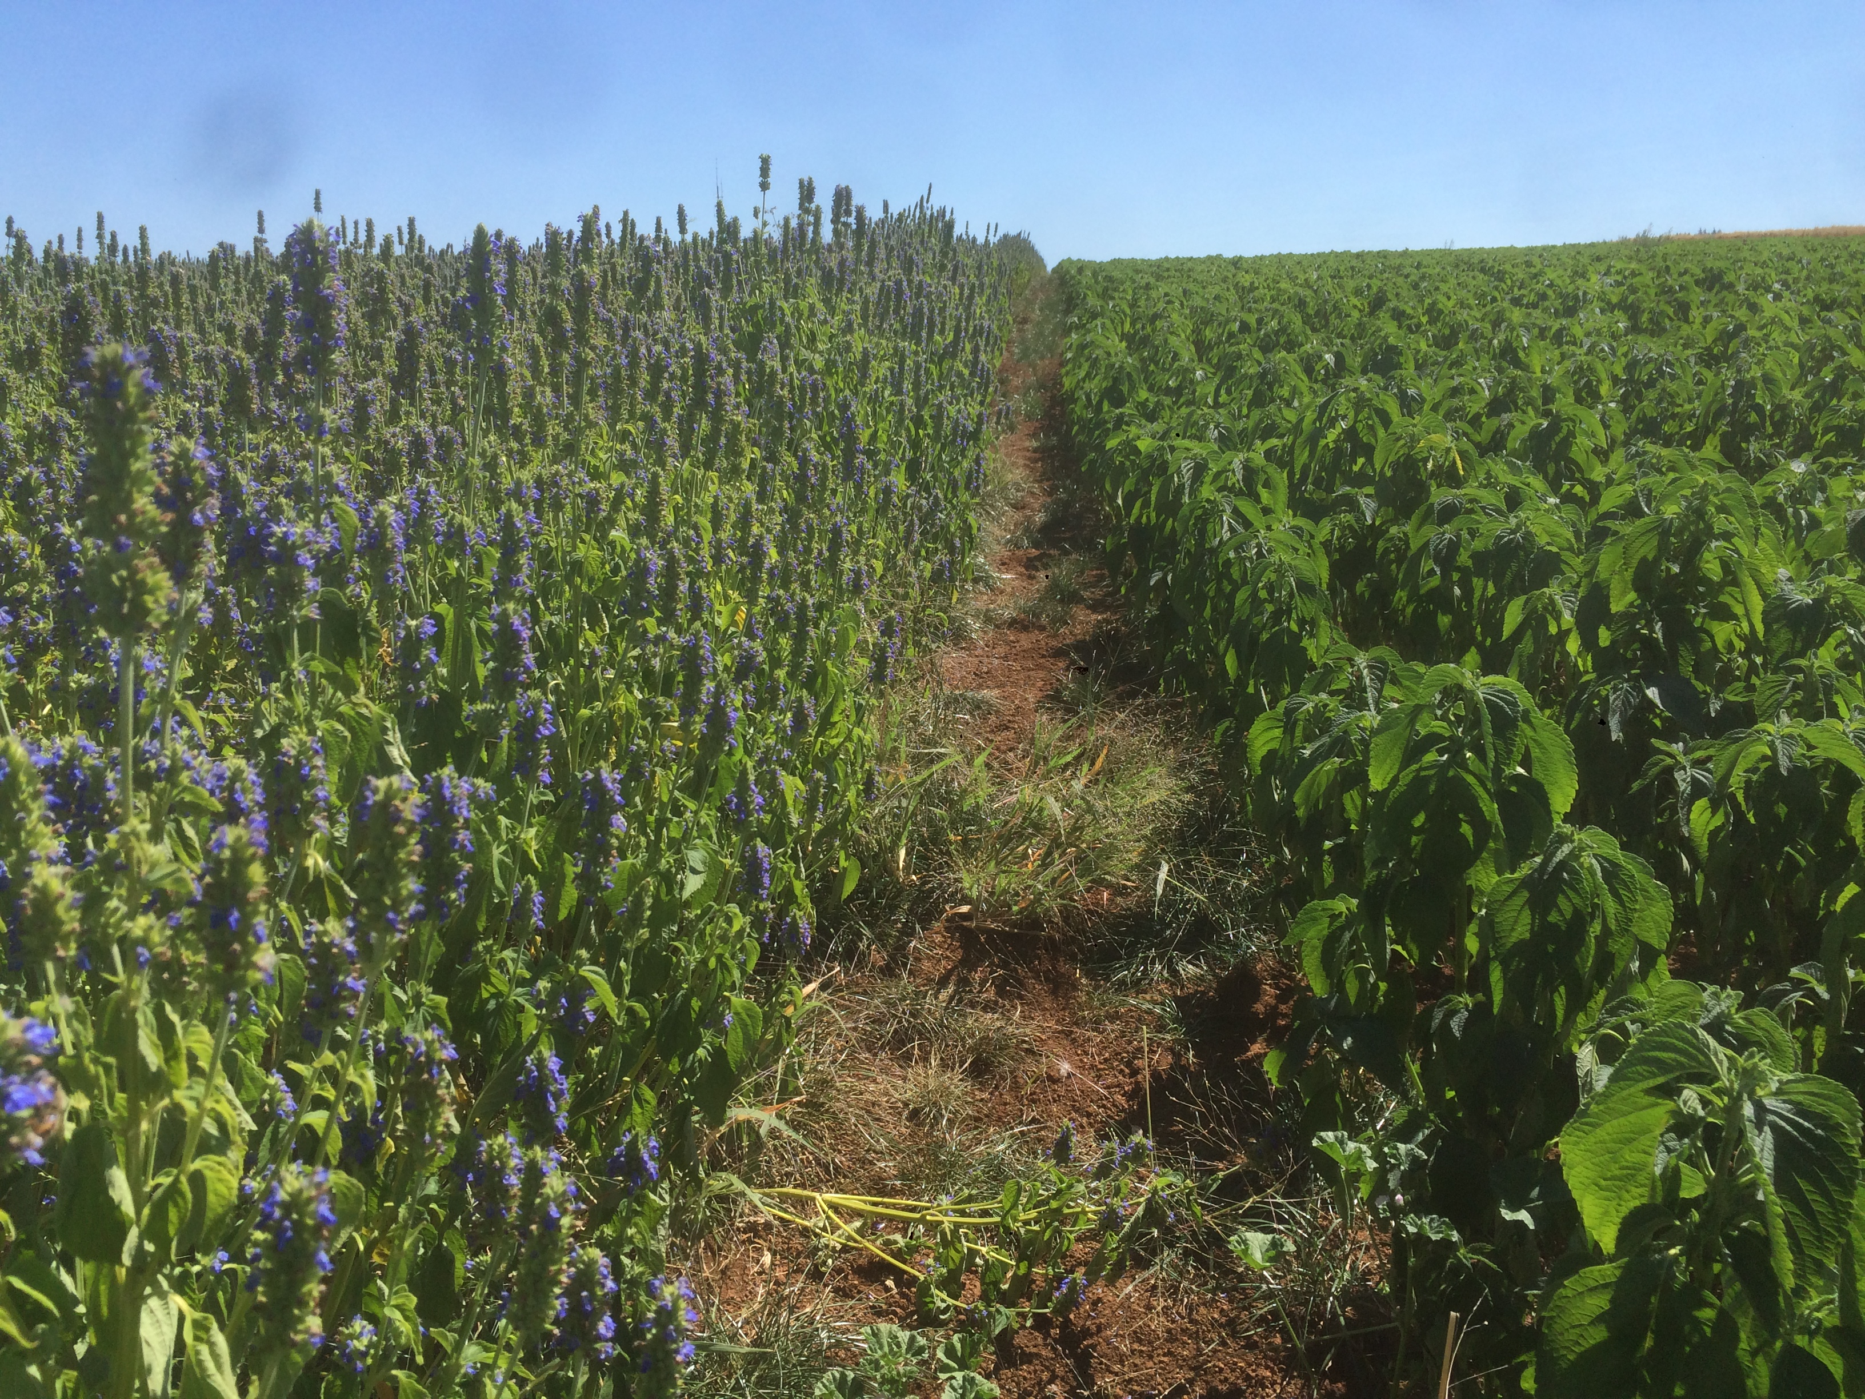
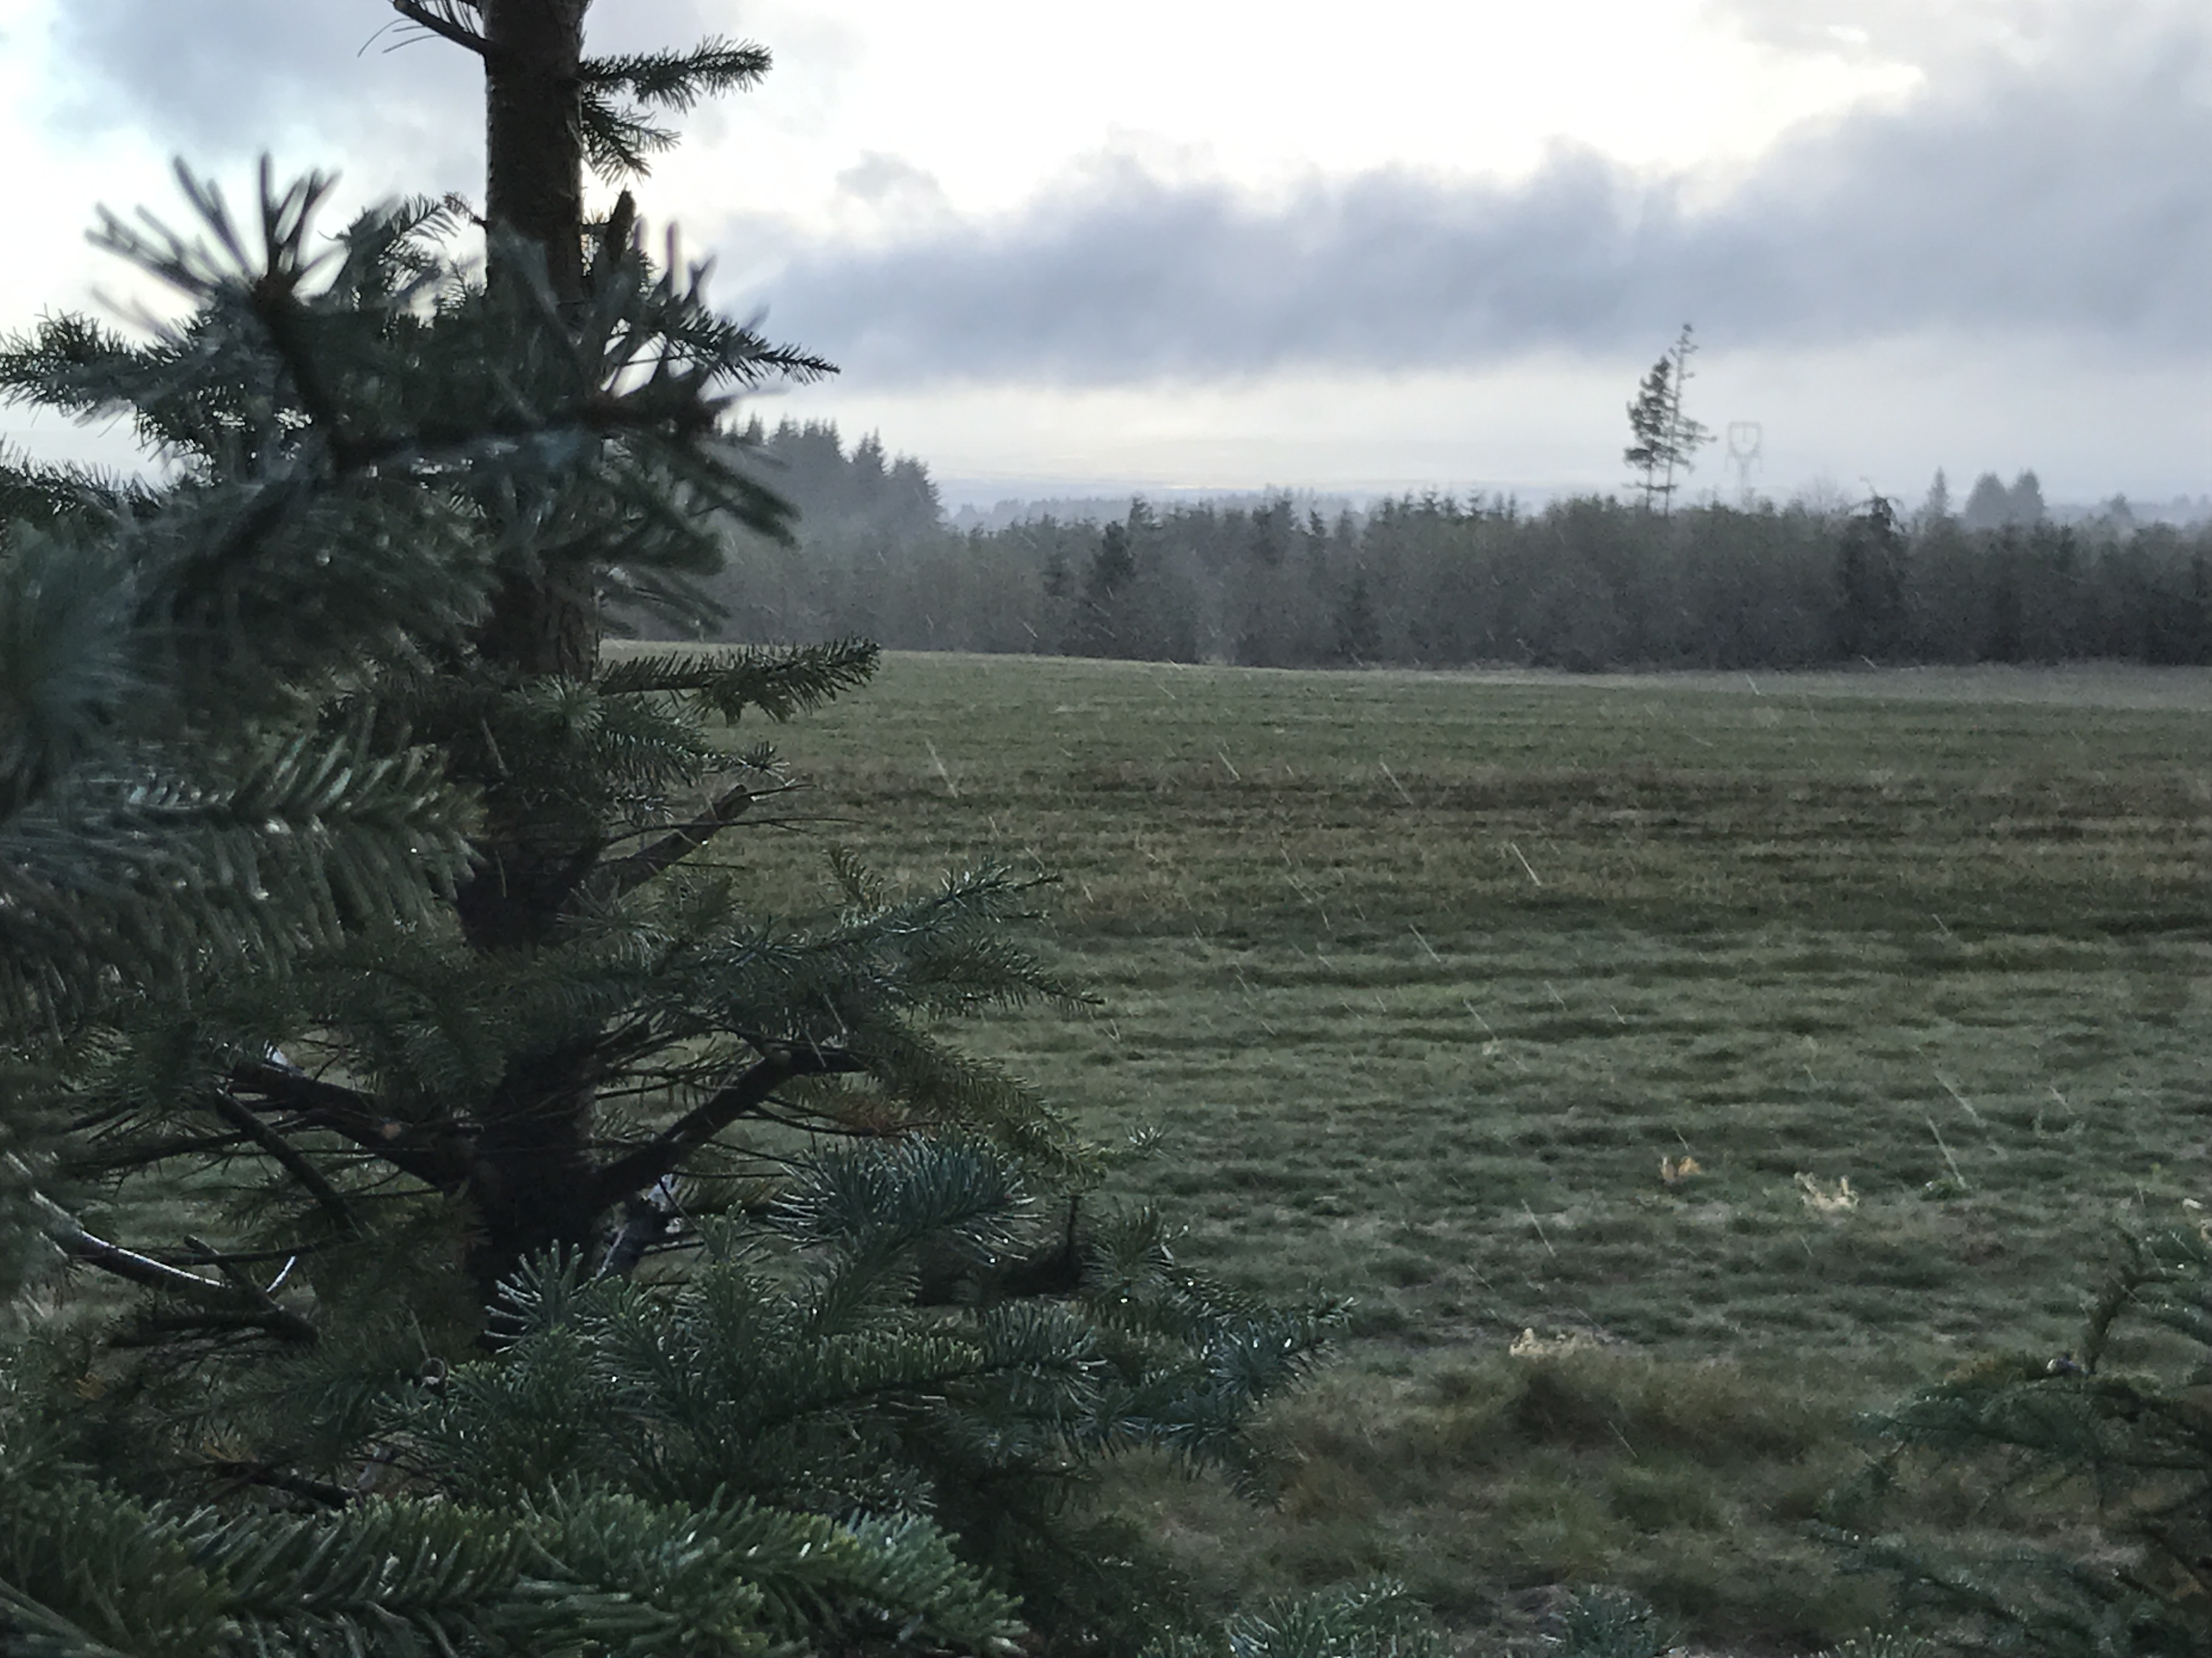
Oregon Agriculture
Variety of practices to reduce yield losses to pests.
Crop choices,
Planting date adjustments, and
Crop rotation
Photos by Patrick R. ODA
Photos by Patrick R. ODA
Photo by Vanessa V. ODA
Notes:
U.S. crop producers use a variety of practices.
They may choose crop choices, planting date adjustments, and crop rotations to limit the emergence and spread of weeds, insects, and funguses

Slide 12
WPS
What is WPS?
Why is important?
When to train?

Slide 13
3.When to Train WPS?
Annual mandatory training
No grace period to train workers (there has never been a grace period to train handlers).

Slide 14
Oregon top violations (2013)
Rank | Standard Violated | Subject | Total Violations
4 | 40 CFR 170.240(f) | Cleaning and maintenance of personal protective equipment | 13
6 | 40 CFR 170.122(c) | Required pesticide application information | 10
7 | 40 CFR 170.130(a) | General requirements for worker pesticide safety training | 7
8 | 40 CFR 170.222(a) |  | 7
10 | 40 CFR 170.230(a) | Requirements for pesticide safety training for handlers | 6
12 | 40 CFR 170.135(b) | Requirements for pesticide safety posters | 5
13 | 40 CFR 170.250(c) | Location of decontamination | 5
16 | 40 CFR 170.135(c) | Requirements for displaying emergency medical care information | 4
17 | 40 CFR 170.230(c) |  | 4
18 | 40 CFR 170.240(c) | Provision of personal protective equipment | 4
25 | 40 CFR 170.120(b) | Notification to workers on farms, nurseries, or forests of pesticide applications | 3
Source: Department of Consumer and Business Services

Slide 15
Oregon top violations (2023)
Rank | Standard Violated | Subject |  | Total Violations
1 | 40 CFR 170.311(b) | Pesticide application & hazard information |  | 18
3 | 40 CFR 170.311(a) | Display of Pesticide Safety Information |  | 16
4 | 40 CFR 170.501(a) | Training requirements for handlers |  | 16
14 | 40 CFR 170.311(b) |  |  | 6
16 | 40 CFR 170.401(a) | Training requirements for workers |  | 5
17 | 40 CFR 170.401(d) |  |  | 4
18 | 40 CFR 170.507(b) | Employer provided PPE |  | 4
21 | 40 CFR 170.309(h) |  |  | 3
22 | 40 CFR 170.501(d) |  |  | 3
23 | 40 CFR 170.507(b) |  |  | 3
Source: Department of Consumer and Business Services

Slide 16

Partnership

Slide 17
Contact
Vanessa Vassilaros
WPS Outreach Specialist
Vanessa.Vassilaros@oda.oregon.gov
Email: Vanessa.Vassilaros@oda.oregon.gov
Phone: 971.707.0001

