Slide 1
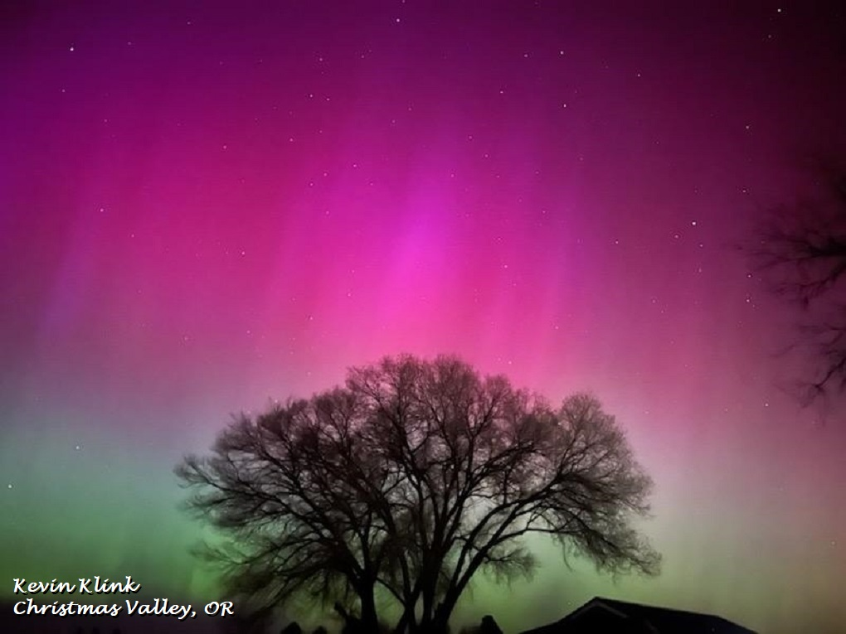
Seasonal Climate Forecast Verification
June – August 2024
Issued: September 12, 2024
Contact: Pete Parsons, ODF Lead Meteorologist
503-945-7448 or peter.gj.parsons@odf.oregon.gov
Production - ODA: Diana Walker; Andy Zimmerman; Jenn Ambrose; Taylor Harding Production - ODF: Julie Vondrachek; Kristin Cody

Slide 2
Format and Purpose:
A side-by-side comparison of the “Seasonal Climate Forecast” vs. what (Actually Occurred) is done for both the 1-month & 3-month forecasts.*
The accuracy of each forecast is reviewed, and the need for analog-year updates is examined.
This is part of an ongoing assessment of the utility of this forecast method.**
*Utilizes 1991-2020 long-term averages
**See “Forecasting Methods…” at:
https://oda.direct/Weather

Slide 3
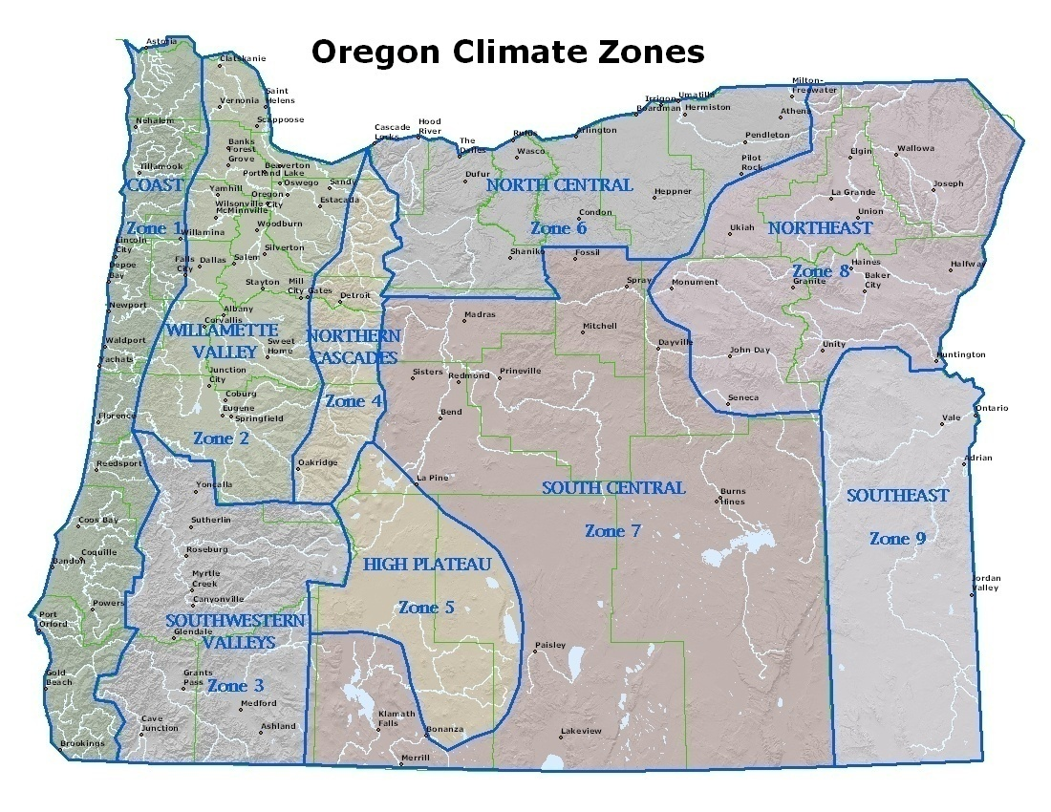

Slide 4
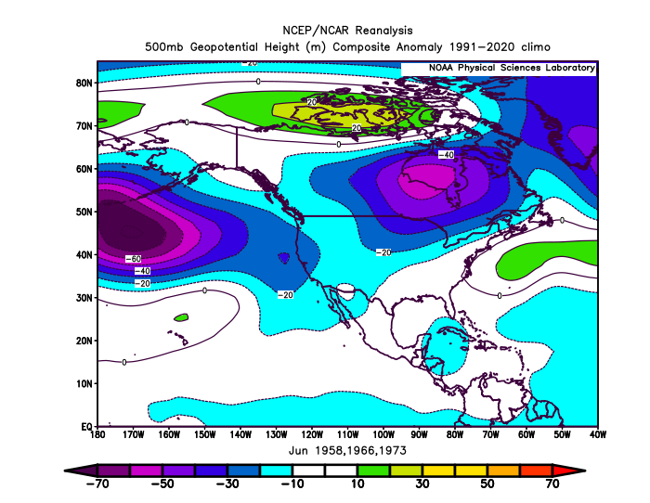
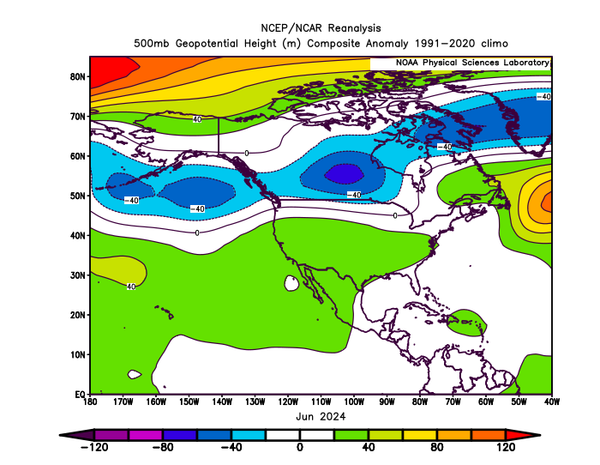
June 2024
(Forecast Issued May 16, 2024)/(Actual)
Forecast Upper-Air Anomalies
Actual Upper-Air Anomalies
Analog forecast (left) and observed pattern (right) both had negative anomalies extending from the Gulf of Alaska across southern Canada. Predicted negative anomalies over Oregon were greater than observed. Mostly a “forecast hit.”

Slide 5
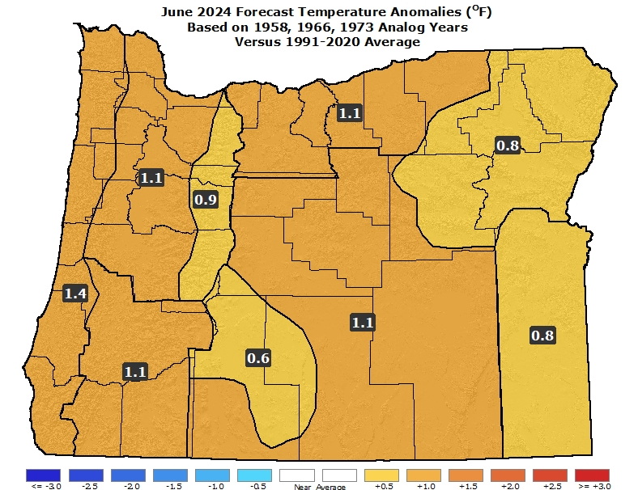
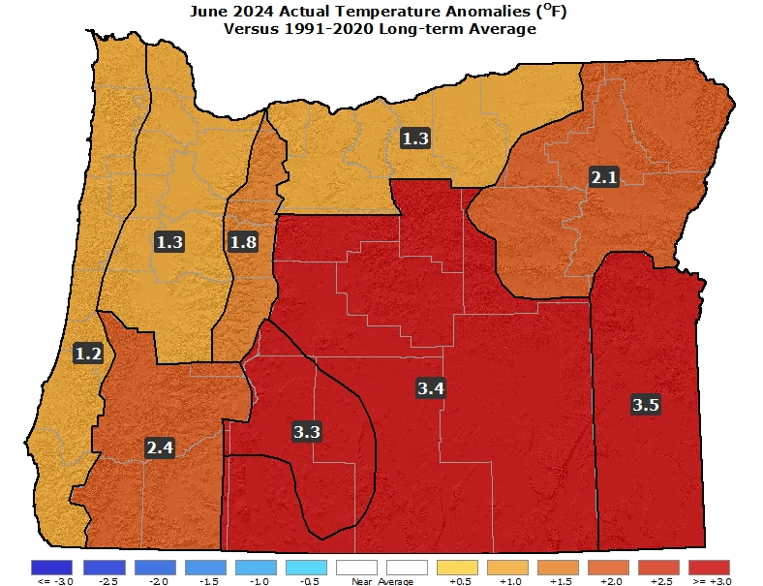
June 2024
(Forecast Issued May 16, 2024)/(Actual)
Forecast Temperatures
Actual Temperatures
Data courtesy of the National Centers for Environmental Information (NCEI)
Notes:
Temp Data: ftp://ftp.ncdc.noaa.gov/pub/data/cirs/drd964x.tmp.txt Precip Data: ftp://ftp.ncdc.noaa.gov/pub/data/cirs/drd964x.pcp.txt

Slide 6
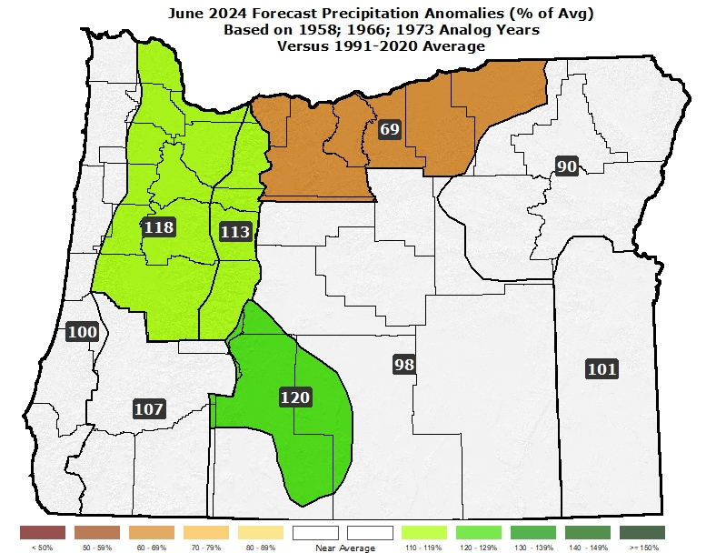
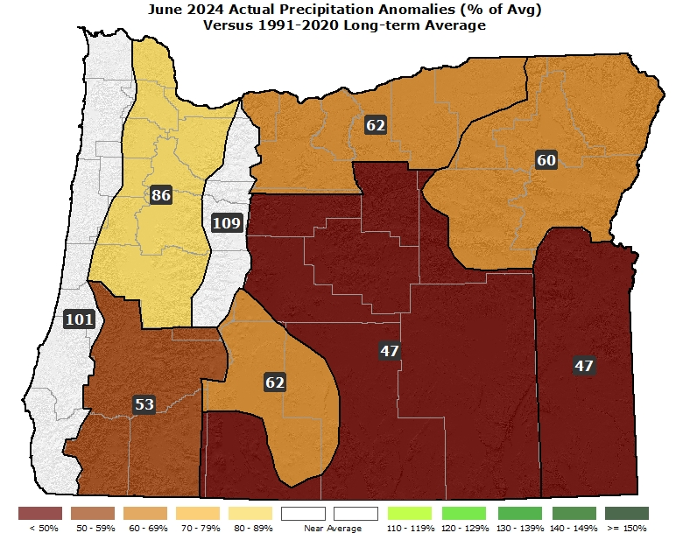
June 2024
(Forecast Issued May 16, 2024)/(Actual)
Forecast Precipitation
Actual Precipitation
Data courtesy of the National Centers for Environmental Information (NCEI)
Notes:
Temp Data: ftp://ftp.ncdc.noaa.gov/pub/data/cirs/drd964x.tmp.txt Precip Data: ftp://ftp.ncdc.noaa.gov/pub/data/cirs/drd964x.pcp.txt

Slide 7
June 2024
(Forecast Issued May 16, 2024)/(Actual)
Above average temperatures with some “warm” spells (over 90°F in the interior) likely from mid-month on. (Alternating cool and warm periods with a “warm” spell just after mid-month helping to push overall temperatures above average.) A “forecast hit.”
Ample days with precipitation…above average from the Cascades westward. (The month started with an unusually wet weather system, especially for NW Oregon. The remainder of the month was drier than average. Overall, precipitation ranged from slightly above average in the NW to below average in the SE.) A “partial forecast hit.”

Slide 8
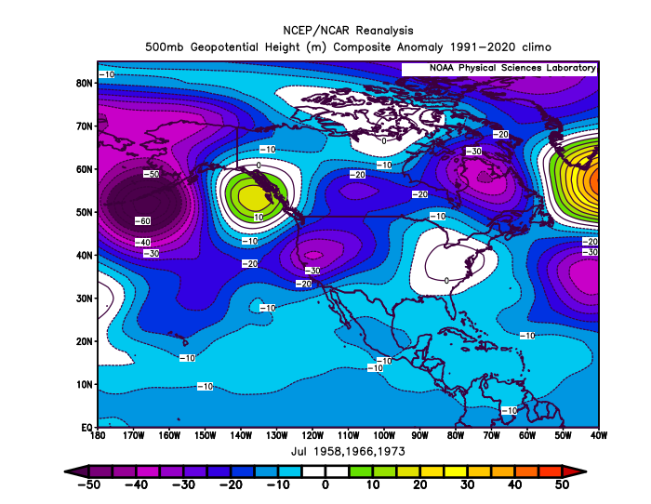
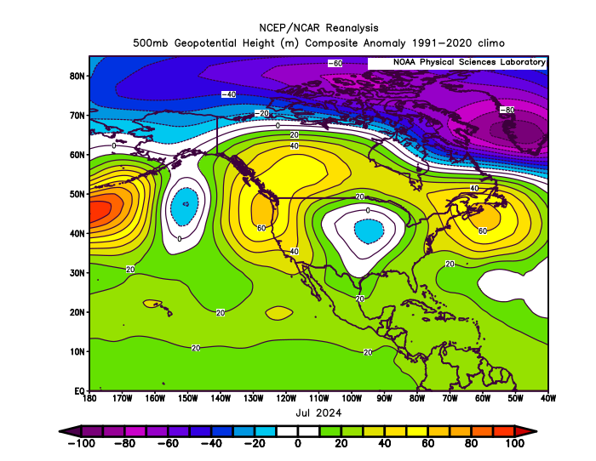
July 2024
(Forecast Issued June 20, 2024)/(Actual)
Forecast Upper-Air Anomalies
Actual Upper-Air Anomalies
The anomalous ridging predicted for just off the British Columbia Coast (left) ended up being centered just off the Pacific NW Coast (right). That led to much more ridging over Oregon than expected. A “forecast miss.”

Slide 9
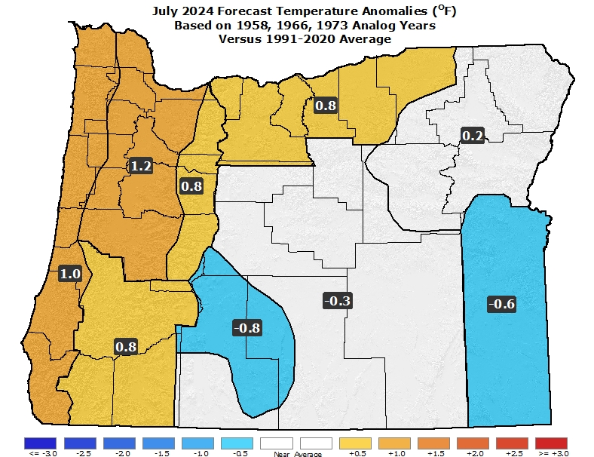
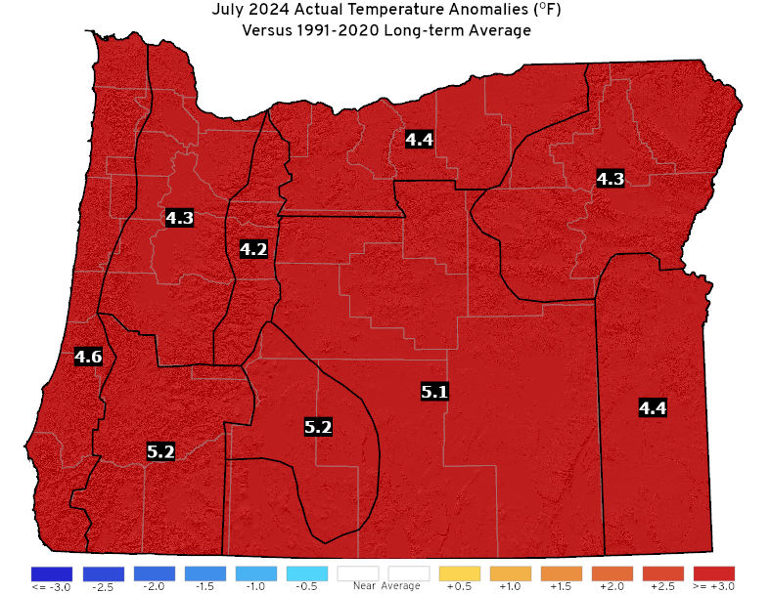
July 2024
(Forecast Issued June 20, 2024)/(Actual)
Forecast Temperatures
Actual Temperatures
Data courtesy of the National Centers for Environmental Information (NCEI)
Notes:
Temp Data: ftp://ftp.ncdc.noaa.gov/pub/data/cirs/drd964x.tmp.txt Precip Data: ftp://ftp.ncdc.noaa.gov/pub/data/cirs/drd964x.pcp.txt

Slide 10
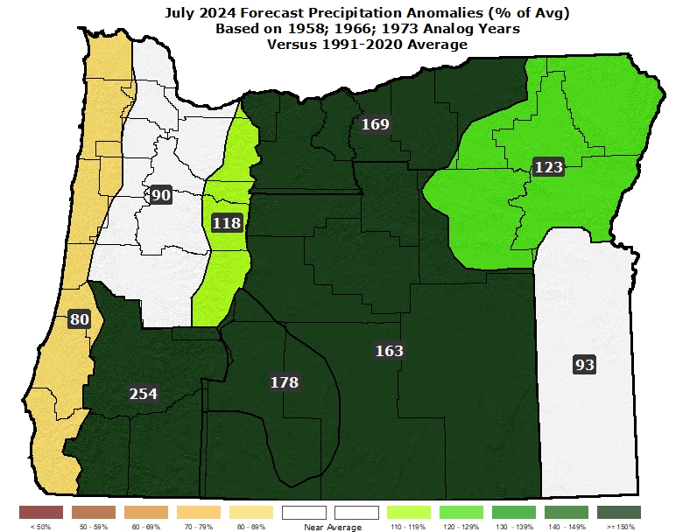
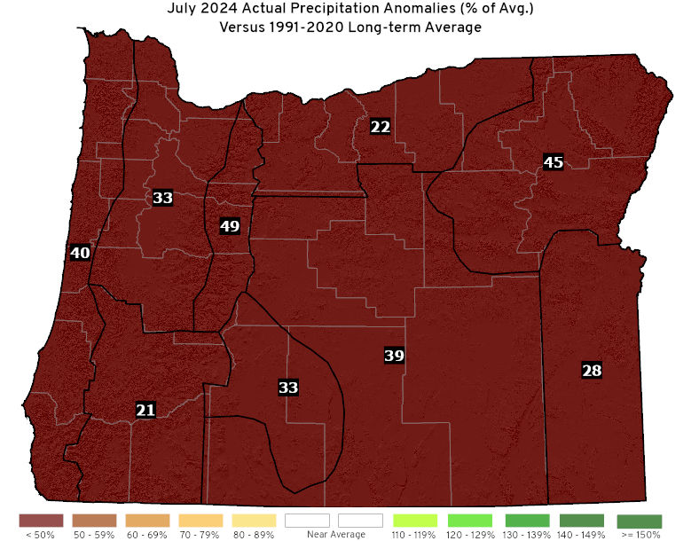
July 2024
(Forecast Issued June 20, 2024)/(Actual)
Forecast Precipitation
Actual Precipitation
Data courtesy of the National Centers for Environmental Information (NCEI)
Notes:
Temp Data: ftp://ftp.ncdc.noaa.gov/pub/data/cirs/drd964x.tmp.txt Precip Data: ftp://ftp.ncdc.noaa.gov/pub/data/cirs/drd964x.pcp.txt

Slide 11
July 2024
(Forecast Issued June 20, 2024)/(Actual)
Analogs straddled either side of average temperatures with 1966 being the coolest and 1958 the warmest. (Temperatures resembled the very warm anomalies seen in 1958, so the “blend” of the ensembles was far too cool. Zones 1-5 recorded their warmest July on record…dating back to 1895. Several cities recorded their warmest July on record, including Portland, Salem, and Eugene.) A “forecast miss.”
A wet 1966 analog skewed the precipitation forecast wet, despite the 1958 & 1973 analogs being drier than average. (The first half of the month was dry with record heat. Monthly precipitation closely resembled the dry analogs of 1958 & 1973, so blending the wet 1966 solution into the forecast skewed it much too wet.) A “forecast miss.”

Slide 12
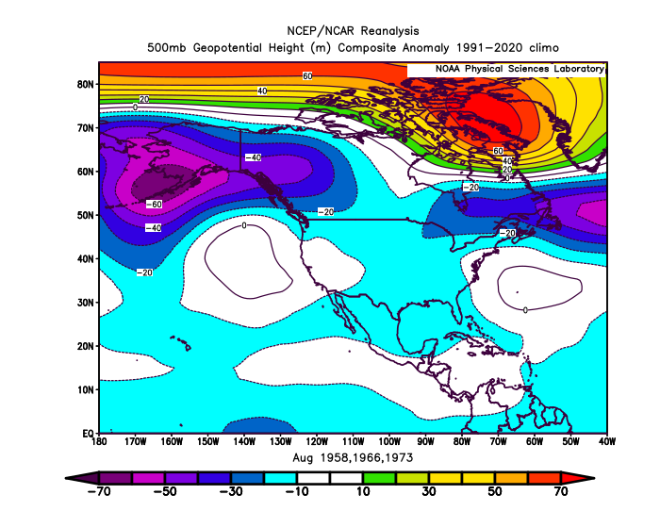
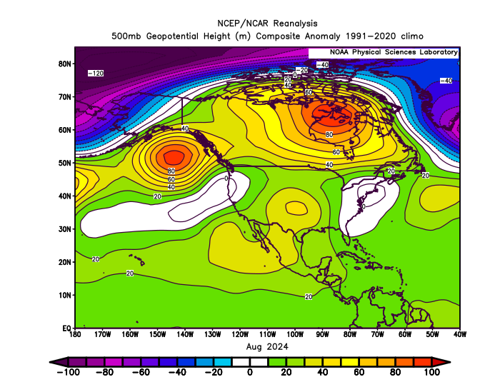
August 2024
(Forecast Issued July 18, 2024)/(Actual)
Forecast Upper-Air Anomalies
Actual Upper-Air Anomalies
Both the forecast (left) and observed “August 2024” (right) had prevailing SW flow aloft over Oregon with minimal overall anomalies….resulting in modestly warm temperatures and enhanced thunderstorm activity. A “forecast hit.”

Slide 13
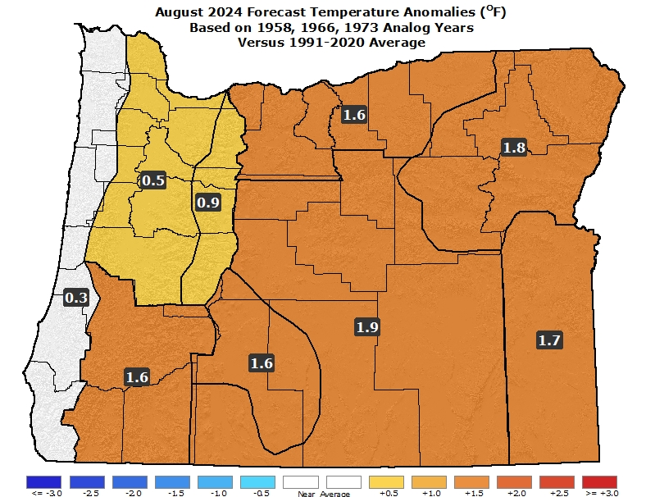
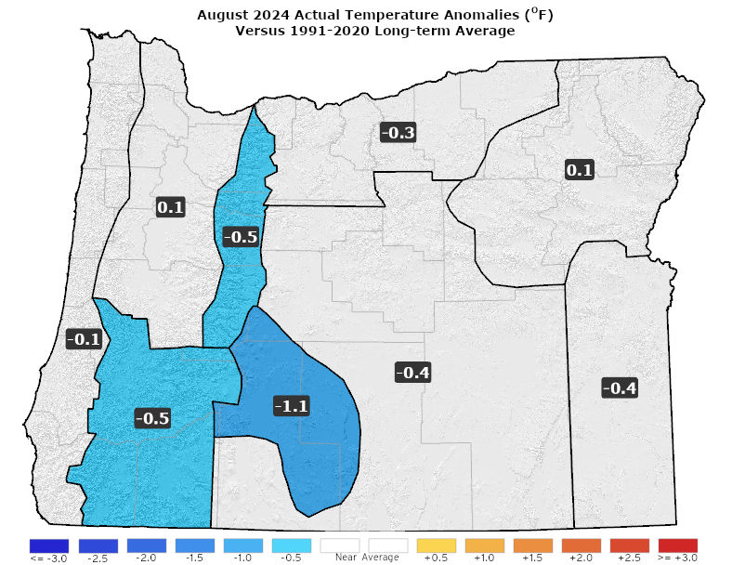
August 2024
(Forecast Issued July 18, 2024)/(Actual)
Forecast Temperatures
Actual Temperatures
Data courtesy of the National Centers for Environmental Information (NCEI)
Notes:
Temp Data: ftp://ftp.ncdc.noaa.gov/pub/data/cirs/drd964x.tmp.txt Precip Data: ftp://ftp.ncdc.noaa.gov/pub/data/cirs/drd964x.pcp.txt

Slide 14
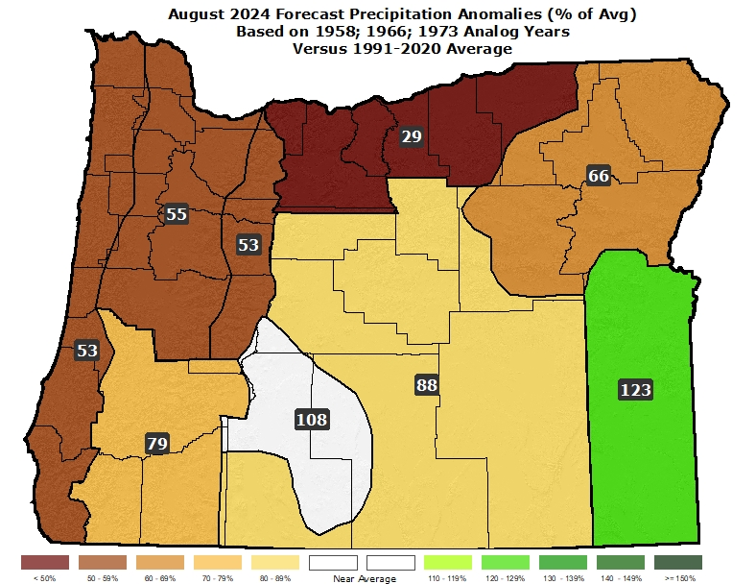
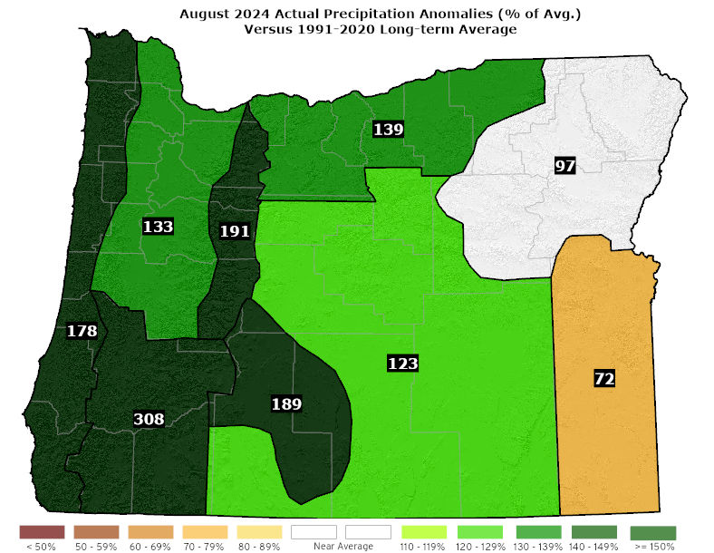
August 2024
(Forecast Issued July 18, 2024)/(Actual)
Forecast Precipitation
Actual Precipitation
Data courtesy of the National Centers for Environmental Information (NCEI)
Notes:
Temp Data: ftp://ftp.ncdc.noaa.gov/pub/data/cirs/drd964x.tmp.txt Precip Data: ftp://ftp.ncdc.noaa.gov/pub/data/cirs/drd964x.pcp.txt

Slide 15
August 2024
(Forecast Issued July 18, 2024)/(Actual)
A very warm 1958 was blended with the progressively cooler 1966 & 1973 analogs for a modestly warm forecast. (The month started and ended with warm spells, with moderate temperatures otherwise. Overall, temperatures were near average.) Mostly a “forecast hit.”
Analogs had enhanced thundershower activity, with spotty downpours, especially 1958 & 1966. (A series of upper-level troughs brought thundershower activity throughout the month. These storms produced locally heavy rainfall.) Mostly a “forecast hit.”

Slide 16
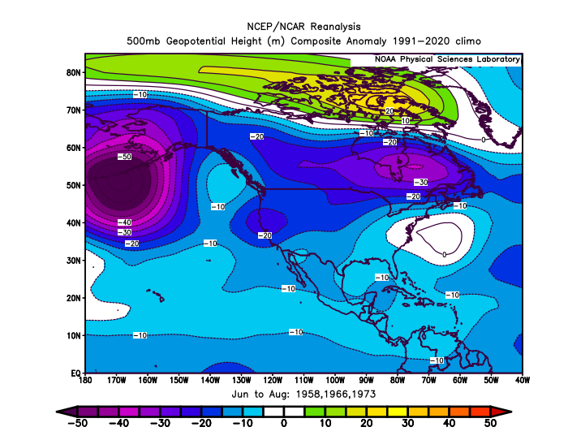
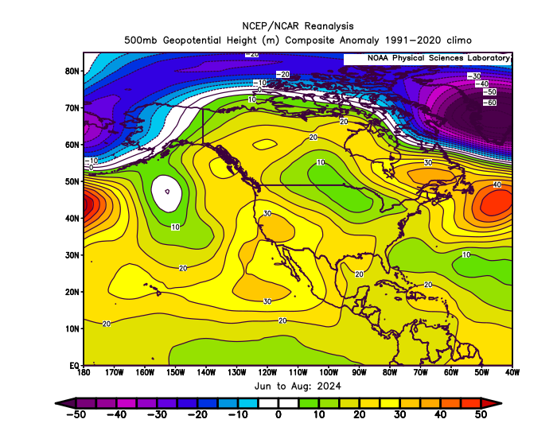
June – August 2024
(Forecast Issued May 16, 2024)/(Actual)
Forecast Upper-Air Anomalies
Actual Upper-Air Anomalies
The forecast (left) and observed (right) had a prevailing SW flow aloft over Oregon, which favored thunderstorm activity at times. 2024 (right) had a mean ridge centered over Oregon, but the analogs (left) placed it just offshore. A “partial forecast hit.”

Slide 17
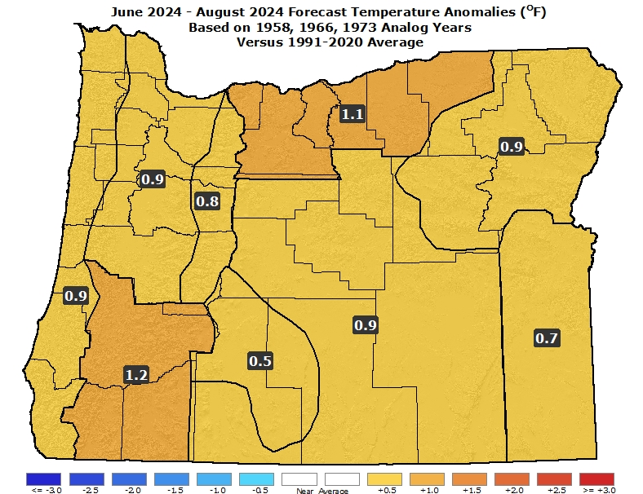
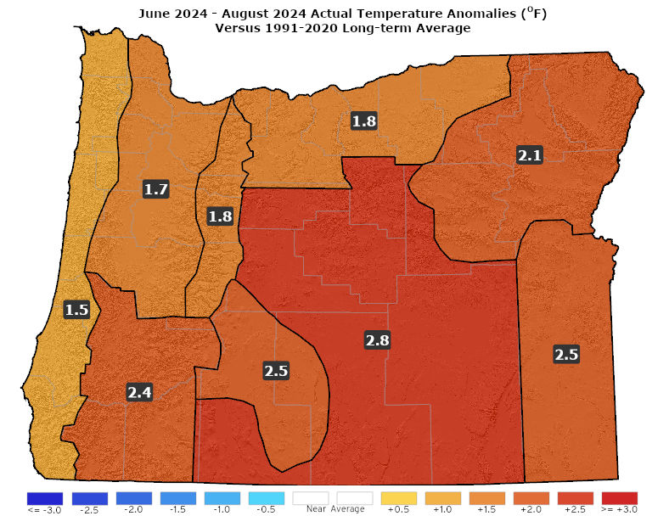
June – August 2024
(Forecast Issued May 16, 2024)/(Actual)
Forecast Temperatures
Actual Temperatures
Data courtesy of the National Centers for Environmental Information (NCEI)
Notes:
Temp Data: ftp://ftp.ncdc.noaa.gov/pub/data/cirs/drd964x.tmp.txt Precip Data: ftp://ftp.ncdc.noaa.gov/pub/data/cirs/drd964x.pcp.txt

Slide 18
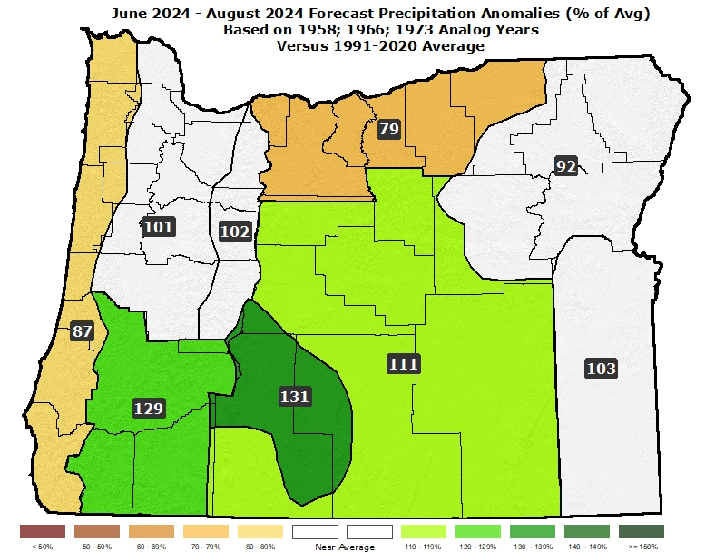
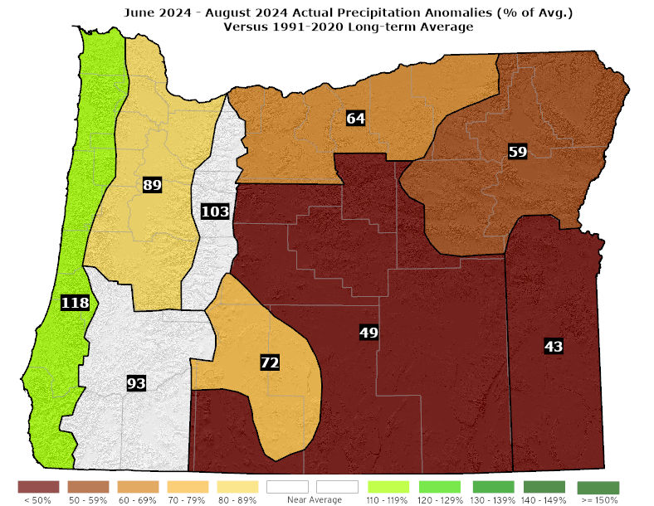
June – August 2024
(Forecast Issued May 16, 2024)/(Actual)
Forecast Precipitation
Actual Precipitation
Data courtesy of the National Centers for Environmental Information (NCEI)
Notes:
Temp Data: ftp://ftp.ncdc.noaa.gov/pub/data/cirs/drd964x.tmp.txt Precip Data: ftp://ftp.ncdc.noaa.gov/pub/data/cirs/drd964x.pcp.txt

Slide 19
June – August 2024
(Forecast Issued May 16, 2024)/(Actual)
Above-average temperatures. The 1958 analog had periods of extremely warm weather. That was “missed” in the forecast. (June began cool then turned warm. July brought record warmth with a very hot stretch during the first half of the month. August began and ended quite warm but was otherwise moderate. Overall, temperatures were well-above average statewide.) A “partial forecast hit.”
Precipitation near average with increasing thundershowers over time. (June began wet, especially for the NW zones, then turned dry. July was dry with scattered light showers. August brought increased thunderstorm activity with local downpours.) Mostly a “forecast hit.”

Slide 20
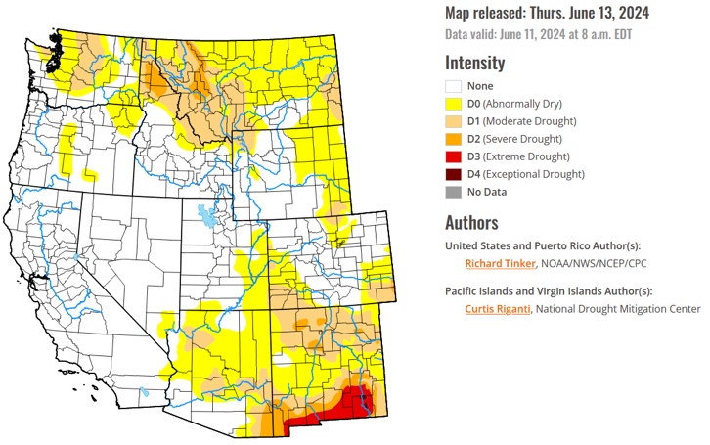
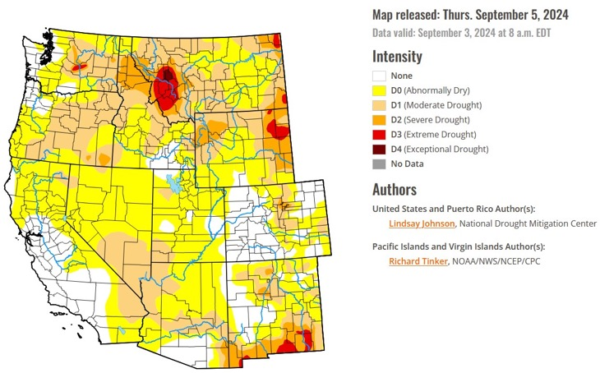
Drought Status Worsened
(over the 3-month period)
June 11, 2024
September 3, 2024
Courtesy: National Drought Mitigation Center (NDMC)
https://droughtmonitor.unl.edu/

Slide 21
Forecast Resources
ODA Seasonal Climate Forecast Home:
https://www.oregon.gov/ODA/programs/NaturalResources/Pages/Weather.aspx
CPC Official US Three-Month Forecasts (Graphics):
https://www.cpc.ncep.noaa.gov/products/predictions/long_range/seasonal.php?lead=01
CPC US 30-Day & 90-Day Forecasts (Discussions):
https://www.cpc.ncep.noaa.gov/products/predictions/long_range/fxus07.html
CPC Weekly & Monthly ENSO Discussions: https://www.cpc.ncep.noaa.gov/products/analysis_monitoring/enso_advisory
Australian Government Climate Model Summary:
http://www.bom.gov.au/climate/model-summary/#region=NINO34&tabs=Overview
Australian Government ENSO Wrap-Up:
http://www.bom.gov.au/climate/enso
IRI ENSO Quick Look:
https://iri.columbia.edu/our-expertise/climate/forecasts/enso/current/

Slide 22
Water Supply / Fire-Potential Outlook
CPC U.S. Seasonal Drought Outlook:
https://www.cpc.ncep.noaa.gov/products/expert_assessment/season_drought.png
NRCS Snow Water Equivalent Oregon Map:
https://www.wcc.nrcs.usda.gov/ftpref/data/water/wcs/gis/maps/or_swepctnormal_update.pdf
NRCS/USDA Snow Water Equivalent Products:
https://www.nrcs.usda.gov/wps/portal/wcc/home/snowClimateMonitoring/snowpack/
NDMC U.S. Drought Monitor:
https://droughtmonitor.unl.edu/
NIDIS North American Drought Portal:
https://www.drought.gov/nadm/content/percent-average-precipitation
WRCC WestWideDroughtTracker:
https://www.wrcc.dri.edu/wwdt/
NWCC Northwest Interagency Coordination Center (video)
https://gacc.nifc.gov/nwcc/predict/outlook.aspx

Slide 23
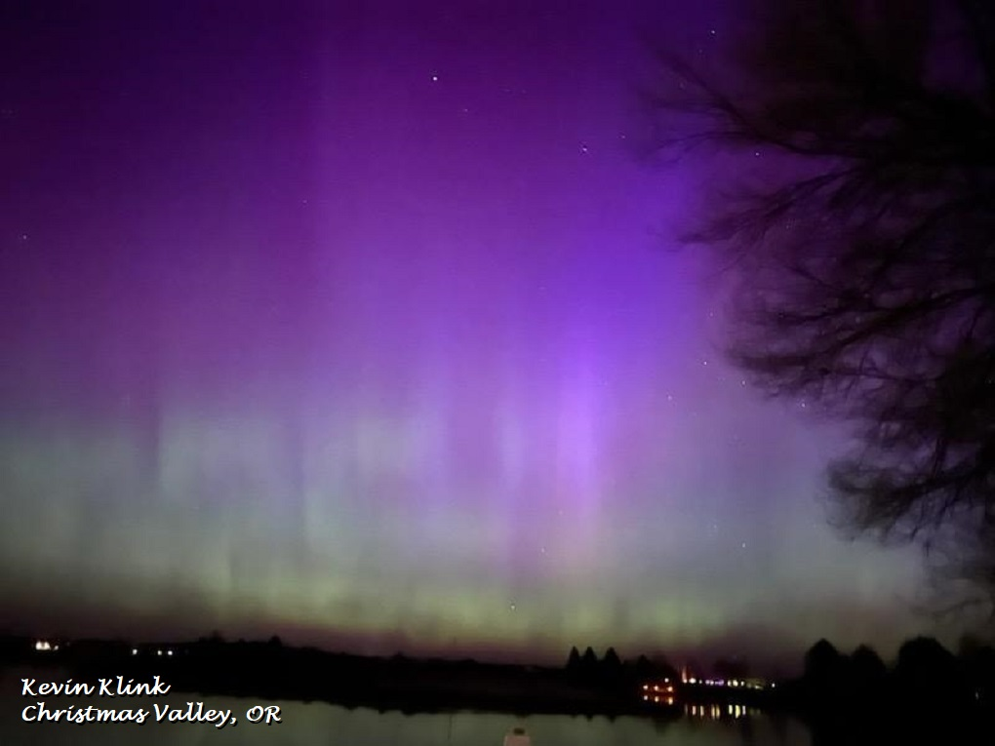
Updated Mid-Month
Your Feedback is Welcome!
Sign-up for Email notification of updates at:
https://oda.fyi/SubscribeSCF
Contact: Pete Parsons, ODF Lead Meteorologist
at 503-945-7448 or peter.gj.parsons@odf.oregon.gov

