Slide 1
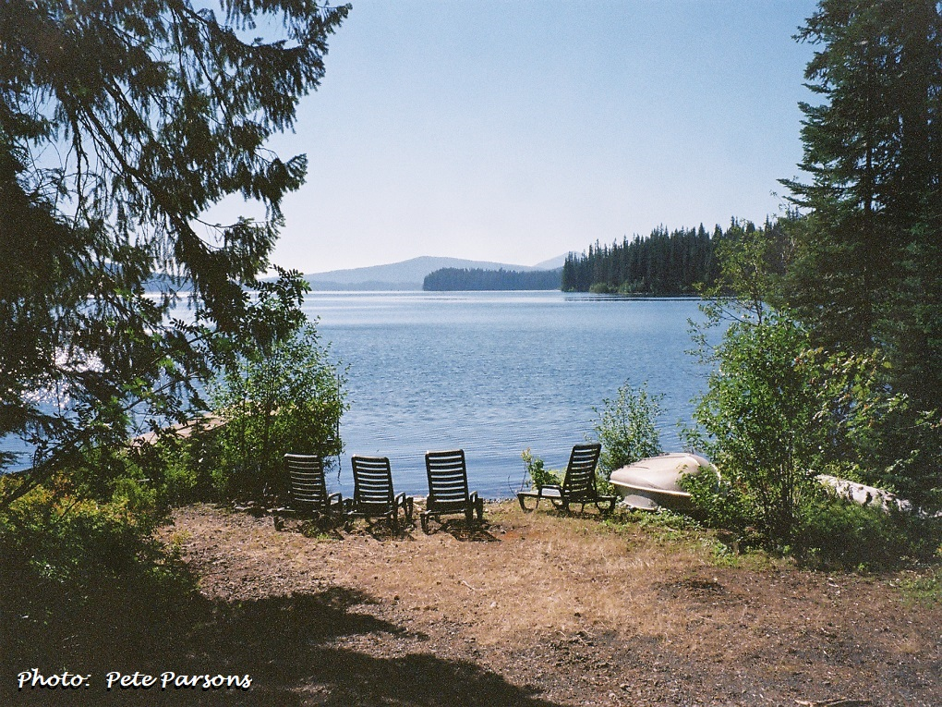
Seasonal Climate Forecast Verification August – October 2023 Issued: November 8, 2023
Contact: Pete Parsons, ODF Lead Meteorologist
503-945-7448 or peter.gj.parsons@odf.oregon.gov
ODA Team: Diana Walker; Andy Zimmerman; Jenn Ambrose; Taylor Harding ODF Team: Julie Vondrachek; Kristin Cody

Slide 2
Format and Purpose:
A side-by-side comparison of the “Seasonal Climate Forecast” vs. what (Actually Occurred) is done for both the 1-month & 3-month forecasts.*
The accuracy of each forecast is reviewed, and the need for analog-year updates is examined.
This is part of an ongoing assessment of the utility of this forecast method.**
*Utilizes 1991-2020 long-term averages
**See “Forecasting Methods…” at:
https://oda.direct/Weather

Slide 4
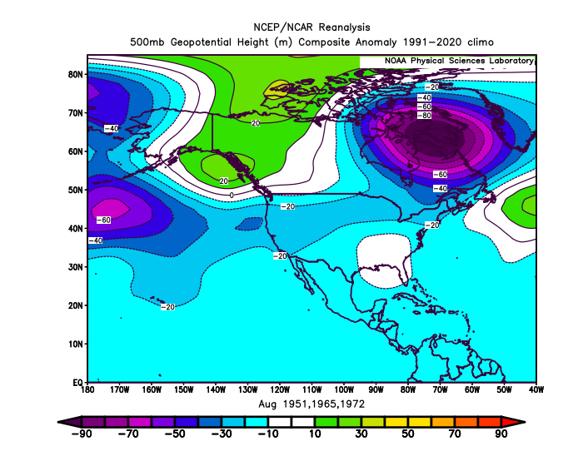
August 2023 (Forecast Issued July 20, 2023)/(Actual)
Forecast Upper-Air Anomalies
Actual Upper-Air Anomalies
Both the analog composite forecast (left) and observed pattern (right) had Oregon wedged between positive anomalies (more ridging than normal) in the Gulf of Alaska and negative anomalies (troughing) over southern California. A “partial forecast hit.”

Slide 5
August 2023 (Forecast Issued July 20, 2023)/(Actual)
Forecast Temperatures
Actual Temperatures
Data courtesy of the National Centers for Environmental Information (NCEI)
Notes:
Temp Data: ftp://ftp.ncdc.noaa.gov/pub/data/cirs/drd964x.tmp.txt Precip Data: ftp://ftp.ncdc.noaa.gov/pub/data/cirs/drd964x.pcp.txt

Slide 6
August 2023 (Forecast Issued July 20, 2023)/(Actual)
Forecast Precipitation
Actual Precipitation
Data courtesy of the National Centers for Environmental Information (NCEI)
Notes:
Temp Data: ftp://ftp.ncdc.noaa.gov/pub/data/cirs/drd964x.tmp.txt Precip Data: ftp://ftp.ncdc.noaa.gov/pub/data/cirs/drd964x.pcp.txt

Slide 7
August 2023 (Forecast Issued July 20, 2023)/(Actual)
Above-average temperatures west and NE with at least one hot spell sending valley temperatures over 100°F. (Temperatures ranged from above average west and central to near average SE. A record-breaking hot spell pushed western valley temperatures over 100°F from the 13th through the 16th , with 100°F+ heat moving across the central and eastern zones from the 14th through the 17th.) A “forecast hit.”
Below-average rainfall along the coast contrasting with above-average rainfall from the Cascades eastward. (Precipitation ranged from slightly below average along the coast to well above average east of the Cascades, due largely to heavy rainfall from the remnants of Hillary, a strong eastern Pacific hurricane.) A “forecast hit.”

Slide 8
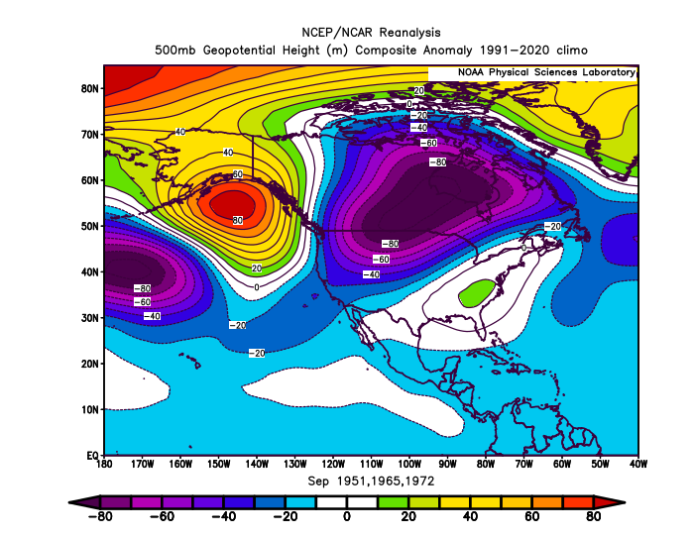
September 2023 (Forecast Issued August 17, 2023)/(Actual)
Forecast Upper-Air Anomalies
Actual Upper-Air Anomalies
Analog forecast (left) was mostly out-of-phase with the observed pattern (right), but both had anomalous troughing over the Pacific Northwest. A “partial forecast hit.”

Slide 9
September 2023 (Forecast Issued August 17, 2023)/(Actual)
Forecast Temperatures
Actual Temperatures
Data courtesy of the National Centers for Environmental Information (NCEI)
Notes:
Temp Data: ftp://ftp.ncdc.noaa.gov/pub/data/cirs/drd964x.tmp.txt Precip Data: ftp://ftp.ncdc.noaa.gov/pub/data/cirs/drd964x.pcp.txt

Slide 10
September 2023 (Forecast Issued August 17, 2023)/(Actual)
Forecast Precipitation
Actual Precipitation
Data courtesy of the National Centers for Environmental Information (NCEI)
Notes:
Temp Data: ftp://ftp.ncdc.noaa.gov/pub/data/cirs/drd964x.tmp.txt Precip Data: ftp://ftp.ncdc.noaa.gov/pub/data/cirs/drd964x.pcp.txt

Slide 11
September 2023 (Forecast Issued August 17, 2023)/(Actual)
Temperature forecast skewed colder than normal by 1965 & 1972, but 1951 was warmer than normal (analogs lacked consistency). (Temperatures were below normal across all zones.) Mostly a “forecast hit.”
Precipitation forecast from the analog blend was below average, but 1972 was wet...analogs lacked consistency. (Rainfall was above average across all zones, more in line with 1972 than with the analog average.) Mostly a “forecast miss.”

Slide 12
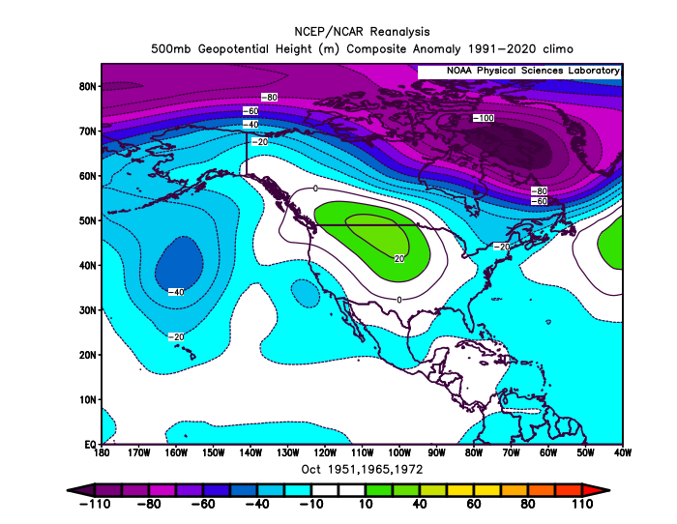
October 2023 (Forecast Issued September 21, 2023)/(Actual)
Forecast Upper-Air Anomalies
Actual Upper-Air Anomalies
Analog composite forecast (left) showed anomalous ridging over SW Canada extending into the Pac NW. The observed pattern (right) was similar but had slightly more ridging than predicted over Canada and the Pac NW. A “forecast hit.”

Slide 13
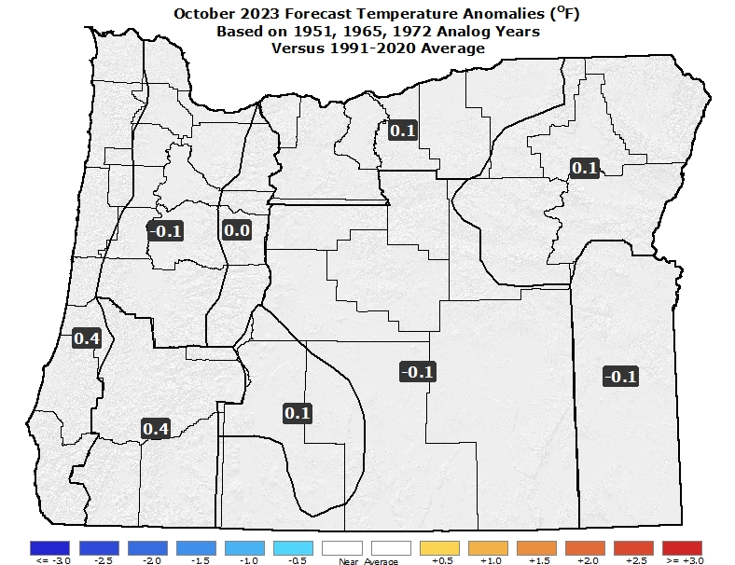
October 2023 (Forecast Issued September 21, 2023)/(Actual)
Forecast Temperatures
Actual Temperatures
Data courtesy of the National Centers for Environmental Information (NCEI)
Notes:
Temp Data: ftp://ftp.ncdc.noaa.gov/pub/data/cirs/drd964x.tmp.txt Precip Data: ftp://ftp.ncdc.noaa.gov/pub/data/cirs/drd964x.pcp.txt

Slide 14
October 2023 (Forecast Issued September 21, 2023)/(Actual)
Forecast Precipitation
Actual Precipitation
Data courtesy of the National Centers for Environmental Information (NCEI)
Notes:
Temp Data: ftp://ftp.ncdc.noaa.gov/pub/data/cirs/drd964x.tmp.txt Precip Data: ftp://ftp.ncdc.noaa.gov/pub/data/cirs/drd964x.pcp.txt

Slide 15
October 2023 (Forecast Issued September 21, 2023)/(Actual)
Analogs had a wide variety of temperature departures with no clear signal in either direction. (Temperatures alternated between relatively warm and cool periods, but a few record-warm days, late in the first week, skewed the averages to slightly above normal.) A “partial forecast hit.”
Precipitation near or slightly below average. (Rainfall was near or slightly below average.) A “forecast hit.”

Slide 16
August – October 2023 (Forecast Issued July 20, 2023)/(Actual)
Forecast Upper-Air Anomalies
Actual Upper-Air Anomalies
The forecast (left) and observed (right) charts both had positive anomalies over western Canada. However, the forecast flipped to weak negative anomalies over Oregon, while the observed pattern was near average. A “partial forecast hit.”

Slide 17
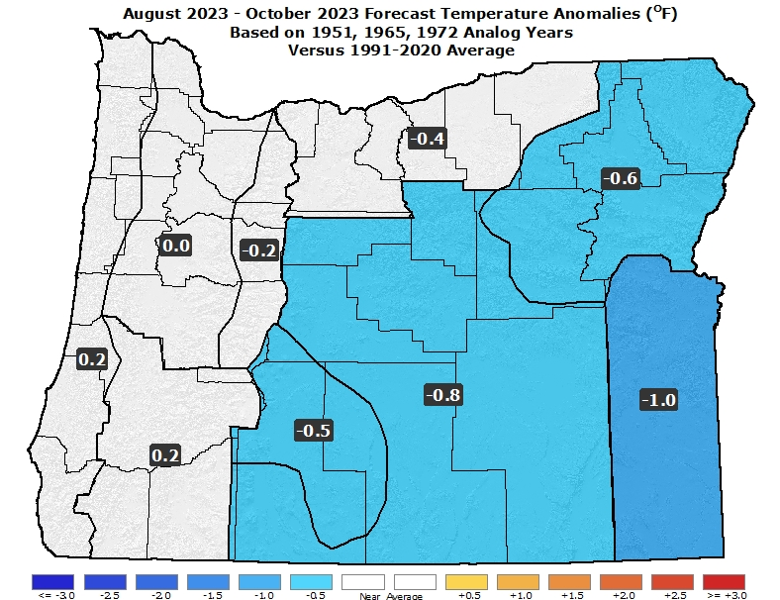
August – October 2023 (Forecast Issued July 20, 2023)/(Actual)
Forecast Temperatures
Actual Temperatures
Data courtesy of the National Centers for Environmental Information (NCEI)
Notes:
Temp Data: ftp://ftp.ncdc.noaa.gov/pub/data/cirs/drd964x.tmp.txt Precip Data: ftp://ftp.ncdc.noaa.gov/pub/data/cirs/drd964x.pcp.txt

Slide 18
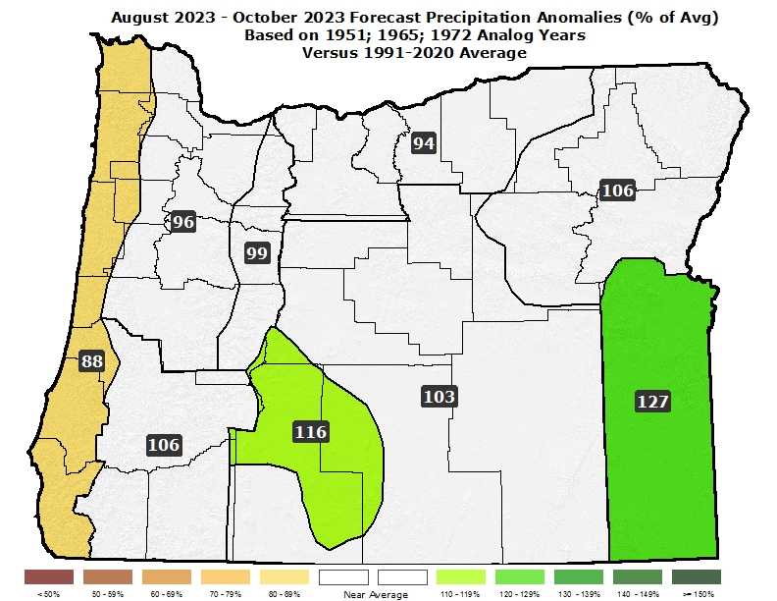
August – October 2023 (Forecast Issued July 20, 2023)/(Actual)
Forecast Precipitation
Actual Precipitation
Data courtesy of the National Centers for Environmental Information (NCEI)
Notes:
Temp Data: ftp://ftp.ncdc.noaa.gov/pub/data/cirs/drd964x.tmp.txt Precip Data: ftp://ftp.ncdc.noaa.gov/pub/data/cirs/drd964x.pcp.txt

Slide 19
August – October 2023 (Forecast Issued July 20, 2023)/(Actual)
Large departures from average temperatures were not indicated by the analogs. (Above-average temperatures in August gave way to cooler-than-average conditions in September with alternating warm and cool periods in October.) A “partial forecast hit.”
Precipitation near average west; slightly above average east. (Rainfall varied from below average west to well-above average east in August. September rainfall was above average with a flip to slightly below-average rainfall in October. Overall, rainfall was near average west and above average east.) Mostly a “forecast hit.”

Slide 20
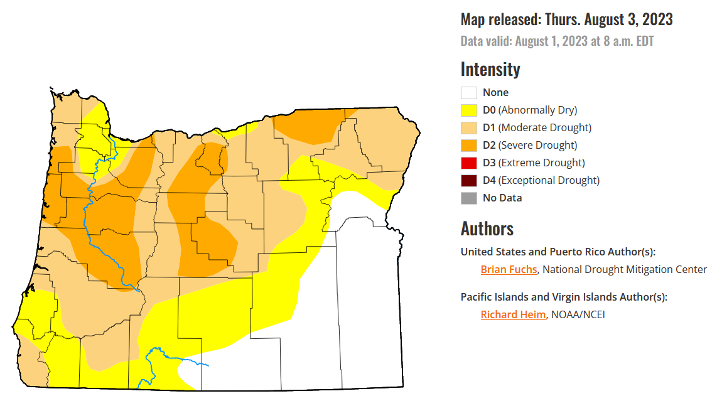
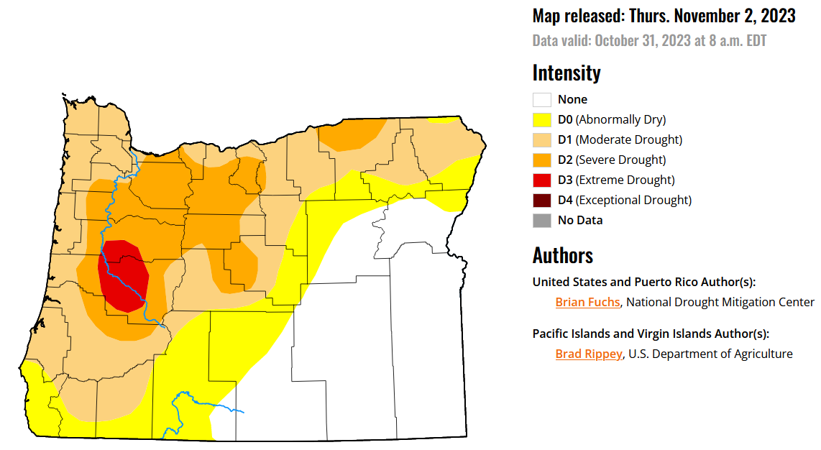
Most of Oregon is Still Abnormally Dry
(despite a relatively damp 3 months for the central and eastern zones)
August 1st
October 31st
Courtesy: National Drought Mitigation Center (NDMC)
https://droughtmonitor.unl.edu/

Slide 21
Forecast Resources
ODA Seasonal Climate Forecast Home:
https://www.oregon.gov/ODA/programs/NaturalResources/Pages/Weather.aspx
CPC Official US Three-Month Forecasts (Graphics):
https://www.cpc.ncep.noaa.gov/products/predictions/long_range/seasonal.php?lead=01
CPC US 30-Day & 90-Day Forecasts (Discussions):
https://www.cpc.ncep.noaa.gov/products/predictions/long_range/fxus07.html
CPC Weekly & Monthly ENSO Discussions: https://www.cpc.ncep.noaa.gov/products/analysis_monitoring/enso_advisory
Australian Government Climate Model Summary:
http://www.bom.gov.au/climate/model-summary/#region=NINO34&tabs=Overview
Australian Government ENSO Wrap-Up:
http://www.bom.gov.au/climate/enso
IRI ENSO Quick Look:
https://iri.columbia.edu/our-expertise/climate/forecasts/enso/current/

Slide 22
Water Supply / Fire-Potential Outlook
CPC U.S. Seasonal Drought Outlook:
https://www.cpc.ncep.noaa.gov/products/expert_assessment/season_drought.png
NRCS Snow Water Equivalent Oregon Map:
https://www.wcc.nrcs.usda.gov/ftpref/data/water/wcs/gis/maps/or_swepctnormal_update.pdf
NRCS/USDA Snow Water Equivalent Products:
https://www.nrcs.usda.gov/wps/portal/wcc/home/snowClimateMonitoring/snowpack/
NDMC U.S. Drought Monitor:
https://droughtmonitor.unl.edu/
NIDIS North American Drought Portal:
https://www.drought.gov/nadm/content/percent-average-precipitation
WRCC WestWideDroughtTracker:
https://www.wrcc.dri.edu/wwdt/
NWCC Northwest Interagency Coordination Center (video)
https://gacc.nifc.gov/nwcc/predict/outlook.aspx

Slide 23
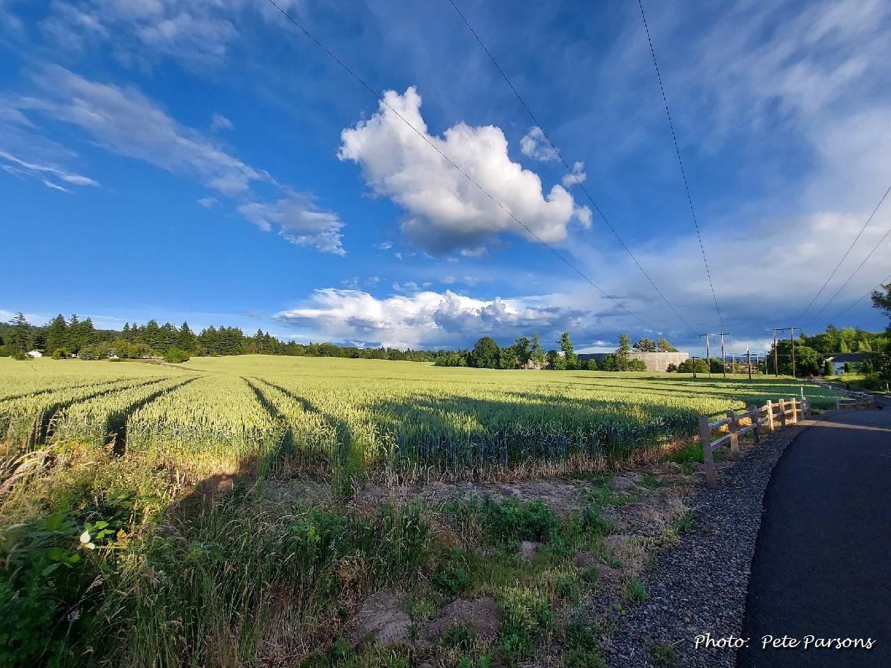
Updated Mid-Month
Your Feedback is Welcome!
Sign-up for Email notification of updates at:
https://oda.fyi/SubscribeSCF
Contact: Pete Parsons, ODF Lead Meteorologist
at 503-945-7448 or peter.gj.parsons@odf.oregon.gov

