Slide 1


Our Students. Our Success.
Community Input Session
The Student Success Act
YOUR School District
October 2019

Slide 2


Welcome!
Your voice matters.
Thank you for being here.
We invite and welcome all voices to contribute.
2

Slide 3

Today’s Agenda
The Student Success Act & Student Investment Account
Timeline
How can we support our students?
5 Areas for input
Breakout Sessions (optional)
Next Steps
Stay Involved!
The Oregon Department of Education wants to hear from you!
Follow on Twitter @ORDeptEd #studentsuccessact
3

Slide 4

The Student Success Act
$2
Billion
The Student Success Act marks a turning point for education in Oregon.
Investment

Slide 5

Student Investment Account
What is the Student Investment Account?
Close to $500 million in non-competitive grant money for all Oregon school districts and eligible charter schools.
Our District has an important role to plan for SIA funds
Your Input
Write our Plan
Apply for SIA Funds
Put plan into action

Slide 6
Student Investment Account
What is the Purpose of the Student Investment Account?
  Meet students’ mental and behavioral health needs.
  Increase academic achievement and reduce academic disparities for:
    Students of color;
    Students with disabilities;
    Emerging bilingual students; and
    Students navigating poverty, homelessness, and foster care; and other students who have historically experienced disparities in our schools.
6

Slide 7
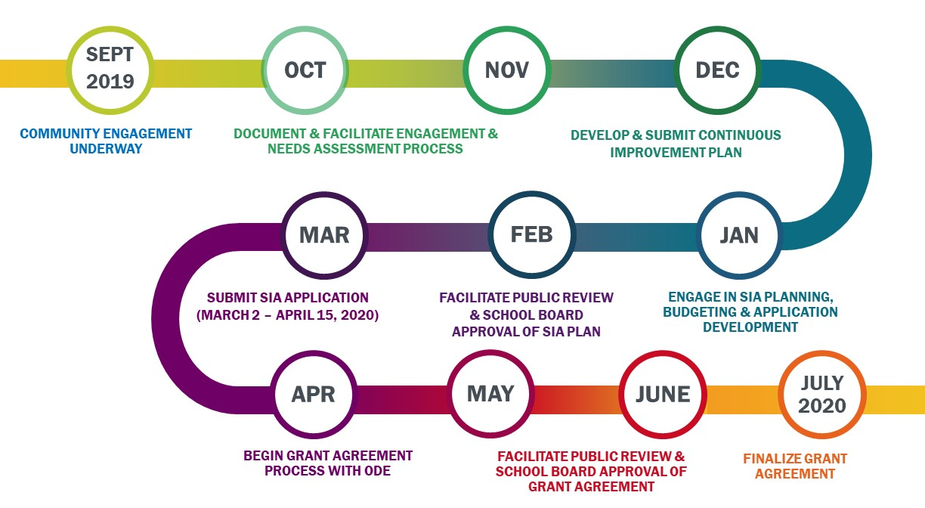
Roadmap
7

Slide 8




How can we spend new money?
Class Size
4 Categories for the Student Investment Account
As part of accepting the Student Investment Account money for our district, we must determine our local needs and priorities and develop a plan to spend the new resources in any or all of the four categories.
Well-Rounded Education
Instructional Time
Health and Safety
8

Slide 9

5 Areas for Input
1
Reducing academic disparities (gaps between outcomes for different student groups)
2
Meeting students’ mental and behavioral health needs
3
Providing access to academic courses
9

Slide 10
5 Areas for Input - continued
4
Allowing teachers and staff to have sufficient time to:
Collaborate with other teachers and staff.
Review data on students’ grades, absences and discipline, based on school and grade level course.
Develop strategies to ensure that at-risk students stay on track to graduate.
5
Establishing and strengthening partnerships
10

Slide 11
Breakout Sessions (example)
Time | Topic
6:20 – 6:25 | Transition to breakout session 1
6:25 – 7:05 | Breakout session 1
7:05 – 7:10 | Transition to breakout session 2
7:10 – 7:45 | Breakout session 2
7:45 – 7:50 | Transition to close
7:50 – 8:00 | Full group: Close
11

Slide 12

Next Steps
[customize this slide with your district’s next steps]
Please send additional comments and further feedback or questions to: XXXX@schooldistrict.com
Save the Date: [how will the conversation continue]
12

Slide 13

Thank You!
Our Students. Our Success.
[Customize with Your School District Contact Information]
13

