Slide 1
INSTRUCTIONS FOR SCHOOL/DISTRICT
This template deck is a resource for applicants to turn and adapt and use in presenting their Integrated Application as covered under, Aligning for Student Success: Integrated Guidance 2025-27.
This resource is designed for governing boards but could, often with translation, be used for communicating to families and the communities served.
Questions?
Contact your ESD Liaison or email ODE.EII@ode.oregon.gov

Slide 2
[Applicant name(s)]
2025-27 Integrated Application
Presentation to Governing Board
Notes:
Suggestion: Add district/applicant logo

Slide 3
Contents
Purpose of Presentation
Background & Context
Planning Team
Plan Inputs
Plan Overview
What’s Next
Notes:
Suggested Speaker Notes: Explain that ‘’plan’’ includes your application, budget, and all materials submitted under the IG

Slide 4

Purpose for Presentation
To share what was prioritized in the plan given the range of inputs
To explain how the plan was developed
To hear additional feedback on the plan now that it has been developed
To [introduce, engage, and/or seek] board approval

Slide 5
Background
Integration effort was responsive to requests from educational leaders and state legislators
Combined processes for community engagement, needs assessment, planning, budgeting and evaluation for nine programs
Designed to reduce burden and redundancies and improve the framework by which progress can be measured over time

Slide 6
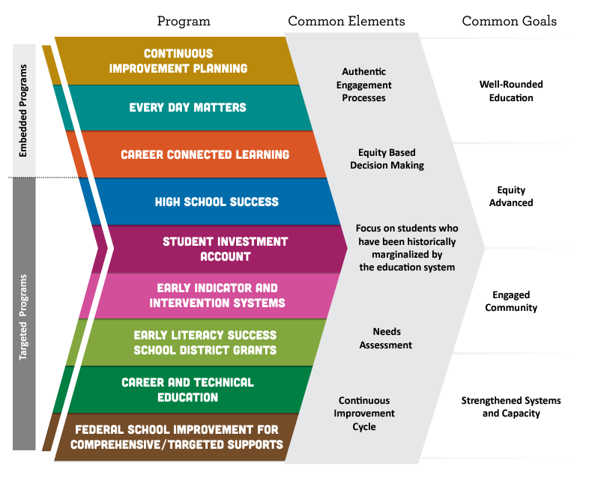
Aligned Programs & Common Goals
Notes:
Suggested Speaker Notes: Integration is possible for these initiatives because of what they have in common. This guidance brings them together so applicants, regions, schools, and programs can leverage multiple strategies and funding sources to implement more cohesive plans that positively impact students. Through the integrated application process, the outcomes and strategies for each initiative will continue to come together into a single strategic plan that supports the common goals. The aim is to build these goals into the entire educational system to embed the work at all levels and ensure sustainability.
Common Engagement of focal student groups presents a unique opportunity and vital resource for collecting high impact community data to inform the practices that impact those same populations. Focal student groups and their families must be engaged in planning under this guidance and there must be demonstrated evidence and artifacts for how engagement strategies/activities impacted your chosen outcomes, priorities, strategies, and activities. Focal student groups are defined within the Student Success Act as “students of color; students with disabilities; emerging bilingual students; and students navigating poverty, houselessness, and foster care; and other students who have historically experienced disparities in our schools”. This list has been expanded in rule to include migratory students, students recently arrived, justice involved youth, and students who identify as LGBTQ2SIA+.
Focal Student Groups:
Students of color;
Students with disabilities;
Emerging bilingual students;
Students navigating poverty, homelessness, and foster care;
Migrant students;
Students with experience of incarceration or detention;
LGBTQ2IA+ students;
Students recently arrived;
Other students who have historically experienced academic disparities.

Slide 7
Summary of Program Purpose
Centering supports from kindergarten readiness through college & career and especially for focal group students.
Continuous Improvement Planning (CIP) - A process involving educator collaboration, data analysis, professional learning and reflection - toward improved outcomes for students and especially students experiencing disparity.
Every Day Matters - (EDM) - Embedded across the five other programs, focusing attention on student engagement, school culture, climate/safety & culturally sustaining pedagogy.
Career Connected Learning (CCL) - Framework of career awareness, exploration, preparation, and training that is both learner-relevant and directly linked to professional and industry-based expectations.
Notes:
Link to Integrated Guidance

Slide 8
Summary of Program Purpose, continued
Centering supports from kindergarten readiness through college & career and especially for students who have experienced disparities.
High School Success (HSS) - Systems to improve graduation rates and college/career readiness.
Student Investment Account (SIA) - To meet students’ mental health, behavioral needs and increase academic achievement/reduce disparities for student focal groups.
Early Indicator and Intervention System (EIIS) - The development of a data collection and analysis system, in which educators collaborate, to identify supports for students.

Slide 9
Summary of Program Purpose, continued
Centering supports from kindergarten readiness through college & career and especially for students who have experienced disparities.
Early Literacy Success School District Grants (ELGSSG) - Grants to school districts in order to Increase early literacy for children from birth to third grade, reduce literacy academic disparities for student groups that have historically experienced academic disparities, increase support to parents and guardians around literacy, and to increase access to early literacy learning through support that is research-aligned, culturally responsive, student-centered and family-centered.
Career and Technical Education - Perkins V (CTE) - Improving access and participation in education and training programs that prepare learners for high-wage, high-skill, in-demand careers.
Federal School Improvement - Address the academic disparities for named focal student groups and subject areas at schools identified as Comprehensive Support and Improvement (CSI) and Targeted Support and Improvement (TSI).

Slide 10
Meet our Planning Team Members
Notes:
NOTE TO SCHOOL/DISTRICT - Introduce the team members and staff that have led your community engagement efforts, needs assessment and planning processes. These are the people (staff and community partners, if applicable) that have stewarded the development of our plan and application.

Slide 11
Required Planning Processes
Use of an Equity Lens
Community Engagement
Comprehensive Needs Assessment
Tribal Consultation
Potential Impact on Focal Students
Development of a four-year plan with clear Outcomes, Strategies, and Activities
The existing plan to review and revise
Input from District Equity Committees
Recommendations from the Quality Education Model (QEM)
Recommendations from Statewide Student Success Act Plans
Reviewing and Using Regional CTE Consortia Inputs
Notes:
Suggested Speaker Notes: The Integrated Application process requires us to follow these steps in order to curate a quality plan matched to our local need. Provide a brief overview of each of these steps and actions. Remove Tribal Consultation if not required.

Slide 12
Equity Lens, Tool(s) & Decision Making
Notes:
NOTE TO SCHOOL/DISTRICT - Share an example of how your team used equity tools to consider the impacts for students, staff and families in your community and provide specific examples.
Suggested Speaker Notes: Use of an equity lens or equity tools supports us to operationalize our commitments and values. It helps translate theory into practice, focuses on assets rather than deficits, and assists us to avoid making decisions that could marginalize or harm students, staff, families, and communities.

Slide 13
Community Engagement Highlights
Notes:
Suggested Speaker Notes: Critical in sharing information about engagement with focal groups is care about ensuring privacy and safety (additional notes below). Detail which focal groups your district team engaged with. Describe a few of the strategies and activities you used to engage with the community. Additional slides may be added with photos or other artifacts. Summarize key learnings from engagement and how that information was used when assessing needs and considering priorities for planning.
Notes on Safety/Privacy
Since many focal groups have historically and/or are currently experiencing incidents of violence and harm due to their identities, special care must be taken when undertaking engagement efforts with these groups. For LGBTQ2SIA+ students, it is important to not inadvertently out a student’s sexual orientation or gender identity when they may otherwise not be out to their family, peers, and/or some school staff. Migrant students and emergent bilingual students and their families should not have immigration status, refugee status, or other information become public. This is particularly important in communities that have experienced unwelcoming or traumatic events against undocumented immigrants.
An excellent resource to consider when planning engagement efforts and sharing with the community, such as at board meetings, is the ODE Ensuring Focal Student Group Safety and Privacy resource. In one example, working with a trusted community partner or intermediary is recommended as a strategy to gather and share back student feedback in a safe manner.
In many cases, the data that is needed to make assessments about plan creation and implementation does not need to include identifiers like name, place, grade level, etc. Patterns from the data collection can still be analyzed and reported upon in a board meeting without these identifiers.
Above all, it is critical to maintain confidentiality, ensure that your data security practices are maintained, and to honor any agreements you made in the engagement space, (for example not sharing any stories or anecdotes that were expressed.)

Slide 14
Needs Assessment Highlights
Notes:
Suggested Speaker Notes: Describe the data and information, including community engagement input, you used to determine strengths and needs in your district.
Summarize key learnings from grade bands and focal groups (taking care with privacy and safety needs of focal groups)

Slide 15
These priorities emerged:
Notes:
Suggested Speaker Notes: Through our community engagement efforts, our needs assessment process and examination of data, these priorities emerged.
Offer transparency where there may have been competing interests or limits to funding (tiered funding coming in a later slide) and how the district considered input and possible impact in order to make decisions

Slide 16
Our intended outcomes are:
Notes:
Suggested Speaker Notes: These reflect the priority work we are setting forward in our plan. These are our long term goals or outcomes.

Slide 17
These key strategies will help us achieve our intended outcomes:
Notes:
Suggested Speaker Notes: These are the specific projects, tactics and approaches that will help us achieve our outcomes. You may wish to organize this share by grade band strategies, focal group strategies or even name some of the program specific strategies.

Slide 18
Key Investments:
[INSERT: Budget Link on Website]
Please do not include your Smartsheet link as these are editable links. We recommend you download your Smartsheet instead.
Notes:
Suggested Speaker Notes: Share key investments and offer time for participants to view the complete planning and budget template while offering context for how the major investments/categories forward your strategies and support positive growth toward your intended outcomes.
This is where the district has posted our application and Integrated Planning and Budget Template on its website

Slide 19
Our Plan - Tiered Approach
Tiers of Planning & Budgeting allow for nimble course changes that have been pre-considered but aren’t within the current budget parameters.
In our district, these additional strategies and activities are possible if we move to another tier in our plan:
Notes:
Suggested Speaker Notes: Explain the concept of tiered planning. Offer the following: At this time, we are working with anticipated budget allocations. Should the actual allocations change we have planned some back-up or bonus activities that we can easily pivot to if needed. For example, if we are unable to hire as many social workers as we are planning, we would have additional funds available and would be able to nimbly move toward these activities.

Slide 20
How the State Understands Success
There are distinct performance measures used in the monitoring and evaluation process for implementation under this integrated guidance:
1. High School Success Eligibility Requirements
2. State CTE Perkins Performance Targets
3. Federal School Improvement Accountability Data
4. Longitudinal Performance Growth Targets (LPGTs)
5. Local Optional Metrics (LOMs)
6. Progress Markers
Notes:
Suggested Speaker Notes: ODE’s Integrated Guidance offers a kind of ‘’performance framework’’ that our work is reviewed through. This includes a mixture of outcome measures, programmatic and financial reporting, and the opportunity for local optional metrics.

Slide 21
Longitudinal Performance Growth Targets (LPGTs)
ODE will co-develop Longitudinal Performance Growth Targets with grant recipients, based on:
  Data available for longitudinal analysis;
  Guidance established by the department; and
  Overall and disaggregated rates for the following metrics:
    Third-grade reading proficiency rates measured by ELA
    Ninth-grade on-track rates
    Regular attendance rates
    Four-year or on-time graduation rates
    Five-year completion rates
*Grantees may also set local optional metrics
Notes:
Suggested Speaker Notes: Applicants at or under 80 ADMr OR Applicants who do not receive SIA funds can delete this slide
For the Student Investment Account, growth targets are required in the areas shown.
We have been asked to develop draft LPGTs to submit with our Integrated Application due this March. Once ODE reviews and approves our plan, they will partner with us, as required by SIA legislation to further co-develop and finalize these growth targets. Our finalized growth targets will then need to be reviewed and approved by the board within the context of our grant agreement.
[You may add slides to show the draft targets or a hand-out if you wish to present them as drafts now, reminding participants that the final targets will need to be reviewed by the school board in the grant agreement coming later this spring or summer. ]

Slide 22
How we understand success
Notes:
Suggested Speaker Notes: Offer your own local optional metrics, your best ways to measure outcomes and review strategies and impacts, and share your draft LPGTs

Slide 23
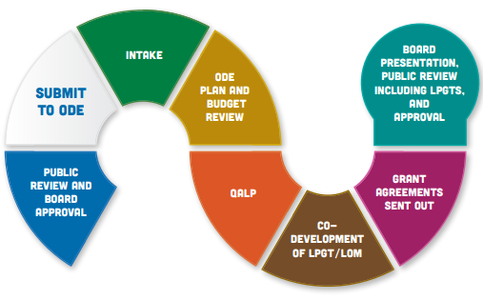
What Happens Next?
WILL RETURN TO PRESENT TO
THE BOARD
*
WE ARE HERE
23
Notes:
Suggested Speaker Notes: Each application will undergo a thorough evaluation process for approval; after which, it will be known as an integrated plan. The timing for this process is outlined on the slide. There are a number of variables, including when applicants submit their initial application and any required follow up of submissions, that can impact these processes.
Additional information as necessary: *QALP(Quality Assurance Learning Panel) will occur simultaneously as the ODE Plan and Budget Review for a randomly selected number of districts. QALP is composed of community members who observe as a quality measure overseeing the review process and requires no additional input from districts.

Slide 24
Questions & Comments
24

