Slide 1
Data in Context
Webinar 1 of 4 supporting developing growth targets and understanding the performance framework in
ODE’s Integrated Guidance

Slide 2
A four-part series
Data in Context
How are connections between diverse data sources essential to setting inclusive targets?
Setting Targets by Making Sense of the Mosaic of Data
How can realistic, ambitious, and attainable targets be developed with the data that is available?
Local Optional Metrics
How can existing or additional data be leveraged to broaden the narrative of particular successes and challenges within districts?
Deep Dive Workshop: Setting Growth Targets
How can collaboration support the complexities of establishing realistic targets?
January 11, 2022
3:30-5:00 PM
January 18, 2022
4:00-5:30 PM
February 1, 2022
4:00-5:30 PM
February 15, 2022
4:00-5:30 PM

Slide 3

Today’s Objectives
This session aims to guide participants to be able to:
Identify levels of data & the role of integration
Identify relationships between levels of data and types of Longitudinal Performance Growth Targets
Implement equitable data practices to achieve realistic and inclusive goal setting
How are connections between diverse data sources essential to setting inclusive targets?

Slide 4
How do we know what we know?
“Working together we can avoid accountability pitfalls experienced in No Child Left Behind, Race to the Top, education compacts, and other education initiatives over the last few decades…
Previous accountability measures often served to narrow the curriculum, using shame and blame of schools as an overly simplistic tactic while offering over-promised or oversimplified outcomes.”
LPGTs:
There is no single formula for setting these targets, as investments in programs and interventions will vary from district to district.
-Integrated Guidance, p 155

Slide 5
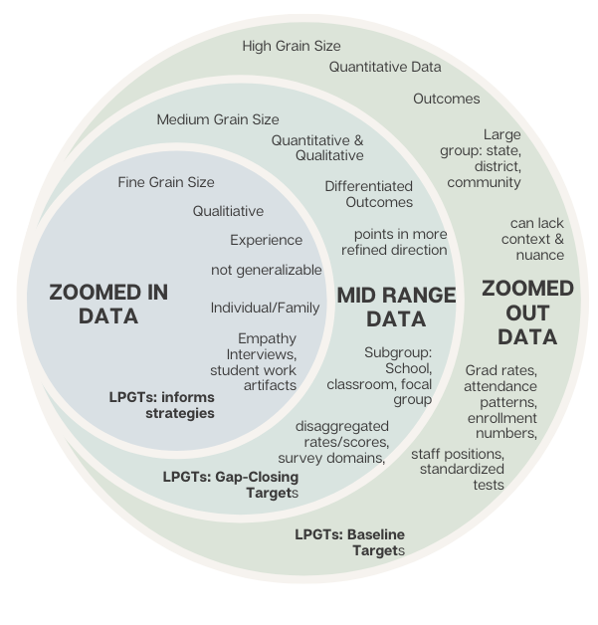

Levels of Data
Integrating Levels of Data means:
Understanding the relationship amongst each of these levels to interpret data
Capturing more of the regional context
Applying context when setting targets
Advancing towards inclusive & equitable practices
Note the relationship between levels of data & where they most apply in setting targets

Slide 6
Exploring Data Levels
3 Essential Understandings for Discussing Data:
Student group performance differs as a function of their experience within the education system and not as a function of anything intrinsic to that group.
Use an asset-based approach (look for what’s going right).
A singular story is not representative of a population.
Break-Out Rounds:
Small groups will receive a different pieces of data each round. Each piece of data represents one of the levels of data.
The group facilitator will share screen to review data together as a group.
The group will discuss prompted by the discussion questions for each round. The facilitator will capture some brief notes.

Slide 7
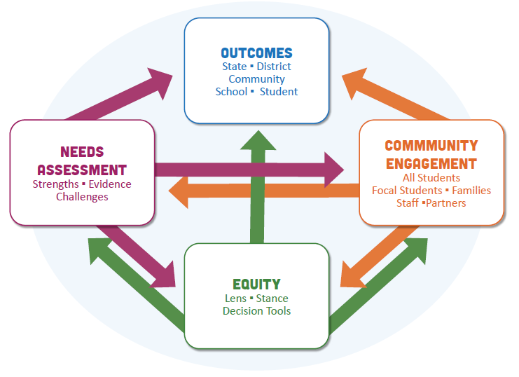
Implementing Equity in Data Practices - Why?
“Leverages multiple perspectives and equity-centered data analysis to identify strengths and areas for improvement as well as to make timely adjustments to improve experiences and outcomes for students.” Integrated Guidance pg. 15
Data should:
Make visible community-driven needs, challenges, and strengths
Represent the community
Be treated in ways that promote community self-determination

Slide 8

Implementing Equity in Data Practices - How?
identities, experiences, expertise
Evaluators
Holistic Data Practices:
“Measure and define improved student outcomes through multiple approaches that holistically center student well-being rather than a singular focus on academics”
Sources
types, representation, levels
Methods
collection, analysis, interpretation

Slide 9


Implementing Equity in Data Practices - How?
Data should:
Make visible community-driven needs, challenges, and strengths
Represent the community
Be treated in ways that promote community self-determination
Disaggregation

Slide 10
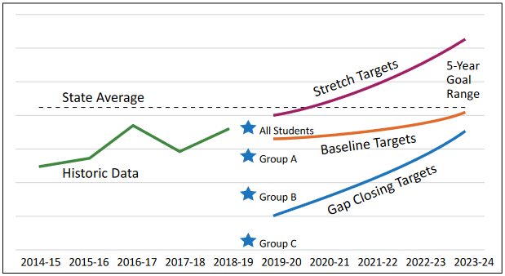
Types of Targets
For the five common metrics, three types of targets need to be set:
Baseline
Stretch
Gap-Closing
Context can alter the trajectories of all

Slide 11
Holistic Target Setting: From Breakout Data
Gap-Closing Targets Brainstorm :
How can data integration allow you to be both ambitious and realistic in target setting?

Slide 12

Reflection
How do equitable practices and a holistic data approach show up in the way you set targets?

Slide 13
Summary
Today we focused on the following objectives:
Identify levels of data & the role of integration
  Example in breakouts and reflecting on the unique contexts in YOUR community
Identify relationships between levels of data and types of Longitudinal Performance Growth Targets
  How to use context to think about setting targets
Implement equitable data practices to achieve realistic and inclusive goal setting
  How does this allow us to set ambitious and realistic targets that meet our objectives for the function of data.
  Context Matters. For all 3 targets, context can alter how closely you adhere to purely mathematical projections of the available data.

Slide 14
Resources & References
Integrated Guidance
  Appendix E of the Integrated Guidance (Equity Lens Tools)
  Appendix I: Detailed Guidance on Longitudinal Performance Growth Targets (LPGTs)(IG pages 154-159)
Navigating Data Sheets Video
Street Data by Shane Safir and Jamila Dugan
  Street Data: A New Grammar for Educational Equity
ODE’s Equity Strategic Plan and the ODE Equity Lens
Coalition of Communities of Color
  For a large list of resources

Slide 15
Next Session & Beyond:
Contextualizing Data
Thank you for joining us!
Setting Targets by Making Sense of the Mosaic of Data
How can realistic, ambitious, and attainable targets be developed with available data?
Local Optional Metrics
How can existing or additional data be leveraged to broaden the narrative of particular successes and challenges within districts?
Deep Dive Workshop: Setting Growth Targets
How can collaboration support the complexities of establishing realistic targets?
January 18, 2022
4:00-5:30 PM
February 1, 2022
4:00-5:30 PM
February 15, 2022
4:00-5:30 PM

