Slide 1
Deep Dive Workshop: Setting Growth Targets
Webinar 4 of 4 in the Evaluation & Monitoring Series

Slide 2

This presentation will not provide every answer, a formula, or a ‘’correct answer’’ for how to set
growth targets of any type.
Ideally you will walk away with a tangible and useful set of concepts and practices to help you
discuss and craft meaningful targets for your specific context and community.
A quick note
before we
dive in!
Guilhem
Noun Project
#itdepends

Slide 3

Today’s Objectives
Our focus this session is to:
Ground key concepts from our prior sessions
Deepened understanding of these processes:
How to draft growth targets
Preparing draft targets for the co-development phase that are justified & contextualized
Presenting approved growth targets to the public
What key concepts can provide guidance through the process of developing, refining, and sharing growth targets?

Slide 4
4 Part Series
Data in Context
How are connections between diverse data sources essential to setting inclusive targets?
Setting Targets by Making Sense of the Mosaic of Data
How can realistic, ambitious, and attainable targets be developed with the data that is available?
Local Optional Metrics
How can existing or additional data be leveraged to broaden the narrative of particular successes and challenges within districts?
Deep Dive Workshop: Setting Growth Targets
How can collaboration support the complexities of establishing realistic
targets?
January 11, 2022
3:30-5:00 PM
January 18, 2022
4:00-5:30 PM
February 1, 2022
4:00-5:30 PM
February 15, 2022
4:00-5:30 PM

Slide 5
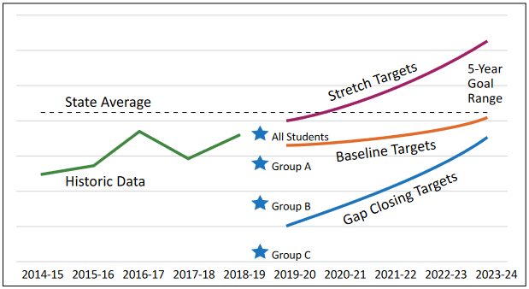
1. Context Matters: Impacting all 3 Types of Targets
For the five common metrics, three types of targets need to be set:
Baseline
Stretch
Gap-Closing
Context can alter the trajectories of all

Slide 6
2. Ambitious, Attainable, Realistic
Goal of Co-Development:
Collaborative crafting of ambitious, attainable, and realistic targets
Preparing for Co-Development:
Bring Focus of Context into relationship with Calculations
We’ll want to understand the why behind draft target and metric determination and decision making based on regionally specific context

Slide 7
3. No Single Formula
#itdepends
LPGTs:
There is no single formula for setting these targets, as investments in programs and interventions will vary from district to district.
-Integrated Guidance, p 155

Slide 8

4. Impact of Investments over Time:
Consider impacts of outcomes & investments over time
Progress can be interrelated amongst the LPGTs and also with Local Optional Metrics
Growth is not linear, and may not be realistic for every year
millennials (nounproject)

Slide 9


Target Guidelines
St Musdalifah (Nounproject)
Gap closing and stretch targets set higher than your baseline (Baseline) targets
Stay below the top historical growth (Baseline+Growth)
Expect an Implementation Curve
Expect less growth if you’re already above the state average
Akbar (Nounproject)

Slide 10
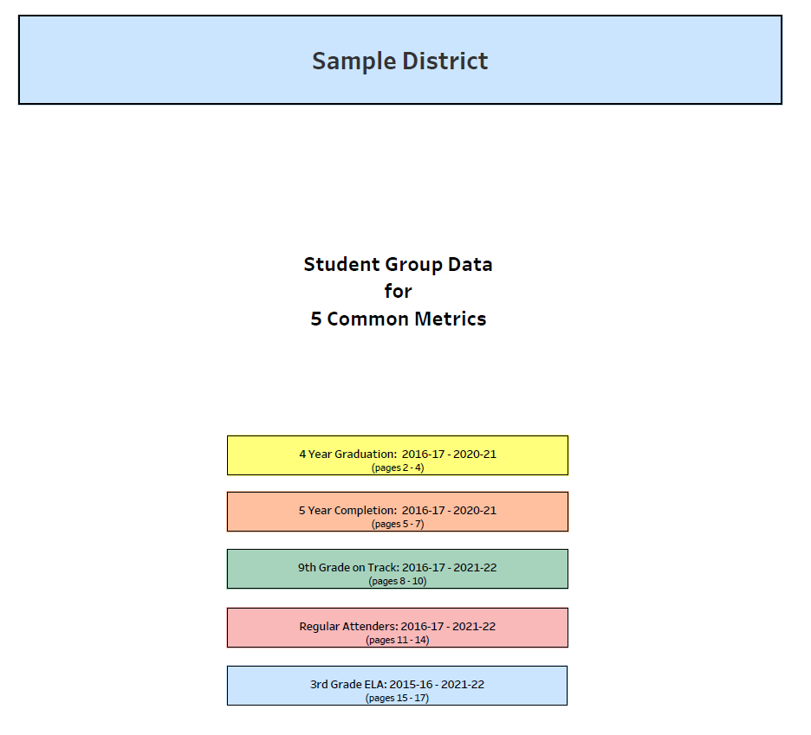
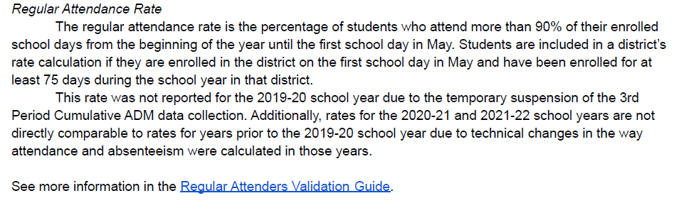
A walk through example
Mock Data for Regular Attenders
Notes:
We will be using mock data for a mid-sized district to work through an example.
Mock data: https://drive.google.com/file/d/1fCAl7-HV5cq0xlMEPLLGYGn8JqcyXkd_/view?usp=share_link
We distributed this with the video for walking through the data:
https://youtu.be/haf4Cx9OOdY

Slide 11
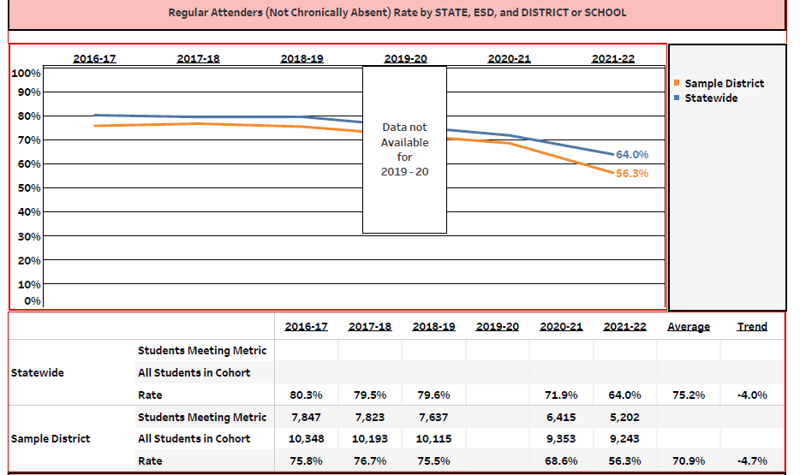
Step 1 - Review History of All Students
The State average 75.2% and (-4.0)
District: Note that the -4.7% rate is not steady. there were large shifts in the last 2 academic years

Slide 12
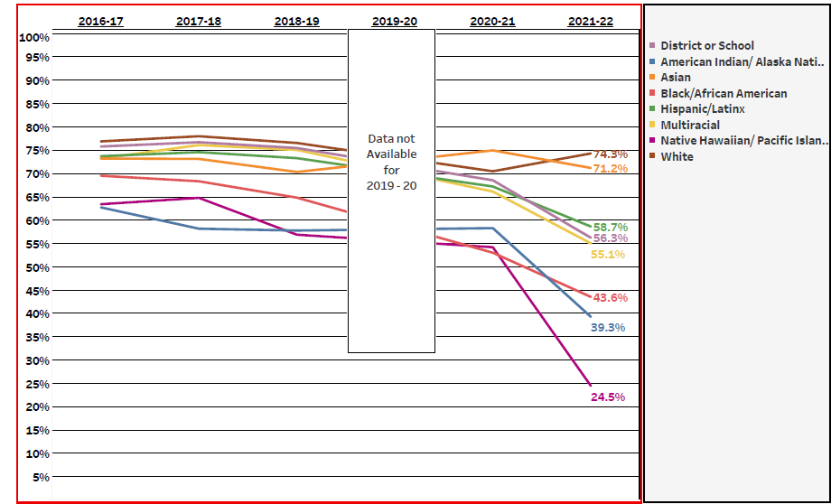
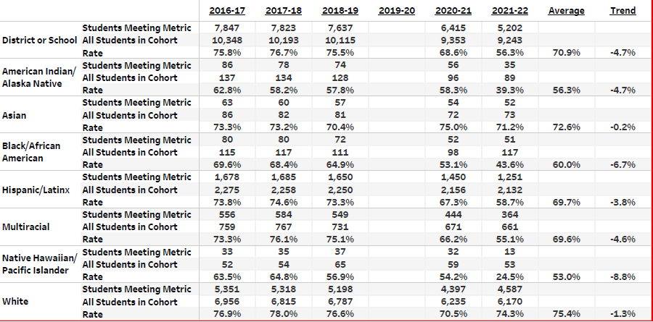
Step 1 - Review History of All Students
Questions to ask:
Where are the disparities?
What are the sample sizes (N) for each focal student group?
Why is this important?

Slide 13
Step 1 - Review History of All Students
Questions to ask:
Where are the disparities?
What are the sample sizes (N) for each focal student group?
Why is this important?

Slide 14
Step 1 - Review History of All Students
Examine:
What happens when you look at a combined focal student group?
Notes:
Data for a combined focal student group will be provided. It is inclusive of all focal groups except those experiencing mobility:
Asian
American Indian/Alaska Native
Black/African American
Multiracial
Hispanic/Latino/a
Native Hawaiian/Pacific Islander
Students experiencing Disabilities (served through IEP)
Migrant (served through federal migrant education program)
Students experiencing houselessness
Recent Arrivers
Experience of incarceration or detention (in current or any prior year)
Current English Learner/Emerging Bilingual
Non-Binary gender
Students navigating Foster Care
Students navigating Poverty (using new SBE-approved definition)

Slide 15
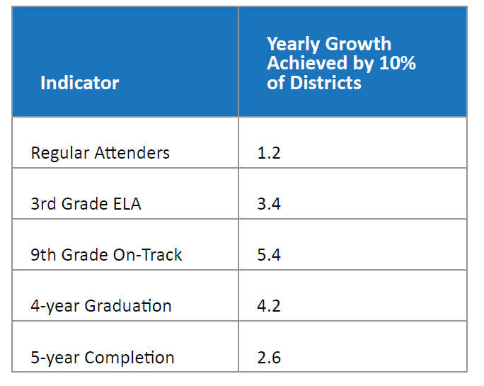

Reminder: Not all metrics move the same
Rafael Garcia Motta (Nounproject)
-Integrated Guidance, p 155
Notes:
As you can see from this table in the IG : “The table below shows the growth that the top ten percent of districts achieved or exceeded from 2013 to 2018”: https://www.oregon.gov/ode/StudentSuccess/Documents/ODE_Integrated%20Guidance.pdf?utm_medium=email&utm_source=govdelivery

Slide 16
Preview Updated Data
Total Growth from 2016-17 to 2021-22 among Districts with n >= 10
Indicator | Top 10% Growth (90th Percentile) |  | Median Growth (50th Percentile)
 | Total over 5 years | Yearly Average | Total | Yearly Average
3rd Grade ELA | 6.7 | 1.3 | -6.2 | -1.2
Regular Attenders | -5.7 | -1.1 | -16.4 | -3.3
9th Grade On-Track | 16.1 | 3.2 | -0.4 | -0.1
4-year Cohort Graduation | 16.9 | 3.4 | 3.2 | 0.6
5-year Cohort Completion | 12.1 | 2.4 | 1.7 | 0.3

Slide 17
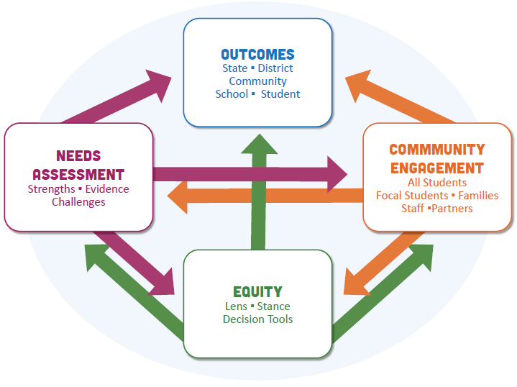
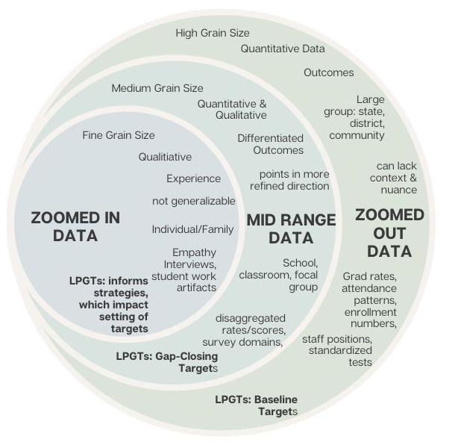

Step 2 - What is the context?
Community Assets?
Local Optional Metrics
Plans and Investments
Broad or targeted
Solikin (Nounproject)

Slide 18
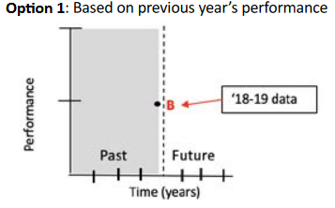
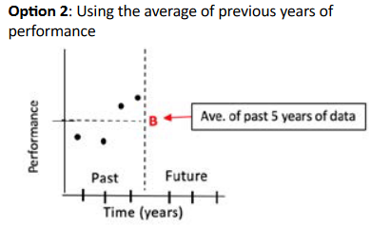
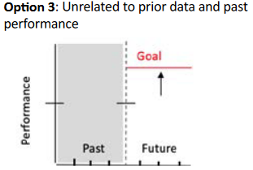
Step 3: Determine the starting point
LPGTs:
There is no single formula for setting these targets, as investments in programs and interventions will vary from district to district.
-Integrated Guidance, p 155

Slide 19
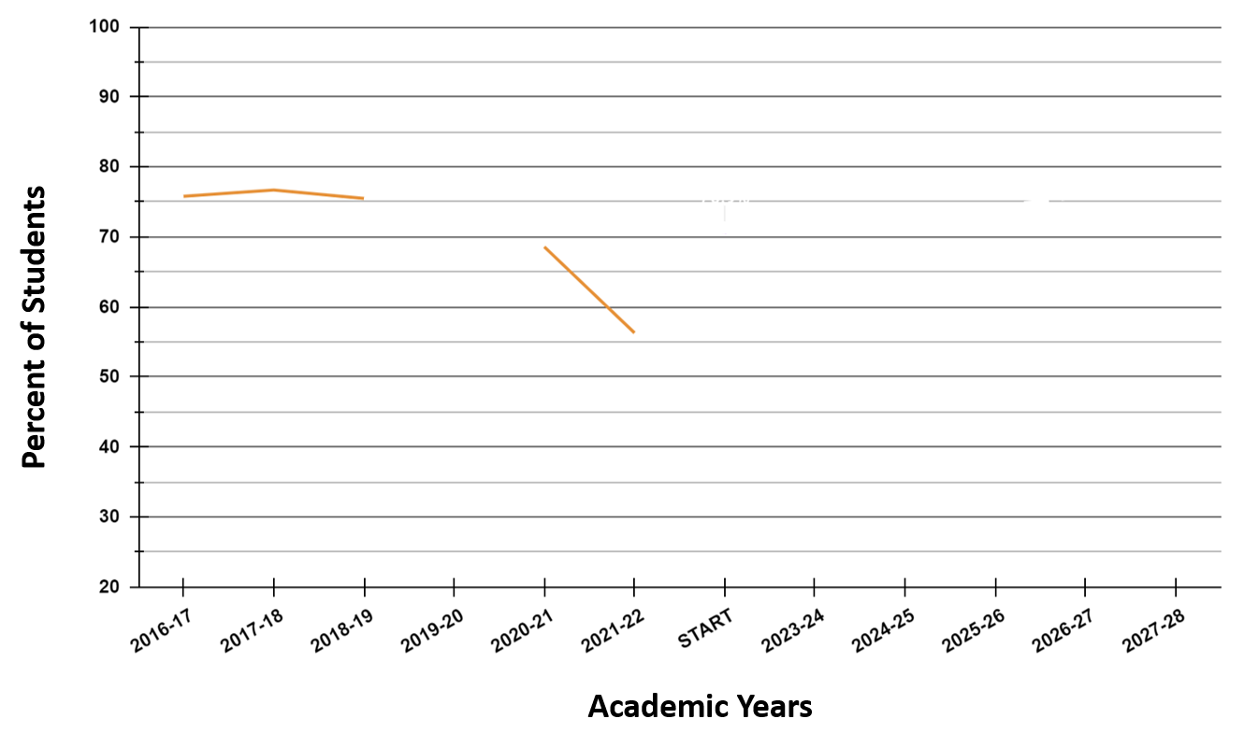
Step 3: Determine the starting point
Legend
District (all students):
State history :
State average :
district average
some other value
Prior year
Scenario 1: District average
Scenario 2: Prior year
Scenario 3: Other value
Notes:
HEIDI
From the IG pg 158: “For the purposes of Longitudinal Performance Growth Target setting, three options are suggested for determining your starting points. These were illustrated in the previous graphic. and are now mapped here in relation to the Regular Attenders data from out mock dataset.
WALK THROUGH THIS GRAPH:
X-axis: The prior academic years, the “start point” for the new biennium and the next 5 academic years
Y axis: Shows the % of students meeting the metric
Legend: walk through
Scenarios 1-3: The dots represent the starting point options. Again, three can be MANY things
ALL require context and justification
The starting point should be set based on an examination of the context and factors in the community. Which of those values best reflects the current state?

Slide 20
Step 3: Starting Points
Legend
District (all students):
State history :
State average :
Each starting point sets a different “floor”
What is the 5-year target?
What does yearly progression look like?
Scenario 1: District average
Scenario 2: Prior year
Scenario 3: Some other value
Lines: if no progress made
Notes:
This graph is the same as before, but now we have added lines extending out from the three “starting point options”
Effectively, each line becomes a potential “FLOOR”. No declines or stasis. growth from here
NOTICE: As you lower or raise the starting point you potentially change trajectories

Slide 21
Types of Targets
For the five common metrics, three types of targets need to be set:
Baseline
Stretch
Gap-Closing
Context can alter the trajectories of all

Slide 22
Step 4: Baseline Targets
Legend
District (all students):
State history :
State average :
Choose a start point
Choose a target
reasonable growth?
Remember that growth is not linear
Context is key
SET THE BASELINE
Scenario 2: Most recent year
line: if no growth or loss
Notes:
Baseline: the minimum growth applicants would be satisfied to meet or maintain over the next five-year period
Run Through Scenario:
Let’s say that we chose one of the three Start Point options we discussed before (although there are many more than three)
We are choose the data point from the most recent year for this example. This is not a prescription. #itdepends on your context. We just chose this point in order to keep moving through our scenario.
The red dot is that value and the line of the same color is stasis across the five years from that point. Our “floor”
Choices to make:
Target: What target do you choose to go for?
Remember that the baseline target represents the minimum expectation of progress
Improvement is expected
Top Growth: what value do you choose?
There are multiple options
From the IG page 156: “Applicants, especially those below statewide averages, should strive to match or exceed statewide progress, and not to see a decline in indicators.”
Applicants at the very high end of achievement might expect less or slower growth, or perhaps to hold steady and see maintenance at these levels as a signal of excellence.
Expecting growth above the “High” values outlined below (table of the top 10% of district rates) may produce an unachievable target for districts.
New programs or investments don’t always impact metrics immediately; we expect growth to accelerate over time. This means intermediate targets may rise slowly at first.

Slide 23
Step 4: Baseline - Review Historical Data
Notes:
The District as a whole. Let’s remind ourselves of a few numbers:
The highest value achieved by the district?: 76.7% (see the mock data for 2017-18):
Because it was higher than the last year we have data for: The five year average: 70.9% (see the mock data):
The most recent year: 56.3% (and currently set as the starting point): Not feasible as this would be no growth

Slide 24
Step 4: Baseline Targets
Legend
District (all students):
State history :
State average :
Choose a start point
Set a floor and a ceiling
Remember that growth is not linear
Context is key
SET THE BASELINE
1.
3.
2.
4.
Scenario 2: Most recent year
line: if no growth or loss
line: Top 10% (2013-2018)
Notes:
In this scenario, it is useful to remember to review District Historical Values (from the last slide)
Remember that we have set a start point and we therefore have a floor
Now let’s review potential targets
The highest value achieved by the district: 76.7% in 2017-2018 (see the mock data):
the five year average: 70.9% (see the mock data): 5 yr Target would be 71.9
state average now (light green dot)
The value reached if we assume an average rate of growth similar to that of the top 10% of districts for this metric from 2013-2018.
This is represented by the dashed teal line
If these are potential targets (there are MANY more), what kind of growth would you have to do to get there and is that reasonable under the guidelines?

Slide 25
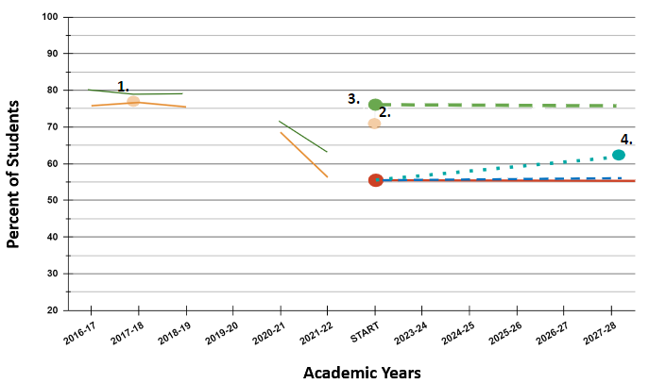
Step 4: Baseline Targets
Legend
District (all students):
State history :
State average :
Choose a start point
Set a floor and a ceiling
Remember that growth is not linear
Context is key
SET THE BASELINE
Scenario 2: Most recent year
line: if no growth or loss
line: Top 10% (2013-2018)
Notes:
We set a floor.
We have some options to consider.
Now we make that graph a bit lighter so we can consider our potential options for a “ceiling”
Now, how do we choose a “ceiling”? Effectively it is the second boundary for a perimeter of projected growth within which we want to set our baseline and other targets
The blue dashed lines represent the floor (no change from the start point)
The solid blue lines represent potential ceilings.
The steepest blue line is for target 1. the highest achieved regular attendance for the district
The next one is for the projected point if we assume growth similar to the top 10% of districts from 2013-2018

Slide 26
Step 4: Baseline Targets
Legend
District (all students):
State history :
State average :
Thought Experiment 2:
What context is needed here?
Choose a start point
Set a floor and a ceiling
Remember that growth is not linear
Context is key
SET THE BASELINE
Scenario 2: Most recent year
line: if no growth or loss
line: Top 10% (2013-2018)
Notes:
For the sake of this discussion (and time): These are the only two options available we are exploring
We might chose a “floor” and a “ceiling” based purely on data patterns—but even that is not straightforward. There is no formula or single answer.
What context do we need and how might that change or support our choices our choices?
Rephrased: What justification and support do these two different decisions need?
What justifications and evidence are needed here to support either choice (only two presented here for simplicity)
What about the baseline? What might we now choose as the baseline now?

Slide 27
Step 4: Baseline Targets
Legend
District (all students):
State history :
State average :
Choose a start point
floor:
ceiling:
Remember that growth is not linear
Context is key
baseline
Scenario 2: Most recent year
line: if no growth or loss
line: Top 10% (2013-2018)
Notes:
For the sake of our continued scenario, we are now going to move forward with this ceiling and floor and therefore with this baseline
Thanks everyone for your sharing. I will now pass if off to my colleague Jennifer.

Slide 28
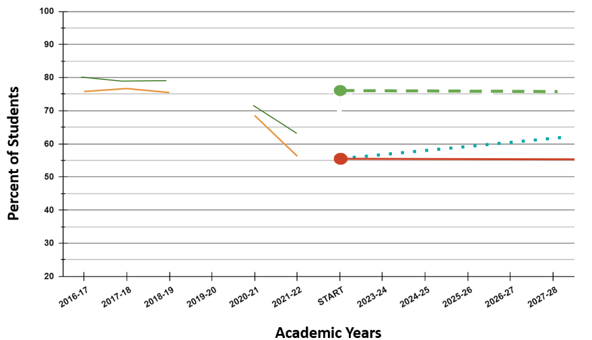
Step 5: Gap-Closing Targets
Legend
District (all students):
State history :
State average :
Combined focal group
In order to close gaps, the gap-closing targets will move at a faster rate than baseline targets
Recall:
the floor and ceiling
the baseline
the combined focal student group
Scenario 2: most recent year
line: if no growth or loss
line: Top 10% (2013-2018)
Notes:
Recall that:
Gap closing targets mostly move at faster rates than baseline (*not always)
Because the objective is to reduce the gaps present
How can we use:
Context
Data: the Combined focal student group and our disaggregated data to close gaps?
From the IG: “When setting gap-closure targets we encourage districts to consider the following gaps:
▪ Within-district gap between the focal group and the applicant student population as a whole (e.g., Group A at the district level compared to all students in the district).
▪ Within-state gap between focal groups for the applicant and the statewide student population as a whole (e.g., Group A at the district level compared to all students in the state, or to Group A at the state level).

Slide 29
Step 5 - Gap-Closing Targets
Reminders:
How can we examine the disaggregated data to inform setting gap closing targets?
How can we factor in plans and incentives (both past and new) to justify draft targets?
Notes:
This is just a subset of the focal student groups and what the combined focal student group data looks like overlaid on top.
The pink line above is an estimate of what the plot of the combined focal student group will look like.
Data for a combined focal student group will be provided. It is inclusive of all focal groups listed except those experiencing mobility:
Gap-closing targets: the five-year series of goals for a calculated “combined focal” group composed of all students who meet at least one of the following criteria:
Asian
American Indian/Alaska Native
Black/African American
Multiracial
Hispanic/Latino/a
Native Hawaiian/Pacific Islander
Students experiencing Disabilities (served through IEP)
Migrant (served through federal migrant education program)
Students experiencing houselessness
Recent Arrivers
Experience of incarceration or detention (in current or any prior year)
Current English Learner/Emerging Bilingual
Non-Binary gender
Students navigating Foster Care
Students navigating Poverty (using new SBE-approved definition)

Slide 30
Step 5: Gap-Closing Targets
District (all students):
State history :
State average :
Combined focal group
In order to close gaps, the gap-closing targets will move at a faster rate than baseline targets*
Recall:
floor
ceiling
baseline
the combined focal student group
Scenario 2: most recent year
line: if no growth or loss
line: Top 10% (2013-2018)
Notes:
For the sake of moving forward with this example let’s say we chose the following floor, ceiling and baseline
THE GAPS NEED TO CLOSE so let’s choose a gap closing target
How can we use:
Context
Data: the Combined focal student group and our disaggregated data to close gaps?
From the IG: “When setting gap-closure targets we encourage districts to consider the following gaps:
▪ Within-district gap between the focal group and the applicant student population as a whole (e.g., Group A at the district level compared to all students in the district).
▪ Within-state gap between focal groups for the applicant and the statewide student population as a whole (e.g., Group A at the district level compared to all students in the state, or to Group A at the state level).

Slide 31
Step 5: Gap-Closing Targets
District (all students):
State history :
State average :
Combined focal group:
Gap Closing:
In order to close gaps, the gap-closing targets will move at a faster rate than baseline targets*
Recall:
the floor and ceiling
the baseline
the combined focal student group
Gap closing target and trajectory
Scenario 2: most recent year
line: if no growth or loss
line: Top 10% (2013-2018)

Slide 32
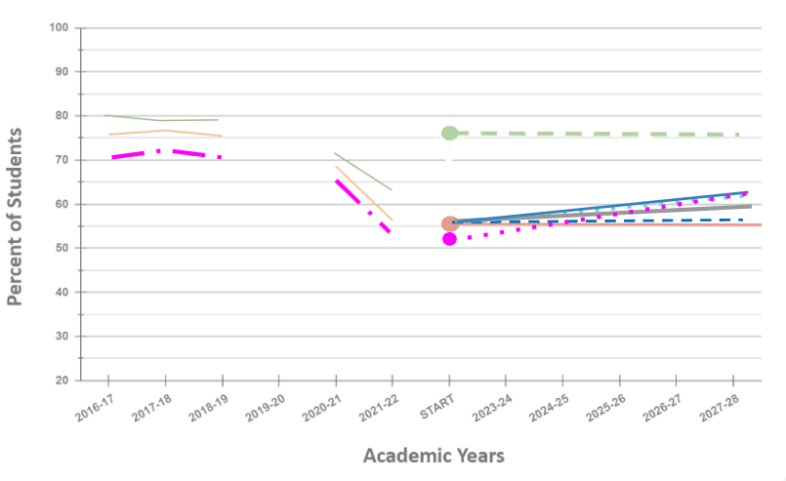
Step 6: Stretch Targets
District (all students):
State history :
State average :
Combined focal group:
Gap Closing:
Stretch:
match or exceed statewide progress
exceed baseline*
Ambitious but attainable
Scenario 1: Prior year
line: if no growth or loss
line: Top 10% of districts (2013-2018)
Notes:
From the IG page 158: “Stretch targets represent significant improvement by the district in either:
▪ Raising academic achievement; or
▪ Reducing academic disparities and closing gaps
The baseline and gap closing targets were defined in the previous slides.
The stretch target is now overlaid on top by the dashed black line

Slide 33

Growth is not Linear

Slide 34
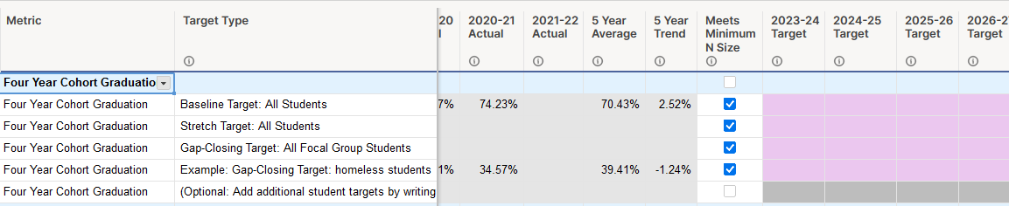
Submitting Draft Targets
Draft targets will be submitted via your application portal in Smartsheet
Notes:
All targets, including local optional metrics, will be submitted via the application portal using Smartsheet.
Here is a link to a preview so you can see what this will look like:
Smartsheet Preview: https://publish.smartsheet.com/607c6dde522a47e2a9cf735d6924775d
In the guidance that you’ll be receiving on March 1st, there will be more details on how to submit these targets
Including a video tutorial will also be released with the guidance
If you’re walking through the Smartsheet, if time allows:
The last five years of suppressed data will be included in your template for the five common metrics
The “meets minimum N size” will be checked if the student group is large enough (at least 10 students) to need to set a target
There will be rows for the baseline, stretch, and gap-closing targets. Additional rows are available for other focal groups that you want to set targets for
There is space for comments/background information for your thinking/reasoning (e.g. beginning implementation on new program that will take 3 years to really see results)
Any changes made during the codevelopment process will be made directly to your Smartsheet for shared communication and understanding

Slide 35

The Co-development Partnership
Draft Targets not required, but strongly encouraged for effective collaboration
Co-development will support with calculations, and adjustments can be expected
Most supportive: Bringing the regional context to help inform how context potentially impacts growth. Keep in mind:
challenges the district is working to overcome to best support students
expected impacts of strategies & investments over time
other factors beyond investments from IG supporting growth for metrics
Olena Panasokova (Nounproject)
#itdepends

Slide 36
Co-development Principles
There are meaningful and allowable investments under the integrated guidance that may not result or align with a given LPGT and a review of any one target should take into consideration the totality of what a grantee is proposing for their performance framework
Baseline targets should reflect the minimum growth they and ODE would be satisfied with
Do the targets make sense over a five-year trajectory based on what is known about historic trends for the district, region, and state?
Applicants below statewide averages should strive to match or exceed statewide progress overtime, avoiding projecting declines in any indicators
Applicants at the high end of achievement might expect less or slower growth, or even hold steady and see maintenance at the levels attained as a signal of excellence
New programs or investments won’t impact metrics immediately and so growth rates might change over time – meaning intermediate (year 1, 2, 3) targets might rise more slowly at first.

Slide 37
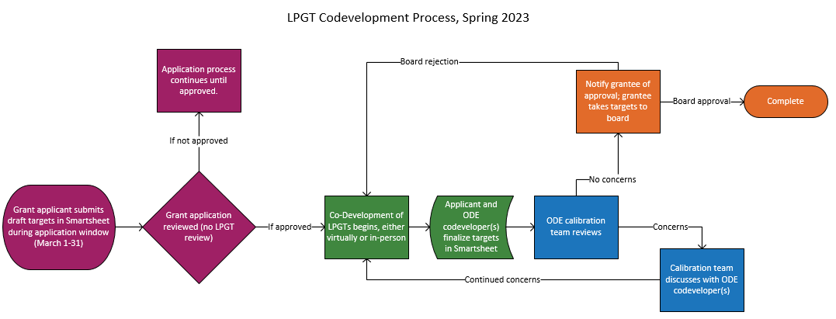
Co-Development of Targets Begins
Notes:
Make sure to highlight:
codevelopment does not start until the application has been reviewed and approved
Codevelopment means coming together in a physical or virtual space in workshop fashion to talk through initial draft targets, understanding starting points, and how you expect your strategies to affect the outcomes.
After codevelopment, a calibration team in ODE (data folks) will check for reasonability
Following ODE approval, you will take these to your board for approval

Slide 38

Public Review & Board Approval of Targets
Grant agreements with co-developed targets embedded are required to be:
1. Posted to the applicant’s website and accessible in their main office;
2. Presented to the governing board with the opportunity for public comment (not a consent agenda item); and
3. Approved by the governing board.
Blackillustrations.com

Slide 39
Summary
1. Context Matters | Reviewing all context and finding connections is essential to start, and must be considered throughout the drafting process
 | Consider Local Optional Metrics to help show in data regionally specific priorities that are likely unfolding ahead of bigger changes in the LPGTs for Common Metrics
2. Effective Targets are Attainable, Realistic & Ambitious | Gap closing and stretch targets should be set higher than your baseline
 | Stay below the top historical growth (Baseline + Growth)
3. No Single Formula for setting these targets | Co-development is a collaborative process that supports in setting these targets.
 | In Co-development, we’ll bring focus of context into relationship with calculations.
4. Consider impacts of outcomes & investments over time | Expect an Implementation Curve ex: Efforts around Graduation are likely to take multiple years to manifest, set your curve appropriately
5. Your performance framework should makes sense to you and your community over time | Keep the community identified priorities in mind. If attendance is not your focus, you wouldn’t set a target for big changes in attendance rates.
Notes:
Tobin

